Slide 1
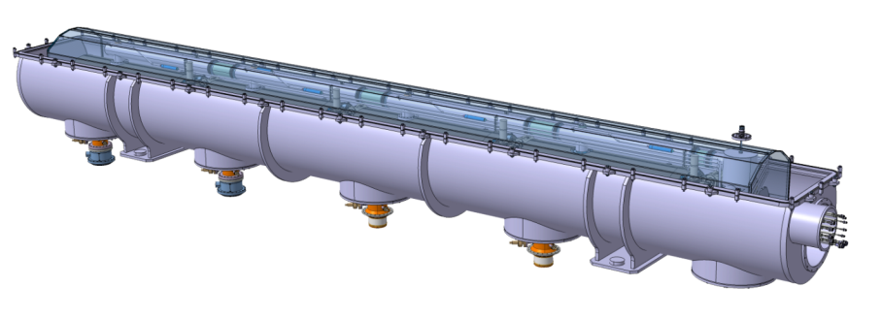

Status of the SPL Short Cryomodule development
Rossana Bonomi, on behalf of the Cryomodule Development Team
Rossana.Bonomi@cern.ch
R. Bonomi TE-MSC-CMI
SLHiPP3 – Louvain-la-neuve 2013

Slide 2
Outline
1
Aim of the SPL SCM study
Main actors
SPL workspace
Status of the development (on behalf of Cryomodule Team)
Vacuum vessel report (on behalf of CNRS Team)
R. Bonomi TE-MSC-CMI
SLHiPP3 – Louvain-la-neuve 2013

Slide 3
Aim of the SPL SCM study
What
  Design/construction/test of short version of Superconducting Cryomodule for High Power Proton beam (SCM)
Why
  For testing of 704 MHz superconducting cavities (SPL linac useful for neutrino factory and LHC physics)
When
  SCM is foreseen to be built and tested in 2013-2015
Where
  Design/production shared btw CERN, CEA, CNRS and industry
  To be tested at CERN, SM18
R. Bonomi TE-MSC-CMI
SLHiPP3 – Louvain-la-neuve 2013

Slide 4
Main actors
System/Component/Activity | Person(s) in charge | Lab
Cavities/He vessel/tuner construction | O. Brunner O. Capatina T. Renaglia F. Pillon N. Valverde I. Aviles G. Devanz | CERN CERN CERN CERN CERN/ESS CERN/ESS CEA-Saclay
SRF, magnetic shielding, Clean-Room activities, RF test stations (SM18) | T. Junginger K. Shirm J. Chambrillon O. Brunner | CERN CERN CERN CERN
RF Power Coupler | E. Montesinos, G. Devanz | CERN CEA-Saclay
Vacuum systems | G. Vandoni | CERN
Cryogenics (cryo infrastructure SM18) | O. Pirotte R. Van Weelderen T. Koettig | CERN CERN CERN/ESS
Survey and alignment | P. Bestman | CERN
Cryo-module conceptual design | R. Bonomi O. Capatina P. Coelho V. Parma D. Perez A. Vande Craen W. Zak | CERN/ESS CERN CERN/ESS former CERN CERN former CERN CERN/ESS
Cryo-module detailed design & Integration & Cryostat assembly tooling | P. Dambre P. Duthil P. Duchesne S. Rousselot D. Reynet | CNRS/IPNO-Orsay CNRS/IPNO-Orsay CNRS/IPNO-Orsay CNRS/IPNO-Orsay CNRS/IPNO-Orsay
SPL Machine architecture | F. Gerigk | CERN
ESS Cryomodule developments | C. Darve | ESS
Cryo-module Technical Coordination | V. Parma | CERN
R. Bonomi TE-MSC-CMI
SLHiPP3 – Louvain-la-neuve 2013

Slide 5
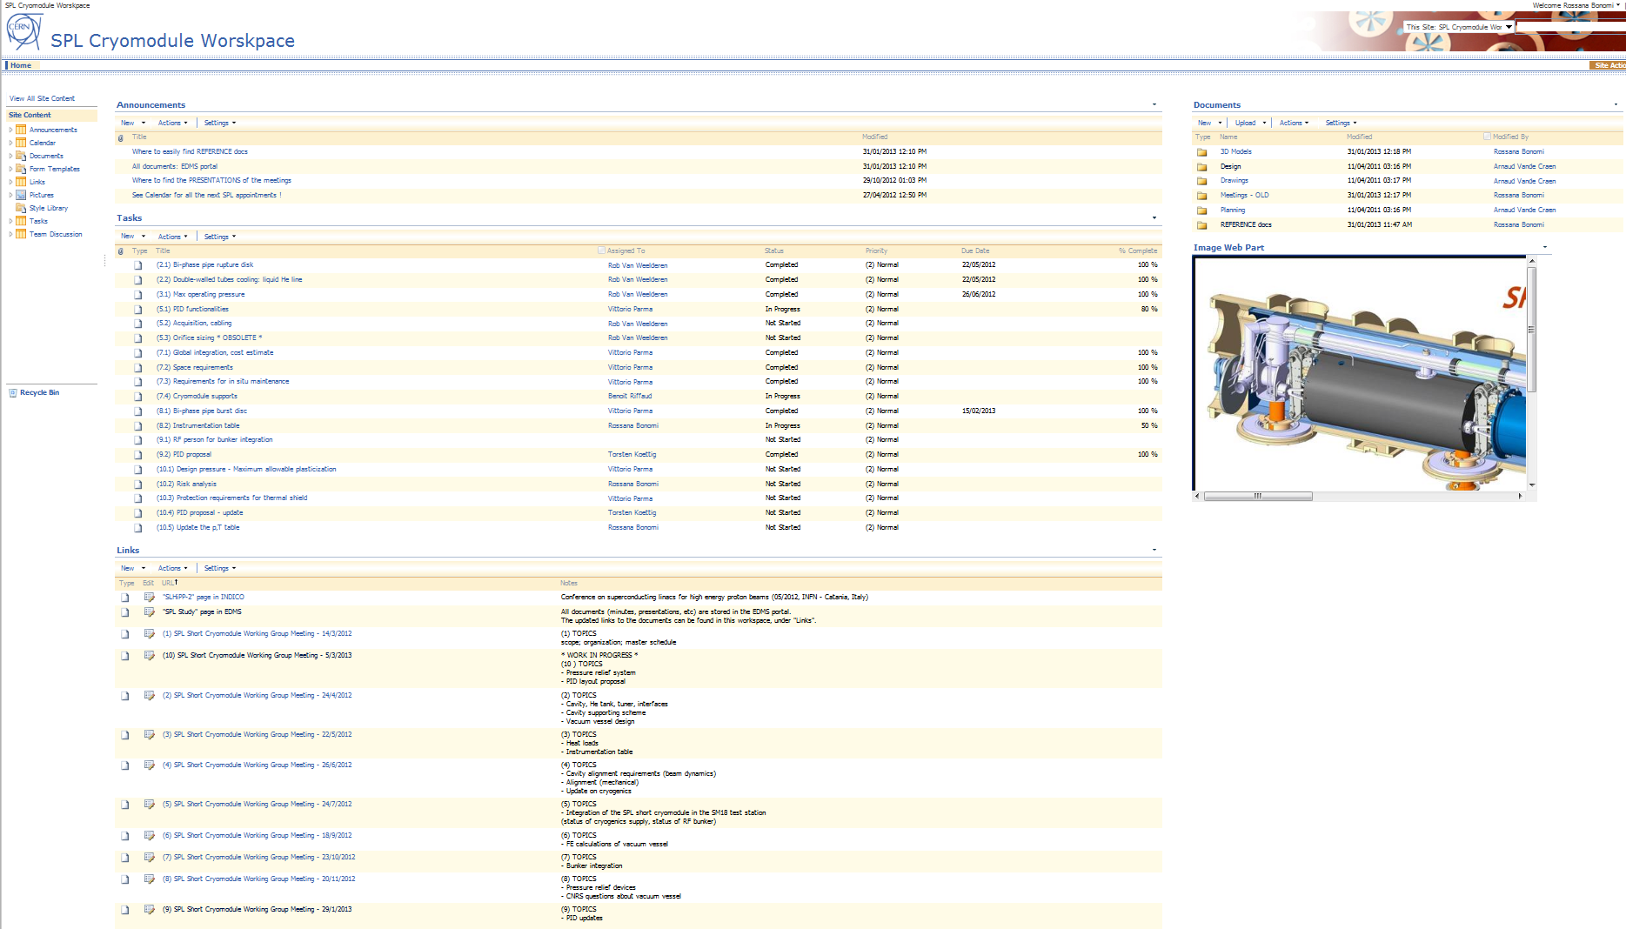
SPL Cryomodule Workspace
https://espace.cern.ch/spl-cryomodule/default.aspx
REFERENCE DOCUMENTS
LIST OF ACTIONS
LINKS TO MEETING SERIES
R. Bonomi TE-MSC-CMI
SLHiPP3 – Louvain-la-neuve 2013

Slide 6
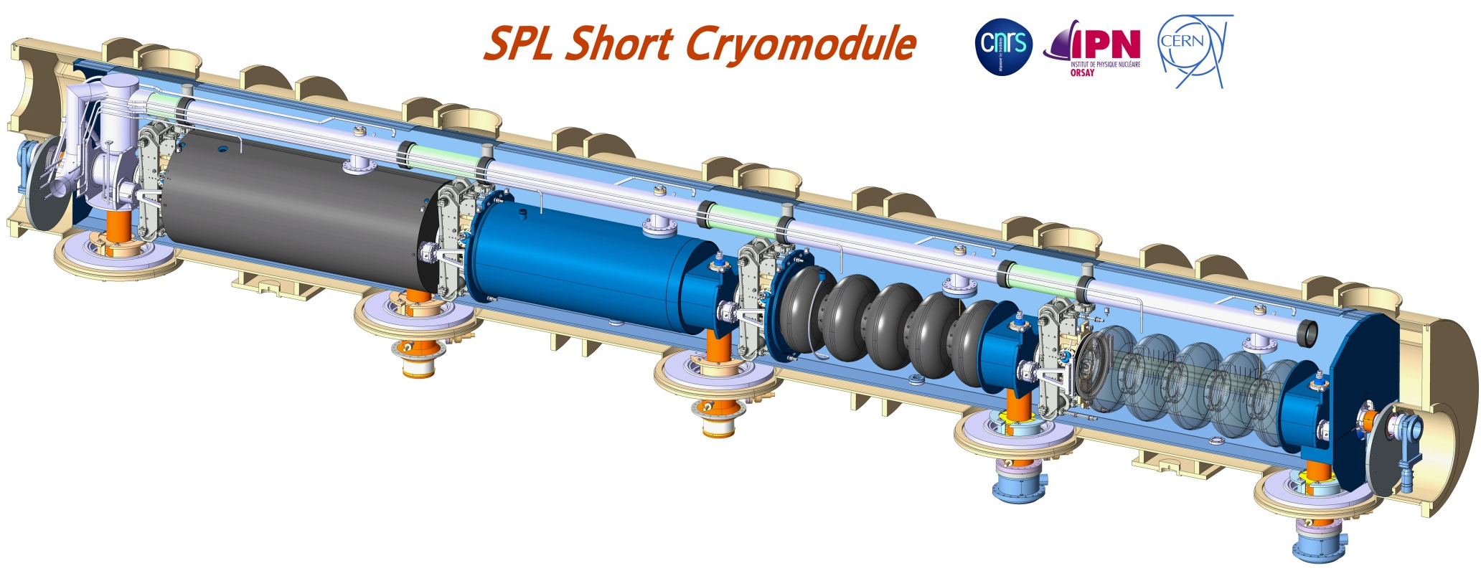
SPL Short Cryomodule
4 MW beam power accelerated up to 5 GeV
Half-length cryomodule (4 cavities) representative of full-length high power S.C. linac
R. Bonomi TE-MSC-CMI
Section meeting x/x/2013
Courtesy of P. Duthil

Slide 7
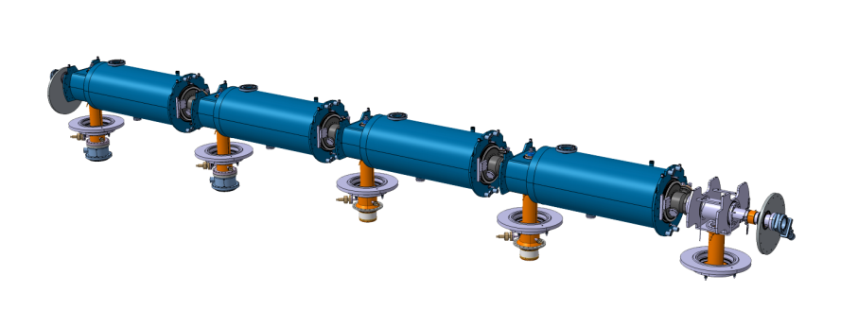
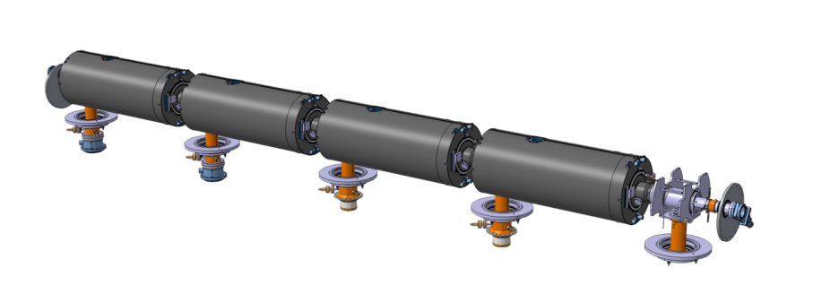
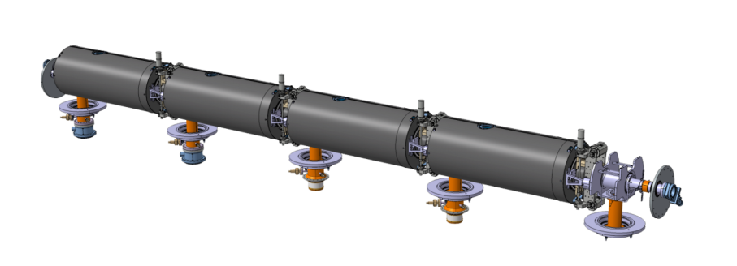
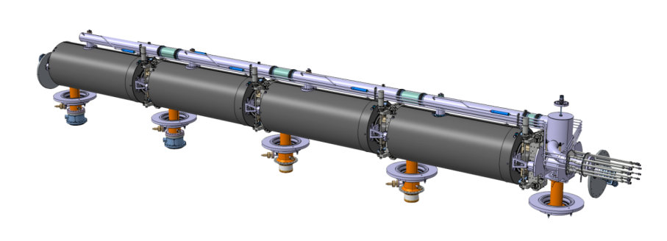
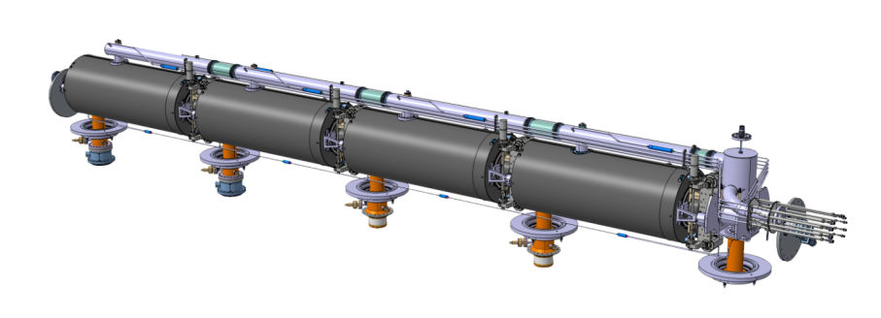
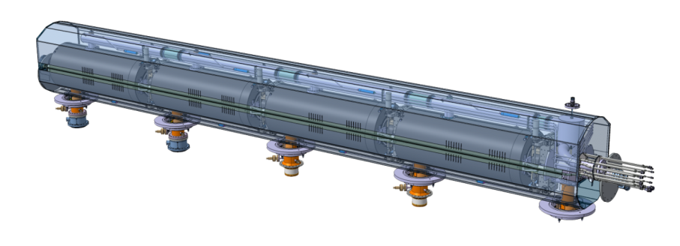
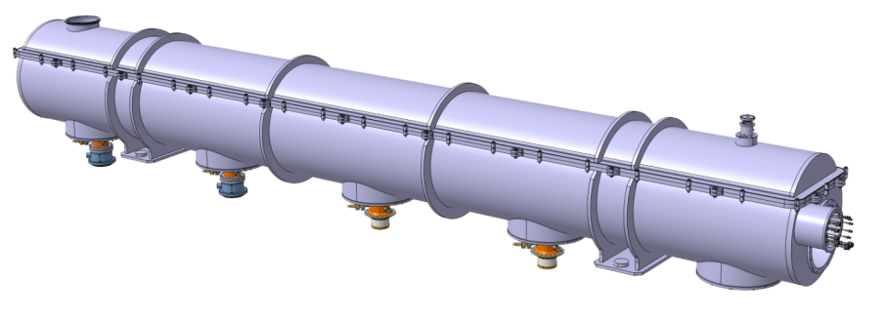
SPL Short Cryomodule
Assembly breakdown
1- String of dressed cavities from clean room
2- Mounting of magnetic shields
3- Mounting of tuners and inter-cavity supports
4- Mounting of cryogenic distribution
5- Mounting of coupler cooling line
6- Mounting of thermal shield
Design by CNRS-IPNO
(courtesy of S.Rousselot)
7- Insertion in vacuum vessel
Not latest design !
8- Closing vacuum vessel
R. Bonomi TE-MSC-CMI
SLHiPP3 – Louvain-la-neuve 2013

Slide 8
SPL operational conditions
Info: K. Papke’s presentation
Operating conditions
Beam current/pulse lenght | 40 mA/0.4 ms beam pulse | 20 mA/0.8 ms beam pulse
cryo duty cycle | 4.11% | 8.22%
quality factor | 10 x 10⁹ | 5 x 10⁹
accelerating field | 25 MV/m | 25 MV/m
Source of Heat Load | Heat Load @ 2K
dynamic heat load per cavity | 5.1 W | 20.4 W
static heat loads per cavity | 0.3 W | 0.3 W
RF power coupler loss at 2 K | <0.1 W | 0.1 W
HOM loss in cavity at 2 K | tbc | tbc
HOM coupler loss at 2 K (per coupl.) | tbc | tbc
beam loss | 1 W | 1 W
Total @ 2 K / cavity | 8.5 W / cavity | 22 W / cavity
R. Bonomi TE-MSC-CMI
SLHiPP3 – Louvain-la-neuve 2013

Slide 9
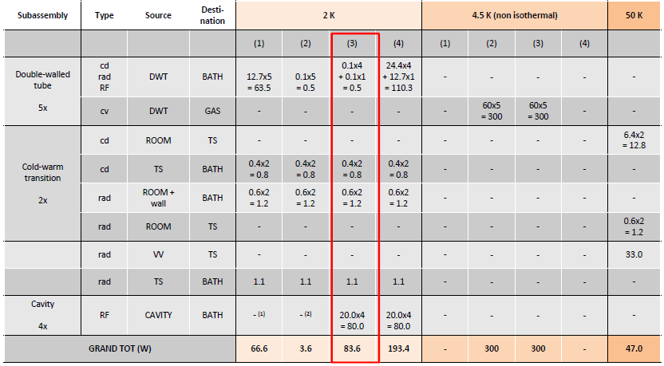
Consolidated heat loads estimation
Instrumentation and critical regions have not been considered so far
STATIC HEAT LOADS
(1) RF off, DWT cool off
(2) RF off, DWT cool on
DYNAMIC HEAT LOADS
(3) RF on, DWT cool on
(4) RF on, DWT cool off
R. Bonomi TE-MSC-CMI
SLHiPP3 – Louvain-la-neuve 2013

Slide 10
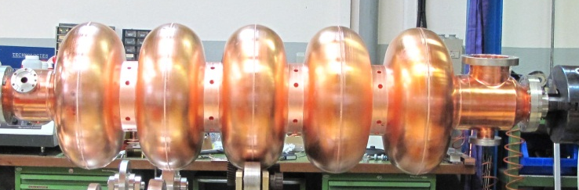
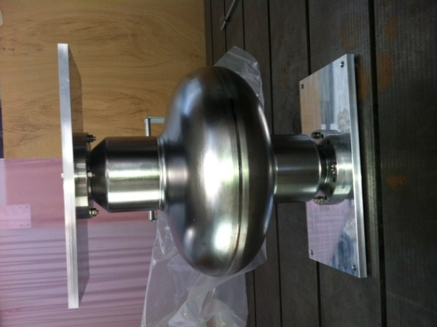
S.C. Cavity (β=1)
Info: N. Valverde and I. Aviles’s presentation
Two 5-cells copper cavities designed/produced at CERN
One 5-cells niobium cavity produced at CERN
Four 5-cells and one 1-cell niobium cavities produced in industry
Features
Standing wave, Superconducting
Frequency 704.4MHz
Quality factor 10¹⁰
Nominal gradient 25MV/m
Courtesy of N. Valverde
R. Bonomi TE-MSC-CMI
SLHiPP3 – Louvain-la-neuve 2013

Slide 11
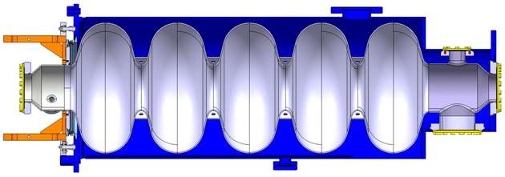
Helium tank
Info: N. Valverde and I. Aviles’s presentation
Designed at CERN (O. Capatina)
Manufactured at CEA
  Tendering phase starting
Dressing at CERN
Features
Design pressure 1.5bar
Contains 2K He and transmits tuning forces
Tank in Stainless steel (Nb-SS 316LN brazing developed at CERN)
Courtesy of N. Valverde
R. Bonomi TE-MSC-CMI
SLHiPP3 – Louvain-la-neuve 2013

Slide 12
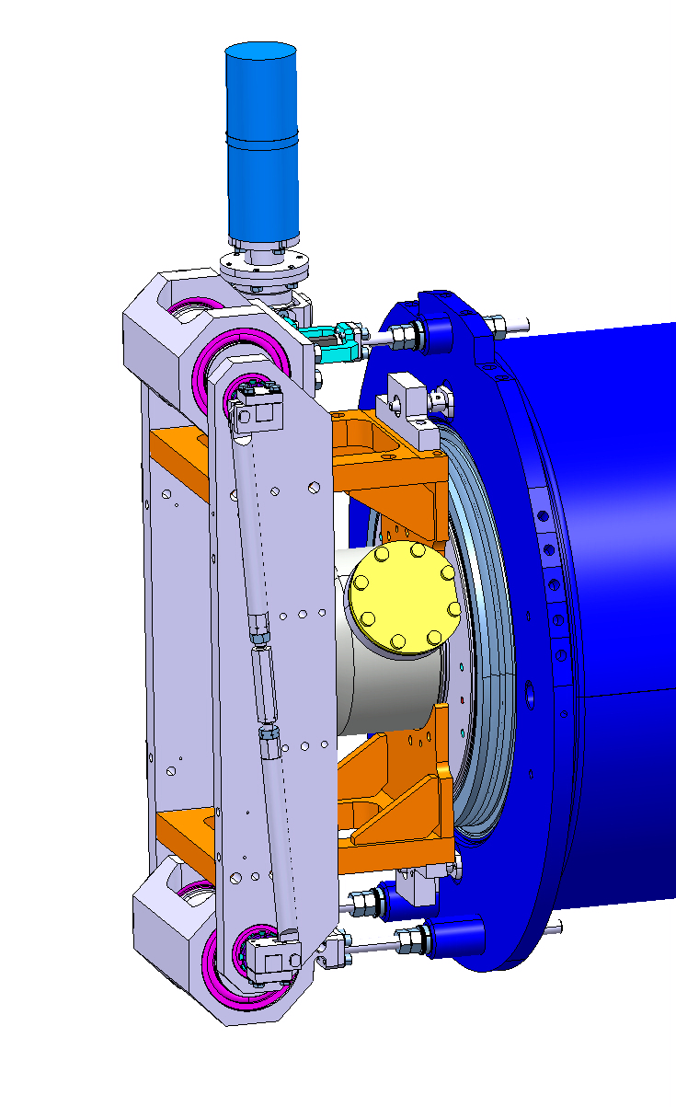
Tuner
Designed/supplied by CEA
Installation at CERN during dressing
Features
Stepper motor + Piezo actuator
Precise tuning of cavity frequency via cavity volume deformation
Courtesy of N. Valverde
R. Bonomi TE-MSC-CMI
SLHiPP3 – Louvain-la-neuve 2013

Slide 13
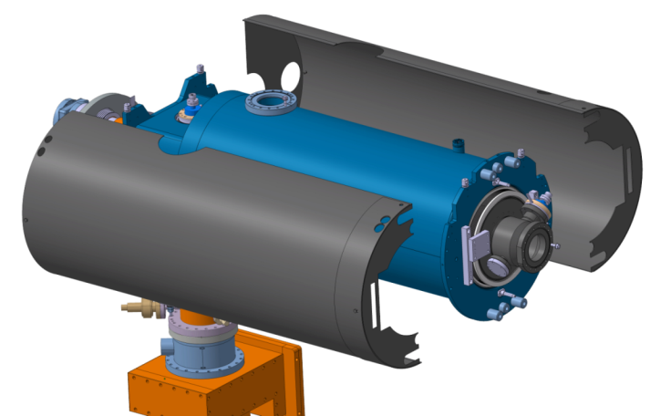
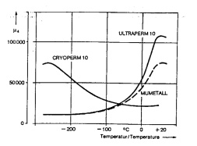
Magnetic shield
Designed at CNRS (specs by T. Junginger, CERN)
Features
Cold «floating» shield made of Cryoperm10 (1mm)
Two-shells design
Permeability with temperature
Courtesy of S. Rousselot
R. Bonomi TE-MSC-CMI
SLHiPP3 – Louvain-la-neuve 2013
Notes:
http://indico.cern.ch/getFile.py/access?contribId=51&sessionId=13&resId=1&materialId=slides&confId=63935

Slide 14
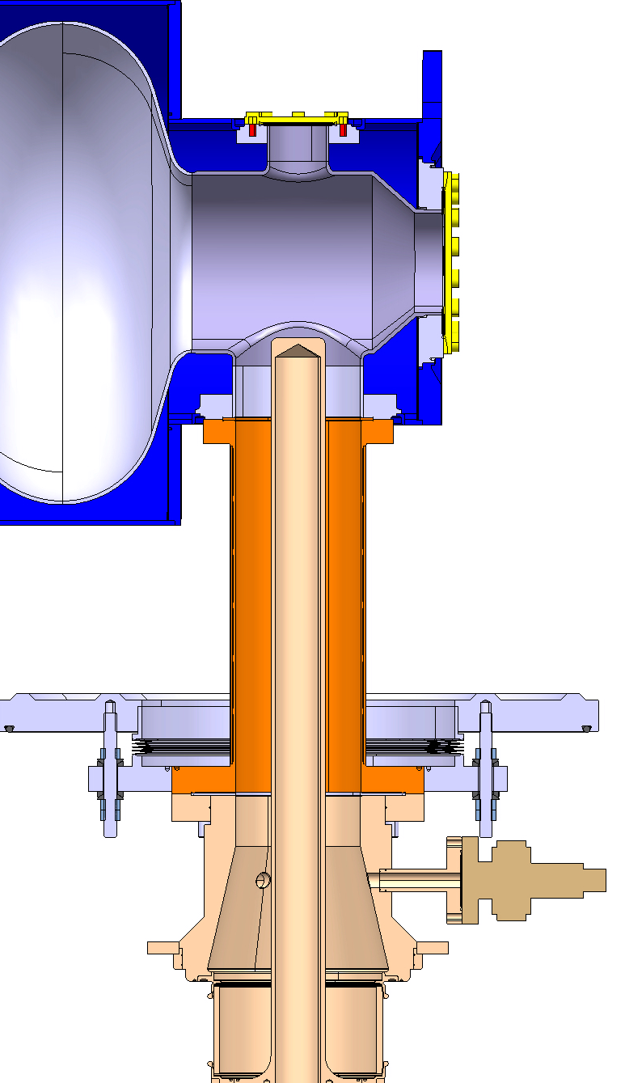
RF power coupler
Designed at CERN (BE-RF and TE-MSC)
Produced at CERN
Tested at CEA with TW/SW
Courtesy of N. Valverde
Features
Stainless steel + copper sputtering
RF feeding of cavity + Mechanical support
Active He gas cooling to reduce heat load to bath (thermally efficient)
R. Bonomi TE-MSC-CMI
SLHiPP3 – Louvain-la-neuve 2013

Slide 15
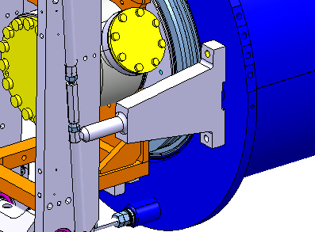
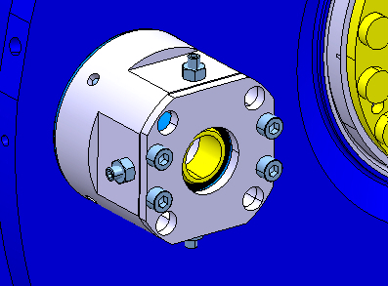
Intercavity supports
Designed at CERN (A. Vande Craen, J.B. Deschamps)
Prototype being tested on mock-up
Production at CERN
Features
Sliding cylinder inside spherical bearing
Longitudinal movements and tilt are allowed
Fine cavity alignment is possible
Courtesy of A. Vande Craen
R. Bonomi TE-MSC-CMI
SLHiPP3 – Louvain-la-neuve 2013

Slide 16
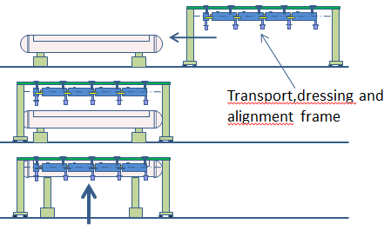
Vacuum vessel
See next talk
Design at CNRS
Production in industry
  Tendering started (CNRS)
Transport, dressing and alignment frame
Courtesy of S. Rousselot
Features
Removable top-lid for in-situ maintenance and for
Vertical cryostating
R. Bonomi TE-MSC-CMI
SLHiPP3 – Louvain-la-neuve 2013

Slide 17
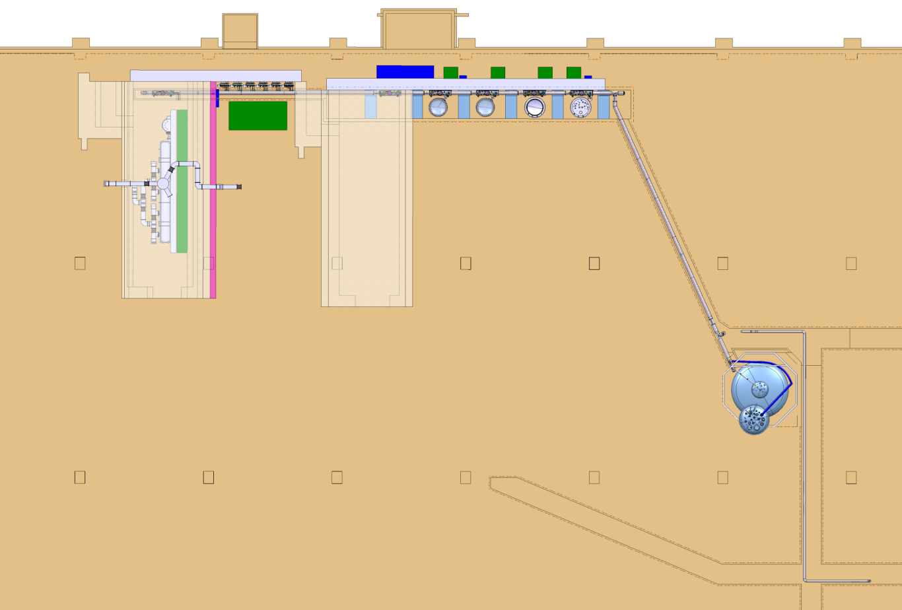
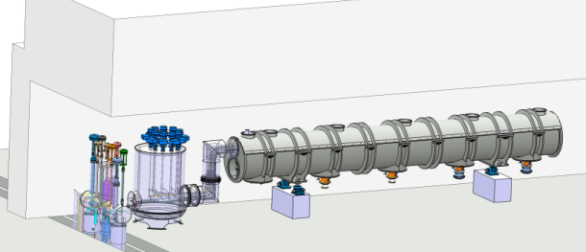
Bunker integration study
Info: T. Koettig’s presentation
Test to be performed at CERN, SM18
Clean room in SM18 being refurbished and upgraded
TRANSFER LINE GALLERY
M7
Courtesy of S. Rousselot
M7
PUMPING TL GALLERY
Courtesy of T. Koettig
R. Bonomi TE-MSC-CMI
SLHiPP3 – Louvain-la-neuve 2013

Slide 18
P&ID
Courtesy of T. Koettig
Not latest design !
R. Bonomi TE-MSC-CMI
Section meeting 26/3/2013

Slide 19
P&ID
Info: T. Koettig’s presentation
1st protection system
  2 safety valves set at 1.5 and 1.8 bara according to operation conditions (warm or cold)
2nd protection system
  2 burst discs (redundancy) set at 2.1 bara
Courtesy of T. Koettig
R. Bonomi TE-MSC-CMI
SLHiPP3 – Louvain-la-neuve 2013

Slide 20
Risk analysis (on-going)
Courtesy of P. Azevedo
Hazard | Cause/component |  |  | Consequences | Probability | Control measures
Leak to vacuum vessel | Thermal cycles Mechanical loads Corrosion | Welds Bellows Pipes Flanges |  | Pressure increase in vacuum vessel Loss of insulation vacuum | Low | VV relief plate
 | Temporary (small) air leak into VV |  |  | Vaporization of condensed air | High | VV relief valve
Pressure increase in LHe volume | Loss of insulation vacuum |  |  | Pressure increase in LHe volume | Low | 2K circuit burst disc
 | Loss of UH vacuum
 | Overpressure in cryo supply
 | Blocked return pipe
 | Power failure |  |  | Static heat loads not compensated | High | 2K circuit relief valve
2nd protection systems
1st protection systems
R. Bonomi TE-MSC-CMI
SLHiPP3 – Louvain-la-neuve 2013

Slide 21
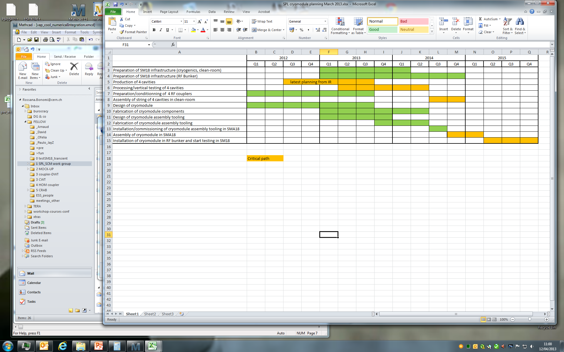
Time schedule (updated 4/2013)
Test => 1.5 years

Slide 22
Achievements since last SLHiPP-2 and summary
Monthly meeting (9 meetings from last SLHiPP-2) – info on SPL workspace https://espace.cern.ch/spl-cryomodule/default.aspx
Technical choices frozen
Vacuum vessel with top-lid tendering phase started (CNRS)
Magnetic shield design done
Consolidated cryomodule heat loads estimate done
Preliminary safety risk analysis done (CERN-HSE group), safety equipment chosen
SM18 bunker integration study done
SM18 being upgraded for test of SCM
Instrumentation list for SCM transmitted
Mock-ups tests done or in progress..
R. Bonomi TE-MSC-CMI
SLHiPP3 – Louvain-la-neuve 2013

Slide 23
Merci beaucoup pour votre attention!
Thanks to all the people of the team!
SPL workspace: https://espace.cern.ch/spl-cryomodule/default.aspx
SPL docs on EDMS: https://edms.cern.ch/nav/P:SLHC-000008:V0/P:SLHC-000076:V0/TAB3
R. Bonomi TE-MSC-CMI
SLHiPP3 – Louvain-la-neuve 2013

Slide 24
Extra slides

Slide 25
Reference people
General info Vittorio.Parma@cern.ch
Intercavity supports, mock-ups Arnaud.Vande.Craen@cern.ch
Mock-ups, alignment issue Wojciech.Zak@cern.ch
Vacuum vessel Duthil@ipno.in2p3.fr
R. Bonomi TE-MSC-CMI
SLHiPP3 – Louvain-la-neuve 2013

Slide 26
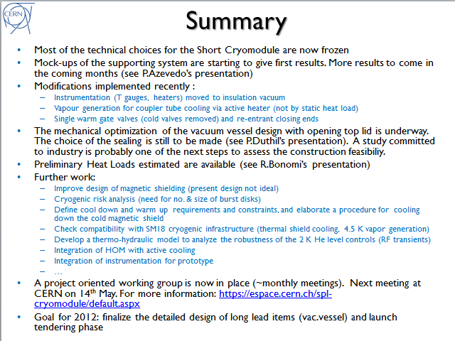
From last SLHiPP-2
From SLHiPP-2
R. Bonomi TE-MSC-CMI
SLHiPP3 – Louvain-la-neuve 2013

Slide 27
Risk analysis
Plastic limit
Cavity under the effect of external pressure and thermal contractions
Based on M. Esposito’s study
R. Bonomi TE-MSC-CMI
SLHiPP3 – Louvain-la-neuve 2013

Slide 28
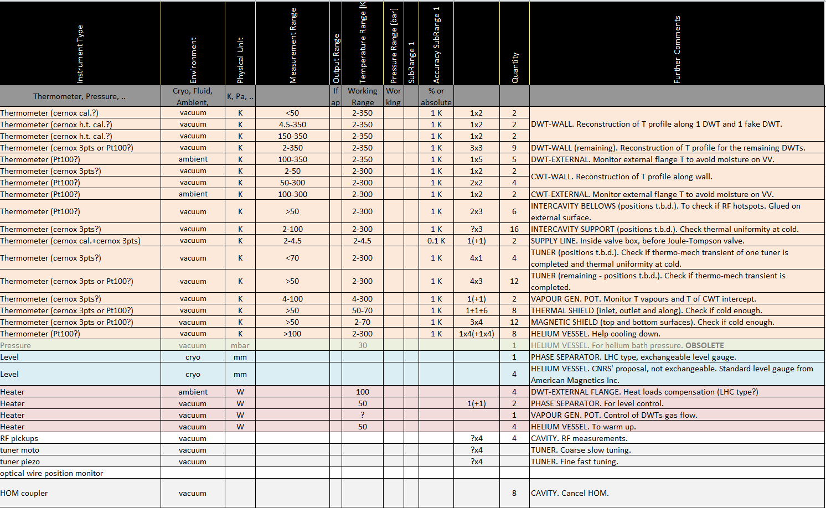
SCM Instrumentation
https://espace.cern.ch/spl-cryomodule/_layouts/xlviewer.aspx?id=/spl-cryomodule/Documents/REFERENCE%20docs/SPL%20SCM%20Instrumentation%20list.xlsx&Source=https%3A%2F%2Fespace%2Ecern%2Ech%2Fspl%2Dcryomodule%2FDocuments%2FForms%2FAllItems%2Easpx%3FRootFolder%3D%252Fspl%252Dcryomodule%252FDocuments%252FREFERENCE%2520docs%26FolderCTID%3D0x0120008F857AEAC0034440A18CEF84BD247C32%26View%3D%7B0743C195%2D489A%2D4E51%2D8027%2D77F054B2A8EA%7D&DefaultItemOpen=1
R. Bonomi TE-MSC-CMI
SLHiPP3 – Louvain-la-neuve 2013

Slide 29
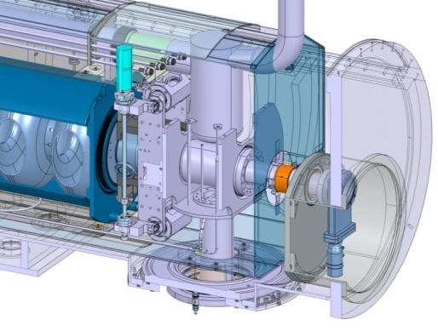
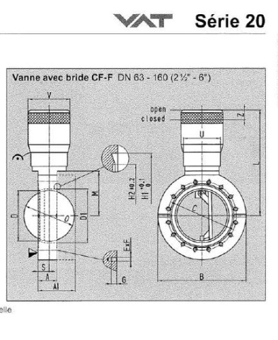
Technical service module
Courtesy of P. Duthil
Phase separator pot
(5 liters at 2 K)
DWT vapor generator
reservoir
(1 liter at 4.5 K)
Last IC support
DN80 gate valve
R. Bonomi TE-MSC-CMI
SLHiPP3 – Louvain-la-neuve 2013

Slide 30
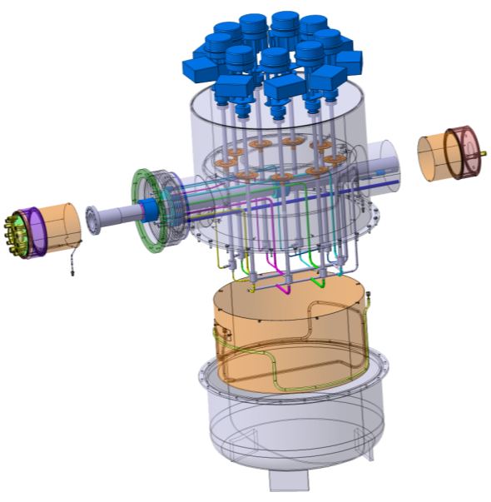
Cold box
To be produced at CERN
Vacuum vessel
From SM18
Thermal shield
To CM
Thermal shield
Courtesy of P. Duthil
Vacuum vessel
R. Bonomi TE-MSC-CMI
SLHiPP3 – Louvain-la-neuve 2013

