Slide 1
Design Status of the Spoke Cryomodule for MYRRHA
SLHIPP
Louvain la Neuve 17-18/04/2013
Design Status of The Spoke Cryomodule for MYRRHA – H. SAUGNAC- SLHIPP3-17&18/04/2013- Louvain la Neuve

Slide 2
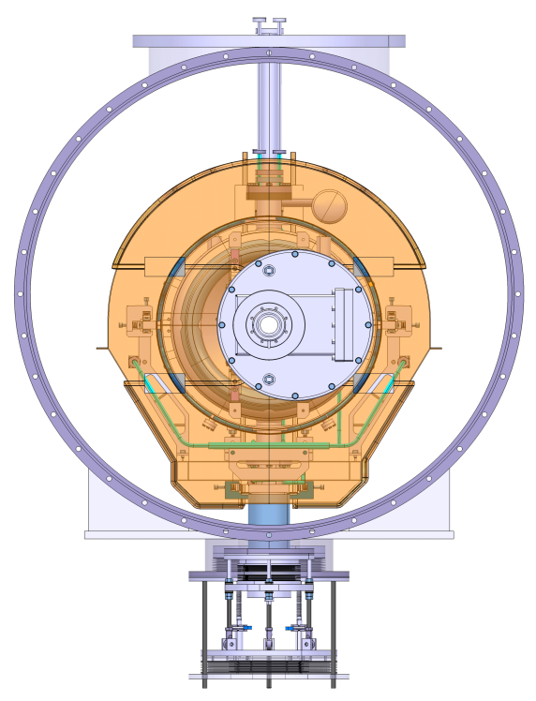
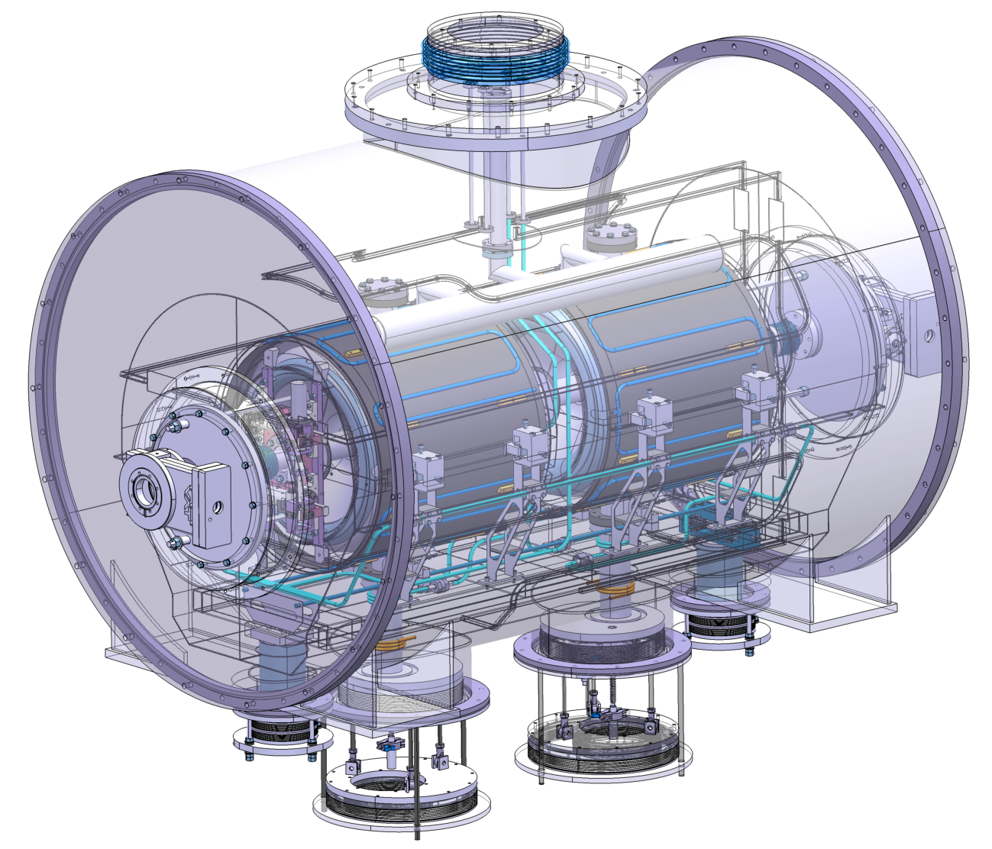
Cryomodule Overview
Connection to Valves Box
One Thermal Shield (40K/80K)
Φ 1200
Coupler Barometric Compensation
Only One Warm Valve
2 Beta 0.37, 352 MHz Spoke Cavities
Warm Window Couplers, 50 Ω, CW 20 kW Max.
Piezo Tuners
Op. Temperatures : 2 K, 5/10 K, 40/80 K
Φ 1200
L 2200
Beam Axis Height 1500
Cold Temp. Magnetic Shielding
Cavity Train Put on adjustable Posts
Design Status of The Spoke Cryomodule for MYRRHA – H. SAUGNAC- SLHIPP3-17&18/04/2013 - Louvain la Neuve

Slide 3
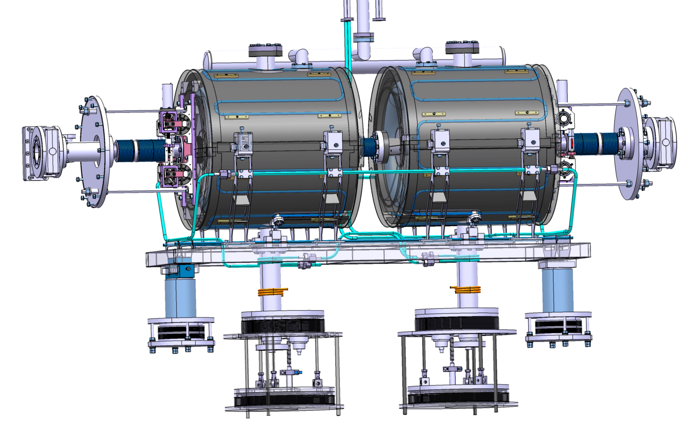
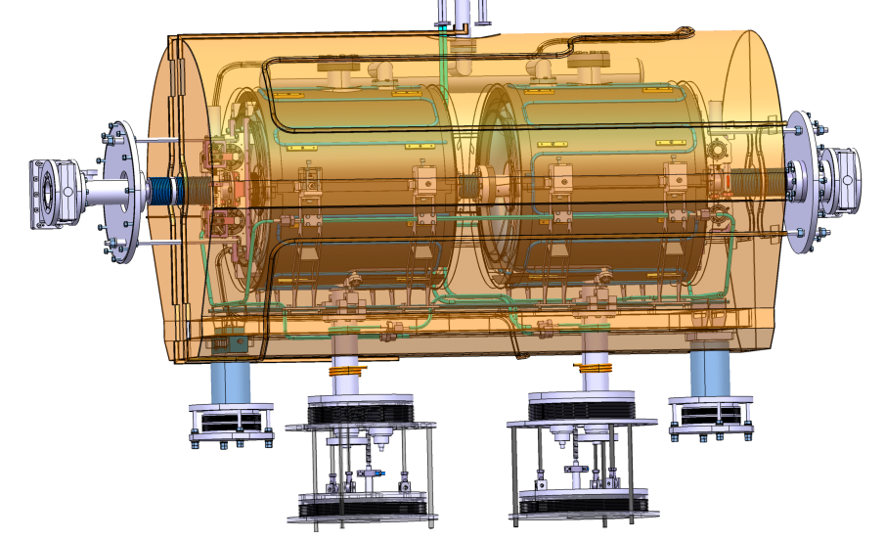
Cryogenic Loops 1/2
2K Separator
Φ _{int.} : 80 mm, Lg ~ 1 m
5K/10K :
Cavity Frame Heat Interception
Coupler Heat Interception
Φ _{int.} : 8 mm, Lg ~ 5 m
5K Cool Down :
Magnetic Shield CD
Cavity CD
T _{CD} ~ < 2 h
 | Fluid | P in | P out | T in | T out | Power/CM
40K/80K | Helium | 4 bars | 3 bars | 40 K | 80 K | 110 W
Cavity/B-Shield Cool Down | Helium | 1,2 bar | 1 bar | 4,5 K | 300 K | ~ 2 g/s
5K/10K | He Supercritic | 3 bars | 1 bar | 5 K | 10 K | 21 W
2K | He Superfluid | < 30 mbar | < 30 mbar | 2 K | ~ 2.2 K | 31,5 W
40K/80K :
Thermal Shield
Coupler Heat Interception
Φ _{int.} : 10 mm, Lg ~ 12 m
t _{CD} ~ 10 h
Design Status of The Spoke Cryomodule for MYRRHA – H. SAUGNAC- SLHIPP3-17&18/04/2013 - Louvain la Neuve

Slide 4
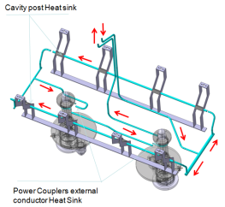
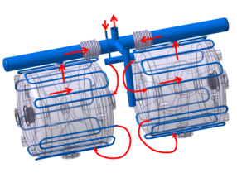
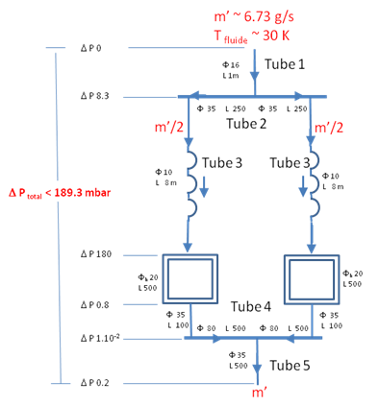
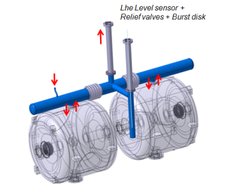
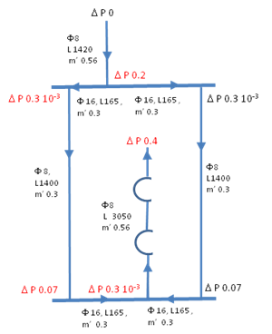
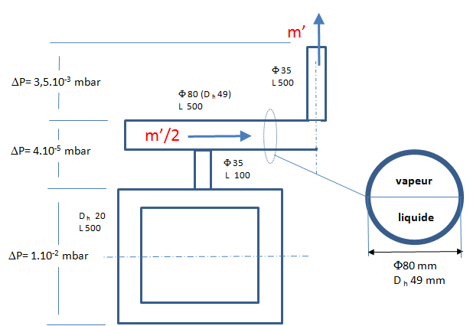
Cryogenic Loops 2/2
Internal CM circuitery | Q | T _{max} | Φ _{Int} & L | t _{CD} | ΔP _{max}
40/80 K Loop Cool Down (Ghe 4/3 bars) | 2g/s | NC | 10 mm, 15 m | 9 hr | 115 mbar
40/80 K Loop Stationary (Ghe 4/3 bars) | 110 W | 86,2 K | 10 mm, 15 m | NC | 4 mbar
① 5/10 K Loop (Lhe 3/1 bar) | 15 W | 10 K |  | NC | 1 mbar
② Mag. Shield Cool Down (LHe 1,2/1 bar) |  |  | 10 mm, 8 m | 0.3 hr | 180 mbar
② Cavity Cool Down (Lhe 1,2/1 bar) |  |  |  | 1,2 hr
③ Cavity Stationary | 30 W |  |  |  | <10⁻¹ mbar
③
①
②
Design Status of The Spoke Cryomodule for MYRRHA – H. SAUGNAC- SLHIPP3-17&18/04/2013 - Louvain la Neuve

Slide 5
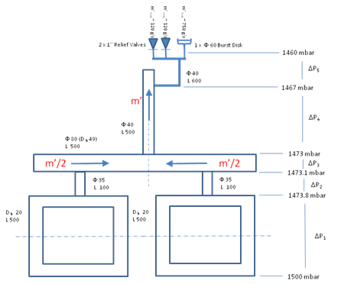
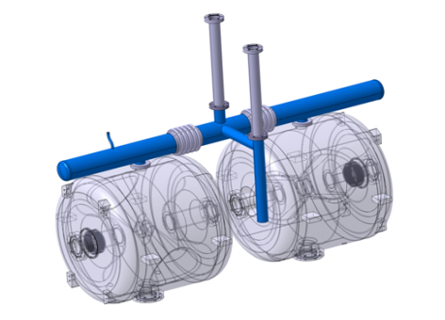
Cryogenic Loops : Pressure Security
Accident : Insulation Vacuum breakage.
Volume _{LHe} ~ 100 litres
Surface _{He loop} ~ 2,6 m²
q = 6 kW/m² (CERN, Conservative)
m’= 742 g/s
T _{fluid out} < 20 K
P _{cav max} =1.5 bar
1 x Burst Disk (K=0.6, Φ = 60 mm)
P _{discharge} = 1.33 bar+/- 10%
m’ _{max} = 750 g/s @ T > 20 K
2 x Relief Valve (Circle seal type 500 F 1 ‘’)
P _{oppening} = 1.15 bar+/- 5%
m’ _{max} (each)= 120 g/s @ T = 20 K.
Prevent overpressure from Cool Down operation, Quench…without breaking the Burst Disk…
Design Status of The Spoke Cryomodule for MYRRHA – H. SAUGNAC- SLHIPP3-17&18/04/2013 - Louvain la Neuve

Slide 6
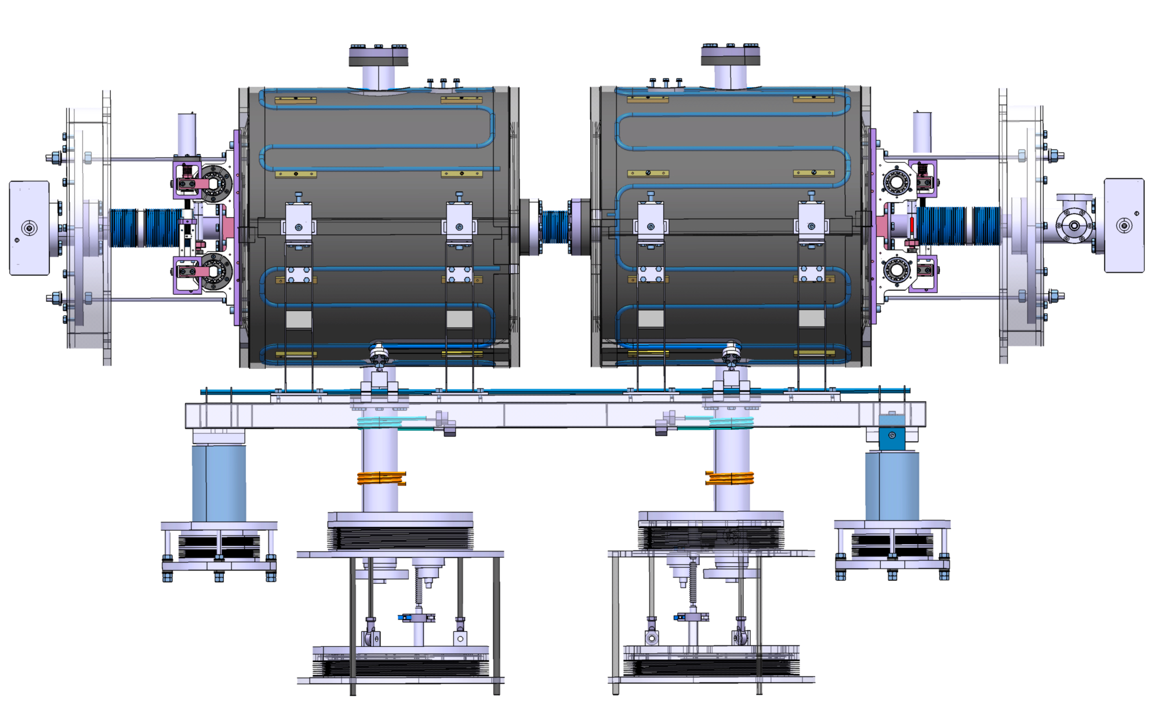
Thermo-Mechanical 1/3
Displacements at 2K- Stationary State
Cavity Sliders
ΔY : 1 mm
ΔY : 1 mm
ΔZ : 3,5 mm
Table Slider
Invar Rods
ΔZ : 0.1 mm
ΔZ : 0.4 mm
Fixed Point
Coupler Compensation : Z, Y, X Adjustable
Design Status of The Spoke Cryomodule for MYRRHA – H. SAUGNAC- SLHIPP3-17&18/04/2013 - Louvain la Neuve

Slide 7
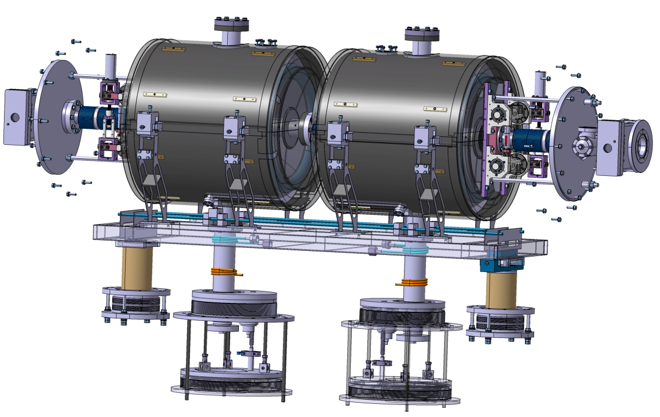
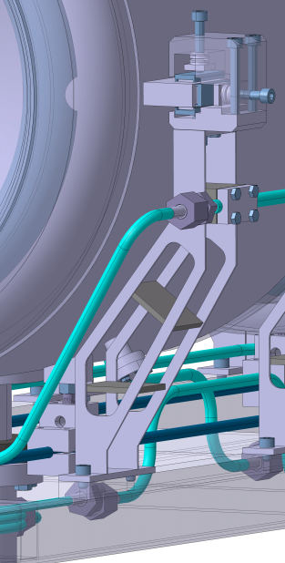
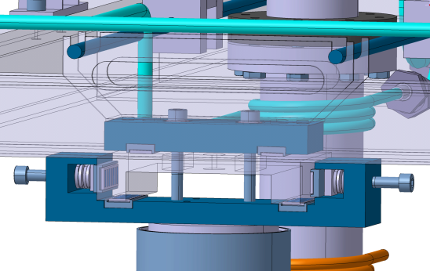
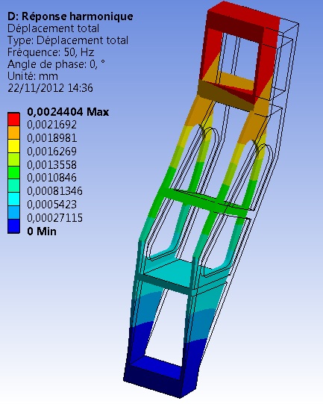
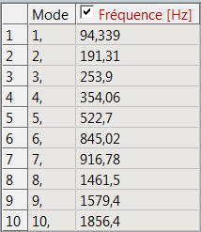
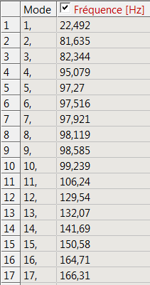
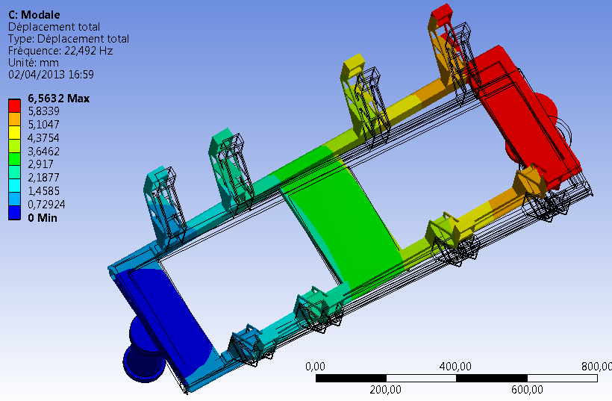
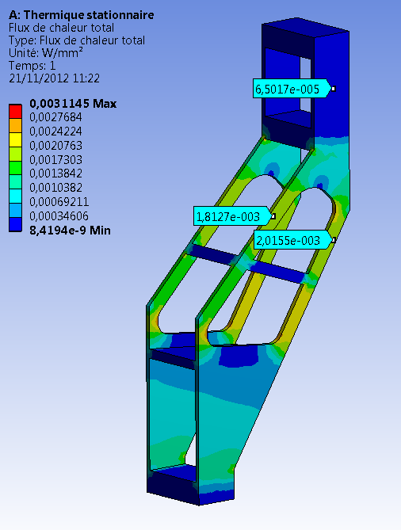
Thermo-Mechanical 2/3
Moving Post Free
Without Sliding Block
Sliding Bloc
Q _{2K} ~ 8 x 2 x 2x30 x 6,5 10 ⁻⁵ = 0,06 W
Q _{10K} ~ 8 x 2 x 10x2x (2,015 10 ⁻³ + 1,81 10 ⁻³ ) = 1,22 W
1 st Eigen Mode @ 22 Hz
Design Status of The Spoke Cryomodule for MYRRHA – H. SAUGNAC- SLHIPP3-17&18/04/2013 - Louvain la Neuve

Slide 8
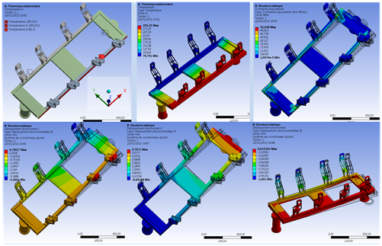
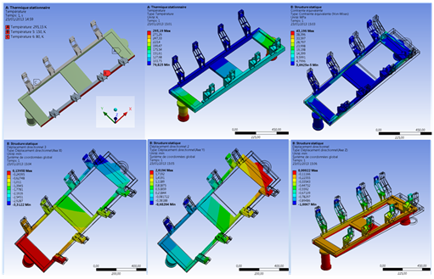
Thermo-Mechanical 3/3
During Cool Down Transient Temperature Gradients may Occur leading to a kind of ‘Banana Effect’. This transient is due to a non-balanced flow in the Table cooling tubes.
Case 1- Strongly Un balanced Cooling
Case2 – ‘Reasonably’ Un balanced Cooling
 | ΔT _{max} | δ X | δ Y | δ Z | σ _{V.M.}
Cas 1 | 215 K (295-80) | 4,5 mm | 6,3 mm | 1,2 mm | 53 MPa
Cas 2 | 70 K (150-80) | 3,4 mm | 2,7 mm | 1 mm | 43 MPa
Stationary | 0 (80-80) | 3,4 mm | 1,6 mm | 1 mm | 50 MPa
Case 2 is taken as a basis to design the maximal displacements, from the nominal position, allowable by the different sliders. This case implies a maximal temperature difference between one side of the Table to other Below 70 K. This value of 70 K has to be controlled with Temperature sensors.
Design Status of The Spoke Cryomodule for MYRRHA – H. SAUGNAC- SLHIPP3-17&18/04/2013 - Louvain la Neuve

Slide 9
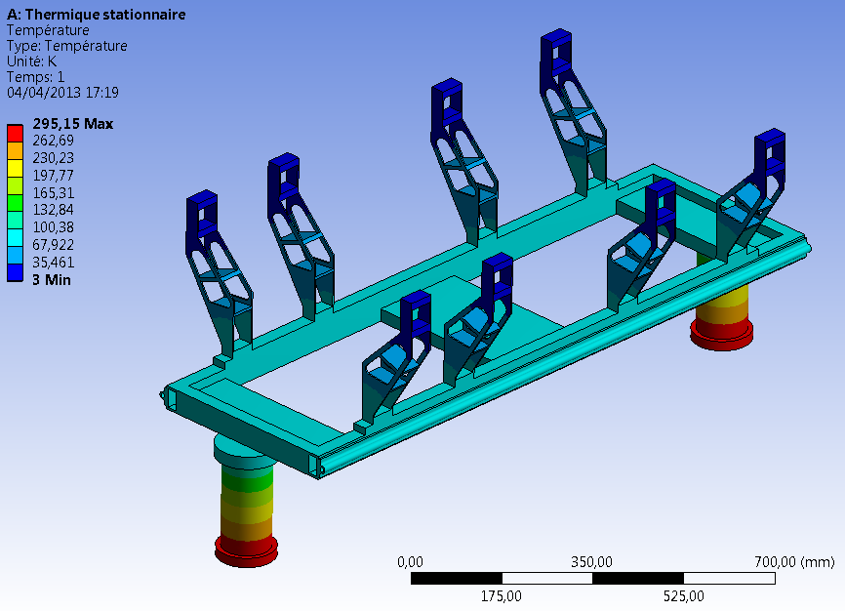
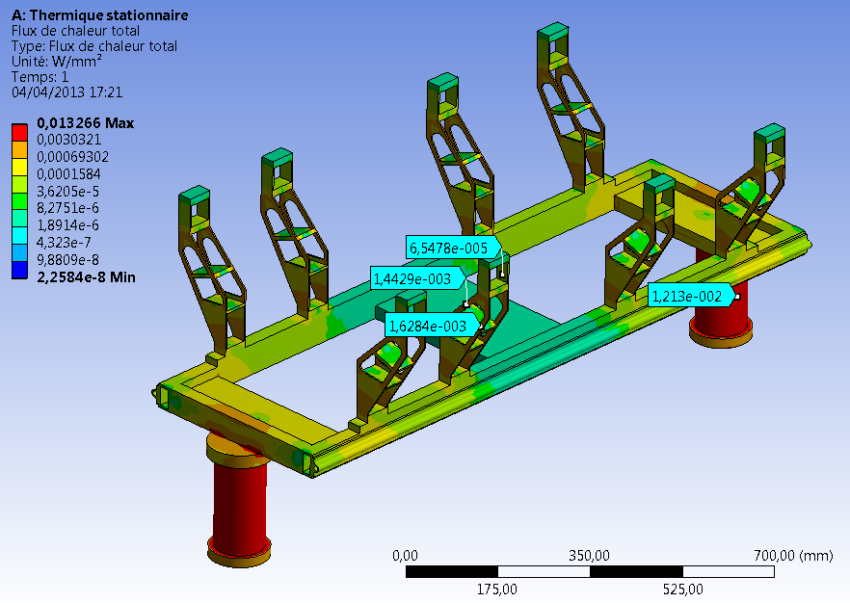
Thermal- Static Losses
~ 3K
Q _{80K} ~ 2 x π x 2 x 104 x 1,2 10 ⁻² ~ 16 W
Q _{80K} ~ 16 W
Q _{10K} ~ 8 x 2 x 10x2x (1,44 10 ⁻³ + 1,63 10 ⁻³ )
Q _{10K} ~ 1 W
Q _{2K} ~ 8 x 2 x 2x30 x 6,5 10 ⁻⁵ ~ 0,06 W
Q _{2K} ~ 0,06 W
~ 10K
~ 295K
~ 80K
Conservative (To Be optimized) | Q* _{300K→70K} | Q _{70K→2K} | Q _{70K→10K} | Q _{10K→2K}
Cavity frame- Solid Conduction (With 5K/10K Heat Sink) | 16 W | NC | 1 W | < 0.1 W
Power Coupler - Solid Conduction (to be evaluated) | <30 W | NC | <5 W | < 0.1 W
Beam Tube solid conduction (300K→2K Transition) | 1,6 W | 0,1 W | NC | NC
Burst disk pipe Solid Conduction (to be evaluated) | < 2 W | < 0.1 W
Thermal radiation (30 layers MLI @60K ; 10 layers MLI @2K ) | W (6W/m²) | 0.2 W (0,06 W/m²) | NC | NC
Thermal radiation (Beam tubes, measurement chimney) | 2,74 W | 0.1 W | NC | NC
Thermal radiation Power Couplers (to be evaluated) | < 5W ??? |  | < 2W ?? | < 2W ??
Instrumentation, Wiring (to be evaluated) | < 5 W | < 0.5 W
TOTAL | < 92 W | < 1 W | < 8 W | < 2.2 W
Design Status of The Spoke Cryomodule for MYRRHA – H. SAUGNAC- SLHIPP3-17&18/04/2013 - Louvain la Neuve

Slide 10
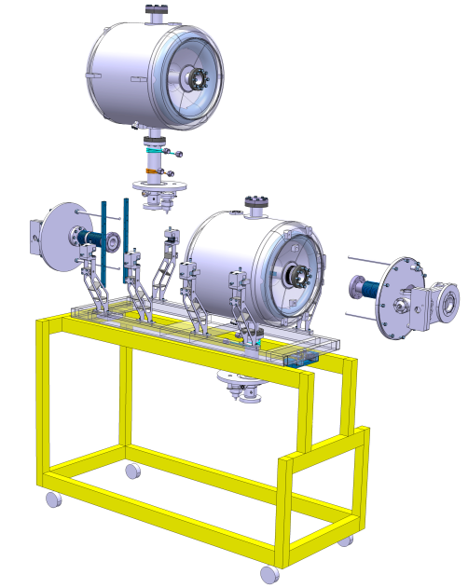
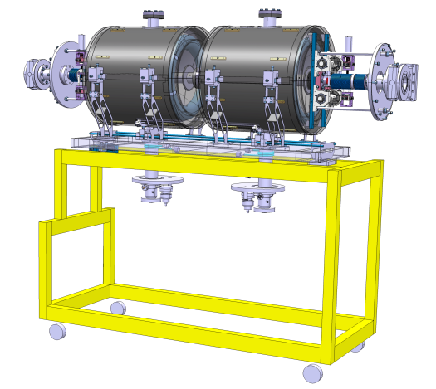
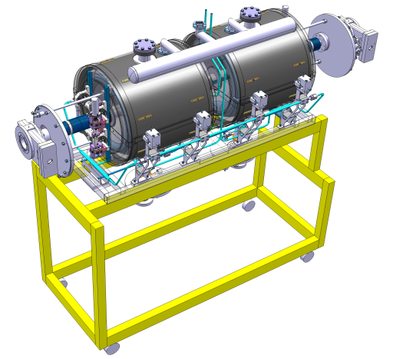
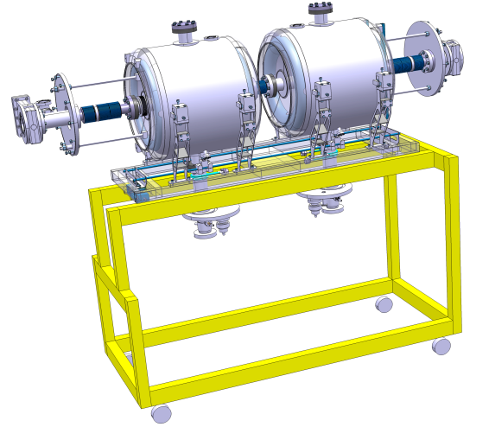
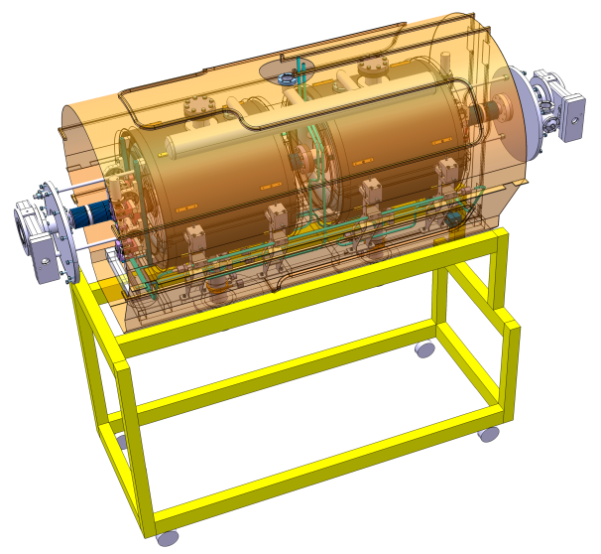
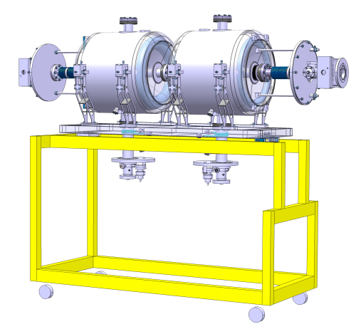
Cold Mass Assembly
Inside Clean Room
Outside Clean Room
Design Status of The Spoke Cryomodule for MYRRHA – H. SAUGNAC- SLHIPP3-17&18/04/2013 - Louvain la Neuve

Slide 11
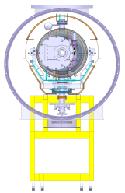
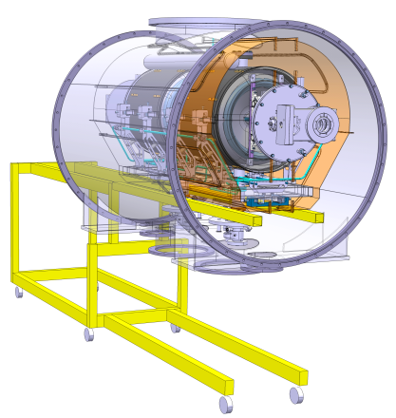
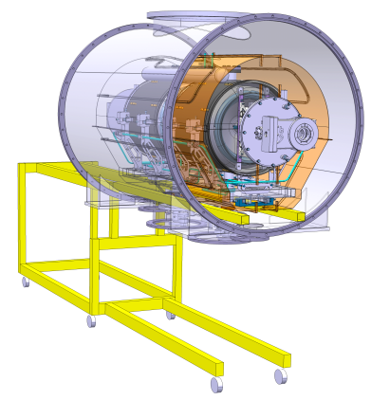
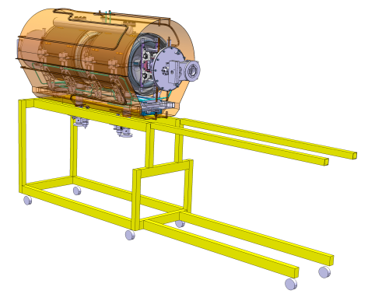
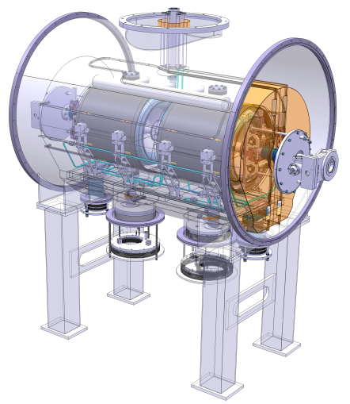
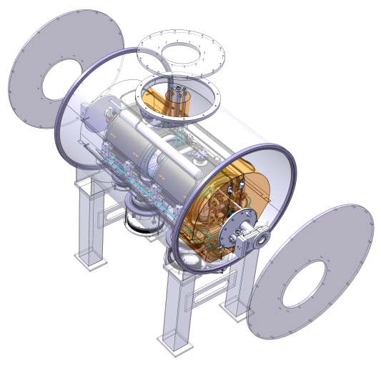
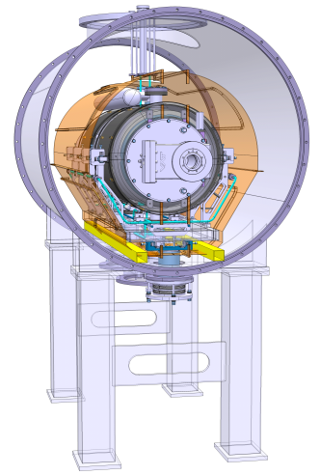
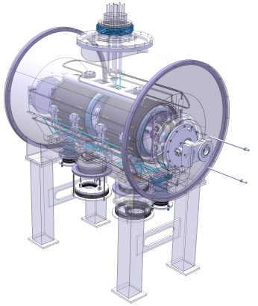
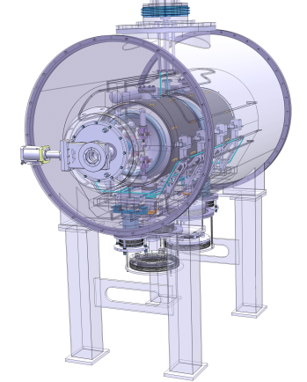
Cryostating
Vacuum vessel moved up
CR frame used for cryostating
Vacuum vessel mooved
Vacuum Vessel endcaps
Cryogenic tubes outlet
Supporting Posts assembly.
Assembly around power couplers
Warm Valves actuator assembly
Cryogenic tubes interface
Warm valves supporting Rods removed
Design Status of The Spoke Cryomodule for MYRRHA – H. SAUGNAC- SLHIPP3-17&18/04/2013 - Louvain la Neuve

Slide 12
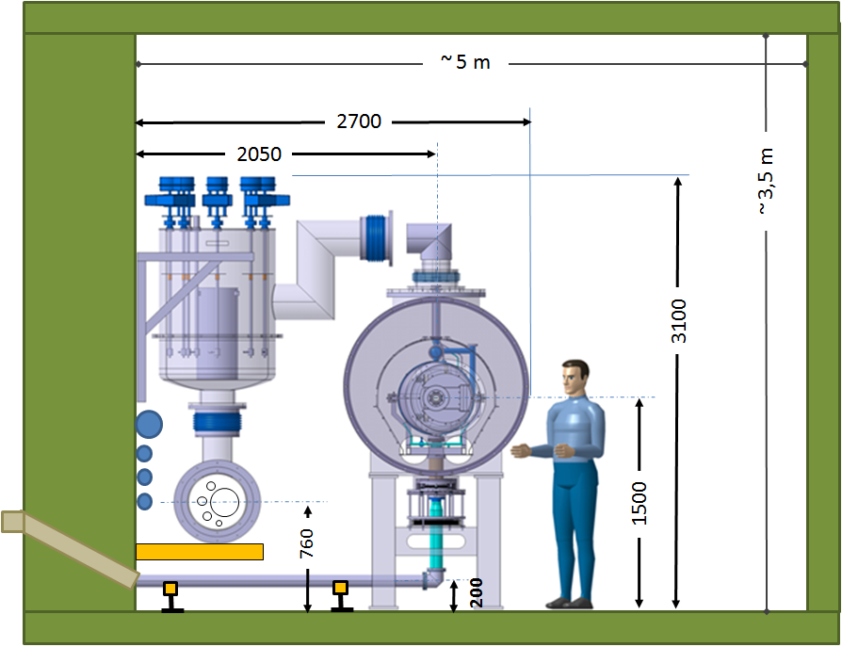
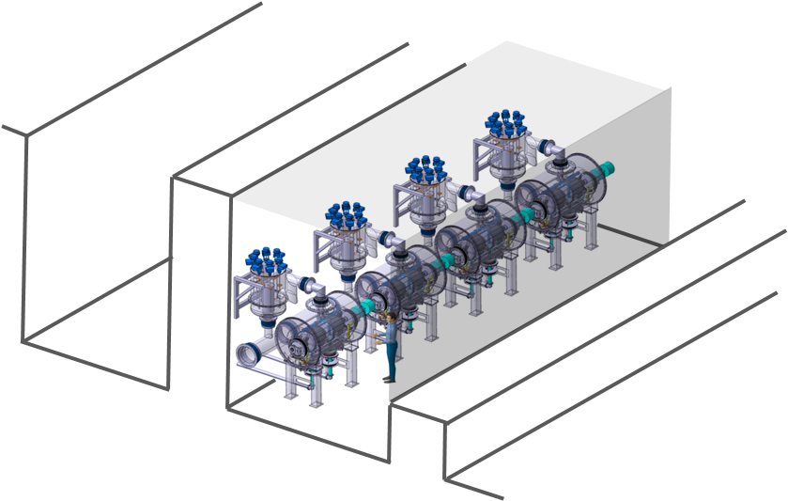
Overall Dimensions/Implementation
One Valve Box per Cryomodule…To Be Fully Confirmed.
Preliminary LINAC Tunnel Dimensions
Design Status of The Spoke Cryomodule for MYRRHA – H. SAUGNAC- SLHIPP3-17&18/04/2013 - Louvain la Neuve

Slide 13
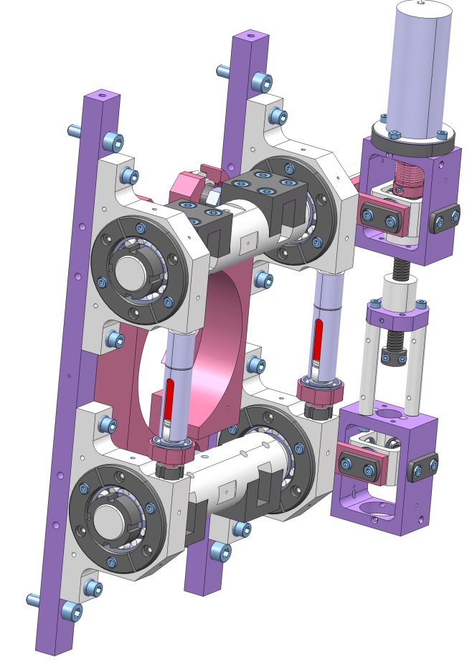
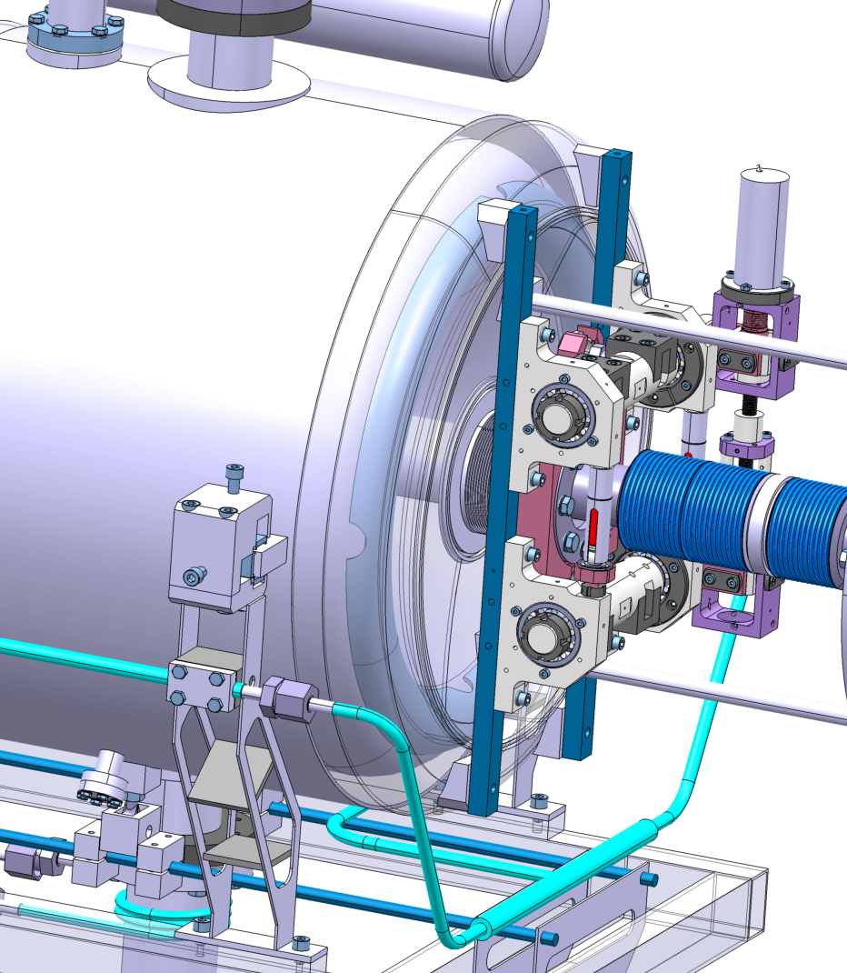
Cavity Helium Tank + CTS
The CTS (CEA ‘Soleil’ Type) for The MAX Spoke cavities is the Same as the one Designed for The ESS Spoke Cavities.
Coarse Range (Stepping Motor) | ~ 150 KHZ @2K | Limited by Max Stress
Fine Range (Piezo) | > 300 Hz
Stiffness | > 100 KN/mm
Design Status of The Spoke Cryomodule for MYRRHA – H. SAUGNAC- SLHIPP3-17&18/04/2013 - Louvain la Neuve

Slide 14
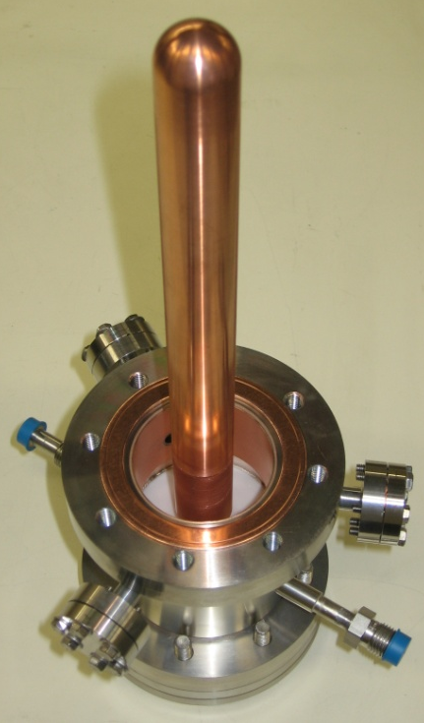
Power Coupler
A Power Coupler 350 MHz, 20 kW CW (designed), 50 Ω. WARM WINDOW
Was manufactured, in the framework of Eurotrans and successfully tested at 8 kW (amplifier limitation) CW on a 350 MHz, beta 0.15 Spoke cavity in a Cryomodule configuration.
The Design (SNS Type) will be kept as it for MAX
Basis for design
2 CF16 ports for vacuum measurements.
1 port for electron emission measurement pick up
1 water cooling loop for the window
Plain Copper Antenna
CF 63 on cavity
Thermal interception at 70 K (~15 W solid conduction) and ~ 10 K (~3 W solid conduction)
Design Status of The Spoke Cryomodule for MYRRHA – H. SAUGNAC- SLHIPP3-17&18/04/2013 - Louvain la Neuve

Slide 15
Thank You For Your Attention…
Design Status of The Spoke Cryomodule for MYRRHA – H. SAUGNAC- SLHIPP3-17&18/04/2013 - Louvain la Neuve

