Slide 1
ESS Control System
Timo Korhonen
ICS

Slide 2
Overview
General
Hardware strategy
Timing system
EPICS setup
Development environment
Conclusions

Slide 3


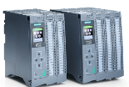
Hardware strategy
Three levels of performance
PLC
  Industrial, process I/O
  Safety systems, high reliability
EtherCAT
  mid-range, beam synchronised I/O
  Used mainly as a fieldbus
MTCA
  High-speed front-end processing
  Digital Frontend Platform
Selection of platform based on requirements and cost
Signal speed
10 MHz
1 MHz
Electronic front-end platform
100 kHz
10 kHz
1 kHz
100 Hz
EtherCAT
10 Hz
1 Hz
Industrial automation (PLC)
0.1 Hz

Slide 4
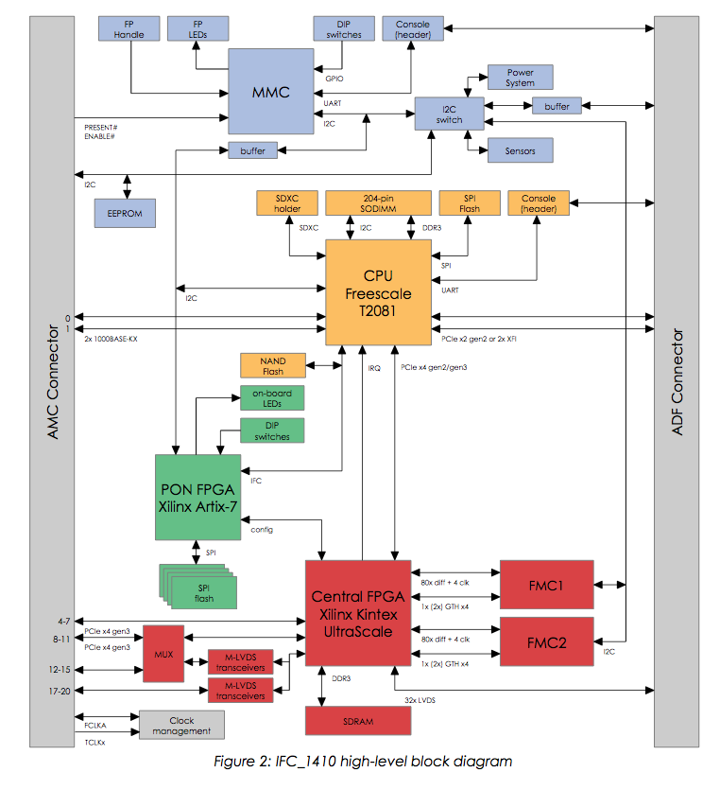
MTCA processing and I/O
Common Digital Platform
  A board for MTCA.4 that can host almost all applications that need FPGAs, high throughput and/or fast real-time responses
In-kind effort with PSI & commercial partner
  IOxOS SA in Gland, Switzerland
  Based on an existing architecture
  FMC (VITA 57.1) carrier
    2 x HPC FMC (IFC_1410) or
    Rear analog interfaces + 1x HPC FMC (1420)
  Modern FPGA + Freescale (NXP) CPU
  Rich interface to Beam Interlock System (BIS)
    Status (OK/NOK) + communication
    standard interface provided as IP core (plan)
    For all fast systems (BI & RF)

Slide 5
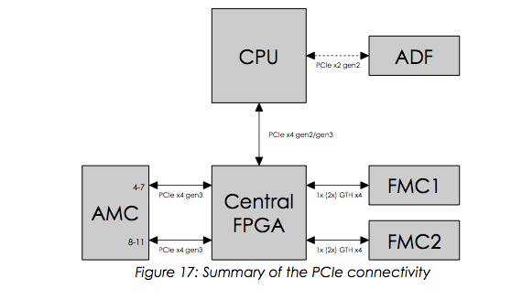
Common Digital Platform
Architecture
  Combination of a FPGA with a CPU, connected with PCIe
    I/O primarily via FMCs (VITA 57.1)
    FMCs allow reuse of digital platform for several purposes
  CPU allows for
    Flexibility in programming (cf. Xilinx SDSoC concept)
    Scalability: Instantiate similar simple resources instead of building a single complicated one
    Use as a standalone unit
  PCI express
    Is the most common computer interfacing standard today
      Also the basis of MTCA.4
    More complicated than e.g. UDP but provides full feature set
      DMA, SR/MR-IOV, interrupts, etc.
    Requires more infrastructure handling (PCIe enumeration, NT port mapping, etc.)

Slide 6
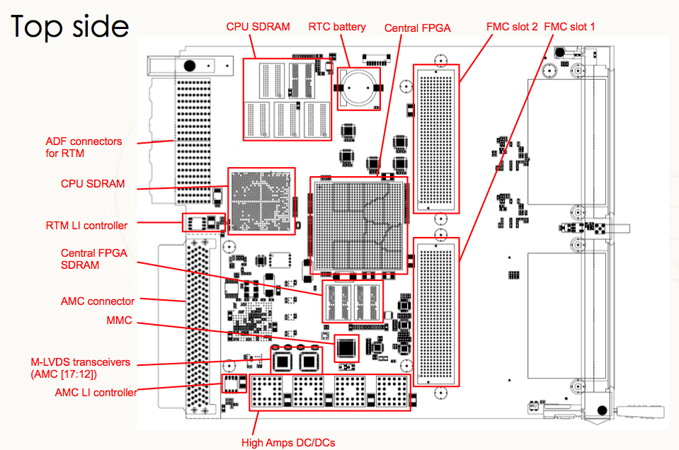
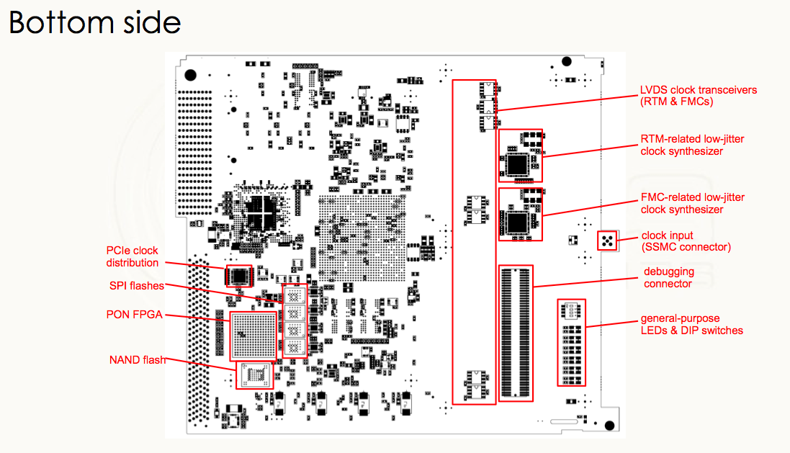
IFC_1410 Layout (status at PDR)
Status as as of 21.July:
Schematic capture done at 99%
Design verification in progress
Peer review (of schematics) to do
PCB placement done at 99%, based on the current version of the schematics
New: beam interlock (FBI) interface redefined

Slide 7
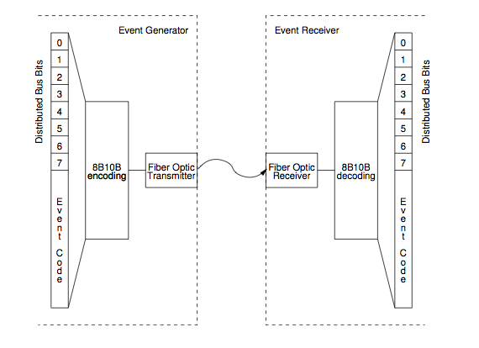
ESS Timing system
RF Generator
88 MHz
Master Event Generator
fanout
Event
receiver
Event
receiver
fanout
Event
receiver
Event
receiver
Triggers
Software synch (IRQ)
Timestamps
Data
Control & setup
Event
receiver
Event
receiver
Event
receiver
Event
receiver
The (accelerator) synchronization frequency (of 88 MHz) is fed into the master event generator and used as the system clock. Downstream will be phase synchronized to that.
Master event generator creates a “stream” of trigger events and data (and bits, e.g., clocks)
Fan-out system with many levels multiplies the event&data stream to the facility
The 14 Hz operating frequency will be generated by downconversion from RF in the event generator
Events and (limited amounts of) data can also flow upstream (optionally)
Notes:
Remember: eye pattern
14 Hz will be generated internally in the EVG. De facto decision.

Slide 8
Timing system
The ESS timing system (aka event system) can:
Distribute synchronous triggers to a (very) large number of devices
  Triggers can be pulses, electrical or optical, with different properties that can be programmed at the receiving end
  Triggers can also be software, triggering some action in the IOC (Control Box)
    By “processing” EPICS channels that read out data, write values, calculate, whatever the IOC is able to do. Can also be non-EPICS actions.
Distribute (limited amounts of) data to many receivers synchronously and simultaneously
  This happens in parallel to the trigger distribution, no effect on accuracy.
  Limited amount = 2 kilobytes in one transmission. The raw speed depends on setup but can be up to 125 MB/sec (even faster in the ESS generation hardware)
  A single transmission takes some microseconds (~2 us for the raw transmission)
Distribute synchronous timestamps (long story to explain how this works)
Generate (programmable) sequences of triggers (events), RF synchronized
Accept asynchronous inputs to generate events
Synchronize to an external input trigger with optional phase adjustment
And many more things…(distribute clock signals, take in interlock inputs,…)

Slide 9
EPICS at ESS ICS
ESS target is to be fully EPICS 4 compliant
  At the moment, we are using version 3.15.4.
  Use EPICS 3 on control level, add high-speed structured data handling to better support scientific applications
Development and deployment is based on a system called EEE (ESS Epics Environment)
The environment handles two kinds of software components, EPICS modules and IOCs.
  Modules provide a set of functionality in the form of resources (shared libraries, templates, substitution files...)
  Modules are building blocks for IOCs.
Configuration of an IOC is done by loading and configuring modules run-time (boot time)
  no compilation for individual IOCs
  Central repository and network-based boot

Slide 10

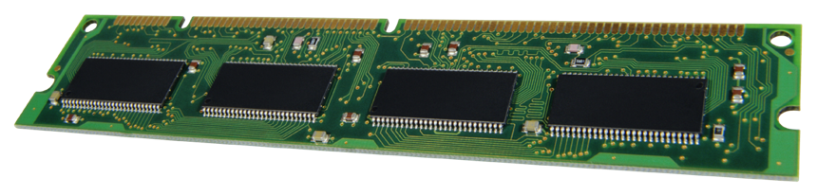
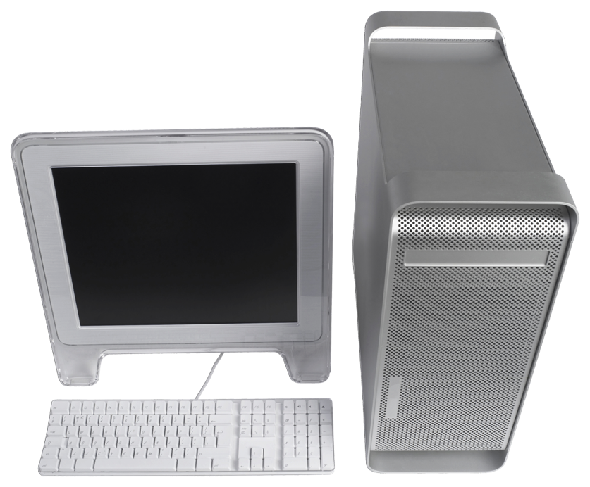
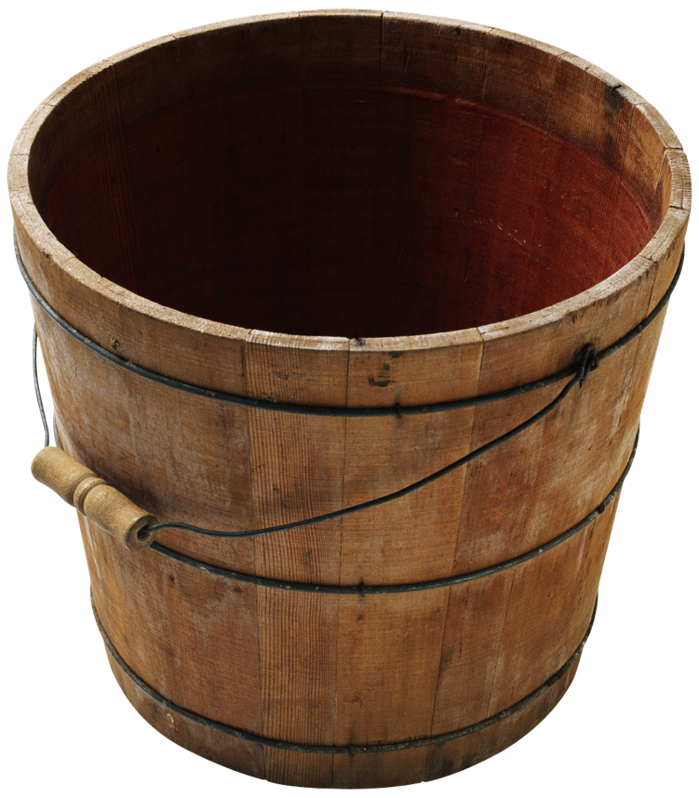

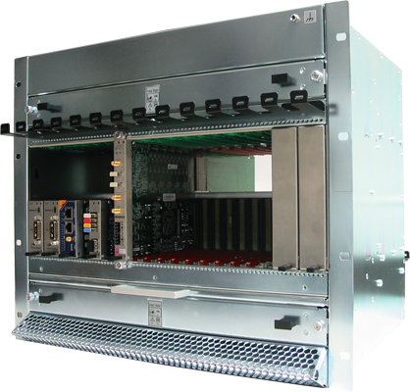
Deployment environment overview
EPICS Base
EPICS modules (community)
EPICS modules (ESS)
Community release
Community (various sources)
ESS internal or in-kind
Download, configure, test, etc.
Develop, configure, test, etc.
Download, configure, test, etc.
CCDB
Compilation, maintenance
Continuous integration, tests, etc.
EPICS core
EPICS modules
(RT)OS image
File system (NFS)
IOC Factory
File system (NFS)
st.cmd
Synchronization
System integration
Boot

Slide 11
Summary
Hardware: MTCA.4 and Common Digital Platform
Timing system: Central Event System (aka MRF)
  Provided by ICS
  Covers the whole facility
EPICS control software
  EPICS 4 pvAccess as the interface protocol
A development environment provided
  Many tools to manage IOC code
  Already familiar for the CEA team

