Slide 1

nBLM for ESS
Scope of Work
Schedule #1.11
Kick-off meeting held at Lund, Sweden
July 25th 2016
CEA Saclay: D. Desforge, F. Gougnaud, C. Lahonde-Hamdoun, M. Kebbiri, P. Legou,
J. Marroncle, T. Papaevangelou, L. Segui, G. Tsiledakis

Slide 2
Outline
Scope of Work
  1. Design
  2. Prototype
  3. Performance studies & optimization
  3. Electronics & CS
  4. “Vertical test”
  5. Manufacturing
  6. Installation & Commisioning
Requirements & Specifications
Interfaces
Risks
Deliverable items
Milestones
Conclusion

Slide 3
Why a new BLM?
Challenges:
RF cavities emit γ-rays. Those γ’s may pose a problem to ionization chambers used as BLMs
In the case of high intensity but low energy regions of an accelerator charged particles and γ’s do not even exit the accelerator vessel
Continuous monitoring of small losses is needed
Signature of beam loss: fast neutrons
  Thermal neutrons can come from moderation inside the walls, so must to be rejected
  Gamma’s and X-rays present during normal operation, so the detector must be insensitive to them
The nBLM should be:
sensitive enough to monitor small losses
sensitive & fast enough to react on
“catastrophic event”
appropriate for high rates
radiation hard
The “nBLM for ESS” consept:
Micromegas equipped with combination of appropriate neutron convertors & moderators

Slide 4
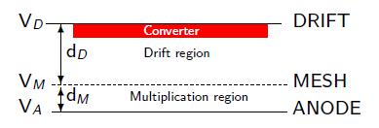
Neutron detection with Micromegas
Neutron detection ➔ neutron-to-charge converter
Solid converter: thin layers deposited on the drift or mesh electrode (¹⁰B, ¹⁰B₄C, ⁶Li, ⁶LiF, U, actinides…)
  Sample availability & handling
  Efficiency estimation
  Limitation on sample thickness from fragment range
  ⇒ limited efficiency
  Not easy to record all fragments
Detector gas (³He, BF₃…)
  Record all fragments
  No energy loss for fragments ⇒ reaction kinematics
  No limitation on the size ⇒ high efficiency
  Gas availability
  Handling (highly toxic or radioactive gasses)
Neutron elastic scattering
  gas (H, He)
  solid (paraffin etc.)
    Availability
    High energies
    Efficiency estimation & reaction kinematics

Slide 5
The proposed BLM for ESS
Assembly of the 2 modules:
1st module (MM + B₄C) capable of monitoring fast neutron fluxes ~ few n · cm⁻² s⁻¹
  minimum E_{n} defined by the absorber
  4π
  adjustable neutron sensitivity
  low gamma sensitivity
  Detection times of ~1 μs possible!!!
2nd module (MM + polyethylene) appropriate for high flux - high energy neutrons, coming from the front
  directional
  insensitive to gammas
  high particle fluxes
  Detection times << 1μs
Extra option as 2nd module:
MM + thin ²³⁸U layer
  E_{n} threshold ~1 MeV
  Fission fragments ➔ very low gain ➔ completely insensitive to gammas
  Very high radiation environment
Cd or other absorber
Polyethylene
MM +
Polyethylene + Al
MM
+
B₄C
~20 cm
~10 cm

Slide 6
The proposed BLM
Gas: Helium + quencher (CO₂ or CF₄, is CH₄ acceptable?)
  High max gain ➔ better stability
  Low sensitivity to gamma & electrons
  - Leek tightness more difficult
Sealed or semi-sealed operation
Front-end electronics integrated
Applied voltages ~ 500 V
Possibility of segmentation ➔ multi channel output
  higher rates
Detector parameters to be optimized according to the expected particle fluxes and desired performance.
Prototype will be characterized at the facilities:
LICORNE (fast neutrons)
COCASE (high activity Cobalt source
ORPHEE (high thermal neutron flux / aging)
SEDI laboratory (long term stability)
Project started on June 1st 2016. Estimated time for optimization, design, construction, characterization, installation & commissioning: 2.5 years (Commissioning: January 2019)
Cd or other absorber
Polyethylene
MM +
Polyethylene + Al
MM
+
B₄C
~20 cm
~10 cm

Slide 7
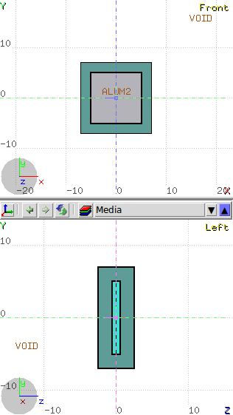
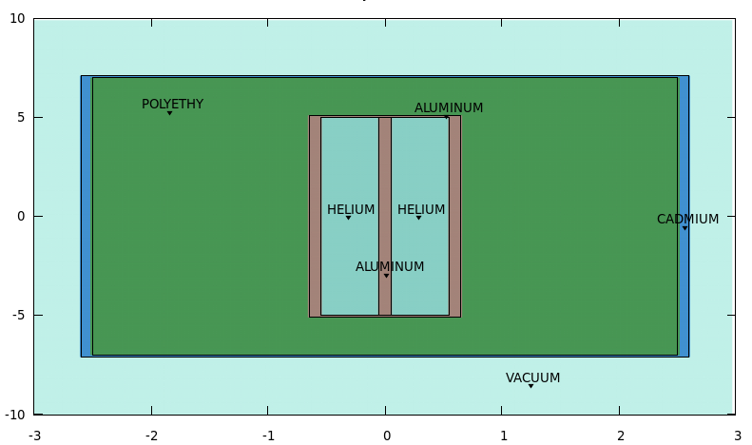
Fast neutron flux monitoring with high sensitivity
[cm]
A double micromegas detector ( ~ 1.5 cm thick)
MM
neutrons
B₄C
B₄C
Simulations by G. Tsiledakis
[cm]
A double Micromegas detector filled with Helium + quencher (CO₂, CF₄)
2 layers of a B₄C converter (~2 μm ) to capture thermalized neutrons
Polyethylene (2, 4, 6 cm) to thermalize beam neutrons
Cadmium (~1 mm) to eliminate incoming thermal neutrons
Detector size (4 cm thick Poly.) ~ 20 x 20 x 10 cm³

Slide 8
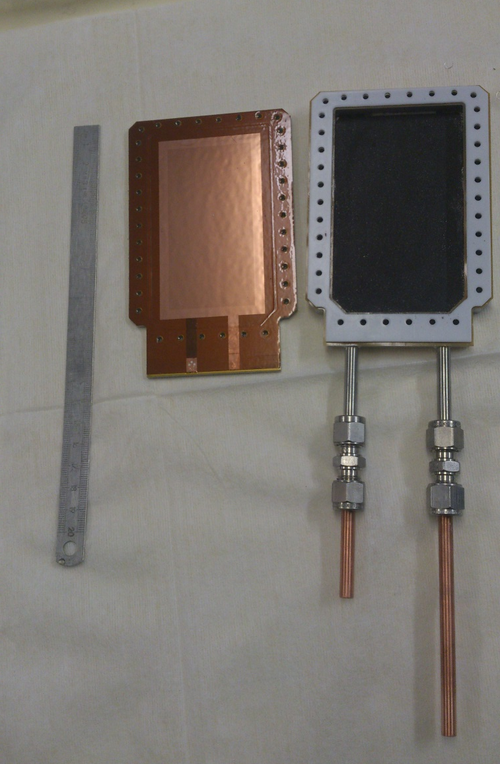
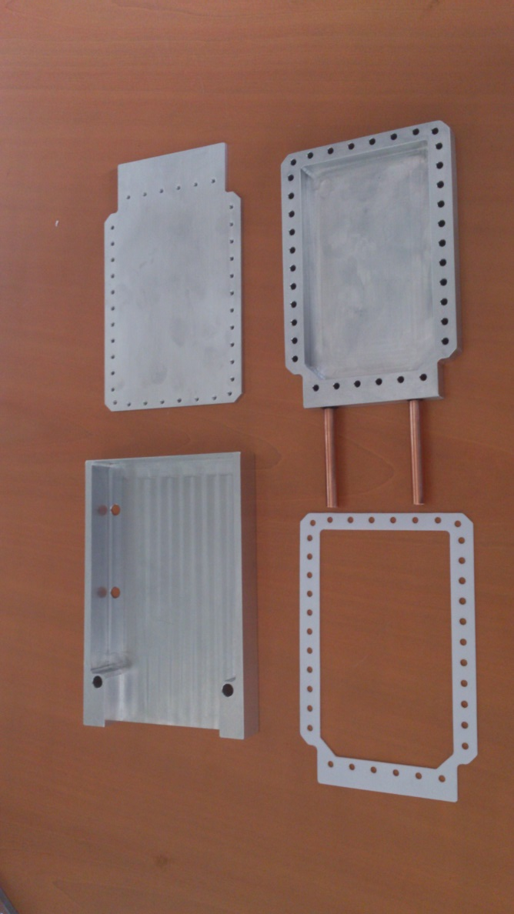
Building a simple neutron counter
¹⁰B layer (thick!) deposited on the inner part of the chamber
The ¹⁰B layer is the less trivial part to build
Material availability
Deposition methode
  Sputtering
  Evaporation
  Electrodeposition
  …
Teflon / kapton joint
Microbulk glued
on a metallic plate
Gas tubes

Slide 9
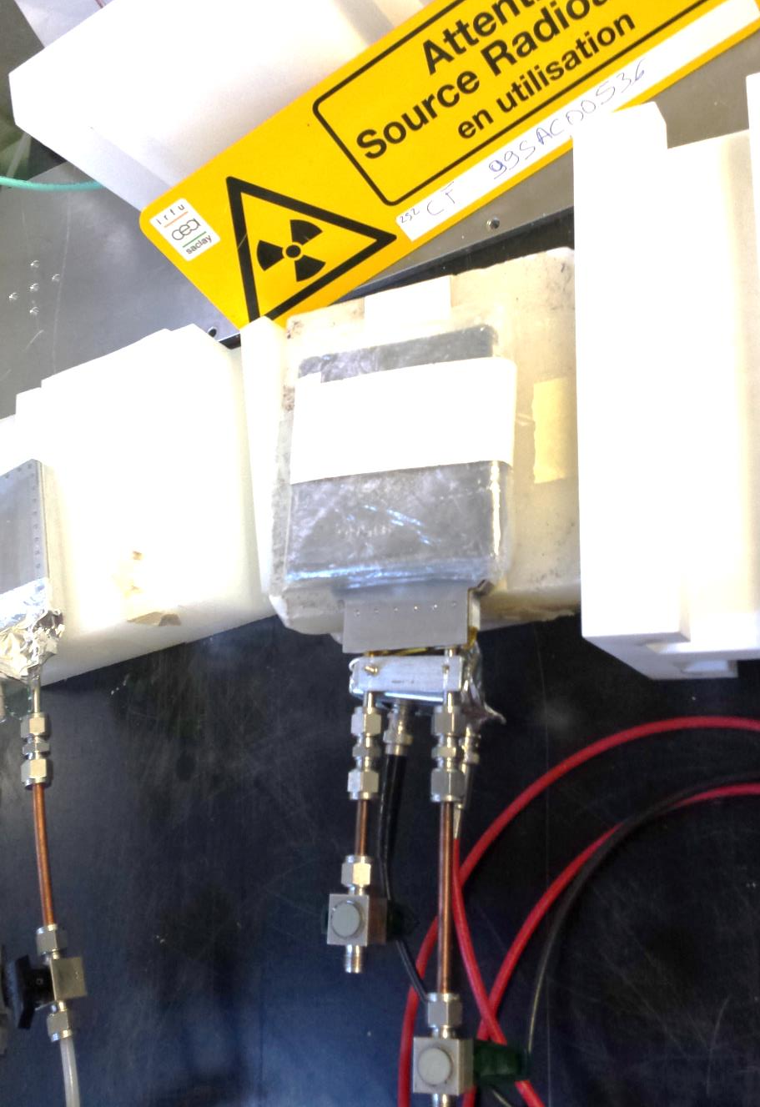
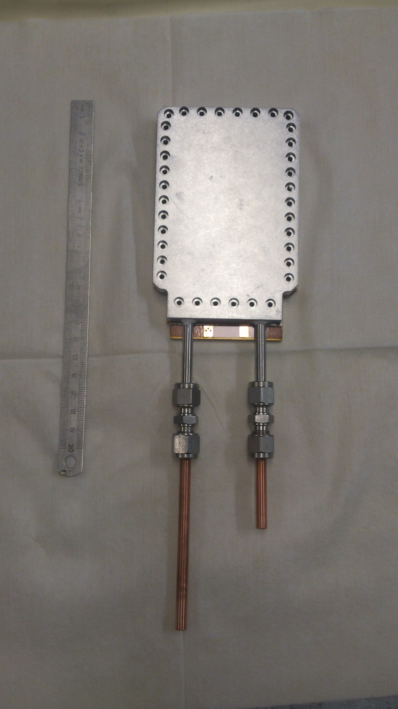
The simple neutron counter

Slide 10
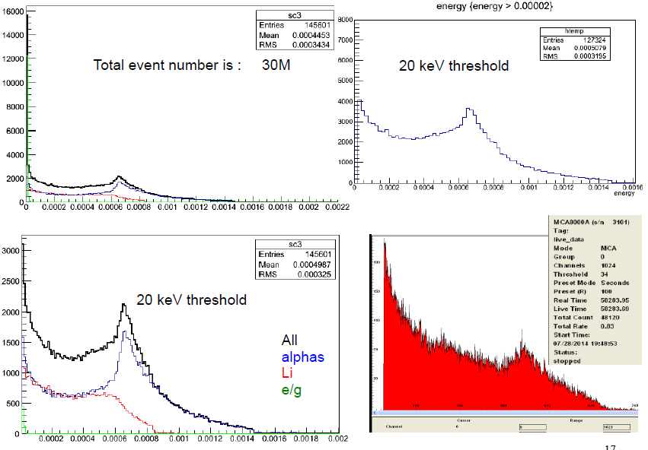
Performance
2 High voltages (+300V & +500V) for the mesh and the anode
Single readout channel
Operation in sealed mode (since July) – no gain loss
Measured efficiency: 4.3 – 5 %
(reference ³He tube)

Slide 11
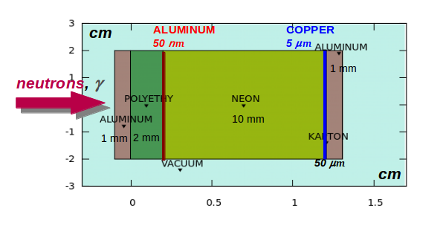
A module for high E_{n} & high particle flux
1 aluminum plate (1 mm) for the detector body
2 mm of polypropylene for “neutron conversion” to proton recoils
50 nm aluminum foil or deposition on the Polyethylene, Adjusting the thickness ➔ set the neutron energy threshold
0.1 - 10 mm gas (neon/helium) to produce electrons by ionization processes induced by the recoil proton.
Directional detection of fast neutrons (E_{n} > ~0.5 MeV)
Strong gamma rejection
High rate capability

Slide 12
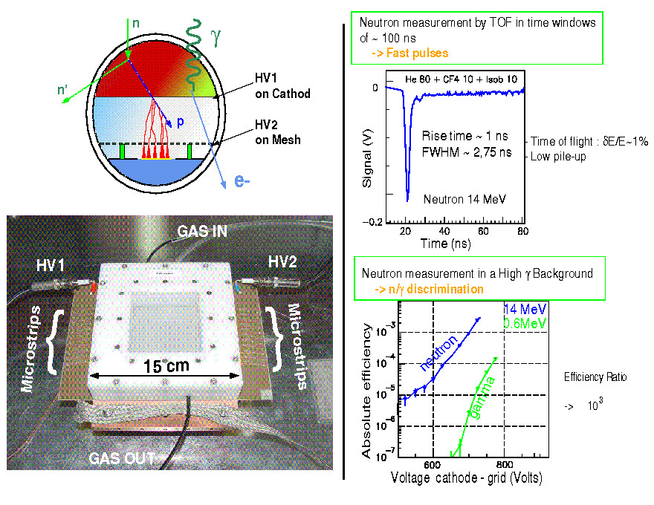
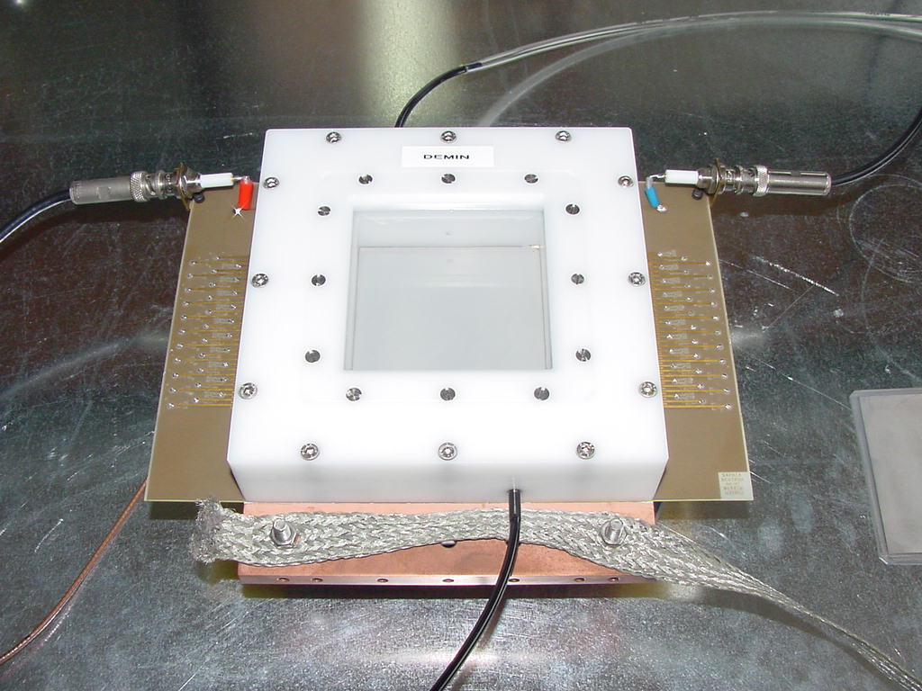
Micromegas Concept for Laser MégaJoule & ICF Facilities
M. Houry et al., NIM,557(2006)648
The γ insensitivity of Micromégas applied to neutron spectroscopy
on Inertial Confinement Fusion experiments
2mm CH₂ converter
Time response < 500 ps
65 strips (1.6 mm pitch)
Gas In
HV1
HV2
Microstrips
Microstrips
Very good γ-rejection
< 15 cm >
Gas Out
Ref: CEA/DIF/DCRE/SDE M. Houry
DEMIN group (CEA/DIF/DCRE and DAPNIA)

Slide 13
Scope of Work
SCHEDULE 1.11 - AIK 7.3

Slide 14
Planning
T₀: June 1st 2016
Commissioning: Dec 2018 – April 2019

Slide 15
Work in 3 main phases
Prototype Production (May 2017)
  Definition of expected response
    Alarm signal
    Reaction time in different loss scenaria
    Continuous monitoring requirements (sampling, sensitivity level etc)
  Monte-Carlo simulation studies
    ESS → Expected particle fluxes for different scenaria
    CEA → Optimization of detector parameters (dimensions, converters, moderators absorbers
  Preliminary Design Report 1 → End November 2016
    Documentation of detector design
    Report on plans for the prototype (design(?),manufacturing, planned tests)
    Documentation on the initial electronics design
  Prototype production (PDR 2)→ End May 2017
    Selection of neutron Converters
    Initial electronics design
    Prototype fabrication
Prototype testing & finalizing of the design → March 2018
  Prototype extensive testing
  Completion of the electronics design
  Critical Design Review 1 (Oct 2017)
    Report on Initial prototype test & suggested changes
    Documentation on the complete electronics design
  Completion of the FPGA firmware
  Completion of the software for the Control System
  Completion of the gas system design
  Critical Design Review 2 (March 2018)
    Report on Final prototype test & suggested changes
    Documentation of the completed FPG firmware development
    Documentation of the completed SW for the CS
Manufacturing – installation – commissioning (end-2018 ?)
  Manufacturing & validation of 42 modules
  Vertical Integration test of the system (for 1 unit)
  Delivery of the system to ESS
  System Acceptance Reviews SAR (end Sept 2018)
    Documentation on “as-built” system
    System installation & commissioning instructions
    Calibration, operation and maintenance manuals
  Installation & commissioning at ESS
  Support with installation & commissioning (end 2018)
  Handover to ESS (April 2019)

Slide 16
1. Prototype production
by end May 2017

Slide 17
1.1 Definition of expected response
Alarm signal
  Definition of alarm condition(s)
  Definition of expected signal(s)
Reaction time in different loss scenario
  Definition of time available for loss detection
    Loss scenario & level
    System reaction time
  ➔ Input needed in order to better understand reaction times:
    Beam time structure (pulses bunches etc)
    MP reaction times, beam evacuation time, beam dump etc
Requirements for Continuous Monitoring
  Sampling frequency
  Sample duration
  Desired sensitivity
  Visualization

Slide 18
1.2 Monte-Carlo simulation studies
ESS → Expected particle fluxes for different scenarios
  Simulate different beam loss scenarios
  Provide for each scenario:
    Particle flux maps
    Energy & momentum
    Time of flight
  Definition of required sensitivity as a function of the neutron energy spectrum (En_{min})
  Definition of detector locations
  ➔ Presentation by Irena
CEA → Optimization of detector parameters for
Optimal neutron sensitivity
Background rejection
Response times
  Detector dimensions & material thicknesses
  Converter selection
    Composition (➔ performance & lifetime)
    Thicknesses (➔ sensitivity & background rejection)
  Moderator definition
    Composition (➔ performance)
    Thicknesses (➔ spectral response)
  Absorber
    Composition (➔ energy response – safety regulations)
    Thicknesses (➔ efficiency)
  Operation mode (gain, pre-amplification etc)
  Number of channels per module
  ➔ Presentations by Georgios & Laura

Slide 19

1.3 Prototype design & manufacturing
Prototype design
  According to the simulation output
  Previous experience from neutron detection
  Semi-sealed operation mode
  Reliability
  Lifetime (years?)
Neutron converter
  Selection of convertors according to simulations
  Fabrication methods
    Slow convertor (Linköping ?)
    Fast converter (metallization robustness)
Neutron moderator & absorber
  Material selection according to simulations & ESS safety considerations

Slide 20
1.4 Initial electronics design
Front-End Electronics → Philippe
  Definition of FEE (Philippe, Thomas, Jacques)
  Very sensitive & low noise – integrated on the detector
  1 – 5 channels per module
  Fast / “slow” signals
  ➔ Radiation hardness requirements
  Low voltages / power consumption
Back-End Electronics → Philippe, Françoise with ESS
  Definition of BEE (Philippe, Françoise, Thomas, Jacques, ESS)
  Count-rate calculation (μTCA, custom acquisition card?)
  Estimation of number of crates
  Estimation of distance to detectors
  Cables
Definition of Acquisition system → Philippe, Françoise with ESS
  Definition of beam loss monitoring requirements
Definition of control system → Philippe, Françoise with ESS
  System monitoring requirements
  HV Power supplies control
  Gas System monitoring
  “OK signal”
  Necessity of a calibration / detector checking system ?
  Necessity of electronics checking system ?
  ➔ Presentations by Phillipe, Françoise & Timo

Slide 21
2. Prototype testing & finalizing of the design phase
by end March 2018

Slide 22
2.1 Prototype testing
Planned tests
  Module Characterization (Laura, Caroline, Mariam / 4-5 weeks)
    Micromegas complete characterization (gain, gas, voltage limits etc)
    Behavior of Micromegas readout
    Spark conditions (resistive bulk technology ➔ minimize spark intensity)
    Detection of fast neutrons
    Efficiency check (thermal neutrons only)
  Prototype Extensive testing (Laura, Caroline, Georgios, Thomas / 9 months)
    LICORNE (fast neutrons)
    COCASE (high activity Cobalt source)
    ORPHEE (efficiency / high thermal neutron flux / aging)
    SEDI laboratory (long term stability)
    TOF facility? (nTOF @ CERN, GELINA @ IRMM Geel,.. ? )
    RF-cryomodule of ESS during testing at SACM Synergium (x/γ sensitivity)
  Data analysis (Laura, Thomas, Georgios – by March 2018)
➔ Finalize the design (Daniel, Thomas, Laura – by March 2018)

Slide 23
2.2 Complete electronics design
  Completion of the electronics design → Philippe, Françoise (Oct 2017)
    FEE
    BEE
    Acquisition & alarm system
    Control system
  Completion of the FPGA (or other selected solution) firmware, → Françoise (March 2018)
  Completion of the software for the Control System → Françoise (March 2018)
  ➔ Strategy to be decided between ESS & CEA (discussion this afternoon)

Slide 24
2.3 Design of gas system
  Selection of gas
    Flammability restrictions
    Gain
    Gamma suppression
    Stability
    Semi-sealed operation – very small gas flow (≤1 l/h)
    BEE
  Gas distribution
    Connect groups of detectors at the same line
    Possibility to isolate specific detectors without disturbing the group
    Gas flow / pressure measurement at entrance & exit of the group
  Safety considerations
    Compatibility with ESS regulations
    Failsafe / uninterrupted gas supply
      Premixed bottles
      Double bottles / bottle replacement without interrupting gas flow
      Backup bottles
    Gas distribution with limited max flow & at small overpressure (overpressure < 1 bar)
    Leak tight system (definition of tightness level needed?)
    Necessity of gas leak detectors?
    “OK” signal to Control System
  To be delivered with CDR 2 (March 2018)

Slide 25
3. Manufacturing & Installation phase
end by mid 2019

Slide 26
3.1 Manufacturing
Detectors parts (April -June 2018)
  Mechanical pieces
  PCBs
  Bulking (SEDI / industry)
  HV tests in air
  Components (gas / electronic connectors)
  X-ray test of Micromegas
  FEE integration (SEDI?)
  Convertor production
  Moderator
  Absorber
Integration (42 modules, May-Aug 2018)
  Module assembly (“slow” & “fast” detector)
  Module testing with source
  Integration of modules & moderator & absorber
  Mechanical support / special interfaces, to be defined
Validation
  Test bench
  Validation procedure
  Vertical integration test (1 unit)
    Detector assembly
    FEE & BEE
    Acquisition / Alarm system
    Control & Monitoring System
    Monitoring
Shipment to ESS
  ➔ Responsibility of CEA/ESS?
  SAR (System Acceptance Review) → September 2018

Slide 27
3.2 Installation & Commissioning
Delivery to ESS
Installation (Oct – Nov 2018?)
  Gas lines
  Cabling
  Electronics racks
  Mechanical supports / special interfaces
  Detectors
  Acquisition / alarm system
  Control system
  ➔ Responsible to be defined
Commissioning (End 2018 - April 2019?)
  Detectors (SEDI)
  Alarm, Acquisition & Control software (SIS)
Reviews, Reports for all nBLM activities → handover: December 2018 / Q1 2019 ?

Slide 28
Control System
CS will be implemented in collaboration with ESS Control System group (ICS)
Strategy to be defined during todays discussion
  ➔ CS to be taken in charge in the CEA scope of nBLM budget?

Slide 29
Planning

Slide 30
Planning

Slide 31
Expectations from ESS
Monte Carlo Studies
  Expected particle fluxes for different beam loss scenarios
  Background fluxes
  Definition of neutron energy threshold
Provide
  Performance specifications (reaction times etc)
  Data for radiation background
  Safety regulations & list of forbidden materials
  Drawing of the beam line, Interfaces, etc
  etc.
Control / Acquisition system requirements definitions

Slide 32
Requirements & Specifications

Slide 33
Technical Specifications - nBLM system
Document which describes the technical specifications for the neutron-based part of the Beam Loss Monitoring (BLM) system - in short the nBLM system - for the ESS linac
➔ To be completed (when?) since this document is part of the schedule contract.
Time response of the nBLM system.
  This is the time from the onset of the beam loss to the time when the BLM system drops the BEAM_PERMIT signal, which is than propagate to the (Beam Interlock System) BIS interface.
  Currently it is required by the Machine Protection System (MPS) that the BLM system reacts within ~10μs in the SC and within a couple of μs in the NC parts of the ESS linac, the latter being applicable for the nBLM system. However, these numbers were set in the past based on a simplified calculation of time needed to melt a block of material under a perpendicular incidence for the beam parameters expected at the time.
  These numbers raise a number of questions and need a revision with a more realistic worst-case scenario (to which BLM should react) in mind. In order to do that a list of beam loss scenarios interesting for BLM needs to be identified, which is the current focus of the work.
The energy limit that distinguishes between fast and slow neutrons.
  To be determined.
Neutron, photon and other particle fluxes with their spectra expected at the selected nBLM detector locations for the relevant beam loss scenarios.
  To be determined.
Expected background fluxes and spectra.
  To be determined
nBLM detector dimensions.
  To be determined.
Number of nBLM detectors to be installed.
Table 1: Number of nBLM devices along the ESS linac.
ESS linac section | Number of detectors
MEBT | 5
DTL | 11
Spoke | 14
Elliptical | 4
HEBT | 1
sum | 35

Slide 34
Technical Specifications - nBLM system
    Any nBLM system component shall be compatible with the radiation environment specific to the component location.
    All components of the nBLM system (detector, electronics, mechanical support, control software, firmware etc) shall be compliant to the ESS standards.
    Thresholds for the Machine protection functionality of the nBLM system.
      To be determined.
    Dynamic range, accuracy and stability.
      To be determined.
    Beam Interlock System (BIS) interface.
      To be determined.
    All additional specifications related to the software for the nBLM control system can be found in [2].
  INTERFACE REQUIREMNTS
    Mechanical interfaces: detector mounting
      To be determined.
      If detectors are mounted on the accelerator tanks, than the interfaces to the "Vacuum" and "EMR" need to be determined. If detectors are mounted on a support attached to the tunnel wall or floor, than interfaces with "Site Infrastructure" need to be determined.
  [2] ESS-00XXXXXXX, Technical Specifications - Software for the nBLM control system

Slide 35
List of identified risks
“As a result of…” | “There is a risk that…” | “Resulting in…” | Mitigation strategy / main actions
Regions with low flux of neutrons with sufficiently high energy to produce signal in the fast module | Insufficient count rate for the desired system reaction time (1μs => 1 MHz detected particles!) | Limited alarm detection sensitivity at those parts | Use of the slow module (investigate reaction times for intermediate times). Use current signals. Fissile converter (U²³⁸, Bi?)
Very high γ/X background | Neutron signal difficult to discriminate | False alarms triggered / alarms not detected | Tune operation parameters (gas, gain). Fissile converter (U²³⁸, Bi?)
Detector sparks | Fake an event. Exclude triggers at “one event” | Reduced alarm sensitivity / False alarms | Resistive bulk technology Tune operation parameters (gas, gain). Fissile converter (U²³⁸, Bi?)

Slide 36
Deliverable Items

Slide 37
Deliverables
No. | WBS | Deliverables | Resp. Org. | Delivery Deadline / Delivery MS (T0 is 1 June 2016)
1 |  | ESS ERIC nBLM system specifications | ESS ERIC | PDR-1: 1. Dec. 2016 Data package delivery 3 months prior to the PDR-1
2 | WBS number | Data package PDR-1 | CEA Saclay | PDR-1: 1.Dec. 2016 Data package delivery 2 weeks prior to the PDR-1
3 | WBS number | Data package PDR-2 | CEA Saclay | PDR-2: 1. June 2017 Data package delivery 2 weeks prior to the PDR-2
4 | WBS number | Data package CDR-1 | CEA Saclay | CDR-1: 1. Nov. 2017 Data package delivery 2 weeks prior to the CDR-1
5 |  | Data package CDR-2 | CEA Saclay | CDR-2: 2. April 2018 Data package delivery 2 weeks prior to the CDR-2
6 |  | Data package SAR | CEA Saclay | SAR: 1. Oct. 2018 Data package 2 weeks prior to the SAR
7 |  | nBLM system delivery | CEA Saclay | 27. Nov.2018
8 |  | Support for the nBLM system installation and commissioning | CEA Saclay | Start Date: ? End Date: ?

Slide 38
Deliverables
PDR- 1
  The work related to the Monte Carlo simulations performed to complete the detector design for the nBLM system is reported.
  The complete plans regarding the prototype tests and manufacturing.
PDR-2
  The initial design reports for the electronics (FEE and BEE) of the nBLM system.
CDR- 1
  The report regarding the initial prototype results
  The final design of the electronics for the nBLM system.
CDR- 2
  Full documentation for the design of the whole nBLM system (detector, electronics, gas and filtering system).
  The development of the software for the nBLM control system shall also be documented, together with the documentation for its integration into the ESS ERIC control system.
SAR
  The "as-built" documentation for the nBLM system;
  Manufacturing and Assembly Data: the detailed technical drawings for manufacturing and assembly of the nBLM units;
  nBLM system installation instruction;
  nBLM system commissioning instructions;
  Report on the vertical integration tests of the nBLM system.

Slide 39
Milestones

Slide 40
Milestones
# MS | Milestone WBS | Short description | Planned / Baseline date | Location | Comment | EV [%]
1 |  | Kick-off meeting | 20. July 2016 (T0) | ESS ERIC
2 |  | PDR -1 : data package |  | CEA-ESSI |  | 10
3 |  | PDR-1 report of recommandations | 1. Dec. 2016 (T0 + 6 months) | ESS ERIC | Milestone for the detector design.
4 |  | PDR -1 : delivery of data pack-age |  | CEA ESSI |  | 20
5 |  | PDR-2 report of recommandations | 1. June 2017 (T0 +12 months) | ESS ERIC | Milestone for the initial electronics design.
6 |  | CDR-1 data package |  | CEA-ESSI |  | 15
7 |  | CDR-1 | 1. Nov. 2017 (T0+17 months) | ESS ERIC | Milestone for the final electronics design and initial prototype tests.
 |  | CDR-2 data package |  | CEA-ESSI |  | 15

Slide 41
Milestones
# MS | Milestone WBS | Short description | Planned / Baseline date | Location | Comment | EV [%]
8 |  | CDR-2 | 1. April 2018 (T0+23 months) | ESS ERIC | Milestone for completing the design of the whole nBLM system. | 15
 |  | SAR deliveries and data package |  | CEA-ESSI
9 |  | SAR | 1. Oct. 2018 (T0+27 months) | ESS ERIC | The nBLM system is manufactured | 30
10 |  | nBLM system delivered to ESS ERIC | 27. Nov. 2018 (T0+27 months) | ESS ERIC | Milestone for the nBLM system to be delivered to ESS ERIC | 5
11 |  | Installation and commissioning start | December 2018 | ESS ERIC | Marks the start of the nBLM system installation and commissioning.
12 |  | Installation and commissioning end - Transfer of ownership to the ESS ERIC | April 2019 | ESS ERIC | Marks the completion of the nBLM system installation and commissioning | 5
Total: |  |  |  |  |  | 100%

Slide 42
Cost book
Cost book as it appears in the SoW
  CEA estimates total amount: 1.18 M€

Slide 43
Summary
Very tight & challenging work plan for the next 2.5 years!
  Plenty of reports to deliver
  Prototype design & extensive testing
  Electronics development
  Acquisition & Control system software development
  Delivery of 42 complete units by 27 Nov 2018
  Installation & Commissioning
High motivation to face the challenges in collaboration with our colleagues from ESS

Slide 44
Extra Slides

Slide 45
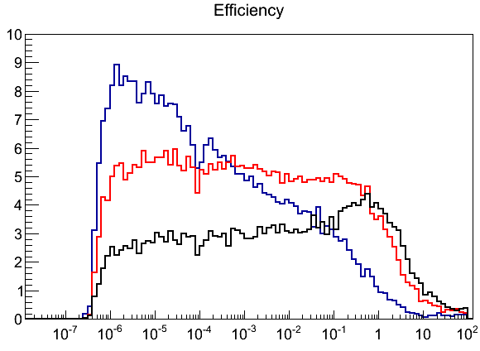
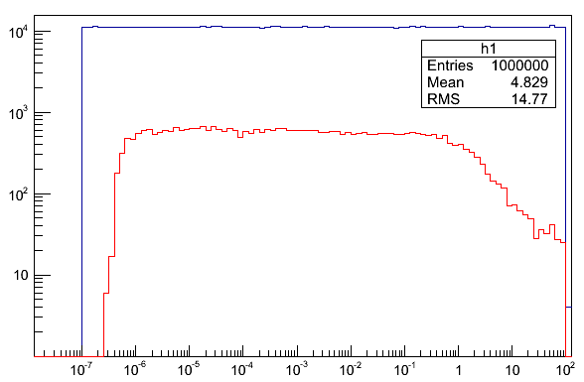


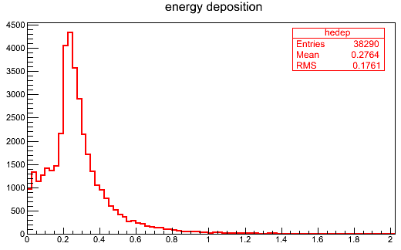
Simulated response to neutrons
Polyethylene
thickness
2 cm
4 cm
6 cm
Beam energy
Efficiency [ % ]
Recorded events in gas (4cm of Poly.)
Neutron Energy [MeV]
Neutron Energy [MeV]
For neutrons with energy 1 eV – 1 MeV, the recorded efficiency for a double-sided Micromegas detector with 2xB₄C layers is > 5% (4cm of Poly.).
Overall Eff. = 3.8% (4cm of Poly.)
For neutrons (10⁻¹ – 10⁷) eV
Threshold > 10 keV
[MeV]

Slide 46
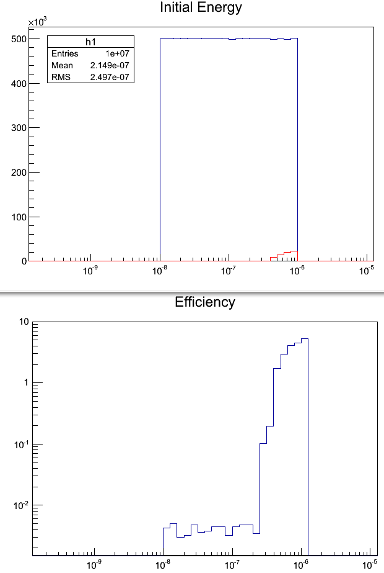
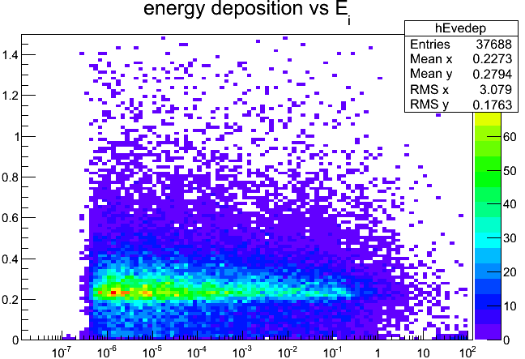
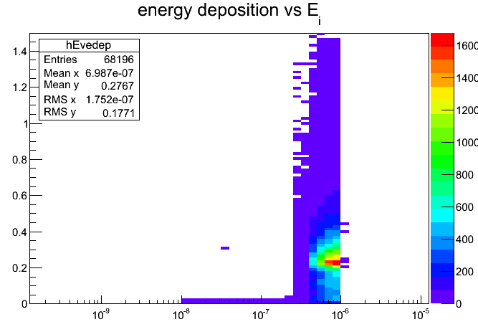
Simulated response to thermal neutrons
Beam energy
Energy Deposition [MeV]
Recorded events in gas (4cm of Poly.)
Efficiency %
Neutron Energy [MeV]
Neutron Energy [MeV]
Neutrons that pass Cd and detected
¹¹³Cd (n,γ) Cd¹¹⁴ capture γ ‘s
Energy Deposition [MeV]
[MeV]
[MeV]

Slide 47
Response to gamma’s
Use of Helium mixtures ➔ low sensitivity to γ / electrons
A threshold ~10 keV, photons from 10 keV to 100 MeV could create a very small background with a detection efficiency of ~ 0.006%
(attenuation ~1000)
A threshold of ~ 30 keV cuts almost all the photons
10 keV – 100 MeV

Slide 48
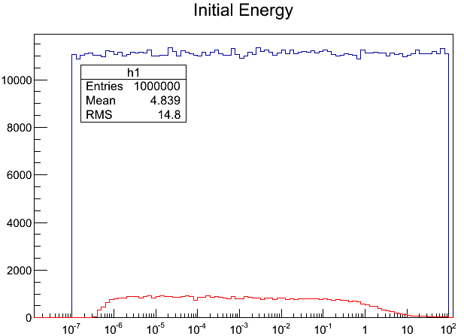
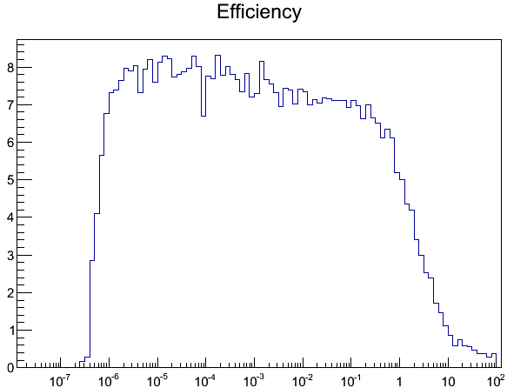
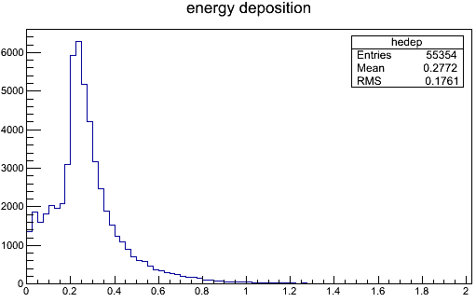
Increasing the efficiency: 4 x B₄C layers + 4cm Polyeth.
Beam energy
Efficiency %
Recorded events in gas (4cm of Poly.)
Neutron Energy [MeV]
Neutron Energy [MeV]
For neutrons with energy 1 eV – 1 MeV, the recorded efficiency for 4xB₄C layer
is 7-8% (4cm of Polyethylene).
[MeV]

Slide 49
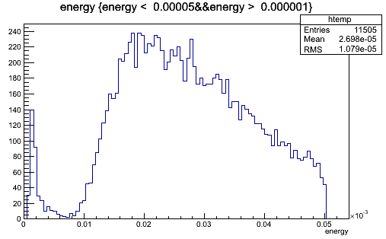
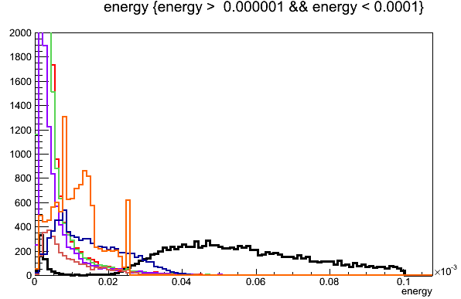
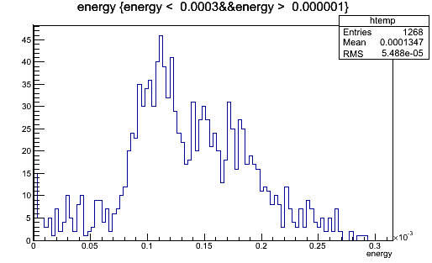
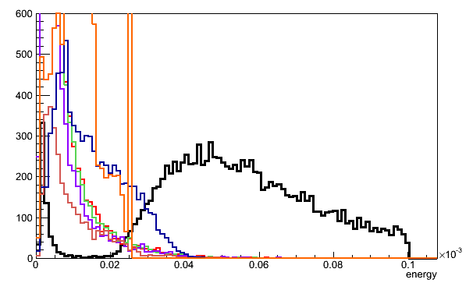
Simulated response
neutrons of 10 MeV
Photons
2 MeV
1 MeV
500 keV
100 keV
50 keV
25 keV
5 mm
~ 0.3% efficiency, 1keV thr
Neutrons – 10 MeV
neutrons of 1 MeV
GeV
Simulations by G. Tsiledakis
5 mm
~ 0.025% efficiency, 1keV thr
Neutrons – 10 MeV
2 MeV
1 MeV
500 keV
100 keV
50 keV
25 keV
Efficiency × 10⁻⁵
Photons
E_{neutron} (MeV) | Threshold (keV)
 | 1 | 10 | 20 | 50
0.1 | 5 | 4 | 3 | 1
0.3 | 9 | 9 | 8 | 6
0.5 | 13 | 13 | 12 | 11
1.0 | 25 | 24 | 24 | 23
10.0 | 300 | 287 | 287 | 192
40 keV
GeV

