Slide 1
Detector and Front End Electronics
For ESS nBLM
Philippe Legou
CEA Saclay - France
ESS Meeting 2016 - Lund - 2016 July 25th

Slide 2

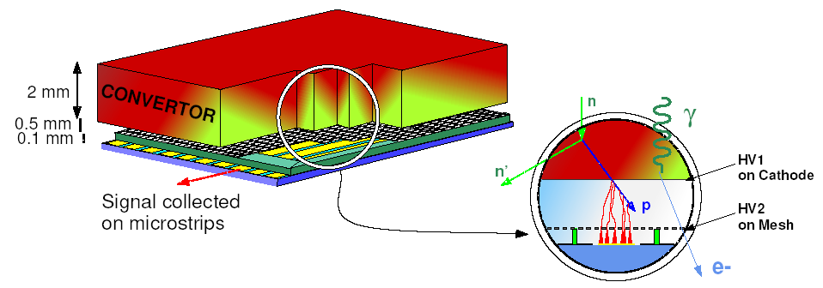
ESS nBLM concept
Thin gas chamber Low ionization probability for electrons compare to recoil ions
Fast response
(Spectroscopy based on time of flight technique in counting mode)
Recoils charged particles liberate ionization electrons in two gas filled gaps defined by three planar electrodes. In the electric fields, electrons are multiplied and drift up to the strips. Electrons produced by g-rays pass through the detector with a lower ionization probability.
→ Insensitivity to g-rays

Slide 3
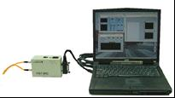
ESS nBLM setup
Laptop in the PI room drive the Acquisition via NETWORK
BEAM
Detectors
PI Room
Cables
Up to 20 m
ESS Network
Technical corridor ?
Ancillary rack
Does a map of the experiment hall already exists an available ?
Distances between nBLM detection boxes and ancillary racks?

Slide 4
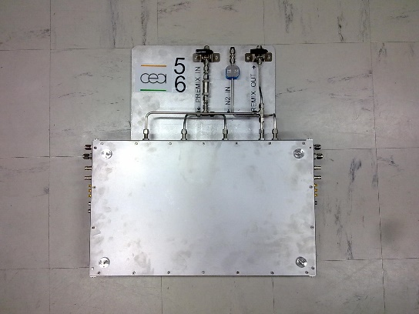
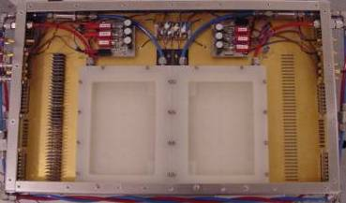
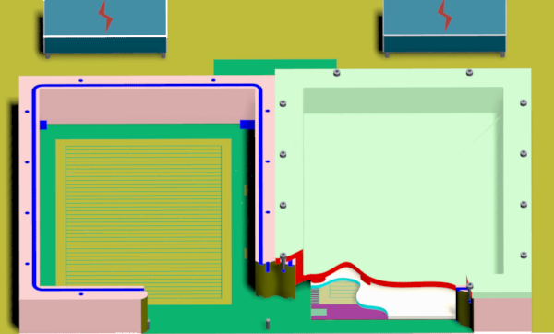
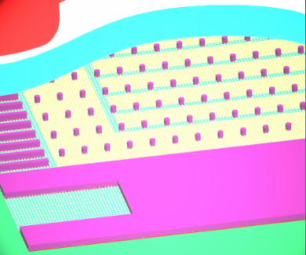
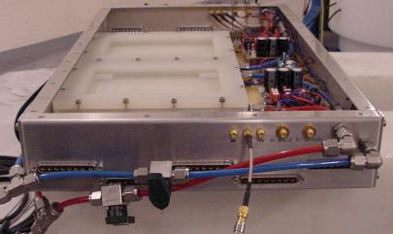
Example of setup for neutrons detection
▪ Board (multi-layer PCB) including :
▪ Detections area
▪ Preamplifiers (plugged on the board)
▪ Hybrid connectors to reduce the space requirement
Preamplifiers
Connectors
Gas flow

Slide 5
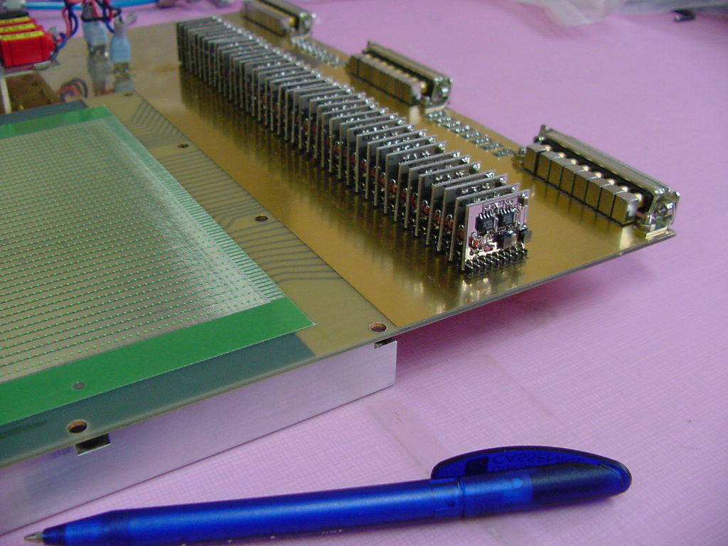
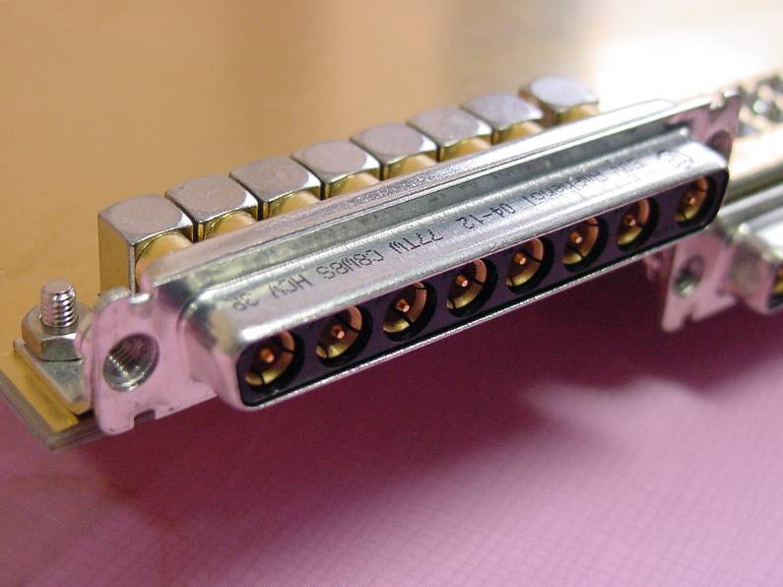
Strips, preamplifiers and connectors :
good signals integrity
Coaxial connectors for analog
signals
Reading strips
preamplifiers
Cables for :
▪ Signals
▪ Low voltage / High Voltage
▪ Temperature sensor
The 4-layers PCB
Strips, spacers and the mesh are sticked
on the PCB by a single process.
Type of cables authorized at ESS
( non flammable ….) ?

Slide 6
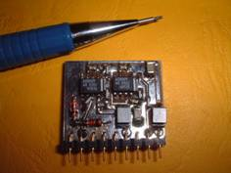
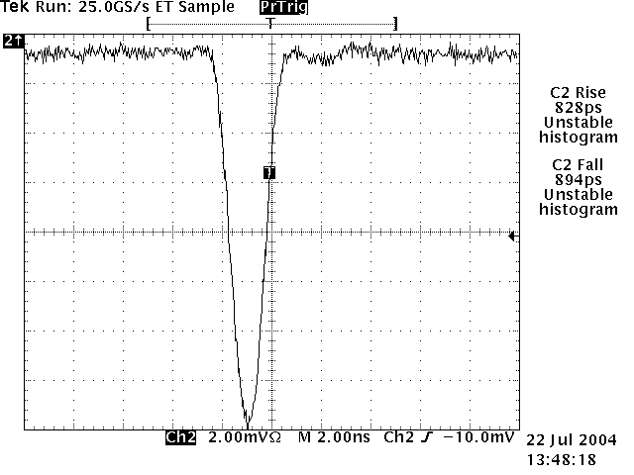
Example of Front end electronics used
in neutron detection
The new front-end : FAMMAS
( Fast Amplifier Module for Micromegas ApplicationS)
In few figures …
Power supply : + 5V -5V
Consumption ≅ 50 mW
Input: positive or negative
Noise: 600 µV rms
Rise time : < 1ns
weight : 4g
Size: 22 x 20 x 5 mm
Radiation hardness capabilities for detector and electronics?

Slide 7
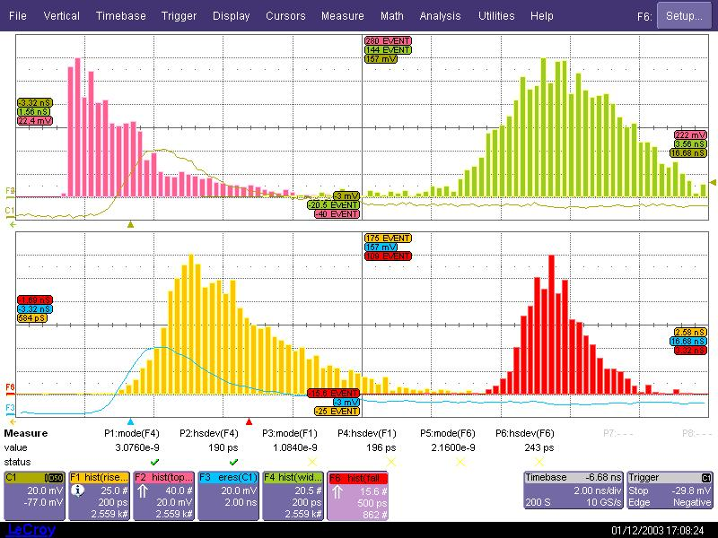
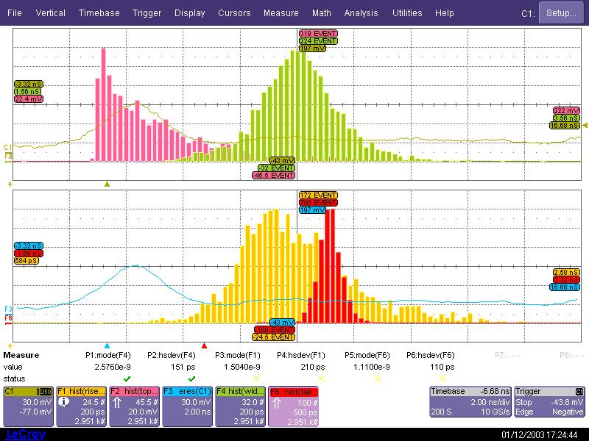
Comparison preamplifier
Minicircuits / CEA
Préamplificateur Minicircuits
1GHz ZFL-1000LN
Préamplificateur CEA – FAMMAS
(Ph.Legou)
Amplitude
3.07ns
Largeur à mi-hauteur
Largeur à mi-hauteur
Amplitude
2.57ns
Temps de descente
90% - 10%
Temps de montée
10% - 90%
Temps de montée
10% - 90%
Temps de descente
90% - 10%
2.16ns
1.08ns
1.50ns
1.11ns

Slide 8
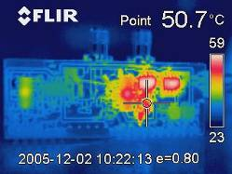
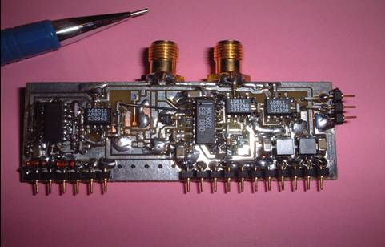
Preamplifier with differential output
In few figures …
Power supply : + 5V -5.2V
Consumption ≅ 400 mW
Noise: 700 µV rms
Size: 60 x 22 x 5 mm
weight : 8g
Input: positive or negative
Output : ECL differential
Buffer area

Slide 9
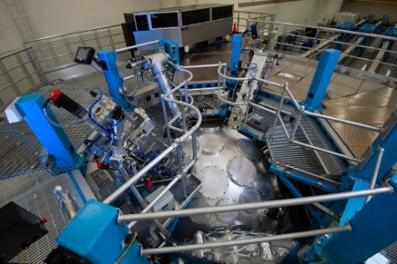
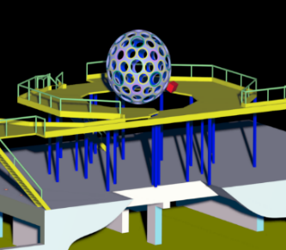

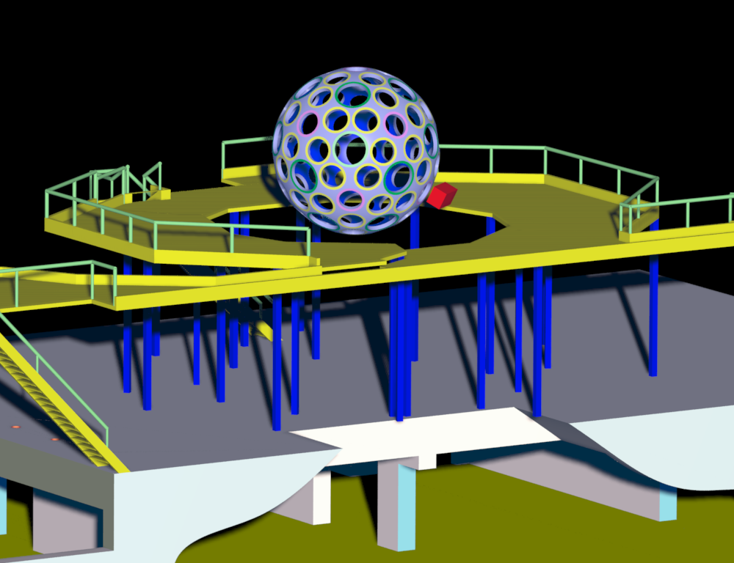
DEMIN AND ANCILLARY RACK LOCATIONS
Example of experimental conditions in neutrons detection and measurement (Inertial Confinement Fusion)
NY- USA
DEMIN
ANCILLARY RACK

Slide 10
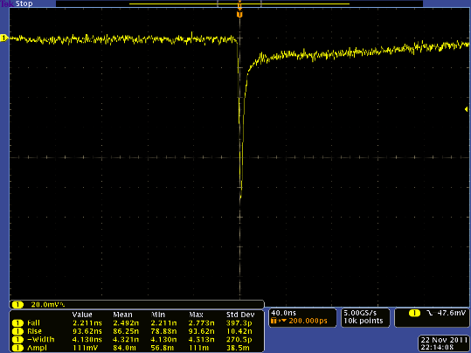
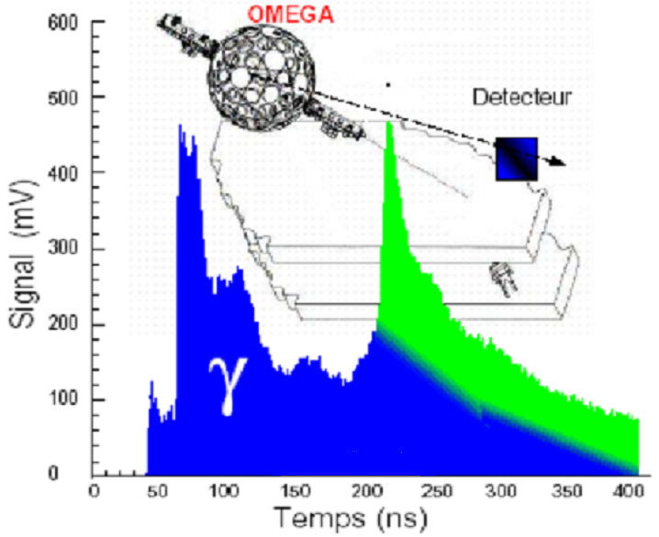
Measurement of neutrons
Measurement are performed in a large background
Neutrons ; Photons ; EMP effects
Before 14 MeV neutrons :
γ−rays induced by (n, γ)
After 14 MeV neutrons :
γ-rays (n, γ)
+ scattered neutrons in the bay
DT shot
n
n
What about the noise and perturbations sources?

Slide 11
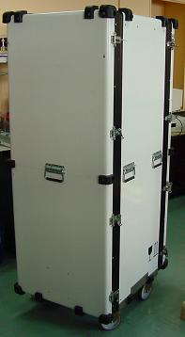
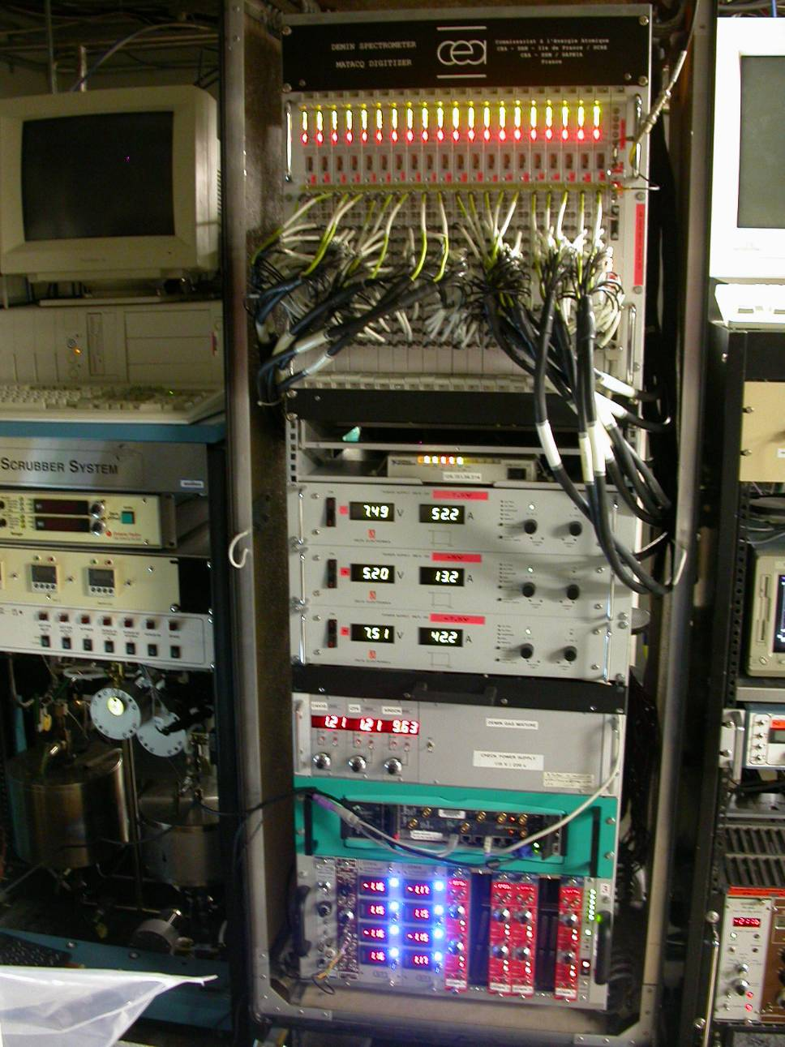
Ancillary rack
▪ Digitizers for pramp cards
▪ GPIB/Ethernet interface
▪ Power supplies for digitizers
▪ Gas flow regulator
▪ PC (drives the gas regulator)
▪ NIM crate :
· High volyage unit
(cathodes & Meshes)
· Power supplies for preamps
180cm=71’’
70cm=27.5’’

Slide 12
Thank You …

