Slide 1
Geant4 simulations of Macrostructures
Irina Stefanescu
ESS Detector Group
DG Jamboree, September 5, 2016

Slide 2
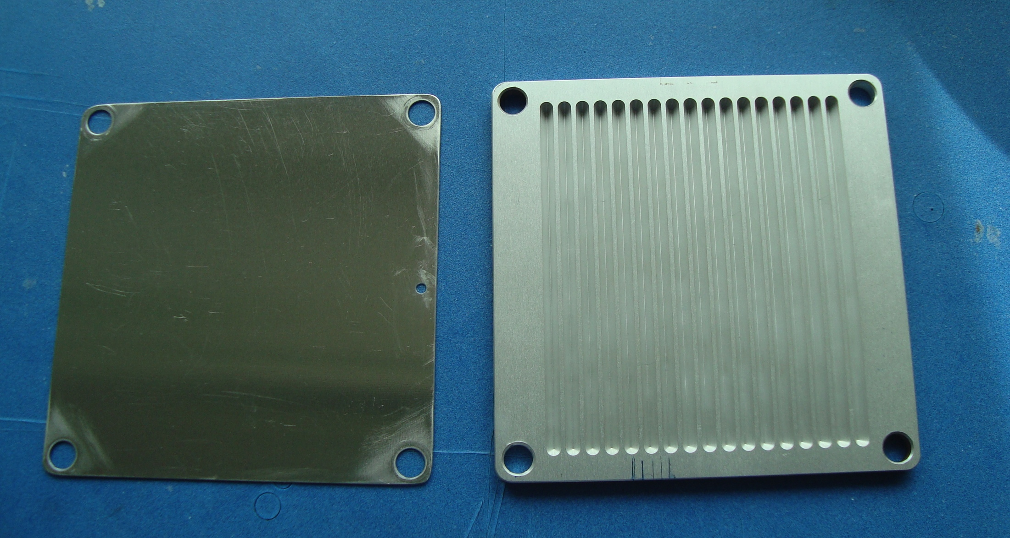
History
Macrostructures refers to a special geometry of the Aluminum substrate upon which the Boron layer is deposited.
The macrostructured (textured) substrate was designed by me during my 3-year contract in the FRM2 Detector Group (2011-2014).
Idea: texture the surface of the substrate in order to increase the area that can be covered with the B-layer, and thus the neutron conversion efficiency.

Slide 3
History
In the B-based gas detectors, the neutron converter and ionization media are separated.
ε_{detection} ≈ ε_{conversion} x ε_{charge collection}
ε_{conversion} depends on the thickness of the B-layer, geometry of the cathode
ε_{charge collection} depends on the anode-cathode distance, wire pitch, HV, gas type, geometry of the cathode
ε_{conversion} investigated with GEANT4 and experimentally ➔ today‘s topics
ε_{charge collection} investigated with Garfield and experimentally

Slide 4
Textured cathodes
Objective:
Find a 3D regular pattern that provides the the highest increase in the conversion efficiency with respect to a flat surface of the same physical area, and a charge collection efficiency >80%.
Requirements:
The macrostructured cathode must be easy to handle and manufacture. I got lods of advice from our technician on the simplest and cheapest manufacturing options.
The coating with Boron must not require special operation conditions and handling.
SRIM stopping power calculations indicate that the (n,¹⁰B) reaction products need to travel at least 2 mm in the Ar-CO₂ counting gas in order to give rise to a signal with an amplitude > 100 keV. Thus, the distance between the 3D features must be around 2 mm or higher.
➔ Geant4 + Garfield simulations needed to prove the validity of the concept

Slide 5
GEANT4 simulations of textured cathodes
I used the GEANT4 version 4.9.3 released on September 17, 2010.
GEANT4 was not ready to handle ¹⁰B- or ⁶Li-based detectors before 2011.
  Version 4.9.1.p01 released in 2008 did not even produce the (n,¹⁰B) reaction.
  Version 4.9.1.p02 produced the two reaction branches from the (n,¹⁰B) reaction with 50:50 ratio instead of 94:6.
  In the early version 4.9.3 released in 2009, the kinetic energies of the charged particles produced in the (n,¹⁰B) reaction were off by ~30 keV and those produced in the (n,⁶Li) reaction were off by ~1 MeV ➔ fixed in 2010.

Slide 6
GEANT4 simulations of textured cathodes
Preliminary calculations for several types of shapes in order to understand how the geometry of the 3D pattern influences the conversion efficiency.
All initial calculations were made with the naïve assumption that the surfaces are uniformly coated.
Also, keep in mind that the collection of low-energy electrons generated in the gas is not a part of the model.

Slide 7
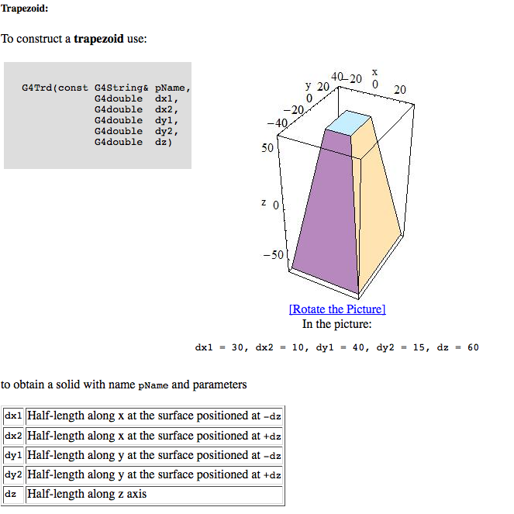
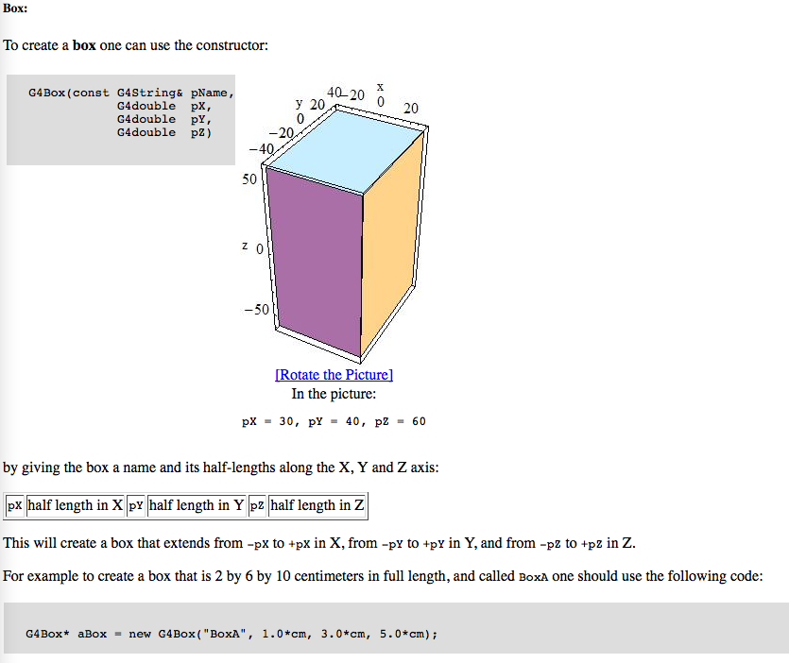
GEANT4 simulations of textured cathodes
The geometry of the various textured cathodes was built by using Boolean operations (union, subtraction, intersection) of simple shapes available directly as solid objects (e.g., trapezoid, box, tube, etc.).
Most of the materials selected from the NIST manager.

Slide 8
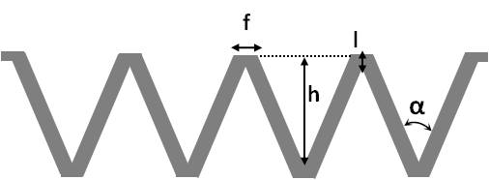
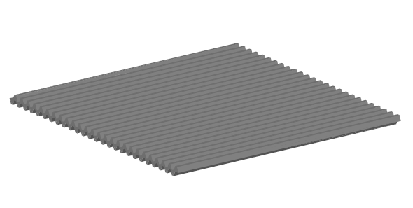
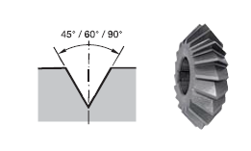
The selected design: 45° grooves
h = 1 ÷ 5 mm
Main shape parameters:
opening angle of the groove, α =45°;
height of the groove, h;
length of the flat top, f;
thickness of the Al-substrate at the bottom (top) of the groove, l;
Calculations indicated an efficiency that is 25-30% larger than that of a flat surface of the same active area.
Production of the substrate test samples was made by milling and coating by MS in Linköping.

Slide 9
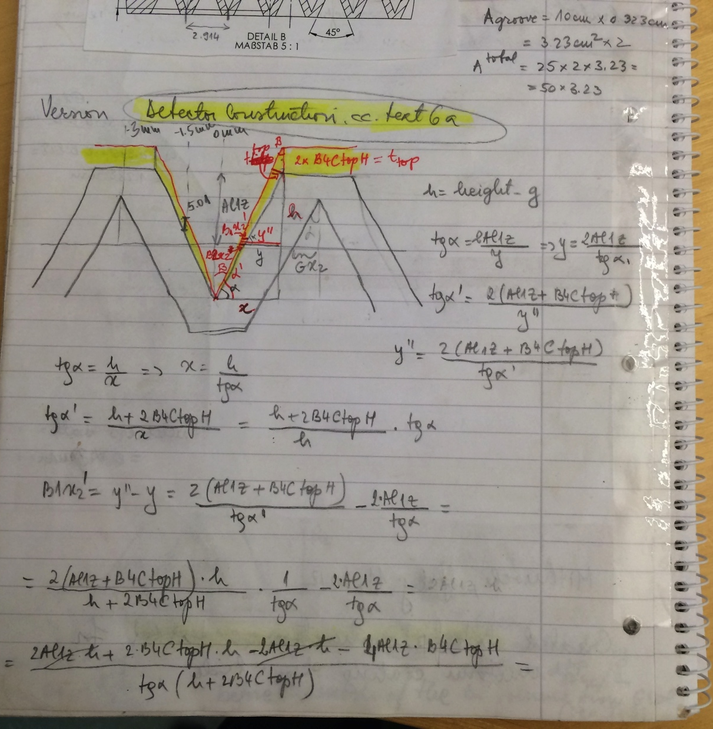
GEANT4 simulations of grooved surfaces
The underlying math was calculated by hand.
The detector details (setup, materials, etc.) were specified in the DetectorConstruction.cc
Basic groove element (G4SubtractionSolid, G4AssemblyVolume)
Boron trapezoid
Boron
trapezoid
Gas
trapezoid
Al trapezoid
-
-
-
=
The shape parameters of the trapezoids were defined in terms of the 4 main shape parameters t_{10B}, t_{Al}, α-opening angle of the groove, length of the flat top.

Slide 10
GEANT4 simulations of grooved surfaces
Basic groove element
Rotated basic groove element
G4AssemblyVolume()
(helper class which allows several logical volumes to be combined together in an arbitrary way in 3D space.)
Finally the double-sided grooves are placed inside the world volume as the imprints of the assembly volume (MakeImprint()).
Two versions of the DetectorConstruction.cc exists, one for uniform and one of non-uniform coating.

Slide 11
GEANT4 simulations of grooved surfaces
Detector Vessel made of Aluminum
Event generation with the ParticleGun() in PrimaryGeneratorAction()
The detector consists of a number of coated cathodes placed inside a detector vessel filled with the Ar/CO2 counting gas at NPT.
I used the built-in physics list QGSP_BIC_HP without modifications.
The laboratory environment was not included in the simulation.

Slide 12
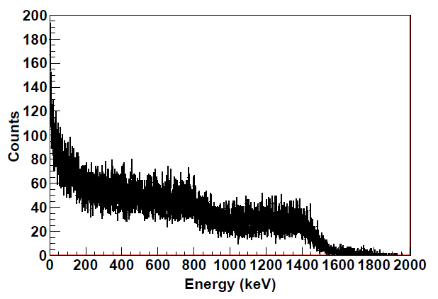
GEANT4 simulations of grooved surfaces
Efficiency extracted from the integral of the calculated energy deposition spectra which are the equivalent of the measured pulse-height-spectra in real life.
ε_{Geant4} ≅ ε_{conversion}
Integral energy spectrum > threshold
Ɛ_{Geant4} =
number of incident neutrons

Slide 13
GEANT4 simulations of grooved surfaces
Volume=Al substrate
Volume=Converter
Volume=Counting Gas
Volume=Converter
E_{dep}=E
E_{α}=0
E_{α}=E
n+¹⁰B
E_{α}=0
E_{dep}=E-E’
E_{α}=E’
α track
E_{α}=E
The useful events were selected and processed in SteppingAction.cc:
Selected the secondary particle of interest (alpha, ⁷Li);
Got the energy deposited in gas as the difference between the kinetic energy of the particle of interest at the first and last steps in the counting gas volume.
Saved that energy value in a root histogram.
For the textured cathode discussed here, more than 60% of the reaction products
will lose only part of their energy in the counting gas.

Slide 14
Validation of the GEANT4 results
Validation of the model through comparison with experimental data is crucial.
The basic GEANT4 model of a stack of MWPC with Boron-coated cathodes was validated first. The theoretical efficiencies and the shape of the PHS were compared to experimental data.
I. Stefanescu et al., JINST 8, P12003 (2013).

Slide 15
Validation of the GEANT4 results
Validation of the macrostructure concept included comparison with experimental efficiencies of single and multi-MWPCs, efficiency scans across the groove and pulse-height-spectra.
experimental
GEANT4
GEANT4
I. Stefanescu et al., JINST 8, P12003 (2013).

Slide 16
Validation of the GEANT4 results
The more complex GEANT4 model of a stack of MWPC with Boron-coated grooved cathodes also validated. Theoretical efficiencies of single and multi-MWPCs, the efficiency scans across the groove and the appearance of PHS compared to experimental data.

Slide 17
Conclusions
Over the last 5 years GEANT4 became a crucial tool for the neutron detector community.
”Exotic” ¹⁰B-based neutron detectors (“exotic”=not the typical MWPCs 😀 ) should not be designed and built without a thorough simulation of the detector concept.
GEANT4 simulations without experimental validation are interesting to a limited number of people, therefore they add low value to the scientific community.
The G4 simulations are more valuable if performed before building the detector prototype. Even the simplest detector prototype requires a budget and manpower.

