Slide 1
Simulation of Gd Gem for NMX detector
05.09.2016
Dorothea Pfeiffer

Slide 2
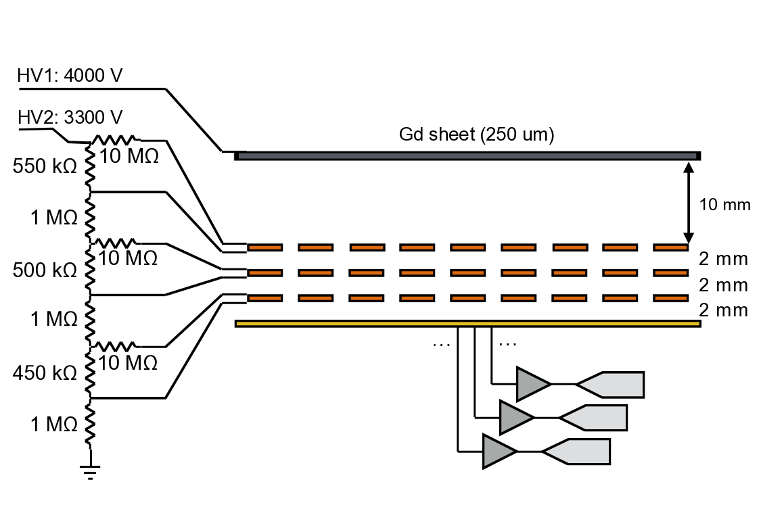
Gd-GEM backwards setup
conversion electron
Start of track
neutron

Slide 3
Detector Model in Geant4
Garfield used:
for creation of ionization clusters
drifting the electrons and ions (diffusion)
Amplification, charge collection at readout and signal not yet simulated
conversion electron
Gas region where Garfield++ is used
neutron

Slide 4
Simulated detector parts
The complete detector geometry implemented in Geant4
Gd cathode, frame, readout board, GEM foils (without holes), ArCO₂ filled drift, transfer and induction
Cathode: Neutron capture and creation of gammas and conversion electrons
Primary ionization
Formation of ionization clusters and the subsequent drift of the electrons (Geant4/Garfield interface)

Slide 5
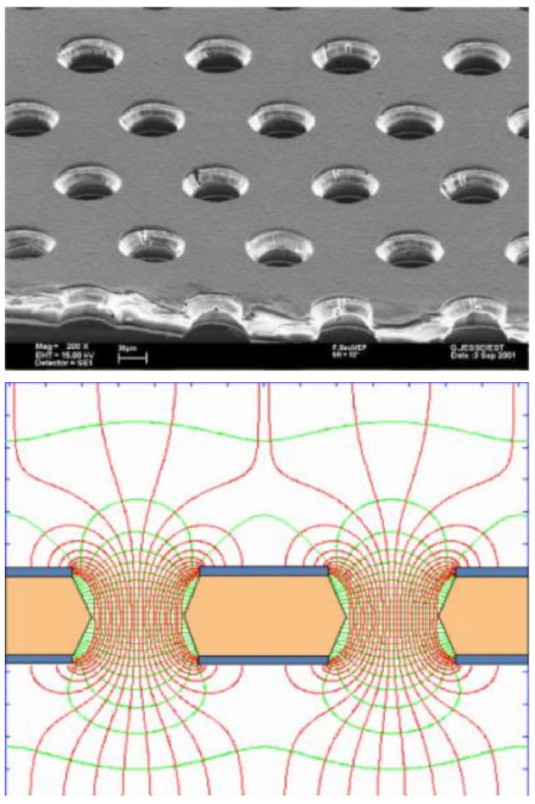
Simulation of GEM amplification and read out?
GEM foil
Very slow (field maps)
Usually done only for a few holes or parts of holes using symmetry
Due to track length of conversion electron difficult
Behaviour of GEM itself well understood
Solution: Use of gain function to multiply signal and convolute with pulse shape function to simulate the read out
Electrical field in holes

Slide 6
Geant4 Gd simulation problems
Impossible to get the conversion electrons and the gamma emission correctly at the same time
To produce conversion electrons, the photo-evaporation model flag has to be used. This model conserves the Q value, but produces a gamma spectrum that differs very much from measured gamma spectra.
If one uses the final state model, there are no conversion electrons, the Q value is wrong, but the gamma spectrum agrees with the measured ones.

Slide 7
Geant4 Gd simulation problems
https://zzz.physics.umn.edu/lowrad/_media/meeting8/ychen_gdgammas_aarm2015.pdf

Slide 8
Geant4 Gd simulation problems
https://zzz.physics.umn.edu/lowrad/_media/meeting8/ychen_gdgammas_aarm2015.pdf

Slide 9
Geant4 Gd simulation problems
Conversion electrons, literature and Geant4:
¹⁵⁵Gd: 0.61 - 0.79 (Geant4 1.25)
¹⁵⁷Gd: 0.60 - 0.61 (Geant4 0.45)
Nat Gd: 0.6 – 0.66 (Geant4 0.66)
For natural Gd the combined results looks ok (by accident? Isotope composition and cross sections seem to balance out the error), about 0.66 conversion electrons per neutron.
For the efficiency not only the conversion electrons per neutron is interesting, but in how many cases at least one conversion electron is produced.
In some cases 2,3 or 4 ce are produced, maybe not correct in Geant4?
Spectra of ce look correct though

Slide 10
CE Spectrum in Gd converter
For all simulation, thermal neutrons and a natural Gd converter were used. The gas in the detector is ArCO₂ (70%/30%)

Slide 11
Efficiency simulations

Slide 12
CE Spectrum in drift

Slide 13
Percentiles of deposited energy ce

Slide 14
CSDA Range and maximum penetration depth of ce

Slide 15
CE track

Slide 16
Mean deposited energy gammas

Slide 17
Detection efficiency gammas

Slide 18
Detection efficiency gammas based on threshold
Threshold where 10% of ce are lost
Threshold where 25% of ce are lost

Slide 19
Outlook
The efficiency and ce simulations and measurements have been published
D. Pfeiffer et al., First measurements with new high-resolution gadolinium-GEM neutron detectors, JINST 11 (2016)
To come:
Publication of the gamma simulations
Track simulations and simulated position resolution using the Geant4/Garfield interface (Collaboration with Carsten Sogaard)
Code written, but simulations have to be run and results analysed

