Slide 1
Data Analysis and Modelling
Thomas Holm Rod
Group Leader Data Analysis and Modelling
www.europeanspallationsource.se
25 August, 2016

Slide 2
Data Analysis and Modeling Scope
Last step in data processing chain that enable users to get value (publications) out of their reduced data ( I(q,ω) / I(hkl) / corrected images )
Scope in construction has been limited to:
Basic (model fitting) data analysis software for the 16 ESS instruments (where possible) incl. resolution convolution
User-friendly, sustainable, maintainable, reliable, easily installable, and extensible software
Enable users to harness the full potential of ESS
Live-analysis for at least high-throughput techniques.
Not in scope of construction budget
Co-analysis (e.g. diffraction + SANS)
Analysis beyond basic analysis (e.g. integration of MD simulations).
Mobile/tablet user interfaces
2
Many users also expect support for analysis beyond what’s currently in the scope!

Slide 3
Required for world class user programme
Maintainable, sustainable, reliable, and extensible software
Modularized
Python scripting interface & GUI
Facilitate 3rd party contributions
Fully open source and free
Preferably Python/C++/Qt
Used at several facilities (and community driven)
Adequate quality assurance
Adequately documented
Enable users to take full advantage of ESS features
E.g. 2D Rietveld, energy resolved imaging, real-time analysis, parametric analysis
Improve & debug existing developments based on user feedback
Silver plated solutions
E.g. automation, support full spectrum of users, single-pulse
More advanced features
(WP10)
SANS
Reflectometry
Imaging
(QENS)
Construction
Hot Commissioning
Operation
Notes:
From TDR

Slide 4
SINE2020 WP10: Data treatment software
Each facility takes control of one technique specific analysis software:
Technique | Facility | Software (PM)
Imaging | PSI | MuhRec/KipTool (23)
QENS | ILL | Mantid/VATES? (12)
Reflectometry | MLZ | BornAgain (36)
SANS | ESS | SasView (42)
Guidelines & Standards | ISIS | N/A (based on Mantid project experience)
+ activities on simulations, muons and Mantid for continuum sources
Ranked most important WP by Head of Facilities among those proposed for SINE2020:
“of highest interest/priority for the future of the neutron community, must be taken forward in a common project.”
Notes:
Double check numbers

Slide 5
High-level requirements/deliverables (across instrument classes)
Intuitive and user friendly analysis software
Graphical User Interface, GUI (command line driven)
Command Line Interface, CLI (Python scripting)
Cross platform (Windows, OS X, Linux, but no support for mobile/tablets!)
Well documented, tutorials (video tutorials)
Fitting to models: (incl. Rietveld, excl. imaging)
Flexible fitting engine (incl. Bayesian)
Model library (if feasible)
Option to use (plug-in) user specified models;
May come from other programs, e.g. SpinW, SpinVert, DFT
Resolution convolution
Parametric analysis, e.g. temperature, time (single pulse)
Real time feedback (Live analysis)
Automation
Analysis of polarized data (excl. eng. diff., NVS)
Same software at all facilities (SINE2020)
(Links to data bases and web services)

Slide 6
Sub-class specific requirements/deliverables
Sub-class | Special features | Software
Imaging | Energy-resolved imaging, commonly used programs, e.g. Octopus | MuhRec/KipTool
Eng. diffraction |  | SteCa2
Powder diff. | 2D Rietveld, real space (e.g. pdfgui) | Fullprof
Single crystal | Request for SpinVert & ISODistort functionality (problematic to make analysis work in practice) | Fullprof/Esmeralda
NMX |  | PHENIX
SANS | 2D fitting, (single pulse) | SasView
Reflectometry | Lambda dependent absorption, (single pulse) | BornAgain
QENS |  | Mantid/VATES?
NVS (VESPA) | DFT | Something like a-climax
INS | 1D, 2D, 3D, 4D fitting in addition to parametric; spurious effects, e.g. multiple scattering, phonon scattering; request for SpinW (publication rate very low!) | Mantid/HORACE?
Notes:
Spinvert: refinement of paramagnetic diffuse scattering
ISOdistort:

Slide 7
High-level schedule
User programmme
MS: Intuitive analysis software
2023
Commissioning
(Cold + Hot)
Make it work & debug!
Respond quickly to user requests
Improve user experience (automation) based on real data and user feedback
>2020
MS: Solid base for ongoing developments
Construction/pre-operation phase
2016
Status: ~15 programs in various conditions

Slide 8
Time line for sub-class with two instruments
Make it work & debug!
Improve user experience (automation) based on real data & user feedback
2016 | 2017 | 2018 | 2019 | 2020 |  | 2021 |  | 2022 |  | 2023
 |  |  |  |  |  | I.T. |  | I.T.
Instr #1
Instr #2
MS: Solid base for ongoing development;
Sustainable, maintainable, reliable, modularized and extensible program(s)
Scripting interface & GUI
Framework for live analysis
Analysis for ESS specific features
Features needed for Hot Commissioning
MS: Intuitive analysis software;
User-friendly
Automation
Functional live analysis
Scripting interface & GUI

Slide 9
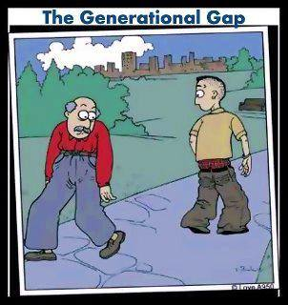
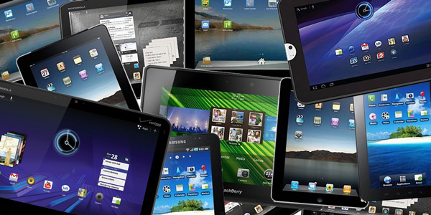
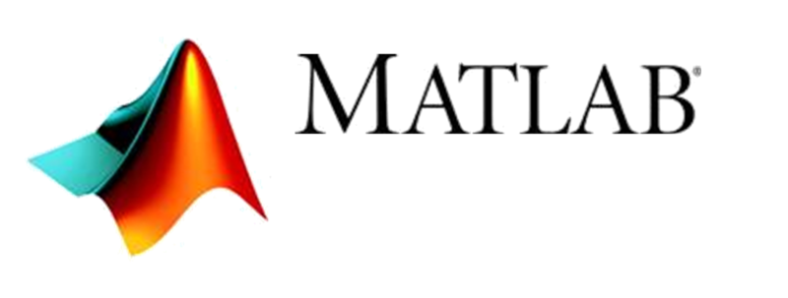
What is intuitive software?
Non-expert and occasional user (few days/year)
Experienced (daily) or geeky user
?
Graphical User Interface
Command Line Interface

Slide 10
Agile development facilitates user involvement
Refinement of requirements and prioritization is an ongoing process involving users (instrument teams)
Feature 6
Feature 2
Feature 2
Feature 10
Plan & Develop
New features
deployed
Feature 5
Feature 6
Feature 8
Feature 9
Prioritize
Feature 9
Feature 5
Feature 10
Feature 11
Evaluate
Feature 11
Feature 8
Feature list
(Backlog)
Prioritized
feature list
New features
Notes:
Atlassian

Slide 11
We use JIRA for project management

Slide 12
Important to prioritize
We can spend a lot and justify it based on user aspirations! But there are limits;
~40-46 PY in DAM WP for creating ‘intuitive data analysis’ software for 16 instruments, 11 instrument sub-classes, ~15 programs, and McStas support.
SINE2020 adds ~9 person years for all facilities.
For comparison, some empirical data:
Sub-class | Program(s)
Imaging | 1. MuhRec 2. KipTool
Eng. Diff. | 3. SteCa2
Powder | 4. Fullprof 5. e.g. pdfgui
SXtal | 6. Esmeralda 7. SpinVert
NMX | 8. Phenix
SANS | 9. SasView
Reflect. | 10. BornAgain
QENS | 11. Mantid/Vates
INS | 12. SpinW 13. Mantid/Horace
NVS | 14. e.g. a-Climax
All | 15. McStas
Program | Effort (PY) | Ref
MDANSE | ~10 | M. Johnson, ILL
BORNAGAIN | ~12 | J. Wuttke, MLZ
PHENIX | ~150 | P. Adams, LBNL
MANTID | ~170 | J. Taylor, ESS
Need to choose in kind partners wisely, should be willing to walk that extra mile!
Notes:
Some cost already moved to operation

Slide 13
Continuous integration facilitates stability

Slide 14
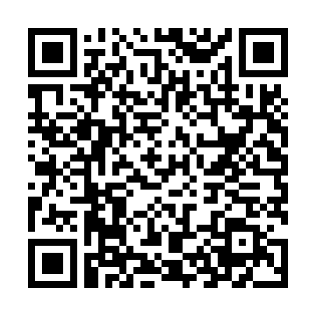
Working with instrument teams and other stakeholders
Direct commun-ication
Meetings
Instrum. Proposal
Requirements
& Roadmap on
Requirements have been gathered from all instrument teams via:
Direct communication with instrument teams
IKON, STAP and other meetings
Instrument proposals and other docs.
First versions of roadmaps for imaging, diffraction, and large-scale structures (live documents) available on
Awaiting IKC for next iterations.
Have some requirements for spectroscopy but still need to develop roadmap
14

Slide 15
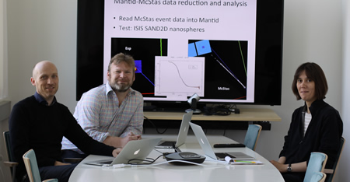
DAM group setup
Small Core group for mng/coordination/interfacing
(+ infrastructure, development, McStas, grant
writing, etc.)
Thomas Holm Rod, Group Leader
Céline Durniak, Scientific Software Developer
Torben R. Nielsen, Scientific Software Developer
Rely on in kind partners for planning, development and domain knowledge
Code specific domain knowledge
Technique specific domain knowledge
In kind partners
(or other collaborators)
Brokerage
Instrument teams
Users
In kind partners

Slide 16
Finding in kind partners
Essential all development has to be performed by in kind partners
To a large extent this includes planning
Core team has been set up accordingly
Potential contributors can be ESS member countries,
but not from; DK, SE, and UK (ISIS) or ILL
Align with SINE2020 where possible
Align with instrument teams where possible
Align with existing activities, create win-win situations
Access to instruments (real testing)
As few in kind contributors as possible
Should have skills and domain knowledge within both technique, software engineering, and selected software

Slide 17
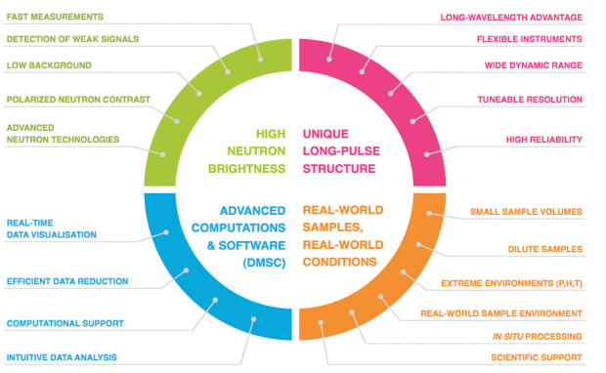
In kind partners
The relation to in kind partners are supposed to be in the form of collaborations. Not a traditional customer – provider relation (reiterated several times by DG).
Essential that in kind partners are enthusiastic about the project and sees benefits
Most of them will properly put more hours in to the project that we are paying for, some already have
A traditional customer – provider relation requires a significantly higher budget and a professional software development company as provider
Roadmap and plans will be based on balanced requirements and input from many stakeholders;
In kind partners
Instrument teams (instrument scientists)
Instrument class coordinators
ESS in general (vision/TDR)
STAPs and SAC
End users

Slide 18
Overview of In kind contributions
Technique | IK partner | S2020 link | Instr links | Status
Imaging | PSI | Yes | Yes | On hold
Eng. Diffr. | MLZ | N/A | Yes | Ready for approval
Powder Diffr | ESSB (+ILL+BCS) | N/A | No | Wants more than can be offered
SXtal | ESSB (+ILL+BCS) | N/A | No
NMX | None (ESS) | N/A | Yes | N/A
SANS | None (ESS) | Yes | Yes | Running
Reflectom | MLZ | Yes | No | Ready for approval
Mol Spec | None (ESS) | N/A | No | N/A
QENS | MLZ | No (NP) | Yes | Ready for approval
INS | TBD (PSI) | No (NP) | (No) | Depends on other IKC

Slide 19
13.4.4: Planned In kind contributions
Facility | Technique | Why
PSI (471 k€) | Imaging | Leverages SINE2020 and PSI in house development. Links to ODIN team.
MLZ/FZJ (1,139 k€) |  | Benefits from professional software development group servicing all MLZ instruments.
 | Reflectometry | Leverages 3-4 years of effort in SINE2020 and ~12 years of effort of MLZ in house development.
 | QENS | Leverages to some extent SINE2020 and J. Wuttke’s domain knowledge. Links to T-REX and C-SPEC team.
 | Engineering diffraction | Leverages MLZ in house development. Links to BEER team.
ESSB (944 k€) Under discussion | Powder and single crystal diffraction | Leverages ILL in house development (30-100 years of effort on Fullprof) and Bilbao Crystallographic Server group and ILL (J.-G. Rodriguez-Caravel) domain knowledge.
TBD (512 k€) | INS | Potentially PSI
19

Slide 20
13.4.4: Planned In kind contributions
Facility | Technique | Why
PSI 3¾ + ¼ PY | Imaging | Leverages SINE2020 and PSI in house development. Links to ODIN team.
MLZ/FZJ 8+1½ PY |  | Benefits from professional software development group servicing all MLZ instruments.
 | Reflectometry | Leverages 3-4 years of effort in SINE2020 and ~12 years of effort of MLZ in house development.
 | QENS | Leverages to some extent SINE2020 and J. Wuttke’s domain knowledge. Links to T-REX and C-SPEC team.
 | Engineering diffraction | Leverages MLZ in house development. Link to BEER team.
ESSB 7½+½ PY Under discussion | Powder and single crystal diffraction | Leverages ILL in house development (30-100 years of effort on Fullprof) and Bilbao Crystallographic Server group and ILL (J.-G. Rodriguez) domain knowledge.
TBD 4+¼ PM | INS | Potentially PSI
20

Slide 21
13.4.4: Current plan aligned to envisioned instrument schedule
The diagram below corresponds to current plan for Data Analysis and Modelling with SINE2020 contributions shown in darker colors where applicable.
Each rectangle corresponds to a scientist year with a nominal value of 117 kEUR incl. direct cost
Core staff are moved (almost entirely) to operation end of 2019
In kind contributions are aligned with current instrument schedule where possible
Staffing based on ESS standard rates for scientists, but IK contributors will make their own staffing plan.
Smooth transition to operation relies on relocation of IK staff to ESS.
Skills of SINE2020 developers will be lost end of 2016 – at the latest!
New instrument schedule creates unwanted gaps but also opportunities!
Knowledge transfer/
Relocation

Slide 22
13.4.4 In kind contributors issues & status
PSI | No tradition or experience with facility supported/driven development of analysis software. There is thus no proper environment at PSI for professional software developers and efforts at PSI will need support with infrastructure and some level of supervision (A Kaestner is however a professionally trained developer). There is a TA for imaging approved by PSI but which is currently put on hold by ESS. No commitments or negotiations have taken place in the case of INS.
MLZ | Despite MLZ being responsible for reflectometry in SINE2020 there is no direct links to ESS reflectometer teams. However, there appears to be an existing collaboration between the MLZ team and the ESTIA instrument scientist Artur Glavic regarding BornAgain. TA is drafted and has been presented for MLZ management that view it positively and are supportive.
ESSB | Contribution relies on sub-contracting to University of the Basque Country (Bilbao Crystallographic Server) and Juan Rodriguez-Carvajal at ILL. None of these are embedded in a professional software development environment, although they seem to be skilled developers. An effort will thus need significant supervision and support from ESS. Moreover, there are no direct links to instrument teams. Despite negotiations it has not yet been possible to reach a deal that both sides are satisfied with.

Slide 23
13.4.4 Risks (1/2)
Staff may not want to relocate from in kind partner to ESS putting required knowledge transfer and a smooth transition from construction to operation at risk.
May not come to an agreement with ESSB regarding IKC for diffraction.
May not find a suitable in kind contributor for INS.
ESSB in kind contribution has a complicated setup with ESSB acting as a broker putting proper management at risk.
No direct links between developers and instrument teams for powder and single crystal diffraction.
ESSB (and to some extent PSI) may not deliver high-quality software, because they do not have tradition and experience with best practice software development.
Mitigation: Supervision and support from ESS. Adherence to DMSC policy on software development as requirement in TA
Local management takes control of developer and has a different agenda than ESS.
Mitigation: Describe most important stakeholders and their role in TA. Use in kind partners that are enthusiastic (give them influence) about the project and/or will benefit from the development themselves.

Slide 24
13.4.4 Risks (2/2)
Local management uses the opportunity to get existing (non-skilled) staff funded.
Mitigation: DMSC involvement in recruitment and approval of staff as requirement in TA.
Local developer does not feel engaged and part of the ESS team.
Mitigation: Code camps
In kind partner does not feel responsible for integrated testing of later instruments even though it is a task explicitly mentioned in the TA.
SINE2020 developers leave prematurely to pursue other opportunities with better long-term perspectives resulting in loss of knowledge and skills and put the ESS contribution to SINE2020 at risk.
Note! Even though the TA states some requirements to the in kind partner it will be hard to enforce in practice!
Thus, it is important that the in kind partners are enthusiastic about the project and feel they have a say!

Slide 25
Scenario A: Introduction
The following Scenario A (and B) has originally been derived in a step by step fashion where each step has been carefully (SWOT) analyzed in order to get at a scenario with most strengths and opportunities and as few weaknesses and threats / risks as possible.
Scenario A exploits the changed instrument schedule and converts in kind contributions to in house developments (i.e. cash) in a 1:1 fashion, thus the scenario is nominally scope neutral.
Scenario A converts 3 months of effort for integrated testing of ODIN in the PSI-ESS TA to development to bridge the gap between SINE2020 and Hot Commissioning and ensure a smooth transition to operation. Overall, the cost and value of the PSI IKC to imaging is preserved.
It is assumed that ESS core staff work as an agile software development team on all projects rather than individuals on individual projects from 2017 and onwards.
The following SWOT analysis compares Scenario A with the current plan.

Slide 26
Scenario A: High-level schedule (with indication of changes)
All in kind integrated testing (~2½ person years ) and ~13 years of development (diagonally hatched areas) are converted to ESS in house tasks (cyan colored areas). Thus, diagonally hatched areas are cancelled and cyan colored areas are added.
~9 person years are placed subsequently to 2019 (i.e. to the right of red line).

Slide 27
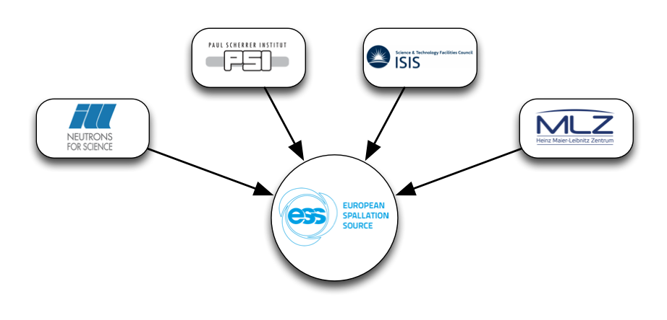
Reduce risks and construction cost
Move in kind to in house development in order to reduce
risks and strengthen core team
~9 person years are placed subsequently to 2019 (i.e. to the right of red line) (~1 M€).
… but 7 person years (cash) are added before the line
Bridges gap between SINE2020 (now) and H.C.
Reduces risks significantly.
Core team can be ready for first instrument.
Make it possible to also establish strong collabora- tions with ISIS and ILL
Opportunity for saving 1 M€ on construction cost by moving core staff to pre-operation end of 2019.
Opportunity for saving an additional 400 k€:
Get pro bono collaboration with ILL (and ISIS?)
Establish productive agile in house team
in kind
collab
collab
in kind
Notes:
Move all integrated testing to ESS
Move INS and diffraction in kind contribution to ESS
Reduce MLZ in kind contribution to ensure that we also have domain knowledge in those three techqniues
Close gap for ODIN

Slide 28
Scenario A: Strengths
S
Removes Risk 1-4, 8, 10 and mitigates significantly Risk 5-7, 9 on Slide 5 and 6.
Ensures core staff get hands on experience with all scattering instruments.
Ensures smooth transition to operation for all instruments.
No dependencies on relocation of staff from in kind partners (but does not prevent relocation either).
Simplified allocation (and payment) of staff during cold commissioning phase.
Continues to leverage SINE2020 and bridges gap between SINE2020 and Hot Commissioning.
Does have the core staff to ensure close collaboration and knowledge transfer from all major European neutron sources (ILL, ISIS, MLZ, and PSI) so that the team is adequately skilled for hot commissioning.
Single-point-of-failures reduced due to team effort.
Flexibility. Core staff can be allocated to the techniques where it is most needed as opposed to in kind staff and even transitioned to other DMSC WPs if needed.
ESS in control of diffraction without a broker.
Simplified and flexible allocation of staff during cold commissioning phases for instruments.
Simplified in kind agreements.
in kind
collab
collab
in kind

Slide 29
Scenario A: Weaknesses
W
Increases cash expenditure by 7 person years (but see Opportunities).
No direct hook into domain knowledge for analysis software for powder diffraction and INS (but will compensate via collaborations with ILL and INS, see opportunities).

Slide 30
Scenario A: Opportunities
Reduce construction budget by ~9 scientist year (1 M€) by transition core staff to pre-operation end of 2019.
Setup close collaborations with ILL (on diffraction) and ISIS (on diffraction and INS), essentially continuing the role ESS has in SINE2020.
Get pro-bono collaboration with ILL about diffraction.
ESS can demonstrate to stakeholders that it takes analysis software seriously (as promised) by pointing to an expanded core team (which however, still is small).
Can recruit ESS SINE2020 developers now:
preventing them from pursuing other opportunities
Increase productivity and efficiency by setting up lean software development team already now composed of all members in the DAM group, and having it addressing tasks in both SINE2020 and in the ESS construction project (this is possible because the ESS SINE2020 deliverables in the current ESS internal plan will be delivered much earlier than the plan approved by the European Commission.)
O

Slide 31
Scenario A: Threats
Recovered instrument schedule will prevent scope to be moved to pre-operation phase.
MLZ rejects and opposes (considered to have low probability)
General resistance amongst stakeholders to increase cash at the cost of in kind.
However, scenario A actually follows an advice from Mark Johnson at the ESS Annual Review in 2015 of developing analysis software in house rather than in kind in order to ensure that proper skills and domain knowledge are developed prior to operation.
T

Slide 32
Scenario B: Introduction
Scenario B triggers the opportunities mentioned for Scenario A:
Core staff is transitioned to operation end of 2019 and thus all scope to be delivered subsequently by core staff is moved to pre-operation. This is considered plausible because in scenario A the core staff can be ready end of 2019 for cold commissioning of first instrument regardless of which instrument is the first (with the exception of ODIN).
A collaboration is established with ISIS on INS. This is also very plausible, there is already good collaboration between ESS and ISIS in SINE2020 and for MANTID, and it would also be beneficial for ISIS (win-win).
A pro-bono collaboration with ILL is established. A scenario where Juan Rodriguez-Carvajal (lead developer of Fullprof) is committed to such a collaboration can be envisioned and would benefit and reduce risks significantly for both ESS and ILL. In Scenario B a contribution of 50% for three years is assumed.
ESS SINE2020 developers are embedded in core team. This is mostly an HR issue, but it would increase productivity and efficiency making it possible to deliver the same scope for less and enabling the team to get a better overview of techniques other than SANS. It is assumed in Scenario B that it removes the need for an extra person in the construction phase.

Slide 33
Desired scenario
Diagonally hatched areas are cancelled thus in house development (cash) reduced by three person years.
in kind
collab
Pro bono
in kind

Slide 34
Scenario B: SWOT analysis
A SWOT analysis for having Scenario B rather than Scenario A is presented below:
S | Moves scope to pre-operation corresponding to 9 person years and 1 MEUR without affecting scope to be delivered before Hot Commissioning. Reduces cash expenditure by three scientist years (350 kEUR) without affecting scope. Formalized collaboration with ILL on powder and single crystal diffraction ensures knowledge transfer. | None (on the contrary, the two weaknesses in Scenario A are significantly mitigated) | W
T | Operation budget may not be able to accommodate the transition of six persons. Juan Rodriguez-Carvajal and / or ILL may not agree to a pro-bono collaboration | Get the Pan-European collaboration initiated in SINE2020 firmly established and extended to powder and single crystal diffraction. Recruit PSI scientist end of 2019 to enhance knowledge transfer for imaging. | O
Note! The first two strengths can be obtained independently from each other!

Slide 35
Summary
High-level requirements (almost) in place for all instruments.
High-level schedule will be aligned with instrument schedule (commissioning of first instrument in sub-class and start of user programme).
Refinement of requirements will involve end users (instrument teams) on an ongoing basis simultaneously with development (agile development methodology).
Presented scenarios that reduce risks and potentially construction cost (≤1.4 M€), but at the cost of increased cash expenditure.
THANK YOU

Slide 36
Engineering

Slide 37
Imaging – Deliverables (& staffing)
Imaging. Will leverage PSI (A. Kaestner) in house developments for MuhRec and KipTool and use SINE2020 for pump priming. PSI is partner in ODIN.
IKC | Deliverables
Partner: PSI | Convert MuhRec & KipTool to open source Standard imaging analysis User interfaces (GUI + scripting) Documentation and tutorials Spectral (energy resolved) imaging analysis Software suite: e.g. Octopus, ImageJ Live-analysis and visualization Integrated Testing
Value: 471 k€ (45 + 3 PM)
Staffing | 2016 | 2017 | 2018 | 2019
Post doc | PSI SINE2020 100% |  | PSI IKC 100% |  |  | Integrated Testing
Scientist | PSI IKC 50%
37
Additional 12 person months for imaging in SINE2020 shared between LLB and ESS/DTU/TUD
Notes:
3DND diffraction imaging

Slide 38
Imaging - Status
In kind agreement approved by PSI but currently on hold by ESS
Lead developer is not yet released from full time duties as instrument scientist
Activities started in SINE2020:
PSI recruited post doc for two years:
Has started to evaluate various frameworks and software -> Recommendation of ParaView for visualization (also used by Mantid)
Also involves ISIS, LLB, DTU, TUD, ESS, and observers HZB, TUM
Approached by a development team at SNS

Slide 39
Engineering diffraction - deliverables
IKC | Deliverables
Partner: MLZ/FZJ | Strain scanning analysis software SteCa2 GUI Python scripting interface Open source Documentation and tutorials Live-analysis Integrated Testing
+ Powder diffraction software from elsewhere
Texture?
Notes:
Work in progress

Slide 40
Engineering diffraction - Status
No support within SINE2020
IKC agreement with MLZ (FZJ) ready for approval;
Current activities on SteCa software for Stress-Spec at MLZ (win-win),
beta version SteCa2 released end of June 2016
HZG co-operator of Stress-Spec instrument (link to BEER team)
TA describes a joint effort for reflectometry, QENS, and engineering diffraction
Professional software development group
Waiting for approval of TA to proceed with more detailed planning and road mapping
Notes:
Texture?

Slide 41
Diffraction

Slide 42
Powder Diffraction – Deliverables for H.C.
IKC | Deliverables
Partner: ESSB ESSB will sub-contract to Bilbao Crystallographic Server and ILL (Fullprof) | 2D Rietveld analysis Access to software for real space analysis (pdfgui?) Access to SpinVert ESS line profiles / resolution functions (wavelength dependent) Convert FullProf to open source software Legacy software is mostly in fortran New user-friendly GUI Python scripting interface Live-analysis Documentation and tutorials Integrated Testing
42

Slide 43
Powder diffraction – status
No support within SINE2020!
Many codes available: FullProf, GSAS II, Maud, Jana, Topas
None of them are fully open source – ESS is not and cannot be in control
All suffers from single-point-of-failure (single developer close to retirement).
Each of them have their strengths and weaknesses.
Major risk for community
Roadmap (initial, need in kind partner to improve) and many user stories – still under discussion with instrument teams and potential in kind partner
Working on IK agreement with ESSB centered around staff at the Bilbao Crystallographic Server and ILL.
Exploits decades of development of Fullprof (30-100 years of effort)
Secure its continued existence for ESS users.
Make it open source
TA is currently stalled due to disagreement on budget
DREAM/PowTex team has done some work on 2D Rietveld
Proof-of-concept for Live-analysis

Slide 44
Single Crystal Diffraction – Deliverables for H.C
IKC | Deliverables
Partner: ESSB ESSB will sub-contract to Bilbao Crystallographic Server and ILL (Fullprof/Esmeralda) | Open source software based on Esmeralda/Fullprof GUI Access to SpinVert for diffuse scattering Extend Fullprof (Basireps) with IsoDistort functionality Python scripting interface Polarized data Documentation and user tutorials Integrated testing
Formally input to analysis is I(hkl), but in practice close linkage to data reduction
Many unknown issues – hard to make work at SNS
44
Notes:
Low publication rate

Slide 45
Single-crystal diffraction - Status
No support within SINE2020
Many codes available; CCSL, FullProf, Jana, ShelX, Crystals, Isodistort, and Spinvert used by MAGiC team
No perfect candidate (all required deliverables are not implemented in a unique software)
some codes are not maintained or are outdated
Seek to get development required for single crystal analysis covered by ESSB in kind contribution (i.e. ILL and BCS) together with powder diffraction
In new scenario is accepted, work will be done in house and to the extent possible in collaboration with ILL (and ISIS)

Slide 46
Macro-molecular diffraction
Input to analysis at ESS are I(hkl), not different from other facilities.
Deliverables:
Open source software
GUI
Python scripting interface
Generally adhering to overall requirements
For Hot Commissioning:
Will install Phenix
In the longer term we should seek to become partner in the development consortium currently consisting of LBNL, LANL, University of Cambridge, and Duke University
Funded by NIH! Still funded?
Notes:
If NMX first instrument, then more needs for single crystal

Slide 47
Large-scale Structures

Slide 48
SANS - Deliverables
IKC/Collaborator | Deliverables
Partner: SasView development community NIST, SNS, ILL, ISIS, ESS, +(ANSTO, TUD) | Development infrastructure McStas support Next generation SasView Sustainable, maintainable, extensible, user-friendly Python scripting interface GUI (based on Qt) Easily installable Extensive model library (SasView + SasFit) Enable user specified models 2D data Capability to handle polarized data Sufficiently fast for live-analysis (GPU computing) Documentation and user tutorials Live-analysis
Collaboration
Heavily leveraging SINE2020.
Small ESS core team commitment for continuity.

Slide 49
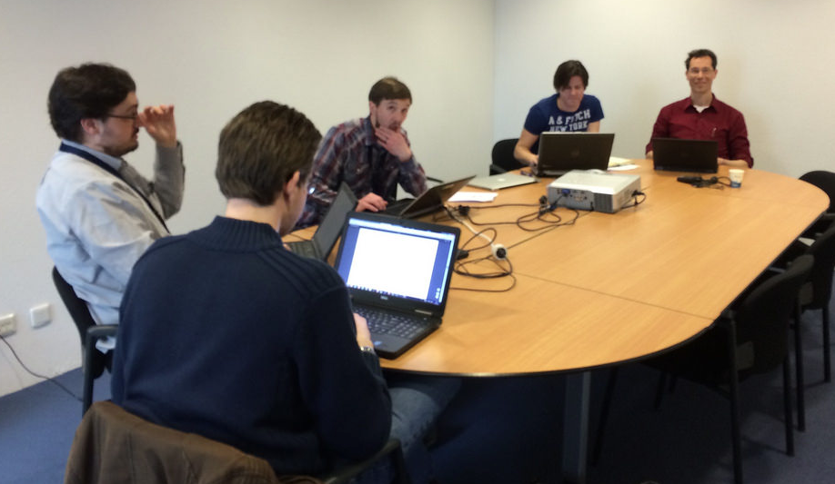
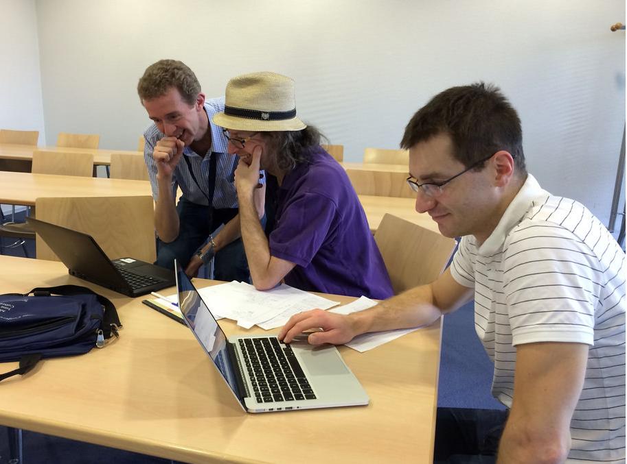
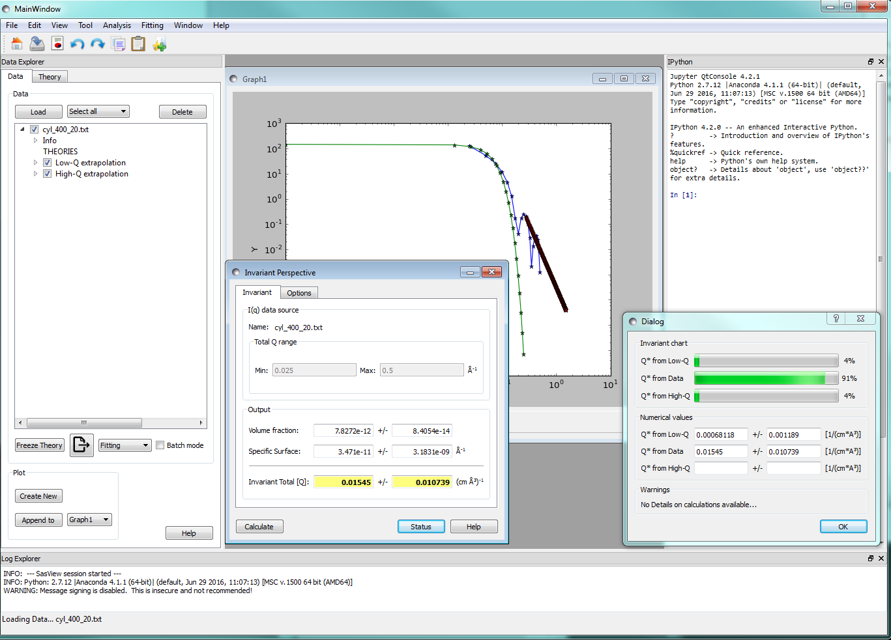
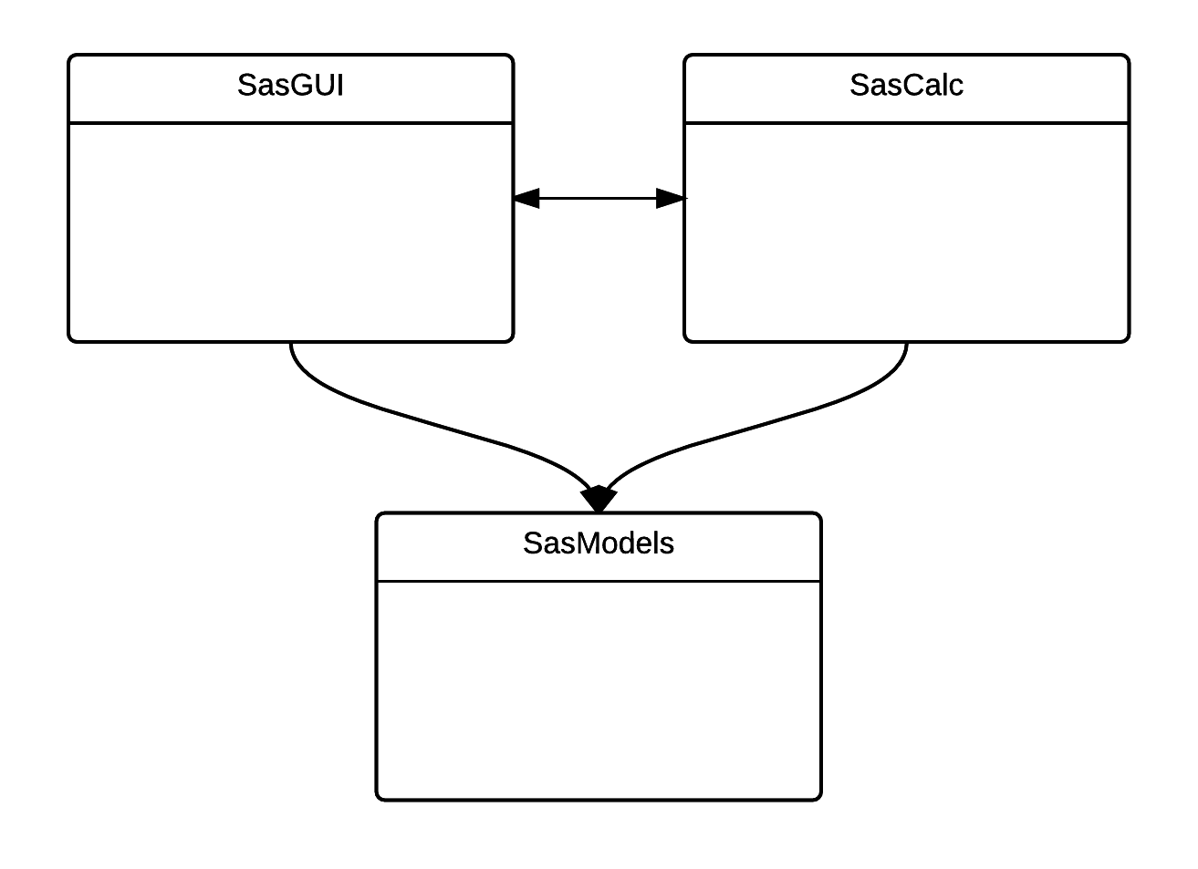
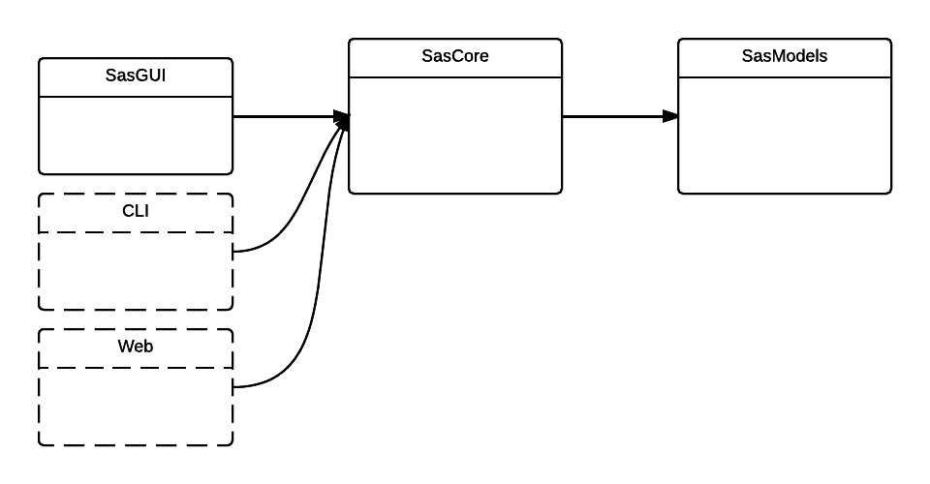
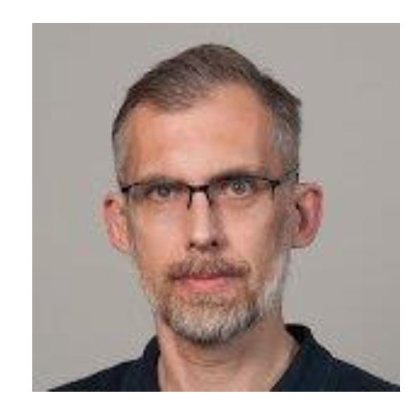
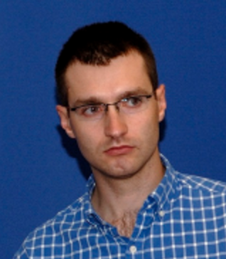
SANS - status
ESS has become important partner in SasView development community consisting of SNS, ISIS, NIST, and ILL (+TUD + ANSTO)
Enabling SasView models to be used in McStas
Aligned ESS and SasView roadmaps
Implemented proper development
processes using
Hosting build services for community for quality assurance.
Integrating SasFit models
Refactored SasView
Developed new GUI
R. Heenan: FISH models -> SasView
SasView code camp @ TUD
Past
Piotr
Now
Wojtek
Only full-time developers!
2016-2017 (Risk of loosing skills!)

Slide 50
Reflectometry – Deliverables for H.C.
IKC | Deliverables
Partner: FZJ | BornAgain extended to conventional reflectometry (all MotoFit functionality with SasView like interface, optical matrix model) User-friendly user interface Python scripting interface GUI Enable user specified models Polarized data Other specular reflectivity fitting tools lambda dependent absorption Documentation and user tutorials Live-analysis Integrated Testing
50
Notes:
Staffing is aligned with SINE2020 like imaging

Slide 51
Reflectometry - Status
In kind agreement with MLZ ready for approval:
Leverages ~12 person years of effort on BornAgain
Leverages ~3 years of effort from SINE2020
TA describes a joint effort for reflectometry, QENS, and engineering diffraction
Professional software development group
Requirements from instrument teams, early version of roadmap – next iteration once IK partner is on board
As part of SINE2020, participating facilities will hand over their requirements for reflectometry to MLZ group
Discussed and evaluated at next GA meeting in Portugal
Users will be invited to participate in later workshops in SINE2020

Slide 52
Spectroscopy

Slide 53
Molecular Spectroscopy
IKC | Deliverables
Partner: ESS (i.e. None) | Something like a-Climax (DFT) Option to compare DFT with experiment in a like-to-like fashion Should be sufficiently fast (run on cluster) User-friendly user interface Python scripting interface GUI Documentation and user tutorials Live-analysis Integrated Testing
Status
Not among first 8 instruments
Will handle software for VESPA internally at ESS
Intend to collaborate with ISIS and SNS

Slide 54
QENS deliverables
IKC | Deliverables
Partner: MLZ/FZJ | Analysis software for QENS adhering to overall requirements GUI / Python scripting Documentation and user tutorial Real-time analysis (good enough statistics) Provide different output formats for reduced data (Matlab, Mantid, Mslice) Fitting: customizable (1-4D, simultaneously fits functions of different metadata), flexible, friendly, and fast in simple cases) Models for quick data analysis (convolution with instrument resolution, quick fit for tunneling peaks) Provide software for MD, DFT Integrated Testing

Slide 55
QENS - Status
In kind agreement with MLZ ready for approval:
TA describes a joint effort for reflectometry, QENS, and engineering diffraction
J. Wuttke has a background as QENS instrument scientist
Links to C-SPEC (MLZ/TUM) and T-REX (MLZ/FZJ)
Professional software development group
Requirements from instrument teams, early version of roadmap – next iteration once IK partner is on board
Requirements also captured in SINE2020

Slide 56
INS – deliverables & status
Inelastic Neutron Scattering is at the core of a neutron scattering facility, at the same time data are hard to analyse presumably resulting in the low publication rates. PSI has shown interest in this WU.
IKC | Examples of Tasks
Partner: TBD | User-friendly analysis software possibly based on Mantid/HORACE Python scripting interface GUI Multi-dimensional fitting (1D-4D data set plus meta data) Fast (live) visualization and analysis (requires cluster backend) + automation Correction for multiple scattering, phonon scattering, etc User-specified models (incl. a solution for SpinW and Matlab?) Documentation and user tutorials Provide DFT codes SpinW Integrated Testing
Value: 512 k€
Seek to hook into efforts at ISIS (Toby Perring)
56

Slide 57
Staffing (in kind contributions) are aligned with instrument schedule
From Workshop at Jülich – is now outdated
TENTATIVE
3 persons for 2 years or
2 persons for 3 years provided by one or two in kind contributors
Try to limit number of In Kind Partners for all instruments and techniques in order to
build up critical developer mass at partner facilities
Notes:
Requirements to in kind contributors

Slide 58
Many diffraction software solutions available, but any sustainable ones?
Program | Language(s) | Comment
Fullprof | Fortran | Small developer communities / single developer code Semi-open
Jana2006 | Fortran
GSAS II | Python/C++
Maud | Java
Topas |  | Commercial
Solution for Day One (backup solution): Fullprof?
Which framework do the ESS instrument teams (DREAM, HEIMDAL, BEER) prefer?
Long-term sustainable solution: Scratch? (integrate existing components in new framework)
Implement 2D Rietveld as inter-operable module (i.e. can be interfaced to
several programs)

Slide 59
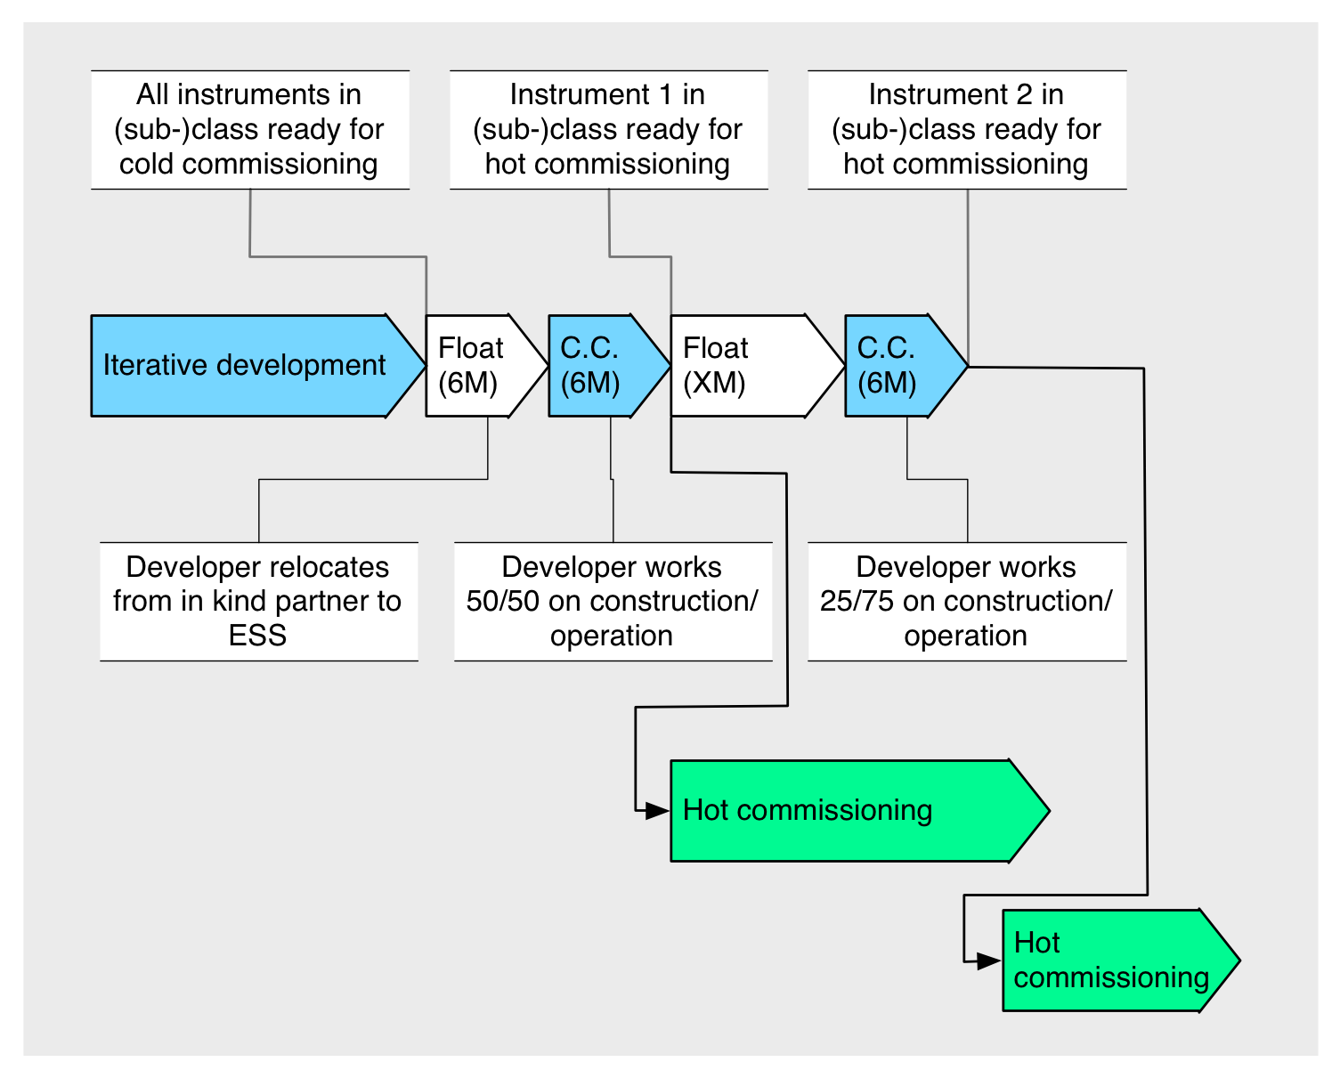

Slide 60
The team
Facility | Class | Thomas | Céline | Piotr | Wojtek | Torben | Peter
PSI | Imaging | IKC
MLZ | Eng. Diff |  | IKC
 | Reflect |  | IKC
 | QENS |  | IKC
ESSB | Powder |  | IKC
 | SXtal |  | IKC
ESS | SANS |  |  | SINE2020 | SINE2020 | Cash
TBD/ESS | INS |  |  |  |  | IKC/Cash
ESS | McStas |  |  |  |  | Cash | Cash

