Slide 1
13.4.2.11: User office software:
Cost Reduction Target Analysis
Sune Rastad Bahn

Slide 2
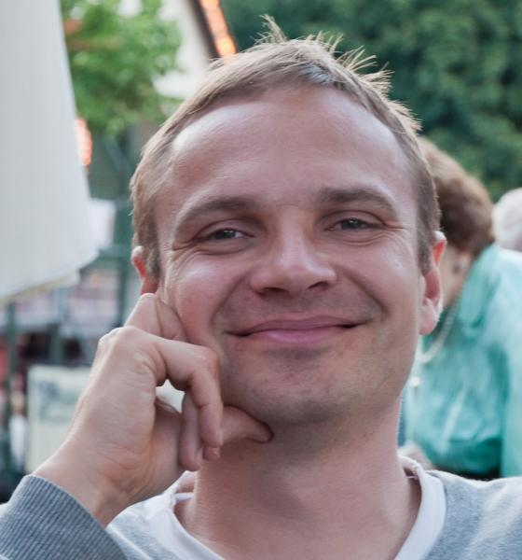
Scientific Coordination and User Office software
Core team:
Group Leader – Sune Rastad Bahn
In-kind partner: To be found
(Project) Lead software developer
2 software developers
Strategy is to deliver user office software by
Leveraging existing software packages to avoid from scratch development
Use in-kind resources
Scope and schedule
Budget and achievements
Cost reduction scenarios
Adapting to change in instrument schedule
Summary
2

Slide 3
User office software scope
Develop and install software supporting the User Office in Scientific Activities Division
User data base
Keep track of visitors and their association
Sample handling
Keep track of samples, including toxicity, radioactivity etc.*
Proposal handling
Keep track of submission and review process
Beam time scheduling
Ensure available beam time is used efficiently
Admin support and training
Keep track of financial aspects and safety training in place for visitors (not including course material)
Publications and reports
Keep track of scientific impact
Area | First Neut. Q4 2019 | Hot comm. Q1 2021 | UserP-12m Q3 2022 | UserP-6m Q1 2023 | UserP Q3 2023
User DB | Nice | Need
Samples | Test | Nice | Need
Proposals | Test |  | Need
Beams | Test |  | Nice | Need
Training | Test | Nice |  | Need
Publications | Test |  | Nice | Need
Test can be done: Resources available to test module.
Nice to have: Module will benefit the organization, but paper and pen are valid substitutes.
Need to have: Administration will be overly expensive if module not available.
* Based on current understanding of legal requirements
3

Slide 4
User office software schedule
The expectations from SAD aligns very well with the original high-level schedule shifted by a year to take later start of user office employees in consideration.
First Neutron
Hot commissioning
User Program -12 month
 | 2019 |  | 2020 |  | 2021 |  | 2022
User Database
Sample handling
Beam scheduling
Proposal handling
Admin support and training
Publication and reports
4

Slide 5
User Office software Budget
Total budget (2018-2021 in P6): 1.6 M€
Current spent : 0.0 M€
Allocated for salary: 0.0 M€
Budget remaining: 1.6 M€
Staff: Project leader + 2 developers
Budget is sized to cover the adaption and extension of existing solutions to ESS needs, not a development from scratch.
Legal requirements might add to cost.
Similar software project at other facilities (ISIS,SNS) have around 5 FTE in operation.
Possible candidates for adaptation and extension
Achievements
A detailed requirement document has been signed off with Science Activities Division (Arno Hiess). Legal requirements have not formally been included, but functionality is consistent with ESS-0024109.
A detailed fit – gap analysis of 83 functional requirements matched against possible solutions from PSI, Solaris and others has verified the need of the order of 100 man month of development.
5

Slide 6
Fit-Gap Analysis

Slide 7
Preliminary result of Fit-Gap analysis
Two parameters control the cost:
How much of the scope is not covered by the solution (and hence needs to be developed)
How good is the framework support for developing the functionality
The latter in most cases trumps the former, i.e. it is more important to have a suitable foundation than things that works out of the box.
Sample handling is one of the more development heavy areas in the current solution candidates.
DUO
Solaris

Slide 8
User office cost reduction scenario
 | Comments
Cost reduction | Reduce developers from 2 to 1
Potential saving | 2019-2022 (In kind): 315 keuro
Risks | The only developer leaves for a better paid opportunity, leaving the user office solution dead in the water, causing all administration to be done by paper and pen (Probability: Medium, Impact: High) Lack of resources causes bugs and delays in Sample tracking module, causes operation permit withdrawal due to lost radioactive samples . (Probability: Low, Impact: High) Bugs in beam scheduling causes double booking or drop in efficiency of instruments, reducing early scientific success (Probability: Medium, Impact: Medium) Lack of experienced candidates when hiring for operational team delays proposal rounds and hence limits early scientific success (Probability: Medium, Impact: Medium)
8

Slide 9
Adapting to the changed instrument schedule
Since hardware and licenses (a small cost) is included in the DST budget, labor is the only cost associated with the user office software development. Therefore the time we enter operation will determine the total construction budget..
Possible achievement based milestones includes:
First internal user in user data base (2019)
First sample in sample handling system (2020)
First instrument using beam scheduling (2021)
First publication in system (2022)
First proposal round completed (2023)
The table above shows the impact on the construction budget of moving into operation at different times. If all the labor (including relocation) is moved into operation the construction delta is 1.6 M€.
Budget / Milestone | EOY 2019 | EOY 2020 | EOY 2021 | EOY 2022 | EOY 2023
Construction delta | -1.1 M€ | -733 k€ | -367 k€ | 0 € | +367 €
9

Slide 10
User office wrap up
Significant cut in labor, causing a high risk of impacting early scientific success and credibility, as well as increasing cost for the User Office will allow the desired cut (320 k€) in the area of User Office software
If we are not allowed to move into operation before the first proposal round is completed, we will be short of 381 k€, more than countering the obtained saving through cutting in labor.
As with data systems in-kind we might be able to save 20% (320 k€) by buying consultants from e.g. the Danish IT-university compared to the in-kind cost book rates.
10

