Slide 1
ODIN: Science case, high-level requirements and Design
ESS: S. Ansell, S. Pullen, M. Strobl
PSI: U. Filges E. Lehmann, M. Morgano
TUM: E. Calzada, M. Lerche, J. Neuhaus, W. Petry, B. Schillinger, M. Schulz

Slide 2
Outline
ODIN overview
Science Case and Requirements
  White beam radio-/tomography
  Time of Flight (ToF) techniques
    Polarized Neutron Imaging
    Grating interferometry
    Bragg Edge imaging
  ODIN Design
  Summary

Slide 3
ODIN Overview
Optical and Diffraction Imaging with Neutrons: Neutron radiography and ToF imaging with variable wavelength resolution
ODIN will be the only imaging instrument installed during the first round
It will be a “day-1” instrument: first neutrons planned for 2021
Joint project with TUM, PSI and ESS
Assigned a cost category A (9M€) despite the recommendations of the STAP. Our project internal target budget was 12.5M€.

Slide 4
ODIN Overview
Multi purpose imaging instrument
50m Source to pinhole
Sample located up to 14m from the pinhole
Straight beamline (direct view of the source)
Chopper cascade consisting of 9 axis (plus 1 PPSc)
Range of operational modes:
  “White beam” imaging with spectral choice
  Grating interferometer in Low Time of Flight Resolution (LToFR)
  SEMSANS imaging in LToFR
  Polarized and polarimetric neutron imaging set-up in Medium ToFR (MToFR)
  Bragg-edge and diffraction geometry set-up in MToFR and High ToFR
  Perpendicular X-ray imaging set-up

Slide 5
High Level Requirements
Large Samples: Field of View (FOV) up to 20✕20cm² with an intensity homogeneity of more than 75%
High resolution: Real space resolution of 10µm (smaller FOV)
➔ Variable L/D (collimation): 100-10,000
  1:1 pixel resolution 6.5µm ➔ FOV=14✕14mm²
  Geometric blur Δd when sample – detector distance l=10mm:
  Δd = l/(L/D) = 1µm
ODIN shall be able to cover a neutron wavelength range from 1 to 20 Å to make optimal use of ESS’s spectrum.
Different wavelength resolutions of 10%, 1% and down to below 0.5% for spectra from 1 Å to 10 Å and 1 Å to 5.5 Å shall be available, respectively.

Slide 6
High Level Requirements
Bandwidths up to about 4.5 Å and 9 Å in every pulse and single pulse suppression modes shall be freely selectable at least between 1 Å and 20 Å.
In kinetic measurements time resolutions below 70 ms shall be achievable.
Time resolutions of the order of 1 µs shall be possible in quasi-stroboscopic mode.
Gamma and fast neutron background as low as reasonably possible.
Complementary x-ray contrast with comparable spatial resolution (10 μm) when full scope is realized
Diffraction capabilities equivalent wavelength resolution (full scope): ∆ λ/λ=0.3%≈ tan⁻¹(θ)∆x/R; 2θ=90°; ∆x=0.003m: R = ∆x/.003 ≥1m

Slide 7
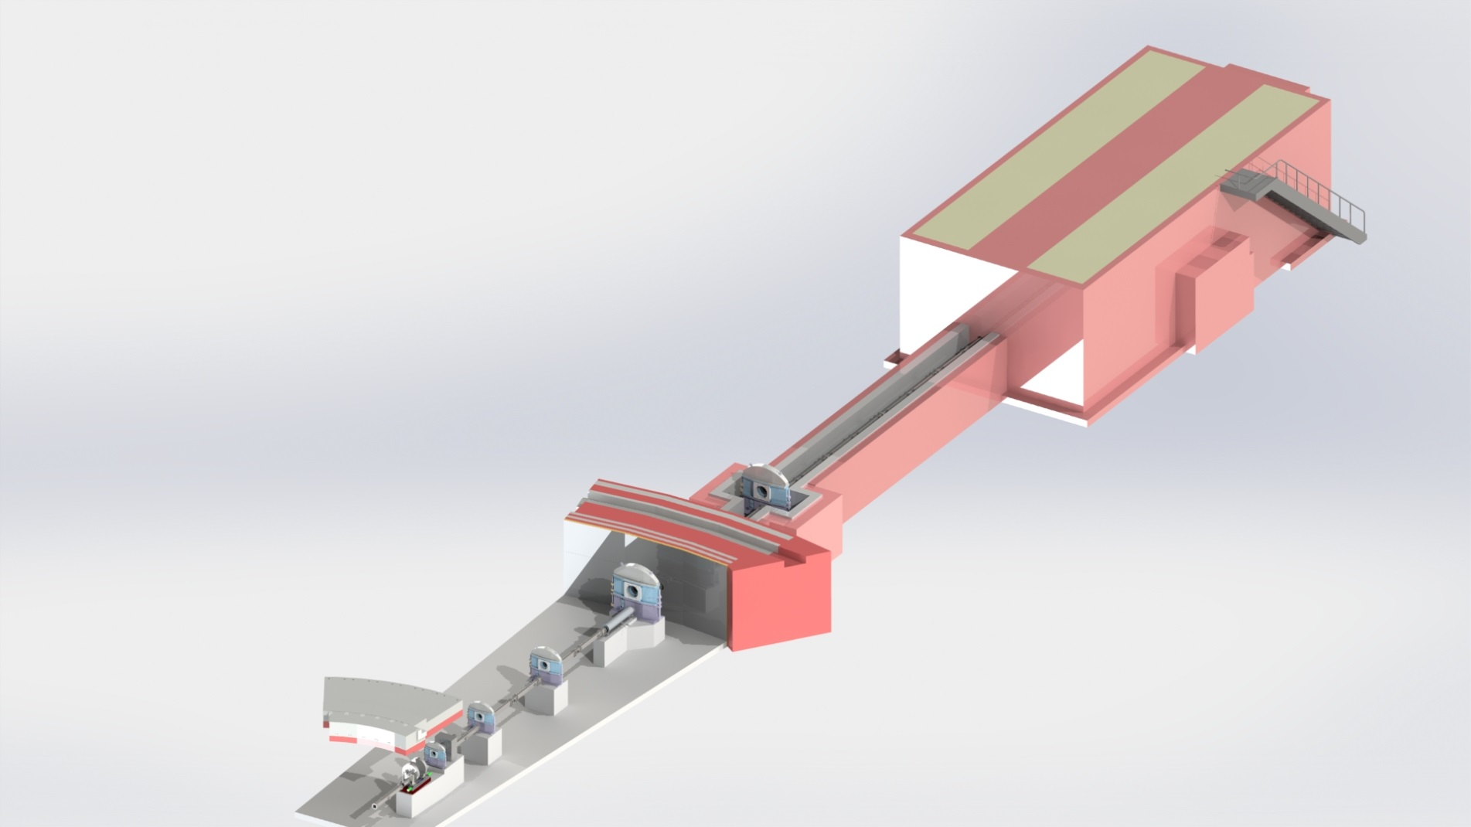
ODIN sketch

Slide 8
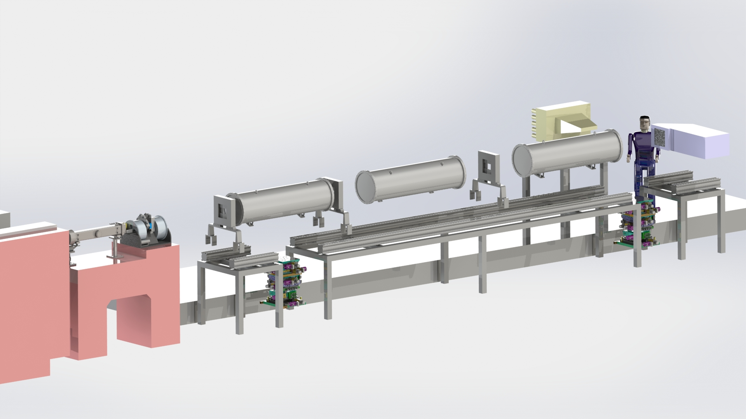
ODIN Cave sketch

Slide 9
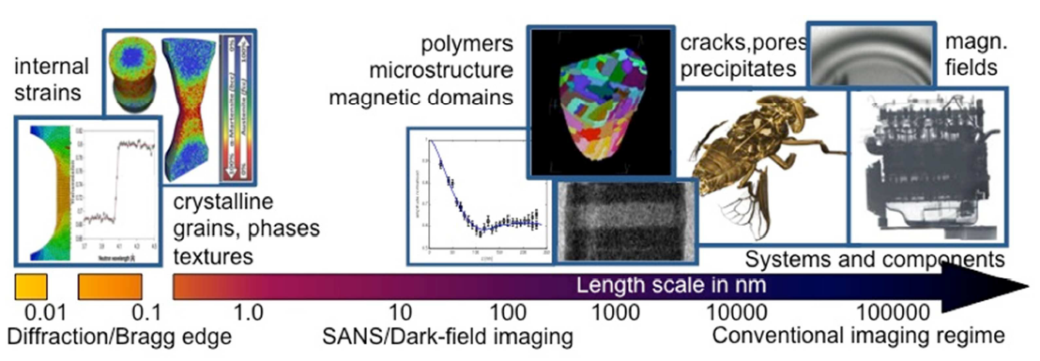
Full scope of ODIN
White beam imaging with best spatial resolution and variable FoV:
  Big objects thanks to the 20 x 20 cm² FoV and cold to thermal spectrum…
M. Strobl, Physics Procedia, 69 (2015) 18-26

Slide 10
Full scope of ODIN
White beam imaging with best spatial resolution and variable FoV:
  Big objects thanks to the 20 x 20 cm² FoV and cold to thermal spectrum,
  and small objects thanks to the high flux and cold spectrum

Slide 11
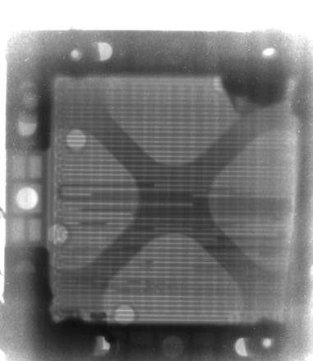
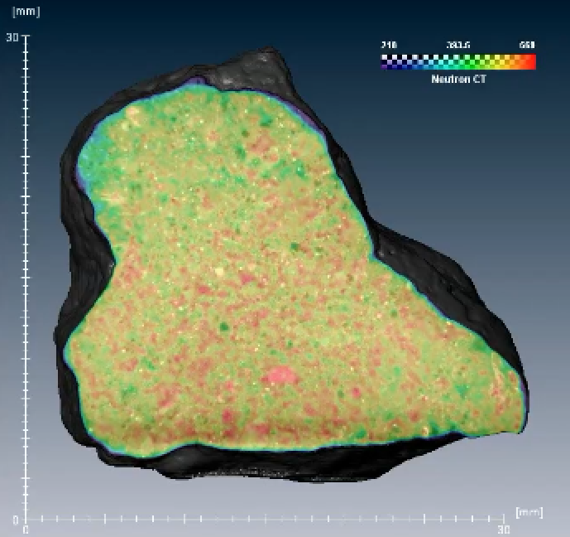
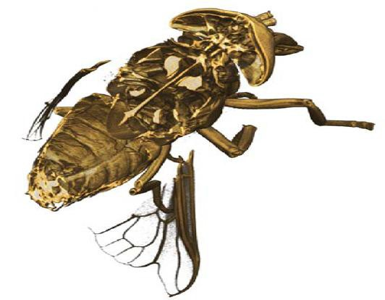
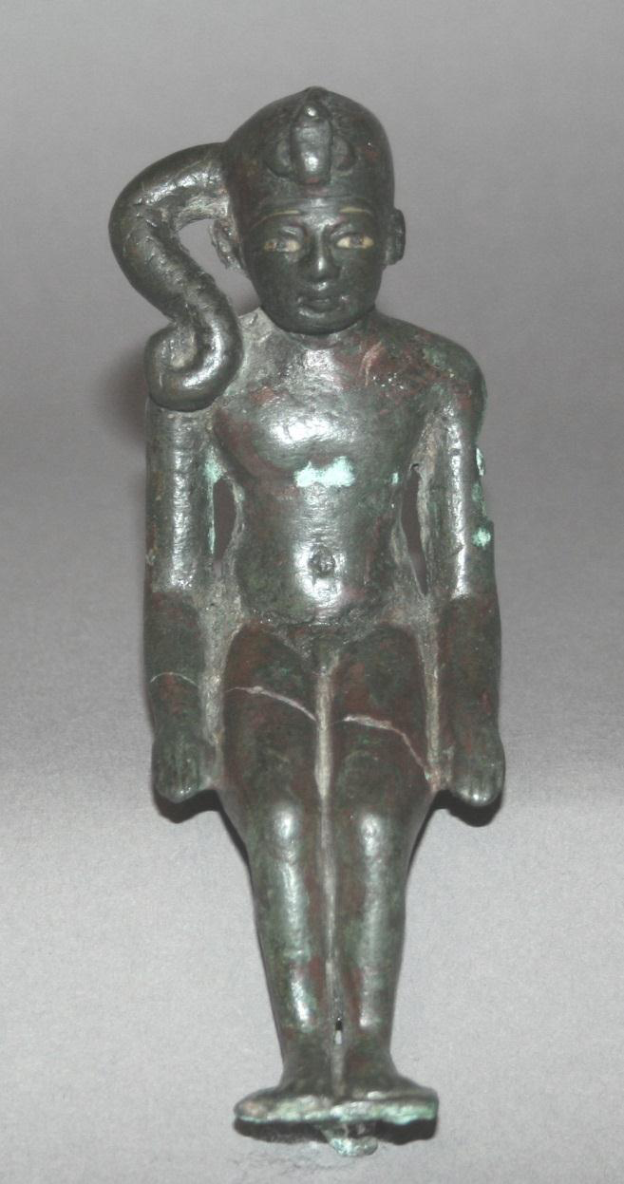
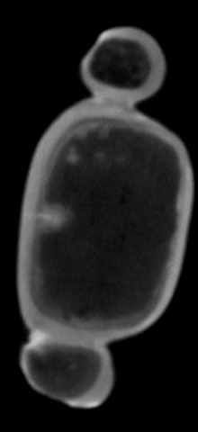
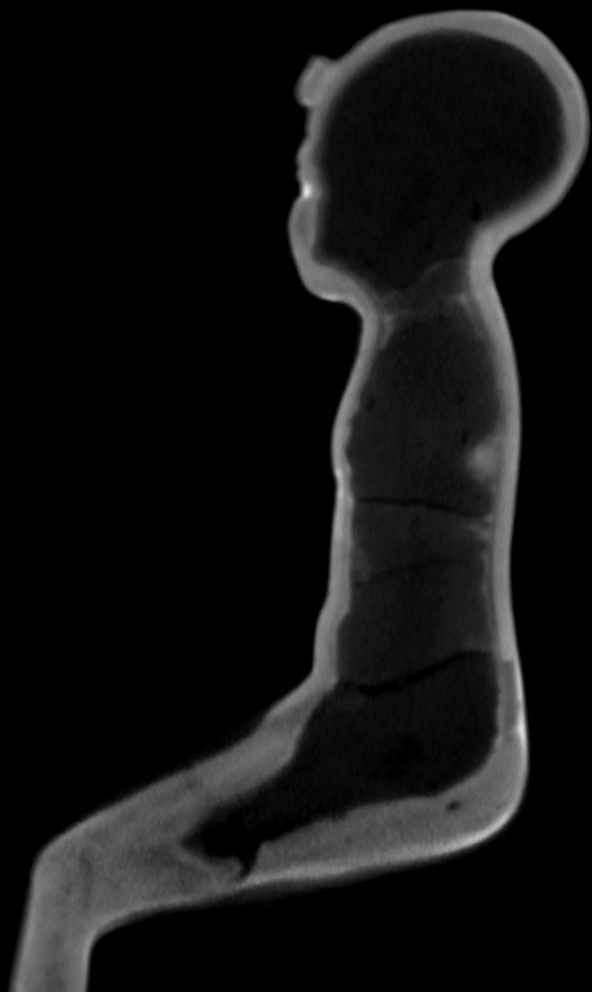

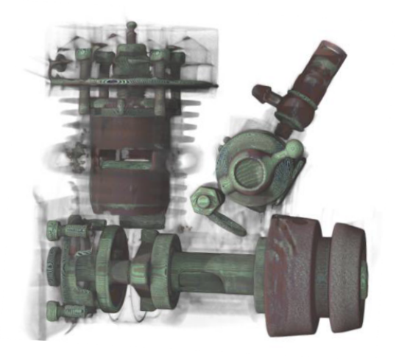
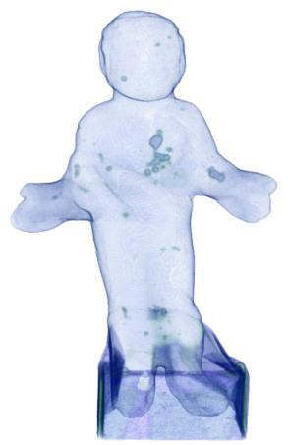
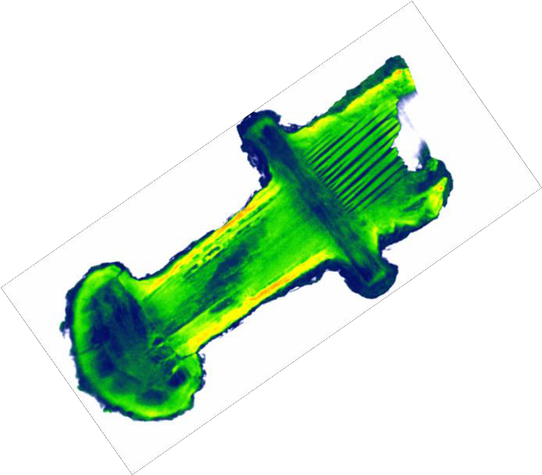
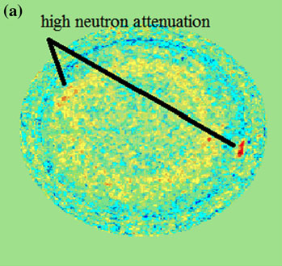
Neutron Imaging Applications
Applied Science
Plant Science
Energy related Science
Earth and Planetary Science
Art and History

Slide 12
Full scope of ODIN
White beam imaging with best spatial resolution and variable FoV:
Polarized neutron imaging
  To visualize (and quantify thanks to ToF information) magnetization in bulk samples and magnetic field outside

Slide 13
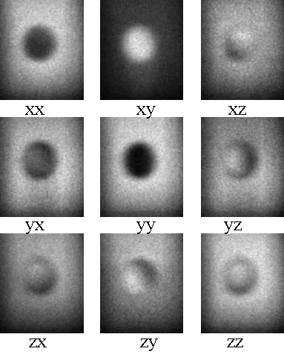
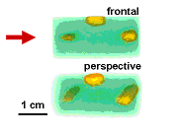
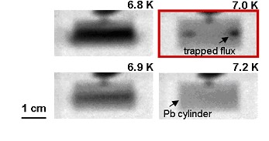
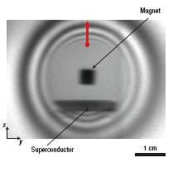
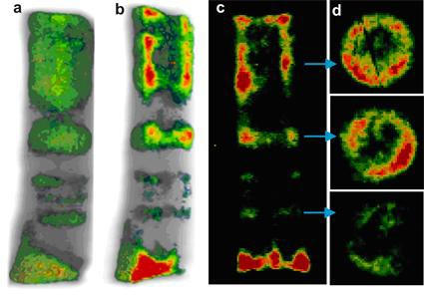

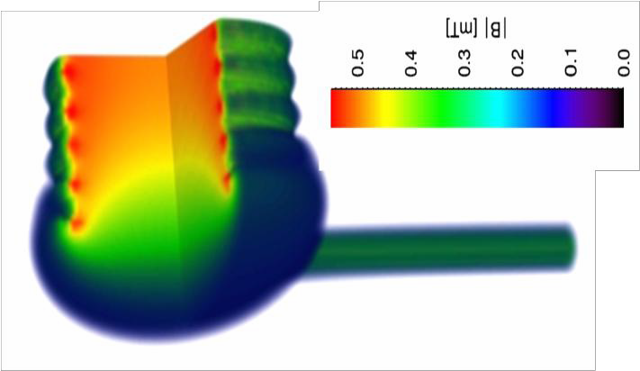
Polarized Neutron Imaging
08)

Slide 14
Full scope of ODIN
White beam imaging with best spatial resolution and variable FoV:
Polarized neutron imaging
Dark field imaging
  To visualize magnetic domains
  Microstructures beyond the image resolution qualitatively

Slide 15
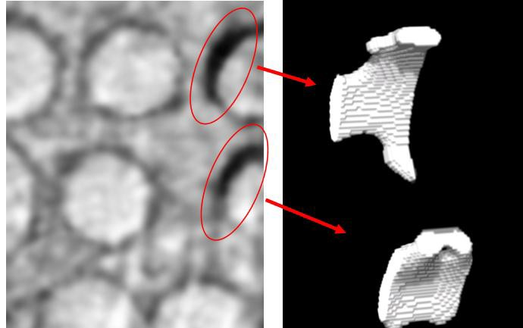
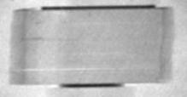
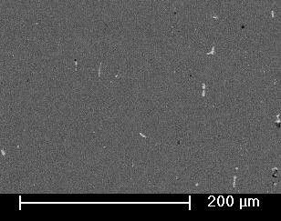
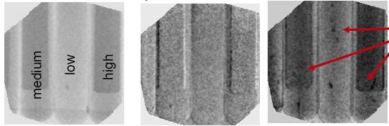

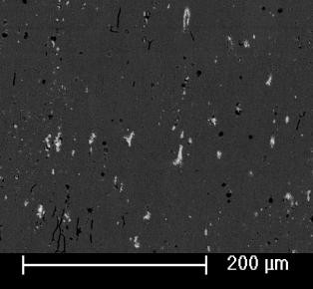
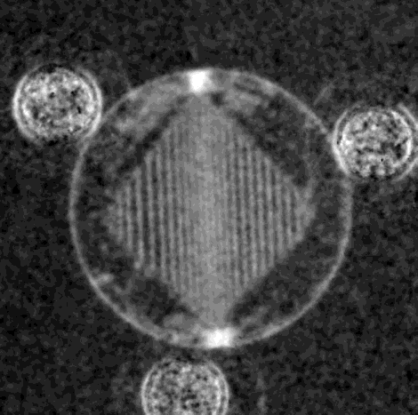
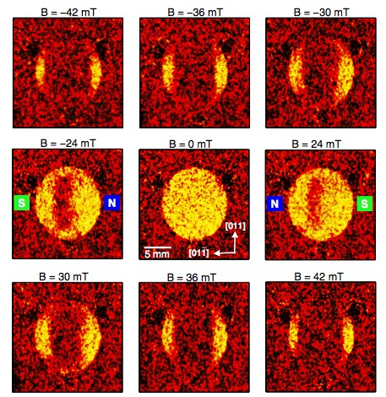
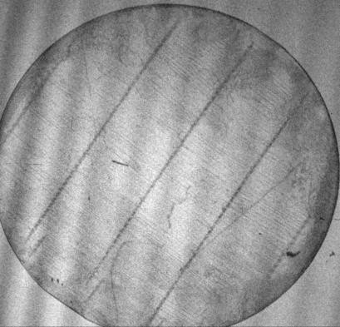
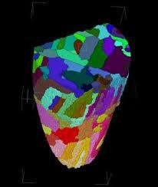
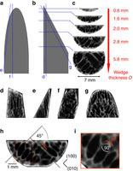
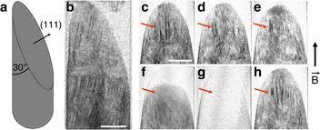
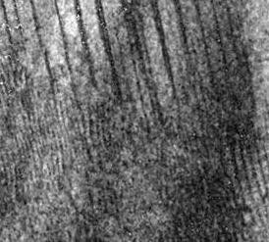
Dark-field/SANS imaging
M. Strobl et al. PRL (2008)
A.Hilger, M. Strobl et al JAP (2010)
Ch. Gruenzweig et al. APL (2008) & PRL (2008)
2cm
I. Manke, N. Kardjilov,..M. Strobl et al. Nature Com (2010)
2mm

Slide 16
Full scope of ODIN
White beam imaging with best spatial resolution and variable FoV:
Polarized neutron imaging
Dark field imaging
  To visualize magnetic domains
  Microstructures beyond the image resolution qualitatively
  and quantitatively

Slide 17
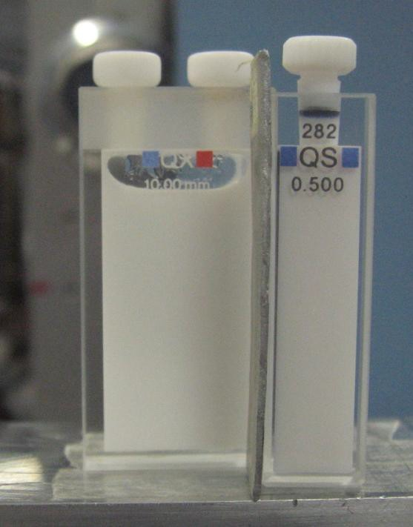
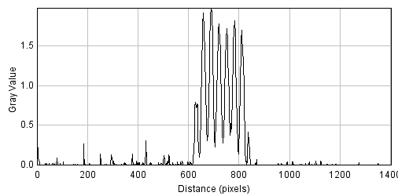
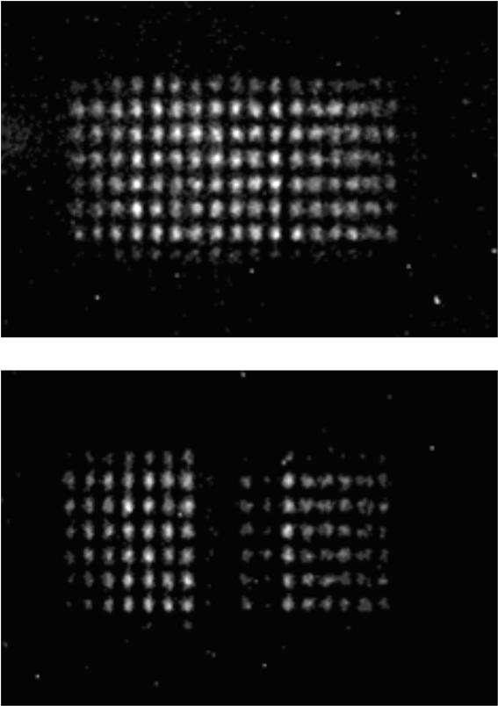
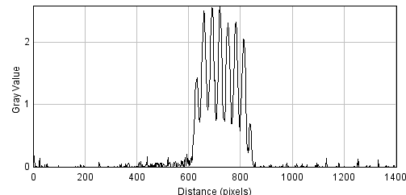
Dark-field/SANS -> 2D spatial resolved SANS
Dark field contrast – SEMSANS (M.Strobl, W. Boumann et al.)
LS 0.7 m
L1-L2 2 m
L2 2.8 m
samp
2.1A
theoret.
spatial resolution app. 1mm
ana
B1
B2
D
L 5.2 m
Cd
Cuvette 1; PS spheres 136nm; 12.4 wt%
1
0.90
0.9
D=136nm
amplitude normalised
ϱ=12.4%
0.85
0.8
rel. modulation amplitude
0.80
0.7
period
0.6
0.75
0.5
0
50
100
150
200
250
z [nm]
0.70
0.02
0.04
0.06
0.08
0.10 0.12 0.14
SE-length [µm]
0.16
0.18
0.20
0.22

Slide 18
Full scope of ODIN
White beam imaging with best spatial resolution and variable FoV:
Polarized neutron imaging
Dark field imaging
Wavelength resolved Bragg edge imaging
  To visualize grains, phases, strains and texture

Slide 19
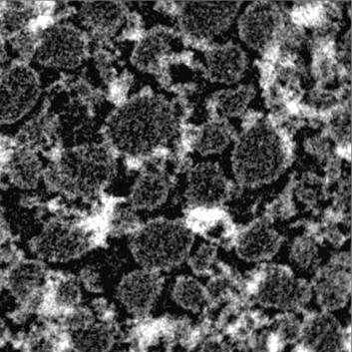
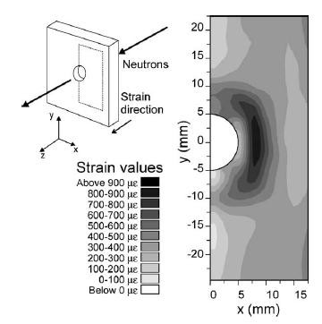
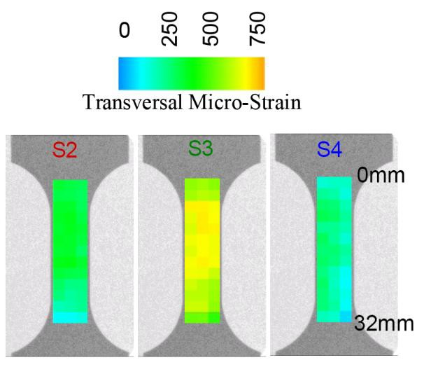
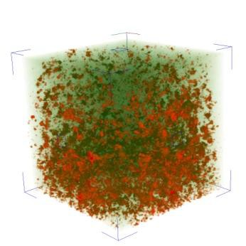
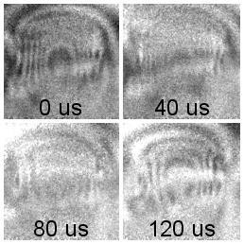
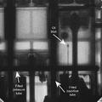
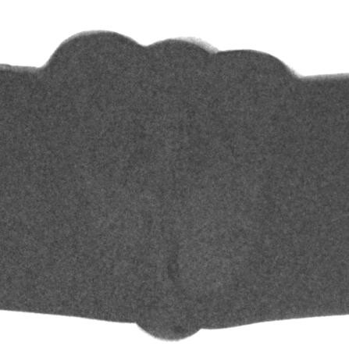
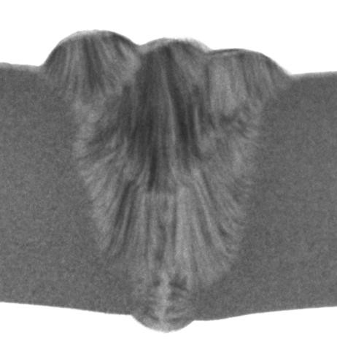
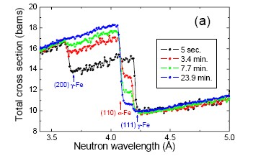
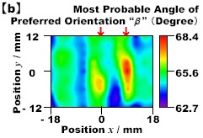
Bragg edge imaging
strain
I. Manke, M. Strobl et al.
R. Woracek, et al. JAP 2011
J.R. Santistepan NIMA (2002)
microstructure
& texture
phase
E. Lehmann, N. Kardjilov et al. NIMA 2009
L. Edwards,
A. Steuwer et al. ISIS (2002)
H. Sato et al. J. Phys 2010

Slide 20
Scope adjustment
Full proposal
  Includes X-ray option
  Includes diffraction
As proposed
  Upgrade to world class
  instrument and full scope
  is straightforward
Cost Category A
  Not easily upgradable

Slide 21
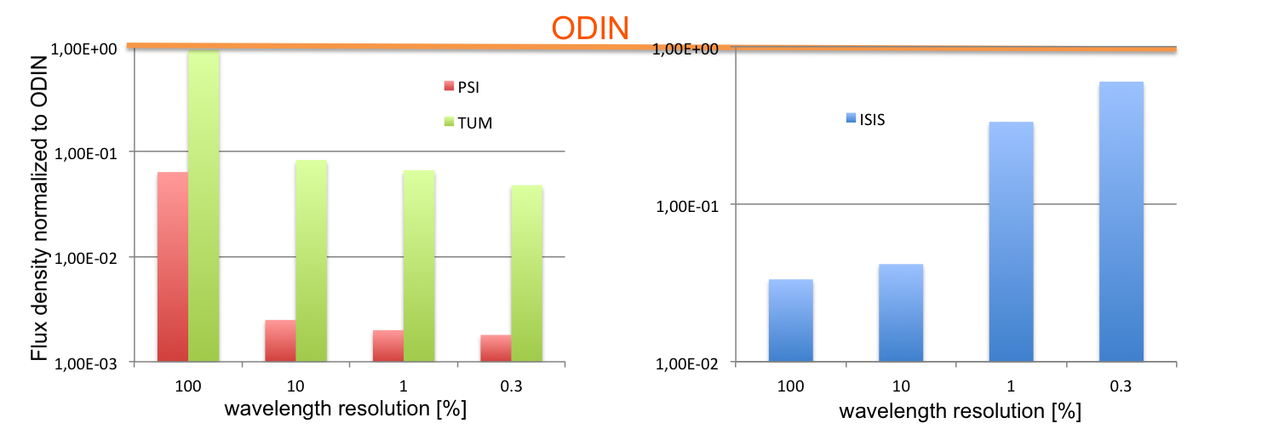
Flux Comparision

Slide 22
ODIN: Design

Slide 23
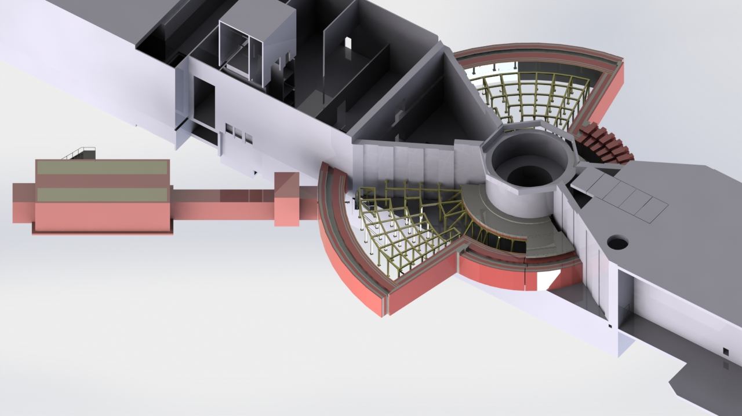
Overview

Slide 24
Overview

Slide 25
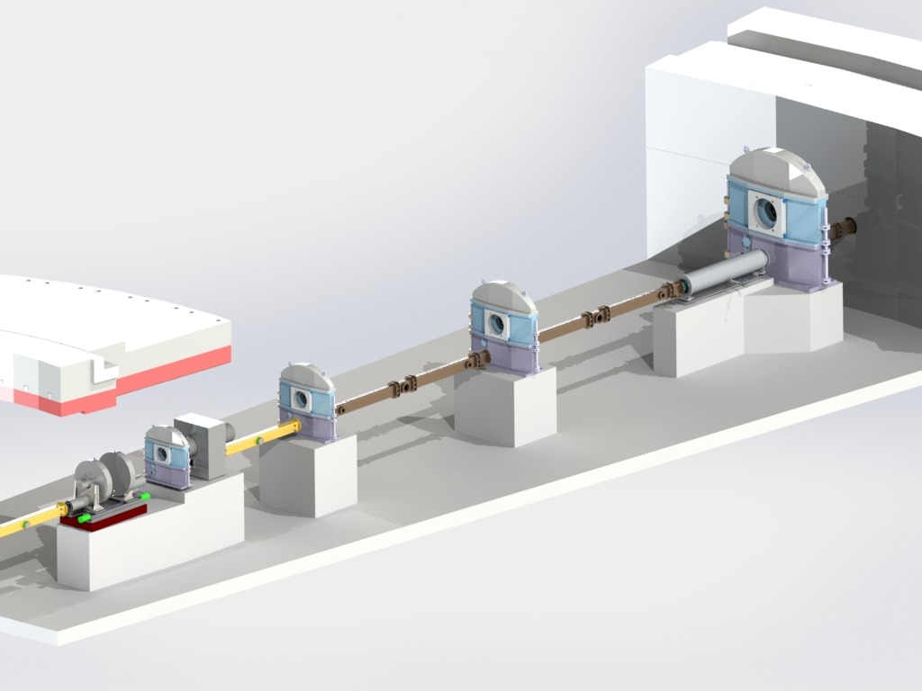
Bunker Area
FOC 4
Heavy Shutter
Beam Delivery System
T0
Bi-spectral Extraction System
FOC 3
FOC 2
FOC 1
WFMC 2
WFMC 1

Slide 26
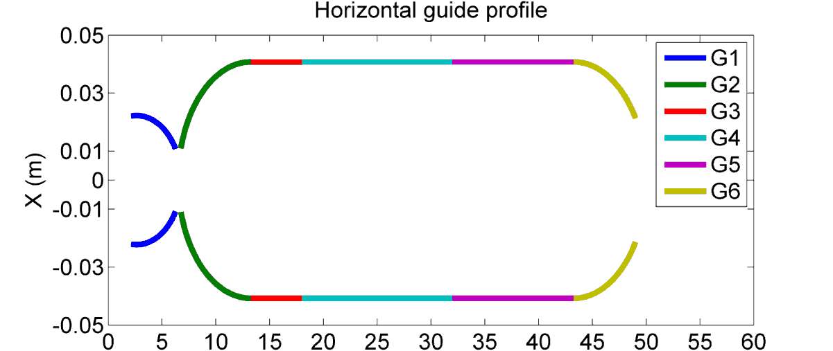
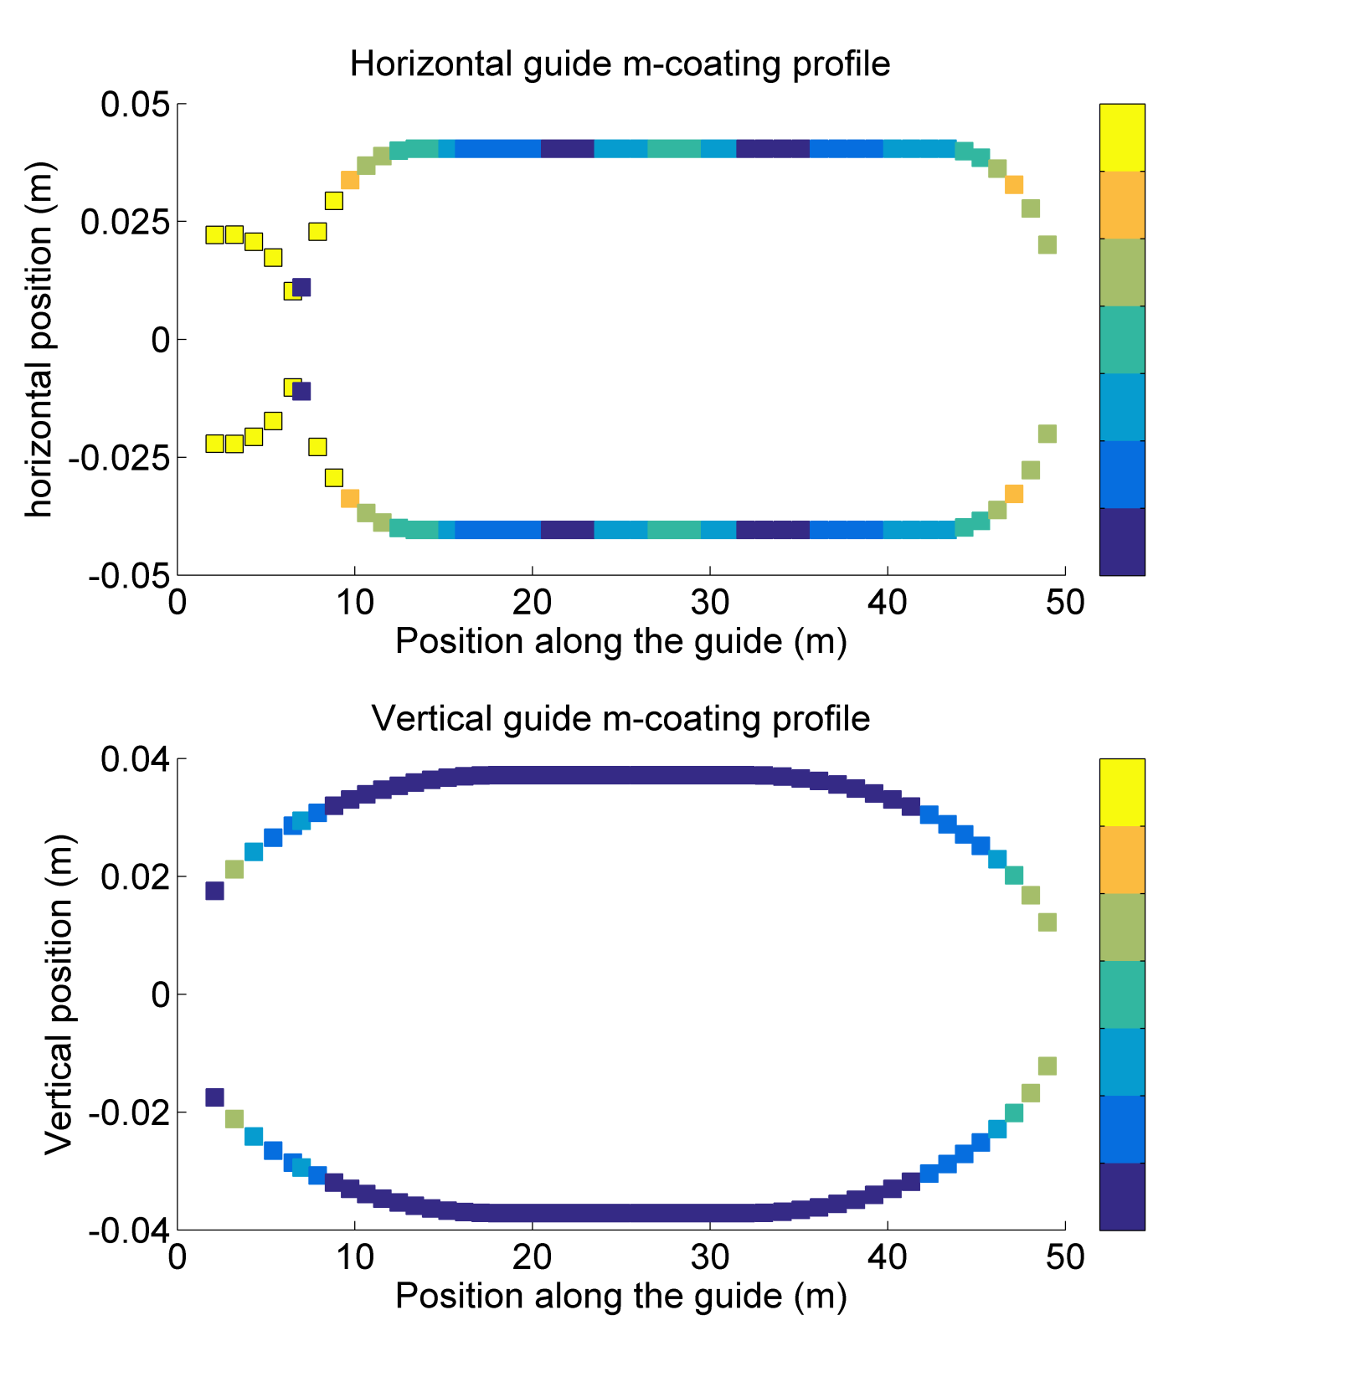

Neutron Guide Shape and Coating
m-value
m=5
m=4.5
m=4
m=3.5
m=3
m=2.5
m=2
m-value
m=5
m=4.5
m=4
m=3.5
m=3
m=2.5
m=2

Slide 27
Bi-spectral Extraction System
Schematic

Slide 28

Intensity Distribution

Slide 29
ODIN’s Chopper System:
McStas Simulations and resulting Design
Work presented is by: P. Schmakat¹, M. Seifert¹, M. Strobl² and M. Schulz¹
¹TUM, ² ESS

Slide 30

Guide/Chopper Integration

Slide 31



Wavelength Frame Multiplication Chopper

Slide 32
Wavelength Frame Multiplication Chopper

Slide 33

Chopper System: Every Pulse

Slide 34

Chopper System: Every 2nd Pulse

Slide 35



Chopper Disks

Slide 36

Wavelength Frame Multiplication Choppers

Slide 37

Frame Overlap Chopper

Slide 38

Frame Overlap Chopper

Slide 39
ODIN: Design – cont’d

Slide 40

Heavy Shutter: proposed design

Slide 41

Neutron guide in Beam position

Slide 42

Beam stopper in Beam position

Slide 43

Neutron Guide detail and FOC 5

Slide 44

Cave

Slide 45

Cave

Slide 46

Cave

Slide 47

Cave - Beamstop

Slide 48

Cave Interior

Slide 49
Cave Interior

Slide 50
STAP Recommendation
“STAP has serious concerns that the recent ESS cost category assignment is inadequate to develop ODIN to its full potential and the funding issue needs to be addressed urgently before the phase 2 process begins”
“strong budget commitment and technical plans for implementing these capabilities should not be an afterthought”
“STAP is of unanimous opinion that the current cost category A is inadequate to construct ODIN to fully utilizes and take advantage of ESS beam and geometry, incorporate modes of operation that are unique to ESS and world’s best, and provide unique and new classes of research and service opportunities that will be not available elsewhere.”

Slide 51
STAP Recommendation
“The current cost category A budget will likely handicap ODIN from the beginning”
“The new budget (about 12 million Euros) is a compromise that mitigates some of the concerns that STAP has. However, STAP still strongly recommends that ESS re-reviews the current allocation to enable ODIN to be developed as world’s best instrument as originally envisioned.”
“STAP again in the strongest possible term recommends that the budget of ODIN is re-assessed before the upcoming tollgate review and to a minimum, awarded a Cost Category B status.”

Slide 52
Thank You!

Slide 53

MNCP – Cave Antechamber

