Slide 1
ODIN: Configurations
ESS: S. Ansell, S. Pullen, M. Strobl
PSI: U. Filges E. Lehmann, M. Morgano
TUM: E. Calzada, M. Lerche, J. Neuhaus, W. Petry, B. Schillinger, M. Schulz

Slide 2
Outline
Description of Configuration 1, Cost Category A, 9M€
Design and Setup Summary
Budget Details

Slide 3
Scope within Cost Category A 9M€
Focussing, de-focussing, focussing neutron guide with m2-5 coatings
Collimator position at 50 m
Sample position from 52 m to 64 m
L/D values (Collimation) between 100-10000
Medium and high resolution scintillator based detector set ups
All necessary associated infrastructure (shielding, cabling, cabins etc)

Slide 4
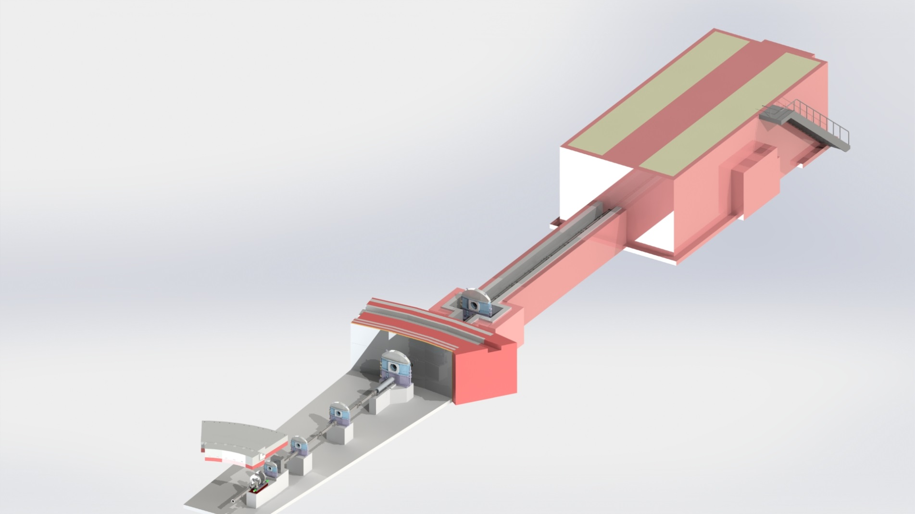
Schematic
X
X
X
X
X
X

Slide 5
Budget, Cost Category A
 | Cost Overview |  | Labor in Person-Years
 | Non-Labor | Labor | 01 Management | 02 Design | 03 Procurem. Labor | 04 Installation | 05 Cold Commissioning | Total
00 Phase 1 | 0 € | 554,000 € | - | - | - | - | - | 4.5
02 Neutron Guide | 1,760,000 € | 414,000 € | 0.81 | 1.11 | 0.44 | 0.57 | 0.36 | 3.29
03 Heavy Shutter | 231,000 € | 194,000 € | 0.50 | 0.52 | 0.17 | 0.19 | 0.09 | 1.47
04 T0 Chopper | 0 € | 2,000 € | 0.00 | 0.00 | 0.05 | 0.05 | 0.00 | 0.10
05 Choppers | 2,000 € | 112,000 € | 0.61 | 0.27 | 0.11 | 0.25 | 0.00 | 1.24
06 Cave Interior | 646,000 € | 462,000 € | 0.94 | 0.89 | 0.69 | 0.49 | 0.57 | 3.58
07 Add ons | 0 € | 0 € | 0 | 0 | 0 | 0 | 0 | 0.00
08 Motion Contr. | 121,000 € | 226,000 € | 0.83 | 0.20 | 0.35 | 0.27 | 0.26 | 1.91
09 White beam detectors | 198,000 € | 65,000 € | 0.28 | 0.25 | 0.14 | 0.13 | 0.04 | 0.84
10 ToF Detectors | 0 € | 0 € | 0.00 | 0.00 | 0.00 | 0.00 | 0.00 | 0.00
11 Shielding | 2,964,000 € | 423,000 € | 1.21 | 1.28 | 0.43 | 0.25 | 0.19 | 3.36
12 Infrastructure | 69,000 € | 194,000 € | 1.08 | 0.18 | 0.18 | 0.13 | 0.14 | 1.71
13 Vacuum | 0 € | 140,000 € | 0.68 | 0.11 | 0.11 | 0.13 | 0.08 | 1.11
14 PSS | 118,000 € | 108,000 € | 0.56 | 0.07 | 0.12 | 0.07 | 0.07 | 0.89
Totals | 6,109,000 € | 2,895,000 € | 7.50 | 4.88 | 2.79 | 2.60 | 1.80 | 4.5+19.5
 | 9,004,000 €

Slide 6
Detailed Labor Budget, Cost
 | 01 Management | 02 Design | 03 Procurem. Labor | 04 Installation | 05 Cold Commissioning | Total
00 Phase 1 | - | - | - | - | - | 554,000 €
02 Neutron Transport | 133,000 € | 158,000 € | 36,000 € | 45,000 € | 42,000 € | 414,000 €
03 Heavy Shutter | 76,000 € | 77,000 € | 14,000 € | 15,000 € | 11,000 € | 194,000 €
04 T0 Chopper | 0 € | 0 € | 1,000 € | 1,000 € | 0 € | 2,000 €
05 Choppers | 65,000 € | 26,000 € | 7,000 € | 15,000 € | 0 € | 112,000 €
06 Cave Interior | 149,000 € | 138,000 € | 61,000 € | 42,000 € | 72,000 € | 462,000 €
07 Add on | 0 € | 0 € | 0 € | 0 € | 0 € | 0 €
08 Motion Control | 119,000 € | 28,000 € | 28,000 € | 21,000 € | 30,000 € | 226,000 €
09 White beam detectors | 29,000 € | 18,000 € | 8,000 € | 7,000 € | 3,000 € | 65,000 €
10 ToF Detectors | 0 € | 0 € | 0 € | 0 € | 0 € | 0 €
11 Shielding | 171,000 € | 177,000 € | 34,000 € | 19,000 € | 22,000 € | 423,000 €
12 Infrastructure | 136,000 € | 22,000 € | 13,000 € | 9,000 € | 14,000 € | 194,000 €
13 Vacuum | 97,000 € | 15,000 € | 9,000 € | 10,000 € | 9,000 € | 140,000 €
14 PSS | 77,000 € | 9,000 € | 9,000 € | 5,000 € | 8,000 € | 108,000 €
Total | 1,053,000 € | 668,000 € | 220,000 € | 188,000 € | 211,000 € | 2,340,000 €
Total incl. Phase 1 |  |  |  |  |  | 2,895,000 €

Slide 7
Budget Details
Neutron guide (PSI)
The mirror coating was optimized to m=2-5 as needed, the cost was preliminarily reduced to 1,600k€ including an estimated 150k€ for the bi-spectral extraction system [1,760 k€].
Heavy shutter (ESS-TUM)
The cost for material and manufacturing of the heavy shutter was estimated at 175k€; [231k€]
T0 chopper (ESS)
No T0 chopper is planned but a concrete foundation is anticipated.
Chopper System (TUM)
No chopper system is planned in this option but we anticipate building concrete foundations to host the choppers at a later point.

Slide 8
Budget Details
Cave Interior (PSI)
Items included are: Crane, Optical bench, Flight tubes, Sample and Detector Stages, Infrastructure etc. The costs of 646k€ are based on a quote for a competitive instrument (Option 2) taking savings of about 100k€ for less equipment into account.
Add on (ESS)
None planned
Motion control (TUM)
A total of about 70 axes is anticipated resulting in 121k€.
White beam detectors (PSI)
One versatile detector system is included in this option, cost based on experience is 180k€. [198k€]

Slide 9
Budget Details
Time of flight detectors (ESS)
No ToF detectors are planned for option 1.
Shielding (TUM)
Shielding cost for estimated based on the Preliminary Shielding Design by Stuart Ansell and ESS cost book values for concrete, steel, lead and B4C as well as an assumed 33k€/t for Tungsten. Net total is 2,245k€ [2,964k€]. (see next slide)
Infrastructure, Vacuum and PSS (TUM)
All numbers based on ESS cost values.

Slide 10
Shielding Cost Calculation
Shielding |  |  |  | Material Pricing
 | Volume (m^3) | Cost (€/m^3) | Price | Steel
Steel | 111.725 | 9,540 € | 1,065,900 € | 1200 | €/tonne
Concrete | 209.929 | 800 € | 167,900 € | 7.95 | tonne/m^3
B4C | 5.68257 | 66,500 € | 377,900 € | B4C
Tungsten | 0.0065686 | 636,900 € | 4,200 € | € 26,600.00 | €/tonne
Lead | 5.33750 | 94,122 € | 502,400 € | 2.5 | tonne/m^3
Total |  |  | 2,118,300 € | Tungsten
 |  |  |  | € 33,000.00 | €/tonne
 |  |  |  | 19.3 | tonne/m^3
Beam Stop |  |  |  | Iron
 | Volume (m^3) | Cost (€/m^3) | Price | € 1,200.00 | €/tonne
Iron | 0.1413 | 9,480 € | 1,300 € | 7.9 | tonne/m^3
Steel | 0.4522 | 9,540 € | 4,300 € | Lead
Concrete | 44.186 | 800 € | 35,300 € | 8300 | €/tonne
B4C | 1.2960 | 66,500 € | 86,200 € | 11.34 | tonne /m^3
Total |  |  | 127,200 € | Concrete
Grand Total |  |  | 2,245,400 € | 800 | €/m^3

Slide 11
Scope within Cost Category, 9 M€
Focussing, de-focussing, focussing neutron guide with m2-5 coatings
Collimator position at 50 m
Sample position from 52 m to 64 m
L/D values (Collimation) between 100-10000
Medium and high resolution scintillator based detector set ups
All necessary associated infrastructure
NO CHOPPER SYSTEM
no T0 i.e. no prompt n and gamma supression
no WFMC and FOC i.e. only natural wavelength resolution ~10%
no BP only 1-5.5Å accessible

Slide 12
Summary and Conclusions II
“STAP has serious concerns that the recent ESS cost category assignment is inadequate to develop ODIN to its full potential and the funding issue needs to be addressed urgently before the phase 2 process begins”
“strong budget commitment and technical plans for implementing these capabilities should not be an afterthought”
“STAP is of unanimous opinion that the current cost category A is inadequate to construct ODIN to fully utilize and take advantage of ESS beam and geometry, incorporate modes of operation that are unique to ESS and world’s best, and provide unique and new classes of research and service opportunities that will be not available elsewhere.”
“The current cost category A budget will likely handicap ODIN from the beginning”

Slide 13
Summary and Conclusions III
“The new budget (about 12 million Euros) is a compromise that mitigates some of the concerns that STAP has. However, STAP still strongly recommends that ESS re-reviews the current allocation to enable ODIN to be developed as world’s best instrument as originally envisioned.”
“STAP again in the strongest possible term recommends that the budget of ODIN is re-assessed before the upcoming tollgate review and to a minimum, awarded a Cost Category B status.”

Slide 14
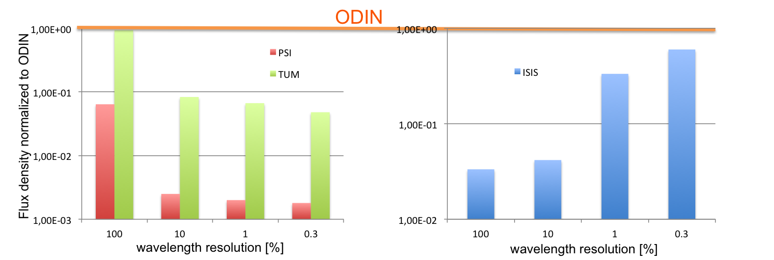
Flux Comparison

Slide 15
THANK YOU!

