Slide 1
ODIN Scope Setting Welcome and meeting objectives
Andreas Schreyer
Director for Science
European Spallation Source ERIC
www.europeanspallationsource.se
8 September 2016

Slide 2
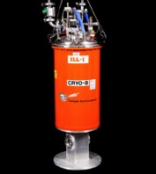
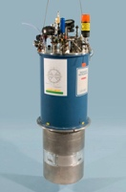
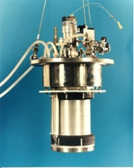
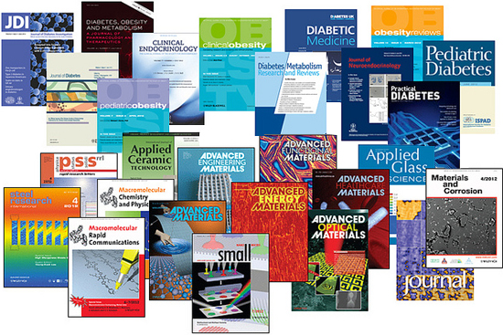
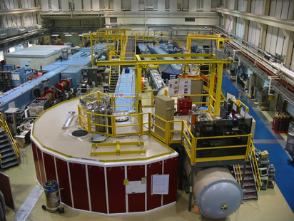
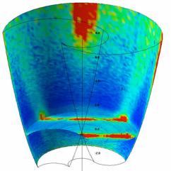
ESS Project Scope on Instruments Neutron Scattering Systems (NSS)
NSS Scope: 22 “public” instrument suite by 2028 together with a technical and scientific support infrastructure that enables scientific excellence and high quality scientific user service.
Science
(Publications)
Sample Environment
Ideas
(Proposals)
Science Support
Laboratories
22 Instruments
Analysis and Visualisation Software
Construction Budget:
16 Instruments

Slide 3
NSS Project: Priorities for 2016
Align the instrument budgets with the NSS budget
Align all other infrastructure (such as bunker, services and labs) and support activities with the NSS budget (Completed on 6 Sept)
Develop a realistic schedule for all instruments in line with ESS dependencies, available in-kind resources and partner capabilities
Match NSS scope to ring-fenced budget of 350 M€
Submit proposal to ERIC Council on 5 - 6 December 2016
how to fund instruments plus everything else required for early science success, and
nominate which instruments are to be operational for start of user operations – August 2023

Slide 4
NSS Project; Neutron Instrument project phases
Proposal and Planning
Design and Construction
Installation and Commissioning
Instrument Proposal
Phase 0
Preparation for Design
Phase 1
Preliminary Design
Phase 2
Detailed Design
Phase 3
Manufacturing and Procurement
Phase 4
Installation and Integration
Phase 5
Hot Commissioning
Deliverables
Science case covering scientific relevance, impact and usage
Conceptual design with credible estimates of performance
Preliminary costing.
Deliverables
Conceptual design updates
Prototyping
Definition of facility requirements and interfaces
Clarification of institutional responsibilities
Resource planning
Deliverables
Scientific and technical requirements
Technical design concept
Delivery plan for all phases (including hot commissioning)
Delivery Schedule covering all phases
Resource plan
Staging plan for later enhancements
Budget with contingency at 10% of cost to complete
Deliverables
Complete definition of all major technical components
Completion of detailed plan for Phase 3
Refined plan for phase 4
Refined Resource plan
Refined delivery schedule, with critical path items and dependencies
Refined budget with contingency at 10% of cost to complete
Deliverables
Procurement and manufacture of all major technical components
Completion of detailed plan for phase 4
Site preparation
Refined plans for phase 5 and for staging
Refined Resource plan
Refine instrument delivery schedule
Maintain budget with contingency at 10% of cost to complete
Deliverables
Construction of physical infrastructure on site.
Assembly and installation of technical components
Integration and testing of technical components
Installation, integration and testing of Personnel Safety System
Submission of application for approval to hot commission
Formal project completion
Deliverables
Verification of performance of Personnel Safety System
Proof of compliance with radiation dose limits
Critical performance demonstration of basic functionality
Scientific performance demonstration
Friendly user experiments
Completion of technical and user manuals
Tollgate 1
STAP review
SAC recommendation
NSS recommendation
STC approval
Tollgate 2 (PDR)
Preliminary Design Review
STAP review
NSS
scope review
assign cost book value
approval
Tollgate 3 (CDR)
Critical Design Review
STAP review
ICB review
NSS approval
Tollgate 4 (IRR)
Installation Readiness Review
ICB review
NSS approval
Tollgate 5 (SAR)
Safety systems acceptance review
NSS approval
Tollgate 6 (ORR)
Operations readiness review
NSS approval
New process for Council approval
STC approval

Slide 5
Procedure for decisions on Construction of Instruments
New process (approved by ERIC Council on 10th June):
The proposal to Council in Dec. 2016 will include a strategy for early science success; which instruments (8) should enter user operation in 2023 and, as far as possible, cost book values for 13* of the instruments now in phase 1, even though most instruments will not have finished Phase 1.
This intermediate step provides an overall breakdown of the ring-fenced NSS construction budget including cost book values for instruments and all other activities as well as the preliminary schedule for the instrument program.
The final Council decision to construct an instrument will take place after Tollgate 2 as agreed previously. (we are working to ensure this does not slow down construction)
* (LOKI & NMX already have cost book values).

Slide 6
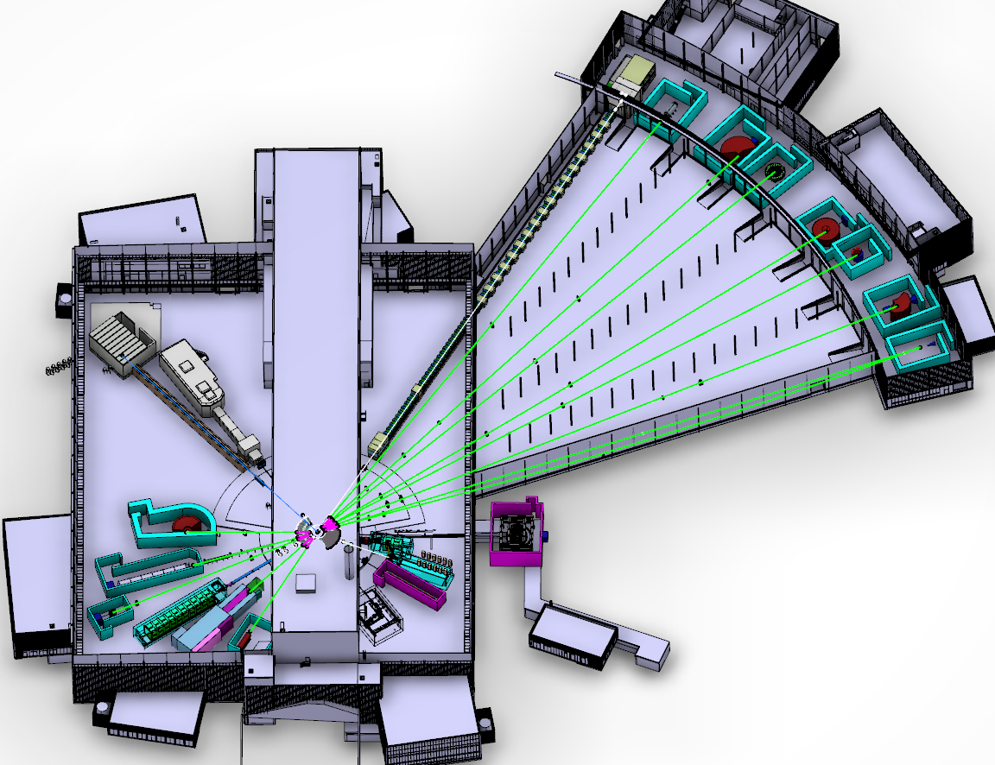
The ESS Neutron Instruments revised layout (June 2016)
Instruments 1-16; funded by NSS construction project
Instruments 17-22; funded by initial operations
NMX
BEER
C-SPEC
Three instruments have moved;
ESTIA; E1 -> E2 – for cleaner view of source
SKADI ; E8 -> E5 – for more space (= lower technical risk)
DREAM; S4 -> S3 – for more space
BIFROST
MIRACLES
MAGIC
T-REX
ODIN
DREAM
HEIMDAL
VOR
15 (+1) Neutron Instruments (2025)
LoKI
ODIN: Discussion on S1 or S2
VESPA
FREIA
HR-NSE
SKADI
ESTIA
Proton beam
50 m
100 m
150 m
Instrument Layout (June 2016)

Slide 7
Neutron Instruments; Phase 1 schedule;
2016-17 | May | Jun | Jul | Aug | Sep | Oct | Nov | Dec | Jan | Feb | Mar | Apr
LOKI
SKADI
ESTIA
FREIA
NMX
MAGIC
HEIMDAL
DREAM
BEER
ODIN
C-SPEC
BIFROST
MIRACLES
T-REX
VESPA
10/5
20
29
14-15/6
20
29
17
22-23/6
19
31
8
15
17/6
14
5
12-13/9
7
12
STAP
scope-setting
TG2
21
28
27
ICB
IKON11
ICB
SAC
COUNCIL

Slide 8
Potential order of commencement of operation of first 8 instruments (August 2023)
2nd Annual Review Recommendation (0.5)
Prioritisation of instruments within budget must ensure that the first tranche of instruments (8) is ready to deliver world-class science at the start of user operations (2023)
Matching early success in delivery of scientific outputs with the capacity of Lead In-Kind partners to deliver on schedule (ISIS, PSI, FZJ, LLB, HZG/NPI, TUM/PSI, TUM/LLB & DTU lead consortium).
Instrument Class | Sub-class | Candidates
Large Scale Structures | Small Angle Scattering | LOKI (ISIS) or SKADI (FZJ)
 | Reflectometry | ESTIA (PSI) or FREIA (ISIS)
Diffraction | Powder Diffraction | DREAM (FZJ) or HEIMDAL (ÅU)
 | Single crystal diffraction | MAGIC (LLB) or NMX (ESS)
Engineering | Strain scanning | BEER (HZG/NPI)
 | Imaging and tomography | ODIN (TUM/PSI)
Spectroscopy | Direct Geometry | C-SPEC (TUM) or T-REX (FZJ)
 | Indirect Geometry | BIFROST (DTU), MIRACLES (Bilbao), VESPA (CNR)
Instruments in Bold type to be operational by Aug 2023
DRAFT

Slide 9
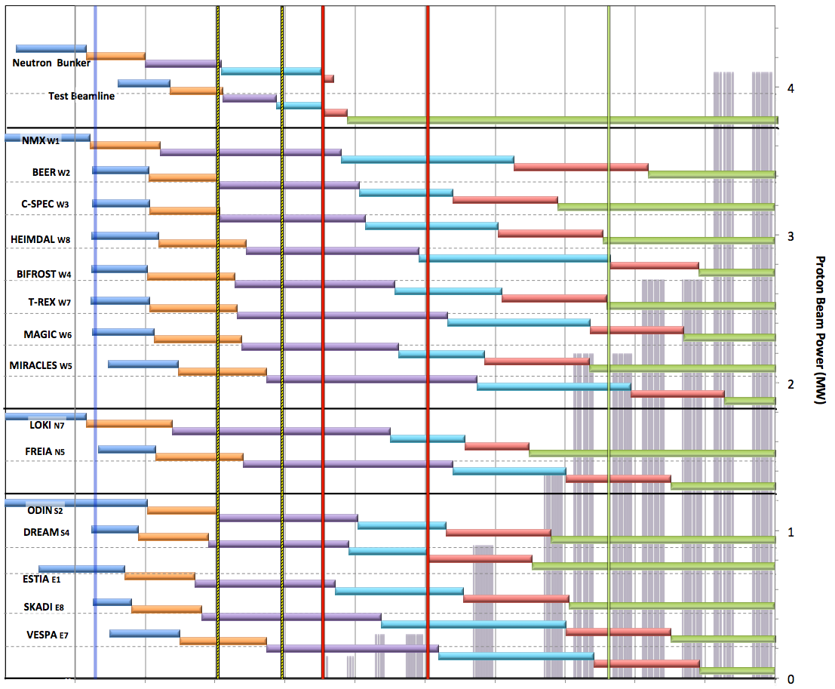
Neutron Beam Instrument Draft Schedule V1.6, 7th April 2016
Currently under review
Current date
Early Access D01/D03
Full Access D01/D03
Beam on Target / 1st spectrum
Start Hot Commission
User instruments
Start User Program
Commissioning of test beam – to demonstrate performance and inform instrument projects
Notes;
The order of completion 1- 8 chosen for science and deliverability
Shift 9-16 to focus on 1-8 for early science success
Hot Commissioning start;
E ≥ 200 MeV
P ≥ 200 kW
January 2021
DRAFT
West sector
North sector
Preliminary Design
Detailed Design
Manufacturing & Procurement
Installation & Integration
Hot Commissioning
Operation
East and South sectors
2016 2017 2018 2019 2020 2021 2022 2023 2024 2025

Slide 10
Scope-Setting Meeting
2 months before TG2 review
Small meeting
instrument team
NSS project management
partners and technical groups, as required
Instrument team presents scope and budget for 1-3 options
1: within cost category (9/12/15M€) minus 10% contingency
2: configuration 2 (optional)
3: configuration 3 (optional)
For each configuration, describe:
degree of achieving requirements and impact on science case
upgradability through staging plan
Outcome: determine scope & budget to be funded by NSS project
revisit after all scope-setting meetings

Slide 11
Objectives for this meeting
Agree on the scope for ODIN within the NSS budget (including essential Sample environment)
Agree on the cost book value for that scope
Agree on the key delivery dates.
Evaluate upgrade options; including paths, scope, strategy & timing

