Slide 1
ODIN: Configurations
ESS: S. Ansell, S. Pullen, M. Strobl
PSI: U. Filges E. Lehmann, M. Morgano
TUM: E. Calzada, M. Lerche, J. Neuhaus, W. Petry, B. Schillinger, M. Schulz

Slide 2
Outline
Description of Configuration 3, Full Scope, 15M€
  Design and Setup Summary
  Budget Details

Slide 3
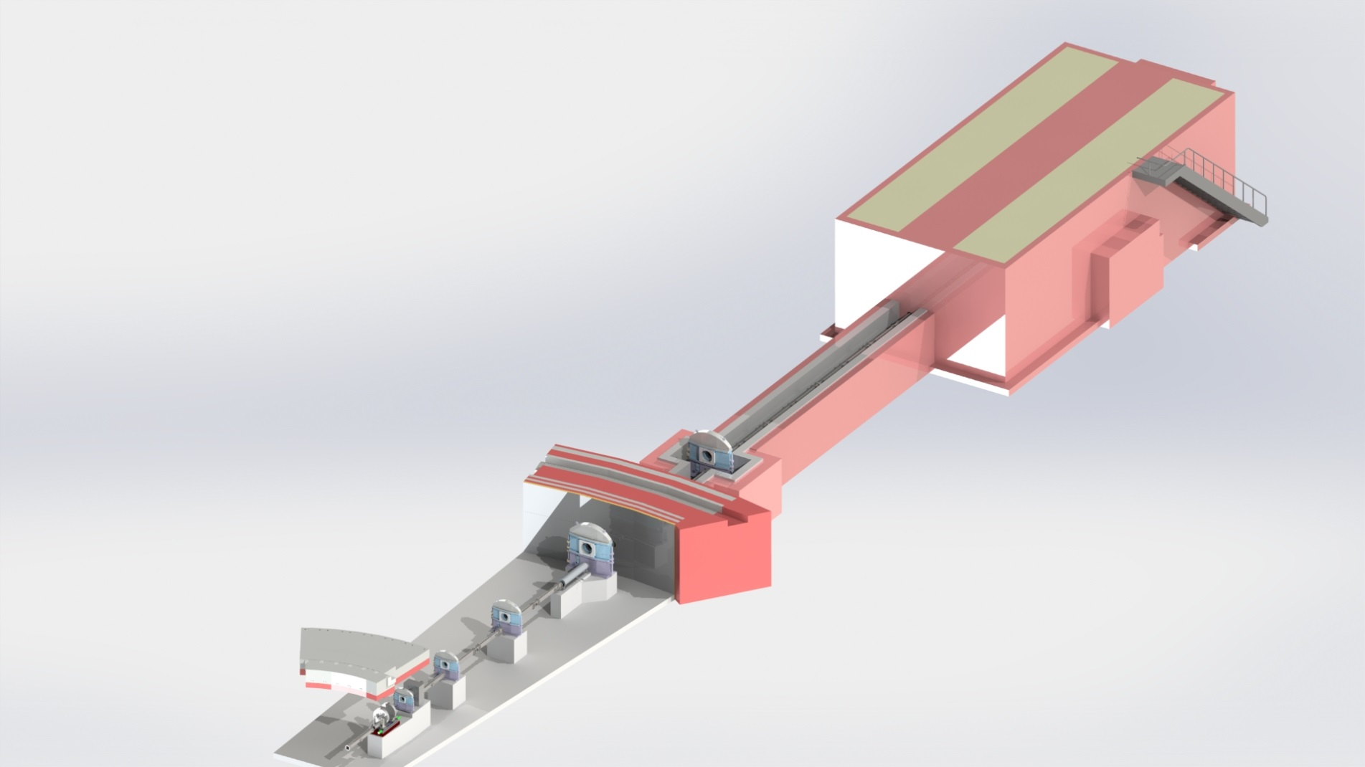
Schematic

Slide 4
Full Scope, 18.3 M€ cont’d
Grating interferometry (one set)
Polarizer – Analyzer setup
Spin Echo Modulated SANS setup
X-ray generator and x-ray radiography set up
Diffraction detector banks around ±90°
Specialized Sample Environment (beyond SE pool):
  Pressure cells
  Cryostats
  Magnets
All necessary associated infrastructure (shielding, cabling, cabins etc)

Slide 5
Budget, Full Scope, 18.3M€
 | Cost Overview |  | Labor in Person-Years
 | Non-Labor | Labor | 01 Management | 02 Design | 03 Procurem. Labor | 04 Installation | 05 Cold Commissioning | Total
00 Phase 1 | 0 € | 554,000 € | - | - | - | - | - | 4.5
02 Neutron Guide | 1,760,000 € | 414,000 € | 0.91 | 1.11 | 0.44 | 0.57 | 0.36 | 3.39
03 Heavy Shutter | 231,000 € | 194,000 € | 0.50 | 0.52 | 0.17 | 0.19 | 0.09 | 1.47
04 T0 Chopper | 191,000 € | 84,000 € | 0.15 | 0.12 | 0.09 | 0.06 | 0.03 | 0.45
05 Choppers | 2,220,000 € | 389,000 € | 1.09 | 1.02 | 0.45 | 0.26 | 0.21 | 3.03
06 Cave Interior | 858,000 € | 591,000 € | 1.02 | 0.91 | 0.83 | 0.81 | 0.71 | 4.27
07 Add ons | 4,502,000 € | 514,000 € | 0.91 | 0.87 | 0.81 | 0.51 | 0.57 | 3.66
08 Motion Contr. | 143,000 € | 287,000 € | 0.84 | 0.21 | 0.36 | 0.27 | 0.27 | 1.95
09 White beam detectors | 248,000 € | 134,000 € | 0.31 | 0.27 | 0.19 | 0.16 | 0.09 | 1.02
10 ToF Detectors | 770,000 € | 174,000 € | 0.23 | 0.32 | 0.37 | 0.22 | 0.11 | 1.25
11 Shielding | 2,964,000 € | 423,000 € | 1.21 | 1.28 | 0.43 | 0.25 | 0.19 | 3.36
12 Infrastructure | 80,000 € | 239,000 € | 1.17 | 0.20 | 0.19 | 0.15 | 0.15 | 1.86
13 Vacuum | 0 € | 147,000 € | 0.69 | 0.13 | 0.12 | 0.14 | 0.09 | 1.17
14 PSS | 118,000 € | 108,000 € | 0.56 | 0.07 | 0.12 | 0.07 | 0.07 | 0.89
Totals | 14,084,000 € | 4,216,000 € | 9.58 | 7.01 | 4.57 | 3.65 | 2.93 | 4.5+27.5
 | 18,300,000 €

Slide 6
Detailed Labor Budget, Cost
 | 01 Management | 02 Design | 03 Procurem. Labor | 04 Installation | 05 Cold Commissioning | Total
00 Phase 1 | - | - | - | - | - | 554,000 €
02 Neutron Transport | 133,000 € | 158,000 € | 36,000 € | 45,000 € | 42,000 € | 414,000 €
03 Heavy Shutter | 76,000 € | 77,000 € | 14,000 € | 15,000 € | 11,000 € | 194,000 €
04 T0 Chopper | 34,000 € | 26,000 € | 11,000 € | 7,000 € | 5,000 € | 84,000 €
05 Choppers | 166,000 € | 137,000 € | 39,000 € | 21,000 € | 26,000 € | 389,000 €
06 Cave Interior | 180,000 € | 167,000 € | 77,000 € | 72,000 € | 95,000 € | 591,000 €
07 Add on | 159,000 € | 148,000 € | 79,000 € | 48,000 € | 80,000 € | 514,000 €
08 Motion Control | 131,000 € | 32,000 € | 31,000 € | 23,000 € | 34,000 € | 250,000 €
09 White beam detectors | 49,000 € | 41,000 € | 19,000 € | 13,000 € | 11,000 € | 134,000 €
10 ToF Detectors | 42,000 € | 57,000 € | 38,000 € | 21,000 € | 16,000 € | 174,000 €
11 Shielding | 171,000 € | 177,000 € | 34,000 € | 19,000 € | 22,000 € | 423,000 €
12 Infrastructure | 167,000 € | 28,000 € | 15,000 € | 11,000 € | 17,000 € | 239,000 €
13 Vacuum | 99,000 € | 18,000 € | 10,000 € | 11,000 € | 10,000 € | 147,000 €
14 PSS | 77,000 € | 9,000 € | 9,000 € | 5,000 € | 8,000 € | 108,000 €
Total | 1,501,000 € | 1,082,000 € | 418,000 € | 316,000 € | 381,000 € | 3,662,000 €
Total incl. Phase 1 |  |  |  |  |  | 4,216,000 €

Slide 7
Budget Details
Neutron guide, Heavy Shutter, T0 and chopper system
  As option 2
Cave Interior (PSI)
  Additional items included in cave interior:
Add on (ESS)
  In addition to option 2, two diffraction detector banks are added, cost of 3,000k€ is estimated from other instruments. 200k€ are planned for an x-ray tomography setup. A grating interferometer setup is estimated at 180k€, a polarizer analyzer setup at 150k€ and a SEMSANS setup for 400k€ as well as an SAXS/WAXS detector system at 200k€ adding a total of about 4,500k€ incl. uncertainty.

Slide 8
Budget Details
Motion control (TUM)
  Some additional axes (about 8) were added to option 2 increasing the total cost by 11k€.
Time of flight detectors (ESS)
  Two ToF detectors are planned for option 3, the additional detector will be a large FOV detector with 256Mpixel adding 500k€.
Shielding, Infrastructure, Vacuum and PSS
  Basically as option 2 with small additions to Infrastructure.

Slide 9
Summary and Conclusions I
Focussing, de-focussing, focussing neutron guide with m2-5 coatings
Collimator position at 50 m
Sample position from 52 m to 64 m
L/D values (Collimation) between 100-10000
Complete wavelength frame multiplication chopper system
  T₀ chopper,
  Set of moveable Wavelength Frame Multiplication Choppers,
  Bandpass Chopper,
  Set of five Frame Overlap Choppers
Medium and high resolution scintillator based detector set ups
Time Of Flight detectors
All necessary associated infrastructure

Slide 10
Summary and Conclusions II
“STAP has serious concerns that the recent ESS cost category assignment is inadequate to develop ODIN to its full potential and the funding issue needs to be addressed urgently before the phase 2 process begins”
“strong budget commitment and technical plans for implementing these capabilities should not be an afterthought”
“STAP is of unanimous opinion that the current cost category A is inadequate to construct ODIN to fully utilize and take advantage of ESS beam and geometry, incorporate modes of operation that are unique to ESS and world’s best, and provide unique and new classes of research and service opportunities that will be not available elsewhere.”
“The current cost category A budget will likely handicap ODIN from the beginning”

Slide 11
Summary and Conclusions III
“The new budget (about 12 million Euros) is a compromise that mitigates some of the concerns that STAP has. However, STAP still strongly recommends that ESS re-reviews the current allocation to enable ODIN to be developed as world’s best instrument as originally envisioned.”
“STAP again in the strongest possible term recommends that the budget of ODIN is re-assessed before the upcoming tollgate review and to a minimum, awarded a Cost Category B status.”

Slide 12
THANK YOU!

