Slide 1
ODIN: Draft Timeline
M. Lerche

Slide 2
Draft Timeline
Design Phase 2/2017-3/2018
Procurement and Assembly 1/2018-6/2020
Installation 1/2020-2/2021
Cold commissioning 1/2021-9/2021
Hot commissioning 9/2021-11/2022
Mar. 2017
Dec. 2017
Sep. 2018
May 2019
Feb. 2020
Nov. 2020
Jul. 2021
Apr. 2022
Design Phase Feb. 2017 – Mar. 2018
Procurement and Assembly Jan. 2018 - Jun. 2020
Installation Jan. 2020- Feb. 2021
Cold Comm. Jan.‘21 – Sep.‘21
Hot Commisioning Sep. 2021- Nov. 2022

Slide 3
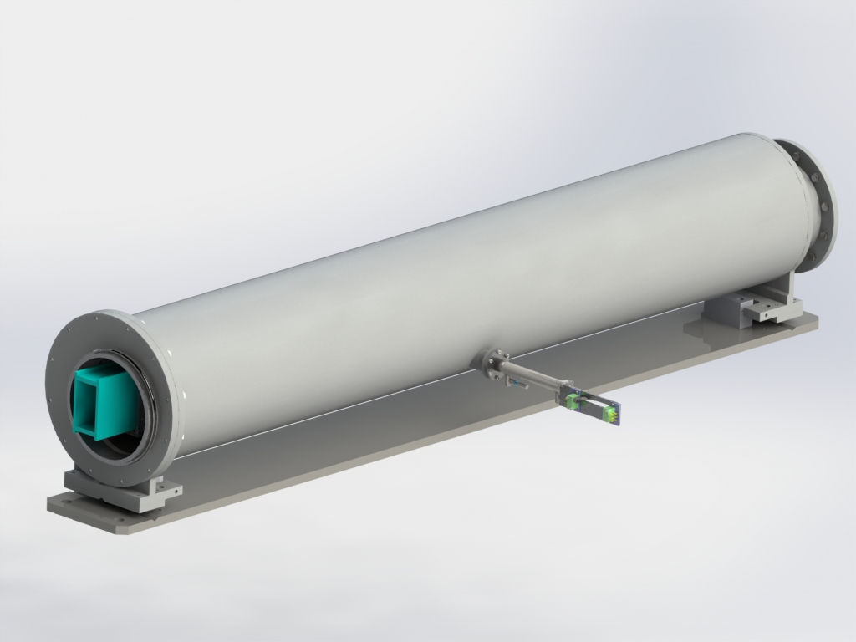
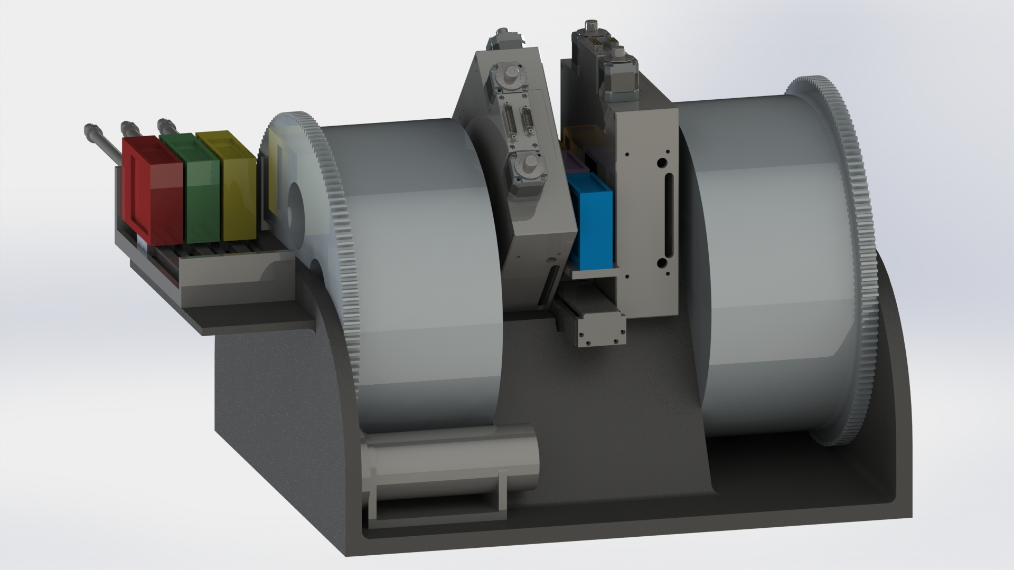
Draft Timeline - Design
Design Phase 2/2017-3/2018
Full McStas simulation of chopper system and Guide
Potential chopper opening re-design and diameter increase
Bunker pillar conflicts
Complete Shielding calculation and design
Cave
Heavy shutter
Collimator
E. Calzada
Mar. 2017
Dec. 2017
Sep. 2018
May 2019
Feb. 2020
Nov. 2020
Jul. 2021
Apr. 2022
Design Phase Feb. 2017 – Mar. 2018
Procurement and Assembly Jan. 2018 - Jun. 2020
Installation Jan. 2020- Feb. 2021
Cold Comm. Jan.‘21 – Sep.‘21
Hot Commisioning Sep. 2021- Nov. 2022

Slide 4
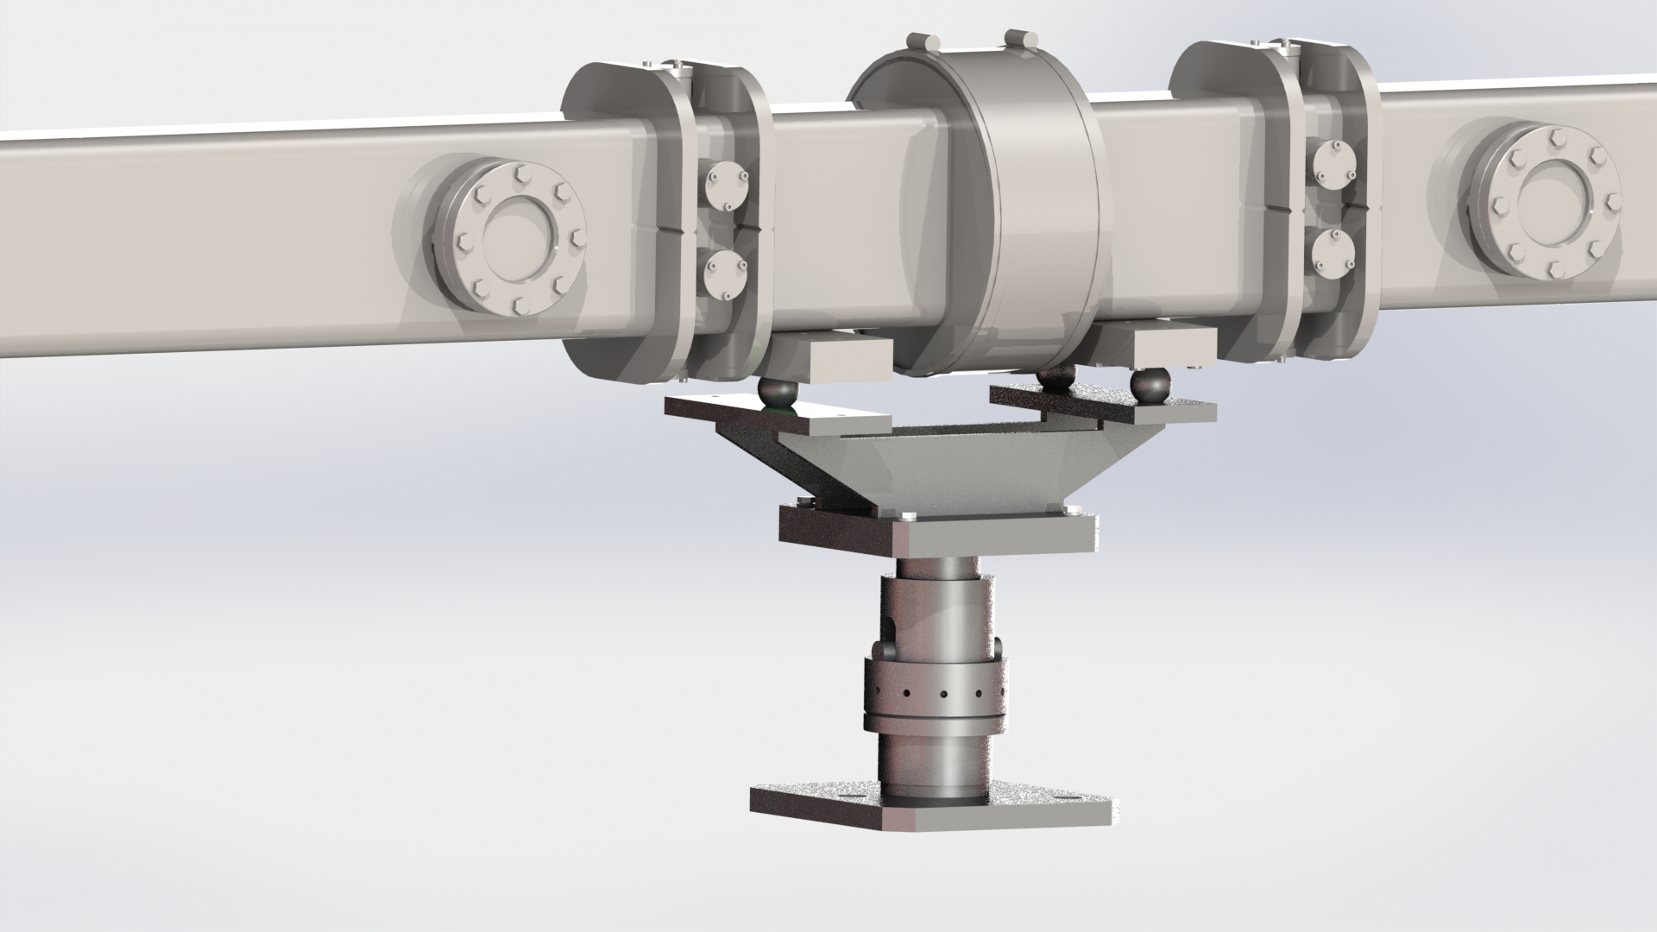
Draft Timeline
Design Phase 2/2017-3/2018
Guide enclosure
Detectors
Motion Control
Infrastructure
etc…
E. Calzada
Mar. 2017
Dec. 2017
Sep. 2018
May 2019
Feb. 2020
Nov. 2020
Jul. 2021
Apr. 2022
Design Phase Feb. 2017 – Mar. 2018
Procurement and Assembly Jan. 2018 - Jun. 2020
Installation Jan. 2020- Feb. 2021
Cold Comm. Jan.‘21 – Sep.‘21
Hot Commisioning Sep. 2021- Nov. 2022

Slide 5
Draft Timeline - Procurement
Procurement and Assembly 1/2018-6/2020
“Big ticket” items
Choppers
Neutron Guide
Shielding
Detectors
Motion Control, etc…
Mar. 2017
Dec. 2017
Sep. 2018
May 2019
Feb. 2020
Nov. 2020
Jul. 2021
Apr. 2022
Design Phase Feb. 2017 – Mar. 2018
Procurement and Assembly Jan. 2018 - Jun. 2020
Installation Jan. 2020- Feb. 2021
Cold Comm. Jan.‘21 – Sep.‘21
Hot Commisioning Sep. 2021- Nov. 2022

Slide 6
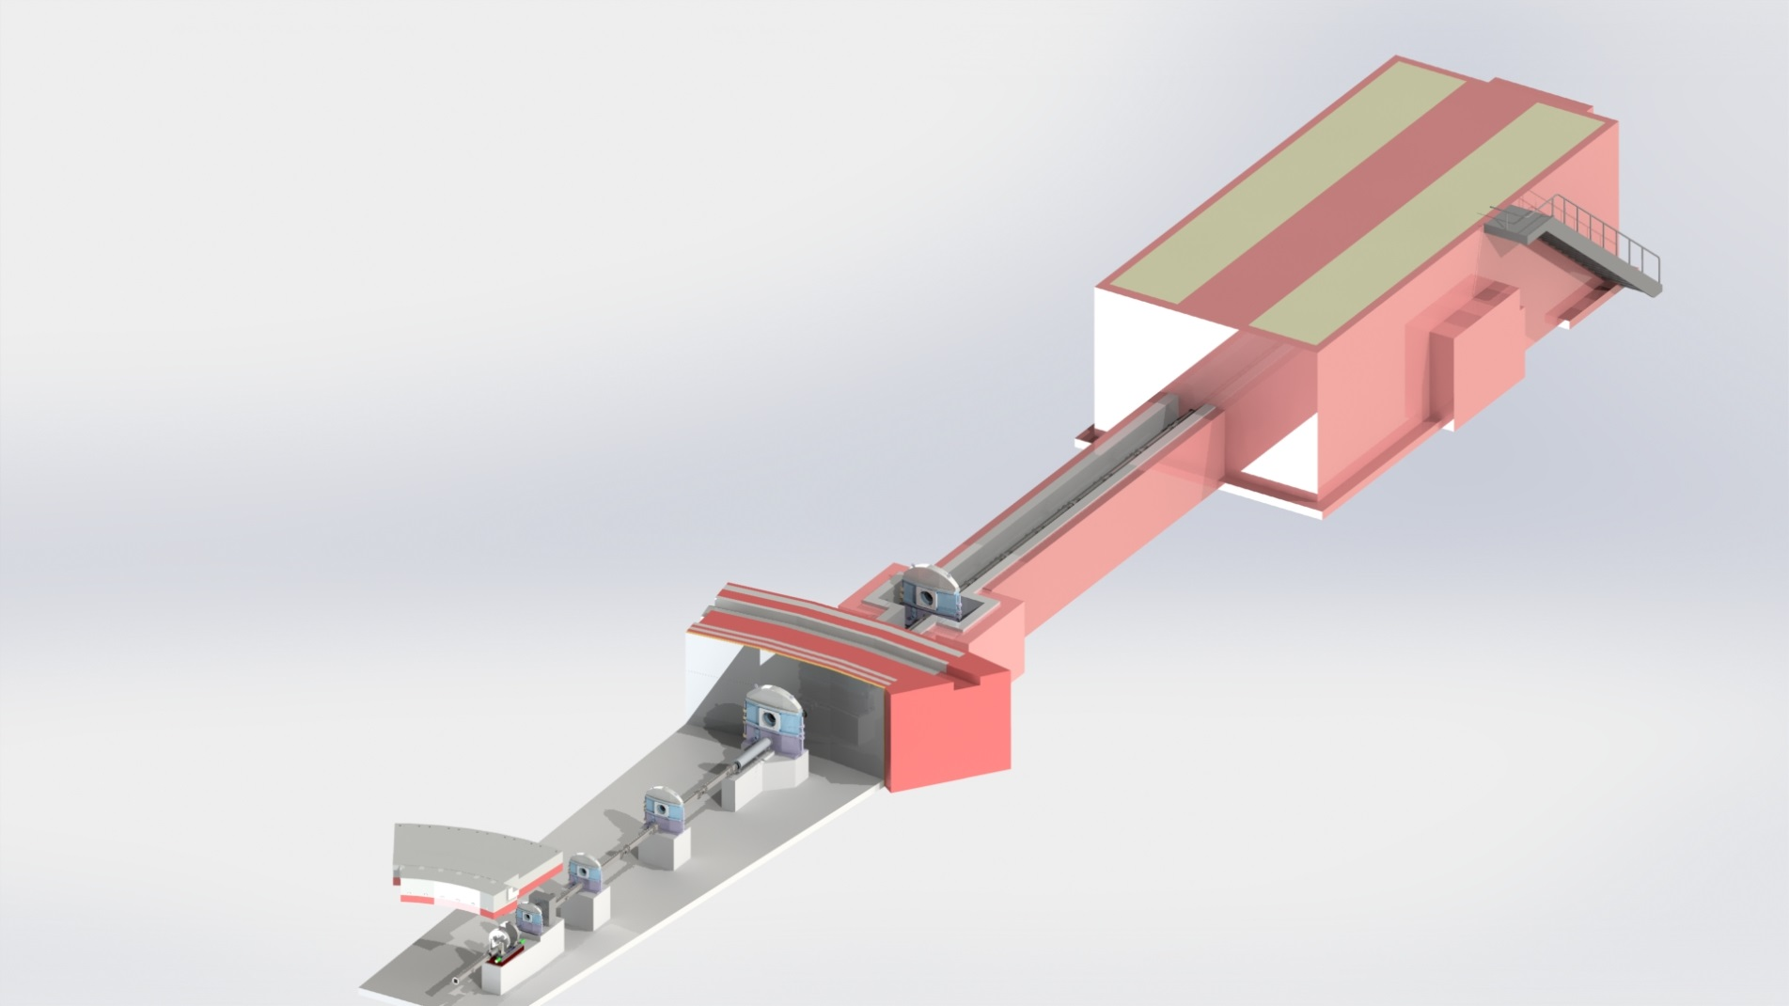
Draft Timeline - Installation
Installation 1/2020-2/2021
Foundations for choppers
and guide
Shielding
…
Details
Mar. 2017
Dec. 2017
Sep. 2018
May 2019
Feb. 2020
Nov. 2020
Jul. 2021
Apr. 2022
Design Phase Feb. 2017 – Mar. 2018
Procurement and Assembly Jan. 2018 - Jun. 2020
Installation Jan. 2020- Feb. 2021
Cold Comm. Jan.‘21 – Sep.‘21
Hot Commisioning Sep. 2021- Nov. 2022

Slide 7
Draft Timeline – Cold Commissioning
Cold commissioning 1/2021-9/2021
Mar. 2017
Dec. 2017
Sep. 2018
May 2019
Feb. 2020
Nov. 2020
Jul. 2021
Apr. 2022
Design Phase Feb. 2017 – Mar. 2018
Procurement and Assembly Jan. 2018 - Jun. 2020
Installation Jan. 2020- Feb. 2021
Cold Comm. Jan.‘21 – Sep.‘21
Hot Commisioning Sep. 2021- Nov. 2022

Slide 8
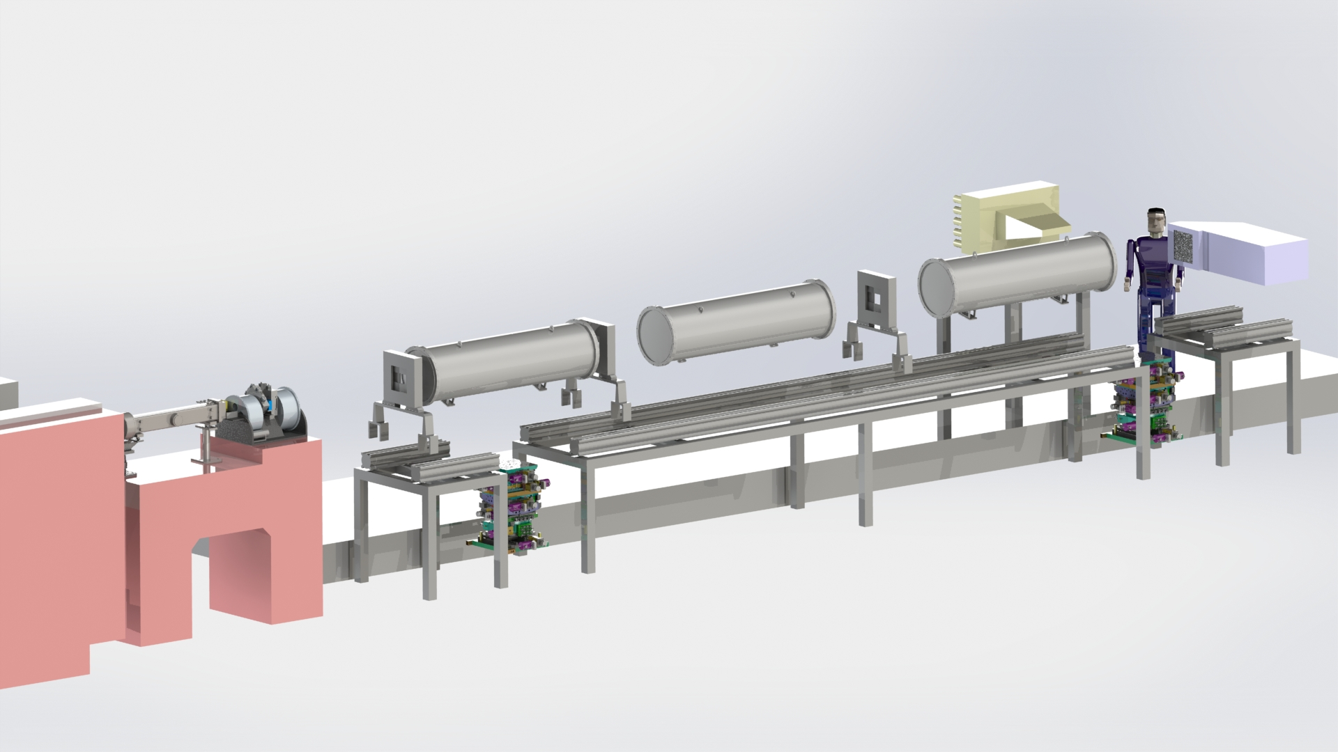
Draft Timeline – Hot Commissioning
Hot commissioning 9/2021-11/2022
Mar. 2017
Dec. 2017
Sep. 2018
May 2019
Feb. 2020
Nov. 2020
Jul. 2021
Apr. 2022
Design Phase Feb. 2017 – Mar. 2018
Procurement and Assembly Jan. 2018 - Jun. 2020
Installation Jan. 2020- Feb. 2021
Cold Comm. Jan.‘21 – Sep.‘21
Hot Commisioning Sep. 2021- Nov. 2022

