Slide 1
ODIN: Configurations
ESS: S. Ansell, S. Pullen, M. Strobl
PSI: U. Filges E. Lehmann, M. Morgano
TUM: E. Calzada, M. Lerche, J. Neuhaus, W. Petry, B. Schillinger, M. Schulz

Slide 2
Outline
Description of Configuration 2, Competitive Option as proposed, 12.5M€
Design and Setup Summary
Budget Details

Slide 3
Competitive Scope, 12.5 M€
Focussing, de-focussing, focussing neutron guide with m2-5 coatings
Collimator position at 50 m
Sample position from 52 m to 64 m
L/D values (Collimation) between 100-10000
Complete wavelength frame multiplication chopper system
T₀ chopper,
Set of moveable Wavelength Frame Multiplication Choppers,
Set of five Frame Overlap Choppers, Bandpass Chopper
Medium and high resolution scintillator based detector set ups
Time Of Flight detector
All necessary associated infrastructure

Slide 4
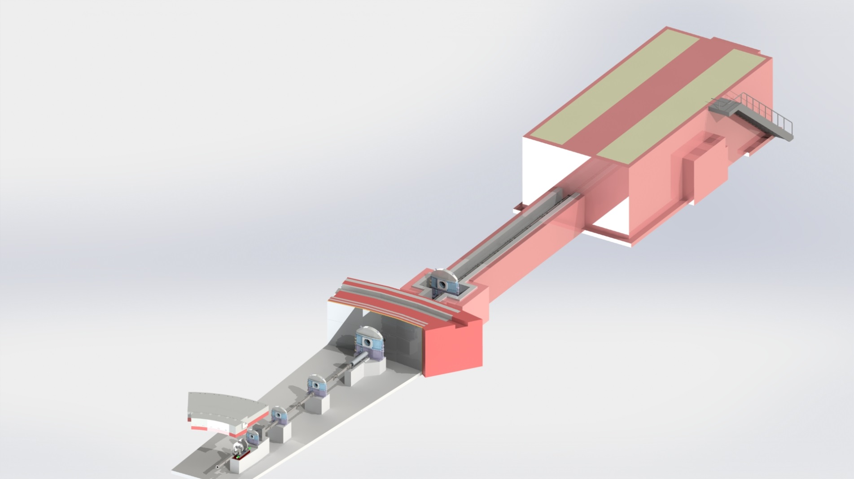
Schematic

Slide 5
Budget, Competitive Option, 12.5M€
 | Cost Overview |  | Labor in Person-Years
 | Non-Labor | Labor | 01 Management | 02 Design | 03 Procurem. Labor | 04 Installation | 05 Cold Commissioning | Total
00 Phase 1 | 0 € | 554,000 € | - | - | - | - | - | 4.5
02 Neutron Guide | 1,760,000 € | 414,000 € | 0.91 | 1.11 | 0.44 | 0.57 | 0.36 | 3.39
03 Heavy Shutter | 231,000 € | 194,000 € | 0.50 | 0.52 | 0.17 | 0.19 | 0.09 | 1.47
04 T0 Chopper | 191,000 € | 84,000 € | 0.15 | 0.12 | 0.09 | 0.06 | 0.03 | 0.45
05 Choppers | 2,220,000 € | 389,000 € | 1.09 | 1.02 | 0.45 | 0.26 | 0.21 | 3.03
06 Cave Interior | 745,000 € | 544,000 € | 1.02 | 0.97 | 0.70 | 0.50 | 0.57 | 3.76
07 Add ons | 0 € | 0 € | 0 | 0 | 0 | 0 | 0 | 0.00
08 Motion Contr. | 132,000 € | 247,000 € | 0.84 | 0.21 | 0.36 | 0.27 | 0.26 | 1.94
09 White beam detectors | 248,000 € | 134,000 € | 0.31 | 0.27 | 0.19 | 0.16 | 0.09 | 1.02
10 ToF Detectors | 220,000 € | 306,000 € | 0.22 | 0.32 | 0.35 | 0.20 | 0.09 | 1.18
11 Shielding | 2,964,000 € | 423,000 € | 1.21 | 1.28 | 0.43 | 0.25 | 0.19 | 3.36
12 Infrastructure | 75,000 € | 208,000 € | 1.08 | 0.19 | 0.19 | 0.15 | 0.15 | 1.76
13 Vacuum | 0 € | 146,000 € | 0.69 | 0.12 | 0.12 | 0.14 | 0.09 | 1.16
14 PSS | 118,000 € | 108,000 € | 0.56 | 0.07 | 0.12 | 0.07 | 0.07 | 0.89
Totals | 8,903,000 € | 3,590,000 € | 8.58 | 6.20 | 3.61 | 2.82 | 2.20 | 4.5+23.5
 | 12,493,000 €

Slide 6
Detailed Labor Budget, Cost
 | 01 Management | 02 Design | 03 Procurem. Labor | 04 Installation | 05 Cold Commissioning | Total
00 Phase 1 | - | - | - | - | - | 554,000 €
02 Neutron Transport | 133,000 € | 158,000 € | 36,000 € | 45,000 € | 42,000 € | 414,000 €
03 Heavy Shutter | 76,000 € | 77,000 € | 14,000 € | 15,000 € | 11,000 € | 194,000 €
04 T0 Chopper | 34,000 € | 26,000 € | 11,000 € | 7,000 € | 5,000 € | 84,000 €
05 Choppers | 166,000 € | 137,000 € | 39,000 € | 21,000 € | 26,000 € | 389,000 €
06 Cave Interior | 180,000 € | 167,000 € | 69,000 € | 47,000 € | 80,000 € | 544,000 €
07 Add on | 0 € | 0 € | 0 € | 0 € | 0 € | 0 €
08 Motion Control | 130,000 € | 32,000 € | 31,000 € | 22,000 € | 32,000 € | 247,000 €
09 White beam detectors | 49,000 € | 41,000 € | 19,000 € | 13,000 € | 11,000 € | 134,000 €
10 ToF Detectors | 35,000 € | 50,000 € | 31,000 € | 17,000 € | 12,000 € | 145,000 €
11 Shielding | 171,000 € | 177,000 € | 34,000 € | 19,000 € | 22,000 € | 423,000 €
12 Infrastructure | 143,000 € | 25,000 € | 14,000 € | 11,000 € | 16,000 € | 208,000 €
13 Vacuum | 99,000 € | 17,000 € | 10,000 € | 11,000 € | 10,000 € | 146,000 €
14 PSS | 77,000 € | 9,000 € | 9,000 € | 5,000 € | 8,000 € | 108,000 €
Total | 1,291,000 € | 916,000 € | 318,000 € | 235,000 € | 275,000 € | 3,036,000 €
Total incl. Phase 1 |  |  |  |  |  | 3,590,000 €

Slide 7
Budget Details
Neutron guide, Heavy Shutter,
As option 1
T0 and chopper system (TUM)
The costs are based on a budgetary quote from a manufacturer and cross-checked using ESS-0060400; Including VAT and budget uncertainty the numbers are consistent.
Cave Interior (PSI)
Additional items included are: Additional Infrastructure and potential motors
Add on (ESS)
An additional simple large FoV detector system is included in this option, cost based on experience and adding 50k€ to option 1.

Slide 8
Budget Details
Motion control (TUM)
Some additional axes for total of 77+ axes were added to option 1 increasing the cost by 10k€.
Time of flight detectors (ESS)
One ToF detectors is planned for option 2, the detector is based on an existing design which currently costs about 200k€.
Shielding, Infrastructure, Vacuum and PSS
Basically as option 1 with small additions to Infrastructure.

Slide 9
Scope within Cost Category, 9 M€
Focussing, de-focussing, focussing neutron guide with m2-5 coatings
Collimator position at 50 m
Sample position from 52 m to 64 m
L/D values (Collimation) between 100-10000
Medium and high resolution scintillator based detector set ups
All necessary associated infrastructure

Slide 10
Competitive Scope, 12.5 M€
Focussing, de-focussing, focussing neutron guide with m2-5 coatings
Collimator position at 50 m
Sample position from 52 m to 64 m
L/D values (Collimation) between 100-10000
Complete wavelength frame multiplication chopper system
T₀ chopper,
Set of moveable Wavelength Frame Multiplication Choppers,
Set of five Frame Overlap Choppers, Bandpass Chopper
Medium and high resolution scintillator based detector set ups, large FOV detector
Time Of Flight detector
All necessary associated infrastructure

Slide 11
Summary and Conclusions II
“STAP has serious concerns that the recent ESS cost category assignment is inadequate to develop ODIN to its full potential and the funding issue needs to be addressed urgently before the phase 2 process begins”
“strong budget commitment and technical plans for implementing these capabilities should not be an afterthought”
“STAP is of unanimous opinion that the current cost category A is inadequate to construct ODIN to fully utilize and take advantage of ESS beam and geometry, incorporate modes of operation that are unique to ESS and world’s best, and provide unique and new classes of research and service opportunities that will be not available elsewhere.”
“The current cost category A budget will likely handicap ODIN from the beginning”

Slide 12
Summary and Conclusions III
“The new budget (about 12 million Euros) is a compromise that mitigates some of the concerns that STAP has. However, STAP still strongly recommends that ESS re-reviews the current allocation to enable ODIN to be developed as world’s best instrument as originally envisioned.”
“STAP again in the strongest possible term recommends that the budget of ODIN is re-assessed before the upcoming tollgate review and to a minimum, awarded a Cost Category B status.”

Slide 13
THANK YOU!

