Slide 1
Beam on target 01/20
2017
2018
2019
2020
2021
2022
2023
Phase 1
Prelim. design
Phase 2
Detailed design
Phase 3
Procurement and start of installation
Phase 4
Cold commissioning
Phase 5
Hot commissioning
Phase 6
Operations
Decommissioning
02/17
01/19
04/20
04/21
01/23
2065
TG2
TG3
TG4
TG5
Proposal and planning
Design and construction
Installation and commissioning
Notes:
Timeline derived from the Work Breakdown Structure (WBS) of CSPEC

Slide 2
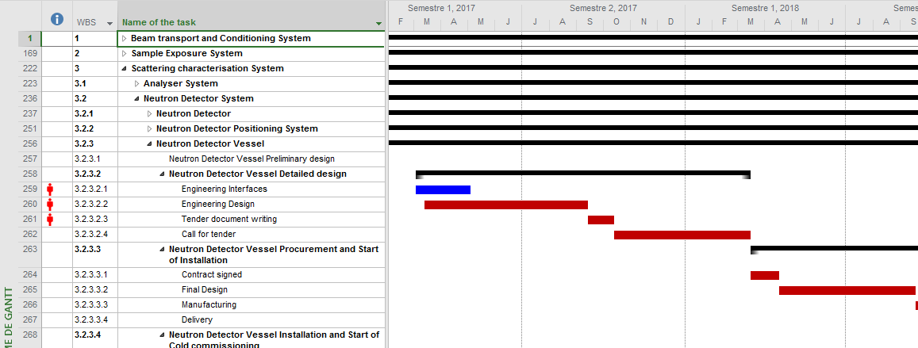
Tasks of the project
Tasks in the critical path
Notes:
Design of the detector tank must be frozen at the end of Q3 2017 (CRITICAL PATH). Latest delivery acceptable for the detector : mid 2020.

Slide 3
Critical path
03/2017 => Decision on the detector technology
09/2017 => Engineering design and interfaces of the Detector Vessel
09/2018 => Final design of the DV by the company
05/2020 => Delivery of the DV at the ESS by the company
04/2021 => Commissioning of the DV and the detectors
Components with float time :
=> Choppers
Latest day for the end of the engineering design => 11/2017
Latest day for the contract signed => 06/2018
=> Guide
Latest day for the end of the engineering design => 03/2018
Latest day for the contract signed => 10/2018
=> Detector
Latest day for the end of the engineering design => 09/2017
Latest day for the contract signed => 10/2018
Notes:
Those are dates where it should be finished
Design of the optics and design of the choppers must be frozen at the latest, at the end of Q4 2017.

Slide 4
Option 1 with B10 : 15 M€
Without 19% VAT from the TUM
 | 01 Management | 02 Design | 03 Procurement & Start of Installation | 04 Installation and Start of Cold Commissioning | Total
01 Shielding | 0 | 0 | 1,129 | 0 | 1,129
02 Neutron Optics | 0 | 0 | 3,097 | 99 | 3,196
03 Choppers | 0 | 0 | 1,320 | 0 | 1,320
04 Sample Environment | 0 | 0 | 375 | 0 | 375
05 Detector (B10) | 0 | 300 | 3,367 | 0 | 3,667
05.1 Detector set (13m²) | 0 | 0 | 2,041 | 0 | 2,041
05.2 Detector Tank and Beam Monitors | 0 | 300 | 1,326 | 0 | 1,626
06 Data Acquisition and Analysis | 0 | 0 | 0 | 0 | 0
07 Motion Control and Automation | 0 | 48 | 33 | 19 | 101
08 Instrument Team | 484 | 1,134 | 628 | 499 | 2,745
09 Instrument Infrastructure (Cave and Shielding) | 0 | 0 | 867 | 0 | 867
10 Vacuum | 0 | 0 | 0 | 0 | 0
11 PSS | 0 | 33 | 33 | 33 | 100
12 Contingency | 0 | 0 | 0 | 0 | 1,500
Total | 484 | 1,816 | 10,850 | 651 | 15,000
Labour included in 08 (Person-Years) | 3.47 | 8.50 | 4.92 | 3.58 | 20.47
All prices are in k€

Slide 6
Notes:
First quarter of 2021 counted in phase 4. Additional 100 to the budget.

Slide 7
Shielding group recommendation
Shielding of the guide
From 30m to 40m => 40cm of steel or steel equivalent and 30 cm of concrete
From 40m to the end of the guide => 40cm of steel or steel equivalent
Shielding of the detector tank
30cm of steel or steel equivalent
Guide & Detector 5 cm Steel all round
Guide: 120 cm light concrete
Guide 30 m - 40 m: additional 30 cm light concrete
Detector tank: 85 cm light concrete.
Beam stop included in the cost of detector tank shielding
Manpower = 5 months
Resulting cost for the shielding of the guide
1.1M€ (included in 01 Shielding)
Resulting cost for the shielding of the detector tank
0.5M€ (included in 09 Instrument Infrastructure)
Notes:
We used 5cm of steel and the resulting in light concrete

Slide 8
Guide system
Quote given by Swiss Neutronics
Guide : 2,45M€*
Guide housing : 0,6M€*
Installation : 0,1M€*
Included in 02 Neutron Optics
*Assuming a relation Swiss Franc/Euro of 0.9

Slide 9
Choppers system
Quote given by Airbus
BW choppers with metal disc and B4C or Gd2O3 coating, 700 mm diameter, 14 Hz, Hybrid Ball bearings | 125 k€/each | (one chopper in one housing)
1* Triple chopper with CFRP disc, B10 coating, 600 mm diameter, 350 Hz, magnetic bearings | 650 k€ | (three choppers in one housing)
1* Double chopper with CFRP disc, B10 coating, 600 mm diameter, 350 Hz magnetic bearing | 420 k€ | (two choppers in one housing)
Resulting cost for the choppers system : 1.32M€ (included in 03 Choppers)
The prices above are calculated as three chopper systems (BW, PS, Mono).
Each system will have one control and one monitoring system.
The prices are also including the onsite commissioning at ESS in Lund.
Notes:
The prices are based on the efforts for paperwork and documentation of already delivered systems in the past.

Slide 10
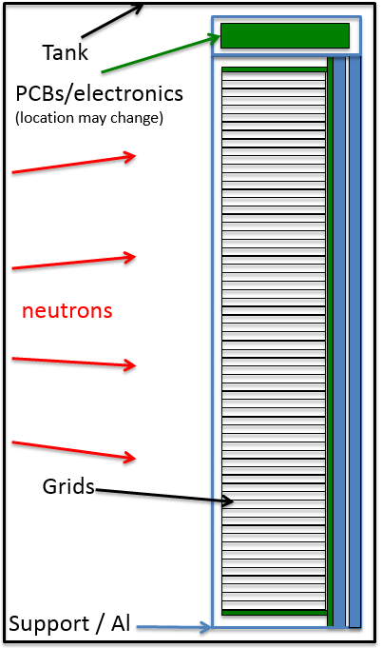
B10 Detectors
Estimate given by the Detector group
Components included:
Detector modules,
Front end electronics (FEE),
back end electronics (BEE),
power supplies (HV+LV),
Support mechanics
Services (gas, coolant)
Not included:
Detector vessel / box,
External shielding
Integration with tank
Included in column mechanics:
Wire PCBs
Grid PCBs
Backbones
Insulators
Internal shielding
Work:
Assembly of grids
Assembly of stacks
Wiring
Assembly of detector
Installation
Testing
Cold Commissioning

Slide 11
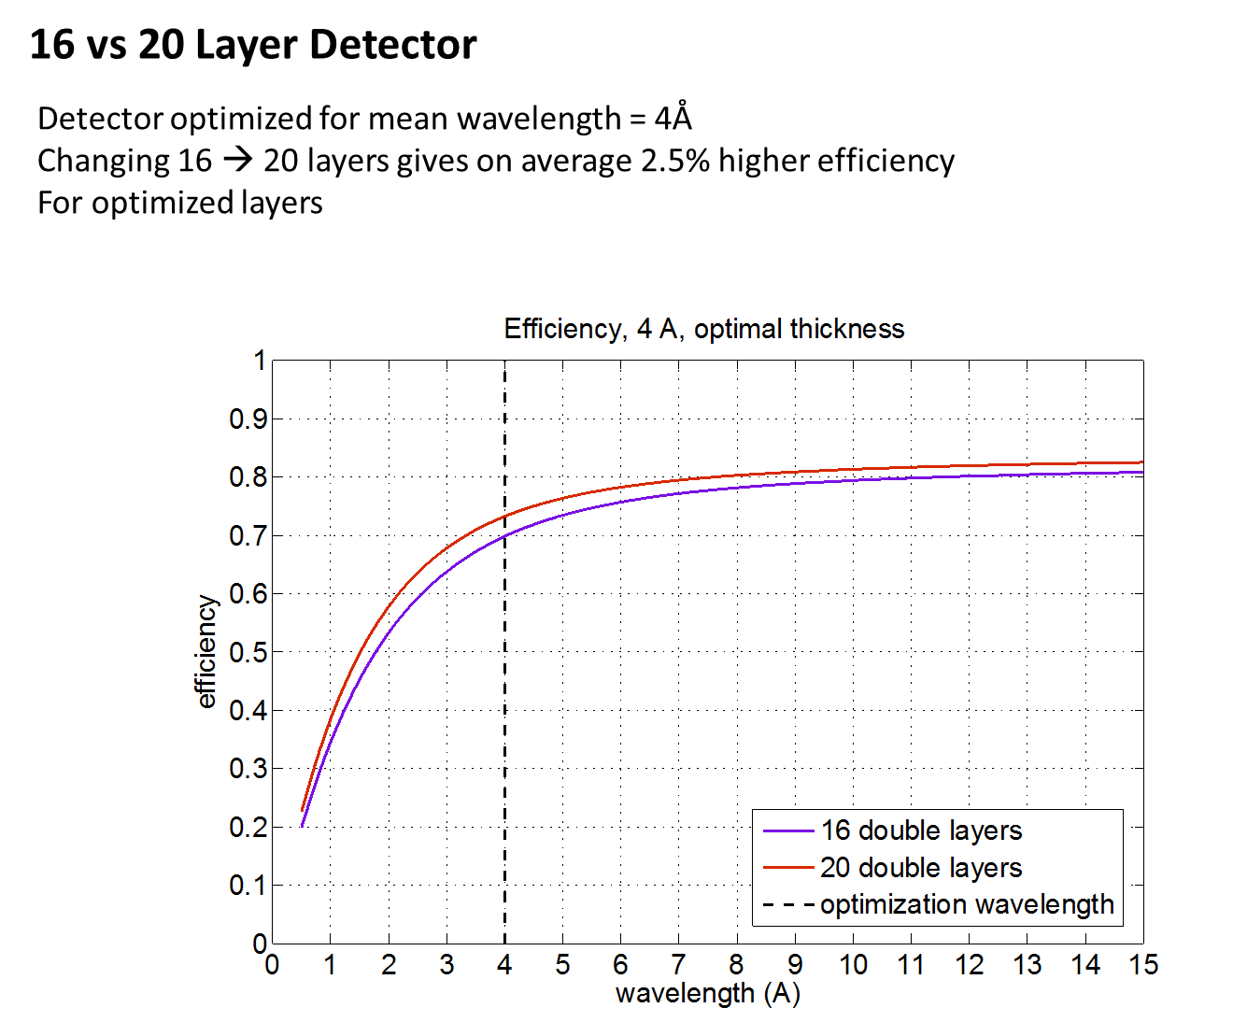

Slide 12
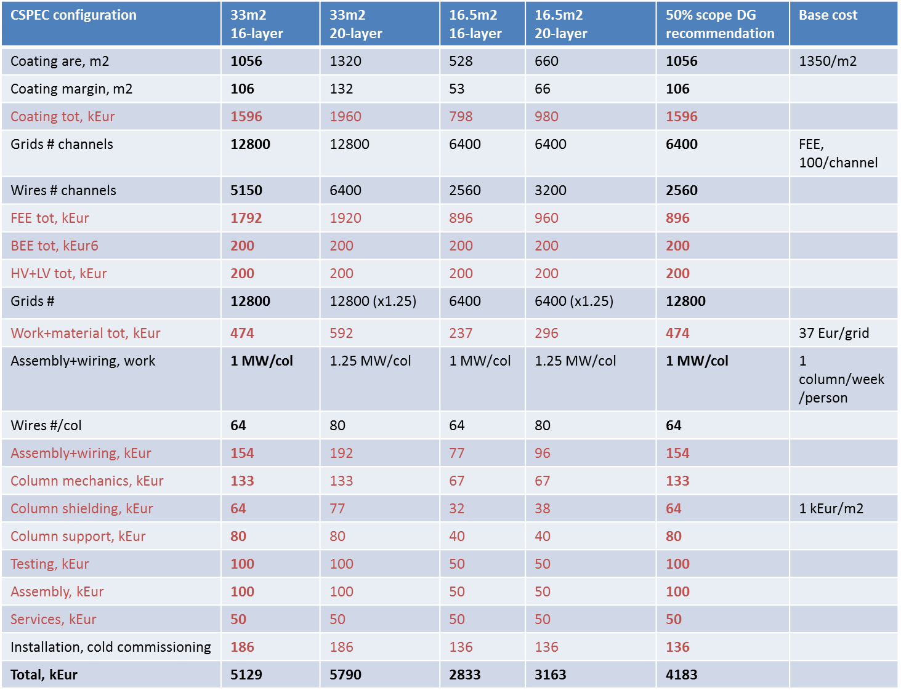
Notes:
15m² detector, 15m² electronics

Slide 13
Increase the efficiency of 2.5% increase the cost of 10%
CSPEC configuration | 33m2 16-layer |  | 16.5m2 16-layer |  | 50% scope DG recommendation
Total, kEur | 5129 |  | 2833 |  | 4183

Slide 14
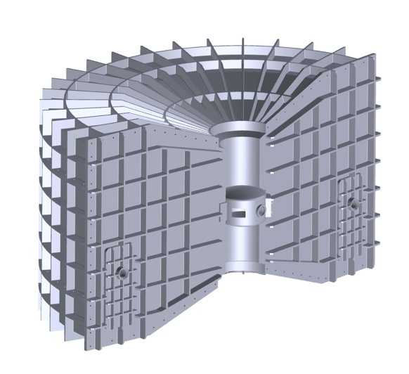
Detector tank
Tank:
Sample - Detector = 3.5 m, 4 m height
angular range 5 - 140º (image pre-stap)
Non-magnetic
Pressure = 10⁻⁶
Implementation of detector array
Cost:1626 k€ (included in 05.2 Detector tank and beam monitors)
Includes radial collimator.
Cadmium sheets.
Manpower.
Design department of LLB (collaboration with SDMS Fa#& PA20 @ LLB.)

Slide 15
Option 2 with B10 : 17.38 M€
Without 19% VAT from the TUM
 | 01 Management | 02 Design | 03 Procurement & Start of Installation | 04 Installation and Start of Cold Commissioning | Total
01 Shielding | 0 | 0 | 1,129 | 0 | 1,129
02 Neutron Optics | 0 | 0 | 3,097 | 99 | 3,196
03 Choppers | 0 | 0 | 1,320 | 0 | 1,320
04 Sample Environment | 0 | 0 | 375 | 0 | 375
05 Detector (B10) | 0 | 300 | 5,509 | 0 | 5,809
05.1 Detector set (33m²) | 0 | 0 | 4,183 | 0 | 4,183
05.2 Detector Tank and Beam Monitors | 0 | 300 | 1,326 | 0 | 1,626
06 Data Acquisition and Analysis | 0 | 0 | 0 | 0 | 0
07 Motion Control and Automation | 0 | 48 | 33 | 19 | 101
08 Instrument Team | 484 | 1,134 | 628 | 499 | 2,745
09 Instrument Infrastructure (Cave and Shielding) | 0 | 0 | 867 | 0 | 867
10 Vacuum | 0 | 0 | 0 | 0 | 0
11 PSS | 0 | 33 | 33 | 33 | 100
12 Contingency | 0 | 0 | 0 | 0 | 1,738
Total | 484 | 1,816 | 12,991 | 651 | 17,380
Labour included in 08 (Person-Years) | 3.47 | 8.50 | 4.92 | 3.58 | 20.47
Upgrade cost to full detector : 1M€
Best path to full scope and satisfy the user community n.b. LET
Notes:
B10 Detector => Full detector coverage, half of the electronics

Slide 17
Option 2 with He3 : 17.84 M€
Without 19% VAT from the TUM
 | 01 Management | 02 Design | 03 Procurement & Start of Installation | 04 Installation and Start of Cold Commissioning | Total
01 Shielding | 0 | 0 | 1,129 | 0 | 1,129
02 Neutron Optics | 0 | 0 | 3,097 | 99 | 3,196
03 Choppers | 0 | 0 | 1,320 | 0 | 1,320
04 Sample Environment | 0 | 0 | 375 | 0 | 375
05 Detector (He3 5bars) | 0 | 300 | 5,926 | 0 | 6,226
05.1 Detector set (16.5m²) | 0 | 0 | 4,600 | 0 | 4,600
05.2 Detector Tank and Beam Monitors | 0 | 300 | 1,326 | 0 | 1,626
06 Data Acquisition and Analysis | 0 | 0 | 0 | 0 | 0
07 Motion Control and Automation | 0 | 48 | 33 | 19 | 101
08 Instrument Team | 484 | 1,134 | 628 | 499 | 2,745
09 Instrument Infrastructure (Cave and Shielding) | 0 | 0 | 867 | 0 | 867
10 Vacuum | 0 | 0 | 0 | 0 | 0
11 PSS | 0 | 33 | 33 | 33 | 100
12 Contingency | 0 | 0 | 0 | 0 | 1,784
Total | 484 | 1,816 | 13,408 | 651 | 17,843
Labour included in 08 (Person-Years) | 3.47 | 8.50 | 4.92 | 3.58 | 20.47
Upgrade cost to full detector : 4.6M€
Notes:
He3 Detectors

Slide 18
Option 3 with B10
Full Scope : 19.67 M€
Without 19% VAT from the TUM
 | 01 Management | 02 Design | 03 Procurement & Start of Installation | 04 Installation and Start of Cold Commissioning | Total
01 Shielding | 0 | 0 | 1,129 | 0 | 1,129
02 Neutron Optics | 0 | 0 | 3,097 | 99 | 3,196
03 Choppers | 0 | 0 | 1,795 | 0 | 1,795
04 Sample Environment | 0 | 0 | 910 | 0 | 910
05 Detector (B10) | 0 | 300 | 6,456 | 0 | 6,756
05.1 Detector set (33m²) | 0 | 0 | 5,130 | 0 | 5,130
05.2 Detector Tank and Beam Monitors | 0 | 300 | 1,326 | 0 | 1,626
06 Data Acquisition and Analysis | 0 | 0 | 0 | 0 | 0
07 Motion Control and Automation | 0 | 97 | 66 | 39 | 202
08 Instrument Team | 484 | 1,134 | 628 | 499 | 2,745
09 Instrument Infrastructure (Cave and Shielding) | 0 | 0 | 867 | 0 | 867
10 Vacuum | 0 | 0 | 0 | 0 | 0
11 PSS | 0 | 33 | 33 | 33 | 100
12 Contingency | 0 | 0 | 0 | 0 | 1,967
Total | 484 | 1,864 | 14,981 | 670 | 19,666
Labour included in 08 (Person-Years) | 3.47 | 8.50 | 4.92 | 3.58 | 20.47
Notes:
Polarization analysis

Slide 20



Scope 1: 15 M€ + VAT (TUM)
Does not fulfil the STAP requirement for broad horizontal detector coverage. Cannot reach full scope easily.
Scope 2(a): 17.38 M€ + VAT(TUM)
Full horizontal detector coverage with 50% electronics - fastest path to fully optimised instrument, minimal sample environment.
Scope 2(b): 18.38 M€ + VAT(TUM)
Full horizontal detector coverage with 100% electronics - minimal sample environment.
Scope 3: 19.67 M€ + VAT(TUM)
Full scope according to SAC May 2014
(Further Upgrade path = PA ~ 750 000 €) .

Slide 22
Other option

Slide 23
Option Half of the Detector: 17.05 M€
With 19% VAT from the TUM
 | 01 Management | 02 Design | 03 Procurement & Start of Installation | 04 Installation and Start of Cold Commissioning | Total
01 Shielding | 0 | 0 | 1,344 | 0 | 1,344
02 Neutron Optics | 0 | 0 | 3,685 | 99 | 3,784
03 Choppers | 0 | 0 | 1,571 | 0 | 1,571
04 Sample Environment | 0 | 0 | 375 | 0 | 375
05 Detector (B10) | 0 | 300 | 4,159 | 0 | 4,459
05.1 Detector set (16.5m²) | 0 | 0 | 2,833 | 0 | 2,833
05.2 Detector Tank and Beam Monitors | 0 | 300 | 1,326 | 0 | 1,626
06 Data Acquisition and Analysis | 0 | 0 | 0 | 0 | 0
07 Motion Control and Automation | 0 | 48 | 33 | 19 | 101
08 Instrument Team | 484 | 1,134 | 628 | 499 | 2,745
09 Instrument Infrastructure (Cave and Shielding) | 0 | 0 | 867 | 0 | 867
10 Vacuum | 0 | 0 | 0 | 0 | 0
11 PSS | 0 | 33 | 33 | 33 | 100
12 Contingency | 0 | 0 | 0 | 0 | 1,705
Total | 484 | 1,816 | 12,695 | 651 | 17,050
Labour included in 08 (Person-Years) | 3.47 | 8.50 | 4.92 | 3.58 | 20.47

Slide 24
Option Half of the Detector: 15.88 M€
Without 19% VAT from the TUM
 | 01 Management | 02 Design | 03 Procurement & Start of Installation | 04 Installation and Start of Cold Commissioning | Total
01 Shielding | 0 | 0 | 1,129 | 0 | 1,129
02 Neutron Optics | 0 | 0 | 3,097 | 99 | 3,196
03 Choppers | 0 | 0 | 1,320 | 0 | 1,320
04 Sample Environment | 0 | 0 | 375 | 0 | 375
05 Detector (B10) | 0 | 300 | 4,159 | 0 | 4,459
05.1 Detector set (16.5m²) | 0 | 0 | 2,833 | 0 | 2,833
05.2 Detector Tank and Beam Monitors | 0 | 300 | 1,326 | 0 | 1,626
06 Data Acquisition and Analysis | 0 | 0 | 0 | 0 | 0
07 Motion Control and Automation | 0 | 48 | 33 | 19 | 101
08 Instrument Team | 484 | 1,134 | 628 | 499 | 2,745
09 Instrument Infrastructure (Cave and Shielding) | 0 | 0 | 867 | 0 | 867
10 Vacuum | 0 | 0 | 0 | 0 | 0
11 PSS | 0 | 33 | 33 | 33 | 100
12 Contingency | 0 | 0 | 0 | 0 | 1,588
Total | 484 | 1,816 | 11,641 | 651 | 15,880
Labour included in 08 (Person-Years) | 3.47 | 8.50 | 4.92 | 3.58 | 20.47

Slide 25
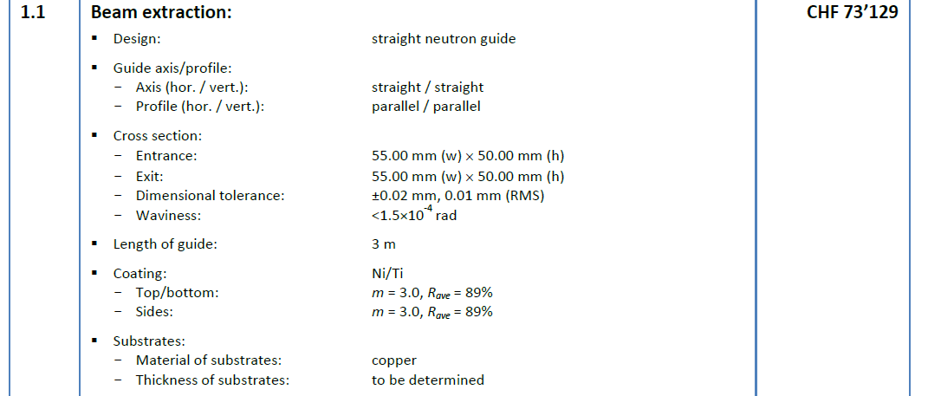

Slide 26
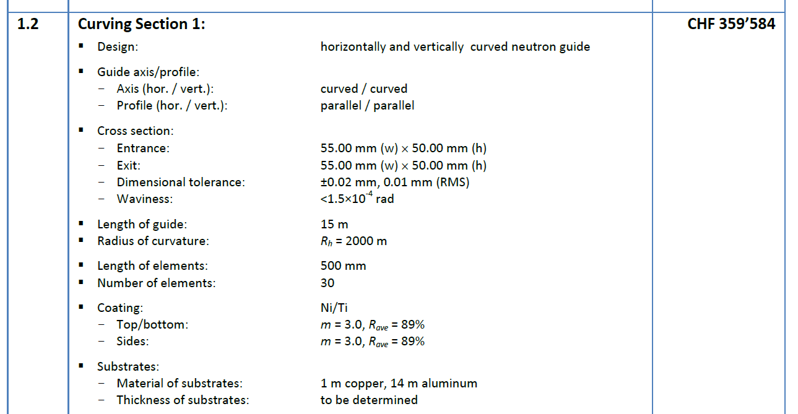

Slide 27
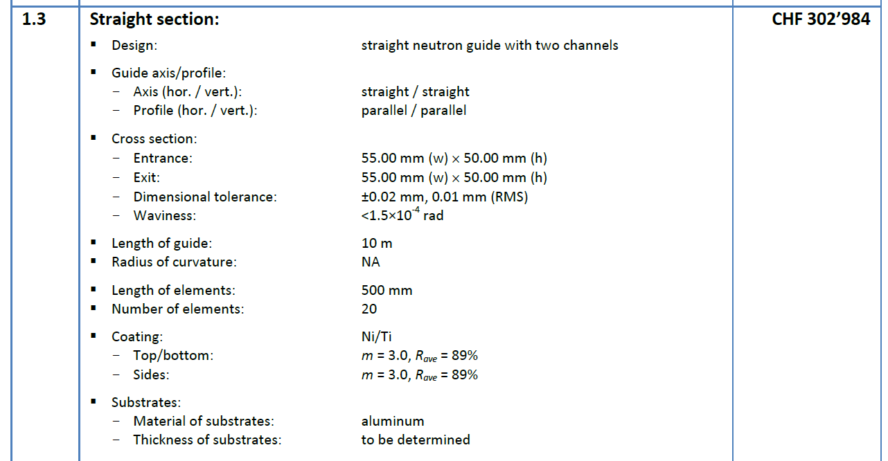

Slide 28
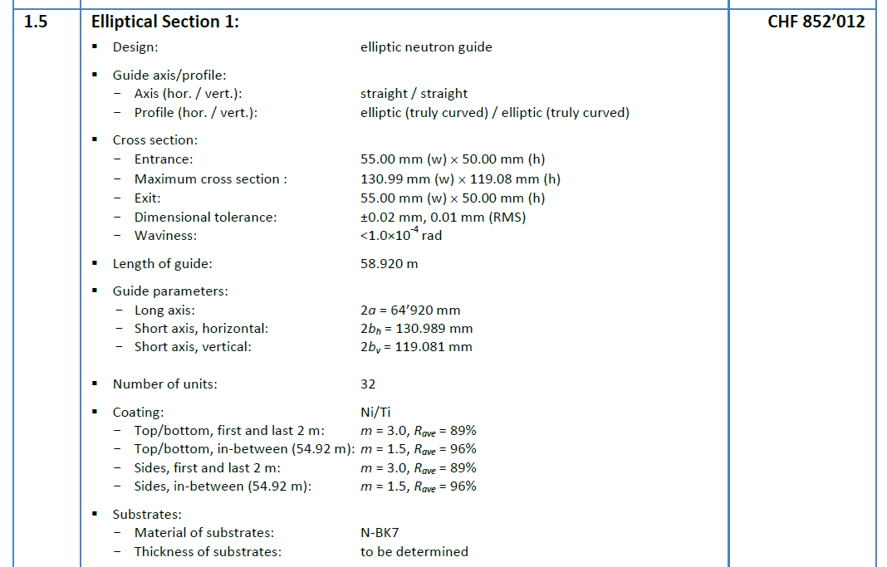

Slide 29
 | 01 Management | 02 Design | 03 Procurement & Start of Installation | 04 Installation and Start of Cold Commissioning | Total
01 Shielding | 0 | 0 | 1,344 | 0 | 1,344
02 Neutron Optics | 0 | 0 | 3,685 | 99 | 3,784
03 Choppers | 0 | 0 | 1,571 | 0 | 1,571
04 Sample Environment | 0 | 0 | 375 | 0 | 375
05 Detector (B10) | 0 | 300 | 2,313 | 0 | 2,613
05.1 Detector set (7m²) | 0 | 0 | 988 | 0 | 988
05.2 Detector Tank and Beam Monitors | 0 | 300 | 1,326 | 0 | 1,626
06 Data Acquisition and Analysis | 0 | 0 | 0 | 0 | 0
07 Motion Control and Automation | 0 | 48 | 33 | 19 | 101
08 Instrument Team | 484 | 1,134 | 628 | 499 | 2,745
09 Instrument Infrastructure (Cave and Shielding) | 0 | 0 | 867 | 0 | 867
10 Vacuum | 0 | 0 | 0 | 0 | 0
11 PSS | 0 | 33 | 33 | 33 | 100
12 Contingency | 0 | 0 | 0 | 0 | 1,500
Total | 484 | 1,816 | 10,849 | 651 | 15,000
Labour included in 08 (Person-Years) | 3.47 | 8.50 | 4.92 | 3.58 | 20.47
Option 1 : 15 M€
With 19% VAT from the TUM
Notes:
Sample environment : Cryofurnace, Multiple sample changer, Sample rotation stage, Goniometer, He3 insert

Slide 30
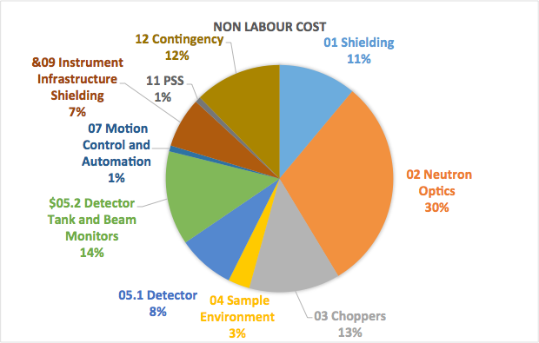
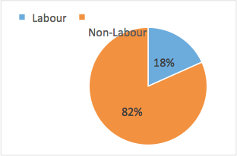
Version 1 with VAT

Slide 31
 | 01 Management | 02 Design | 03 Procurement & Start of Installation | 04 Installation and Start of Cold Commissioning | Total
01 Shielding | 0 | 0 | 1,344 | 0 | 1,344
02 Neutron Optics | 0 | 0 | 3,685 | 99 | 3,784
03 Choppers | 0 | 0 | 1,571 | 0 | 1,571
04 Sample Environment | 0 | 0 | 375 | 0 | 375
05 Detector (B10) | 0 | 300 | 5,509 | 0 | 5,809
05.1 Detector set (33m²) | 0 | 0 | 4,183 | 0 | 4,183
05.2 Detector Tank and Beam Monitors | 0 | 300 | 1,326 | 0 | 1,626
06 Data Acquisition and Analysis | 0 | 0 | 0 | 0 | 0
07 Motion Control and Automation | 0 | 48 | 33 | 19 | 101
08 Instrument Team | 484 | 1,134 | 628 | 499 | 2,745
09 Instrument Infrastructure (Cave and Shielding) | 0 | 0 | 867 | 0 | 867
10 Vacuum | 0 | 0 | 0 | 0 | 0
11 PSS | 0 | 33 | 33 | 33 | 100
12 Contingency | 0 | 0 | 0 | 0 | 1,855
Total | 484 | 1,816 | 14,045 | 651 | 18,550
Labour included in 08 (Person-Years) | 3.47 | 8.50 | 4.92 | 3.58 | 20.47
Option 2 : 18.55 M€
With 19% VAT from the TUM
Notes:
In this option, half of the electronic for the detector is installed and the total area of detector is covered. Advised by the Detector Group

Slide 32
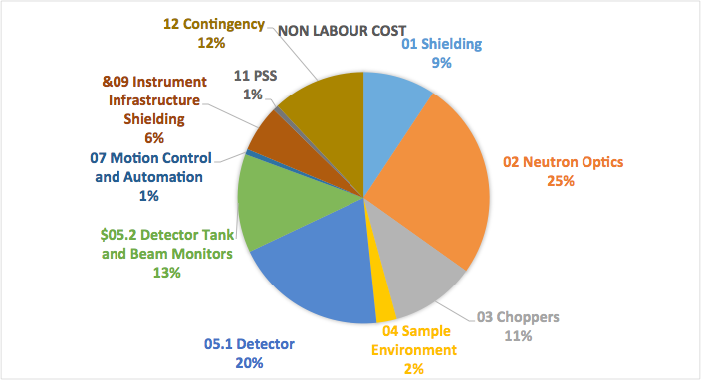
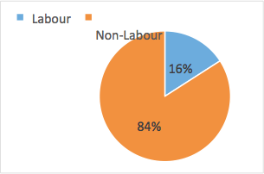
Version 2 with VAT

Slide 33
 | 01 Management | 02 Design | 03 Procurement & Start of Installation | 04 Installation and Start of Cold Commissioning | Total
01 Shielding | 0 | 0 | 1,344 | 0 | 1,344
02 Neutron Optics | 0 | 0 | 3,685 | 99 | 3,784
03 Choppers | 0 | 0 | 2,136 | 0 | 2,136
04 Sample Environment | 0 | 0 | 910 | 0 | 910
05 Detector (B10) | 0 | 300 | 6,456 | 0 | 6,756
05.1 Detector set (33m²) | 0 | 0 | 5,130 | 0 | 5,130
05.2 Detector Tank and Beam Monitors | 0 | 300 | 1,326 | 0 | 1,626
06 Data Acquisition and Analysis | 0 | 0 | 0 | 0 | 0
07 Motion Control and Automation | 0 | 97 | 66 | 39 | 202
08 Instrument Team | 484 | 1,134 | 628 | 499 | 2,745
09 Instrument Infrastructure (Cave and Shielding) | 0 | 0 | 867 | 0 | 867
10 Vacuum | 0 | 0 | 0 | 0 | 0
11 PSS | 0 | 33 | 33 | 33 | 100
12 Contingency | 0 | 0 | 0 | 0 | 2,094
Total | 484 | 1,864 | 16,125 | 670 | 20,937
Labour included in 08 (Person-Years) | 3.47 | 8.50 | 4.92 | 3.58 | 20.47
Option 3 Full Scope : 20.94 M€
With 19% VAT from the TUM

Slide 34
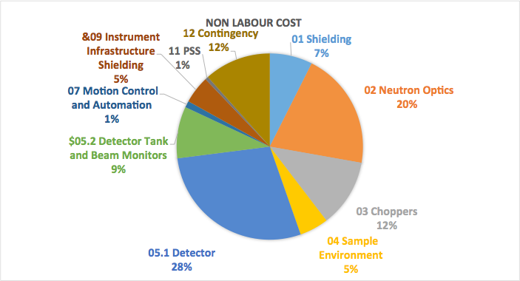
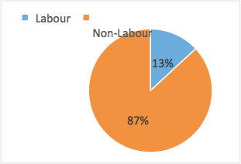
Full scope with VAT

Slide 35
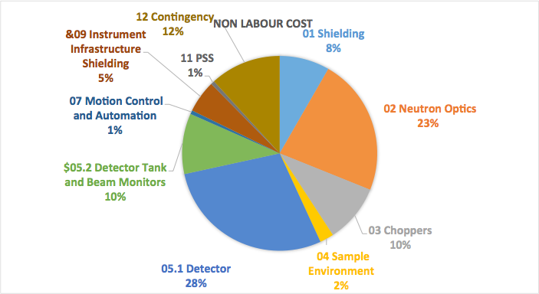
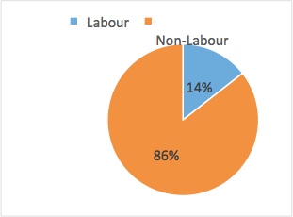
Version 2 He3 (how many 5 bar ) with VAT

