Slide 1
The Bifrost spectrometer
Science case, outline and requirements
Rasmus Toft-Petersen
Technical University of Denmark

Slide 2
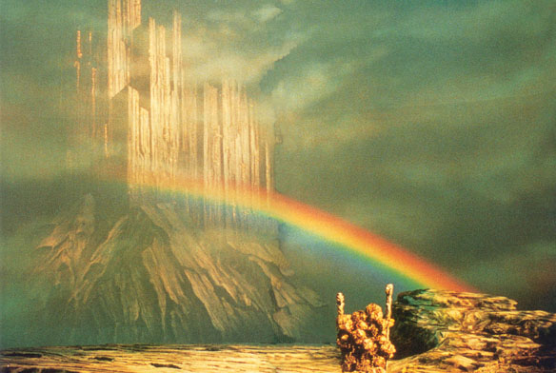
Outline
Motivation
Science case
Operating principle
Technical
requirements

Slide 3
Bifrost motivation
Current state-of-the-art:
Triple-axis spectrometer
Mono Flux | 10⁷-10⁸ n/s/cm²
Spatial angle | 0.015 steradians
Energy transfer | Single value
Flux in reactor:
10¹⁵ n/s/cm²
Time-of-flight
spectrometer
Monochromatic flux
at sample: 10⁸ n/s/cm²
Mono Flux | 10⁵-10⁶ n/s/cm²
Spatial angle | 3 steradians
Energy transfer | Continuous
Typical detector
count rate: 0.5-5 cts/s
In both cases, getting the
full picture takes about a week

Slide 4
Bifrost motivation
Three main reasons for building BIFROST:
Flux optimization for weak signals
Parametric overview studies
Optimization for sample environment
Bifrost
aims to perform
efficient overview studies with triple-axis flux:
Polychromatic beam,
large detector angular coverage and multiple analyser energies
makes this possible!
BIFROST
Poly Flux | 10⁹-10¹⁰ n/s/cm²
Spatial angle | 0.1 steradians pr. Ef
Energies pr Q-channel | Continuous
SE performance | Great
Bifrost will have enough flux and
probe a large enough (Q, E)-range
to see the unexpected and to
sacrifice flux for resolution!

Slide 5
Bifrost motivation
Three main reasons for building BIFROST:
Flux optimization for weak signals
Parametric overview studies
Optimization for sample environment
Bifrost
aims to perform
efficient overview studies with triple-axis flux:
Polychromatic beam,
large detector angular coverage and multiple analyser energies
makes this possible!
BIFROST
Poly Flux | 10⁹-10¹⁰ n/s/cm²
Spatial angle | 0.1 steradians pr. Ef
Energies pr Q-channel | Continuous
SE performance | Great
Bifrost will have enough flux and
probe a large enough (Q, E)-range
to see the unexpected and to
sacrifice flux for resolution!

Slide 6
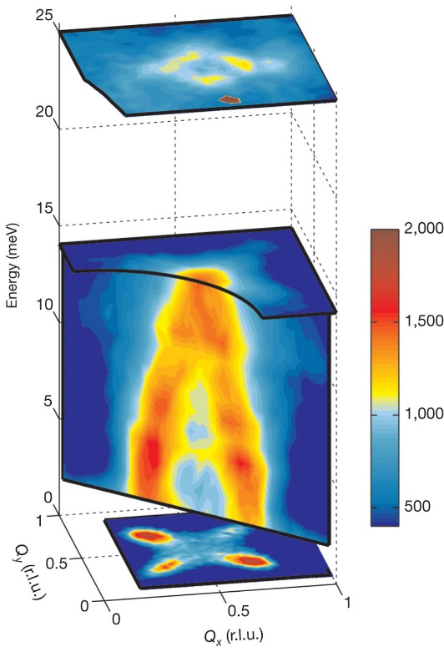
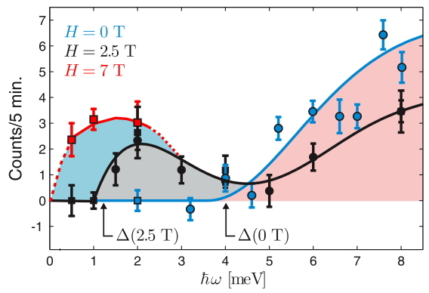
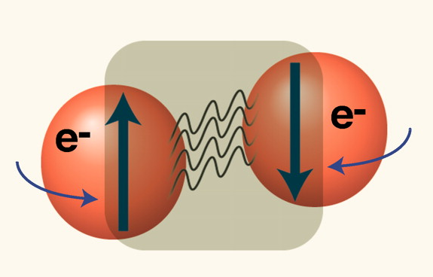
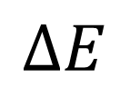
Magnetism in superconductors
A. Boothroyd,
et al.
Nature 2011
J. Chang et al, Physical Review Letters 102 , 177006 (2009)
Applied magnetism:
Magnetic excitations, the electron-glue in the high-Tc superconductors?
This entire field is limited by
lack of neutron flux
Gap
$$∆E$$

Slide 7
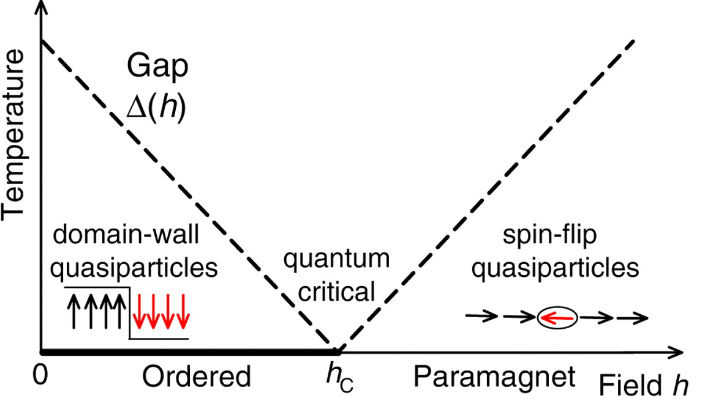
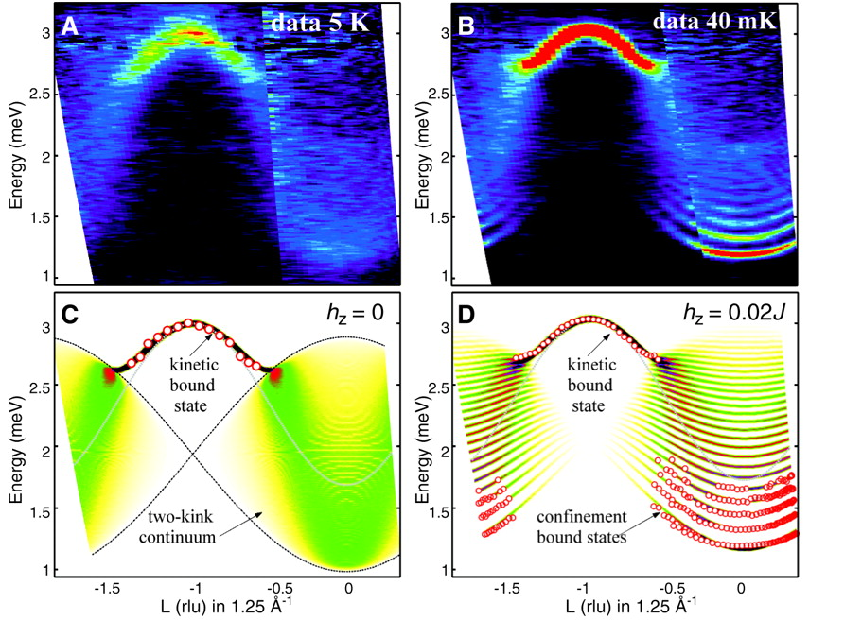
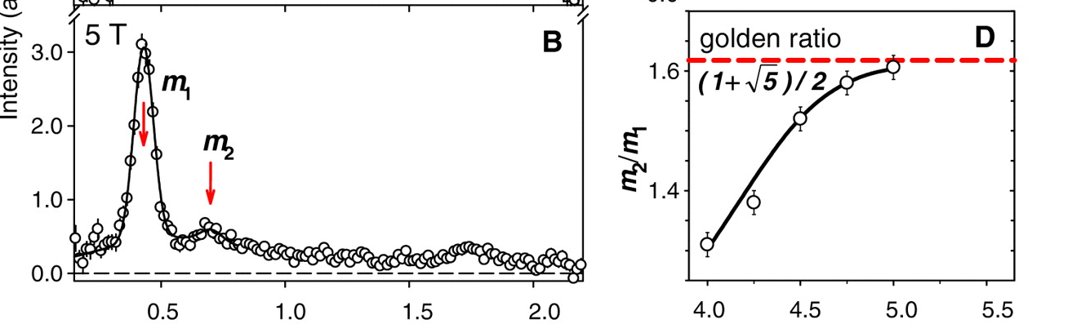
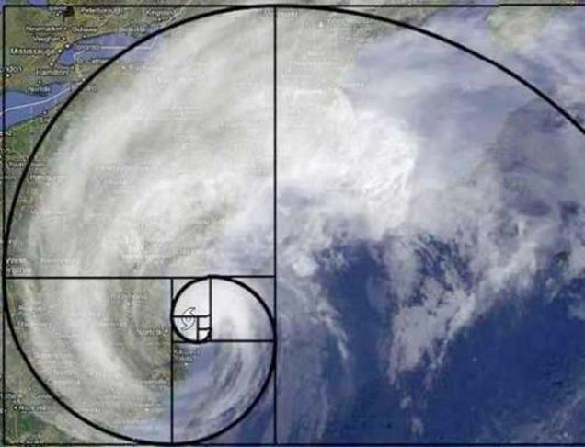
Quantum magnetism
Fundamental magnetism: as the quantum critical point is reached, the golden ratio
pops out!
R.Coldea, et. al, Science, 327 (2010)

Slide 8
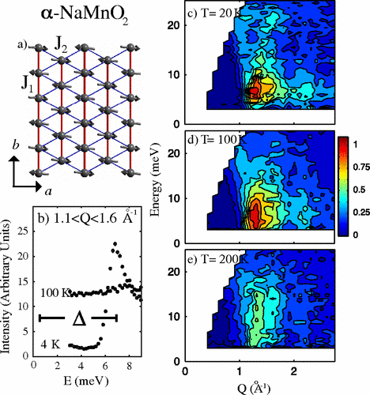
Crystal growth
as the main limitation
Organic superconductors -
electrocrystallization
Many ionic conductors are
magnets – flux growth
C. Stock, et. Al.
PRL (2009)
NaMnO2
Powder
A. Boothroyd, et. Al.
PRL (2004)
0.25 cm² sample
Na0.75CoO2

Slide 9
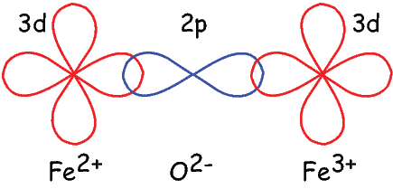
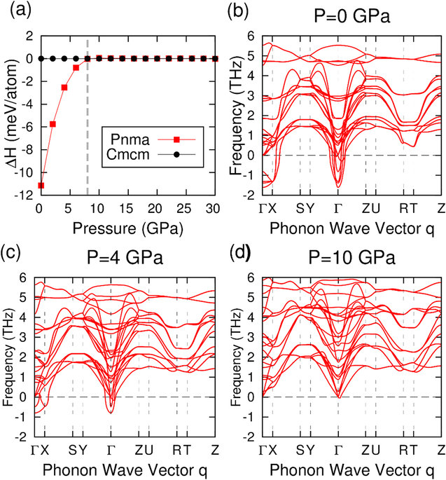
Pressure studies
Pressure changes structure and
the exchange path. Detailed parametric
studies could allow complicated theories
for exchange to be tested more
precisely. DFT? Dzyaloshinsky-Moriya?
Phonons under pressure:
Structural phase transitions?
Lifetimes?
Phonons near melting points?
Yu, et al, Scientific Reports, SnSe
(2016). Phonons in Iron near TC
DFT+measurements

Slide 10
A new opportunity:
Earth science
New option: Efficient low resolution QENS at high pressures. Can’t be done
With X-rays or backscattering
Earth science: Dynamics of water in earths
mantle

Slide 11
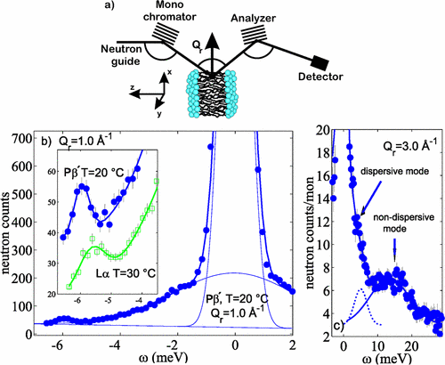
Soft matter
In membranes, collective dynamics are believed to drive transport of molecules, pore opening, membrane fusions and protein-protein interactions
M. C. Rheinstädter,
PRL (2004)

Slide 12
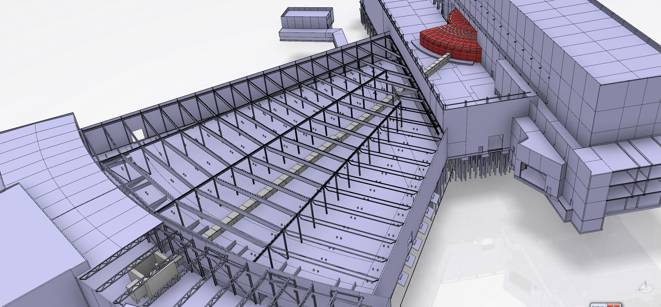
The beamline

Slide 13
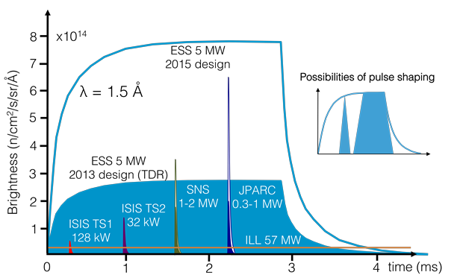
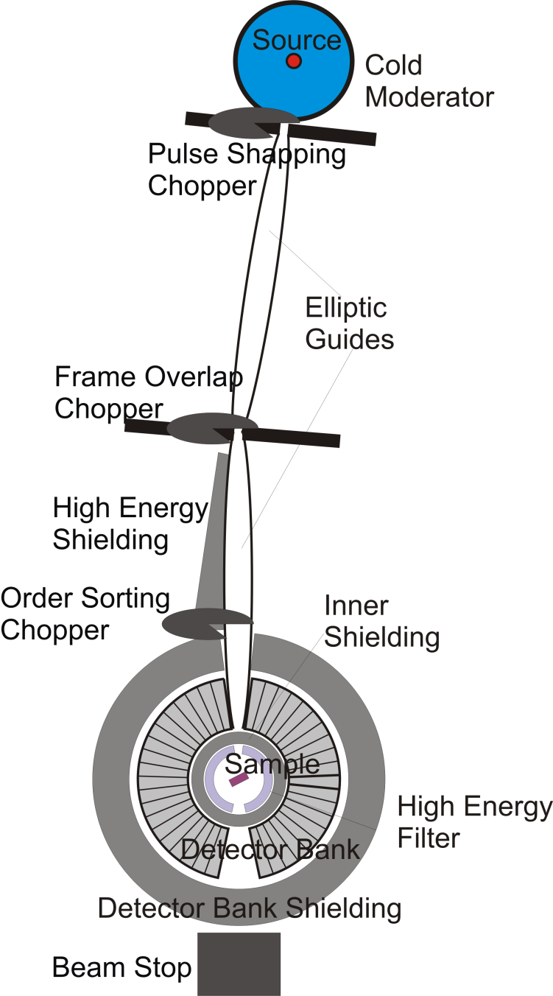
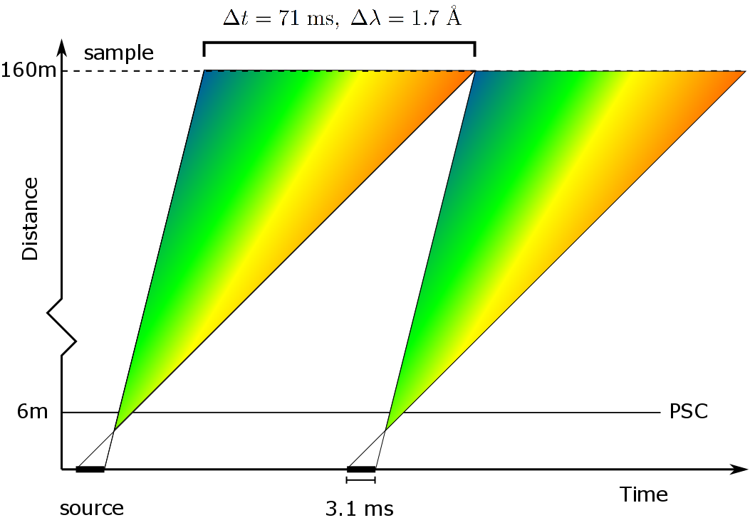
Operating principle: primary spectrometer
Combine a long
instrument with
long-pulsed source.
Flight time: 100 ms

Slide 14
Operating principle: secondary spectrometer
Pyrolythic graphite is transparent at E < 5 meV
Efficient use of pyrolytic graphite and a long primary flight path
is a powerful cocktail in a single scattering plane
We can over 0.5 ster in the scattering plane:
A compression of the capabilities of a TOF spectrometer

Slide 15
The chopper system
A relatively simple chopper setup
1 fast double-disc PSC chopper
3 slow frame overlap choppers
A fast chopper before sample
enables order sorting

Slide 16
Improving the backend resolution
The prismatic analyzer concept (Jonas Okkels Birk):
Use broad PG mosaicity and distance collimation.
Resolution
at the E_{f} = 5 meV
Analyzer -> 70 µeV.
Match the PSC to this analyzer and achieve unprecented flux and resolution at E_{i} = 15 meV

Slide 17
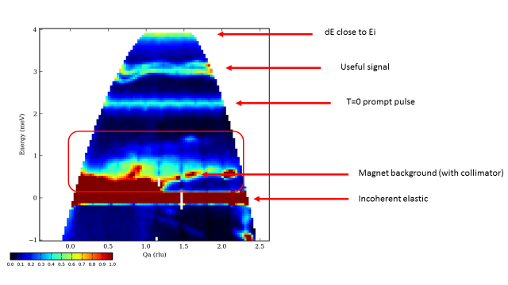
Sample environment
4 seasons, JPARC
BIFROST can keep
elastic sample environment
scattering in the elastic
line due to the long flightpath!
Direct geometry ToF cannot

Slide 18
Main requirements
Primary spectrometer
Secondary spectrometer
1.7 Å bandwidth
Polychromatic flux > 10¹⁰ n/s/cm²
PSC: Pulse duration 0.1-3.1 ms
Beam size: 2x2 cm
Divergence < 0.75 degrees
Flexible E-resolution, 30-170 μeV
Angular resolution 0.7 degrees
10 analysers pr Q-channel
Order sorting chopper
120 degree angular coverage
Moveable evacuated tank
Translateable filter+collimator
Sample environment
Temperatures below 50 mK
Magnetic fields above 15 T
Pressures above 2 GPa

Slide 19
Schedule
considerations
PSI CAMEA → Many of the technical solutions and the prototyping
regarding the secondary spectrometer are in place:
PG holders, crosstalk shielding, Be-filter.
The Bifrost team is strong, we believe we can be ready
for user operation in 2023.
LLB: Detectors, tank design
polarization, choppers
Philippe Bourges
Sylvain Rodrigues
IFE: Shielding
Rodion Kolevatov
Isabel Jansa Llamas
Wigner: Slow choppers
Marton Marko
PSI: Guide, Vacuum housing
Be-filter, prototyping
Jonas Okkels Birk
Christof Niedermayer
Felix Groitl
KU: Guide design and
more
Kim Lefmann
Martin Olsen
Sonja Holm
DTU: Management
and more
Niels Bech Christensen
Rasmus Toft-Petersen
Lead engineer

Slide 20
Schedule
considerations
Focus on settling the guide design – early procurement
of monolith insert
2017 will mainly focus on guide design, chopper design
and shielding design
Tank and detailed detector design will be settled end of
2017, start 2018
Possible early procurement of guide, choppers and
the more complicated shielding parts.

Slide 21
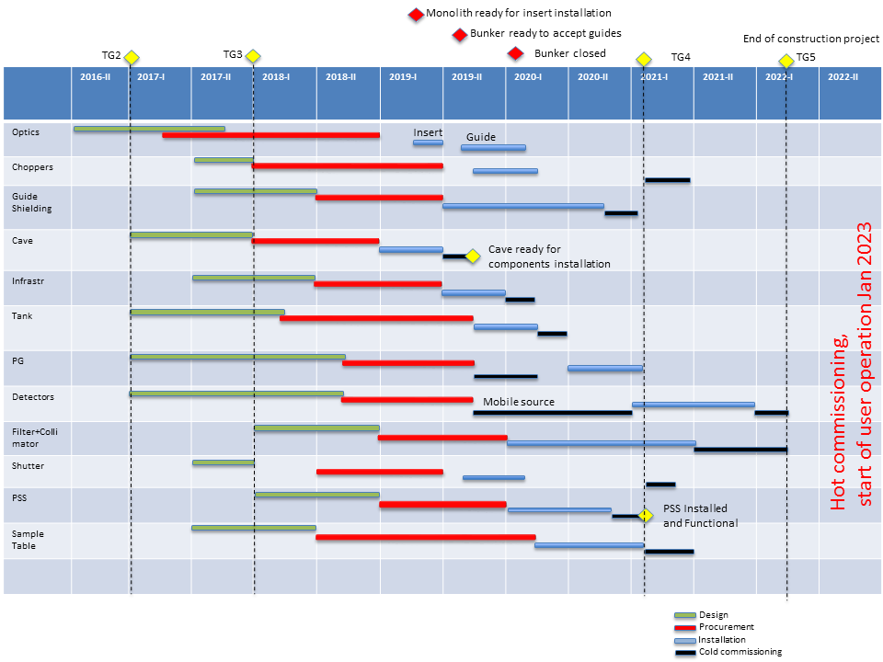

Slide 22






Thank you for your attention

