Slide 1
The Bifrost spectrometer
The three options – Budget and scope
Rasmus Toft-Petersen
Technical University of Denmark

Slide 2
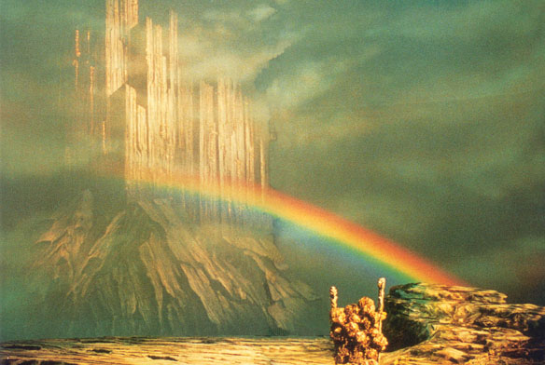
Outline
Technical requirements and the choices made
Option 1 – Cost Category B – 12 M€
Option 2 – world leader – 14.1 M€
Option 3 – primary scope – 16.4 M€
Summary and our position

Slide 3
Main requirements
Primary spectrometer
Secondary spectrometer
1.7 Å bandwidth
Polychromatic flux > 10¹⁰ n/s/cm²
PSC: Pulse duration 0.1-3.1 ms
Beam size: 2x2 cm
Divergence < 0.75 degrees
Flexible E-resolution, 30-170 μeV
Angular resolution 0.7 degrees
10 analysers pr Q-channel
Order sorting chopper
120 degree angular coverage
Moveable evacuated tank
Translateable filter+collimator
Sample environment
Temperatures below 50 mK
Magnetic fields above 15 T
Pressures above 2 GPa

Slide 4
Main requirements
Primary spectrometer
Secondary spectrometer
1.7 Å bandwidth
Polychromatic flux > 10¹⁰ n/s/cm²
PSC: Pulse duration 0.1-3.1 ms
Beam size: 2x2 cm
Divergence < 0.75 degrees
Flexible E-resolution, 30-170 μeV
Angular resolution 0.7 degrees
10 analysers pr Q-channel
Order sorting chopper
120 degree angular coverage
Moveable evacuated tank
Translateable filter+collimator
Sample environment
Temperatures below 50 mK
Magnetic fields above 15 T
Pressures above 2 GPa

Slide 5
STAP recommendations
Take activation into account – consider sample changer. ✓
Cover 90 degrees scattering angle from Day 1 ✓
Divergence jaws for small samples ✓
Investigate saturation from Bragg peaks
Upgrade priority: 1. High field magnet, 2. PA,
3. Order sorting chopper. ✓
Avoid building a tank to be disposed of ✓

Slide 6
Changed requirements for all options
Strategy:
Full scope primary spectrometer
Do not sacrifice resolution
Reduce tank size as full scope tank
will cost 1.5 M€
Sacrifice detection area and sample
environment
Secondary spectrometer
Flexible E-resolution, 30-170 μeV
Angular resolution 0.7 degrees
6 analysers pr Q-channel
90 degree angular coverage
Moveable evacuated tank
Translateable filter+collimator
Sample environment
Temperatures below 50 mK
Magnetic fields above 15 T
Pressures above 2 GPa

Slide 7
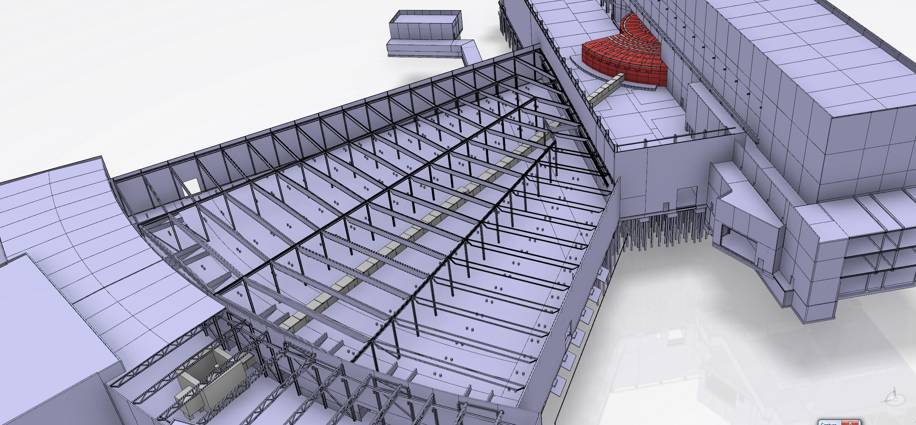
Guide: Design after shielding requirements
E02 - Long section –
Need low price pr m
D03 – short section with fast neutron
expensive

Slide 8
Guide: Design after shielding requirements
E02 - Long section –
Need low price pr m
D03 – short section with fast neutron
expensive
Guide boundary conditions:
1) Metallic substrates before bunker wall
2) Borcron after bunker wall
3) Loose LoS to avoid too heavy a shutter
and for background
4) Use m = 1 where possible due to
gamma radiation

Slide 9
Guide proposals
A straight double ellipse with static prompt pulse suppression
Kinked double ellipse, with kink before bunker wall
A S-bend m = 3 guide, loosing LoS twice – once before bunker wall
ending up in m = 1 straight section
Long m = 1 section
for all options

Slide 10
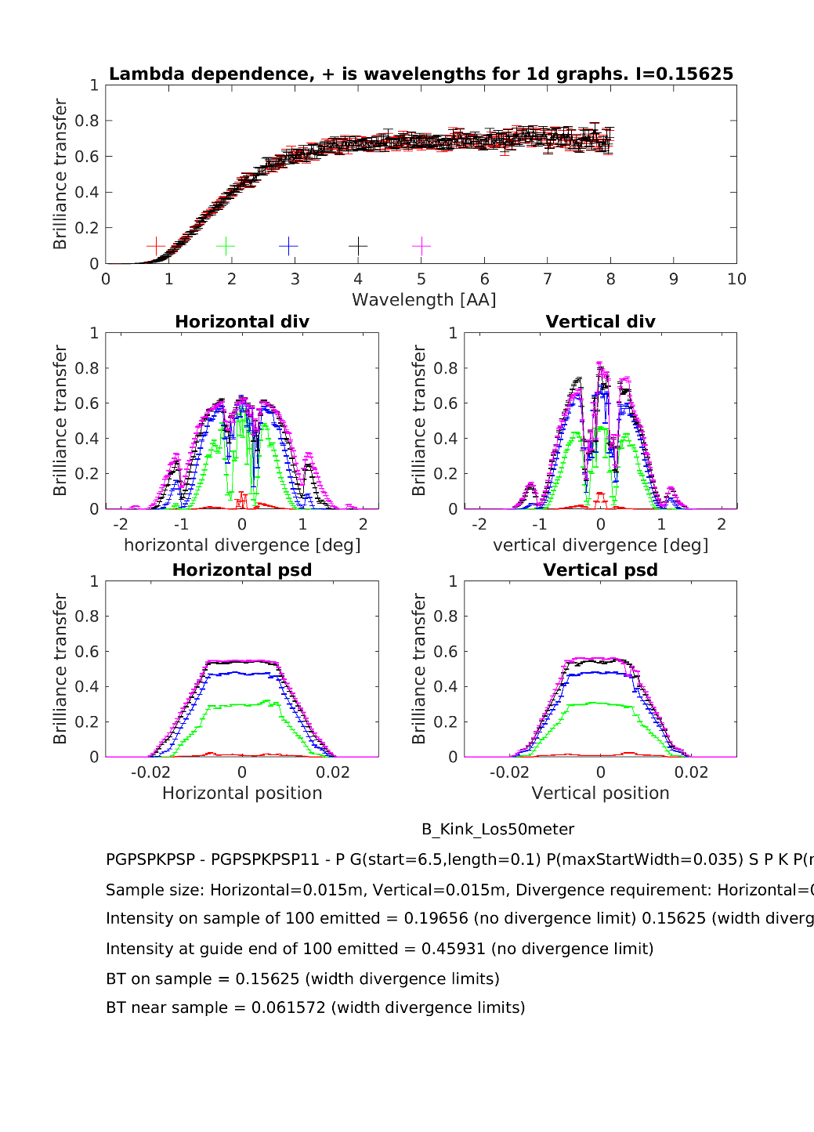
Comparison

Slide 11
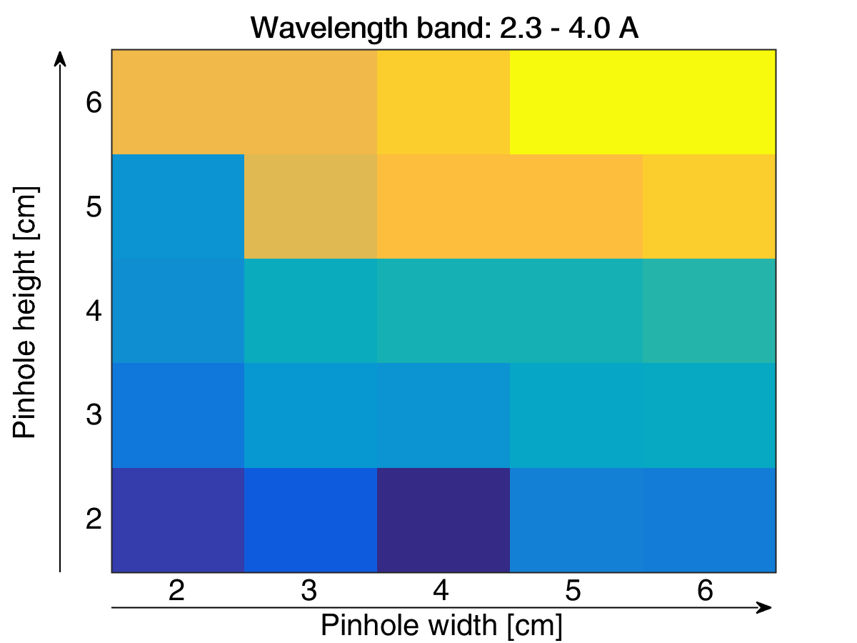
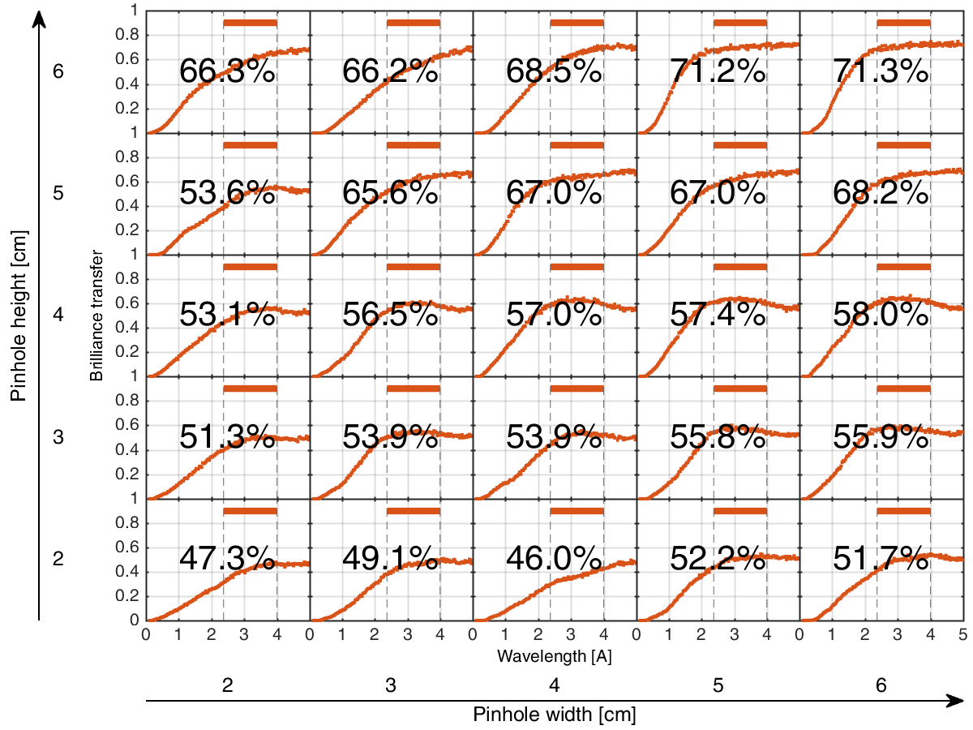
Optimizing the feeder for early procurement
Benchmark with flat moderator and pinhole for a chopper
Pinhole
Sample
Elliptical guide
Source
Feeder

Slide 12
Robust guide price
Feeder
Two ellipses – 2x5 cm -> 8x8 cm
Metallic substrate < 30 m and Borcron elsewhere
Price for the guide (Swiss neutronics quote): 2.160 k€
Price for vacuum housing: 630 k€
Monolith insert infrastructure: 100 k€
Special housing near monolith (steel, sapphire filters): 70 k€
Price for guide installation (Included in quote): 100 k€
Monolith gamma shutter customization: 80 k€
Total price for the system: 3167 k€
Almost independent of our choice of guide – m = 1 requires expansion of
guide in all cases, and substrates are the cost drivers for that part….

Slide 13

Kinked guide in D03: More steel
Lose LoS
outside bunker,
fast neutron beam
stop 4 m³ steel
Assume addtional steel
Before LoS is lost at 50 m:
an additional 10 m³
We still end up below ODIN
values due to our double slit
before bunker wall
Old budget: 30 m³
New budget 45 m³ steel
to the price of 500 k€
Increased by 150 k€

Slide 14
Steel considerations in D03
Fast neutron shielding relevant < 50 m from moderator…
Stuarts work on ODIN (straight):
Between 25-35 cm steel, 30 cm of concrete
Pending calculations, we estimate a little less for our guide
up to lossing LoS 40 m³
Add 5 cm of steel for gammas: An additional 5 m³ of steel
Fair kinked guide estimate: 45 m³ of steel
Increased by 150 k€ compare

Slide 15
D03 guide summary
Kinked guide is the better performer, but expensive to
shield and we might need metal substrate outside the bunker
PPS-guide performs 40 % worse than kinked but is cheaper
to shield, possibly 3-400 k€ in total. Optimisation pending.
S-bend is requires little fast neutron sheilding, but does
require steel in D03 to shield for hard gammas. Possibly
the cheapest option: chosen if performance is
acceptable (Brilliance transfer, divergence, beam profile,
expansion into m = 1)

Slide 16
Concrete
Few fast neutrons
Low gamma-flux
We hope to get away with
using only concrete
50 cm thickness
for 100 m E02 hall: 200 m²
Extra concrete near D03 hall
And cave: 30 m²
Floor and shielding in D03: 70 m²
Thickness [m]
Length [m]
Due to craning limitations we will
end up with complex elements
to avoid streaming and limit
the number of elements needed:
300 m³ x 1000 €/ m³ = 300 k€

Slide 17
Lead near cave
We don’t want activation,
and ferromagnetism!
Stainless steel not cost
effective and lead is
10 times better than
concrete for hard gammas!
We chosea lead+concrete
solution:
5 cm lead on the last
15 m’s
Price: 250 k€
Thickness [m]
Length [m]
Normal steel magnetic, so:
Lead versus stainless steel?
Lead: 90 k€/m³
Stainless: 40 k€/m³
Similar shielding power pr Euro

Slide 18
Labor for shielding
Mobile gantry
cranes
1 crane
We estimate
3 people take
3 hours on average
Pr element, from
The load-off point
to secure bolted
position,
Two FTE’s in total for shielding
1 crane
1 crane

Slide 19
The cave
We aim for a large cave of reinforced concrete. This can shield for primary beam scattered in 4pi or converted into 2 meV gammas
1 m thick concrete: 450 k€
3 mm of Boralcan plates: 200 K€
Manpower: 100 k€

Slide 20
Total shielding costs
Item | Price [k€]
Design – 1.75 FTE | 190
Bunker feedthrough | 30
Mirrobor in bunker | 8
Steel – D03 | 500
Concrete – beamline | 300
Lead near cave | 250
Chopper pit Concrete+Boralcan) | 40
Cave (Boralcan + concrete) | 600
Beamstop + vacuum tube | 250
Tungsten | 80
Installation – 3 FTE | 260
Total | 2508
Material costs
for beamline:
1050 k€
Cave costs is
excluding cabling

Slide 21
The chopper system
1 fast double-disc PSC chopper
3 slow frame overlap choppers
Total price: 910 k€ including
MP, Vac, cooling, Racks, comm
Option: A fast order sorting chopper

Slide 22
Pulse shaping chopper
Item | Cost [k€]
Double disc chopper, face-to-face, 700 mm, speeds above 196 Hz | 280
Chopper integration module | 33
Vacuum | 5
Chopper cooling | 10
Master rack | 15
Chopper drive | 40
Installation | 17
Integration | 15
Commissioning | 10
Power system | 5
Sum | 405
ESS
estimate:
405 K€
LLB
Estimate:
400 k€

Slide 23
The three slow choppers
Item | Cost [k€]
3 single disc choppers 700 mm, max 70 Hz | 221
Chopper integration modules | 100
Vacuum | 15
Chopper cooling | 20
Master rack x 2 | 30
Slave rack | 7
Drives + power | 65
Installation | 17
Integration | 15
Commissioning | 10
Power system | 5
Sum | 505
Total for all
choppers:
910 k€
Workforce:
85 k€
Second slow
chopper
double disc?
Add 120k€

Slide 24
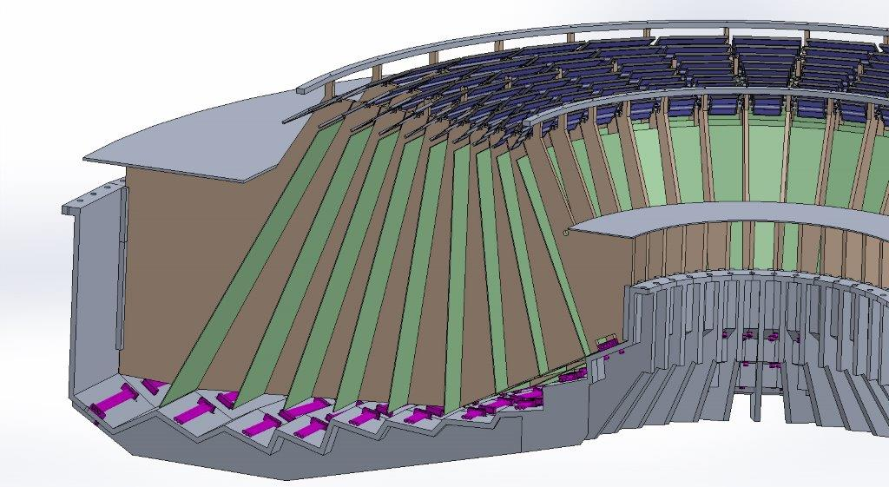
Detector system
Our costing of the secondary spectrometer tank
uses the PSI quotes as a starting point.
We are considering separate detectors
to allow for rowland geometry and more flexibility

Slide 25
Option 1 – sacrifices
No sample environment
To afford detectors at all, we need to build a small tank – 22 degrees
Tank unevacuated
We save money on filter and collimators but costs are not linear
We develop and buy equipment to be thrown away
upon upgrades
Detector voltage needs to be ramped doen before moving the tank – substantial dead time

Slide 26
Cost Category B detector system
For cost category B, we can afford a simple tank in air covering 21.5 degrees,
possibly more if we redesign everything after CC-B
Item | Price [k€]
Detectors | 110
PG | 100
Mounts | 50
Electronics | 180
Cross talk | 70
Detector tank | 120
Frame+rail+motor | 100
Detector safety | 50
Beam monitor/Camera/preamps | 120
Total | 900
Labor for design, installation and commissioning: 330 k€

Slide 27
Instrument specific cost category
Item | Price [k€]
Management labor incl travel | 1260
Be-filter | 100
Radial collimator | 70
Light shutter | 150
Divergence jaws | 100
Installation + commissioning | 50
Total | 1730

Slide 28
Sample environment, motion control, instrument infrastructure and PSS
Sample environment in CC-B budget:
Sample table: 108 k€
Cryofurnace: 50 k€
Activation sticks: 60 k€
Total: 220 k€
Motion control, all budgets
16 slit motors (divergence jaws)
2 sample rotation motors
2 translation stages
2 oscillation motors
1 tank motor
Total:180 k€, with
the tank motor included in
spectrometer budget
Infrastructure in all budgets
Design of infrastructure: 27 k€
Cranes: 40 k€
Media distribution: 80 k€
False floor + He recovery: 40 k€
Control Hutch: 150 k€
Installation: 173 k€
Total: 500 k€
Total PSS system (NMX):
120 k€

Slide 29
WBS breakdown
 | Project Management and integration | Design | Procurement and fabrication | Install-ation | Cold commissioning | Non labour | Labour | Total
Shielding | € 0 | € 189.000 | € 2.078.750 | € 259.200 | € 0 | € 2.078.750 | € 448.200 | € 2.526.950
Neutron Optics | € 0 | € 27.000 | € 3.040.000 | € 100.000 | € 0 | € 2.960.000 | € 207.000 | € 3.167.000
Choppers | € 0 | € 0 | € 841.000 | € 62.400 | € 20.000 | € 861.000 | € 62.400 | € 923.400
Sample Environment | € 0 | € 0 | € 210.000 | € 3.840 | € 3.840 | € 210.000 | € 7.680 | € 217.680
Detector and beam monitor | € 0 | € 175.000 | € 880.000 | € 54.000 | € 108.000 | € 880.000 | € 337.000 | € 1.217.000
DMSC | € 0 | € 0 | € 0 | € 0 | € 0 | € 0 | € 0 | € 0
Motion contro | € 17.400 | € 60.000 | € 112.000 | € 6.000 | € 34.000 | € 77.000 | € 152.400 | € 229.400
Instrument specific Tech equipment | € 1.260.000 | € 0 | € 420.000 | € 21.600 | € 27.000 | € 480.000 | € 1.248.600 | € 1.728.600
Instrument Infrastructure | € 0 | € 27.000 | € 300.000 | € 172.800 | € 0 | € 300.000 | € 199.800 | € 499.800
Vacuum | € 0 | € 0 | € 0 | € 0 | € 0 | € 0 | € 0 | € 0
PSS | € 0 | € 20.000 | € 50.000 | € 30.000 | € 20.000 | € 70.000 | € 50.000 | € 120.000
Contingency |  |  |  |  |  |  |  | € 1.169.281
Phase I |  |  |  |  |  |  |  | € 250.000
TOTAL | € 1.277.400 | € 498.000 | € 7.931.750 | € 709.840 | € 212.840 | € 7.916.750 | € 2.713.080 | € 12.049.111
Man year | 12 | 5 | 0 | 8 | 2 |  |  | 27

Slide 30
WBS breakdown
 | Project Management and integration | Design | Procurement and fabrication | Install-ation | Cold commissioning | Non labour | Labour | Total
Shielding | € 0 | € 189.000 | € 1.905.500 | € 259.200 | € 0 | € 1.905.500 | € 448.200 | € 2.353.700
Neutron Optics | € 0 | € 27.000 | € 3.040.000 | € 100.000 | € 0 | € 2.970.000 | € 197.000 | € 3.167.000
Choppers | € 0 | € 0 | € 841.000 | € 62.400 | € 20.000 | € 861.000 | € 62.400 | € 923.400
Sample Environment | € 0 | € 0 | € 150.000 | € 3.840 | € 3.840 | € 150.000 | € 7.680 | € 157.680
Detector and beam monitor | € 0 | € 200.000 | € 1.010.000 | € 54.000 | € 108.000 | € 1.010.000 | € 362.000 | € 1.387.000
DMSC | € 0 | € 0 | € 0 | € 0 | € 0 | € 0 | € 0 | € 0
Motion contro |  | € 0 | € 116.000 | € 15.000 | € 50.000 | € 116.000 | € 65.000 | € 181.000
Instrument specific Tech equipment | € 1.260.000 | € 0 | € 420.000 | € 21.600 | € 27.000 | € 480.000 | € 1.248.600 | € 1.728.600
Instrument Infrastructure | € 0 | € 27.000 | € 300.000 | € 172.800 | € 0 | € 300.000 | € 199.800 | € 499.800
Vacuum | € 0 | € 0 | € 0 | € 0 | € 0 | € 0 | € 0 | € 0
PSS | € 0 | € 20.000 | € 50.000 | € 30.000 | € 20.000 | € 70.000 | € 50.000 | € 120.000
Contingency |  |  |  |  |  |  |  | € 1.157.000
Phase I |  |  |  |  |  |  |  | € 280.000
TOTAL | € 1.260.000 | € 463.000 | € 7.832.500 | € 718.840 | € 228.840 | € 7.862.500 | € 2.640.680 | € 11.955.180
Man year | 12 | 5 | 0 | 8 | 2 |  |  | 27

Slide 31
WBS breakdown
 | Project Management and integration | Design | Procurement and fabrication | Install-ation | Cold commissioning | Non labour | Labour | Total
Shielding | € 0 | € 189.000 | € 1.905.500 | € 259.200 | € 0 | € 1.905.500 | € 448.200 | € 2.353.700
Neutron Optics | € 0 | € 27.000 | € 3.040.000 | € 100.000 | € 0 | € 2.970.000 | € 197.000 | € 3.167.000
Choppers | € 0 | € 0 | € 841.000 | € 62.400 | € 20.000 | € 861.000 | € 62.400 | € 923.400
Sample Environment | € 0 | € 0 | € 150.000 | € 3.840 | € 3.840 | € 150.000 | € 7.680 | € 157.680
Detector and beam monitor | € 0 | € 200.000 | € 1.010.000 | € 54.000 | € 108.000 | € 1.010.000 | € 362.000 | € 1.387.000
DMSC | € 0 | € 0 | € 0 | € 0 | € 0 | € 0 | € 0 | € 0
Motion contro |  | € 0 | € 116.000 | € 15.000 | € 50.000 | € 116.000 | € 65.000 | € 181.000
Instrument specific Tech equipment | € 1.260.000 | € 0 | € 420.000 | € 21.600 | € 27.000 | € 480.000 | € 1.248.600 | € 1.728.600
Instrument Infrastructure | € 0 | € 27.000 | € 300.000 | € 172.800 | € 0 | € 300.000 | € 199.800 | € 499.800
Vacuum | € 0 | € 0 | € 0 | € 0 | € 0 | € 0 | € 0 | € 0
PSS | € 0 | € 20.000 | € 50.000 | € 30.000 | € 20.000 | € 70.000 | € 50.000 | € 120.000
Contingency |  |  |  |  |  |  |  | € 1.157.000
Phase I |  |  |  |  |  |  |  | € 280.000
TOTAL | € 1.260.000 | € 463.000 | € 7.832.500 | € 718.840 | € 228.840 | € 7.862.500 | € 2.640.680 | € 11.955.180
Man year | 12 | 5 | 0 | 8 | 2 |  |  | 27

Slide 32
Evaluation of option 1 from Bifrost team
Overview studies is essential for
Bifrost with its polychromatic beam. The flux
allows you to find the unexpected but only if
you are looking!
Option 1 wastes money and manpower on
an tank that will be replaced as soon
as possible
We compete not only on flux, but also
on sample environment, simplicity and
software. Option 1 will not be world leading…

Slide 33
Cost category worst case
ThALES monochromatic flux: 3*10⁸ n/s/cm²
BIFROST 3MW polychromatic flux: 10¹⁰ n/s/cm²
similar flux at specific wavelengths
ThALES multiplexing option,
assume the worst: 0.75 m² of PG.
Gain factor reduced to 8. Assume
BIFROST background could be higher,
and reduce gain to 2-4.
Worst case:
ThALES: 2 meV dynamic range at three E_{i} settings.
BIFROST: Four A4 settings
13.8 M€ BIFROST excluding phase I:
Gain factor 12+ With sample environment limitations as they are,
this is what we need to call ourselves world leader!

Slide 34
Option 2
Option 2 covers 90 degrees of scattering angle, and is able to cover
a Brillouin Zone in most systems using a cold beam.
Option 2 includes a dilution stick, which allows us partly to
address the quantum magnetism and unconventional SC communities
The upgrade path of option 2 is straightfoward and cost effective in terms of
scope/price ratio. We will aim to leave space for a single analyzer E > 5 meV
for order sorting

Slide 35
Option 2 – sacrifices
Limited magnet availability – we do not directly
address the magnetism and SC communities
Bifrost can do small samples – options for very high
magnetic field not there.
No polarization analysis – definite loss of scope
and excellence
P. Dalla Piazza,
Nature Physics
(2014)
V. O. Garlea, et. al,*
PRL 98, 167202 (2007)

Slide 36
Detector system for option 2
Here, we cover 90 degrees as recommended by the STAP council.
Item | Price [k€]
Detectors | 450
PG | 400
Mounts | 120
Electronics | 400
Cross talk | 100
Detector tank | 500
Frame+rail+motor | 100
Detector safety | 50
Beam monitor/Camera/preamps | 120
Total | 2240
Labor for design, installation and commissioning: 360 k€

Slide 37
Instrument specific
+ SA for option 2
Item | Price [k€]
Management labor incl travel | 1260
Be-filter | 250
Radial collimator | 100
Light shutter | 150
Divergence jaws | 100
Installation + commissioning | 50
Total | 1910
For the sample environment, we include a dilution stick
For 150 k€ and 100 k€ for development labor costs (SAD estimate)

Slide 38
WBS breakdown
 | Project Management and integration | Design | Procure-ment and fabrication | Installation | Cold commissioning | Non labour | Labour | Total
Shielding | € 0 | € 189.000 | € 2.078.750 | € 259.200 | € 0 | € 2.078.750 | € 448.200 | € 2.526.950
Neutron Optics | € 0 | € 27.000 | € 3.040.000 | € 100.000 | € 0 | € 2.960.000 | € 207.000 | € 3.167.000
Choppers | € 0 | € 0 | € 841.000 | € 62.400 | € 20.000 | € 861.000 | € 62.400 | € 923.400
Sample Environment | € 0 | € 108.000 | € 360.000 | € 3.840 | € 3.840 | € 360.000 | € 115.680 | € 475.680
Detector and beam monitor | € 0 | € 207.000 | € 2.240.000 | € 54.000 | € 108.000 | € 2.240.000 | € 369.000 | € 2.609.000
DMSC | € 0 | € 0 | € 0 | € 0 | € 0 | € 0 | € 0 | € 0
Motion control | € 17.400 | € 60.000 | € 112.000 | € 6.000 | € 34.000 | € 77.000 | € 152.400 | € 194.990
Instrument specific Tech equipment | € 1.356.000 | € 0 | € 600.000 | € 21.600 | € 0 | € 660.000 | € 1.317.600 | € 1.977.600
Instrument Infrastructure | € 0 | € 27.000 | € 310.000 | € 172.800 | € 0 | € 310.000 | € 199.800 | € 509.800
Vacuum | € 0 | € 0 | € 0 | € 0 | € 0 | € 0 | € 0 | € 0
PSS | € 0 | € 20.000 | € 50.000 | € 30.000 | € 20.000 | € 70.000 | € 50.000 | € 120.000
Contingency |  |  |  |  |  |  |  | € 1.375.486
Phase I |  |  |  |  |  |  |  | € 250.000
TOTAL | € 1.373.400 | € 638.000 | € 9.631.750 | € 709.840 | € 185.840 | € 9.616.750 | € 2.922.080 | € 14.129.906
Man year | 12 | 7,4 | 0 | 8,2 | 2,23 |  |  | 29,83

Slide 39
WBS breakdown
 | Project Management and integration | Design | Procure-ment and fabrication | Installation | Cold commissioning | Non labour | Labour | Total
Shielding | € 0 | € 189.000 | € 1.905.500 | € 259.200 | € 0 | € 1.905.500 | € 448.200 | € 2.353.700
Neutron Optics | € 0 | € 27.000 | € 3.020.000 | € 100.000 | € 0 | € 2.950.000 | € 197.000 | € 3.167.000
Choppers | € 0 | € 0 | € 841.000 | € 62.400 | € 20.000 | € 861.000 | € 62.400 | € 923.400
Sample Environment | € 0 | € 100.000 | € 300.000 | € 3.840 | € 3.840 | € 300.000 | € 107.680 | € 407.680
Detector and beam monitor | € 0 | € 200.000 | € 2.390.000 | € 54.000 | € 108.000 | € 2.390.000 | € 362.000 | € 2.752.000
DMSC | € 0 | € 0 | € 0 | € 0 | € 0 | € 0 | € 0 | € 0
Motion control |  | € 0 | € 116.000 | € 15.000 | € 50.000 | € 116.000 | € 65.000 | € 181.000
Instrument specific Tech equipment | € 1.260.000 | € 0 | € 600.000 | € 21.600 | € 27.000 | € 660.000 | € 1.248.600 | € 1.908.600
Instrument Infrastructure | € 0 | € 27.000 | € 310.000 | € 172.800 | € 0 | € 310.000 | € 199.800 | € 509.800
Vacuum | € 0 | € 0 | € 0 | € 0 | € 0 | € 0 | € 0 | € 0
PSS | € 0 | € 20.000 | € 50.000 | € 30.000 | € 20.000 | € 70.000 | € 50.000 | € 120.000
Contingency |  |  |  |  |  |  |  | € 1.355.550
Phase I |  |  |  |  |  |  |  | € 300.000
TOTAL | € 1.260.000 | € 563.000 | € 9.532.500 | € 718.840 | € 228.840 | € 9.562.500 | € 2.740.680 | € 13.978.730
Man year | 12 | 7 | 0 | 9 | 2 |  |  | 30

Slide 40
WBS breakdown
 | Project Management and integration | Design | Procure-ment and fabrication | Installation | Cold commissioning | Non labour | Labour | Total
Shielding | € 0 | € 189.000 | € 1.905.500 | € 259.200 | € 0 | € 1.905.500 | € 448.200 | € 2.353.700
Neutron Optics | € 0 | € 27.000 | € 3.020.000 | € 100.000 | € 0 | € 2.950.000 | € 197.000 | € 3.167.000
Choppers | € 0 | € 0 | € 841.000 | € 62.400 | € 20.000 | € 861.000 | € 62.400 | € 923.400
Sample Environment | € 0 | € 100.000 | € 300.000 | € 3.840 | € 3.840 | € 300.000 | € 107.680 | € 407.680
Detector and beam monitor | € 0 | € 200.000 | € 2.390.000 | € 54.000 | € 108.000 | € 2.390.000 | € 362.000 | € 2.752.000
DMSC | € 0 | € 0 | € 0 | € 0 | € 0 | € 0 | € 0 | € 0
Motion control |  | € 0 | € 116.000 | € 15.000 | € 50.000 | € 116.000 | € 65.000 | € 181.000
Instrument specific Tech equipment | € 1.260.000 | € 0 | € 600.000 | € 21.600 | € 27.000 | € 660.000 | € 1.248.600 | € 1.908.600
Instrument Infrastructure | € 0 | € 27.000 | € 310.000 | € 172.800 | € 0 | € 310.000 | € 199.800 | € 509.800
Vacuum | € 0 | € 0 | € 0 | € 0 | € 0 | € 0 | € 0 | € 0
PSS | € 0 | € 20.000 | € 50.000 | € 30.000 | € 20.000 | € 70.000 | € 50.000 | € 120.000
Contingency |  |  |  |  |  |  |  | € 1.355.550
Phase I |  |  |  |  |  |  |  | € 300.000
TOTAL | € 1.260.000 | € 563.000 | € 9.532.500 | € 718.840 | € 228.840 | € 9.562.500 | € 2.740.680 | € 13.978.730
Man year | 12 | 7 | 0 | 9 | 2 |  |  | 30

Slide 41
Option 3
Option 3 includes a high field magnet to fully address the magnetism
and SC communities
Option 3 includes polarization analysis. We use an S-bender before the
sample and either a wide angle analyser or a set of Heusler analysers
after the sample. Bifrost would have the worlds most intense polarized beam
and offer completely new possibilities.
The upgrade path of option 3 is to
install a fast OS chopper before the sample.

Slide 42
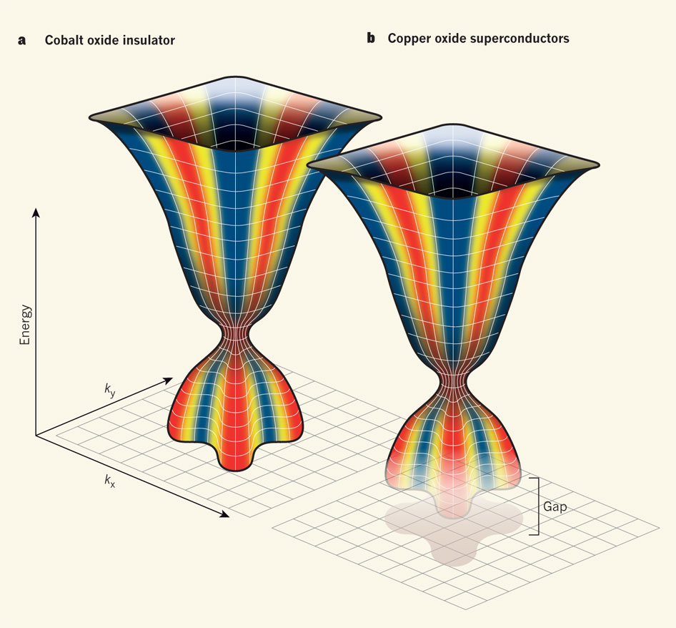
Option 3 – sacrifices
We do not implement order sorting – a unique option
is postponed
We do not cover the full range of scattering angle –
a loss of efficiency.
Y. Li, et. al,
Nature, 468
(2010)
Jan Zaanen
Nature
(2011)

Slide 43
Detector system for option 3
Item | Price [k€]
Detectors | 450
PG | 400
Mounts | 120
Electronics | 400
Cross talk | 100
Detector tank | 500
Frame+rail+motor | 100
Detector safety | 50
Beam monitor/Camera/preamps | 120
S-bender | 200
Heussler analyzers | 1000
Flipper | 100
Guide fields | 200
Total | 3890
Labor for design, installation and commissioning: 510 k€

Slide 44
Sample environment option 3
Possibility 1: A 14 T large bore magnet – 620 k€
(Dy-booster could get us to 16.5 T)
Possbility 2: Design a magnet. No heat shield,
built-in radial collimation large bore – targeted specifications
- 1000 k€

Slide 45
Polarization option 3
Wide angle analyser: Focus on PA for all analysers, more efficient
Heusler: Spin-flip and total cross sections simultaneously, more efficient
on the specific analyser
Item | Price [k€]
S-bender polarizer | 350
Heussler analysers | 850
Flipper | 100
Guide fields | 200
Wide angle PA instead of Heusler | 1500
Total | 1500-2000

Slide 46
WBS breakdown
 | Project Management and integration | Design | Procurement and fabrication | Installation | Cold commissioning | Non labour | Labour | Total
Shielding | € 0 | € 189.000 | € 2.078.750 | € 259.200 | € 0 | € 2.078.750 | € 448.200 | € 2.526.950
Neutron Optics | € 0 | € 27.000 | € 3.040.000 | € 100.000 | € 0 | € 2.960.000 | € 207.000 | € 3.167.000
Choppers | € 0 | € 0 | € 841.000 | € 62.400 | € 20.000 | € 861.000 | € 62.400 | € 923.400
Sample Environment | € 0 | € 100.000 | € 1.000.000 | € 3.840 | € 3.840 | € 1.000.000 | € 107.680 | € 1.107.680
Detector and beam monitor | € 0 | € 350.000 | € 3.740.000 | € 54.000 | € 108.000 | € 3.740.000 | € 512.000 | € 4.252.000
DMSC | € 0 | € 0 | € 0 | € 0 | € 0 | € 0 | € 0 | € 0
Motion control | € 17.400 | € 60.000 | € 112.000 | € 6.000 | € 34.000 | € 77.000 | € 152.400 | € 229.400
Instrument specific Tech equipment | € 1.260.000 | € 0 | € 600.000 | € 21.600 | € 27.000 | € 660.000 | € 1.248.600 | € 1.908.600
Instrument Infrastructure | € 0 | € 27.000 | € 310.000 | € 172.800 | € 0 | € 310.000 | € 199.800 | € 509.800
Vacuum | € 0 | € 0 | € 0 | € 0 | € 0 | € 0 | € 0 | € 0
PSS | € 0 | € 20.000 | € 50.000 | € 30.000 | € 20.000 | € 70.000 | € 50.000 | € 120.000
Contingency |  |  |  |  |  |  |  | € 1.621.931
Phase I |  |  |  |  |  |  |  | € 250.000
TOTAL | € 1.277.400 | € 773.000 | € 11.771.750 | € 709.840 | € 212.840 | € 11.756.750 | € 2.988.080 | € 16.616.761
Man year | 12 | 8 | 0 | 9 | 2 |  |  | 31

Slide 47
WBS breakdown
 | Project Management and integration | Design | Procurement and fabrication | Installation | Cold commissioning | Non labour | Labour | Total
Shielding | € 0 | € 189.000 | € 1.905.500 | € 259.200 | € 0 | € 1.905.500 | € 448.200 | € 2.353.700
Neutron Optics | € 0 | € 27.000 | € 3.020.000 | € 100.000 | € 0 | € 2.950.000 | € 197.000 | € 3.167.000
Choppers | € 0 | € 0 | € 841.000 | € 62.400 | € 20.000 | € 861.000 | € 62.400 | € 923.400
Sample Environment | € 0 | € 100.000 | € 800.000 | € 3.840 | € 3.840 | € 800.000 | € 107.680 | € 907.680
Detector and beam monitor | € 0 | € 350.000 | € 3.890.000 | € 54.000 | € 108.000 | € 3.890.000 | € 512.000 | € 4.402.000
DMSC | € 0 | € 0 | € 0 | € 0 | € 0 | € 0 | € 0 | € 0
Motion control |  | € 0 | € 116.000 | € 15.000 | € 50.000 | € 116.000 | € 65.000 | € 181.000
Instrument specific Tech equipment | € 1.260.000 | € 0 | € 600.000 | € 21.600 | € 27.000 | € 660.000 | € 1.248.600 | € 1.908.600
Instrument Infrastructure | € 0 | € 27.000 | € 310.000 | € 172.800 | € 0 | € 310.000 | € 199.800 | € 509.800
Vacuum | € 0 | € 0 | € 0 | € 0 | € 0 | € 0 | € 0 | € 0
PSS | € 0 | € 20.000 | € 50.000 | € 30.000 | € 20.000 | € 70.000 | € 50.000 | € 120.000
Contingency |  |  |  |  |  |  |  | € 1.592.050
Phase I |  |  |  |  |  |  |  | € 300.000
TOTAL | € 1.260.000 | € 713.000 | € 11.532.500 | € 718.840 | € 228.840 | € 11.562.500 | € 2.890.680 | € 16.365.230
Man year | 12 | 8 | 0 | 9 | 2 |  |  | 31

Slide 48
WBS breakdown
 | Project Management and integration | Design | Procurement and fabrication | Installation | Cold commissioning | Non labour | Labour | Total
Shielding | € 0 | € 189.000 | € 1.905.500 | € 259.200 | € 0 | € 1.905.500 | € 448.200 | € 2.353.700
Neutron Optics | € 0 | € 27.000 | € 3.020.000 | € 100.000 | € 0 | € 2.950.000 | € 197.000 | € 3.167.000
Choppers | € 0 | € 0 | € 841.000 | € 62.400 | € 20.000 | € 861.000 | € 62.400 | € 923.400
Sample Environment | € 0 | € 100.000 | € 800.000 | € 3.840 | € 3.840 | € 800.000 | € 107.680 | € 907.680
Detector and beam monitor | € 0 | € 350.000 | € 3.890.000 | € 54.000 | € 108.000 | € 3.890.000 | € 512.000 | € 4.402.000
DMSC | € 0 | € 0 | € 0 | € 0 | € 0 | € 0 | € 0 | € 0
Motion control |  | € 0 | € 116.000 | € 15.000 | € 50.000 | € 116.000 | € 65.000 | € 181.000
Instrument specific Tech equipment | € 1.260.000 | € 0 | € 600.000 | € 21.600 | € 27.000 | € 660.000 | € 1.248.600 | € 1.908.600
Instrument Infrastructure | € 0 | € 27.000 | € 310.000 | € 172.800 | € 0 | € 310.000 | € 199.800 | € 509.800
Vacuum | € 0 | € 0 | € 0 | € 0 | € 0 | € 0 | € 0 | € 0
PSS | € 0 | € 20.000 | € 50.000 | € 30.000 | € 20.000 | € 70.000 | € 50.000 | € 120.000
Contingency |  |  |  |  |  |  |  | € 1.592.050
Phase I |  |  |  |  |  |  |  | € 300.000
TOTAL | € 1.260.000 | € 713.000 | € 11.532.500 | € 718.840 | € 228.840 | € 11.562.500 | € 2.890.680 | € 16.365.230
Man year | 12 | 8 | 0 | 9 | 2 |  |  | 31

Slide 49
Option 2+
Sharing a magnet with another instrument –
compromise specifications, but
focus on high field.

Slide 50
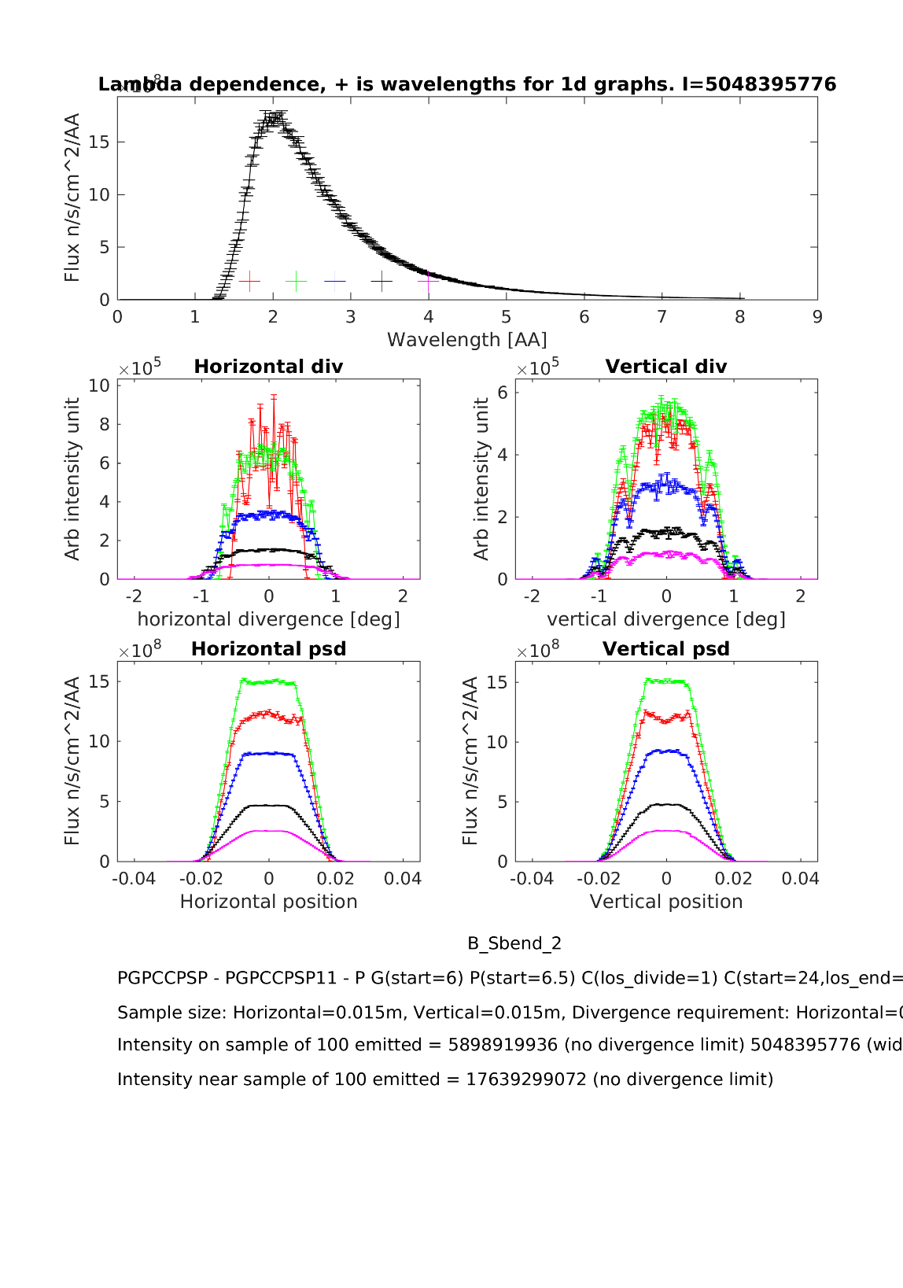
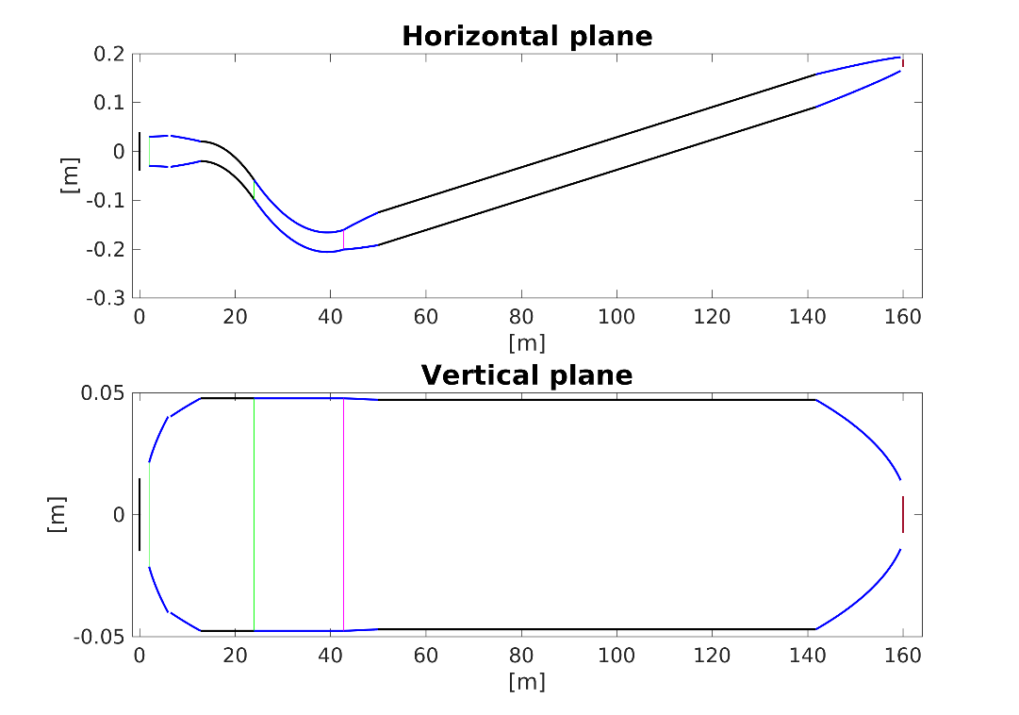
Backup slides

Slide 51






Thank you for your attention

