Slide 1
BEER – Scopes & Budget
Science case and Scopes introduction
Nuclear Physics Institute CAS
Czech Republic
Přemysl Beran
Jan Šaroun
Petr Lukáš
Petr Šittner
Helmholtz-Zentrum Geesthacht
Germany
Jochen Fenske
Dirk Jan Siemers
Martin Müller
Peter Staron
Rüdiger Kiehn
Gregor Nowak
Mustapha Rouijaa
John Hedde
ESS coordinator
Markus Strobl

Slide 2
Outlook
Engineering material overview
Modalities of engineering research
Instrument scientific requirements
Sample environment
BEER instrument overview
Modulation technique
Comparison of performance
Draft Time-line
Scopes introduction and overview

Slide 3
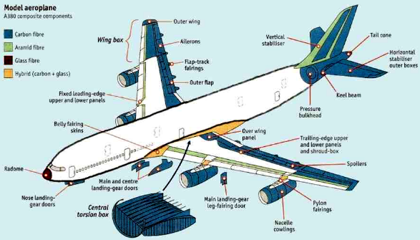
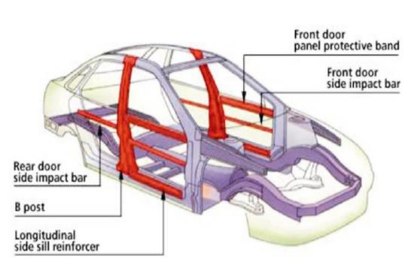
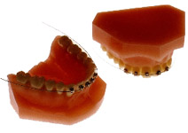
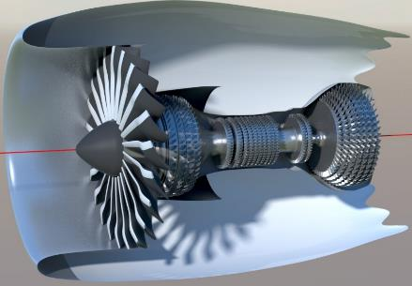
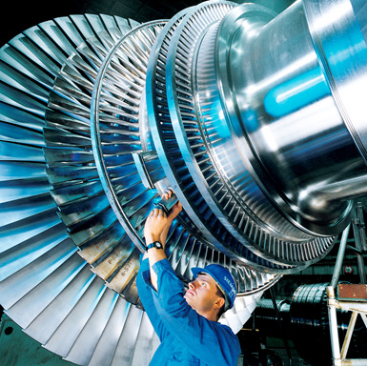
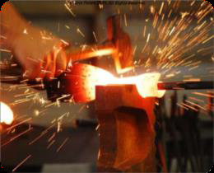
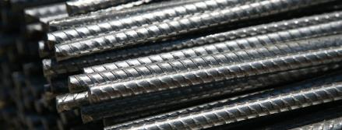
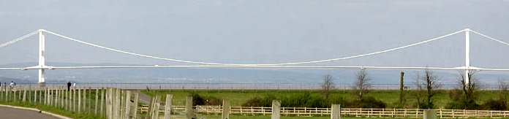
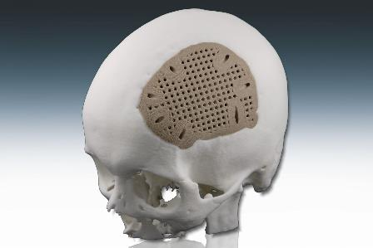
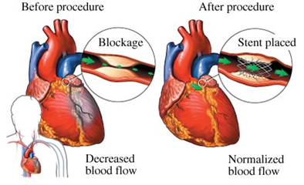
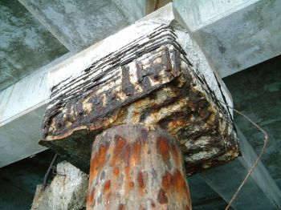
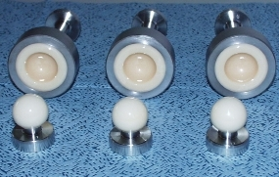
Engineering Materials
Areas of usage

Slide 4
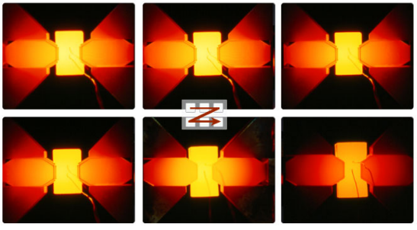
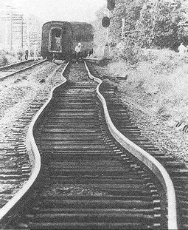
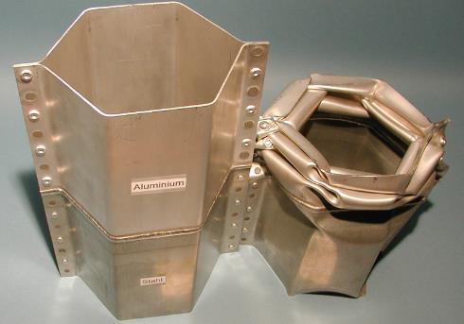
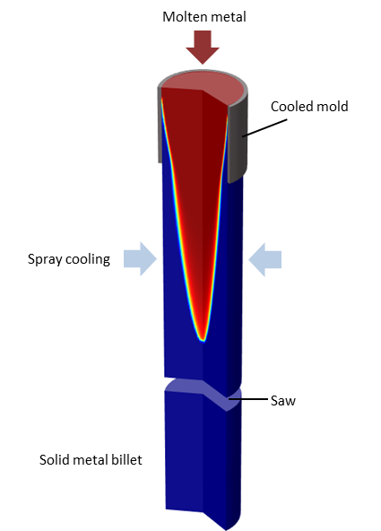
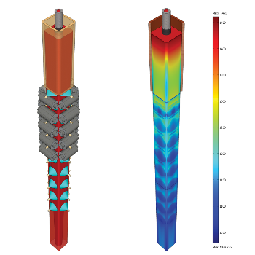
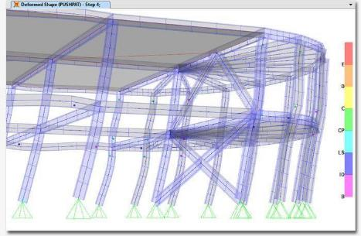
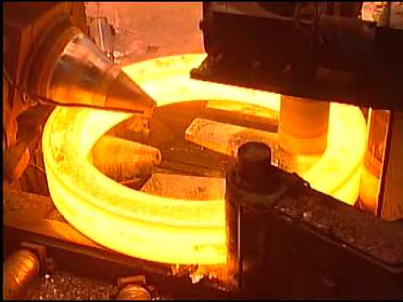
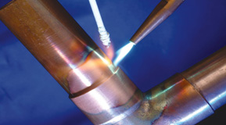
Engineering Materials
Modalities of engineering research
In-situ / in-operando experiments close to the real conditions
  Study the processes to tailor the material properties for application needs
  To optimise thermo-mechanical treatment to reduce production cost
  Understand processes happening during material application

Slide 5
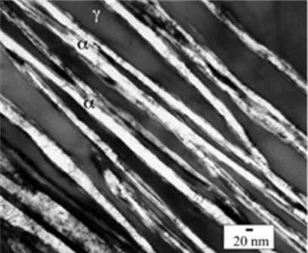
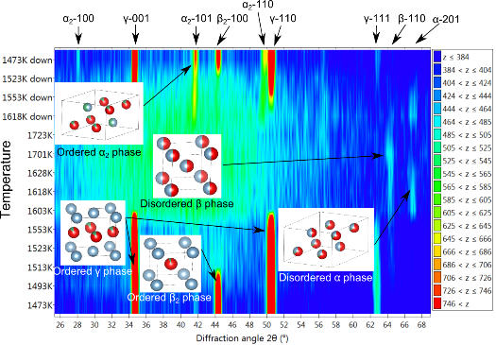
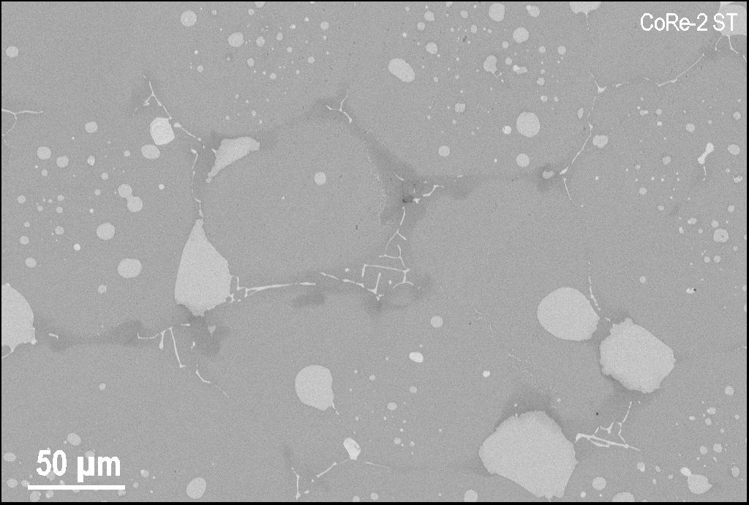
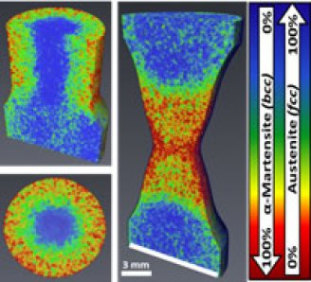
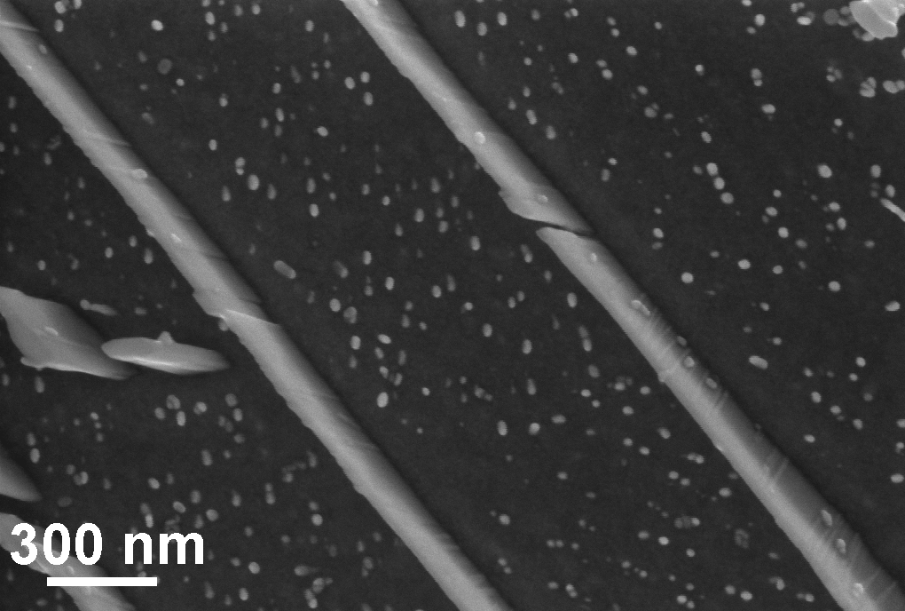
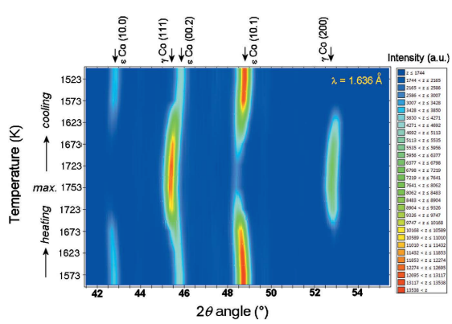
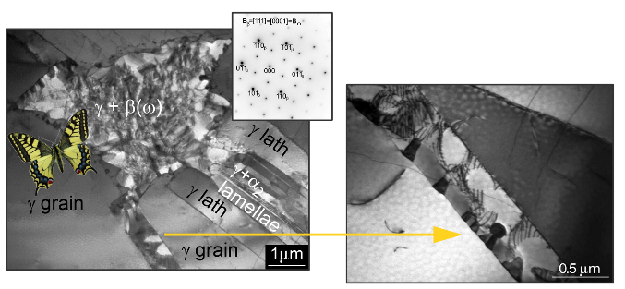
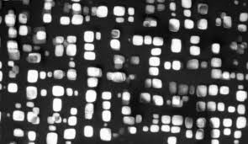
Engineering Materials
Modalities of engineering research
Multi-phase and/or composite materials
  Resolve phases evolution together with microstructure changes
  Multi-scale characterisation
SEM image
σ phase
Cr₂₃C₆ lamellae
TaC

Slide 6
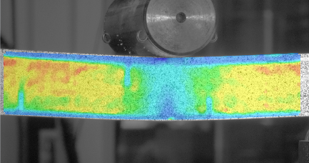
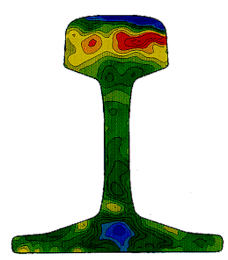
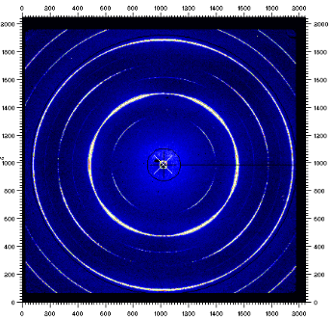
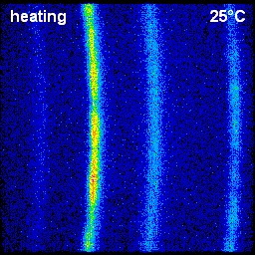
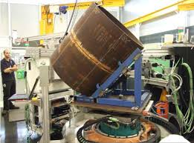
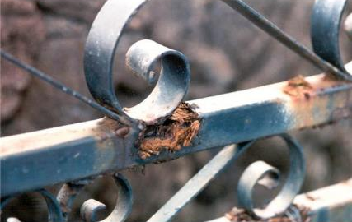
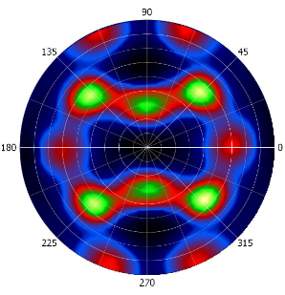
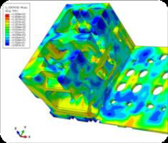
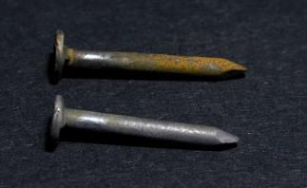
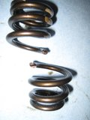
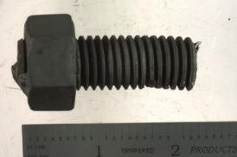
Engineering Materials
Modalities of engineering research
In-situ texture or grain growth evolution
Fast strain scanning
Long-term experiments

Slide 7
Scientific requirements
Scientific requirements linked with instrument modalities
I. In-situ & in-operando experiments
Purpose
• multi-phase structural characterization
• study of complex materials e.g. composites
• study of fast processes with time resolution bellow 1sec in special case enablen measurement at 14 Hz
• in-situ experiments with dedicated sample environment
• multi-scale characterization
• SE driven experiments
Requirement
• Δ d/d resolution down to 0.1%
• d-range from 0.6 to 9 Å
• high flux of ESS pulse
• space and capacity for SE
• SANS and imaging option
• active feedback and advance instrument control
• sample environment
II. Strain scanning
Purpose
• strain mapping from larger volumes
• scanning of big and complex samples
• fast mapping
• strain visualization
• automatic sample handling
Requirement
• high flux using multiplexing
• space and positioning system
• measurement of two components at once
• Bragg edge imaging
• SE in the form of advanced positioning system

Slide 8
Scientific requirements
Scientific requirements linked with instrument modalities
III. Texture and texture evolution
Purpose
• in-situ texture evolution
• fast texture with less sample rotation
• full texture measurement
Requirement
• advanced detector coverage
• advanced positioning system
• sample environment
IV. Long-term experiments
Purpose
• characterization of slow engineering processes
Requirement
• laboratory for ex-situ experiments
• free access to the laboratory
• sample environment

Slide 9
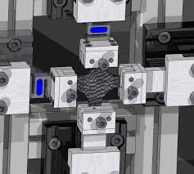
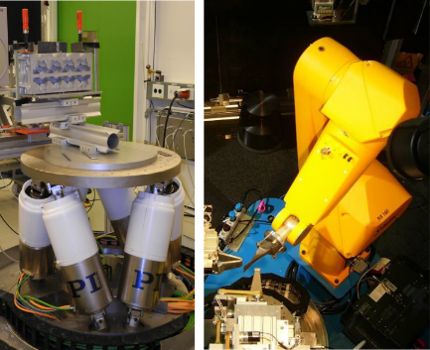
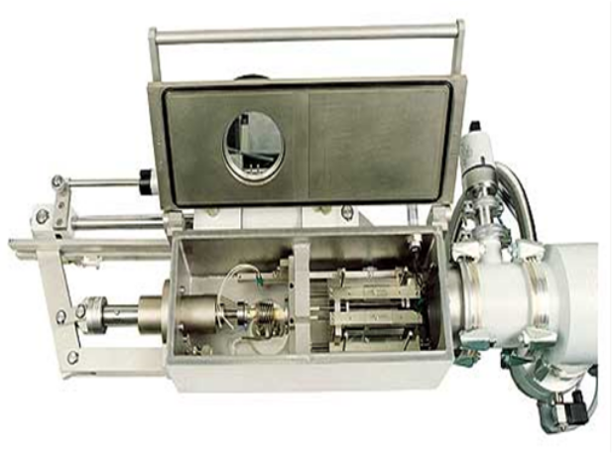
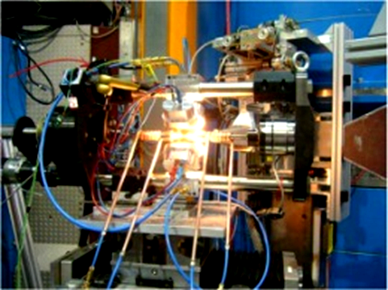
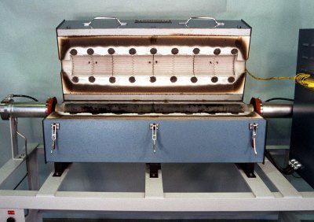
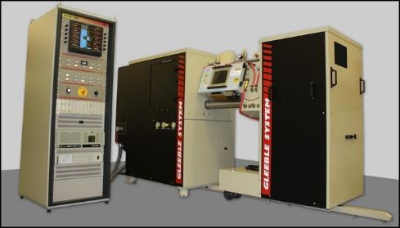
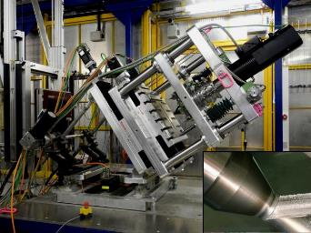
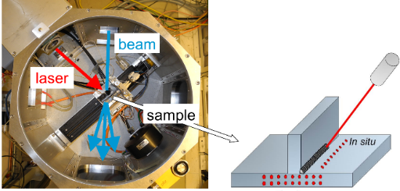
Sample environment
Expected sample environment
Advanced deformation rig with vacuum system
Furnace for the deformation rig up to 1200°C
Advanced positioning system
Dilatometer
Laser and stir welding system
Bi-axial deformation rig
Annealing furnaces
Gleeble®
User defined

Slide 10
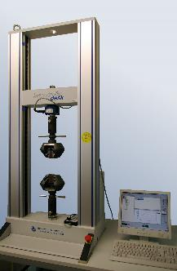
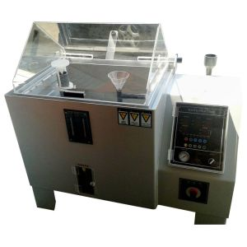
Sample environment
Expected sample environment
Advanced deformation rig with vacuum system
Furnace for the deformation rig up to 1200°C
Advanced positioning system
Dilatometer
Laser and stir welding system
Bi-axial deformation rig
Annealing furnaces
Gleeble®
User defined
Long-term experiments
Collaboration with users
Pool SE
Access to the engineering laboratory
Universal platform for smooth transport
Easy access to the experimental cave
Further support and equipment
Chalmers University and Technical University of Stockholm → development of ultra-height temperature furnace for temperatures up to 1500°C
Lund University and UC Berkeley → development of advanced detector and sample environment for mechanical testing for in-situ TOF imaging

Slide 11
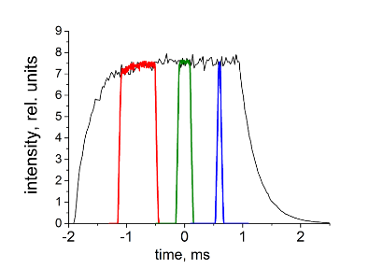






BEER Overview
Reminder of BEER instrument overview

Slide 12

BEER Overview
Instrument infrastructure and neighbourhood
Experimental hall E01
Beam port W2
Neighbours: NMX, C-Spec
Engineering laboratory: 25 m

Slide 13




Modulation technique
Advantages of the BEER instrument
For high symmetric materials
High resolution with high intensity
Enhanced throughput for strain scanning
Special data reduction procedure
Simulation before experiment
Multiplication factor up to 12
MCa: 42 – 280 Hz
Diameter: 700 mm
Slit opening: 16 x 4°
Slit distance: 22.5°

Slide 14
Modulation technique
Advantages of the BEER instrument
For high symmetric materials
High resolution with high intensity
Enhanced throughput for strain scanning
Special data reduction procedure
Simulation before experiment
Multiplication factor up to 12

Slide 15


Comparison
Advantages of the BEER instrument

Slide 16


Comparison
Advantages of the BEER instrument
High versatility in resolution
Tuneable wavelength range mean
Pulse suppression mode (t × 1.7 Å)
High detector coverage (1.6 sr in FS)

Slide 17

Draft time line
Instrument development process and life-cycle
• procurement and construction duration - 4 years
• hot commissioning starts in 2022
• operation in user program from 2023
• staging to full scope

Slide 18

Draft time line
Guide manufacturing time problem
Manufacturing time for:
High m-value (22 m bunker +13 m focussing) is 20 month (2-3 weeks/m)
Transport guide with low m-value (120 m) is 18 month (30 weeks/50 m)
Two manufacturers are needed!

Slide 19
Proposed scopes
Philosophy of proposed scopes
Further presentation sorted by WBS items with direct comparison of each scope
Cost category B instrument
Try to design instrument with advantages (TOF, modulation)
High mandatory items – optics, shielding
Sever reduction of the equipment and functionalities together with the scope
Expensive and difficult to upgrade later
Result: not competitive instrument
World class instrument
Design follows the original proposal
Reduction of the functionalities with easy later upgrade
Competitive and in some cases more advanced instrument
Able to produce flag ship experiments on day-one
Full Scope instrument
All features envisaged by original proposal
Future update in the form of development of sample environment

Slide 20






Proposed scopes
Summary of proposed scopes
Cost category instrument – 12 M€ with detector coverage – 0.125 sr
World class instrument – 18 M€ with detector coverage – 0.5 sr
Full scope instrument – 27 M€ with detector coverage – 1.63 sr
Modalities | Cost category | World class | Full scope
In-situ & In-operando
Strain scanning
Texture evolution
Long-term experiments
Modalities | Cost category | World class | Full scope
In-situ & In-operando
Strain scanning
Texture evolution
Long-term experiments
Modalities | Cost category | World class | Full scope
In-situ & In-operando
Strain scanning
Texture evolution
Long-term experiments

Slide 21
Thank you for your attention

Slide 22
Scientific requirements
Scientific requirements from the Concept of Operation
BEER shall allow the measurement of nuclear and/or magnetic structural data.
BEER shall allow the collection of scattering data in-situ and in-operando using a variety of sample environments.
BEER shall allow the scanning of residual strains within complex shape samples with high throughput.
BEER shall allow the measurement of microstructures (lattice strain, micro-strain, texture, etc.).
BEER shall allow the long-term experiments.
The detector coverage together with the available wavelength bandwidth shall allow access to a sufficient d-range for common engineering materials which is identified as 0.6 - 9 Å.
The detector coverage shall allow the measurement of an almost complete intensity pole figure for texture analysis by rotation of the sample around one sample axis.
The detector coverage shall allow monitoring of partial texture evolution without sample rotation during an in-situ experiment when the sample itself or sample environment does not allow the rotation because of its size and/or technical construction (cryostats, ovens, etc.).
The instrument shall allow measurements of two strain components at once.
The experiment control shall allow users to choose a continuation (besides standard pause procedure) of the material test experiment after an interruption of the neutron beam due to a temporary source failure.
The experiment control shall allow in-situ experiments driven by the sample environment with an active feedback.
BEER shall allow the gauge volume to be adjusted for the experiment down to about 1 mm³.
BEER shall allow data to be collected to d_{min} of about 0.7 Å for detectors at 90°.
BEER shall allow d-resolution (Δd/d) to be optimized for the experiment (0.1% < Δd/d < 0.8 %) by trading intensity for resolution.
BEER shall provide sufficient space for large sample environments.
BEER shall allow the placement of heavy samples and/or sample environment with a total weight up to 3 tonnes.
BEER should allow for collecting SANS data simultaneously with diffraction.
BEER should allow for direct imaging over a 40x40mm² field of view with energy resolution sufficient for Bragg edge contrast enhancement.

