Slide 1
BEER – Scopes & Budget
Nuclear Physics Institute CAS
Czech Republic
Přemysl Beran
Jan Šaroun
Petr Lukáš
Petr Šittner
Helmholtz-Zentrum Geesthacht
Germany
Jochen Fenske
Dirk Jan Siemers
Martin Müller
Peter Staron
Rüdiger Kiehn
Gregor Nowak
Mustapha Rouijaa
John Hedde
ESS coordinator
Markus Strobl

Slide 2
BEER – Budget & Configuration
Cost Category Instrument 11.994.402 €
World Class Instrument 17.935.509 €
Full Scope Instrument 27.265.819 €
stay in budget
deliver best performance possible within budget
be competitive or even better than other engineering diffractometers
keep flexibility (resolution/intensity, …)
easy to upgrade
BEER proposal with revised budget
be competitive or even better than other engineering diffractometers

Slide 3
BEER Overview
01 Shielding & 02 Neutron Optics
03 Choppers
04 Sample Environment
05 Detectors and Beam Monitors
08 Instrument Specific Technical Equipment
09 Instrument Infrastructure
Others (06 DMSC, 07 MCA, 10 Vacuum, 11 PSS)

Slide 4
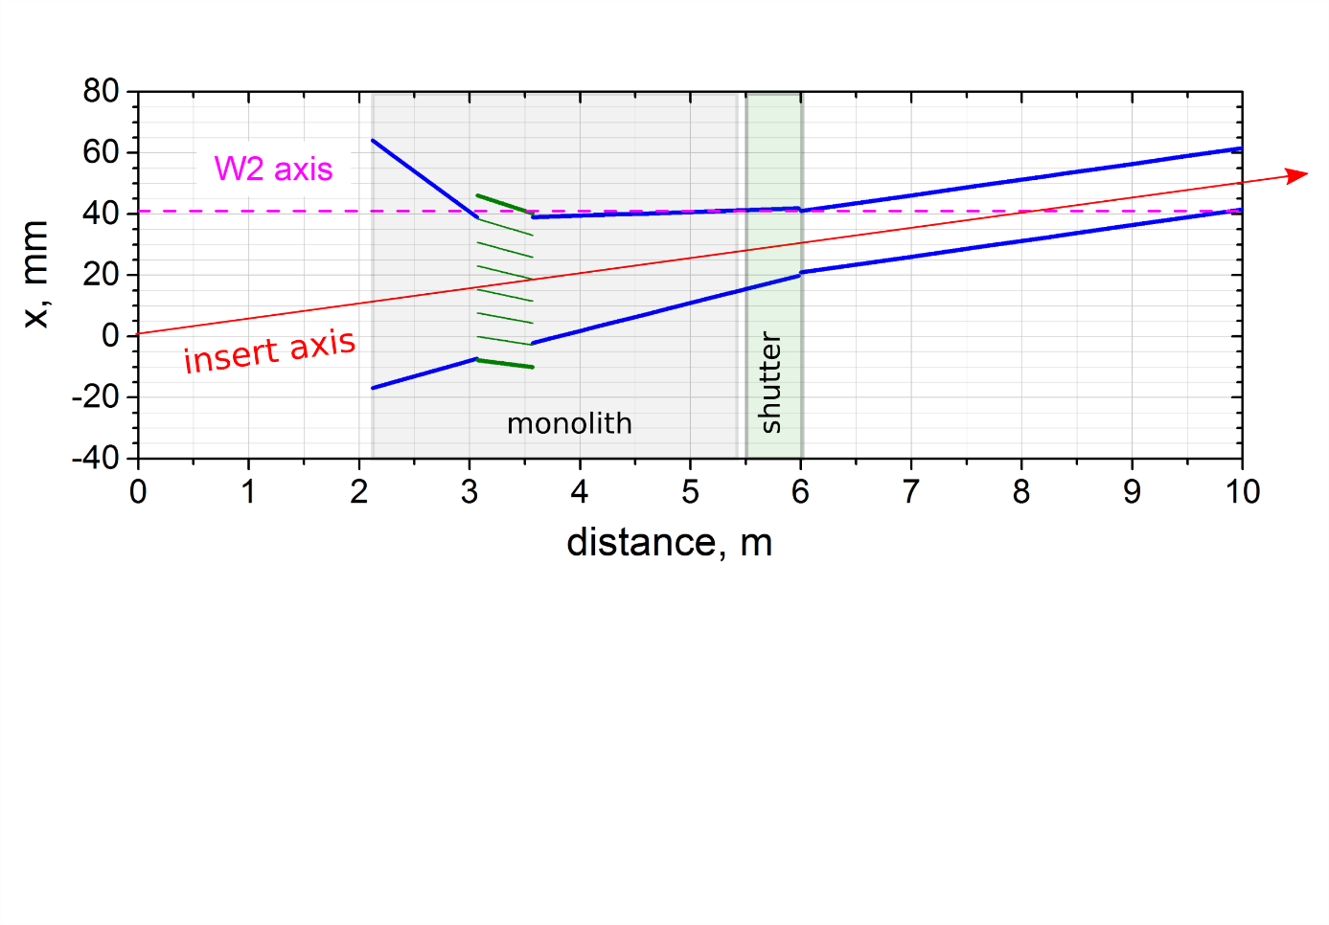
Neutron Optics Monolith Insert
Focusing at the thermal moderator:
beam axis angle: + 0.295 deg
beam axis shift: -30 mm at the entry -10 mm at the shutter
bi-spectral extraction
Si blades, m=4, t=0.5 mm
y, mm
m=4
beam axis
m=4
m=0 ?
narrow beam section with choppers
Horizontal guide profile with the monolith insert.
2.12 m

Slide 5
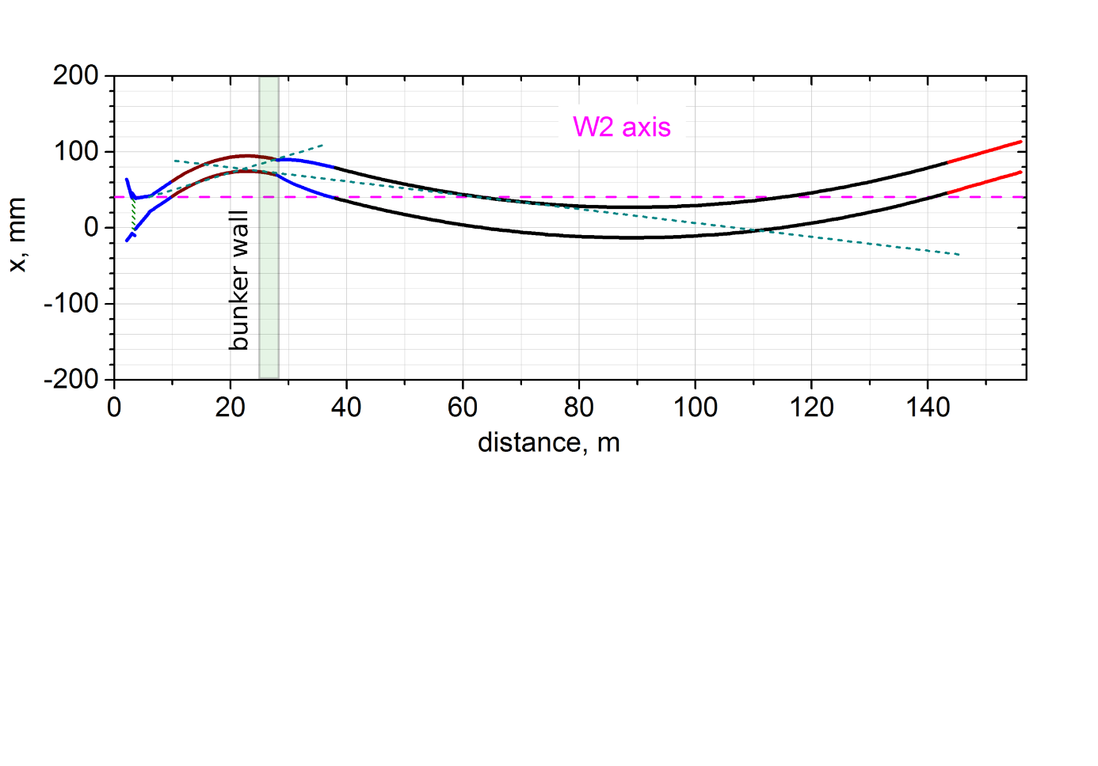
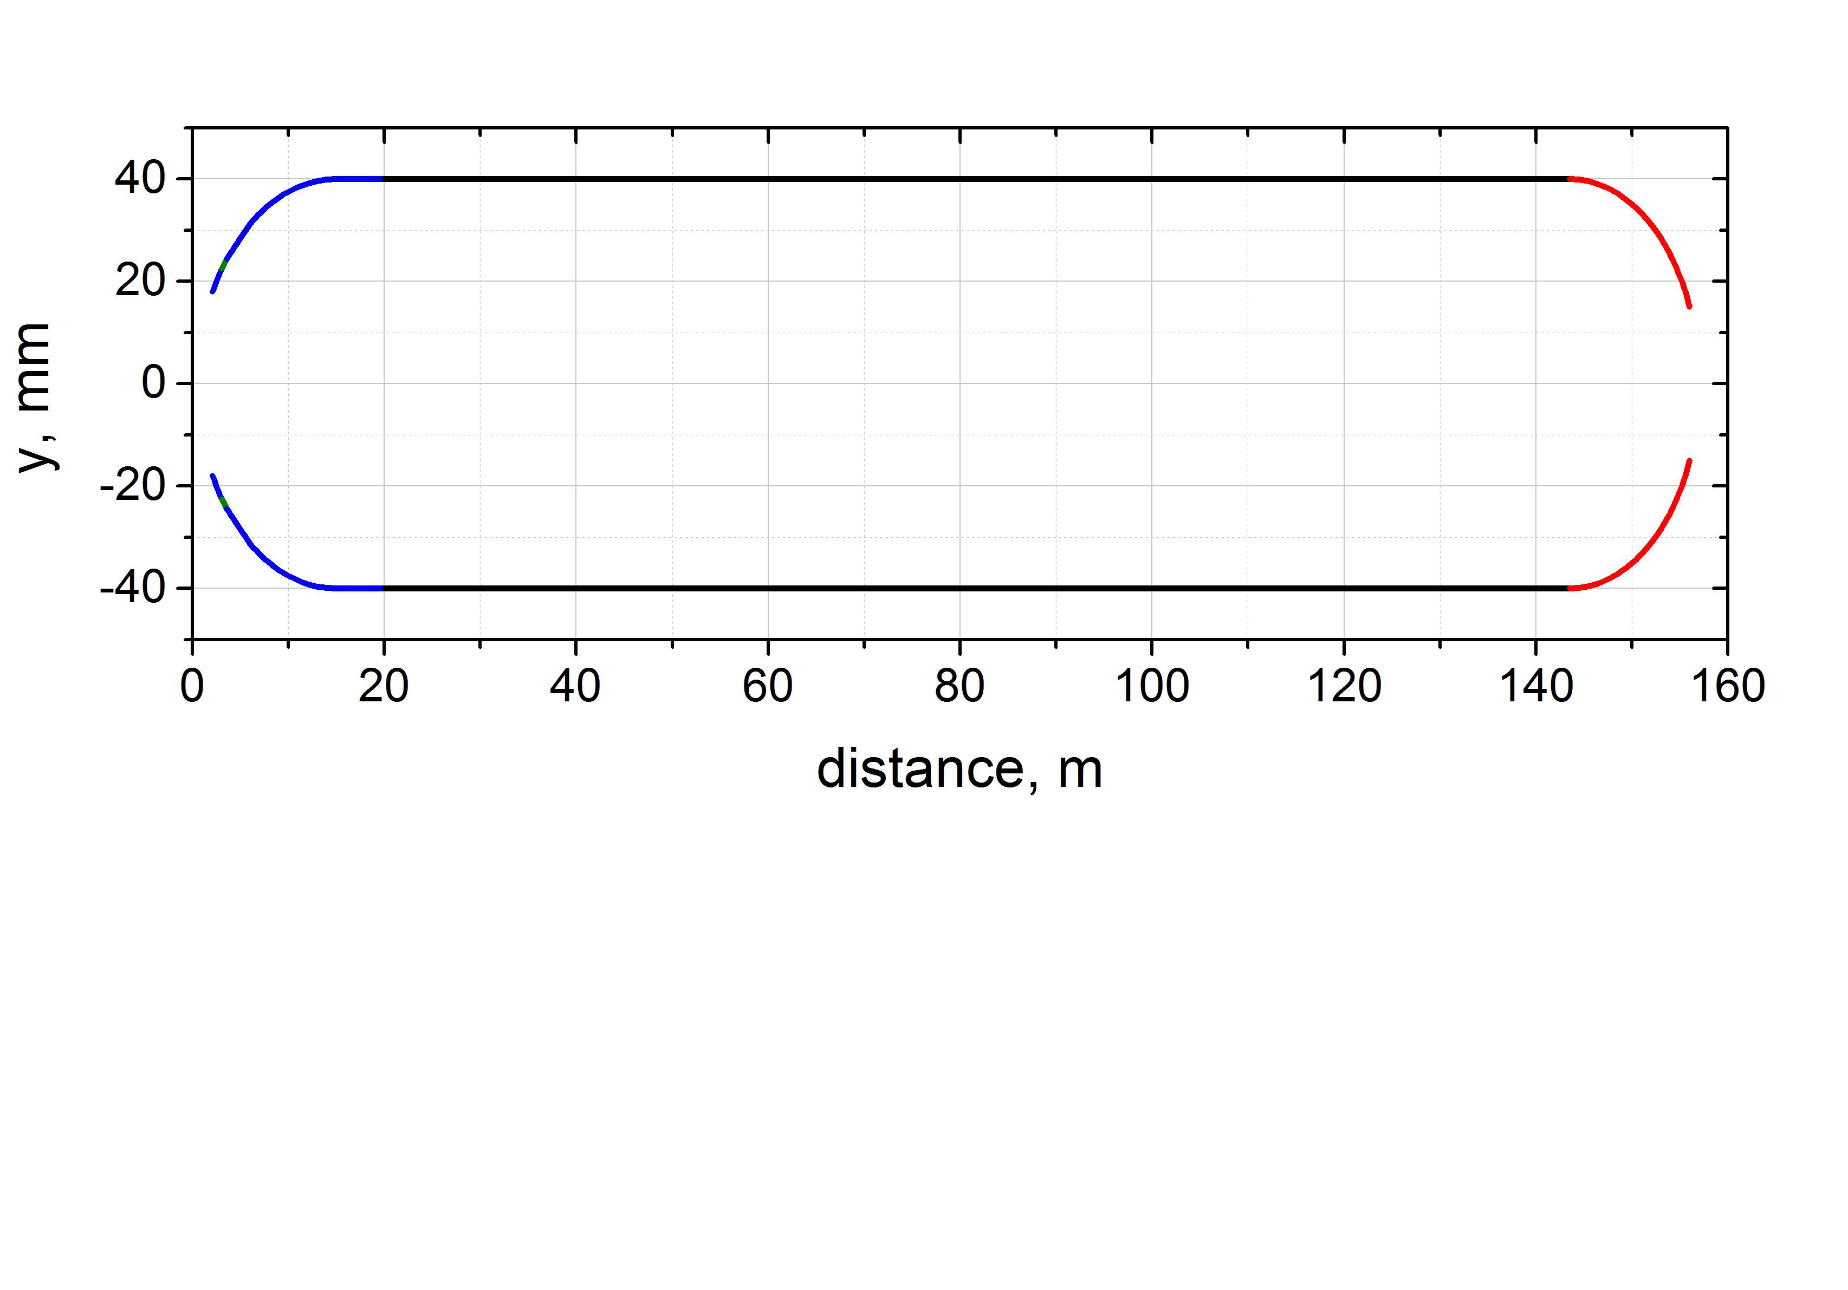
Neutron Optics Guide Profile
horizontal
DLS closed once inside the bunker,
2nd closure is outside (dashed green lines).
Guide 1:
width = 2 cm
length = 18 m
R = -2 km
Guide 2:
width = 4 cm
length = 105.5 m
R = 25 km
beam expansion, w= 2 cm -> 4 cm, length=10 m
vertical
m=2.5
Focused at the top moderator ( 3cm).
z, mm
m=4 to 2.5
m=2.5 to 5
The profile results from numerical optimization
and subsequent trade-off between cost and
performance.
Vertical divergence at the sample ~ 30 mrad.

Slide 6
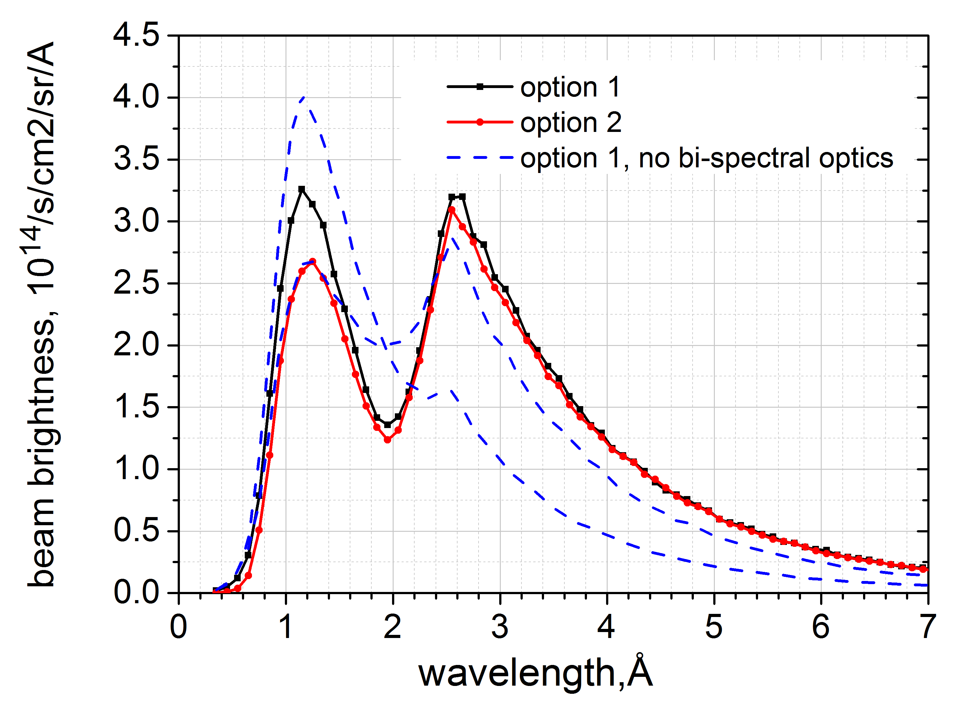
Neutron Optics Performance
Beam brightness at the sample
Option 2:
yields less thermal neutrons
saves shielding cost
dashed curves: beam axis focused near the moderators boundary

Slide 7
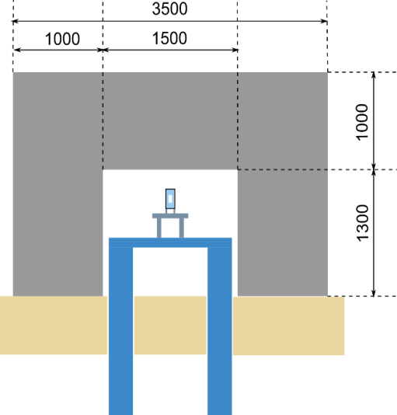
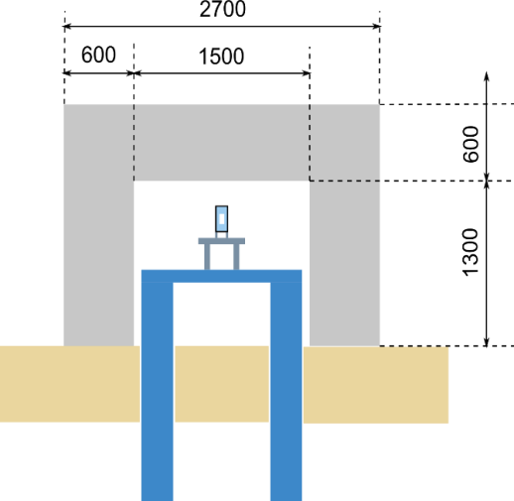
Shielding
Guide Shielding
DLS closed
-1 m
Before DLS
After DLS
hd concrete
hd concrete

Slide 8
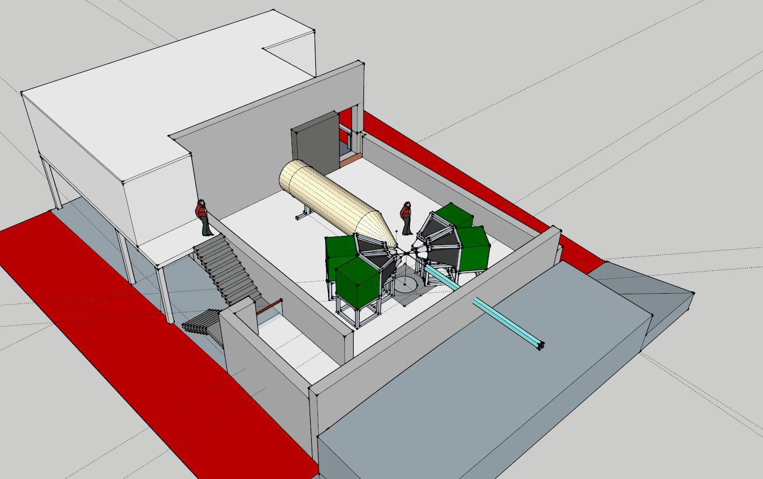
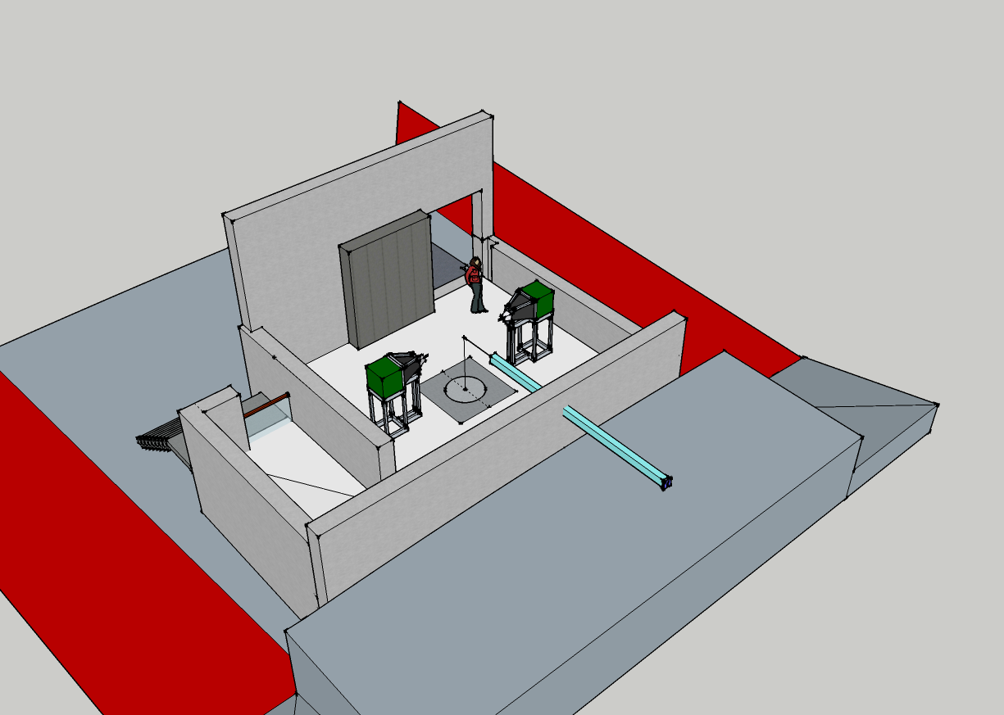
Shielding
Experimental Cave
Cost Category: reduced size
Cave shielding
(Ø 50 cm hd concrete)
12 m
8 m
Laboratories
7 m
10 m
Guide Hall
8

Slide 9
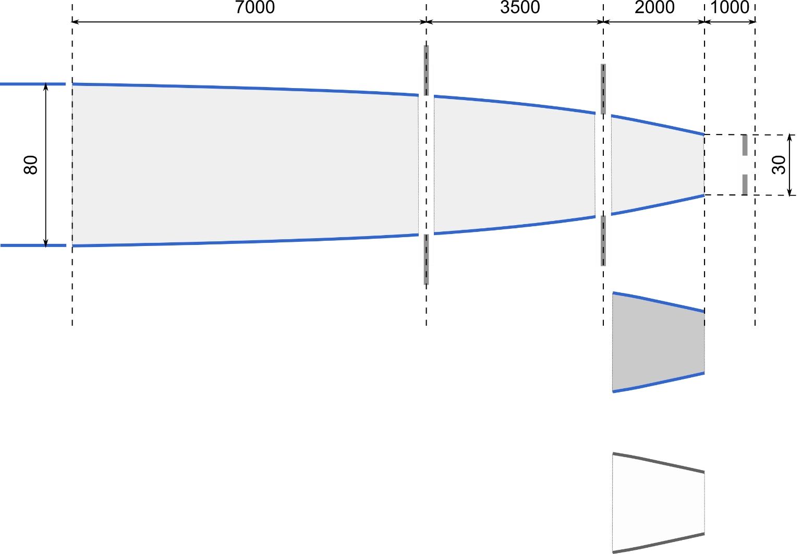
Neutron Optics Focusing Guide
World Class: only two options
Cost Category: no guide exchanger
sample axis
S1
S2
divergence
S3
Beam shaping optics:
vertically focusing guide with exchangeable end section
2 adjustable divergence slits (S1, S2)
adjustable slit S3 for gauge volume definition, variable distance
guide exchanger
wall
absorbing walls

Slide 10
01 Shielding & 02 Neutron Optics Budget
 | Cost Category | World Class | Full Scope
01 Shielding | 2.749.142 | 3.020.398 | 3.020.398
guide shielding + shutters | 2.308.518 | 2.362.118 | 2.362.118
cave shielding | 440.624 | 658.280 | 658.280
02 Neutron Optics | 2.643.000 | 2.791.000 | 2.891.000
Insert+ BS switch | 194.000 | 194.000 | 194.000
chopper section | 98.000 | 98.000 | 98.000
expansion part | 324.000 | 324.000 | 324.000
narrow bent guide | 297.000 | 297.000 | 297.000
transport guide | 1.470.000 | 1.470.000 | 1.470.000
focusing guide | 230.000 | 303.000 | 403.000
adjustable slits 3x | 30.000 | 30.000 | 30.000
guide exchanger |  | 75.000 | 75.000

Slide 11
BEER Overview
01 Shielding & 02 Neutron Optics
03 Choppers
04 Sample Environment
05 Detectors and Beam Monitors
08 Instrument Specific Technical Equipment
09 Instrument Infrastructure
Others (06 DMSC, 07 MCA, 10 Vacuum, 11 PSS)

Slide 12
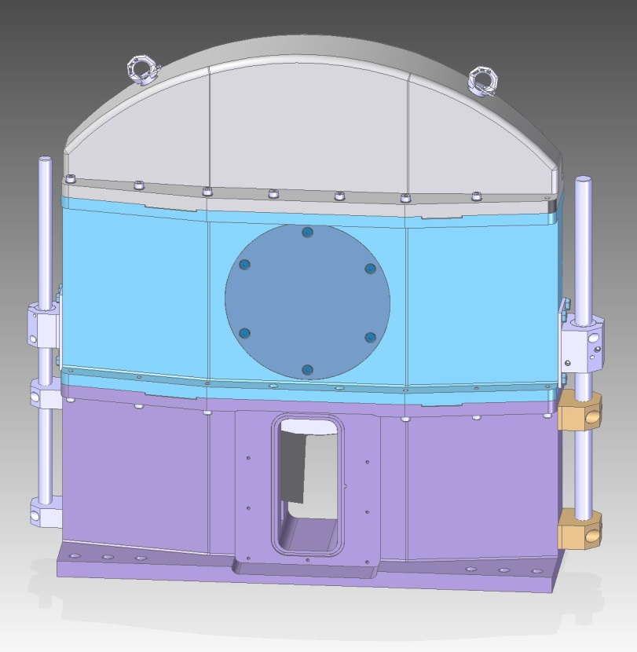
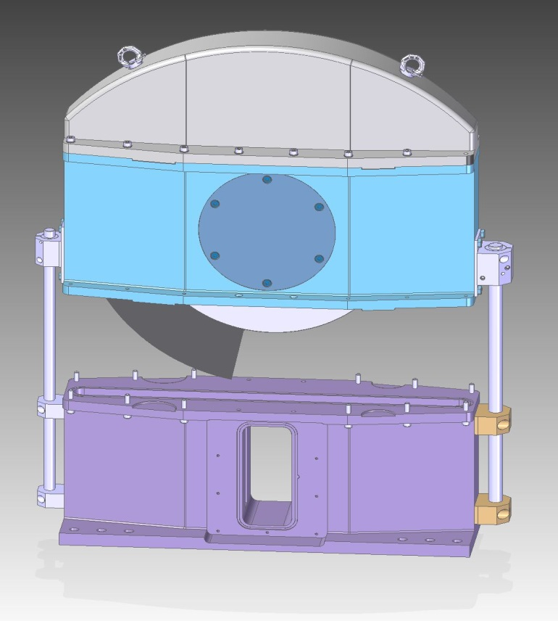
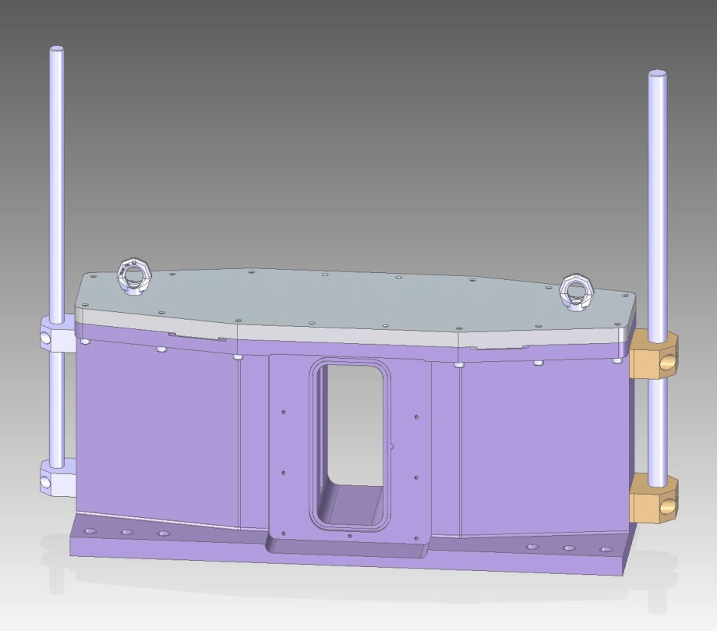
Chopper System
Housing
Crane (Lifting)
Lid
Part B
Part A
Motor position
(spindle)
Lid: to guarantee vacuum
Chopper
→remove of chopper without dismantling of the guide

Slide 13
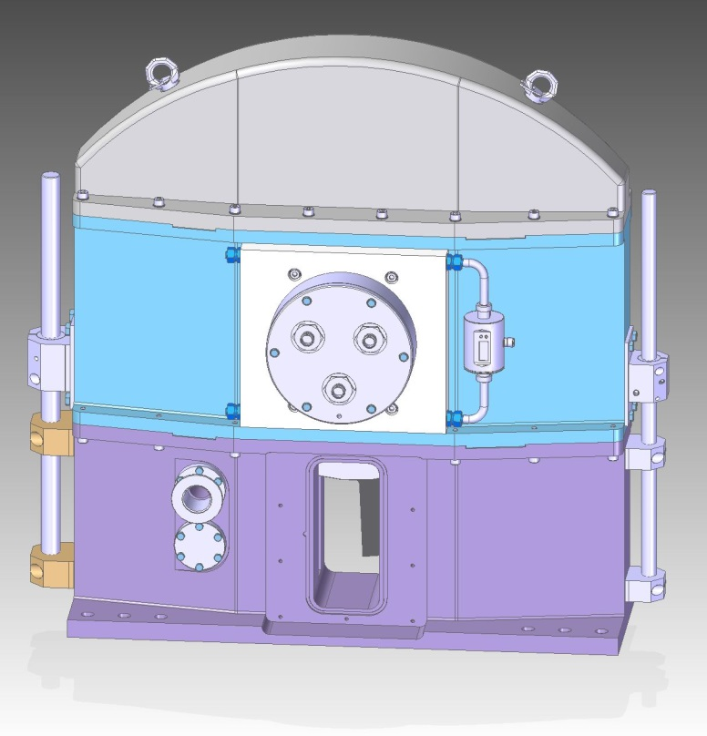
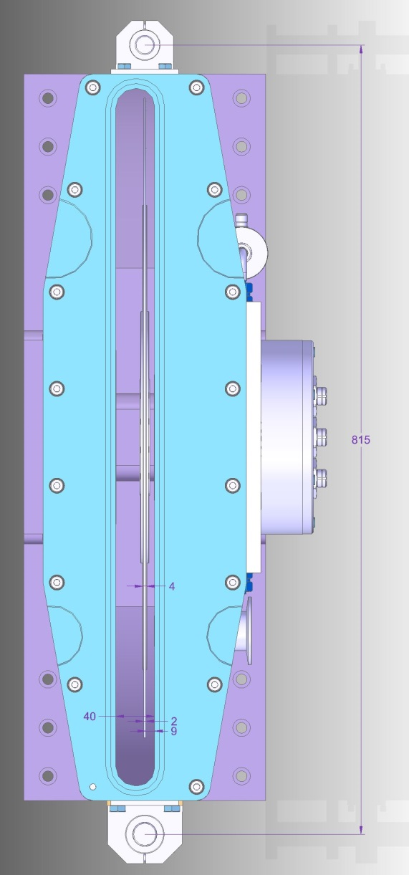
Chopper System
Housing
Front
Back
Top
Part B
Part A
Vacuum, etc.
Cooling
Chopper
Bearing position

Slide 14
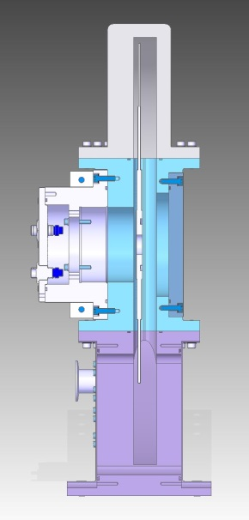
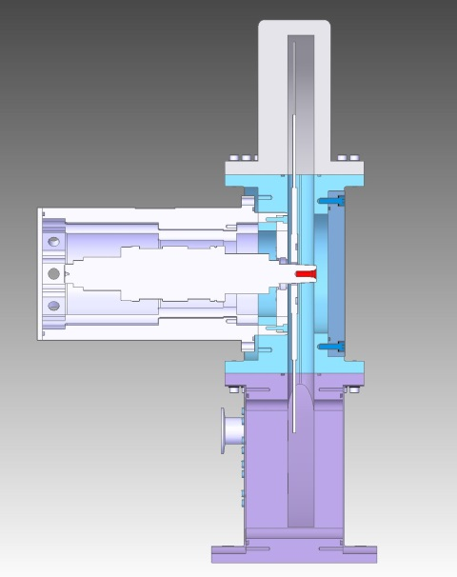
Chopper System
Bearing System
Ball bearing
Magnetic bearing
Supplier recommendations:
For FAST choppers (fmax ≥ 168 Hz)
→ magnetic bearings
For SLOW choppers (fmax ≤ 70 Hz)
→ hybrid ball bearings
Reliability: almost the same
Cost: lower costs
For slower choppers (fmax ≤ 42 Hz)
→ hybrid ball bearings
Reliability: even better

Slide 15
Chopper System
Bearing System
Chopper | Name | Function | Speed [Hz] | Bearing Alternative 1 | Bearing Alternative 2
1 | PSC1 (fast) | Pulse Shaping | 168 | Magnetic | Magnetic
2 | PSC2 (fast) | Pulse Shaping | 168 | Magnetic | Magnetic
3 | PSC3 (fast) | Pulse shaping | 168 | Magnetic | Magnetic
4 | MCa (fast) | Modulation | 42-300 | Magnetic | Magnetic
5 | MCb (fast) | Modulation | 42-300 | Magnetic | Magnetic
6 | MCc (slow) | Modulation | 42-70 | Ball | Magnetic
7 | FC1a (slow) | Framing | 14/7 | Ball | Magnetic
8 | FC1b (slow) | Framing | 63/70 | Ball | Magnetic
9 | FC2a (slow) | Framing | 14 | Ball | Magnetic
10 | FC2b (slow) | Framing | 7 | Ball | Magnetic

Slide 16
Chopper System
Overview
Pulse Shaping Chopper
Frame definition Chopper
Modulation Chopper

Slide 17
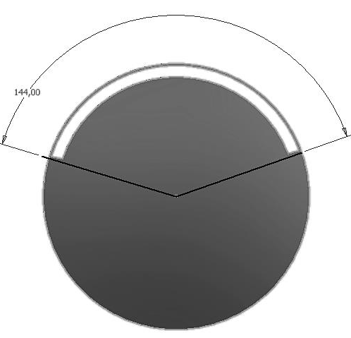
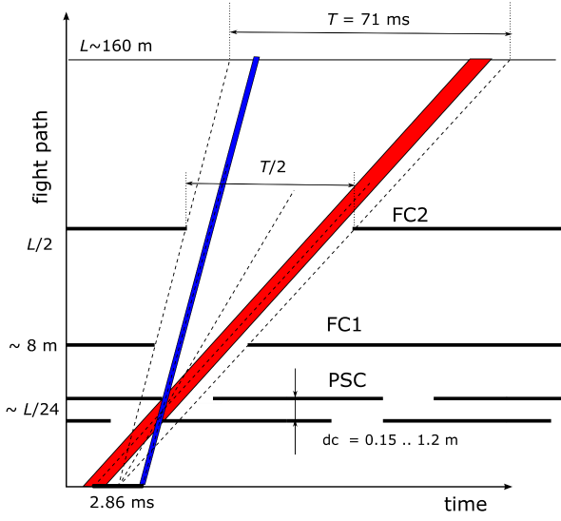
Chopper System
Pulse Shaping
at ~ 6.5m
-Diameter: 700 mm
-Slit opening: 144°
- frequency: 168 Hz
-Diameter: 700 mm
-Slit opening: 144°
- frequency: 168 Hz
FC1a
FC1b
PSC1
PSC2
optically blind setting provides:
constant Δλ/λ, independent on wavelength
broad variety of resolution options

Slide 18
Chopper System
Overview
Pulse Shaping Chopper
Frame definition Chopper
Modulation Chopper

Slide 19
Chopper System
Pulse Modulation
MCa at ~8.95m
MCb at ~ 9m
Diameter: 700 mm
Slit opening: 16 x 4°
Slit distance: 22.5°
MCc at ~ 9.5m
Diameter: 700 mm
Slit opening: 4 x 4°
Slit distance: 90°
Diameter: 700 mm
Slit opening: 7 x 4°
(slit distance 22.5°)
+ 1 x 180°
T = 17%
for high symmetric materials
T = 4.4%
for low symmetric materials
T1 = 17%, T2 = 100%
to combine SANS and Diffraction

Slide 20
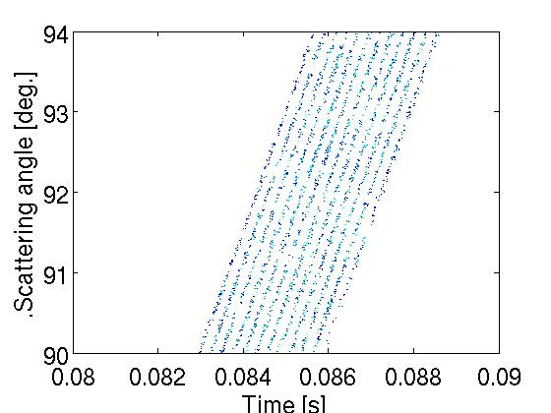
Chopper System
Performance
Resolution:
Pulse Modulation :
Pulse Shaping:
Pulse Modulation:
+ high intensity, high resolution for high symmetric materials
- overlap of reflections for low symmetric materials possible
→ avoid overlap with frequency below 42Hz → low resolution

Slide 21
Chopper System
Overview
Pulse Shaping Chopper
Frame definition Chopper
Modulation Chopper

Slide 22
Chopper System
Frame Definition
FC1:
limits the range of wavelengths and
blocks undesired overlaps
FC1a at ~ 8.28m
FC1b at ~ 8.32m
Diameter: 700 mm
Slit opening: 70°
frequency: 14 Hz or 7 Hz
Diameter=700 mm
Slit opening: 180°
frequency: 63 Hz or 70 Hz
Pair of FC1
FC2:
operates with FC1 to set the wavelength frame
FC2a at ~ 79.55m
FC2b at ~ 79.59m
Diameter: 700mm
Slit opening: 180°
frequency: 14 Hz
Diameter: 700 mm
Slit opening: 90°
frequency: 7 Hz
FC1b
FC2b
Pair of FC2

Slide 23
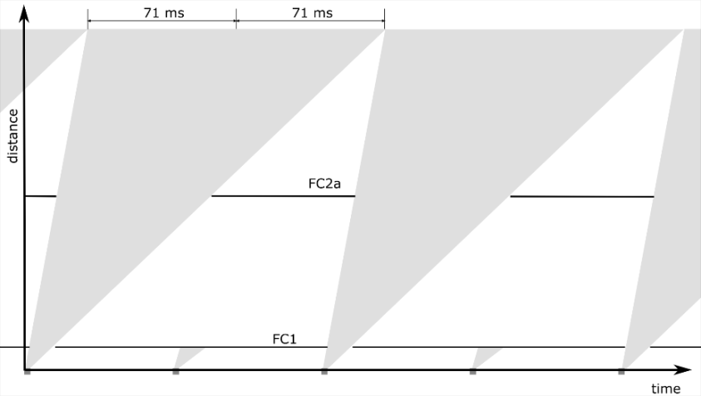
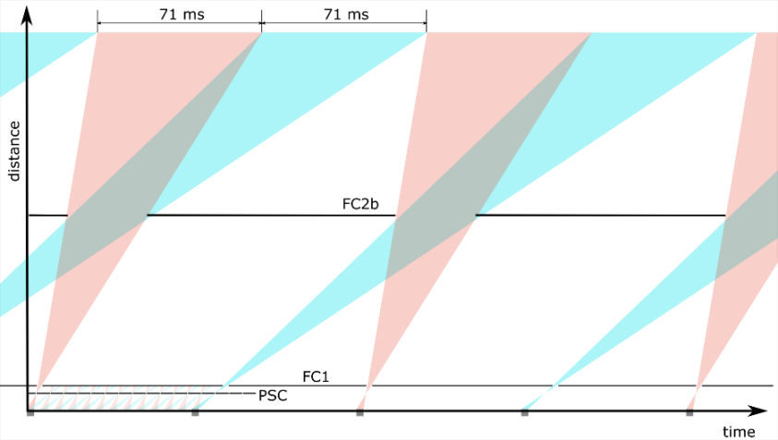
Chopper System
Performance
Pulse suppression
(2 x 1.7Å)
Alternating wavelength frames
Only thermal or cold neutrons reach
the sample successively

Slide 24
Chopper System
Performance
pulse n: thermal
pulse n+1: cold
Adequate setting of FC1a and FC1b
pre-selection of thermal and cold neutrons in successive pulses

Slide 25
Chopper System
Overview
Cost Category
+ high intensity for high symmetric materials
- almost limited to high symmetric materials
- no extension of wavelength-band
World Class
+ high flexibility (wide resolution range)
- no combination of diffraction and SANS
Pulse Shaping Chopper
Frame definition Chopper
Modulation Chopper

Slide 26
03 Choppers Budget
 | Cost Category | World Class | Full Scope
03 Choppers | 490.050 | 1.990.900 | 2.207.450
PSC1 |  | 218.500 | 218.500
PSC2 |  | 191.550 | 191.550
PSC3 |  | 191.550 | 191.550
CHIM |  | 150.000 | 150.000
MCa | 233.500 | 206.550 | 206.550
MCb |  | 206.550 | 206.550
MCc |  |  | 176.550
CHIM | 40.000 | 40.000 | 80.000
FC1a |  | 176.550 | 176.550
FC1b |  | 176.550 | 176.550
CHIM |  | 40.000 | 40.000
FC2a |  | 176.550 | 176.550
FC2b | 176.550 | 176.550 | 176.550
CHIM | 40.000 | 40.000 | 40.000

Slide 27
BEER Overview
01 Shielding & 02 Neutron Optics
03 Choppers
04 Sample Environment
05 Detectors and Beam Monitors
08 Instrument Specific Technical Equipment
09 Instrument Infrastructure
Others (06 DMSC, 07 MCA, 10 Vacuum, 11 PSS)

Slide 28
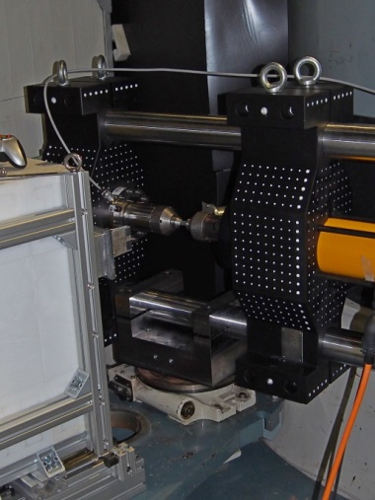
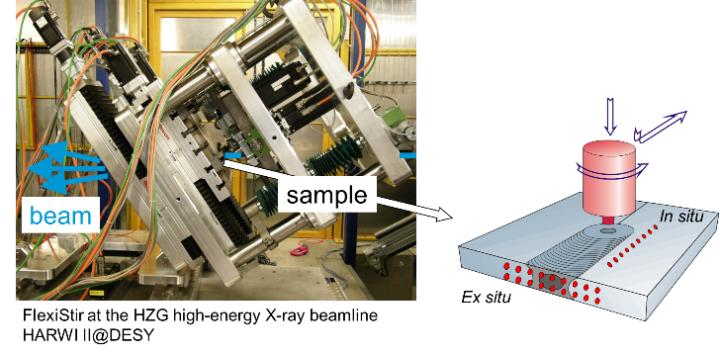
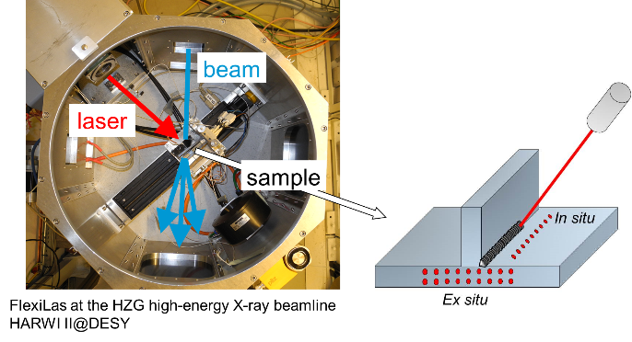
Sample Environment Overview
Stress rig:
Cost Category
World Class
Welding devices:
friction stir welding
max. force 60 kN
vacuum chamber
resistive and inductive heating 1100° C
laser welding
Dilatometer:
commercial dilatometer (Bähr 805 A/D)
induction heating: – max. heating rate 4000 K/s – max. cooling rate 2500 K/s (hollow samples)
DSC unit
deformation units (compr., tension; 25 kN)

Slide 29
04 Sample Environment Budget
 | Cost Category | World Class | Full Scope
04 Sample Environment | 0 | 330.000 | 1.130.000
Stress-rig + furnace | 0 | 300.000 | 300.000
Coordinate measuring machine | 0 | 30.000 | 30.000
Laser and stir welding | 0 | 0 | 400.000
Dilatometer | 0 | 0 | 400.000
+ pool SE and other collaborations

Slide 30
BEER Overview
01 Shielding & 02 Neutron Optics
03 Choppers
04 Sample Environment
05 Detectors and Beam Monitors
08 Instrument Specific Technical Equipment
09 Instrument Infrastructure
Others (06 DMSC, 07 MCA, 10 Vacuum, 11 PSS)

Slide 31
Detectors
Overview
Requirements:
D1 – D4: 1 x 1 m² (res. 2 mm x 5 mm)
arc: 3 x (0.5 x 0.5 m²) (res. 5 mm x 5mm)
SANS: 0.5 x 0.5 m² (res. 5 mm x 5 mm)
D5 (backscattering): 0.5 x 0.5 m²
(res. 5 mm x 5 mm)
Imaging: → ODIN
η > 60 % ( 2 Å)
countrate < 10⁶ 1/s (global)
D1 - D2: 0.5 x 0.5 m² (res. 5 mm x 5 mm)
Technologies:
¹⁰B₄C converter blades
MWPC
FPGA readout
Cost Category
World Class

Slide 32
Detectors
Overview
Requirements:
D1 – D4: 1 x 1 m² (res. 2 mm x 5 mm)
arc: 3 x (0.5 x 0.5 m²) (res. 5 mm x 5mm)
SANS: 0.5 x 0.5 m² (res. 5 mm x 5 mm)
D5 (backscattering): 0.5 x 0.5 m²
(res. 5 mm x 5 mm)
Imaging: → ODIN
η > 60 % ( 2 Å)
countrate < 10⁶ 1/s (global)
D1 - D2: 0.5 x 0.5 m² (res. 5 mm x 5 mm)
Instrument (option) | sample-dete. dis. | Detector size [m²] | Detector coverage [sr]
BEER (FS) | 1.2 m - 2 m | 5.25 | 1.63
BEER (WC) | 2 m | 2 | 0.5
BEER (CC) | 2 m | 0.5 | 0.125
TAKUMI | 2 m | 2.46 | 0.62
ENGIN-X | 1.53 m | 2.06 | 0.88
VULCAN | 2 m | 1.75 | 0.44
SMARTS | 1.50 m | 1.30 | 0.58

Slide 33
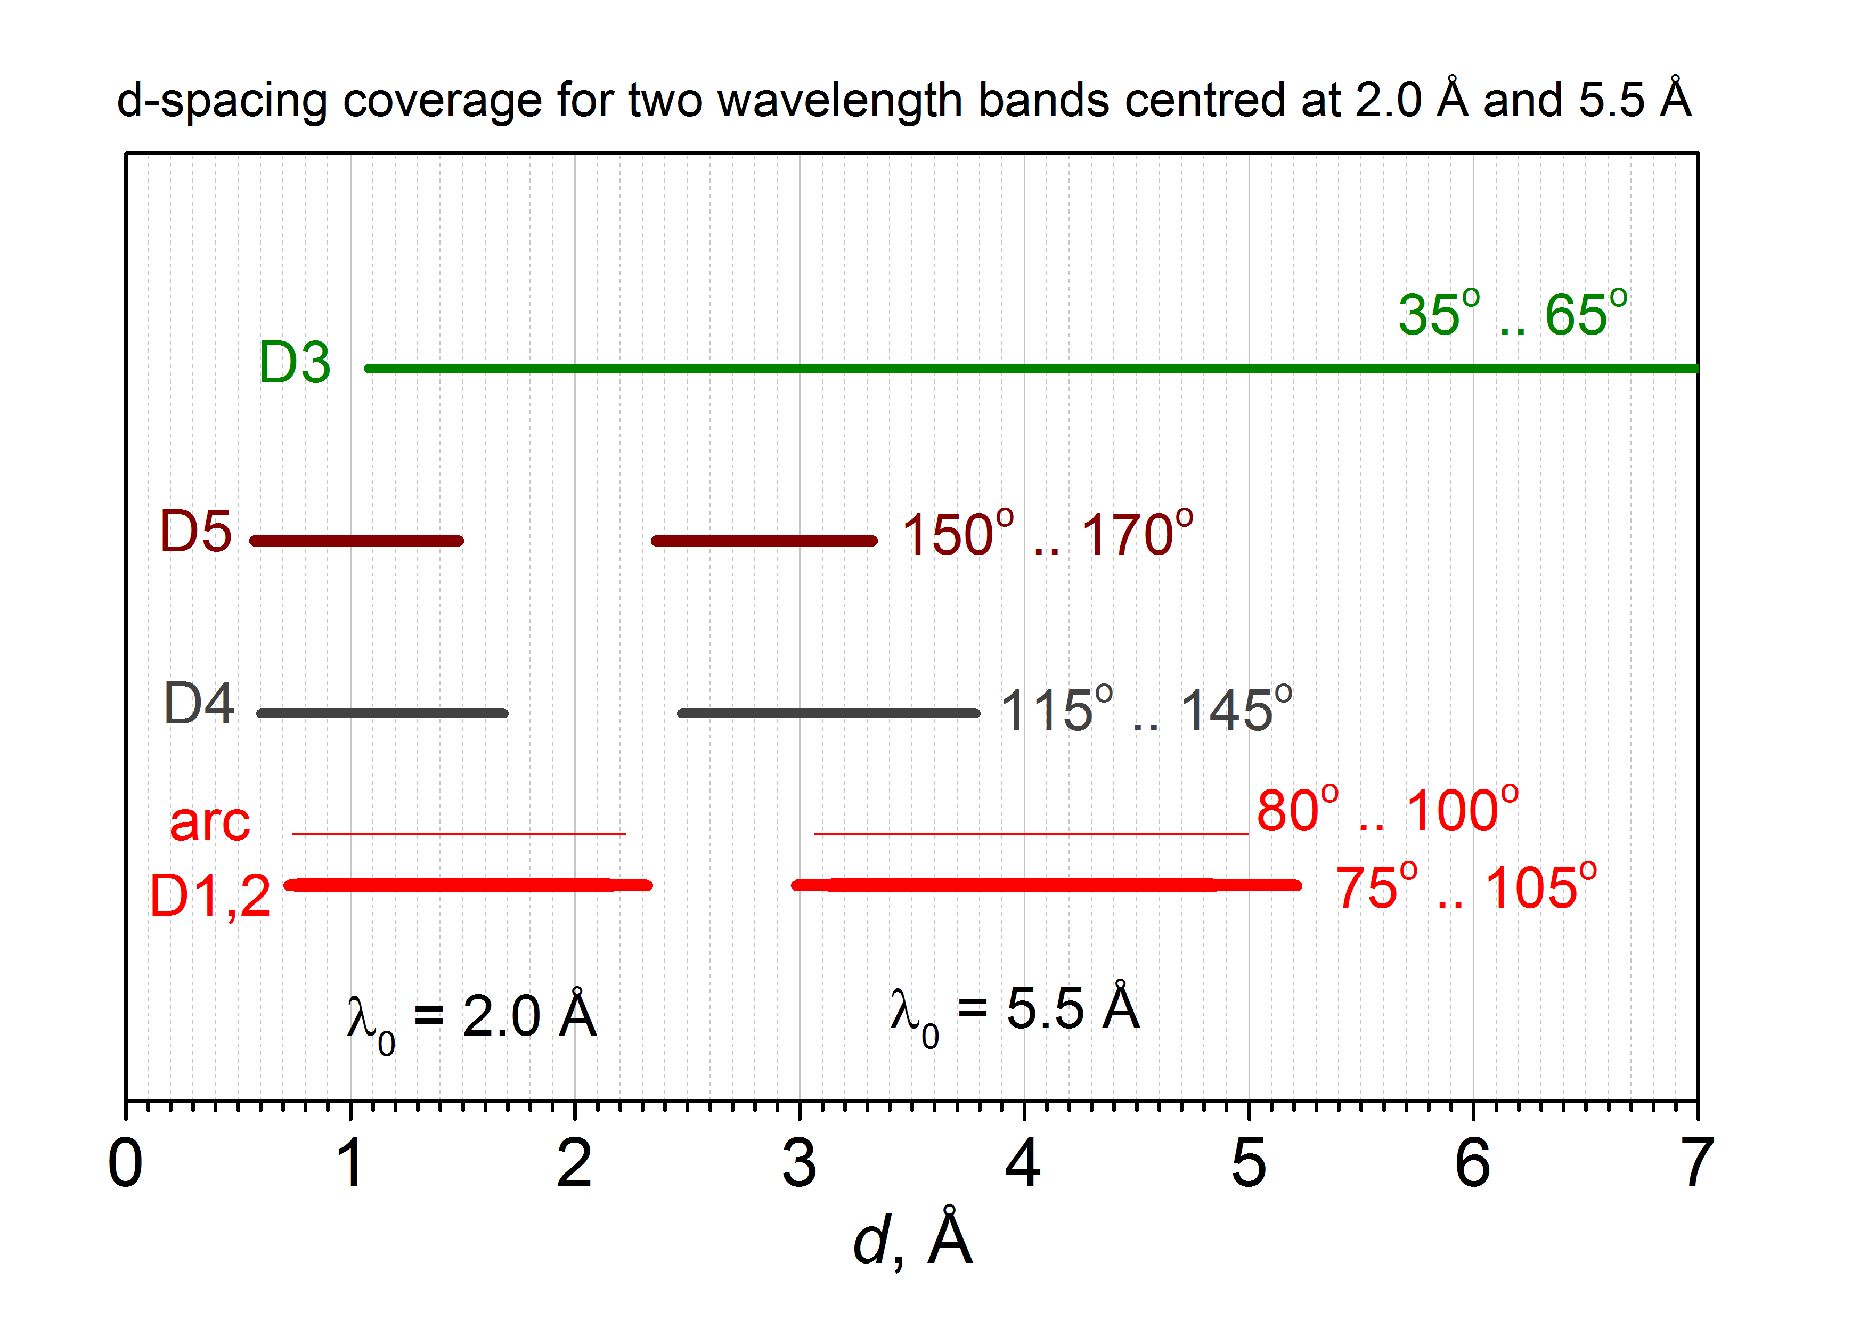
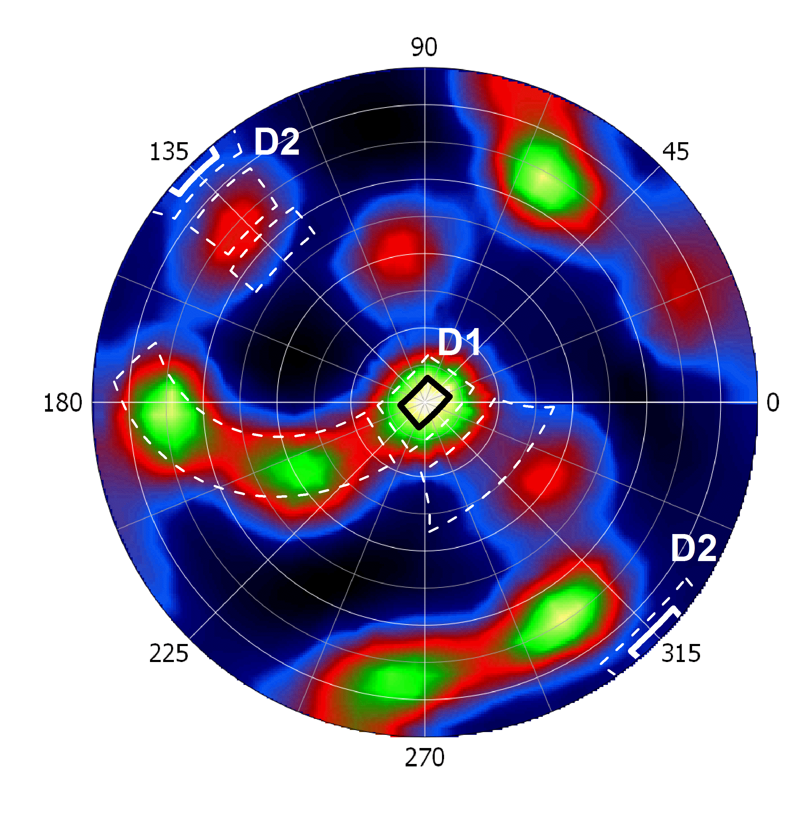
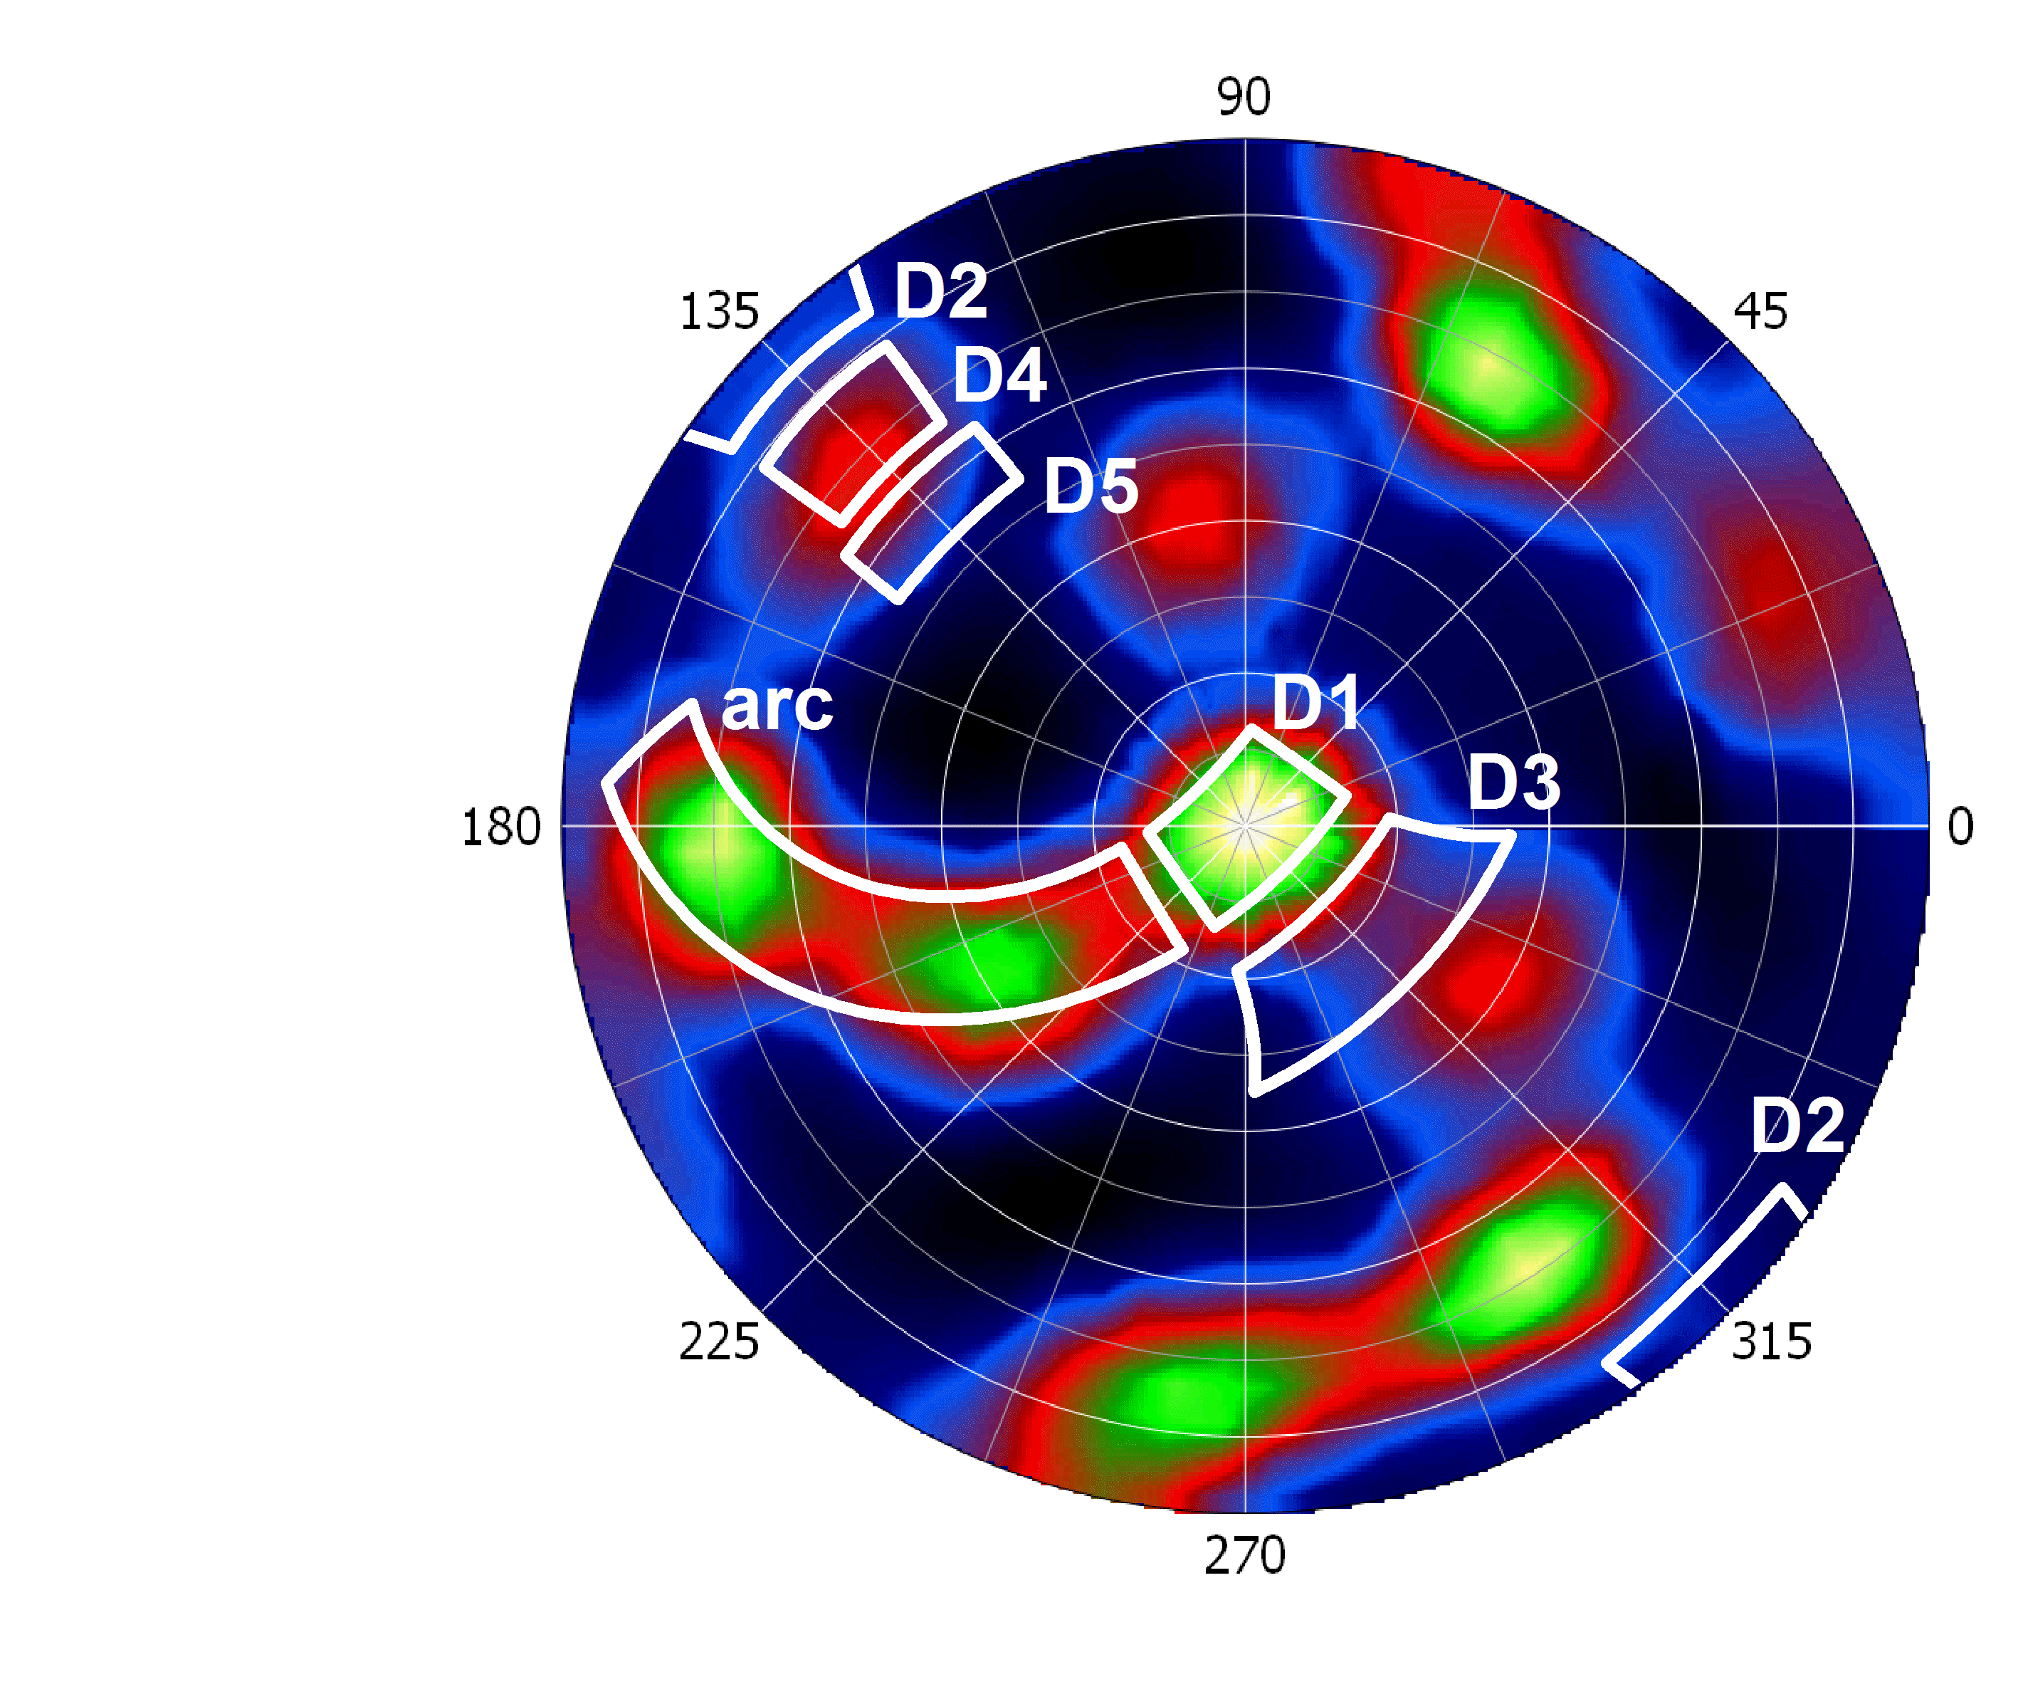
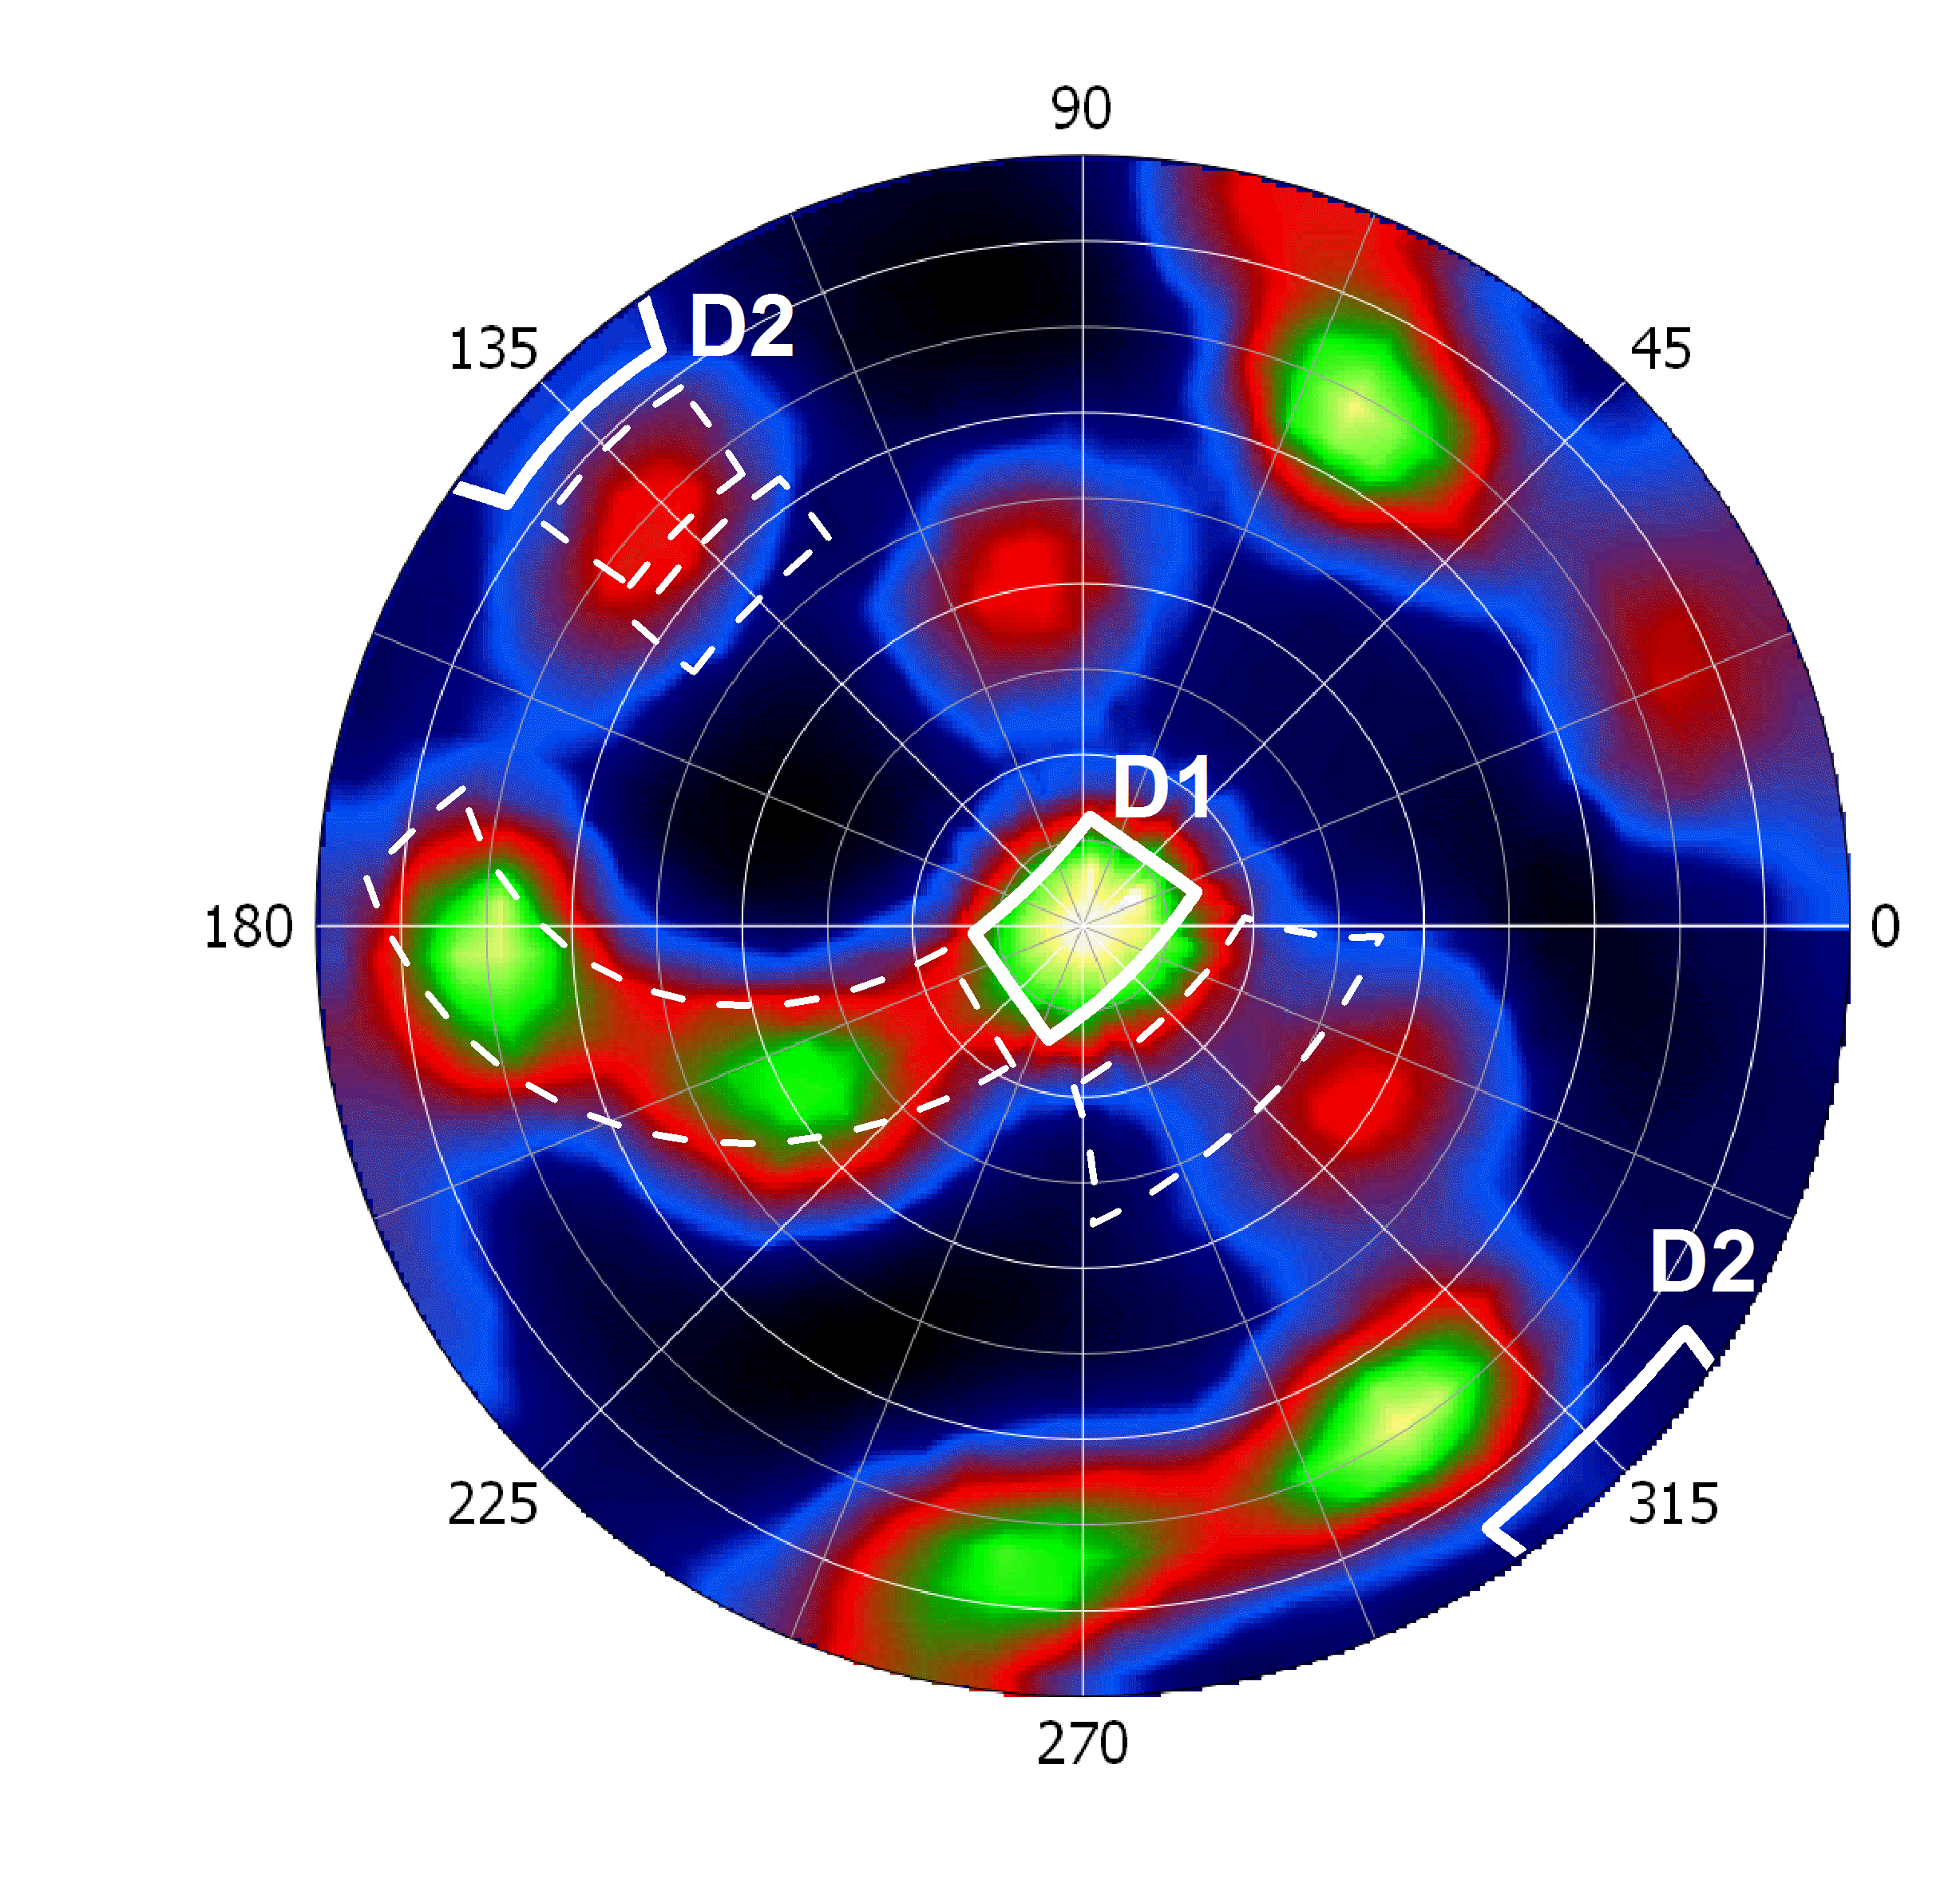
Detectors
Performance
d-spacing:
pole figure coverage:
82° .. 98°
Cost Category
World Class

Slide 34
Detectors
Surrounding
Cost Category
Requirements:
D1 – D4: 1 x 1 m² (res. 2 mm x 5 mm)
arc: 3 x (0.5 x 0.5 m²) (res. 5 mm x 5mm)
SANS: 1 x 1 m² (res. 5 mm x 5 mm)
D5 (backscattering): 0.5 x 0.5 m²
(res. 5 mm x 5 mm)
Imaging: → ODIN
η > 60 % ( 2 Å)
countrate < 10⁶ 1/s (global)

Slide 35
05 Detectors Budget
 | Cost Category | World Class | Full Scope
05 Detector and Beam Monitors | 1.663.500 | 2.888.900 | 9.068.750
Beam monitor | 20.000 | 20.000 | 20.000
Beam monitor | 20.000 | 20.000 | 20.000
Am 0.5 x 0.5 (arc detector)
Hardware | 550.000 | 0 | 550.000
Readout electronics | 89.400 | 0 | 89.400
Coating | 38.400 | 0 | 38.400
Radiacollimator | 20.000 | 0 | 80.000
Hardware | 440.000 | 0 | 440.000
Readout electronics | 89.400 | 0 | 89.400
Coating | 38.400 | 0 | 38.400
Radiacollimator | 20.000 | 0 | 80.000
Hardware | 0 | 0 | 440.000
Readout electronics | 0 | 0 | 89.400
Coating | 0 | 0 | 38.400
Radiacollimator | 0 | 0 | 80.000
arc detectorportal | 0 | 0 | 446.500

Slide 36
05 Detectors Budget
 | Cost Category | World Class | Full Scope
05 Detector and Beam Monitors | 1.663.500 | 2.888.900 | 9.068.750
Am 1 m x 1m
Hardware | 0 | 1.026.000 | 1.026.000
Readout electronics | 0 | 89.400 | 89.400
Coating | 0 | 153.600 | 153.600
Radiacollimator | 0 | 90.000 | 90.000
Detectorportal | 247.450 | 287.450 | 287.450
Hardware | 0 | 750.000 | 750.000
Readout electronics | 0 | 89.400 | 89.400
Coating | 0 | 153.600 | 153.600
Radiacollimator | 0 | 90.000 | 90.000
Detectorportal | 90.450 | 119.450 | 119.450
Hardware | 0 | 0 | 750.000
Readout electronics | 0 | 0 | 89.400
Coating | 0 | 0 | 153.600
Radiacollimator | 0 | 0 | 90.000
Detectorportal | 0 | 0 | 119.450
Hardware | 0 | 0 | 750.000
Readout electronics | 0 | 0 | 89.400
Coating | 0 | 0 | 153.600
Radiacollimator | 0 | 0 | 90.000
Detectorportal | 0 | 0 | 119.450

Slide 37
05 Detectors Budget
 | Cost Category | World Class | Full Scope
05 Detector and Beam Monitors | 1.663.500 | 2.888.900 | 9.068.750
Backscattering
Hardware | 0 | 0 | 440.000
Readout electronics | 0 | 0 | 89.400
Coating | 0 | 0 | 38.400
Radiacollimator | 0 | 0 | 30.000
detectorportal | 0 | 0 | 109.450
SANS
Hardware | 0 | 0 | 440.000
Readout electronics | 0 | 0 | 89.400
Coating | 0 | 0 | 38.400

Slide 38
BEER Overview
01 Shielding & 02 Neutron Optics
03 Choppers
04 Sample Environment
05 Detectors and Beam Monitors
08 Instrument Specific Technical Equipment
09 Instrument Infrastructure
Others (06 DMSC, 07 MCA, 10 Vacuum, 11 PSS)

Slide 39
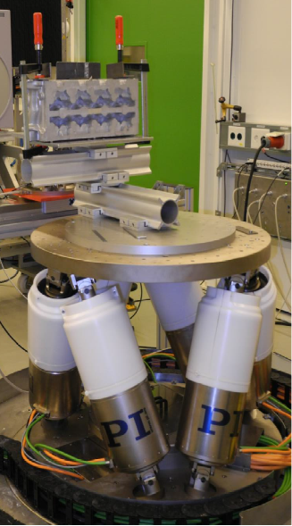
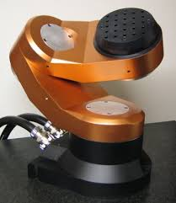
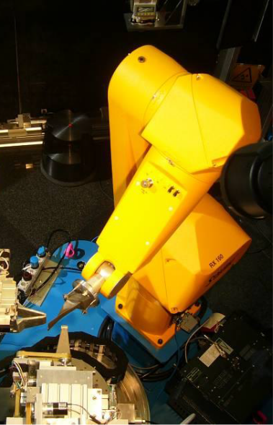
08 Instrument Specific Technical Equipment Overview
Cost Category
World Class
Hexapod:
payload 2 t
x, y: ±200 mm
z: ±250mm
Cybaman:
payload 25 kg
high load table:
payload 2 t
rotation ±180°
z: ± 500 mm
payload 3 t
rotation ±180°
z: ± 500 mm
linear stages:
payload 300 kg
travel 1000 mm
accuracy ±26.9 µm
six axis robot:
payload 14 kg
repeatability : ±0.06 mm

Slide 40
08 Instrument Specific Technical Equipment Budget
 | Cost Category | World Class | Full Scope
08 Instrument Specific Technical Equipment | 2.982.950 | 4.187.050 | 5.366.750
Phase 1 | 471.850 | 471.850 | 471.850
Travel | 125.000 | 300.000 | 300.000
Personnel | 2.156.400 | 2.749.500 | 3.027.000
high load table | 200.000 | 300.000 | 300.000
hexapod 2t | 0 | 200.000 | 200.000
cybaman | 0 | 0 | 71.000
six axis robot | 0 | 36.000 | 36.000
linear stage x | 9.900 | 9.900 | 9.900
linear stage y | 9.900 | 9.900 | 9.900
linear stage z | 9.900 | 9.900 | 9.900
positioning control | 0 | 100.000 | 100.000
SANS scattering tube | 0 | 0 | 831.200

Slide 41
BEER Overview
01 Shielding & 02 Neutron Optics
03 Choppers
04 Sample Environment
05 Detectors and Beam Monitors
08 Instrument Specific Technical Equipment
09 Instrument Infrastructure
Others (06 DMSC, 07 MCA, 10 Vacuum, 11 PSS)

Slide 42
Instrument Infrastructure
Experimental Cave
Cost Category:reduced size
Equipment
Access
Control hutch
elevated floor
Cave shielding
12 m
7 m
Laboratories
8 m
10 m
Personnel
Access
Guide Hall
Heavy load
table < 3 t

Slide 43
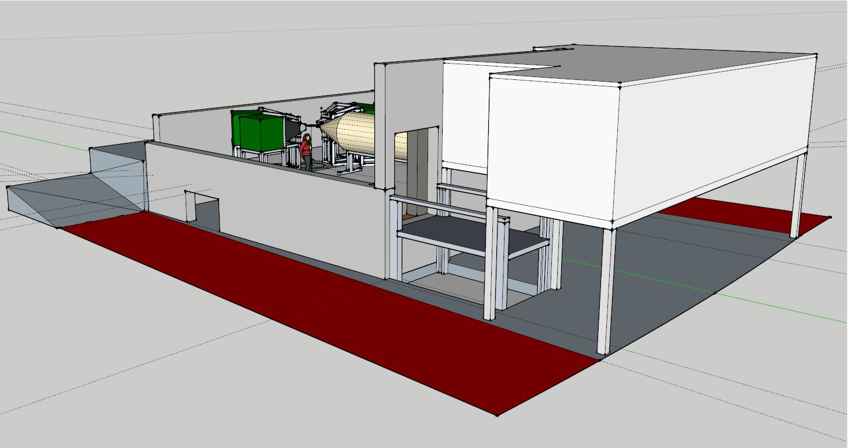
Instrument Infrastructure
Experimental Cave
Cost Category: reduced size
Control hutch
Storage + Lab
Space
Guide Hall
Access to
cables, etc.
Laboratories
Equipment
Access
Lift ~5t

Slide 44
09 Instrument Infrastructure Budget
 | Cost Category | World Class | Full Scope
09 Instrument Infrastructure | 160.000 | 780.000 | 780.000
Instrument Cave | 100.000 | 500.000 | 500.000
Control hutch | 60.000 | 280.000 | 280.000

Slide 45
BEER Overview
01 Shielding & 02 Neutron Optics
03 Choppers
04 Sample Environment
05 Detectors and Beam Monitors
08 Instrument Specific Technical Equipment
09 Instrument Infrastructure
Others (06 DMSC, 07 MCA, 10 Vacuum, 11 PSS)

Slide 46
Others – Budget (06 DMSC, 07 MCA, 10 Vacuum & 11 PSS)
 | Cost Category | World Class | Full Scope
06 Data Acquisition and Analysis | 0 | 0 | 0
07 Motion Control and Automation | 115.360 | 139.760 | 145.760
EPICS integration | 9.800 | 11.200 | 13.200
Network | 12.600 | 14.000 | 15.000
control rack, etc. | 92.960 | 114.560 | 117.560
10 Vacuum | 0 | 0 | 0
11 PSS | 100.000 | 177.000 | 177.000

Slide 47
Cost Category Instrument Summary
All optical devices (extraction system, no guide exchanger,…)
Only MCa and FC2b
Only ±90° detectors (reduced size)
No SANS option
No Sample Environment (only pool SE)
reduced size of experimental cave
no platform for easy transport of SE and equipment
- fully included
- easy to upgrade
- cost & time intensive upgrade

Slide 48
Cost Category Instrument Upgrade & Staging
Upgrades to full scope:
Reconstruction of Experimental Cave
Detectors D1 & D2 (full size)
exchange of guide segments
Pulse shaping choppers PSC1 – PSC3
Frame definition choppers FC1a/b, Fc2a
Hexapod
Robot
Arc detectors
backscattering detector
SANS
……
→ time + cost intensive

Slide 49
World Class Instrument
Summary
All optical devices (extraction system, focusing guide, guide exchanger 2 options, …)
all Choppers except MCc
Only ±90° detectors
No SANS option
Stress rig with furnace
full size of experimental cave
platform for easy transport of SE and equipment
- fully included
- easy to upgrade
- cost & time intensive upgrade

Slide 50
World Class Instrument
Upgrade & Staging
Upgrades to full scope:
Detector D4
Arc detector
Backscattering detector
Detector D3
SANS option
+
1. biaxial stress rig
2. digital image correlation
3. annealing furnace
4. welding devices
5. Gleeble® simulator

Slide 51
Full Scope Instrument
Summary
All optical devices (extraction system, focusing guide, guide exchanger, …)
all Choppers
Full detector coverage
SANS option
Stress rig, dilatometer, …
full size of experimental cave
platform for easy transport of SE and equipment
- fully included
- easy to upgrade
- cost & time intensive upgrade

Slide 52
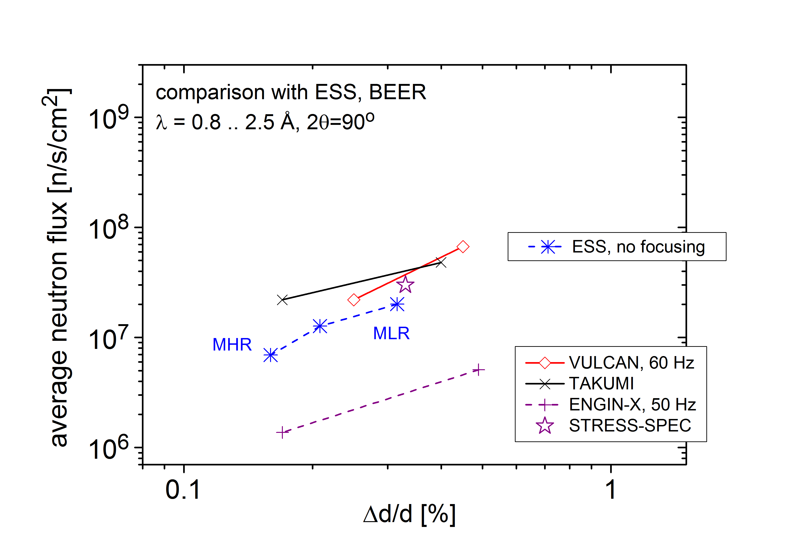
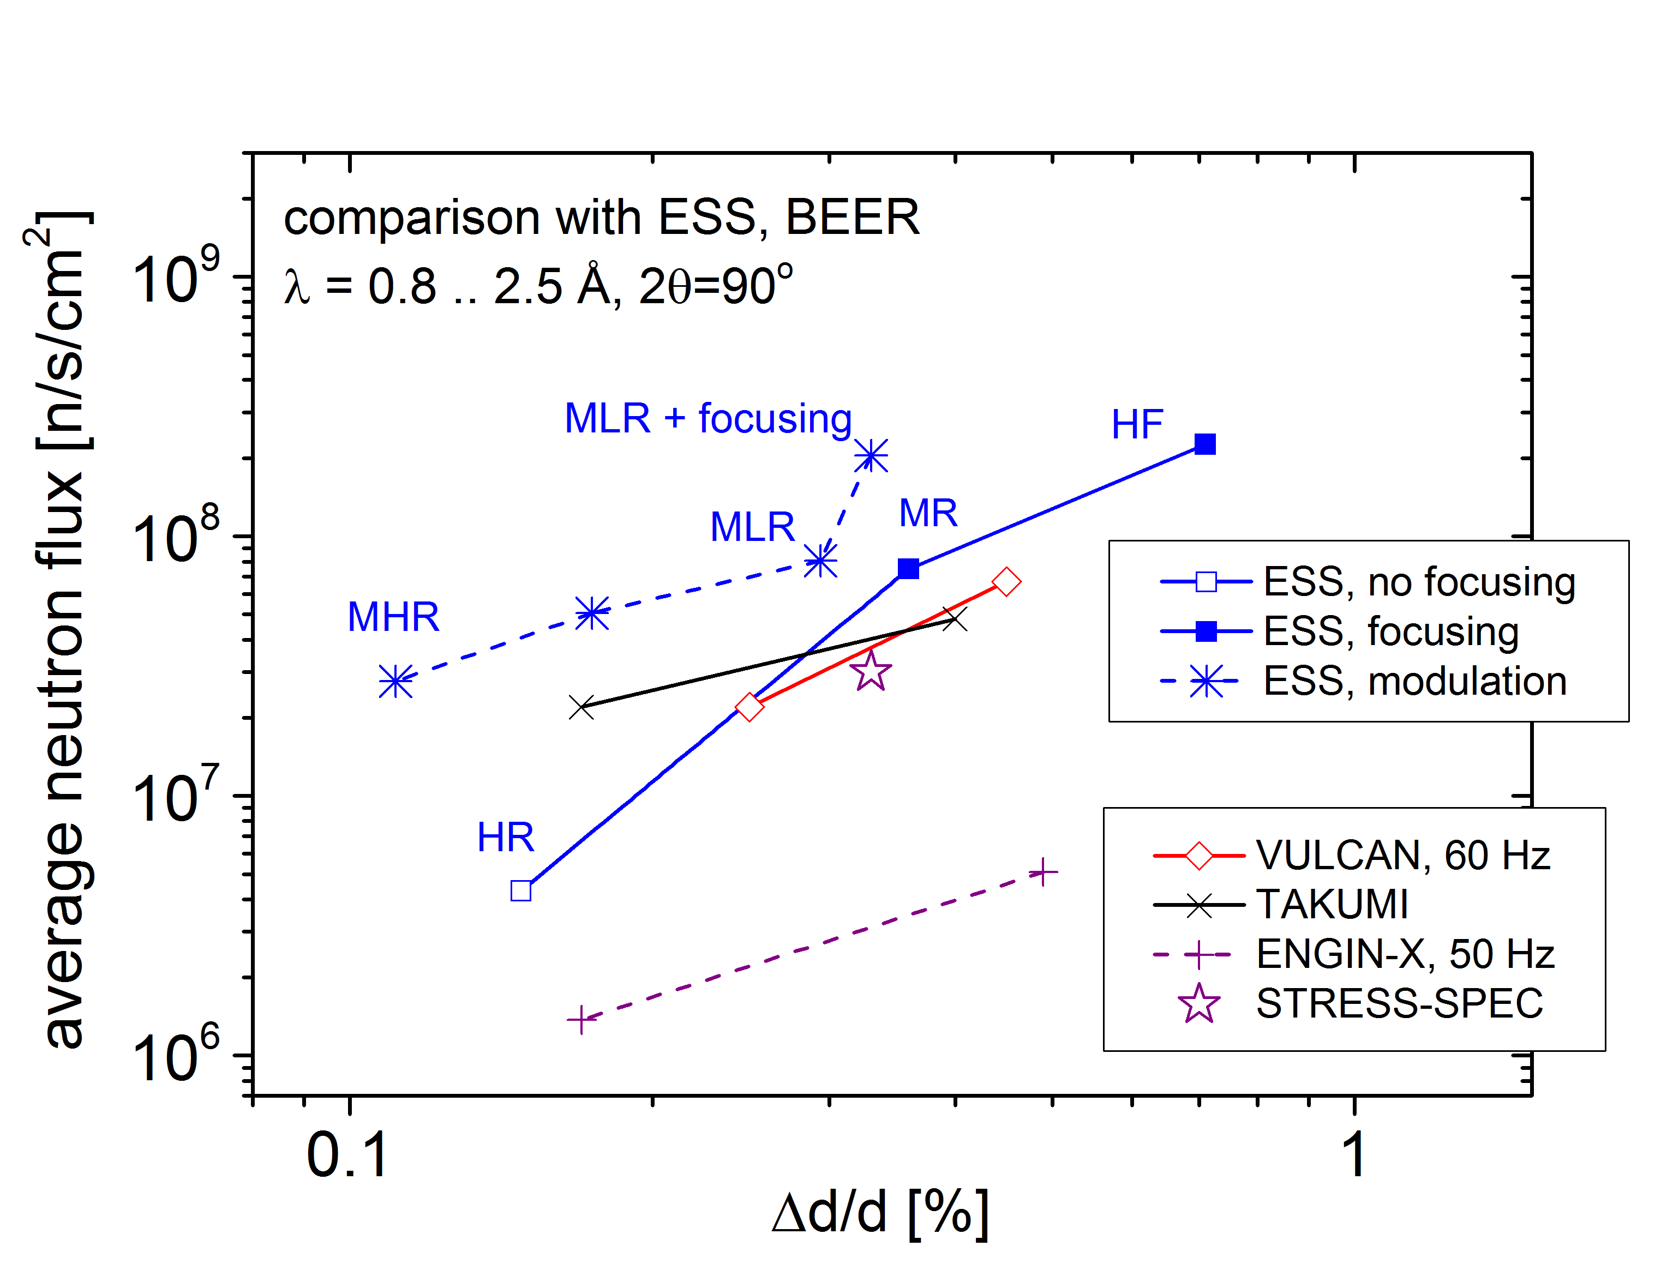
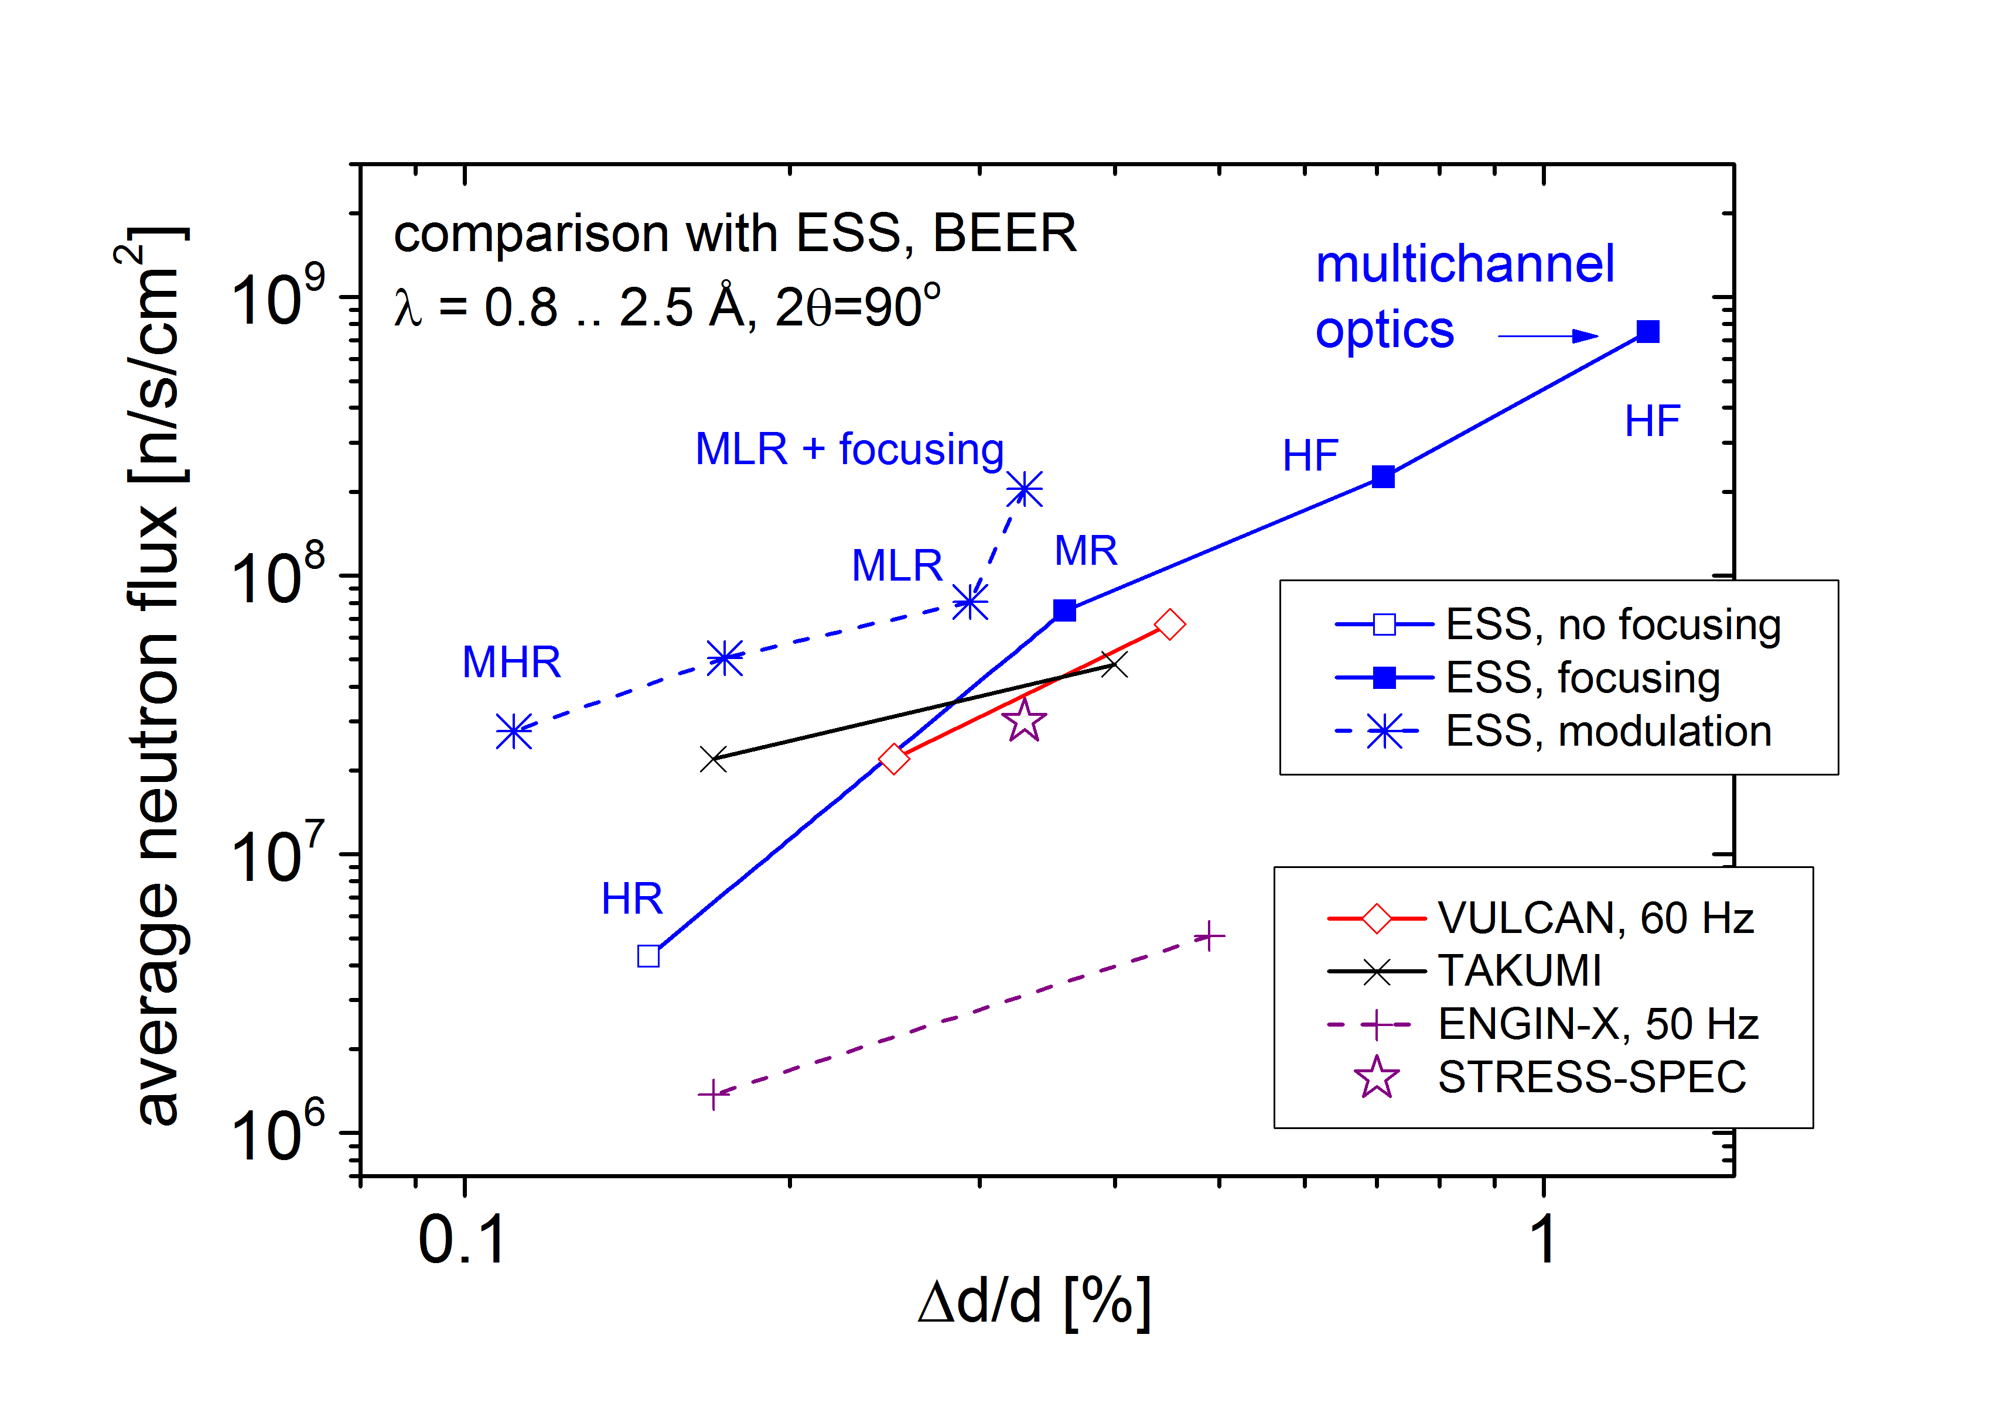
BEER Instrument Performance Summary
Cost Category:
World Class:
Full Scope:
Instrument (option) | sample-dete. dis. | Detector size [m²] | Detector coverage [sr]
BEER (FS) | 1.2 m - 2 m | 5.25 | 1.63
BEER (WC) | 2 m | 2 | 0.5
BEER (CC) | 2 m | 0.5 | 0.125
TAKUMI | 2 m | 2.46 | 0.62
ENGIN-X | 1.53 m | 2.06 | 0.88
VULCAN | 2 m | 1.75 | 0.44

Slide 53
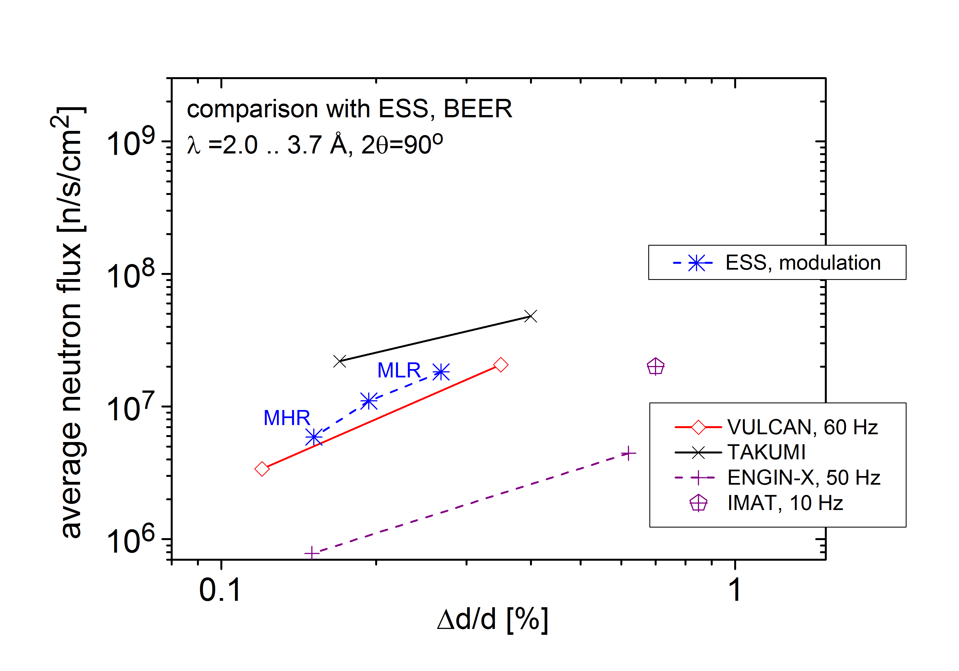
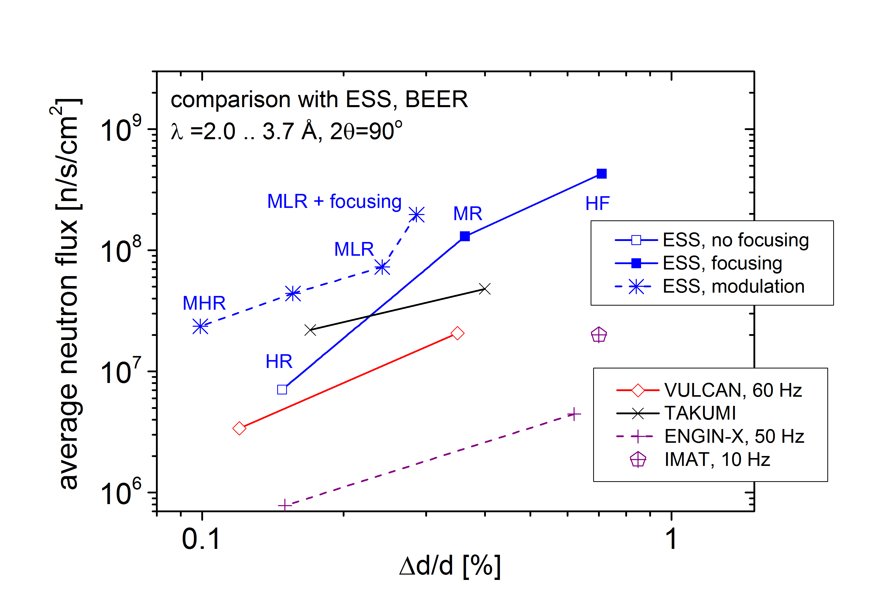
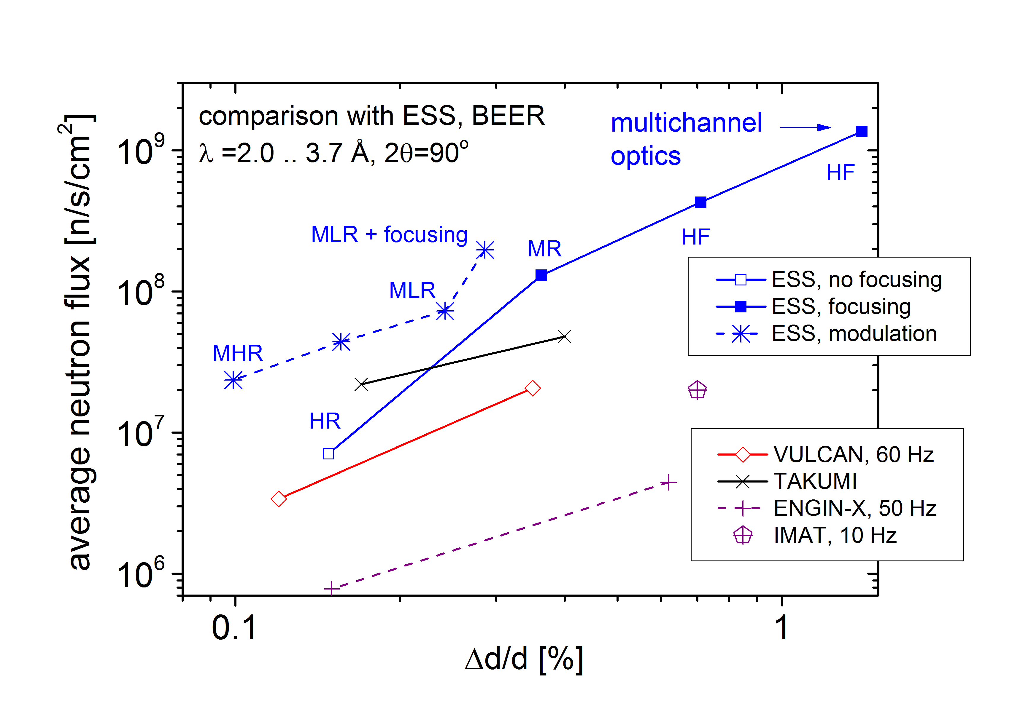
BEER Instrument Performance Summary
Cost Category:
World Class:
Full Scope:
Instrument (option) | sample-dete. dis. | Detector size [m²] | Detector coverage [sr]
BEER (FS) | 1.2 m - 2 m | 5.25 | 1.63
BEER (WC) | 2 m | 2 | 0.5
BEER (CC) | 2 m | 0.5 | 0.125
TAKUMI | 2 m | 2.46 | 0.62
ENGIN-X | 1.53 m | 2.06 | 0.88
VULCAN | 2 m | 1.75 | 0.44

Slide 54
BEER Instrument Scientific Scope
 | Cost Category | World Class | Full Scope
In situ & in operando | (reduced d- range, limited SE, difficult multiphase analysis) | (reduced d-range, not full SE suite)
Strain scanning | (limited positioning system capabilities and precision) | (reduced d-range)
Texture & texture evolution | (significant reduced pole figure coverage) | (slight pole figure coverage)
Long term experiments | (no transport platform)
 | Not competitive to existing instruments | Competitive to or exceeding existing instruments | Competitive to or exceeding existing instruments

Slide 55
BEER Instrument System Requirements
 | Cost Category | World Class | Full Scope
#1 nuclear and magnetic structure
#2 in situ & in operando | (limited SE for engineering) | (not full SE suite)
#3 residual strain | (limited sample complexity, load and throughput)
#4 microstructure | (microstructure except microstrain)
#5 long term experiments | (no transport platform, no lift)
#6 d-range | (reduced detector size and coverage) | (reduced detector coverage)
#7 pole figure coverage | (significant reduced detector coverage) | (reduced detector coverage)
#8 texture evolution | (significant reduced detector coverage) | (reduced detector coverage)
– fully included – easy to upgrade – time and cost intensive upgrade (reconstruction necessary)

Slide 56
BEER Instrument System Requirements
 | Cost Category | World Class | Full Scope
#9 two strain components
#10 continuation measurements
#11 sample environment driven
#12 gauge volume | (Only one set of collimators)
#13 d_{min}
#14 d- resolution | (only 1 modulation Chopper)
#15 space for SE
#16 heavy samples | (limited load of heavy table)
#17 SANS | (no SANS option) | (no SANS option)
#18 direct imaging
– fully included – easy to upgrade – time and cost intensive upgrade (reconstruction necessary)

Slide 57
BEER Instrument Budget Summary
 | Cost Category | World Class | Full Scope
01 Shielding | 2.749.142 | 3.020.398 | 3.020.398
02 Neutron Optics | 2.643.000 | 2.791.000 | 2.891.000
03 Choppers | 490.050 | 1.990.900 | 2.207.450
04 Sample Environment | 0 | 330.000 | 1.130.000
05 Detector | 1.663.500 | 2.888.900 | 9.068.750
06 Data Acquisition and Analysis | 0 | 0 | 0
07 Motion Control and Automation | 115.360 | 139.760 | 145.760
08 Instrument Specific Technical Equipment | 2.982.950 | 4.187.050 | 5.366.750
09 Instrument Infrastructure | 160.000 | 780.000 | 780.000
10 Vacuum | 0 | 0 | 0
11 PSS | 100.000 | 177.000 | 177.000
12 Contingency | 1.090.400 | 1.630.501 | 2.478.711
Total | 11.994.402 | 17.935.509 | 27.265.819
Person years | 19.9 | 25.2 | 27.7

Slide 58
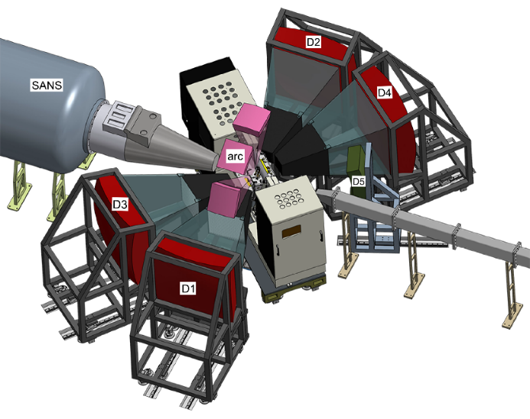
Thank you for your attention!

