Slide 1
ESS Freia
Scope Setting
ESS - Lund - 17/10/2016

Slide 2
Scope Setting Data
Used data from phase II Instruments
  Larmor
  IMAT
  ChipIR
  Zoom
Used ESS Estimates where “required to”
Estimated additional cost for the “In Kind” element
This is design work since May and the level of detail required is very high for the maturity of the design

Slide 3
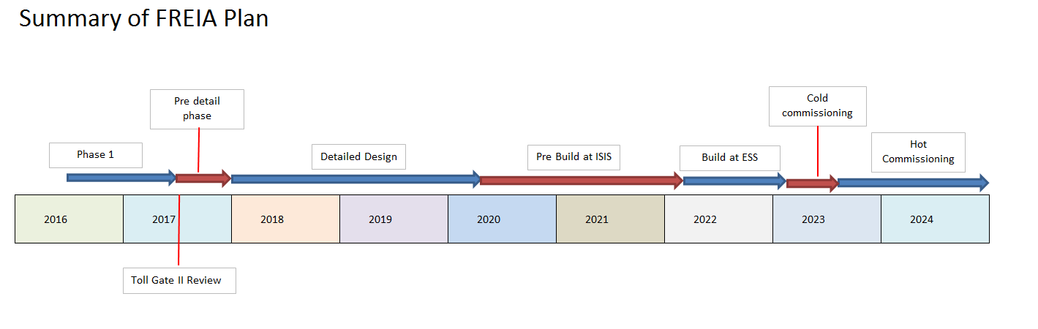
Timeline
Larmor mid 2009-Mar 2014
ChipIR mid 2009-May 2014
IMAT mid 2009-sept 2015
Zoom mid 2009-Dec 2016

Slide 4
OPTION 1 Cost Category
2x line of sight benders (horizontal)
Inclined elliptical guide focusing on sample position
Heavy shutter installed in the bunker wall
Sample position at 22.2 m
Collimation length of 2m with vertical/horizontal two slit collimation
Basic sample stack for mounting one sample
Single helium tube detector at 3m from sample, movable ±700mm vertically
All necessary associated infrastructure for the above (shielding, cabling etc.)

Slide 5
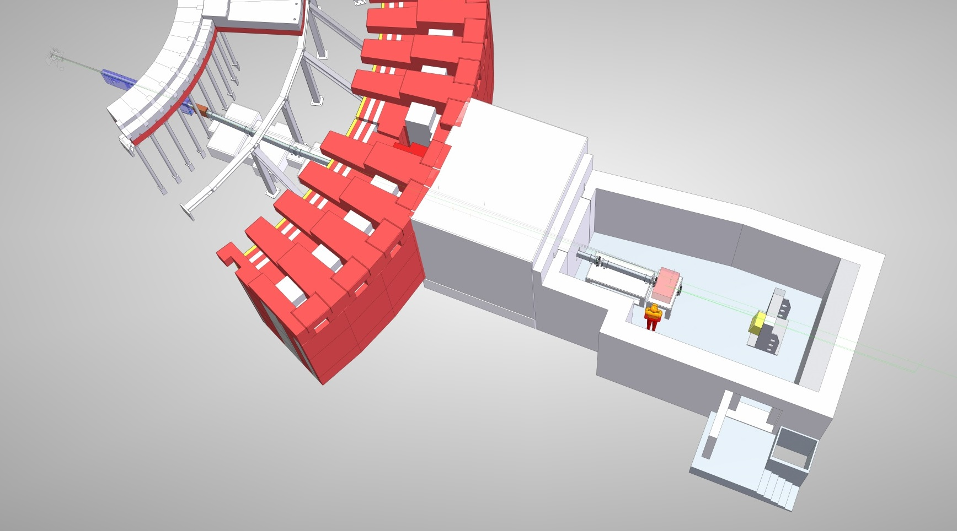
OPTION 1 Cost Category
It is not possible to build a functional instrument within cost category A.
Cost estimate = €9M
Assumes work is carried out by ESS – i.e. no collaboration costs

Slide 6
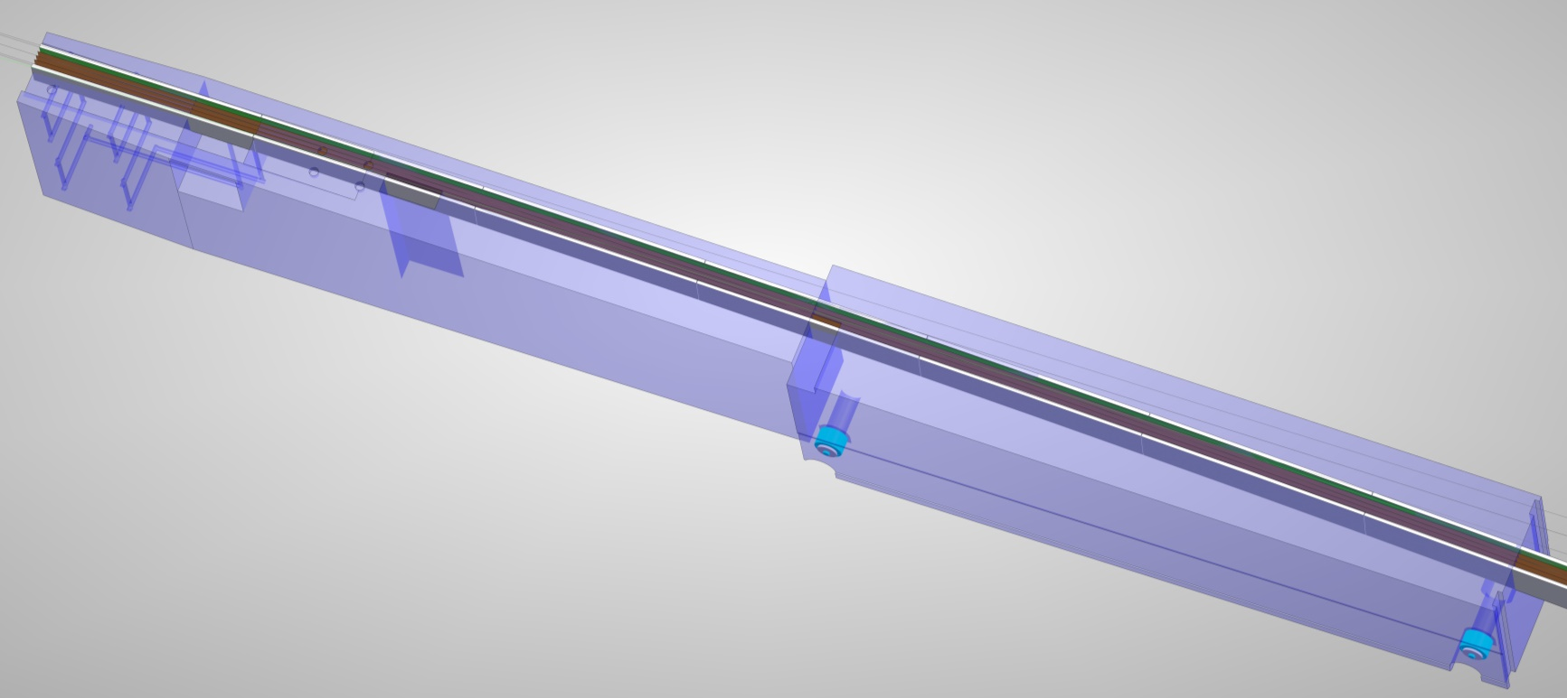
OPTION 1 Cost Category
 | Price (each) | Qty | Total | Notes
Insert Vessel |  |  | 0 | ESS funded? Only if we are in the first 6
Tooling for installation into Monolith |  |  | 0 | ESS funded? Only if we are in the first 6
Shims and packing |  |  | 0 | ESS funded? Only if we are in the first 6
Streaming shielding |  |  | 0 | ESS funded? Only if we are in the first 6
Insert Cooling system |  |  | 0 | ESS funded? Only if we are in the first 6
Windows |  |  | 0 | ESS funded? Only if we are in the first 6

Slide 7
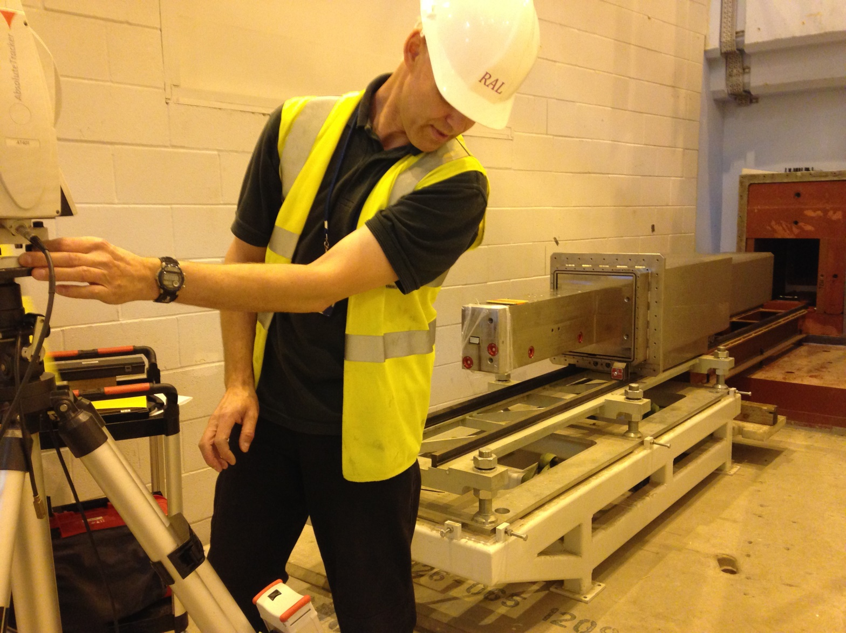
OPTION 1 Cost Category
Zoom Insert and Bender

Slide 8
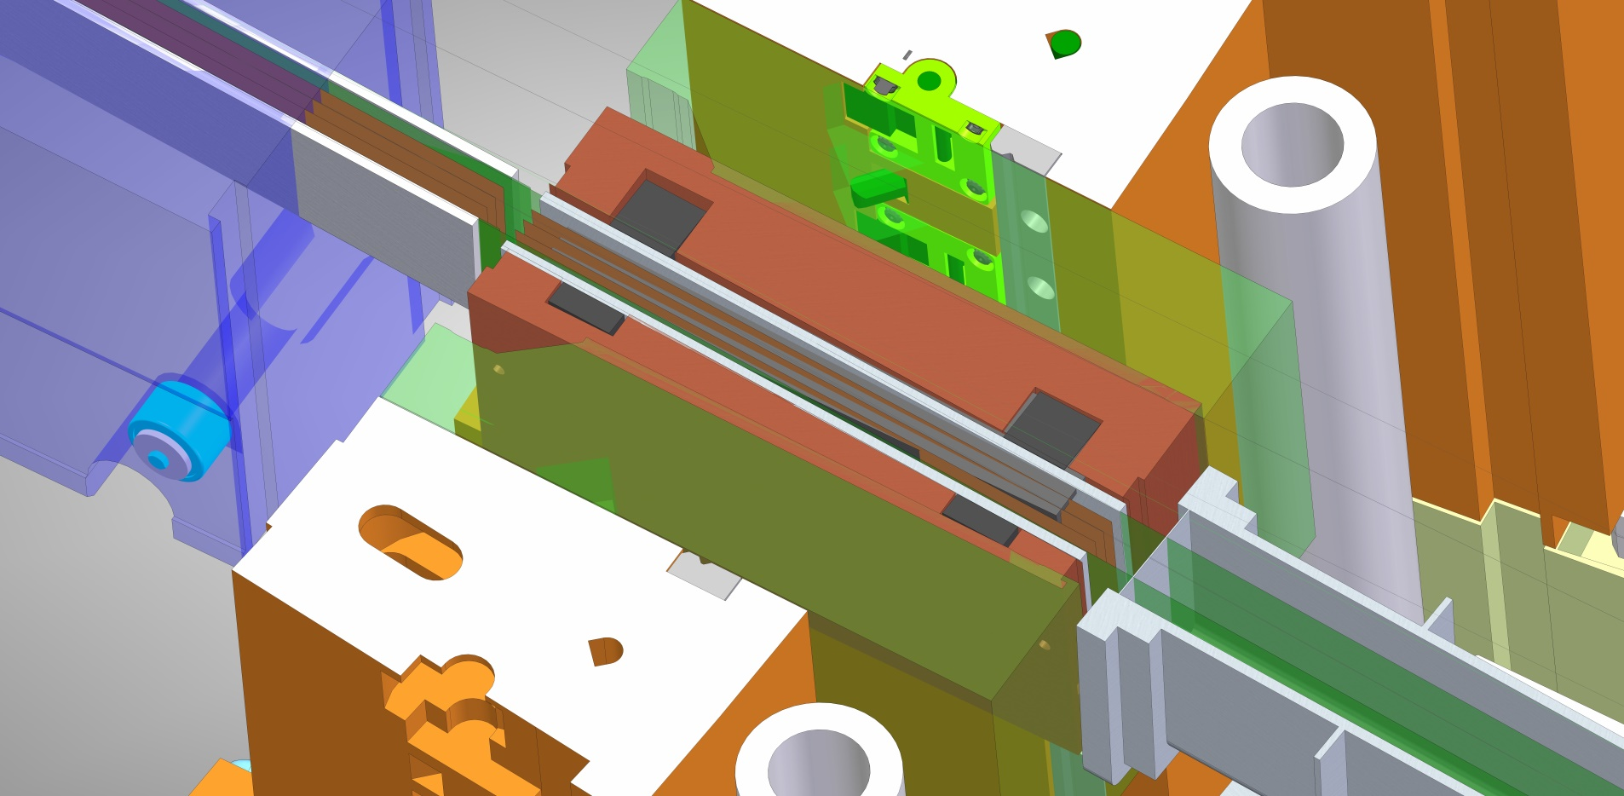
OPTION 1 Cost Category
Housing (expensive material?)
Alignment features
Streaming blocks
 | Price (each) | Qty | Total | Notes
Gamma shutter insert | €k 17 | 1 | €k 17 | guide housing (assume complex adjustment)

Slide 9
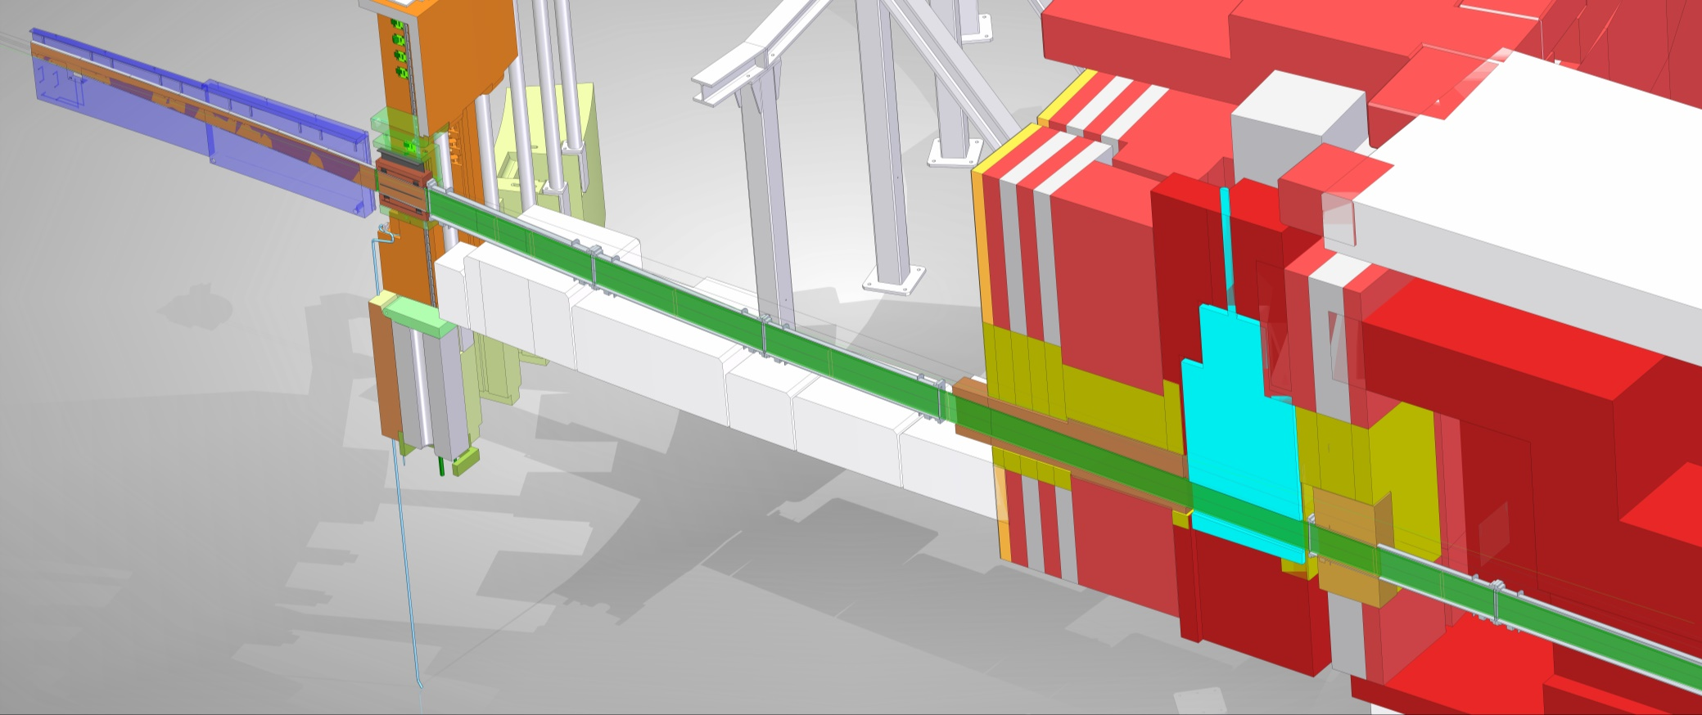
OPTION 1 Cost Category
Heavy Shutter €375k
Guide €2.1M
Guide Shielding (copper shroud) €50k
Guide collimation blocks €11k
Bunker components activation shielding €33k
Bunker Wall Plug Shielding €83k
Bunker Zone Component Support Structures €56k

Slide 10
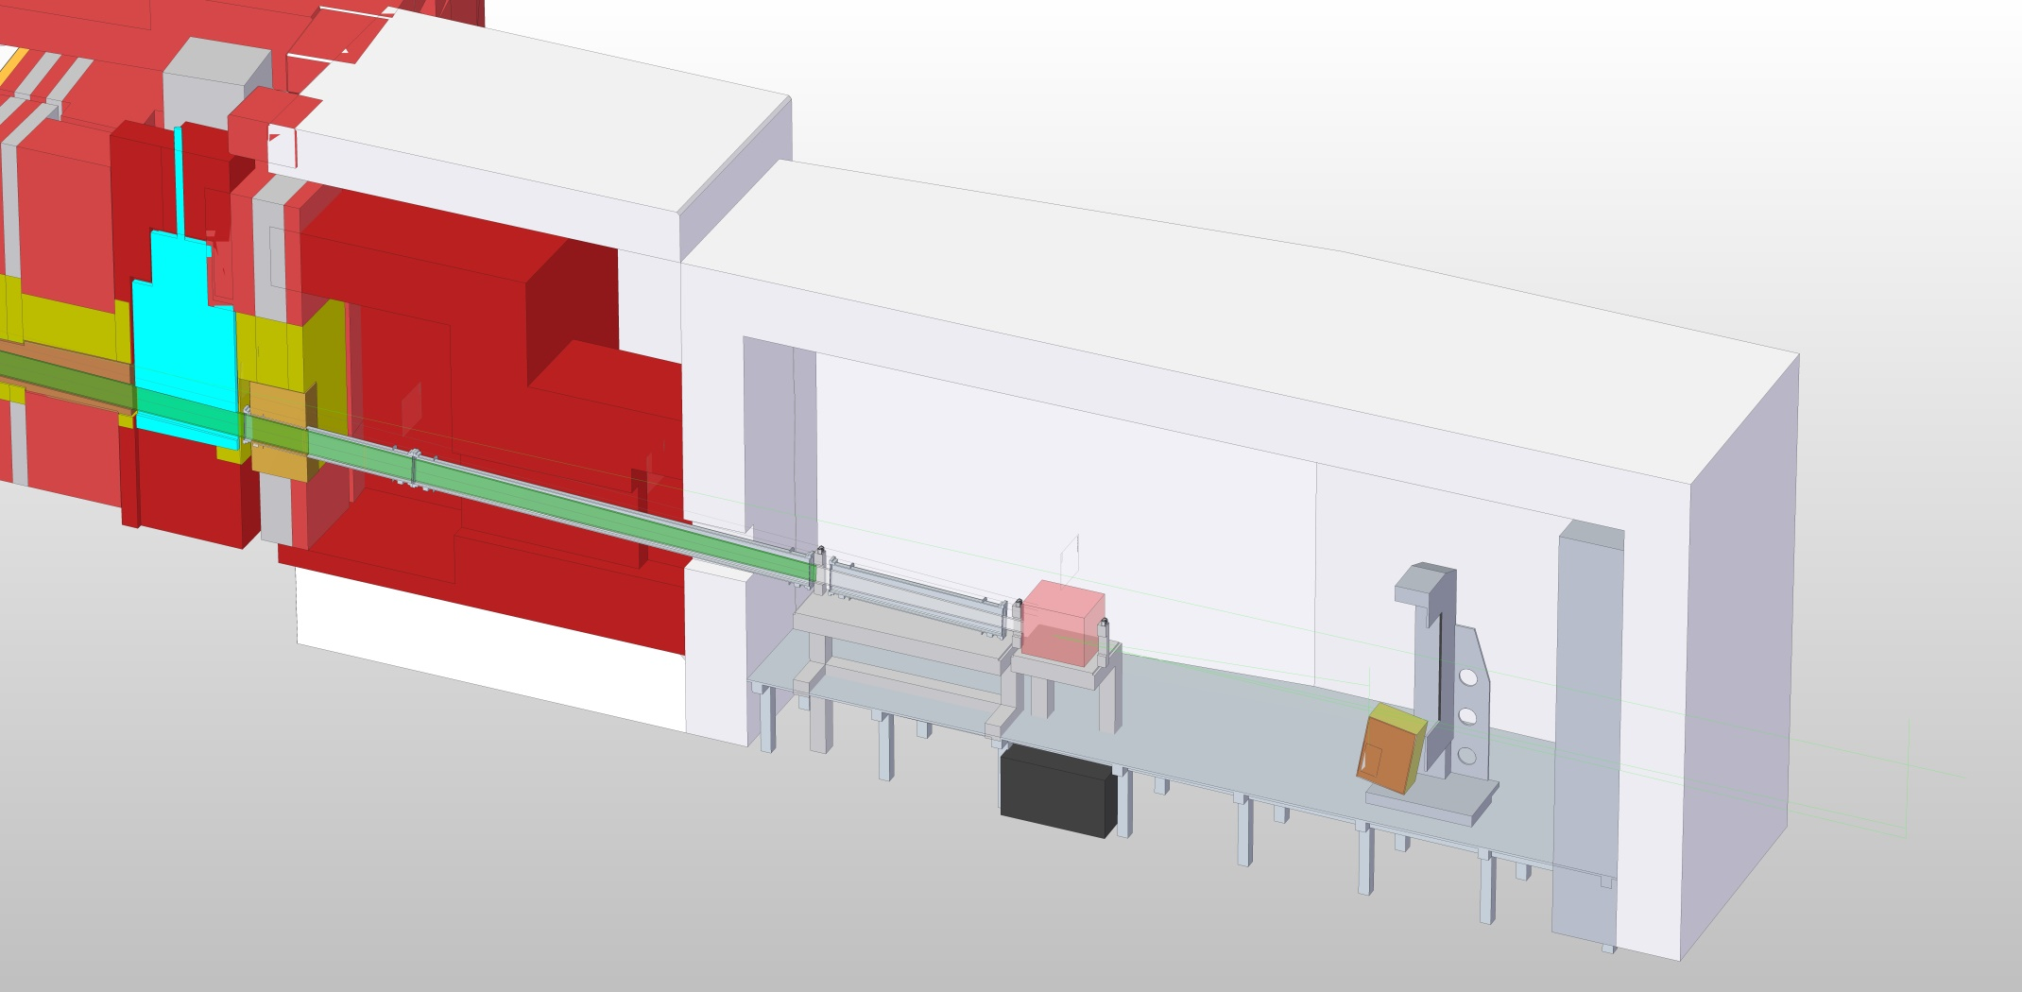
OPTION 1 Cost Category
Steel €355k
Concrete €56k
Boron Collimation €11k

Slide 11
OPTION 1 Cost Category
No offline sample prep area
No hutch
XY slits sets €67k
Sample table €44k (no precision alignment)
Detector 300mm helium tube €5k
Motion system (z) €22k
Cave €500k
Beamstop €222k
Access & Flooring €111k

Slide 12
OPTION 1 Cost Category
 | 01 Phase 1 | 02 Project Management & Integration | 03 Design | 04 Procurement & Fabrication | 05 Installation | 06 Cold Commissioning | Total
01 Shielding | € 0 | € 0 | € 0 | € 1,743,490 | € 0 | € 0 | € 1,743,490
02 Neutron Optics | € 0 | € 0 | € 0 | € 2,100,000 | € 0 | € 0 | € 2,100,000
03 Choppers | € 0 | € 0 | € 0 | € 0 | € 0 | € 0 | € 0
04 Sample Environment | € 0 | € 0 | € 0 | € 0 | € 0 | € 0 | € 0
05 Detector and Beam Monitors | € 0 | € 0 | € 0 | € 128,400 | € 0 | € 0 | € 128,400
06 Data Acquisition and Analysis | € 0 | € 0 | € 0 | € 0 | € 0 | € 0 | € 0
07 Motion Control and Automation | € 0 | € 0 | € 0 | € 133,200 | € 0 | € 0 | € 133,200
08 Instrument Specific Technical Equipment | € 0 | € 0 | € 0 | € 27,750 | € 0 | € 0 | € 27,750
09 Instrument Infrastructure | € 0 | € 0 | € 0 | € 573,900 | € 0 | € 0 | € 573,900
10 Vacuum | € 0 | € 0 | € 0 | € 0 | € 0 | € 0 | € 0
11 PSS | € 0 | € 0 | € 0 | € 133,200 | € 0 | € 0 | € 133,200
Labour & Travel (Cost) |  |  |  |  |  |  | € 3,342,000
12 Contingency |  |  |  |  |  |  | € 818,194
Total | € 0 | € 0 | € 0 | € 4,839,940 | € 0 | € 0 | € 9,000,134

Slide 13
FREIA Cost Estimates in Euros
ESS LIST | OPTION 1
Shielding | €k 1,743
Neutron Optics | €k 2,100
Choppers | €k -
Sample Environment | €k -
Detector and Beam Monitors | €k 128
Data Acquisition and Analysis | €k -
Motion Control and Automation | €k 133
Instrument Specific Technical Equipment | €k 28
Instrument Infrastructure | €k 574
Vacuum | €k -
PSS | €k 133
Labour & Travel | €k 3,342
TOTAL | €k 8,182
TOTAL + 10% contingency | €k 9,000

Slide 14
Staff Costs
Option 1

Slide 15
OPTION 2 World Class
Inverted beam option (m=6 mirror)
Three-slit system for faster kinetics (10s-1min.)
Evacuated collimation changer for the above
Slit positions prepared for GISANS ~8m, ~6.5m and ~4m before sample
Bandwidth, frame overlap and pulse-skipping choppers
  1m Double disk counter-rotating at ~6.5 m
  1m Double disk counter-rotating at ~10 m
  1m Double disk counter-rotating at ~16 m
WFM/frame overlap choppers for high-resolution option
  1.3m WFM Double disk co-rotating at ~6.9 m
  1.3m FOC single disc at ~8.5m
  1.3m FOC single disc at ~11m
  1.3m FOC single disc at ~15.5 m

Slide 16
OPTION 2 World Class
This option will meet most of Reflectometry science case (75%)
30cm x 30cm 0.5mm x 2.5mm resolution ¹⁰B detector at 3m from sample, movable ±400mm vertically
Vacuum flight path for above
Sample stage with ±200mm translation vertically and ±500mm horizontally
Two goniometers at sample position
Sample environment: 392k€
This option is easily upgradable to polarised NR and the full sample environment. GISANS upgrade would involve cave rebuild.

Slide 17
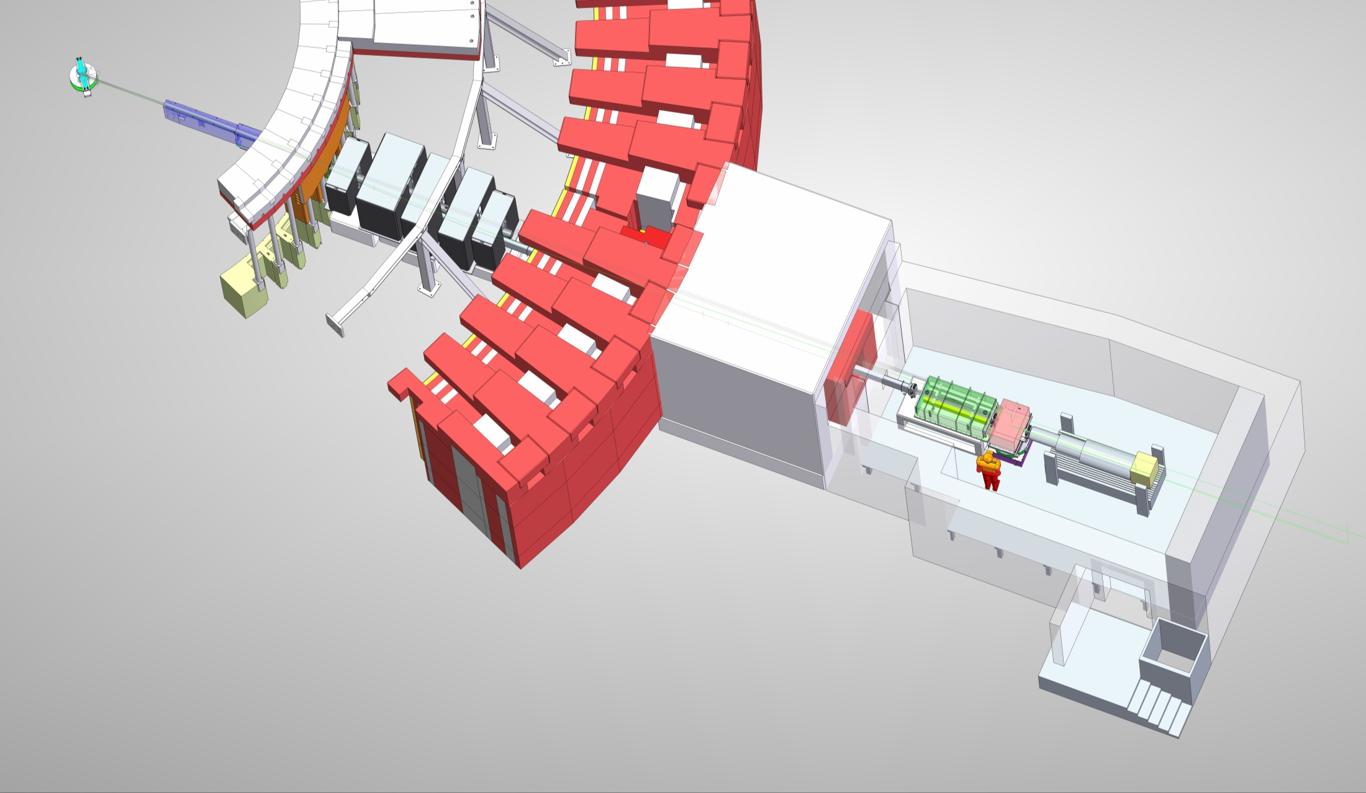
OPTION 2 World Class
This configuration meets the minimum requirements defined by the STAP as necessary for day 1.
Cost estimate = €16.34M

Slide 18
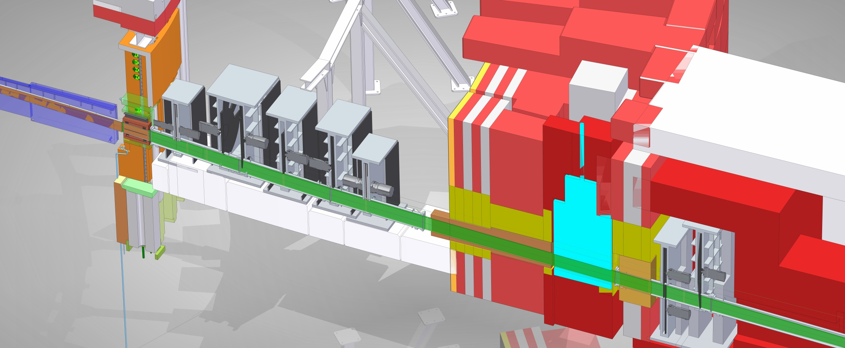
OPTION 2 World Class
Heavy Shutter €375k
Guide €2.1M
Guide Shielding (copper shroud) €50k
Guide collimation blocks €11k
Bunker components activation shielding €50k
Bunker Wall Plug Shielding €83k
Bunker Zone Component Support Structures €100k
Choppers €2.93M

Slide 19
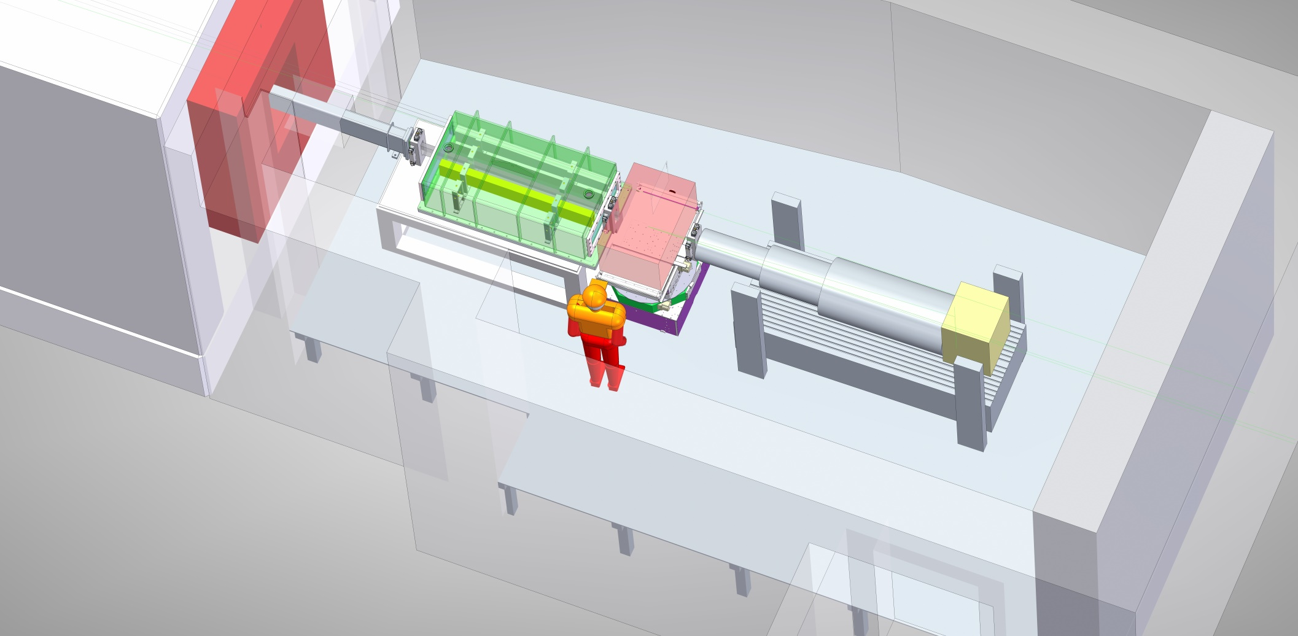
OPTION 2 World Class
XY slits sets €67k
Guide selector €222k
Fast Slits €194k
Sample Stack €416k
Detector 300mm Boron Blade €770k
Motion system €111k
Cave €500k
Beamstop €222k
Access & Flooring €111k
Offline sample prep area €44k
Hutch €178k

Slide 20
OPTION 2 World Class
 | 01 Phase 1 | 02 Project Management & Integration | 03 Design | 04 Procurement & Fabrication | 05 Installation | 06 Cold Commissioning | Total
01 Shielding | € 0 | € 0 | € 0 | € 1,821,000 | € 0 | € 0 | € 1,821,000
02 Neutron Optics | € 0 | € 0 | € 0 | € 2,100,000 | € 0 | € 0 | € 2,100,000
03 Choppers | € 0 | € 0 | € 0 | € 3,014,000 | € 0 | € 0 | € 3,014,000
04 Sample Environment | € 0 | € 0 | € 0 | € 392,000 | € 0 | € 0 | € 392,000
05 Detector and Beam Monitors | € 0 | € 0 | € 0 | € 952,000 | € 0 | € 0 | € 952,000
06 Data Acquisition and Analysis | € 0 | € 0 | € 0 | € 0 | € 0 | € 0 | € 0
07 Motion Control and Automation | € 0 | € 0 | € 0 | € 1,010,000 | € 0 | € 0 | € 1,010,000
08 Instrument Specific Technical Equipment | € 0 | € 0 | € 0 | € 172,000 | € 0 | € 0 | € 172,000
09 Instrument Infrastructure | € 0 | € 0 | € 0 | € 1,201,000 | € 0 | € 0 | € 1,201,000
10 Vacuum | € 0 | € 0 | € 0 | € 0 | € 0 | € 0 | € 0
11 PSS | € 0 | € 0 | € 0 | € 133,000 | € 0 | € 0 | € 133,000
Labour & Travel (Cost) | € 367,965 | € 320,790 | € 1,294,260 | € 0 | € 1,929,180 | € 148,629 | € 4,060,824
12 Contingency |  |  |  |  |  |  | € 1,485,582
Total | € 367,965 | € 320,790 | € 1,294,260 | € 10,795,000 | € 1,929,180 | € 148,629 | € 16,341,406

Slide 21
FREIA Cost Estimates in Euros
ESS LIST | OPTION 1 | Diff | OPTION 2
Shielding | €k 1,743 | €k 78 | €k 1,821
Neutron Optics | €k 2,100 | €k - | €k 2,100
Choppers | €k - | €k 3,014 | €k 3,014
Sample Environment | €k - | €k 392 | €k 392
Detector and Beam Monitors | €k 128 | €k 823 | €k 952
Data Acquisition and Analysis | €k - | €k - | €k -
Motion Control and Automation | €k 133 | €k 877 | €k 1,010
Instrument Specific Technical Equipment | €k 28 | €k 144 | €k 172
Instrument Infrastructure | €k 574 | €k 627 | €k 1,201
Vacuum | €k - | €k - | €k -
PSS | €k 133 | €k - | €k 133
Labour & Travel | €k 3,342 | €k 718 | €k 4,060
TOTAL | €k 8,182 | €k 6,673 | €k 14,855
TOTAL + 10% contingency | €k 9,000 | €k 7,340 | €k 16,341

Slide 22
Staff Costs
Option 2

Slide 23
Staff Costs
Option 2

Slide 24
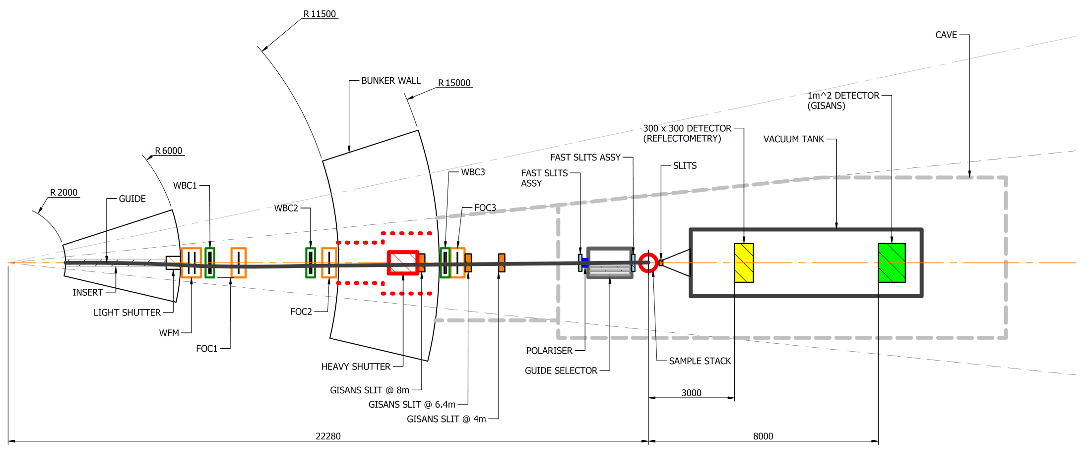
OPTION 3 Full Scope
1m² ¹⁰B GISANS detector at 8m from sample, movable 300mm vertically
Slit positions for GISANS ~8m, ~6.5m and ~4m before sample
Vacuum tank, beam stops and mechanism for changing detector used for the above
Full suite of sample environment: 607k€
Full configuration meets most of Reflectometry science case (~85%) at world-leading level
+ complementary GISANS (d~200nm)

Slide 25
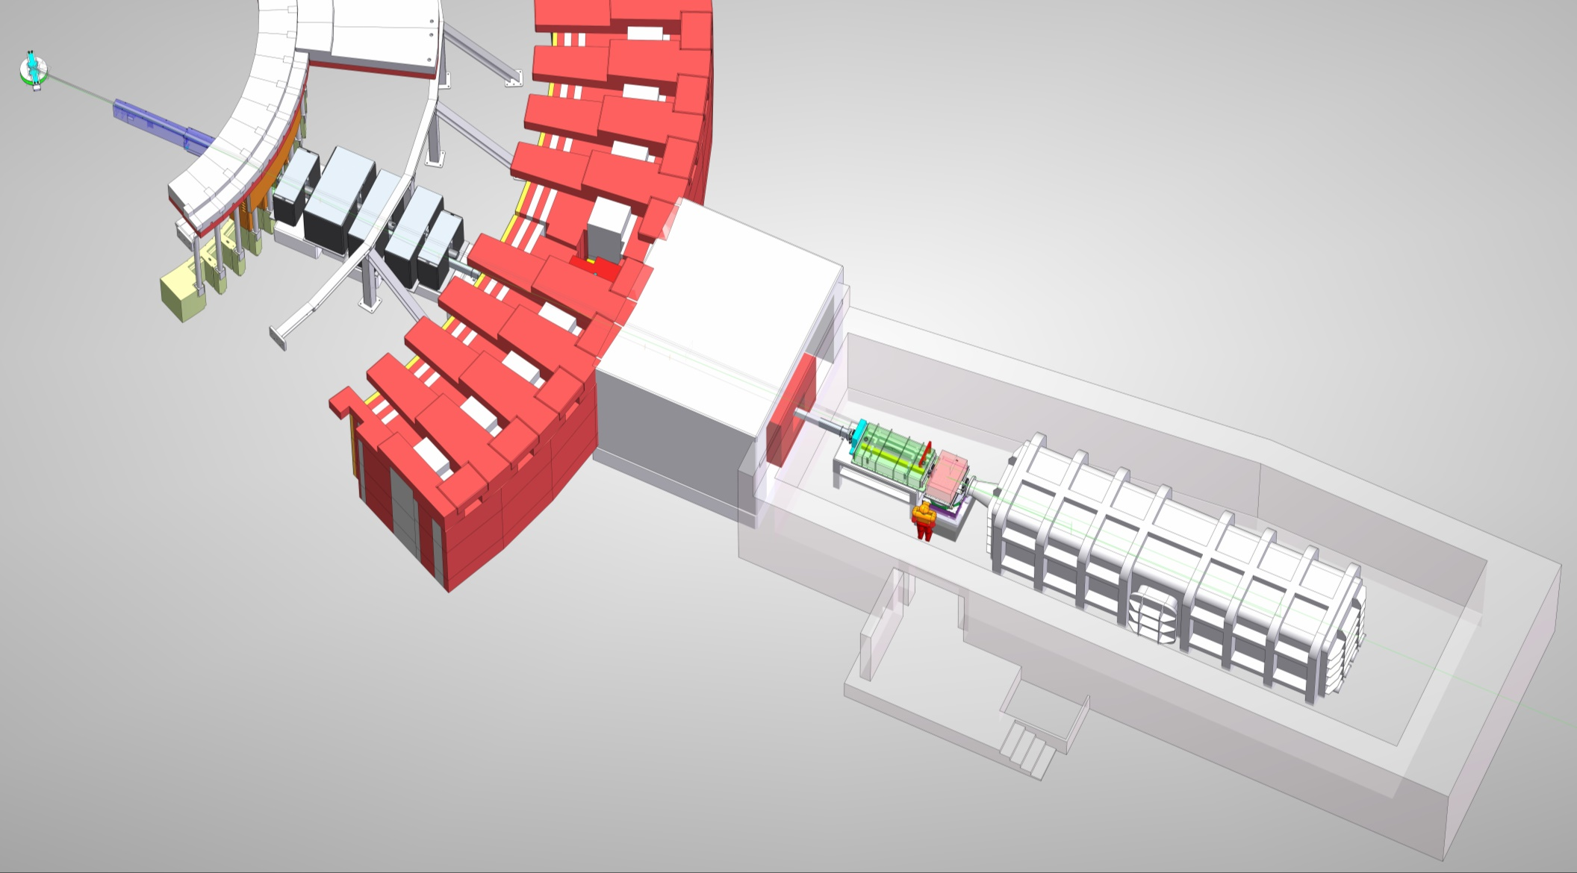
OPTION 3 Full Scope
Cost estimate = €21.35M

Slide 26
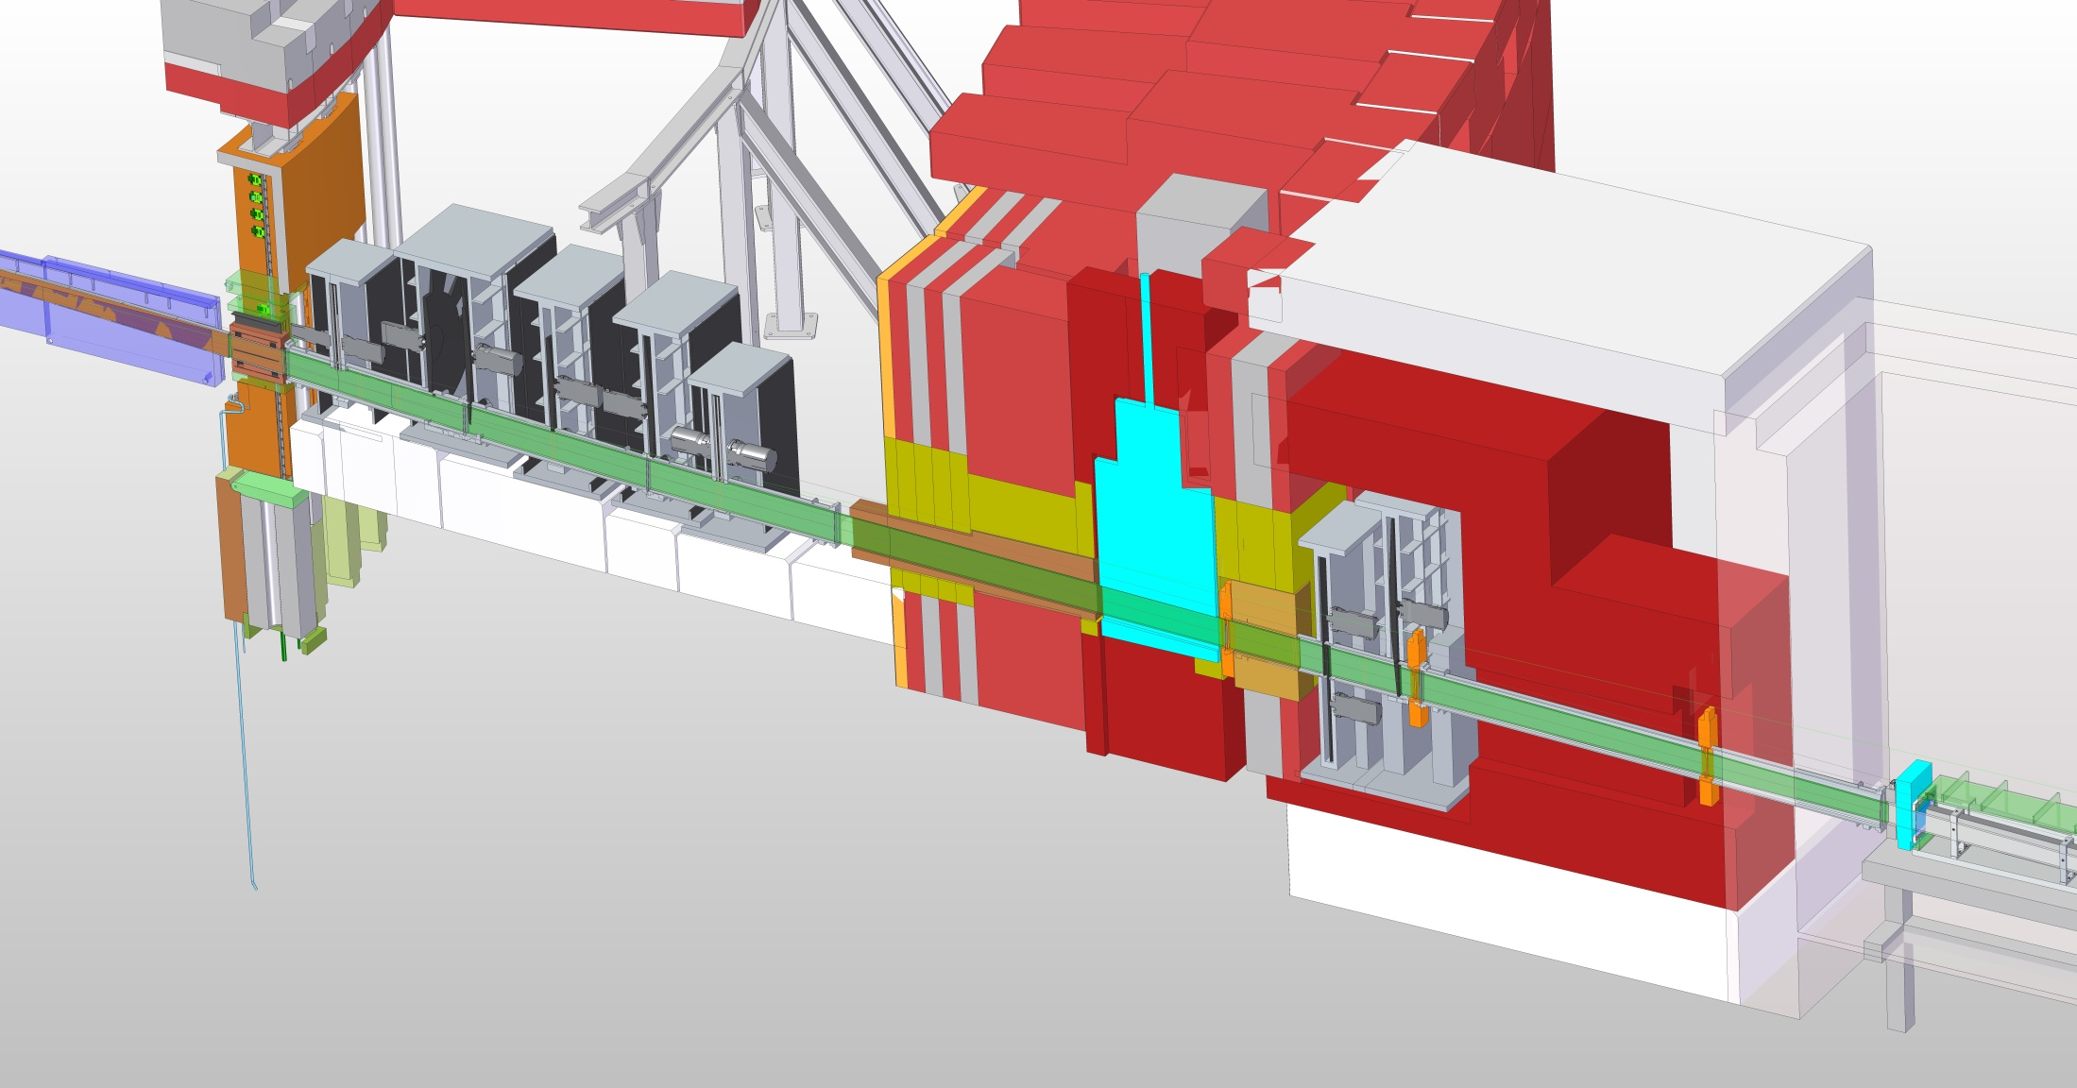
OPTION 3 Full Scope
3 x GiSans slits €67k

Slide 27
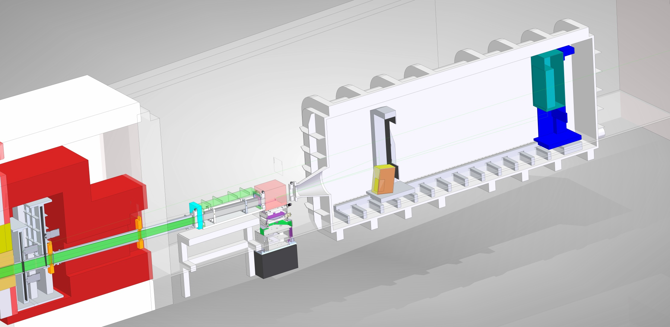
OPTION 3 Full Scope
Polariser €286k
Fast shutter system €278k
Vacuum Tank €666k
GiSans 1m² detector €2.4M
Motion system €278k
Large Cave €1M
Beamstop €222k
Access & Flooring €111k

Slide 28
OPTION 3 Full Scope
 | 01 Phase 1 | 02 Project Management & Integration | 03 Design | 04 Procurement & Fabrication | 05 Installation | 06 Cold Commissioning | Total
01 Shielding | € 0 | € 0 | € 0 | € 2,338,000 | € 0 | € 0 | € 2,338,000
02 Neutron Optics | € 0 | € 0 | € 0 | € 2,100,000 | € 0 | € 0 | € 2,100,000
03 Choppers | € 0 | € 0 | € 0 | € 3,014,000 | € 0 | € 0 | € 3,014,000
04 Sample Environment | € 0 | € 0 | € 0 | € 607,000 | € 0 | € 0 | € 607,000
05 Detector and Beam Monitors | € 0 | € 0 | € 0 | € 3,352,000 | € 0 | € 0 | € 3,352,000
06 Data Acquisition and Analysis | € 0 | € 0 | € 0 | € 0 | € 0 | € 0 | € 0
07 Motion Control and Automation | € 0 | € 0 | € 0 | € 1,343,000 | € 0 | € 0 | € 1,343,000
08 Instrument Specific Technical Equipment | € 0 | € 0 | € 0 | € 980,000 | € 0 | € 0 | € 980,000
09 Instrument Infrastructure | € 0 | € 0 | € 0 | € 1,240,000 | € 0 | € 0 | € 1,240,000
10 Vacuum | € 0 | € 0 | € 0 | € 0 | € 0 | € 0 | € 0
11 PSS | € 0 | € 0 | € 0 | € 133,000 | € 0 | € 0 | € 133,000
Labour & Travel (Cost) | € 371,295 | € 321,567 | € 1,419,690 | € 0 | € 1,995,225 | € 197,469 | € 4,305,246
12 Contingency |  |  |  |  |  |  | € 1,941,225
Total | € 371,295 | € 321,567 | € 1,419,690 | € 15,107,000 | € 1,995,225 | € 197,469 | € 21,353,471

Slide 29
FREIA Cost Estimates in Euros
ESS LIST | OPTION 2 | Diff | OPTION 3
Shielding | €k 1,821 | €k 517 | €k 2,338
Neutron Optics | €k 2,100 | €k - | €k 2,100
Choppers | €k 3,014 | €k - | €k 3,014
Sample Environment | €k 392 | €k 215 | €k 607
Detector and Beam Monitors | €k 952 | €k 2,400 | €k 3,352
Data Acquisition and Analysis | €k - | €k - | €k -
Motion Control and Automation | €k 1,010 | €k 333 | €k 1,343
Instrument Specific Technical Equipment | €k 172 | €k 808 | €k 980
Instrument Infrastructure | €k 1,201 | €k 39 | €k 1,240
Vacuum | €k - | €k - | €k -
PSS | €k 133 | €k - | €k 133
Labour & Travel | €k 4,060 | €k 246 | €k 4,306
TOTAL | €k 14,855 | €k 4,558 | €k 19,413
TOTAL + 10% contingency | €k 16,341 | €k 5,014 | €k 21,355

Slide 30
FREIA Cost Estimates in Euros
ESS LIST | OPTION 1 | Diff | OPTION 2 | Diff | OPTION 3
Shielding | €k 1,743 | €k 78 | €k 1,821 | €k 517 | €k 2,338
Neutron Optics | €k 2,100 | €k - | €k 2,100 | €k - | €k 2,100
Choppers | €k - | €k 3,014 | €k 3,014 | €k - | €k 3,014
Sample Environment | €k - | €k 392 | €k 392 | €k 215 | €k 607
Detector and Beam Monitors | €k 128 | €k 823 | €k 952 | €k 2,400 | €k 3,352
Data Acquisition and Analysis | €k - | €k - | €k - | €k - | €k -
Motion Control and Automation | €k 133 | €k 877 | €k 1,010 | €k 333 | €k 1,343
Instrument Specific Technical Equipment | €k 28 | €k 144 | €k 172 | €k 808 | €k 980
Instrument Infrastructure | €k 574 | €k 627 | €k 1,201 | €k 39 | €k 1,240
Vacuum | €k - | €k - | €k - | €k - | €k -
PSS | €k 133 | €k - | €k 133 | €k - | €k 133
Labour & Travel | €k 3,342 | €k 718 | €k 4,060 | €k 246 | €k 4,306
TOTAL | €k 8,182 | €k 6,673 | €k 14,855 | €k 4,558 | €k 19,413
TOTAL + 10% contingency | €k 9,000 | €k 7,340 | €k 16,341 | €k 5,014 | €k 21,355

Slide 31
Staff Costs
Option 3

Slide 32
Staff Costs
Option 3

Slide 33
Travel Costs
Option 1
  Assumed 22.2 K€
Option 2
Option 3
Assumed 1 trip for 2 days for 2 people =£1000

Slide 34
Cost of collaboration
 | Option 1 | Option 2 (£k) | Option 2 (K€) | Op2 M/Y | Option 3 (£K) | Option 3 (K€) | Opt 3 M/Y
Staff
Integration | 0 | 456 | 506.16 | 3.7 | 475 | 527.25 | 3.9
Second scientist | 0 | 155 | 172.05 | 1.6 | 155 | 172.05 | 1.6
ESS Cross functional staff | 0 | 199 | 220.89 | 1.6 | 199 | 220.89 | 1.6
Logistics | 0 | 38 | 42.18 | 1 | 38 | 42.18 | 1
Prebuild |  | 169 | 187.59 | 3 | 169 | 187.59 | 3
 |  |  | 0 |  |  | 0
Travel | 0 | 357 | 396.27 |  | 375 | 416.25
Shipping | 0 | 225 | 249.75 |  | 250 | 277.5
Pre build | 0 | 25 | 27.75 |  | 25 | 27.75
Total |  | 1624 | 1802.64 | 10.9 | 1686 | 1871.46 | 11.1

