Slide 1
MAGiC Shielding Simulations
Uwe Filges
Laboratory for scientific Developments and novel Materials (LDM)
Paul Scherrer Institut

Slide 2
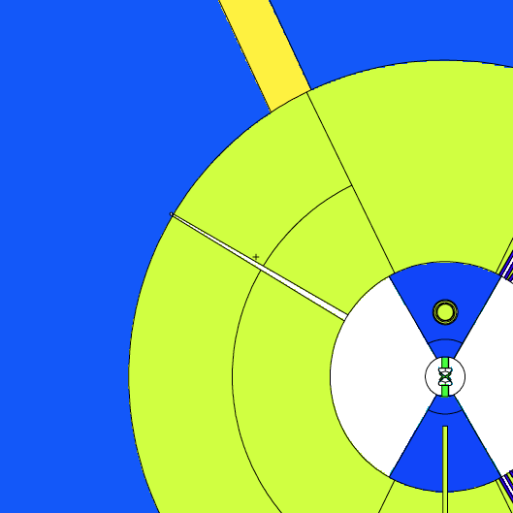
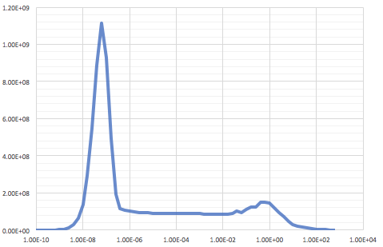
Neutron and prompt gamma dose rates at 5.5m (W6)
Total: 27 Sv/h
Gamma dose rate (muSv/h)
Energy (MeV)
Neutron flux: 8.4*E9 n/s/cm²
Total: 447 Sv/h
W6 – beam entrance 30 mm x 124 mm
Neutron dose rate (muSv/h)
W6 – beam exit 30 mm x 38 mm
Note: no other beamports are modelled
Energy (MeV)

Slide 3
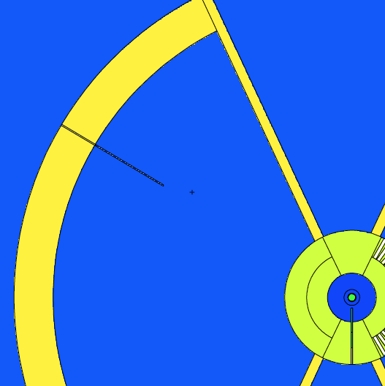
Neutron and prompt gamma dose rates at 24.5 m (W6)
Gamma dose rate
Dose rates @ 24.5m
Gamma dose rate (muSv/h)
Total: 0.79 Sv/h
Energy (MeV)
Neutron dose rate
Neutron dose rate (muSv/h)
Total: 13.8 Sv/h
W6 – vacuum channel 10 cm x 10 cm (0.5 deg tilt)
New SDEF-card defined for guide shielding calculations
Energy (MeV)

Slide 4
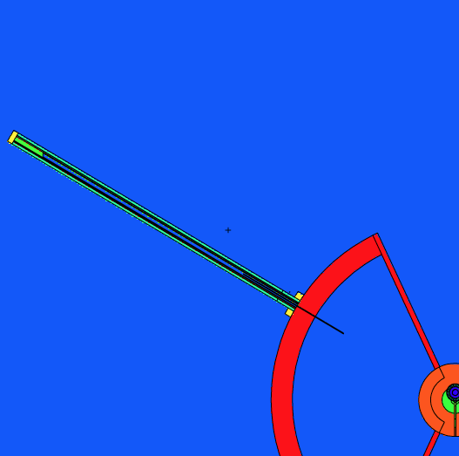
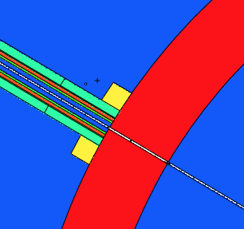
Neutron dose rates along guide system (W6)
cross section inside shielding: 50 cm x 50cm
Shielding around guide:
10 cm borated concrete
10 cm standard steel
50 cm standard concrete
New neutron source definition
(SDEF card)
A
D
Source – tally S: 13.8 Sv/h
@77m - tally A: 8.8 mSv/h
fast neutron flux: 4.7E4 n/cm²/s
@30m – outside guide shielding
tally B: 3.4 µSv/h
@50m ouside guide shielding
tally C: 1.9 µSv/h
@77m ouside guide shielding
tally D: 1.1 µSv/h
C
B
S

Slide 5
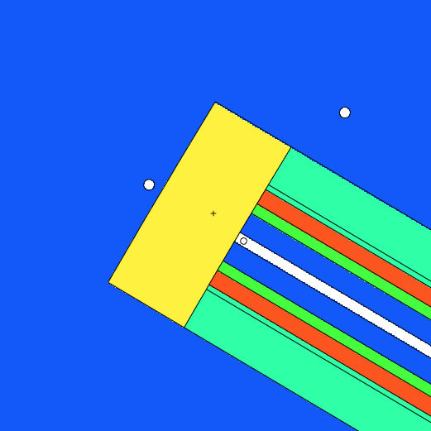
Shielding the direct beam at 77m
Remember:
@77m center of beam: 8.8 mSv/h neutron dose rate
Beam dump consists of 50 cm
heavy concrete (4.9 g/cm³)
Concrete includes 5 % B₄C
Behind beam dump:
n-dose rate : 1.6 µSv/h
g-dose rate : < 0.1 µSv/h
Detector size: d=6 cm
30 n/s/cm²

Slide 6
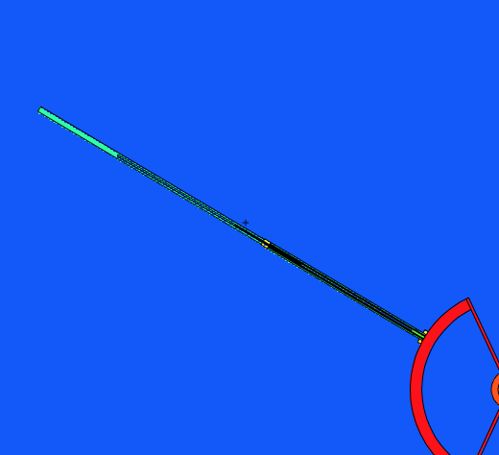
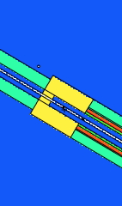
150m Guide Shielding
Neutron background at 150 m
Shielding around guide behind 77m:
2m heavy concrete with vacuum tube belt
75m standard concrete (0.5 m thickness)
F
neutrons
Source – tally S: 13.8 Sv/h
@80m ouside guide shielding
tally E: 1.3 µSv/h
@150m inside guide shielding
tally F: 0.2 µSv/h
4.2 n/s/cm²
E

Slide 7
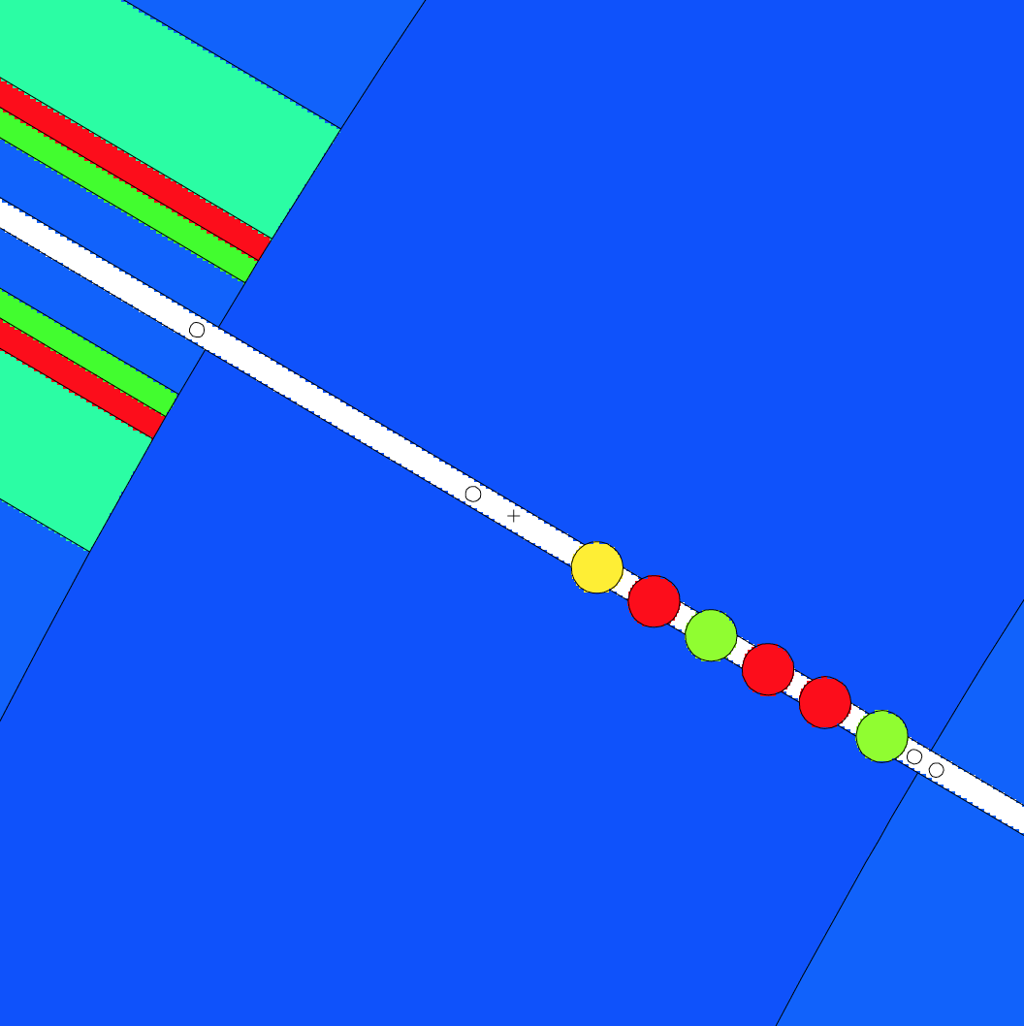
High energy shutter setup
6 drums are positioned within the neutron bunker wall.
Drum Sequence:
Borax (50% epoxy / 50% B₄C)
Standard steel
Standard steel
Borax
Standard steel
Tungsten/parafin (density 11.8 g/cm³)
Effective thickness: each drum 20 cm
n-dose rate: 15.2 µSv/h
g-dose rate: 0.5 µSv/h
(only prompt gammas from the drums)
N-Dose rate can be reduced more by replacing steel with tungsten drums.

Slide 8
Neutron flux at 6 m
How much neutron flux hits the permanent magnets?
Distance between the magnets and the center of the beam is around 40 mm.
Neutron fluxes (vertical plane):
@ +40 mm: 4.1*E6 n/s/cm²
@ center : 8.4*E9 n/s/cm²
@ -40 mm : 3.1*E6 n/s/cm²
Magnets should be protected by Poly/Lead/Boral .
W6 – beam exit 30 mm x 38 mm

