Slide 1
SCOPE – MAGiC
MAGiC Components
S. Klimko

Slide 2
Layout of MAGiC, W6
Experimental cave
& Control hutch
NBES
Neutron guide shielding
D01
E01
Guide hall
Bunker
6 m
28 m
86 m
171 m

Slide 3
Layout of MAGiC, W6
Thermal neutron
polarizer
Neutron guide
& Magnetic guide
Detectors &
Sample Environment
SSB
Choppers
D01
E01
Guide hall
6 m
80 m
86 m
171 m

Slide 4
Layout of MAGiC, W6
Detectors &
Sample Environment
Experimental cave
& Control hutch
Choppers
Thermal neutron
polarizer
SSB
Neutron guide
& Magnetic guide
Neutron guide shielding
6 m
80 m
86 m
171 m

Slide 5
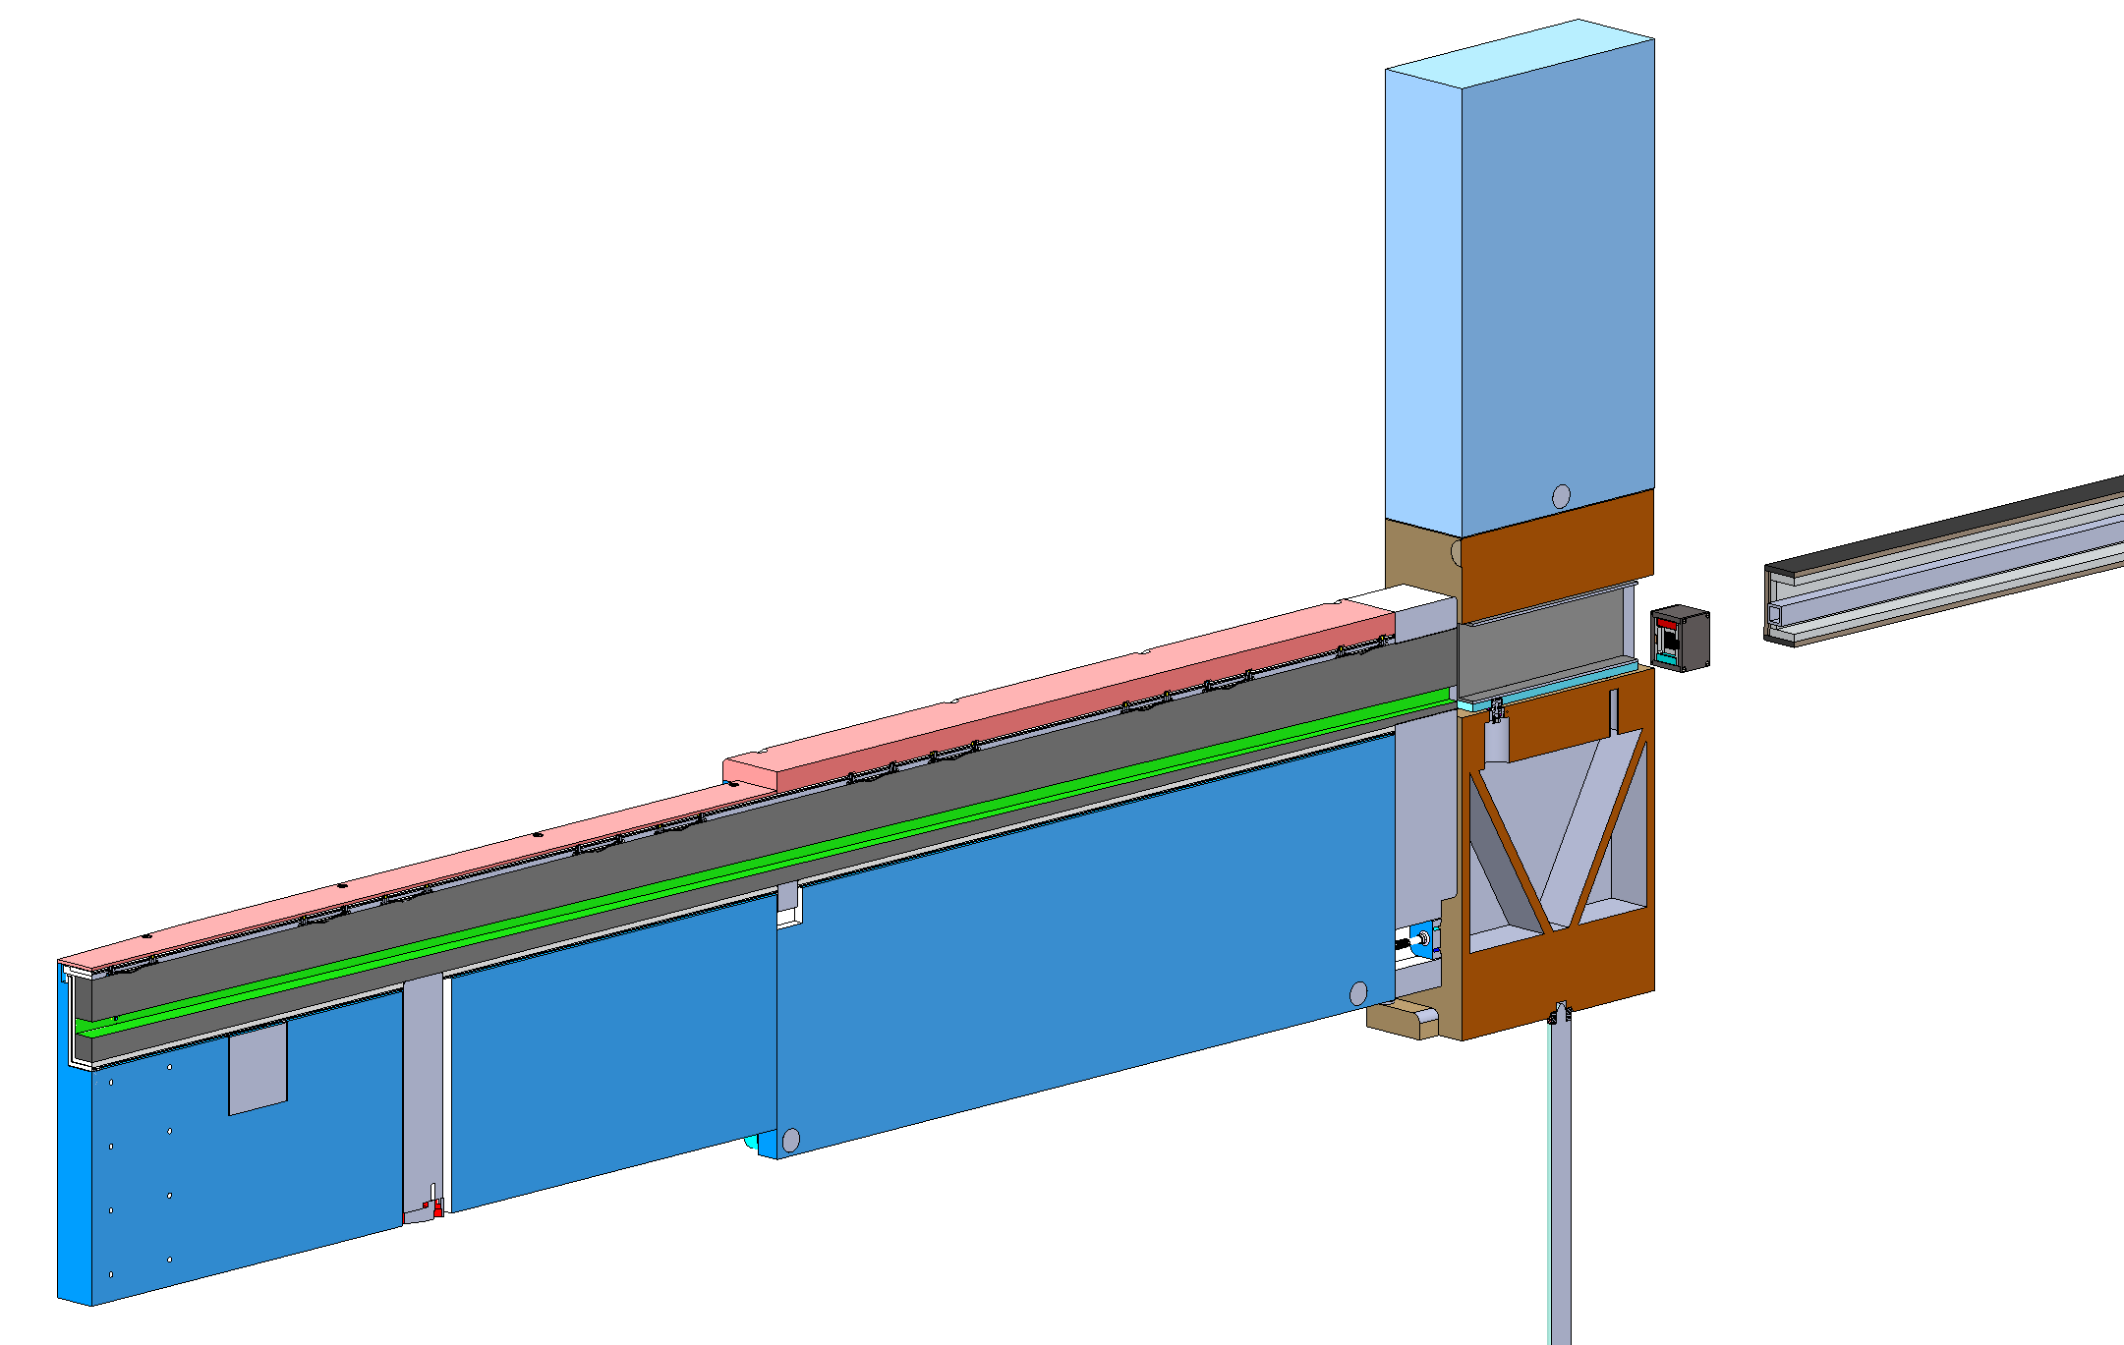
NBES, W6
No guides in the insert
Dimensions @ 2.0 m: 124x30 mm
Dimensions @ 5.5 m: 38x30 mm
Design has been agreed with Bengt Jönsson.
Light shutter
Neutron guide origin
Insert W6 of Neutron Beam Extraction System
Cold neutron polarizer
SSB

Slide 6
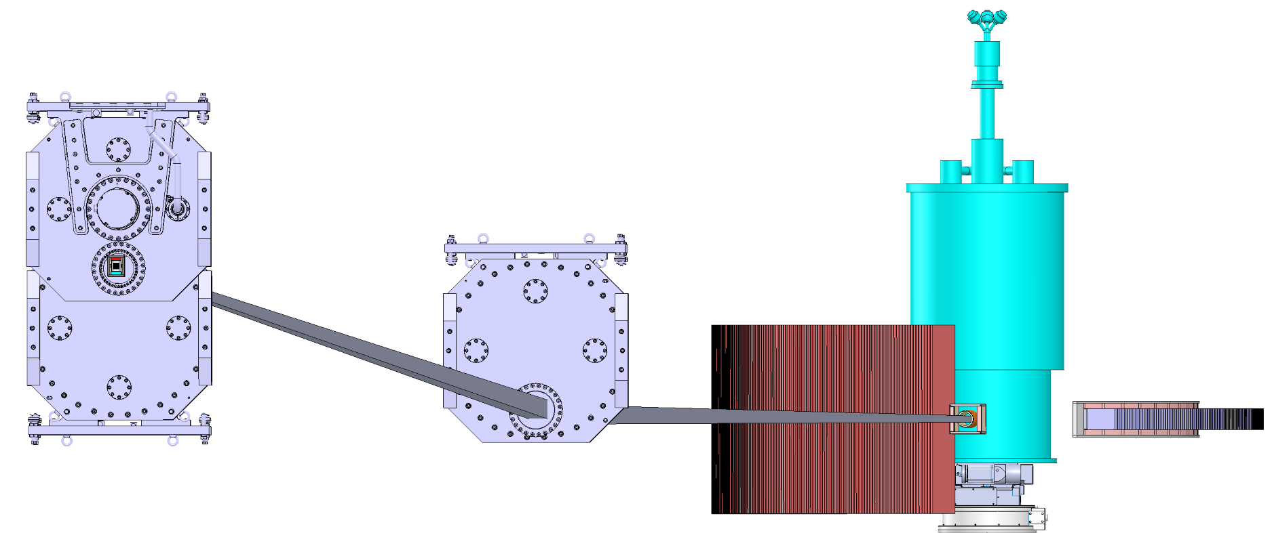
Choppers
(JCNS parters)
PSC, SC
6.2 m
Cold neutron
Polarizer, SSB
Band Chopper
80 m
First chopper assembly: @~6,2 m, Estimated cost: 500 k€
PSC (>182 Hz): select 𝜆 resolution
Thermal spectrum: 𝛿𝜆/𝜆 = 3,0%
Cold spectrum: 𝛿𝜆/𝜆 = 1,9%
Selection Chopper (14 Hz): eliminate sub-pulses from PSC, Estimated cost: 125 k€
Second chopper assembly: before thermal polarizer- half length of the guide
Band Chopper (14 Hz): select wavelength range @~80 m, Estimated cost: 125 k€
TOTAL 750k€
Neutron guide

Slide 7
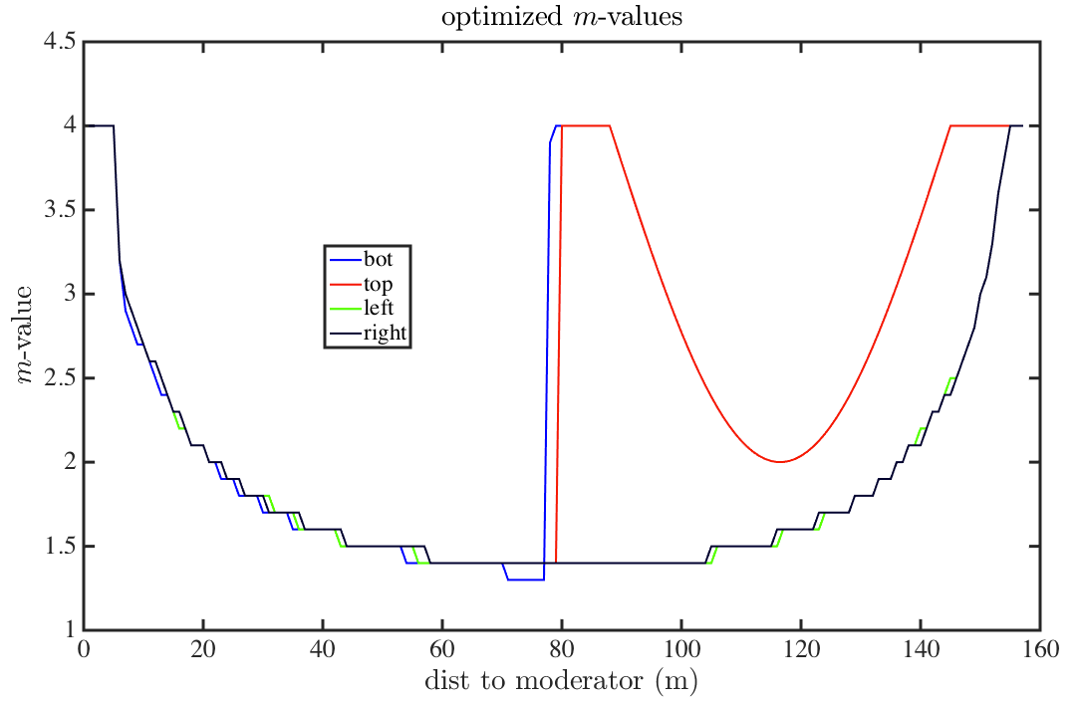
Neutron guide
Elliptical supermirror guide,
divided in two half ellipses
6.2 m
-0,5°
83 m
86 m
162 m
Thermal neutron
Polarizer.
Kink position
0°
-0,25°
m-coating optimization of the guide
Super-mirrors cost: 2050 k€
SwissNeutronics
Vacuum housing: 470 k€
Total: 2 520 k€

Slide 8
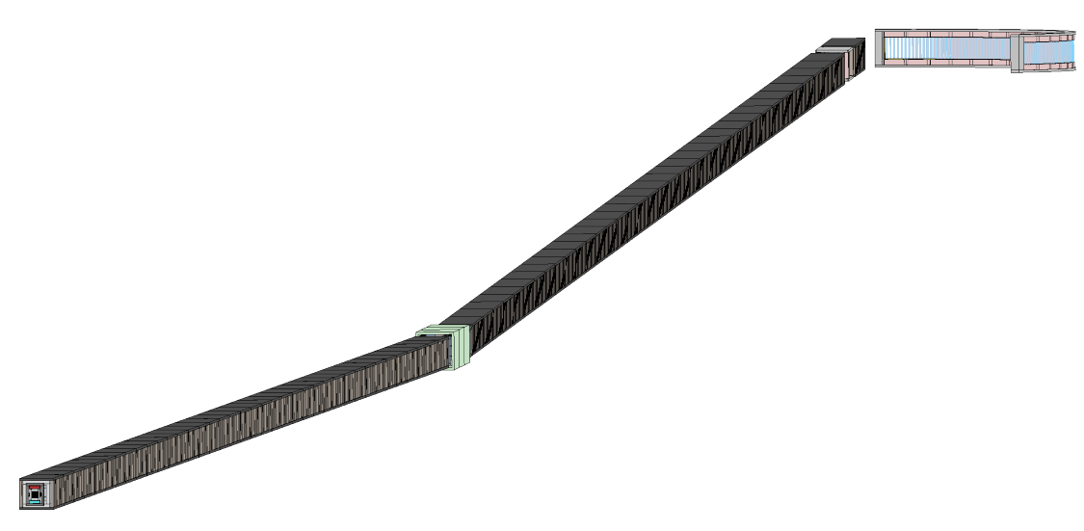
Neutron polarization
Cold neutron polarizer (2 ÷ 6Å), SSB
Magnetic guide fields
Polarization rotators
Thermal neutron polarizer (0,6 ÷ 2,3Å) – super-mirrors
Spin-flipper
XYZ- polarization analysis coils
Polarization analyser
Polarization
analyser
Spin-flipper
Magnetic guide fields
Polarization rotators
Thermal neutron polarizer
SSB polarizer

Slide 9
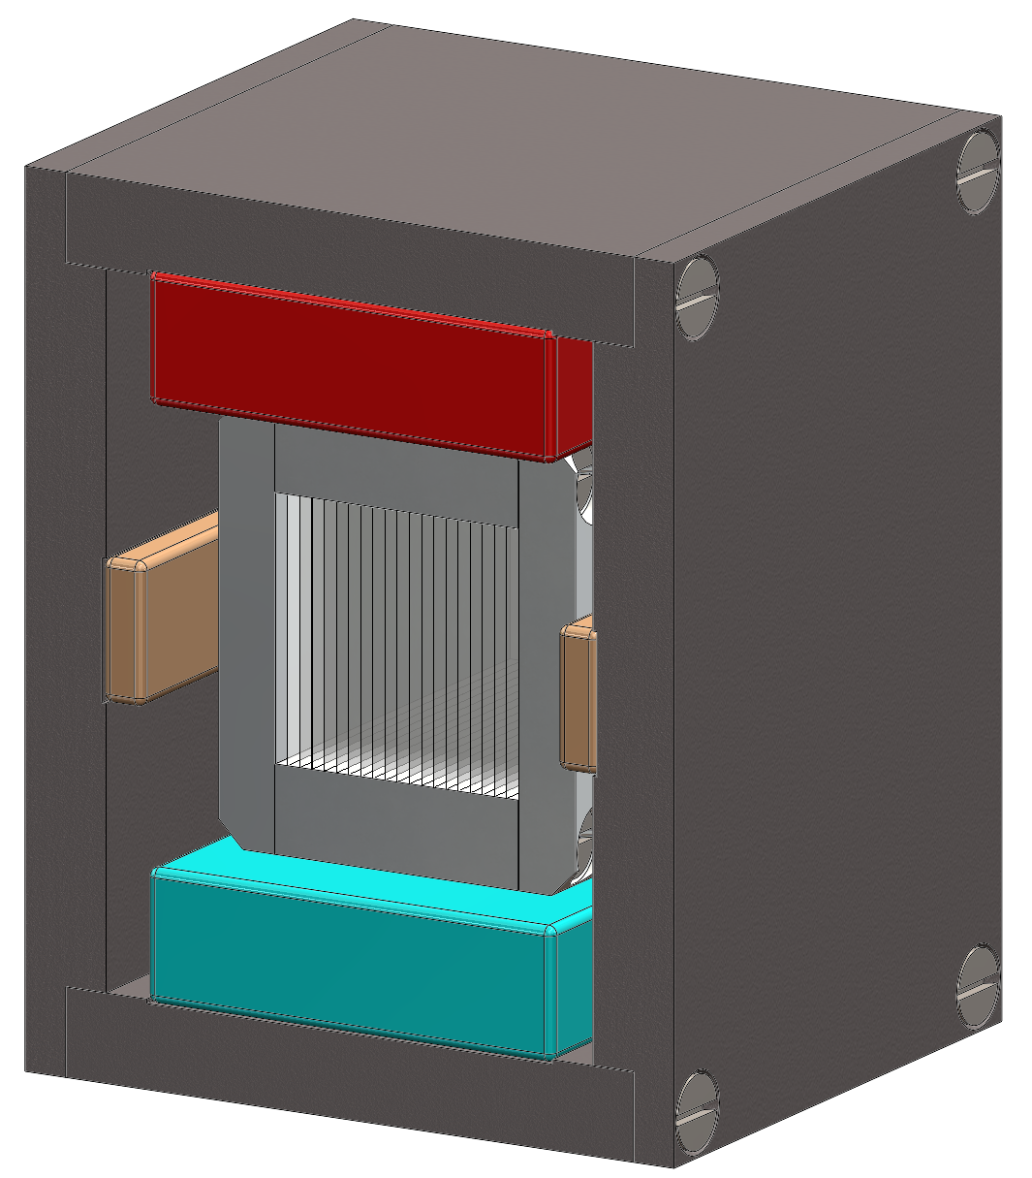
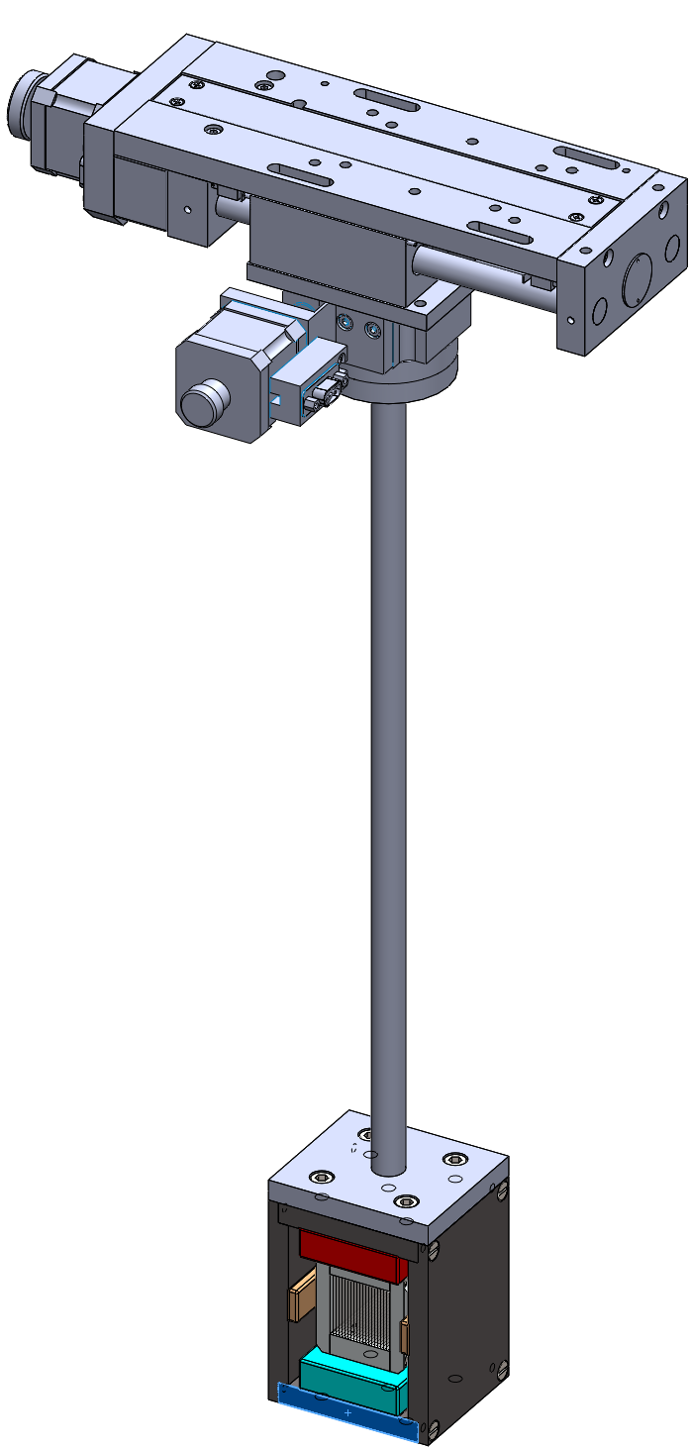
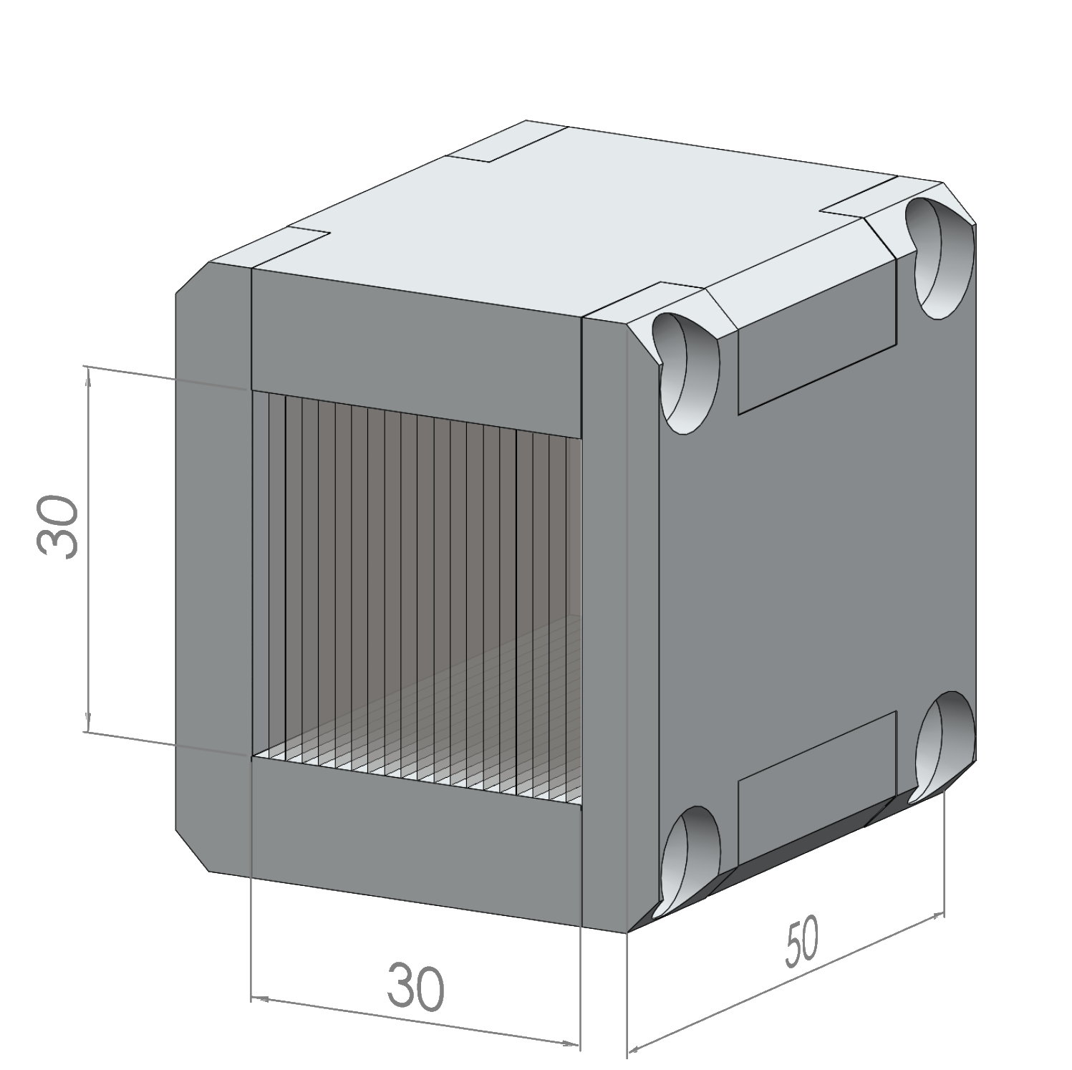
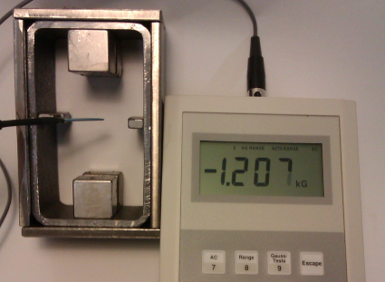
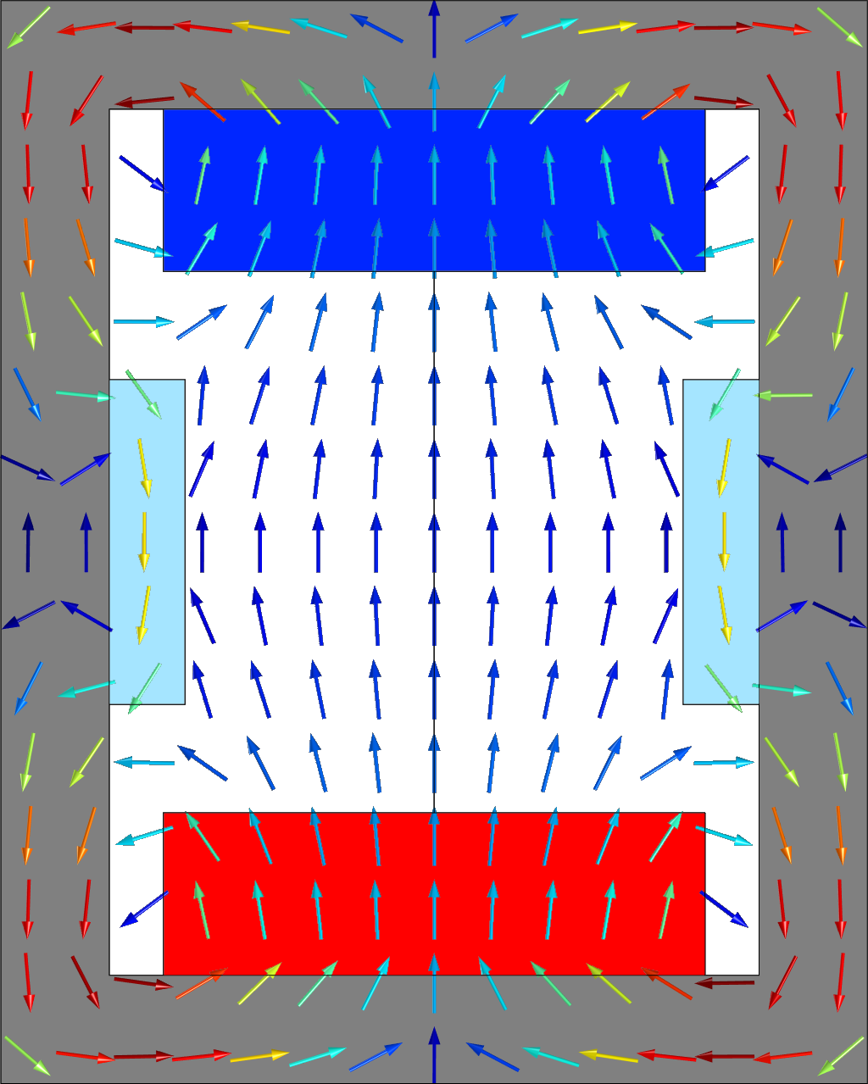
Cold neutron polarizer
Position: in front of PSC
Solid state bender (3m), 150 µm thick Si wafer coated with FeSi;
Vertical saturation field of 1 kGauss;
Kinematic mount to easily adjust and switch between thermal (0,6 ÷ 2,3Å) and cold (2 ÷ 6Å) polarized neutron beams;
Estimated cost: 60k€.

Slide 10
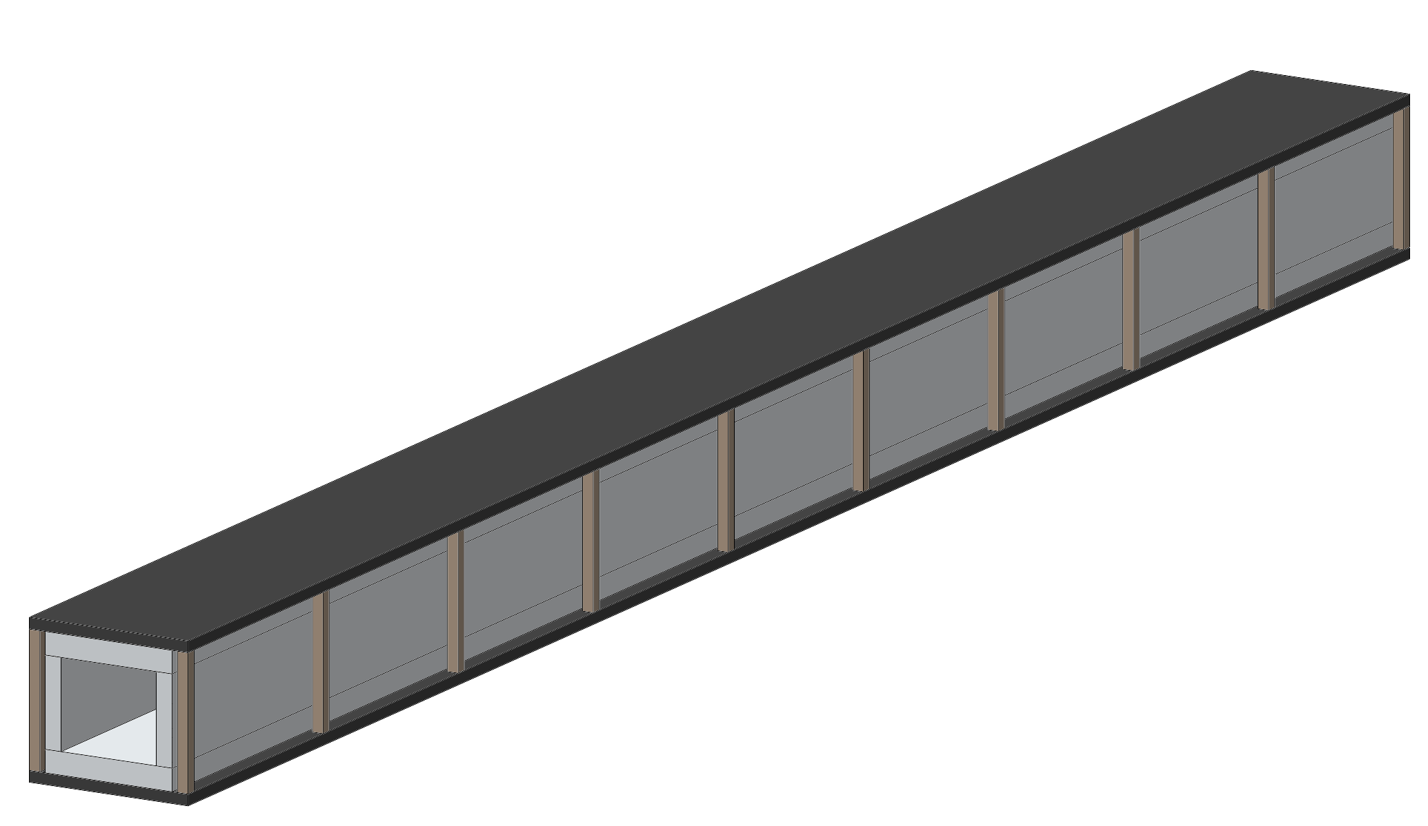
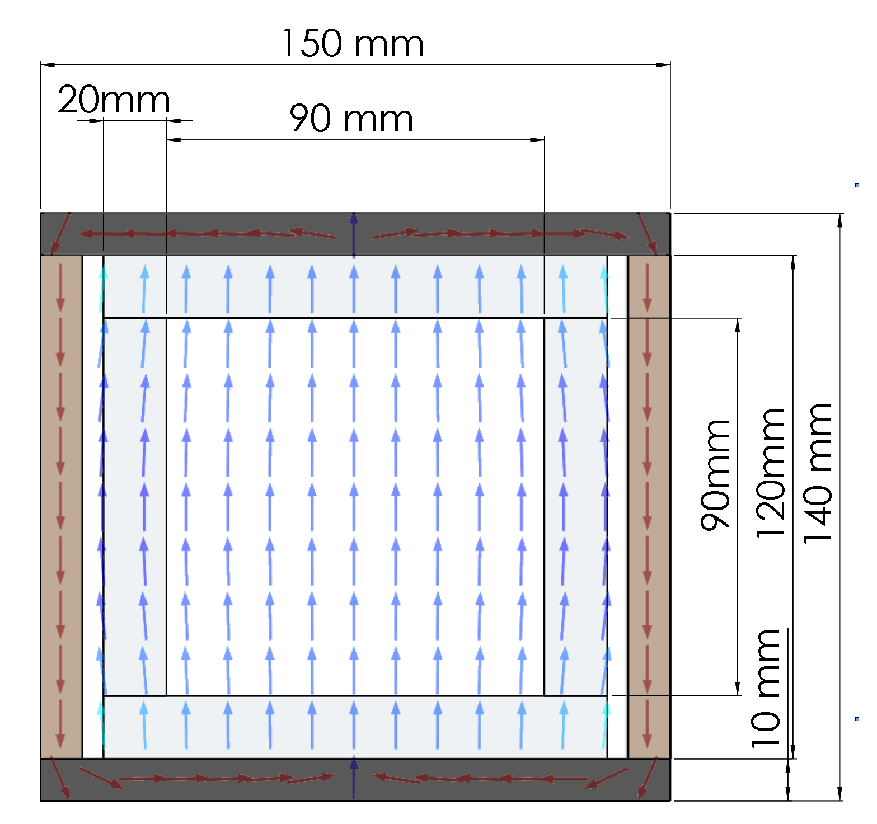
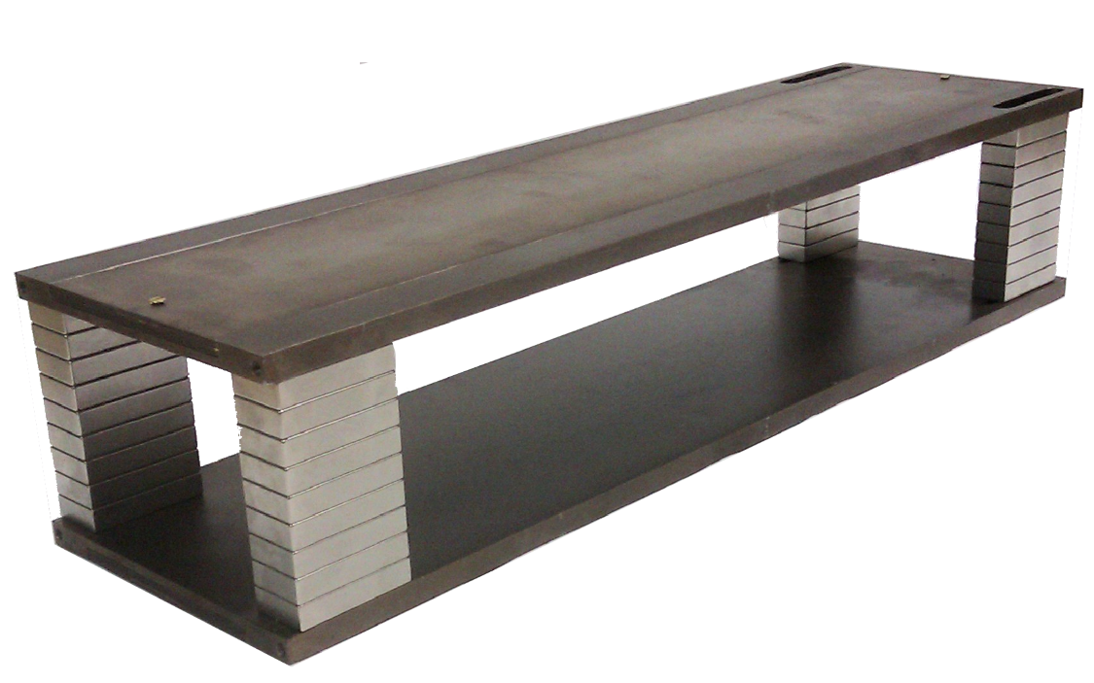
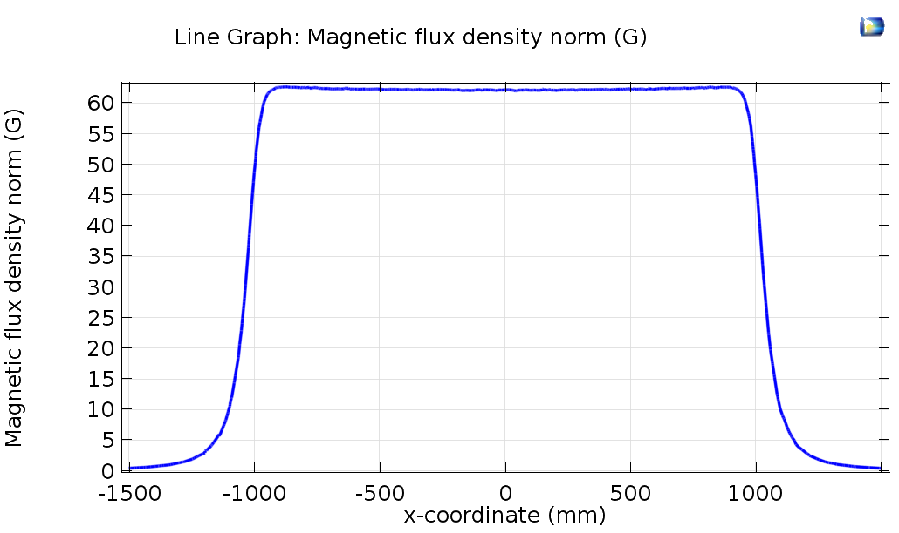
Magnetic guide field
To keep polarization, magnetic guide field is applied along the full instrument;
Homogeneous vertical guide field of 60 Gauss inside the guide;
Soft iron plates + NdFeB magnets;
Estimated cost: 82.7 k€.
Soft iron plates
Vacuum
housing
NdFeB
magnets
10

Slide 11
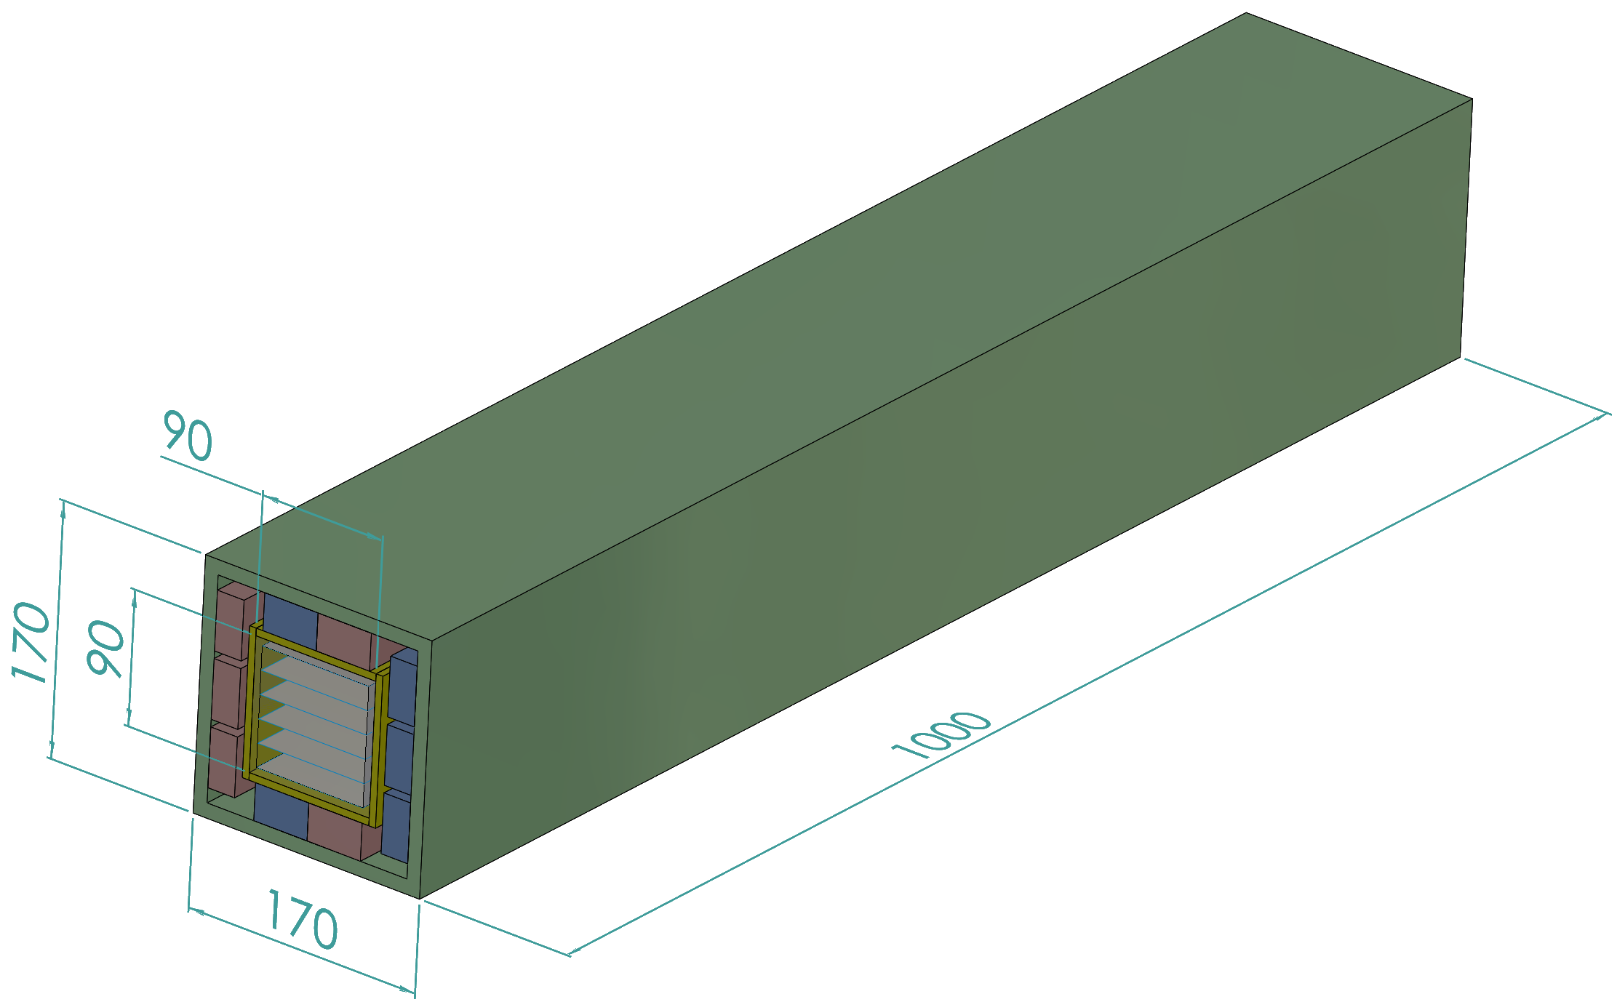
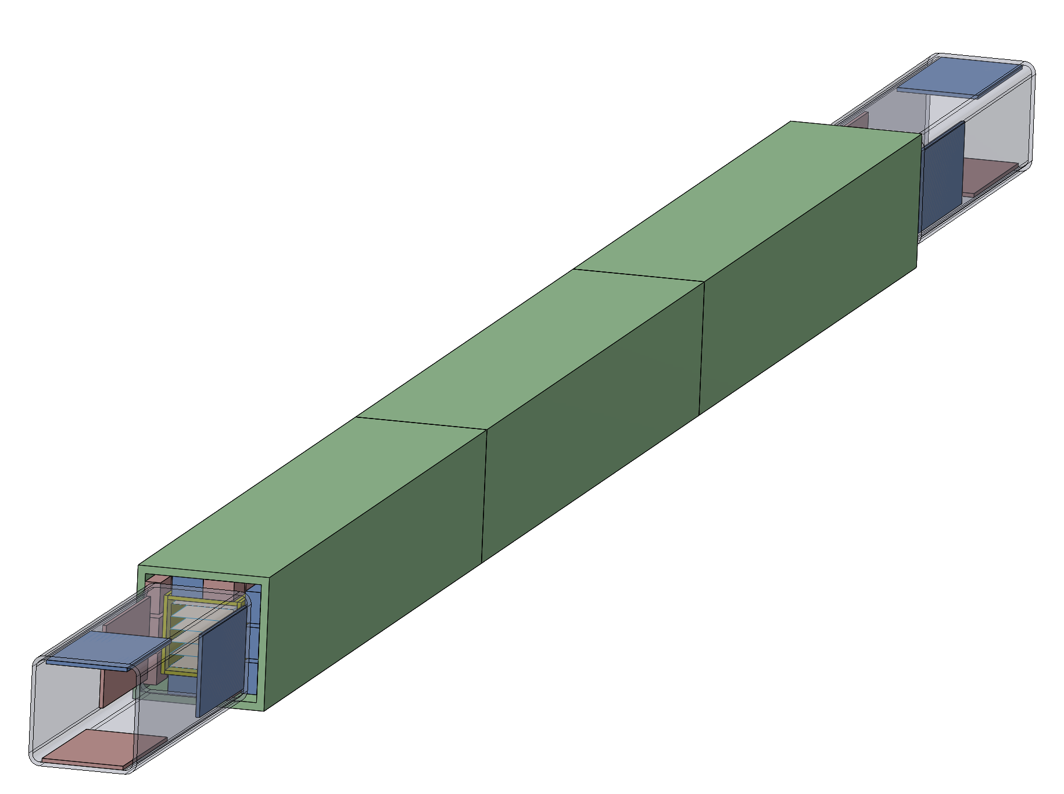
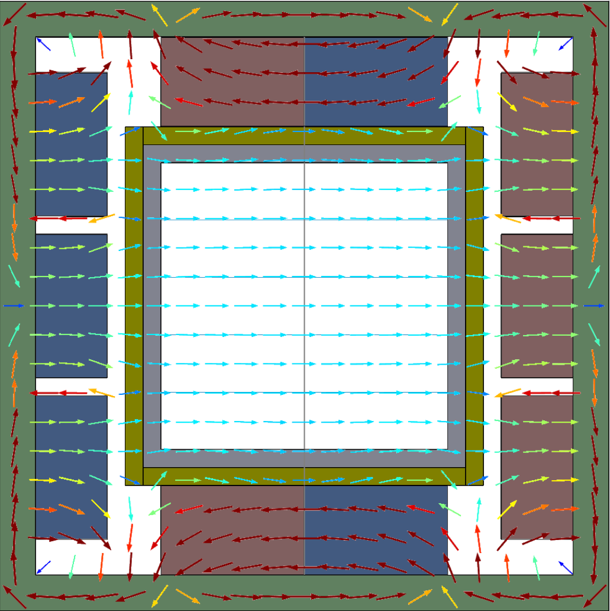
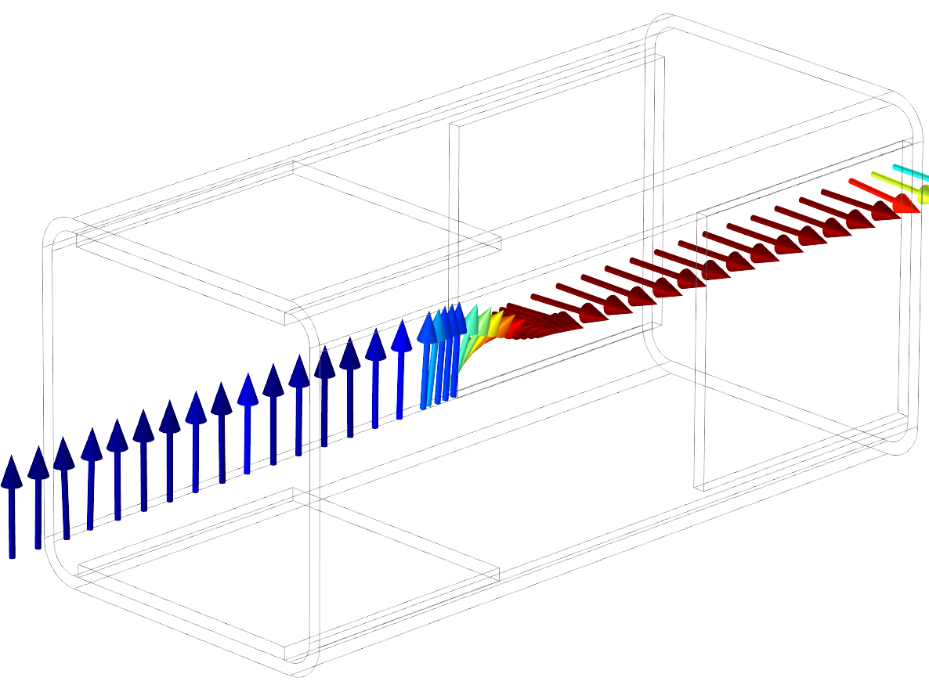
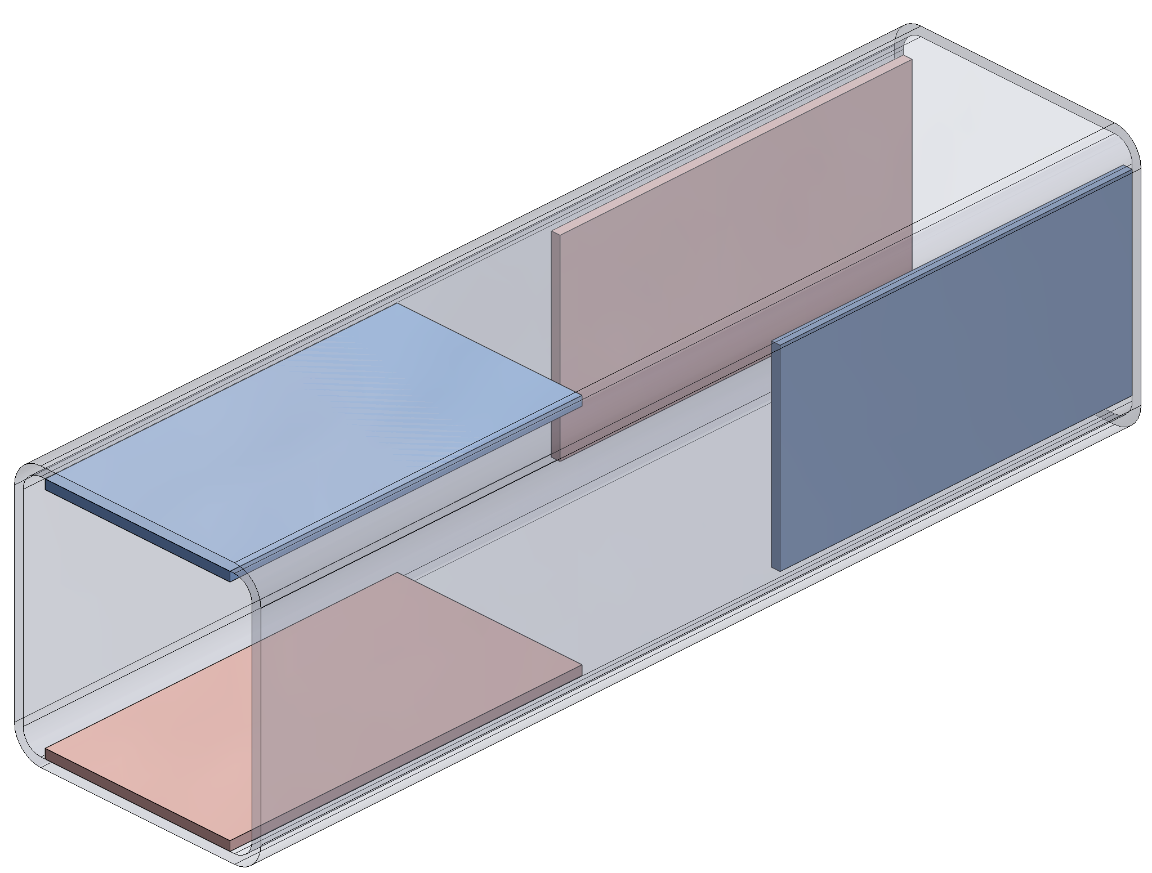
Thermal neutrons polarizer Polarization rotator
6 channels FeSi super-mirror polarizer; 3 section by 1m long;
Horizontal saturation field of 1 kGauss;
Soft iron yoke + NdFeB magnets;
Polarization rotator – turn polarization 90°;
Estimated cost: 100 k€.
Soft iron yoke
NdFeB
magnets
11

Slide 12
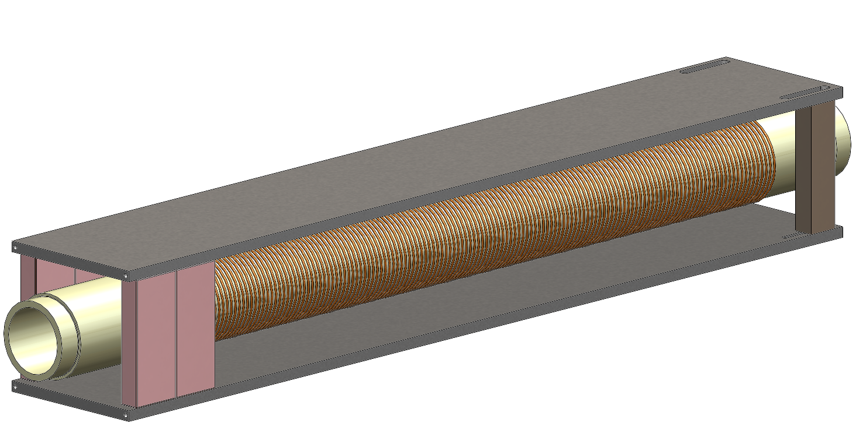
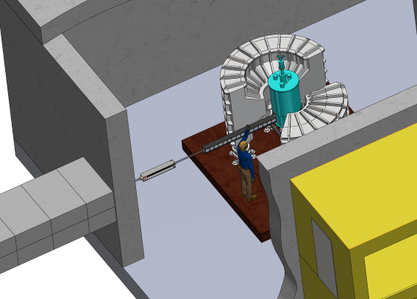
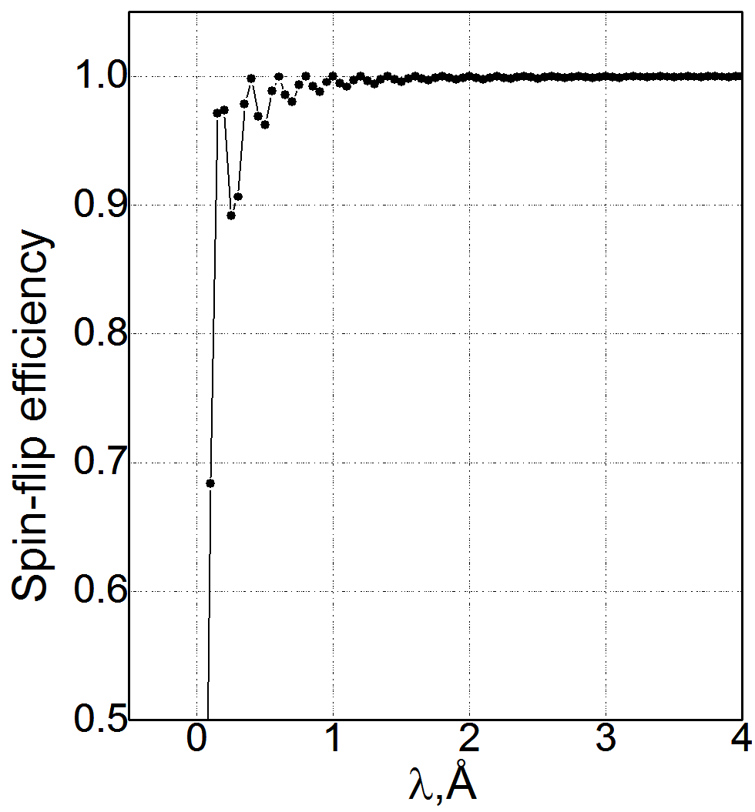
Adiabatic spin flipper
Adiabatic spin flipper will be installed in the second guide section at distance from the sample position to limit stray field from 10 T magnet;
Spin-flip efficiency is ~1 from 0,6Å to higher wavelength;
Estimated cost: 30k€.
12

Slide 13
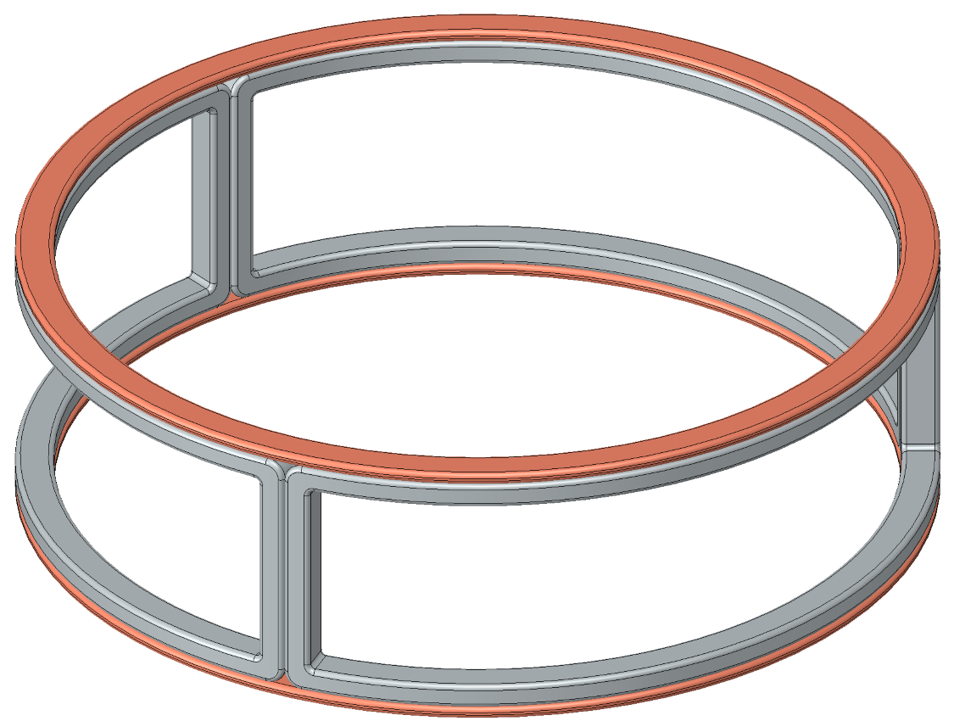
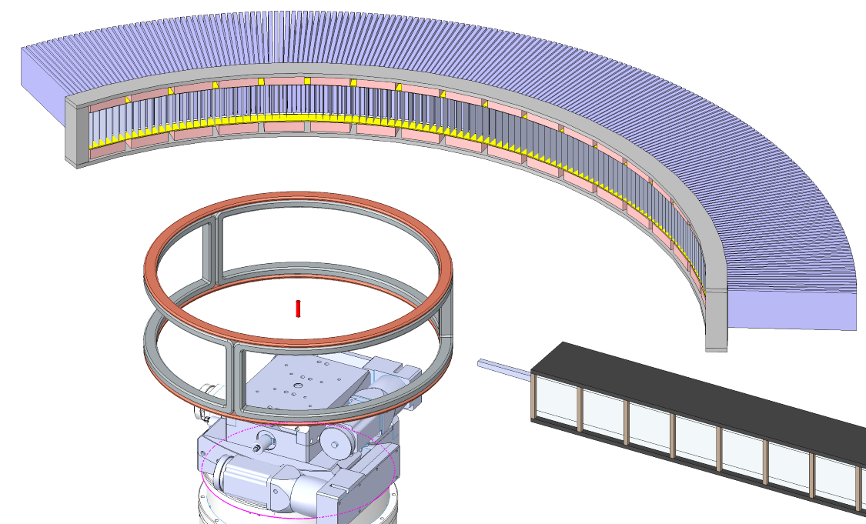
XYZ- polarization analysis coil
Set of XYZ coils to manipulate the guide field at sample position;
Estimated cost: 20k€.
13

Slide 14
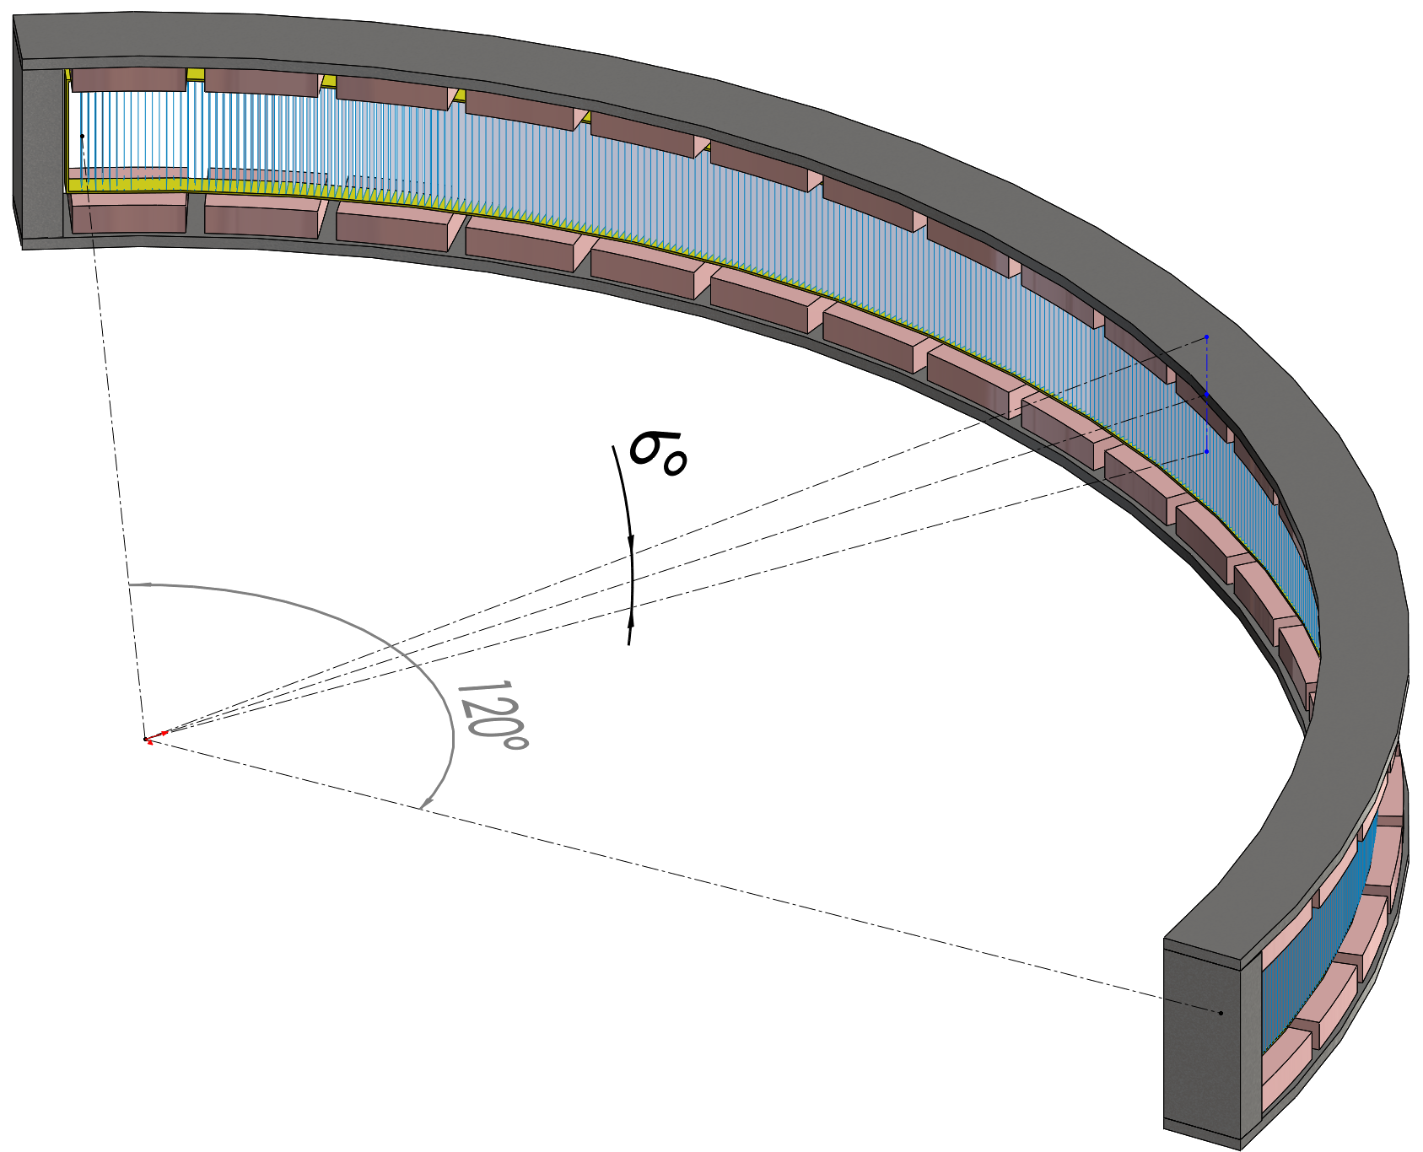
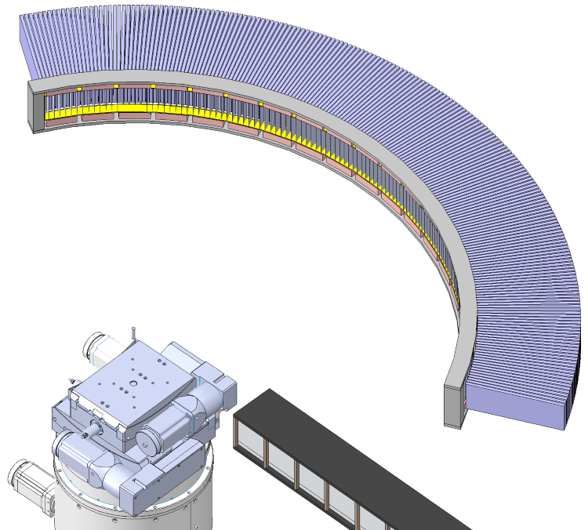
Polarization analyser (PSI partner)
Solid state analyser, 150 µm thick Si wafer coated with FeSi;
120° horizontal angular aperture, 6° vertical aperture;
Estimated cost: 1885k€.
Cold neutron
detector
Polarization analyzer

Slide 15
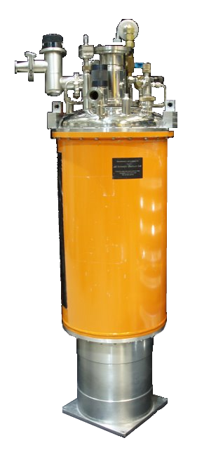
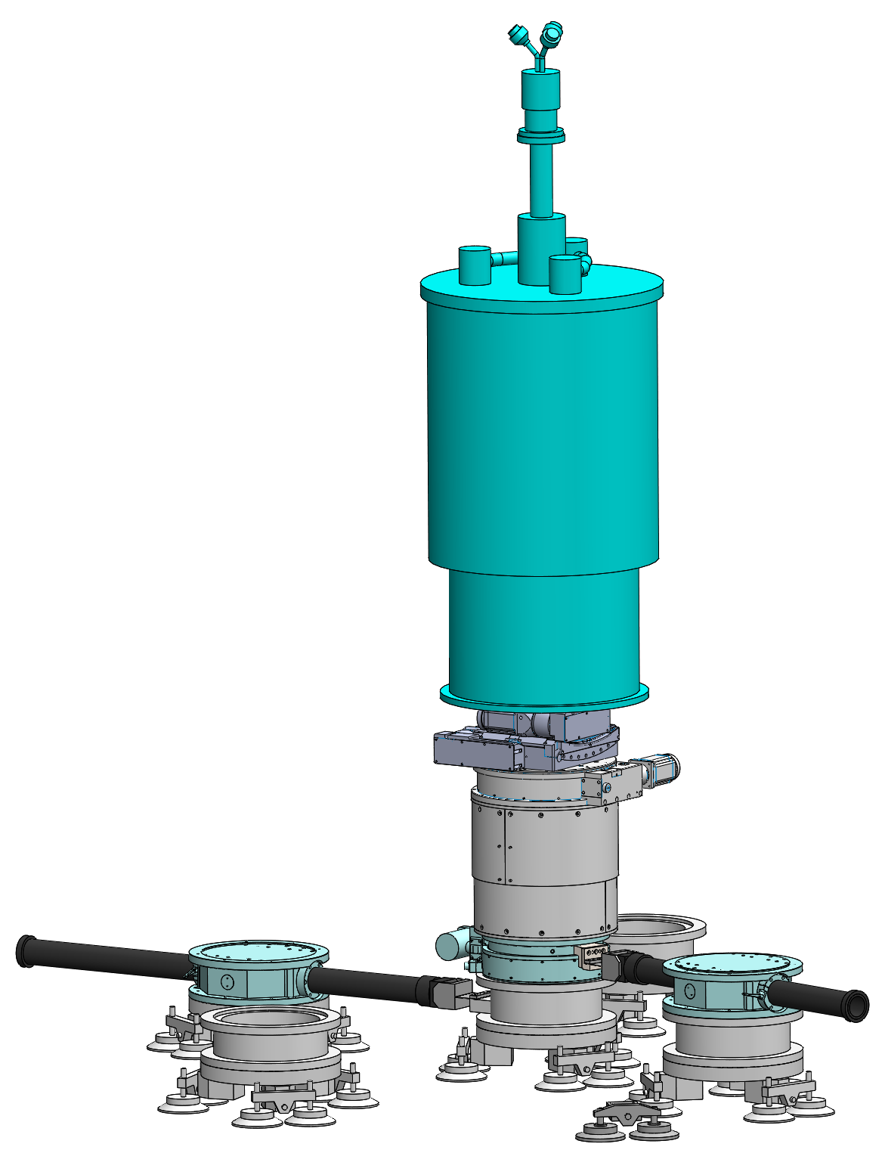
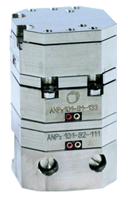
Sample Exposure System
Sample table : 40k€
10T magnet, wide vertical angle opening: 1000 k€
Cryostat: 50k€
Dilution fridge: 250k€
Piezo positioning system: 45 k€
Attocube
Utilities: 50 k€

Slide 16
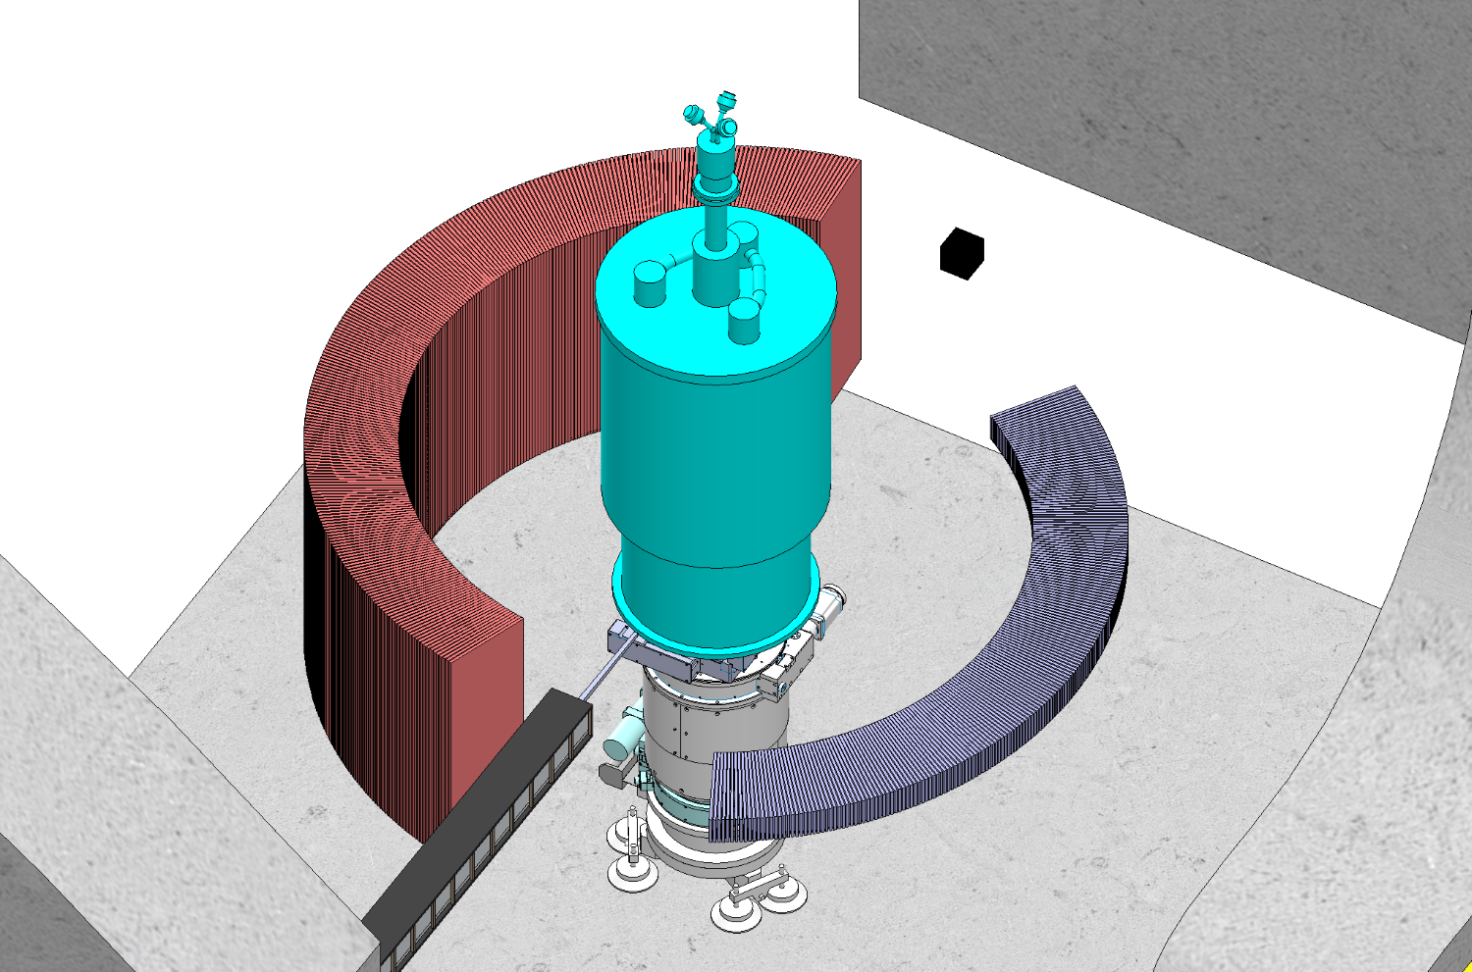
Detectors and Monitors
¹⁰B Jalousie Detector 156ºx48º: 2632 k€
¹⁰B Jalousie Detector 120ºx6º: 244 k
CASCADE Detector Technologies
2PSD/TOF monitors: 40k€

Slide 17
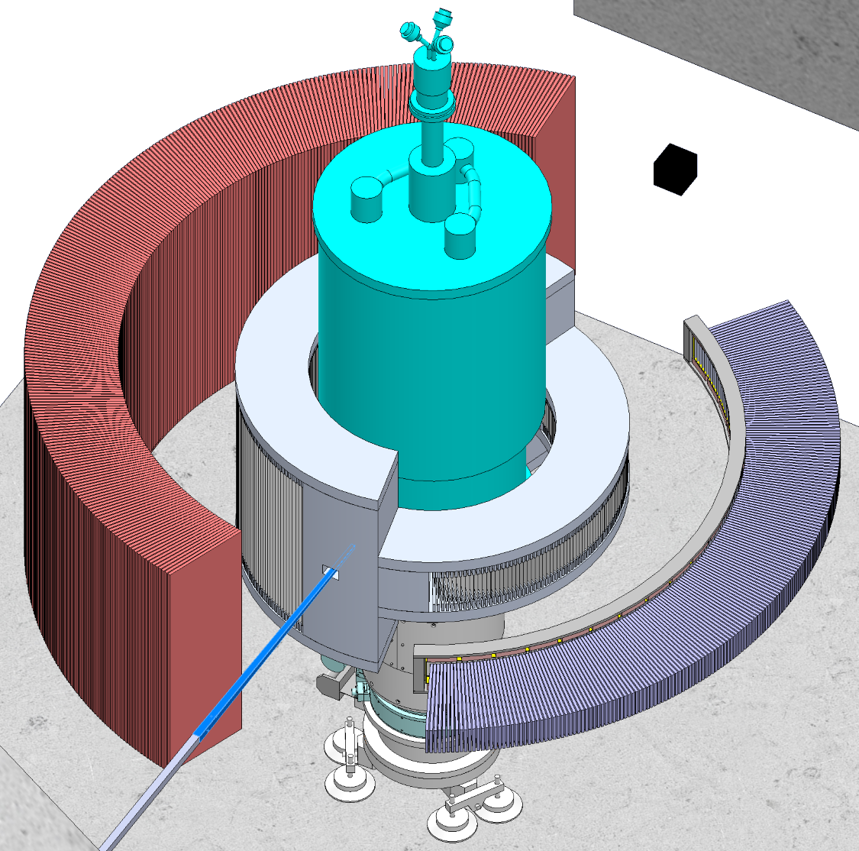
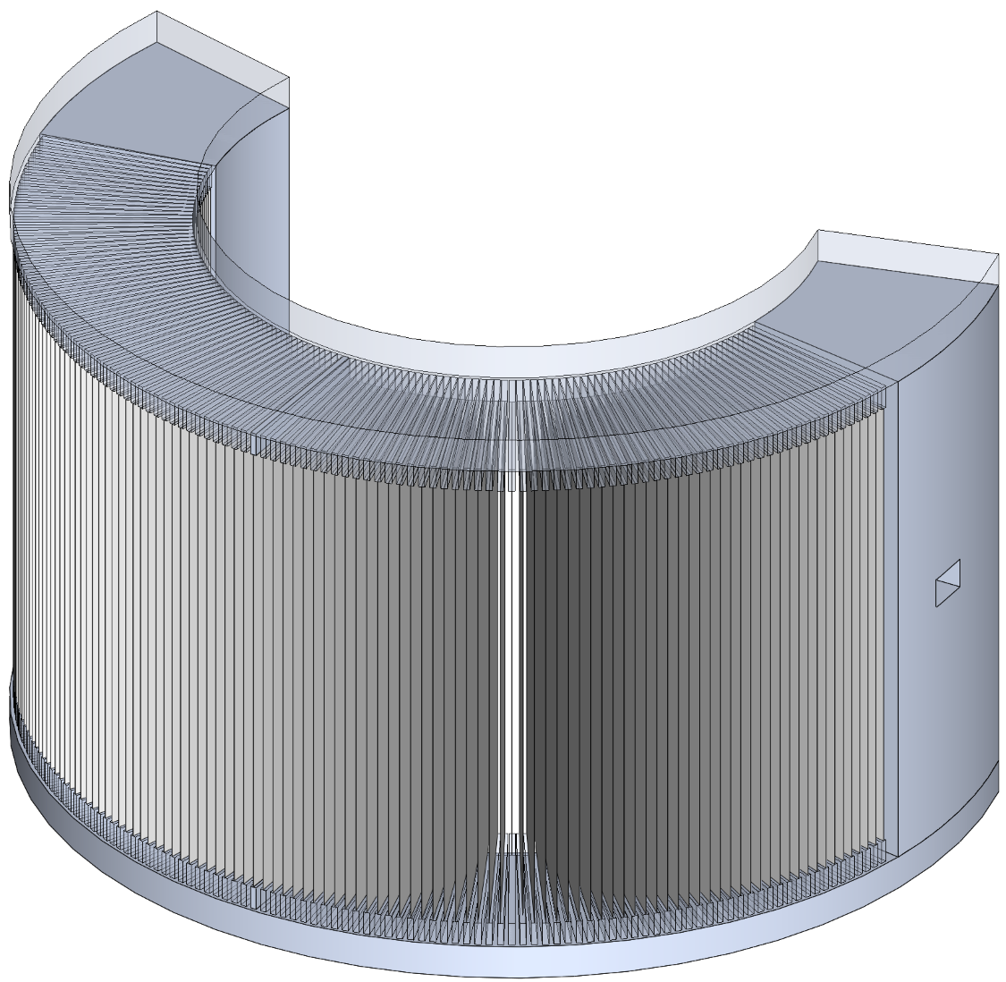
Beam Shaping
Beam focusing, SM m=6: 75 k€
SwissNeutronics
2 Radial Collimators 156ºx48º, 120ºx6º: 110 k€
Euro collimators
Divergence control: 100 k€
Collimators
Beam focusing
Angular spacing: 1.3°
Collimator angular span: 160°(120°)
Foil inside radius: 400 mm
Foil outside radius: 624 mm
Beam height: 624 mm (110mm)
Overall height: 624 < height < 1000 mm
Foil material: Mylar 36 micron
Absorber material: Gd oxide 2x25 micron

Slide 18
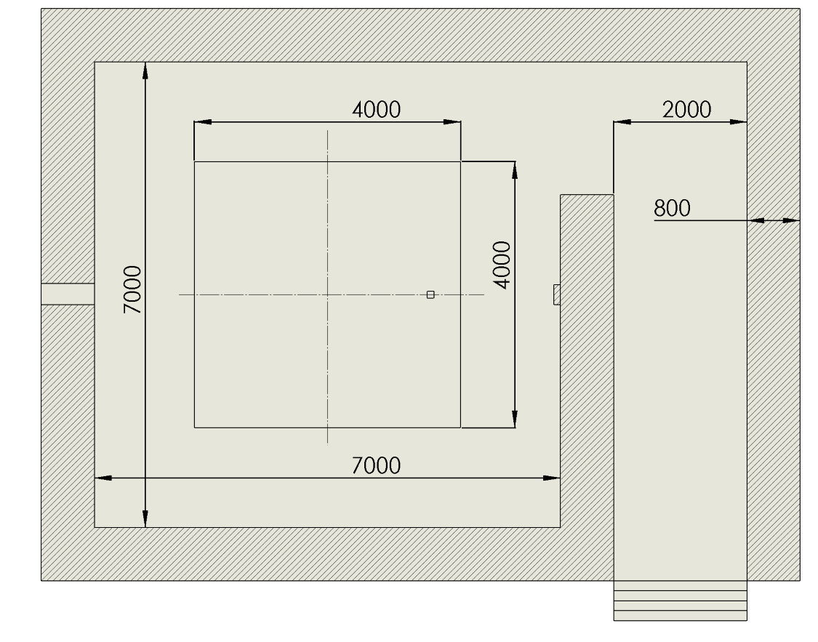
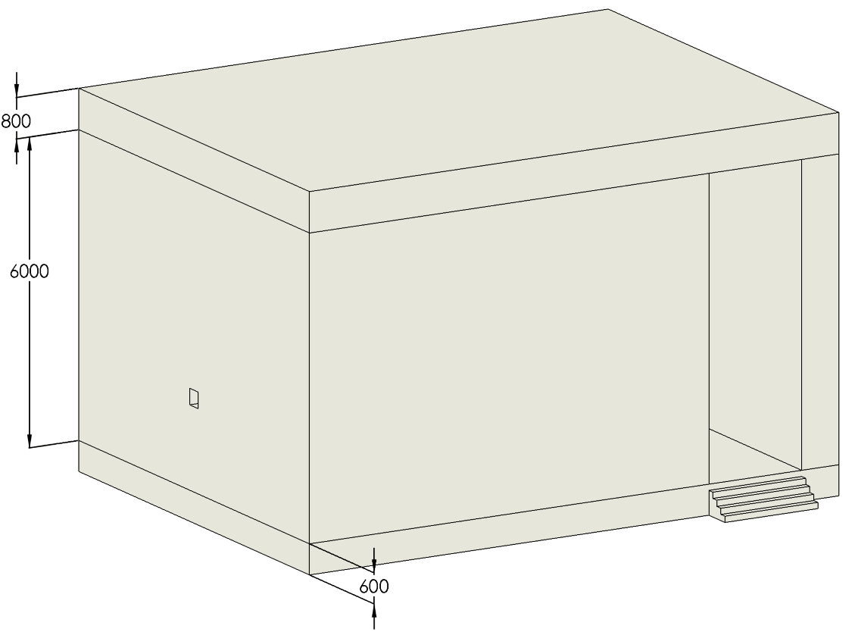
Experimental cave
Walls & Roof - 80 cm concrete: 296k€
Beamline baselevel- 60 cm concrete: 53k€
Detector support - 40 cm concrete: 10k€
B4C - 5mm at all inner surface: 108k€
PSS - 100k€
Light shutter: 20 k€
No direct view
1.5 µSv/hr outside
6 m height walls - load = 14.4 T/m2
Roof 80 cm = +6 T/m2

Slide 19
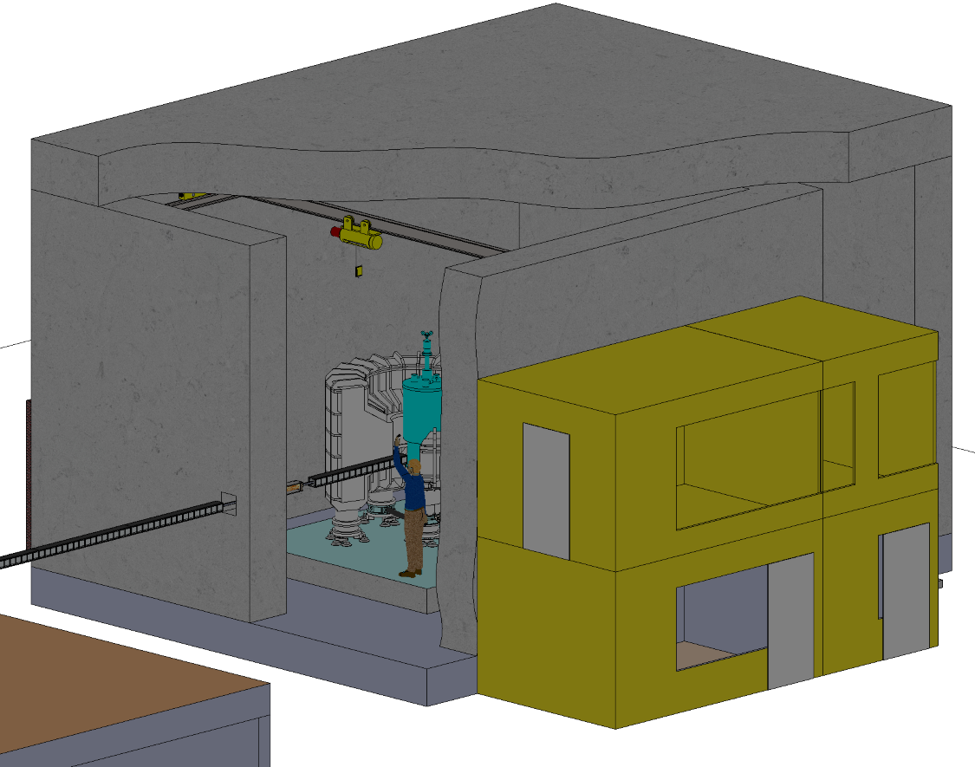
Instrument Infrastructure
Control Hutch: 100 k€
2 floors, desks, computers, chairs…
Sample preparation laboratory: 25 k€
Glove box, fume, binocular micro
Bridge Crane 1T: 30 k€
Utilities: 50k€ (SAD request)
Various costs: 190 k€
mechanical assembly of concrete,
metallic beam for support

Slide 20
Heavy Shutter & Shielding
28 m
55 m
83 m
86 m
155 m
163 m
Heavy
shutter

Slide 21
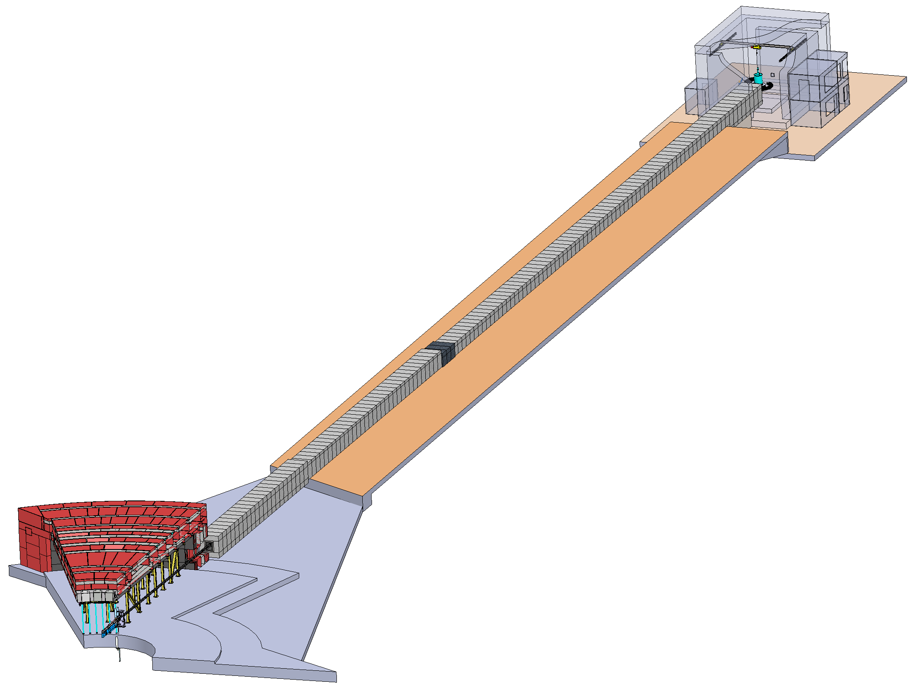
MAGnetism
in
Crystals

