Slide 1
MIRACLES SCOPE (2/2)
Secondary Spectrometer,
Motion Control, Infrastructure

Slide 2
Index
Secondary Spectrometer
Analyzer
Radial Collimator
Beryllium filter
Secondary cave, vacuum tank and beam stop
Detectors and beam monitors
Motion Control
Infrastructure

Slide 3
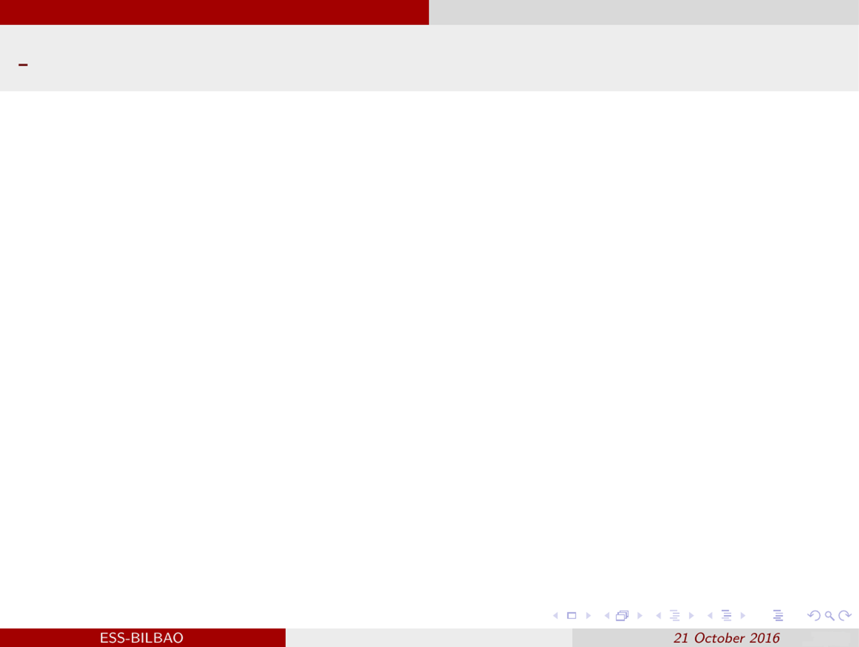
Analyzer
Components
Si-111 hexagonal crystal wafers: dimensions: 2mm thick, 12 cm diagonal.
Single analyzer panel (aluminum): 15 º horizontal coverage, 22º vertical coverage.
B4C coating backside of the Silicon wafers.
B4C,
neutron absorber
Configurations
3: 150 º horizontal coverage and 44 º vertical coverage.
20 panels, 1890 wafer. Analyzer area = 12.60 m².
2: 120 º horizontal coverage and 44 º vertical coverage.
16 panels, 1512 wafer. Analyzer area = 10.08 m².
1: 30 º horizontal coverage and 44 º vertical coverange.
4 panels, 378 wafer. Analyzer area = 2.52 m².
Si-111 wafers
Aluminum plate
Analyzer layout

Slide 4
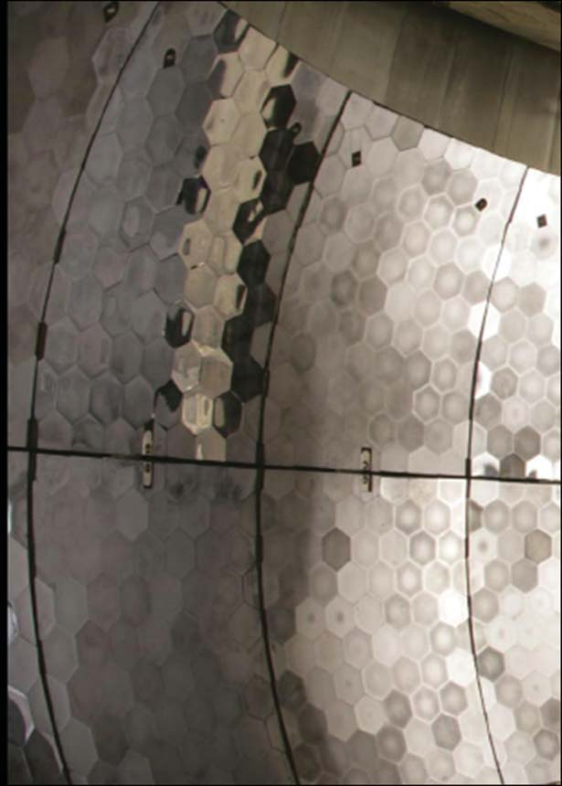
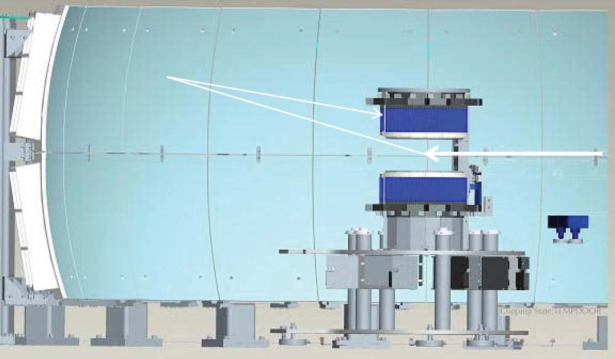
Analyzer
Components

Slide 5
Analyzer
QUOTATION AND SOURCES OF INFORMATION
Waffers: 200 $/waffer. Source: BASIS.
340 k€ configuration 3.
272 k€ configuration 2.
68 k€ configuration 1.
B4C coating. 7.93 k€/m². Source: IN16B.
100 k€ configuration 3.
80 k€ configuration 2.
20 k€ configuration 1.
Aluminum support structure 22.5 k€/panel. Source: IN16B.
450 k€ configuration 3.
360 k€ configuration 2.
90 k€ configuration 1.

Slide 6
Radial collimator
Detailed design of our radial collimator not done yet.
Preliminary concept:
Foils: Mylar 0.036mm.
Absorber: Gd2O3.
Coated foil thickness:0.085mm/0.090mm.
Foil Height: 600mm.
Inside Radius: 348mm.
Outside Radius: 780mm.
Angular Spacing: 2°.
Bottom Aluminium Support Plate: 40mm.
Top Aluminium Support Plate: 40mm.
Radial Beam Scan:160°.
Quotation: 105k€. Reference: Source: JJ-Xray. Responsible of the radial collimator of ARCS (Spectrometer at the SNS).

Slide 7
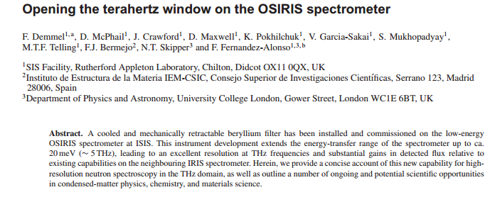
Beryllium filter
Detailed design of our Be filter not done yet. Our quotation is 450 k€:
300 Be blocks. 383 €/block: Be cost: 114.8K€.
Housing and shielding of the filter: 155 k€.
Electronics, cooling and installation: 182 k€.
We can find an example of BSS using Be filter in OSIRIS (ISIS).
During a conversation with the OSIRIS team, the suggested us a full economic cost of £400k, including overhead, electronics, installation…

Slide 8
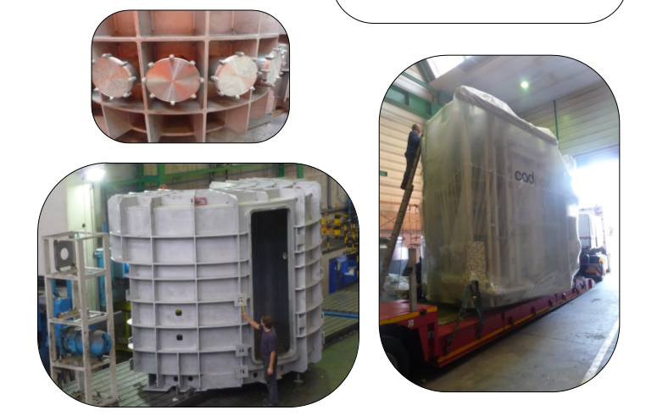
Secondary cave, vacuum tank & shielding, beam stop
Vaccum tank
Estimation based on IN16B vacuum tank, made by Cadinox.
Extrapolation with volume difference.
Configurations 2 and 3 include vacuum tank with full covering (940 k€).
Configuration 1 includes vacuum tank with half covering (600 k€).

Slide 9
Secondary cave, vacuum tank & shielding, beam stop
Vacuum tank shielding:
Estimation based on IN16B, considering the area difference.
HDPE + ¹⁰B rubber + structure.
660 k€ in configurations 3 and 2. 400 k€ in configuration 1.
Secondary cave:
Concrete volume: 10x10 m inner surface, 6 m height, 0.5 m thickness.
This means an estimation of ca 186 m³ of concrete.
Assuming 800 €/m³ this would mean ca 150 k€.
In order to include labyrinth and door, we assume 200 k€.
Beam stop:
Design not ready yet.
Assumed 150 k€, based on BIFROST estimation.
The sum of these 3 items gives us 1.08 M€, whereas P. Benley suggested us 1.5 M€ for the secondary shielding. Necessary to clarify if something is missing.

Slide 10
Detectors and beam monitors
Spectrometer detectors:
³He tubes. Source: Toshiba.
326.7 k€ in configuration 3 (150 tubes).
275.2 k€ in configuration 2 (120 tubes).
117.8 k€ in configuration 1 (30 tubes).
Power supplies and cables. Source: CAEN quotation.
50.26 k€ in configuration 3.
40.4 k€ in configuration 2.
13.8 k€ in configuration 1.
Difractometer detectors.
90 k€ for 30 ³He tubes. Source: Toshiba.
7.96 k€ for power supplies and cables. Source: CAEN quotation + cables.
Detector electronics. Source: ESS.
160 k€ for back end electronics. Assumed a fixed cost for the 3 configurations.
Front end electronics not considered in our budget.
Necessary to discuss what is missing regarding detector electronics (the quotation for BASIS spectrometer detectors is 273.2k€).

Slide 11
Detectors and beam monitors
PSD Beam monitors. 7 in configuration 3. Quotation: 30 k€ each. Source: ESS
After the PWD chopper pair.
After the PS chopper pair.
After Chopper 5.
After Chopper 6.
After Chopper 7.
Between the guide exit and the sample.
After the sample.

Slide 12
Motion Control
Preliminary elaboration of Table of Motion.
21 axis in configuration 3; 16 axis in configuration 2; 12 axis in configuration 1.
Sent to Federico Rojas for quotation.
Added 1k€/axis for motor and encoder (not MC budget).
Modifications came after the scope setting report was uploaded.
Axis Number | Device Description | WBS Element | Custom / Off The Shelf | Axis description | Motion Type | Actuator Type | Range (mm/°) | Accuracy (mm/°) | Precision / Repeatability (mm/°) | Encoder Type | Synch' with other axis | Synch' with signals / sensors | Load (Kg) | Force / Torque | Speed | Acceleration | Brake Required | Fixed or Removable
1 | Slit | 13.6.16.X.X.X- |  | Z1 | Linear | Electrical | 50 | 0,1 | 0,1 | Absolute |  |  | 5 |  | Low | Low |  | Fixed
2 | Slit | 13.6.16.X.X.X- |  | Z2 | Linear | Electrical | 50 | 0,1 | 0,1 | Absolute |  |  | 5 |  | Low | Low |  | Fixed
3 | Slit | 13.6.16.X.X.X- |  | Y1 | Linear | Electrical | 50 | 0,1 | 0,1 | Absolute |  |  | 5 |  | Low | Low |  | Fixed
4 | Slit | 13.6.16.X.X.X- |  | Y2 | Linear | Electrical | 50 | 0,1 | 0,1 | Absolute |  |  | 5 |  | Low | Low |  | Fixed
5 | Sample Positioner | 13.6.16.X.X.X- |  | X1 | Linear | Electrical | 50 | 0,1 | 0,1 | Absolute |  |  | 50 |  | Medium | Low |  | Removable
6 | Sample Positioner | 13.6.16.X.X.X- |  | Y1 | Linear | Electrical | 50 | 0,1 | 0,1 | Absolute |  |  | 50 |  | Medium | Low |  | Removable
7 | Sample Positioner | 13.6.16.X.X.X- |  | Z1 | Linear | Electrical | 50 | 0,1 | 0,1 | Absolute |  |  | 50 |  | Medium | Low |  | Removable
8 | Sample Positioner | 13.6.16.X.X.X- |  | X1 | Rotary | Electrical | 90 | 0,1 | 0,1 | Absolute |  |  | 50 |  | Medium | Low |  | Removable
9 | Sample Positioner | 13.6.16.X.X.X- |  | Y1 | Rotary | Electrical | 90 | 0,1 | 0,1 | Absolute |  |  | 50 |  | Medium | Low |  | Removable
10 | Sample Positioner | 13.6.16.X.X.X- |  | Z1 | Rotary | Electrical | 360 | 0,1 | 0,1 | Absolute |  |  | 50 |  | Medium | Low |  | Removable
11 | Upper detector array | 13.6.16.X.X.X- |  | X1 | Rotary | Electrical | 30 | 0,001 | 0,001 | Absolute |  |  | 100 |  | Low | Low |  | Fixed
12 | Lower detector array | 13.6.16.X.X.X- |  | X1 | Rotary | Electrical | 30 | 0,001 | 0,001 | Absolute |  |  | 100 |  | Low | Low |  | Fixed
13 | Be filter | 13.6.16.X.X.X- |  | Z1 | Linear | Electrical | 3000 | 1 | 1 | Absolute |  |  | 100 |  | Low | Low |  | Removable
14 | Radial Collimator | 13.6.16.X.X.X- |  | Z1 | Linear | Electrical | 3000 | 1 | 1 | Absolute |  |  | 300 |  | Low | Low |  | Removable
15 | Beam monitor 1 | 13.6.16.X.X.X- |  | Z1 | Linear | Electrical | 1000 | 0,001 | 0,001 | Absolute |  |  | 50 |  | Low | Low |  | Removable
16 | Beam monitor 2 | 13.6.16.X.X.X- |  | Z1 | Linear | Electrical | 1000 | 0,001 | 0,001 | Absolute |  |  | 50 |  | Low | Low |  | Removable
17 | Beam monitor 3 | 13.6.16.X.X.X- |  | Z1 | Linear | Electrical | 1000 | 0,001 | 0,001 | Absolute |  |  | 50 |  | Low | Low |  | Removable
18 | Beam monitor 4 | 13.6.16.X.X.X- |  | Z1 | Linear | Electrical | 1000 | 0,001 | 0,001 | Absolute |  |  | 50 |  | Low | Low |  | Removable
19 | Beam monitor 5 | 13.6.16.X.X.X- |  | Z1 | Linear | Electrical | 1000 | 0,001 | 0,001 | Absolute |  |  | 50 |  | Low | Low |  | Removable
20 | Beam monitor 6 | 13.6.16.X.X.X- |  | Z1 | Linear | Electrical | 1000 | 0,001 | 0,001 | Absolute |  |  | 50 |  | Low | Low |  | Removable
21 | Beam monitor 7 | 13.6.16.X.X.X- |  | Z1 | Linear | Electrical | 1000 | 0,001 | 0,001 | Absolute |  |  | 50 |  | Low | Low |  | Removable

Slide 13
Motion Control
Configuration 3 = 138.573 k€ according to Feredico Rojas. Currently 209.158 k€.
17.4 k€ of Project Management and Integration.
41.7 k€ of Design. Currently 59.952 k€.
39.494 k€ of Procurement and Fabrication. Currently 90.409 k€.
5.995 k€ of Installation. Currently 6.263 k€.
33.984 k€ of Cold Commissioning. Currently 35.134 k€.
Configuration 2 = 116.313 k€ according to Feredico Rojas. Currently 185.279 k€.
17.4 k€ of Project Management and Integration.
36.312 k€ of Design. Currently 53.95 k€.
29.373 k€ of Procurement and Fabrication. Currently 80.046 k€.
4.65 k€ of Installation. Currently 4.768 k€.
28.578 k€ of Cold Commissioning. Currently 29.115 k€.
Configuration 1 = 103.193 k€ according to Feredico Rojas. Currently 125.696 k€.
17.4 k€ of Project Management and Integration.
31.357 k€ of Design. Currently 37.057 k€.
27.424 k€ of Procurement and Fabrication. Currently 44.244 k€.
3.413 k€ of Installation. Currently 3.396 k€.
23.599 k€ of Cold Commissioning.

Slide 14
Infrastructure
Already estimated items:
Cabling: 5 k€. Source: Gábor László.
Personal Safety System Design: 120 k€. From BIFROST.
Crane outside cave: 30 k€. From BIFROST.
Crane in cave: 10 k€. From BIFROST.
Media distribution: 80 k€. From BIFROST.
False floor: 20 k€. From BIFROST.
Helium recovery. 20 k€. From BIFROST.
Control hutch. 150 k€. From BIFROST.
Infrastructure installation. 172 k€. From BIFROST.
Instrument cabin. 30 k€. From TREX.
Items not estimated yet:
Cooling installation. ESS-0063538: is provided by ESS and paid by the instrument.
Fiber connection from the instrument to the galleries: ESS-0063538: is provided by ESS and paid by the instrument.
Domestic and waste water: ESS-0063538: is provided by ESS and paid by the instrument.

