Slide 1

Scope Setting Meeting MIRACLES

Slide 2
Scope setting meeting MIRACLES: outline
Presentation: MIRACLES overview and timeline
(Félix J Villacorta)
High-level technical report (Íñigo Herranz)
Budget methodology (Paula Luna and Íñigo Herranz)
Coffee break
Summary of 3 budget configurations (Félix J Villacorta)
Science case (Heloisa N Bordallo)

Slide 3
MIRACLES overview and timeline

Slide 4
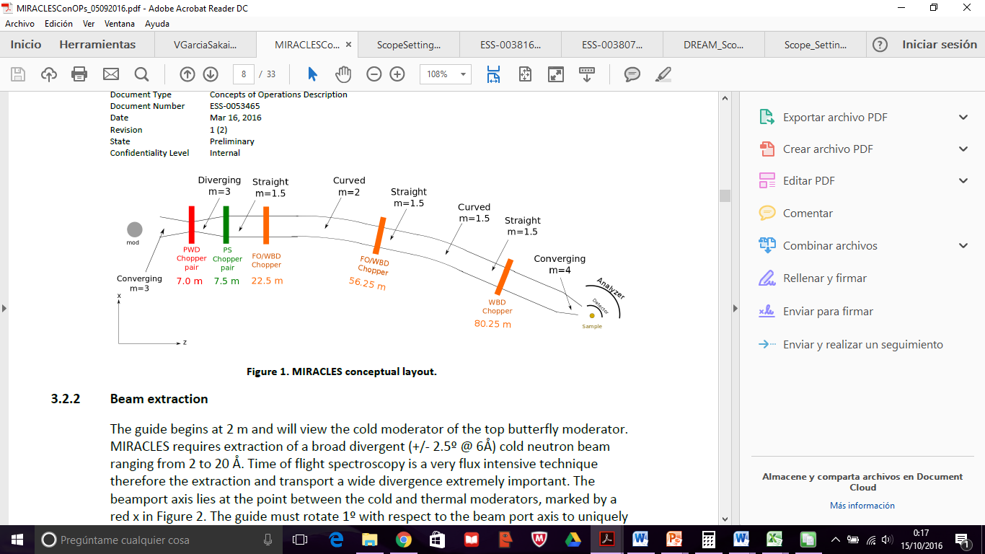
MIRACLES: the ToF Backscattering Spectrometer at ESS
Part of the neutron spectroscopy instruments suite of the ESS.
Located in W5 (between MAGIG and BIFROST).
Moderator to sample distance 162.5 m. Slightly curved guide (to avoid line of sight and remove neutrons with wavelength < 1.5 Å).
Chopper cascade: PWD pair (to improve the spectral resolution); PS pair to select a single frame per source period; WBD/FO choppers to select the wavelength band and avoid the frame overlap.

Slide 5
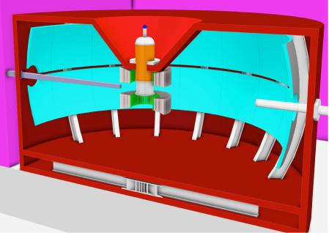
MIRACLES: the ToF Backscattering Spectrometer at ESS
Analyzer: spherical, radius 2.5 m. Half/Full coverage of Si single crystals. Used to select E_{F}:
  Si(111) (λ=6,27 Å),
  Si(333) (λ=2,08 Å), and
  Si(311) as an update (λ=3,27 Å).
³He detector arrays covering same angle.

Slide 6
Requirements for MIRACLES
MIRACLES shall provide exceptional flux.
MIRACLES shall be capable of covering a wavelength range between 2 and 20 Å (key parameters to allow for flexibility of the elastic resolution, wide Q-range coverage and extension of the energy range covered well beyond the quasielastic regime).
MIRACLES shall allow for a variable elastic energy resolution between 2 and 32 µeV, when using a wavelength of 6.267 Å (Si(111) reflection), with an energy transfer range centered at the elastic line from -600 to +600 µeV.
[In addition, when selecting λ=2.08 Å (Si(333) reflection), the resolution can be relaxed to 300 µeV, and ℏω from about 10 meV in energy gain to -40 meV in energy loss.]
MIRACLES shall have spatial Q-resolution in the range of 0.02 Å⁻¹ in forward and 0.1 Å⁻¹ in backscattering, and allow the measurement of sample areas < 1x1 cm².
MIRACLES chopper cascade design shall allow for the selection of a well-defined wavelength band of approximately 1.7 Å width centered at any wavelength in the range of 2-20 Å, to allow the measurement of low-energy inelastic excitations.

Slide 7
Requirements for MIRACLES
MIRACLES guide shall provide for upgrade avenues for the continuous development of the instrument include the incorporation of Si(311), which will enable covering an intermediate resolution and momentum transfer.
The system’s design shall provide the space and flexibility necessary to host and drive future developments in the neutron backscattering field.
MIRACLES’ secondary spectrometer design shall facilitate the coverage of all surfaces with neutron absorbing materials such to allow for background suppression. Moreover, a collimator system shall suppress unwanted neutron scattering from the sample environment and a Be Filter will remove higher order contamination and contribute to a cleaner background and improved signal to noise ratio.
MIRACLES sample environment capabilities shall provide for the wide range of scientific cases covered by MIRACLES that range from magnetic systems to life science.
MIRACLES should serve the user and science and instrumental development program without interruptions during source operations.

Slide 8
Benchmark: BS spectrometers in pulsed sources
 | BASIS | OSIRIS | DNA | MIRACLES
Facility | Pulsed Source | Pulsed Source | Pulsed Source | Pulsed Source
Energy Transfer Range | ± 200 μeV | 15 meV | ± 600 μeV | ± 600 μeV
Q-range | 0.2 Å⁻¹ < Q < 2.0 Å⁻¹ | PG002: 0.18-1.8 Å⁻¹ PG004: 0.37 - 3.6 Å⁻¹ | 0.08 - 1.98 Å⁻¹ | Si(111): 0.2 - 2 Å⁻¹
Dynamic range | 0.5 Å | PG002: -0.4 -0.4 meV PG004: -3.5 -4 meV | 1 - 2.5 Å | 1.6Å
nBS Bragg Angle | 88º | 85º | 87.5º | 88º
Collimation | Radial Collimator | Radial Collimator | No | Radial collimator
Filter | No | Be Filter | No | Be filter
Secondary Spectrometer Angular Coverage [deg] | 150º | 137º | 156º | 150º

Slide 9
Draft Project Timeline
2016
2017
2018
2019
2020
2021
2022
2023
2024
2025
Phase 1:
Preliminary Design
Phase 2:
Detailed Design
Phase 3:
Manufacturing and Procurement
Phase 4:
Installation and Integration
Phase 5:
Commissioning
Phase 6:
Users
Tollgate 2:
PDR
Tollgate 3:
CDR
Tollgate 4:
IRR
Tollgate 5:
SAR
Tollgate 6:
ORR

Slide 10
Three budget Configurations
Configuration 1, within cost category B: 12.9 M€
Configuration 2, world-class scope (competitive): 15.9 M€
Configuration 3, full scope: 17.7 M€

