Slide 1
MIRACLES budget: Summary of the 3 configurations

Slide 2
+ MANPOWER

Slide 3
Three budget Configurations
Configuration 1, within cost category B: 12.9 M€
Configuration 2, world-class scope (competitive): 15.9 M€
Configuration 3, full scope: 17.7 M€

Slide 4
Configuration 1: 12.9 M€
What it has:
Primary Spectrometer
30º Secondary Spectrometer (4 panels of Si(111) analyzers / ³He detectors covering 30º)
1 beam monitor (pre-sample)
Secondary cave (half cylinder) + shielding

Slide 5
Configuration 1: 12.9 M€
What it does NOT have:
Beam monitors to track the neutron beam in the guide
Space for upgrade in the tank
A competitive Secondary Spectrometer, (narrow Q-range, signal to the detectors)
Diffraction detector
Radial collimator (no good signal-to-noise ratio)

Slide 6
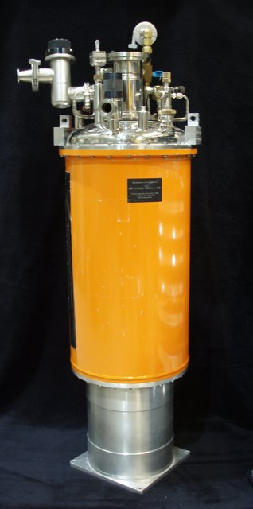
Configuration 1: 12.9 M€
What it does NOT have:
Own sample environment
Science case development will depend on availability from SEE pool
Sample environment equipment (SEE), recommendations of the STAP report (p. 3): “The STAP recommends that each spectroscopy instrument should have its own cryofurnace as a minimum”.

Slide 7
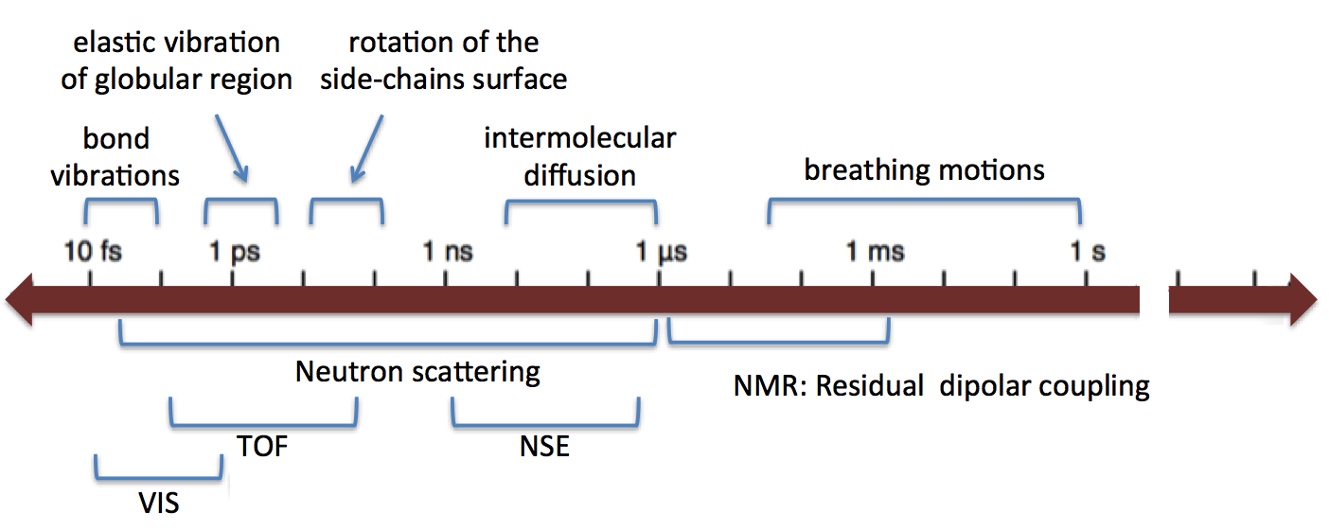
Configuration 1: 12.9 M€
Low Q → t ~10-100 ns → Diffusion, magnetic scattering (high background)
High Q → t ~10-100 ps → Rotation
Recommendation from STAP committee (STAP report, p. 2): “We would like to stress that the current budget will result in serious damage to the user program as the instruments will not be able to take full advantage of the ESS source.”
MIRACLES

Slide 8
Configuration 2: 15.9 M€
What it has:
Primary Spectrometer
Secondary cave (full tank) + shielding
120º Secondary Spectrometer (14 panels Si(111) analyzers / ³He detectors covering 120º)
3 beam monitor (pre-sample, transmitted, PWD-PS choppers)
Diffraction detector
Electronics detectors (to discuss costs)
Detectors, the STAP report states: “Spectroscopy detectors: PSD’s are essential on day 1 for good E and Q resolution. Diffraction detectors: due to a relatively small price, it is advised to have them on day 1.”

Slide 9
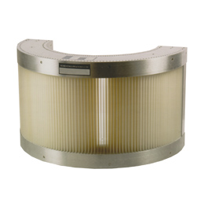
Configuration 2: 15.9 M€
What it has:
Radial collimator
Day-one sample environment:
Sample holders
Cryofurnace (4-600 K) and furnace (<1600ºC)
Top-loading cryogen-free CCR (closed-cycle refrigerator): 10-400 K
Gas pressure cell and Humidity chamber.
+ SAD collaboration design + commissioning
To improve the signal to noise ratio, the STAP report recommends (p. 7): “As a minimum, a radial collimator should be installed for day 1.”

Slide 10
Configuration 2: 15.9 M€
What it does NOT have:
4 beam monitors tracking the neutron beam in the guide
Be filter (background and good signal-to-noise ratio)
Frequent user of pool’s sample environment

Slide 11
Configuration 2: 15.9 M€
Upgrade:
Beam monitors to track the neutron beam in the guide (space was allocated in advance).
Half coverage of analyzers in the Secondary Spectrometer, (120º → 150º, parameter that all the pulsed-neutron-source backscattering instruments possess)
Be filter (space was allocated in advance)
Additional sample environment equipment by sharing costs between other spectroscopy instruments (Minipool) or by collaborations / external grants.

Slide 12
Configuration 2: 15.9 M€
Life sciences:
methyl group & main
chain dynamics in proteins
Energy sciences:
methyl iodide clathrate hydrate
Zaccai G, Bagyan I, Combet J, et al. Scientific Reports. 2016, 6, 31434.
A. Desmedt et al., J. Phys. Chem. C, 115, 12689 (2011).

Slide 13
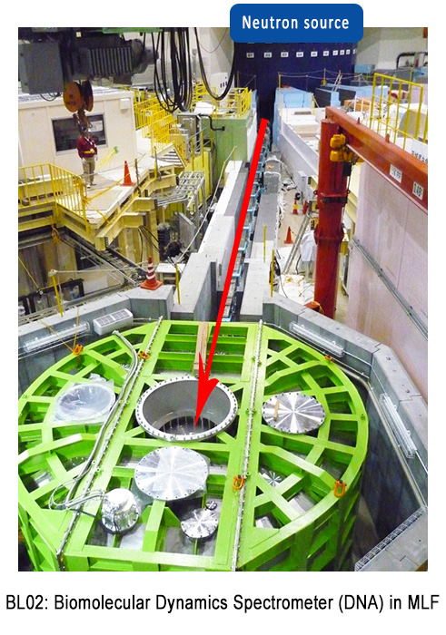
Configuration 3: 17.7 M€
What it has:
Primary Spectrometer
150º Secondary Spectrometer (18 panels Si(111) analyzers / ³He detectors covering 150º)
7 beam monitor (pre-sample, transmitted, 5 in the guide after choppers device to track neutron beam)
Diffraction detector
Electronics detectors (to discuss costs)

Slide 14
Configuration 3: 17.7 M€
What it has:
Radial collimator & Be filter
Full suite Day-one sample environment, including:
All from Configuration 2, plus
Clamped pressure cell
In-situ gas adsorption measurements
High magnetic field (up to 9 T) through SAD pool
Dilution (down to 4 mK) through SAD pool
+ SAD coolaboration design + commission + continuous user operation

Slide 15
Configuration 3: 17.7 M€
Upgrade:
Full coverage with analyzers in the Secondary Spectrometer, (150º Si(111) + 150º Si(311))
Addition of ³He tube arrays for full coverage.
Additional sample environment equipment by sharing costs between other spectroscopy instruments (Minipool) or by collaborations / external grants.
STAP committee in relation to the secondary spectrometer (p. 7): “The STAP recommends starting with an analyzer crystal coverage of one full side. This will save cost and allow testing the Si(311) upgrade option on the empty side.”

Slide 16
Configuration 3: 17.7 M€
Benchmark angular coverage of secondary spectrometer (+detectors): competitive option → A good starting point!
 | BASIS | OSIRIS | DNA | MIRACLES
Facility | Pulsed Source | Pulsed Source | Pulsed Source | Pulsed Source
Energy Transfer Range | ± 200 μeV | 15 meV | ± 600 μeV | ± 600 μeV
Q-range | 0.2 Å⁻¹ < Q < 2.0 Å⁻¹ | PG002: 0.18-1.8 Å⁻¹ PG004: 0.37 - 3.6 Å⁻¹ | 0.08 - 1.98 Å⁻¹ | Si(111): 0.2 - 2 Å⁻¹
Dynamic range | 0.5 Å | PG002: -0.4 -0.4 meV PG004: -3.5 -4 meV | 1 - 2.5 Å | 1.6Å
nBS Bragg Angle | 88º | 85º | 87.5º | 88º
Collimation | Radial Collimator | Radial Collimator | No | Radial collimator
Filter | No | Be Filter | No | Be filter
Secondary Spectrometer Angular Coverage [deg] | 150º | 137º | 156º | 150º

Slide 17
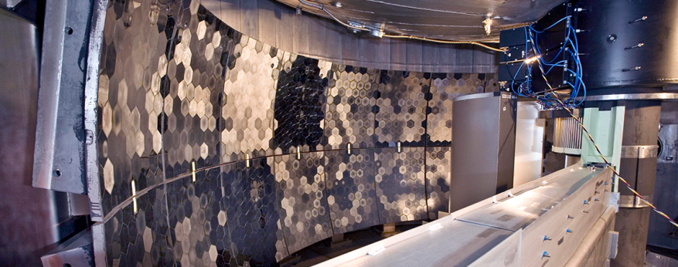
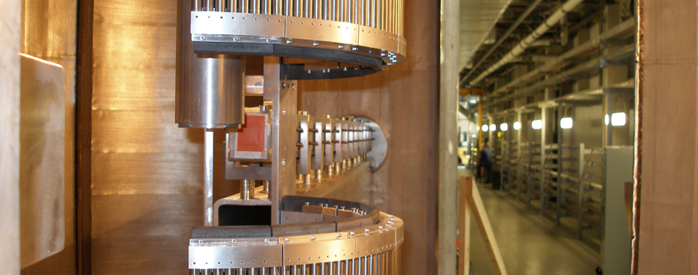
Configuration 3: 17.7 M€
Benchmark angular coverage of secondary spectrometer (+detectors): competitive option → Starting point
BASIS (SNS)
DNA (JPARC)

Slide 18
Configuration 3: 17.7 M€
Matchless flux
Excellent sample environment
Outstanding signal/noise ratio
Very large Q-range
Even broader elastic energy resolution coverage

Slide 19
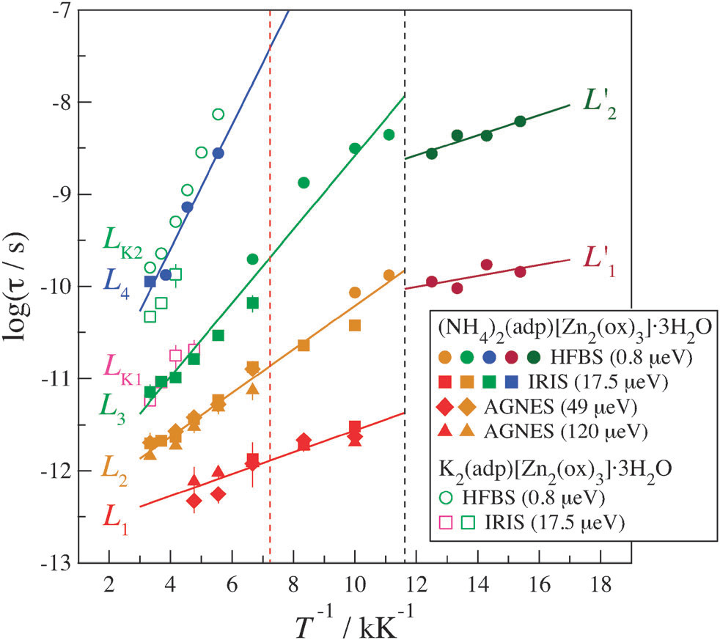
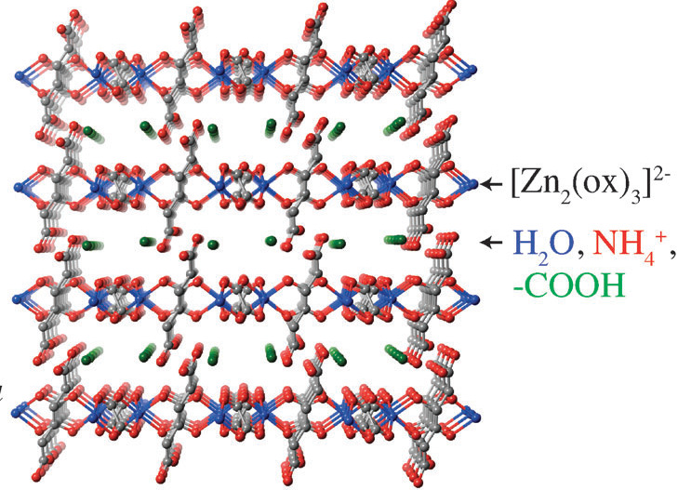
Multiple spectrometers-beamtime-etc…
HFBS
IRIS
AGNES
Miyatsu et al, Phys Chem Chem Phys, 2014

Slide 20
Scope setting meeting MIRACLES: outline
Time for (more) discussion
MIRACLES Closed session (Conference Room Tänkartanken)
NSS Closed session (Conference Room Scheele)
Discussion
Wrap up

