Slide 1



istituto
dei sistemi
complessi
VESPA: Vibrational
Excitation Spectroscopy with
Pyrolytic-graphite Analysers
(A: Science Case & Resultant High-level Requirements)
¹D. Colognesi, ^{2,3}L. Di Fresco,²G. Gorini
⁴M. Hartl, ⁵R. Senesi
  1) ISC-CNR, Sesto F.no (FI), Italy;
  2) Un. Milano-Bicocca, Milan, Italy;
  3) STFC, RAL, Harwell Ox., UK;
  4) European Spallation Source, Lund, Sweden;
  5) Un. Roma-Tor Vergata, Rome, Italy.

Slide 2
istituto
dei sistemi
complessi
Instrument Presentation Outline
I. VESPA OVERVIEW
  1. Vespa science case
  2. Vespa high-level requirements
  3. Vespa high-level technical description
II. VESPA PROJECT TIMELINE
III. PRESENTATION OF THE 3 VESPA CONFIGURATIONS

Slide 3
istituto
dei sistemi
complessi
I) VESPA Overview
1) Science case.
2) High-level scientific requirements.
D. Colognesi
3) High-level technical description.
II) VESPA project timeline.
III) Presentation of the three VESPA configurations.
L. Di Fresco

Slide 4
istituto
dei sistemi
complessi
1. VESPA Science Case
1.1 VESPA: what is it?
1.2 Research areas.
1.3 VESPA: complementary and unique.
1.4 Two selected examples.

Slide 5
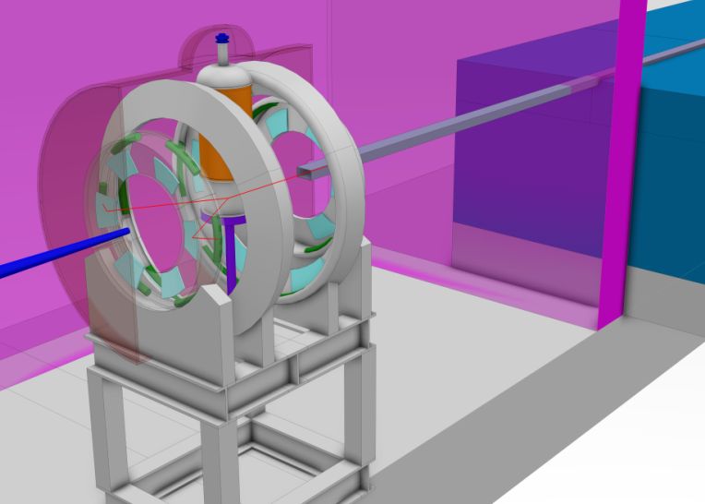
1.1 VESPA: what is it?
istituto
dei sistemi
complessi
V. E. S. P. A. (Vibrational Excitation Spectrometer with Pyrolytic-graphite Analysers)
A crystal-analyser inverse-geometry time-of-flight spectrometer fully devoted to Neutron Vibrational Spectroscopy (NVS).
It’ll be the only inelastic instrument at ESS focused on molecular vibrations in chemistry and material science!

Slide 6
istituto
dei sistemi
complessi
Why vibrational spectroscopy?
Vibrational spectroscopy is a technique widely used in scientific and technological research, fundamental as well as applied:
probing potential energy surfaces and interatomic interactions;
permitting the identification of bonds and functional groups, as well as their transformations;
determining the vibrational density of states (related to various thermodynamic properties).

Slide 7
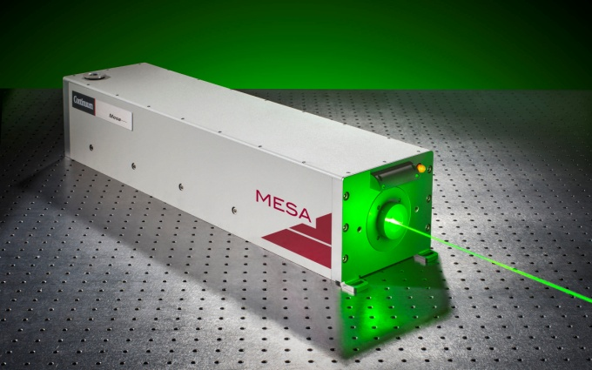
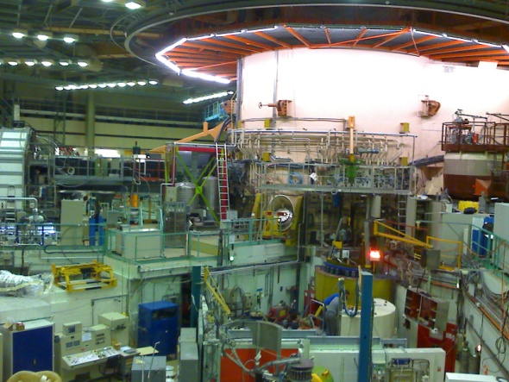
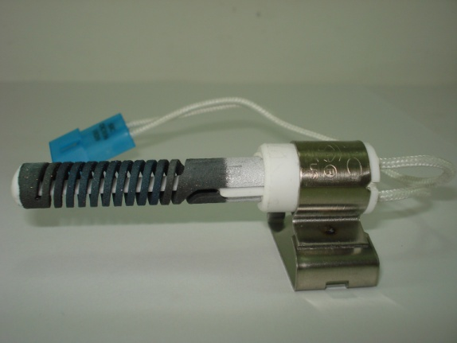
istituto
dei sistemi
complessi
Neutrons vs. IR/Raman
Vibrational spectroscopy: cross-sections and intensities
σ(Raman)∼10⁻²⁸ cm²/molec. J_{ph}(Nd:YAG)∼10²⁰ cm⁻²s⁻¹
σ(Neutr.)∼10⁻²⁴ cm²/molec. J_{n}(ILL)∼10¹⁵ cm⁻²s⁻¹
σ(IR)∼10⁻¹⁸ cm²/molec. J_{ph}(Globar)∼10²⁰ cm⁻²s⁻¹
Nd:YAG
ILL
Globar

Slide 8
istituto
dei sistemi
complessi
So why neutron vibrational spectroscopy?
In Raman, polarizability normally grows with Z: possible problems to detect protons.
In IR (sensitive to electric dipole), H-bond provides a strong signal, but can be distorted by the so-called electric anharmonicity (not vibrational).
Molecules with a high symmetry: many modes are optically inactive (e.g. in C₆₀ more than 70%!).

Slide 9
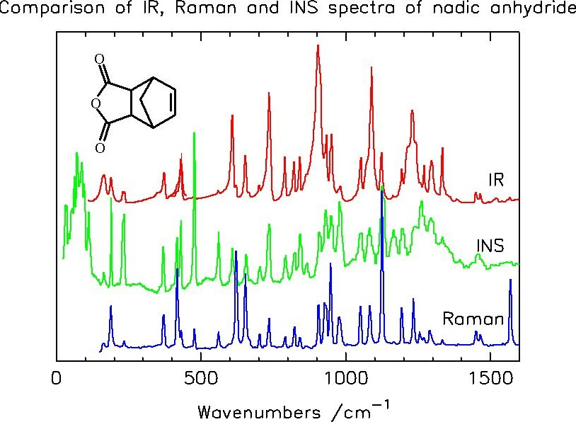
istituto
dei sistemi
complessi
4. Direct relationship between neutron spectra and vibrational eigenvectors.
Conclusions
NVS is complementary to optical spectroscopy and is often crucial for studying proton dynamics!
Example: nadic anhydride (C₉H₈O₃) on TOSCA (courtesy of S. F. Parker)

Slide 10
1.2 Research areas
istituto
dei sistemi
complessi
* Neutron Vibrational Spectroscopy (+ Diffraction)
High-performance polymers
Renewable energies
Catalysis
Earth science
General
Polymers, pharma-ceuticals
•
Hydrogen storage
Bioprotectants
•
Battery materials
Amino-acids
•
Photolysis /solar cells
H, CO_{x},NO_{x}
Applied, industrial catalysis
DFT-benchmarking
•
Molecules in confinement
Short H-bonding
•
H-spillover
Water in minerals
•
•
•
Fracking
•
CO₂ sequestration
Waste repositories
Science
Notes:
-Lagrange ILL: has B, but not AC
-TOSCA: has c but not A+B
-VISION: has B+C not A
VESPA should have all simultaneously

Slide 11
istituto
dei sistemi
complessi
* Neutron Vibrational Spectroscopy (+ Diffraction)
*high-pressure
High-performance polymers
Renewable energies
Catalysis
Earth science
General
Polymers, pharma-ceuticals
*gas loading
•
Hydrogen storage
*gas analysis
Bioprotectants
*high-pressure
•
Battery materials
*photocatalysis
*photocatalysis
Amino-acids
•
Photolysis /solar cells
*electrical cell
H, CO_{x}/NO_{x}
Applied, industrial catalysis
DFT-benchmarking
•
Molecules in confinement
Short H-bonding
•
H-spillover
*gas loading, reactor
Water in minerals
•
*gas analysis
*photocatalysis
•
•
*electrical cell
Fracking
•
CO₂ sequestration
Waste repositories
Science
* Techniques
*high-pressure
*gas analysis
*gas loading
Notes:
-Lagrange ILL: has B, but not AC
-TOSCA: has c but not A+B
-VISION: has B+C not A
VESPA should have all simultaneously

Slide 12
istituto
dei sistemi
complessi
* Neutron Vibrational Spectroscopy (+ Diffraction/PDF)
To achieve these goals, one needs:
A: constant & high rel. E resolution;
B: intensity;
C: bandwidth (i.e.‘one shot’).
A+B+C simultaneously is hardly available worldwide!
*high-pressure
High-performance polymers
Renewable energies
Catalysis
Earth science
General
Polymers, pharma-ceuticals
*gas loading
•
Hydrogen storage
*gas analysis
Bioprotectants
*high-pressure
•
Battery materials
*photocatalysis
*photocatalysis
Amino-acids
•
Photolysis /solar cells
*electrical cell
H, CO_{x}/NO_{x}
Applied, industrial catalysis
DFT-benchmarking
•
Molecules in confinement
Short H-bonding
•
H-spillover
*gas loading, reactor
Water in minerals
•
*gas analysis
*photocatalysis
•
•
*electrical cell
Fracking
•
CO₂ sequestration
Waste repositories
science
* techniques
*high-pressure
*gas analysis
*gas loading
Notes:
-Lagrange ILL: has B, but not AC
-TOSCA: has c but not A+B
-VISION: has B+C not A
VESPA should have all simultaneously

Slide 13
1.3 VESPA: complementary and unique
istituto
dei sistemi
complessi
Existing NVS instruments at spallation sources:
VISION (US): about 3 × oversubscribed;
TOSCA (UK): about 2 × oversubscribed.
VOR (0.1÷100 meV)
2014
instruments
CSPEC (0.1÷20 meV)
BIFROST (0.1÷80 meV)
2015
instruments
MIRACLES (-8.0÷2.0 meV)
T-REX (0.2÷150 meV)
VESPA (-0.1÷500 meV)
Notes:
Add reference for Tosca oversubscription

Slide 14

istituto
dei sistemi
complessi
Existing NVS instruments at spallation sources:
VISION (US): about 3 × oversubscribed;
TOSCA (UK): about 2 × oversubscribed.
VOR (0.1÷100 meV)
2014
instruments
CSPEC (0.1÷20 meV)
BIFROST (0.1÷80 meV)
2015
instruments
MIRACLES (-8.0÷2.0 meV)
T-REX (0.2÷150 meV)
VESPA (-0.1÷500 meV)
Fingerprint region!
Notes:
Add reference for Tosca oversubscription

Slide 15
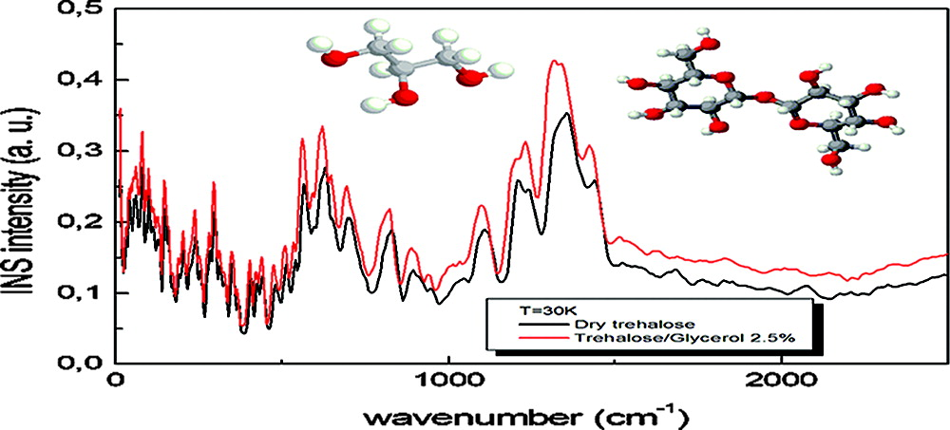
1.4 Two selected examples
istituto
dei sistemi
complessi
High Resolution - Bioprotectants
VESPA resolution will be almost twice better than TOSCA’s one.
(meV)
100
200
300
TOSCA: spectra of dry trehalose (red line) and a mixture of trehalose plus 2.5 wt-%. glycerol (black line).
Hydrogen bonding network greatly affected by addition of 2.5% glycerol!
bioprotectant system (cryo/lyo – stem cells), not present in mammals .
from S. Magazù et al., 2011 (TOSCA data).
SAC13 Meeting 18-20 May 2015

Slide 16
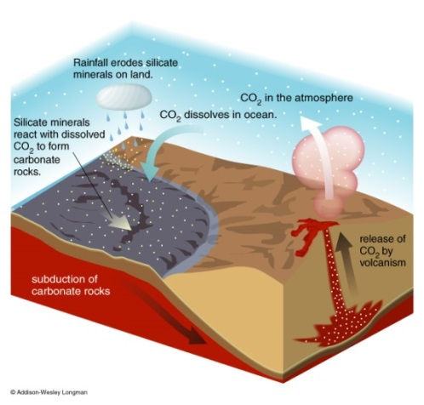
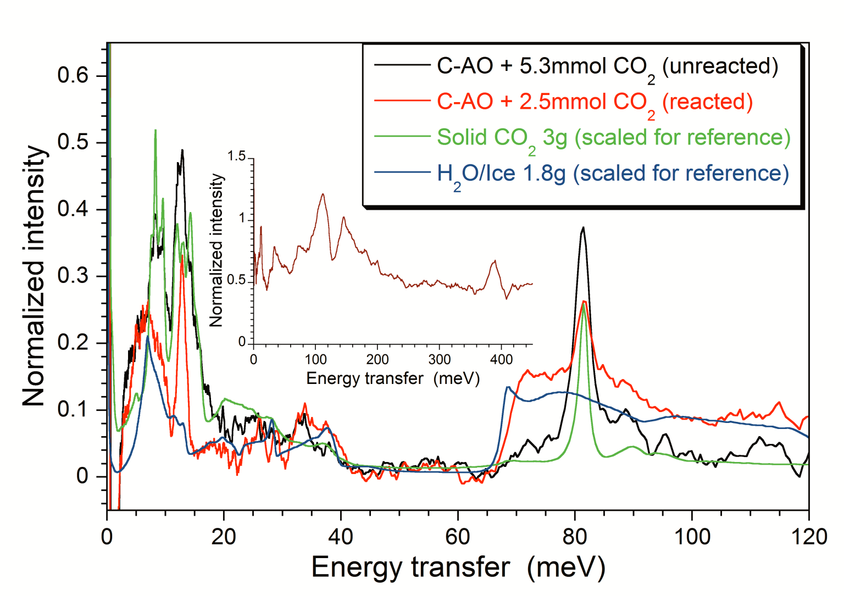
istituto
dei sistemi
complessi
High intensity - Carbon Sequestration
VESPA intensity in the “fingerprint” region: comparable with or better
than VISION’s one.
Real time, kinetic studies & smaller samples
Nanopores (7 Å) of S-doped carbon (C-AO).
CO₂ is reduced to C, H₂O forms.
CO₂ is not observable using IR.
From T. Bandosz et al., 2016 (VISION data).

Slide 17
istituto
dei sistemi
complessi
VESPA
High-performance polymers
Renewable Energies
Catalysis
Earth Science
General
Polymers, pharma-ceuticals
•
Hydrogen storage
Bioprotectants
will have:
A: constant & high rel. E resolution
B: intensity
C: bandwidth (i.e. in ‘one shot’)
AND most importantly…
A+B+C simultaneously!
•
Battery materials
Amino-acids
•
Photolysis /solar cells
H, CO_{x}/NO_{x}
Applied, industrial catalysis
DFT-benchmarking
•
Molecules in confinement
Short H-bonding
•
H-spillover
Water in Minerals
•
•
•
Fracking
•
CO₂ sequestration
Waste repositories

Slide 18
istituto
dei sistemi
complessi
2. VESPA High-level
Requirements
2.1 Energy and momentum transfer ranges.
2.2 Incident neutron flux on sample.
2.3 Secondary spectrometer and detectors.
2.4 Energy transfer resolution.
2.5 Advanced sample environment.

Slide 19

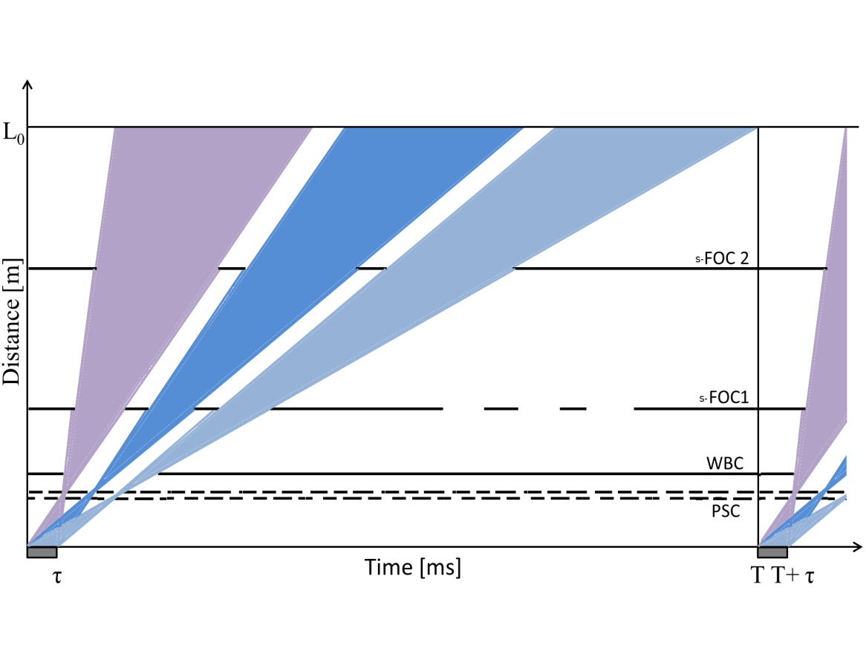
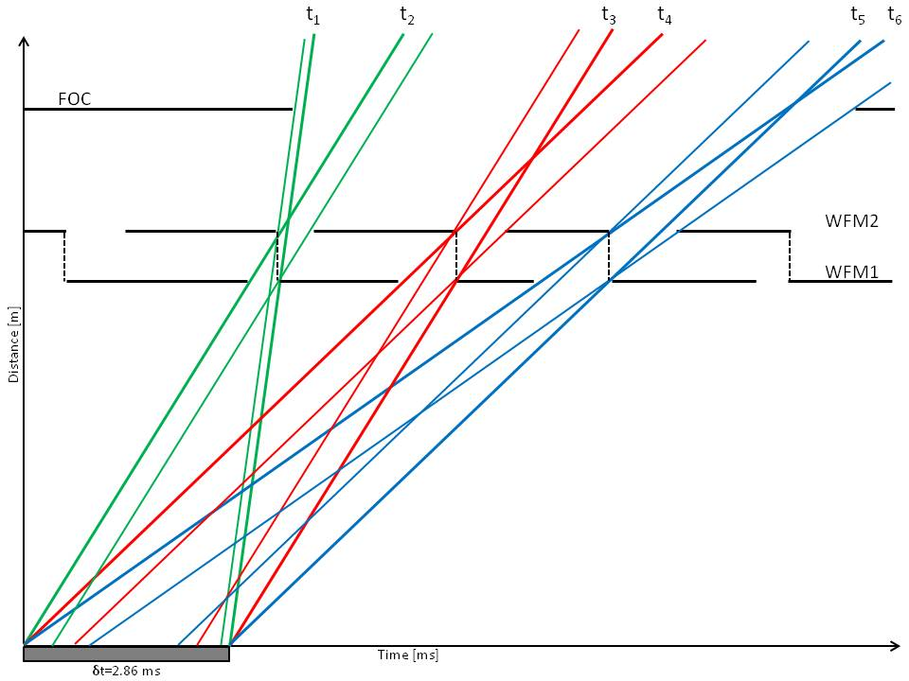
2.1 Energy and Momentum
Transfer Ranges
istituto
dei sistemi
complessi
Consiglio
Nazionale delle
Ricerche
  For VESPA the following Wavelength Frame Multiplication (WFM) scheme, based on optically blind choppers, has been set up, covering the incident energy range from E₀=3.56 meV to 503 meV:
  with L₀=59 m, τ=2.860 ms, T=71.429 ms;
  t₁÷t₂⇔503÷24.02 meV; t₃÷t₄⇔25.14÷8.45 meV; t₅÷t₆⇔8.53÷3.56 meV
  FOC (or WBC)@ 10 m, s-FOC₁@ 19 m, s-FOC₂@ 52 m

Slide 20
istituto
dei sistemi
complessi
Consiglio
Nazionale delle
Ricerche
  giving rise to the these TOF and λ distributions, fully
  optimized for the VESPA vibrational spectroscopic needs:
  The details of the Pulse Shaping Chopper (PSC) system based on optically-blind counter-rotating chopper pairs are:
 | Low-Res | Mid-Res | High-Res
WFM-PSC1 [m] | 6.50 | 6.80 | 6.50
WFM-PSC2 [m] | 7.44 | 7.44 | 6.80
z₀ [m] | 0.94 | 0.64 | 0.30
L_{ToF} [m] | 52.03 | 51.88 | 52.35

Slide 21
istituto
dei sistemi
complessi
Consiglio
Nazionale delle
Ricerche
  The price to pay for having: wide E₀ range, good ω resolution, and the “one shot” option, is the Q behavior:
  Q lies on two narrow stripes and grows monotonically with E₀! Not so important for neutron vibrational spectroscopy...

Slide 22
  An approach alternative to the WFM method
  Correlation spectroscopy implemented via a so-called “statistical chopper” might provide some advantages over WFM, for example:
1) the intensity of the modulated beam would exceed that of direct spectroscopy by up to two orders of magnitude;
2) reduced sensitivity to external background, due to the much higher recorded signal intensity.
  Currently used on the CORELLI diffuse scattering spectrometer at SNS (Oak Ridge, USA).
  Under investigation for VESPA by F. Mezei, S. Magazù and F. Migliardo.
istituto
dei sistemi
complessi

Slide 23
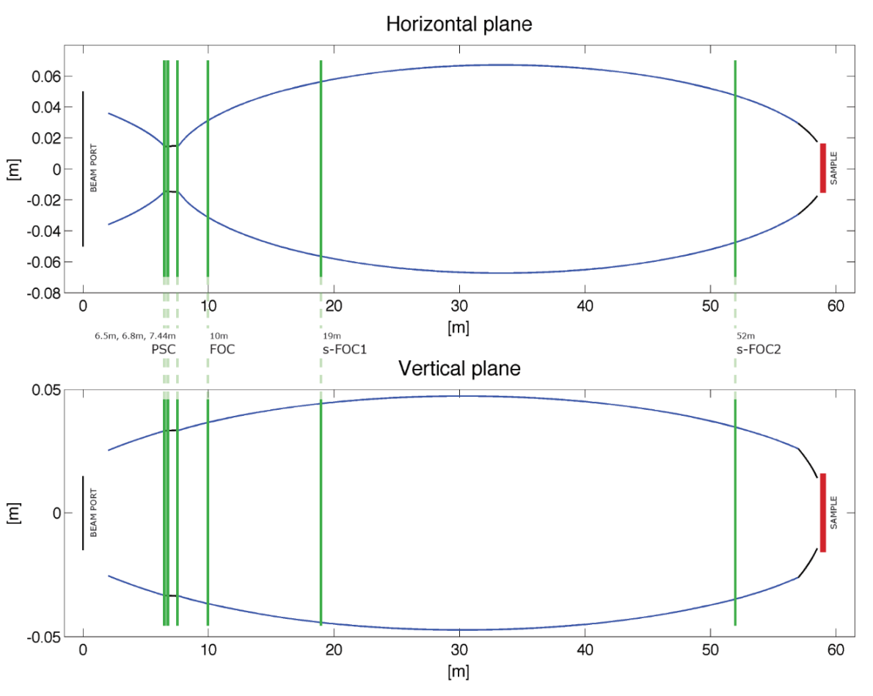
istituto
dei sistemi
complessi
2.2 Incident Neutron
Flux on Sample
  Neutron Optics: the elliptical guide system
  VESPA can achieve its high-flux performances using a guide system optimized for the ESS long pulse.
m=4 elliptical guide (55.4 m),
m=4 linear guide (1.1 m);
guide starts from 2.0 m after
the moderator (“feeder”), and
ends 0.5 m before the sample.

Slide 24
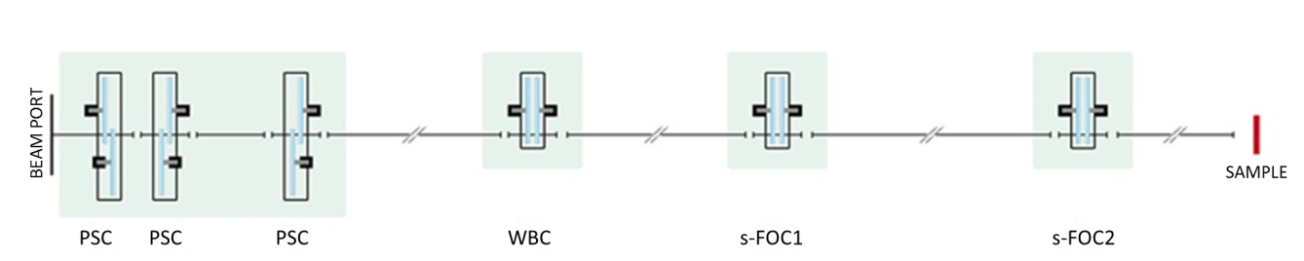
istituto
dei sistemi
complessi
  The VESPA guide system has to be fully integrated with the WFM chopper system:
  …with the beam size modified as follows (mm²):
  30×60 – PSC
  60×70 – FOC
  110×95 – sFOC₁
  100×78 – sFOC₂
  30×30 – Sample

Slide 25
istituto
dei sistemi
complessi
  Incident wavelength
  … giving rise to the following “flux on sample” performances:
  Incident energy
  … that compare well with the VISION ones, especially in the so-called “fingerprint” zone.

Slide 26
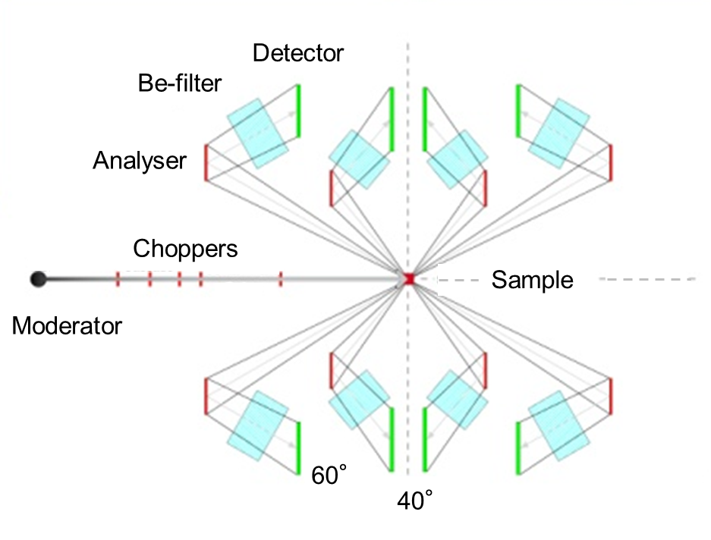
2.3 Secondary Spectrometer
and Detectors
istituto
dei sistemi
complessi
4 arms:
  - 2 in backsc. (130º, 150º)
  - 2 in forwardsc. (30º, 50º)
2 final energies (selected by HOPG):
  - 2.4 meV (60° Bragg angle)
  - 4.4 meV (40° Bragg angle)
Cold Be filters still usable
(E_{cut}=5.2 meV).
Squashed ³He tubes (200×12.5×2.5 mm³, 20 bar): 20 in each module.
4 diffraction banks (diffract.):
  3 mid resolution
  1 high resolution
Side view
30 modules
 | Backscattering bank | Equatorial banks
2θ (deg.) | 152-174 | 75-105
Q (Å⁻¹) | 31.37-2.77 | 24.92-1.74
d (Å) | 0.2-2.3 | 0.25-3.6
Full Configuration
Notes:
-40, 60 deg is Bragg angle (sample plane to analyzer crystal)
-total 3He needed: 113 l at standard pressure/temperature or 5.6l at 20 bar
-NPD/PDF for phase identification, crude PDF

Slide 27
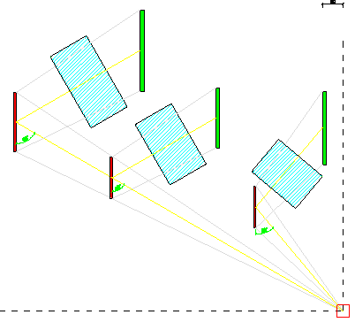
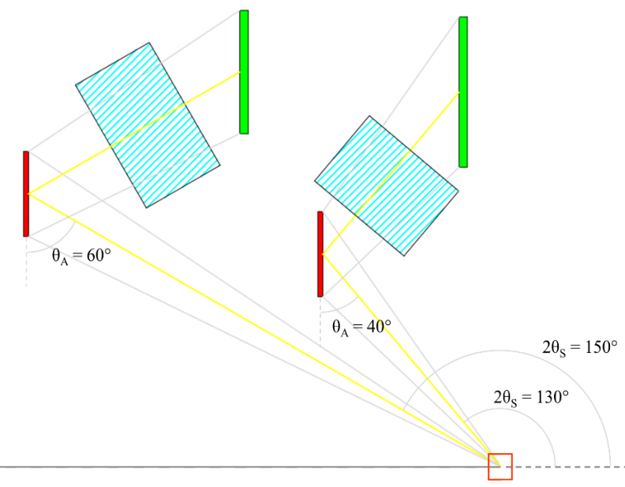
istituto
dei sistemi
complessi
Secondary spectrometer details
2×2 sets of HPOG analyzers (40° & 60°) in forward- and backscattering: Ω= 1.20 sr.
60°
60°
40°
3rd proposed set of Cu (?) analyzers (≈ 60°) for upgrade at a later point: Ω = 1.52 sr (28% more coverage).
Backscattering section

Slide 28
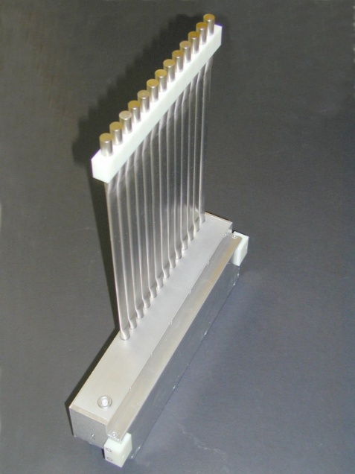
istituto
dei sistemi
complessi
  Detectors
  The VESPA proposal reports the use of the following detectors:
  Spectroscopy: 600 ³He squashed tube (pressure: 20 bar)
  200 mm × 12.5 mm × 2.5 mm.
  2. Diffraction: 32 ³He squashed tube (pressure: 20 bar)
  100 mm × 12.5 mm × 2.5 mm.
    Dead time estimate (e.g. on TOSCA): τ≈10 μs ⇒
    Upper limit for Count Rate: < 40 kHz peak rate per tube;
    Upper limit for peak flux: < 2×10³ n/cm²/s.

Slide 29
          Assuming the following hypotheses:
          - a “bulky” fully-protonated solid sample (≈1 g);
          - in one single tube;
          - at ESS full power;
          - with ideal beamline performances.
istituto
dei sistemi
complessi
  One gets:
  “Elastic line” (i.e. -1 meV <ω< 1 meV):
  ≈ 371 kHz per tube;
  2) Inelastic (i.e. 1 meV <ω<500 meV), example:
  big acoustic phonon at ω≈6.6 meV:
  ≈ 45 kHz per tube.
  We may run into slight saturation problems in spectroscopy,
  but only after several years of operation and for big samples!

Slide 30
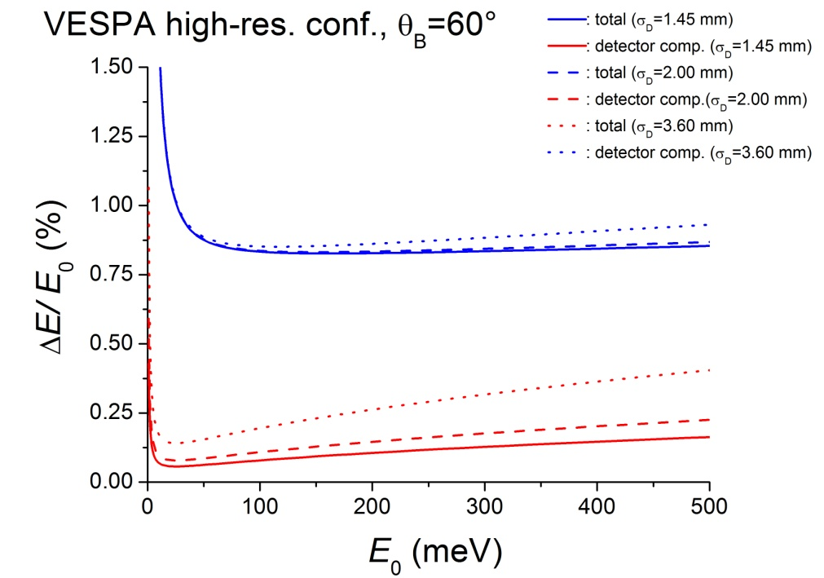
istituto
dei sistemi
complessi
  If squashed ³He-tubes (p=20 bar) turn out to be unavailable, two scenarios will have to be explored:
  I) boron-coated “straw detectors” (d∼7 mm);
  II) standard cylindrical ³He-tubes (∅=12.5 mm, p=5 bar).
  Thickness effects on ΔE/E₀ (see later) have to be carefully taken into accounts!

Slide 31
2.4 Energy Transfer
Resolution
Consiglio
Nazionale delle
Ricerche
istituto
dei sistemi
complessi
The estimates of the relative energy resolution, ΔE/E₀, are close to 0.90%, 1.8% & 2.5% (averaging over 1 meV<E<500 meV), roughly ranging from TOSCA to VISION.
 | Low-Res | Mid-Res | High-Res
WFM-PSC1 [m] | 6.50 | 6.80 | 6.50
WFM-PSC2 [m] | 7.44 | 7.44 | 6.80
z₀ [m] | 0.94 | 0.64 | 0.30
L_{ToF} [m] | 52.03 | 51.88 | 52.35

Slide 32
istituto
dei sistemi
complessi
Consiglio
Nazionale delle
Ricerche
  Studying the E resolution…
  An analytical treatment of the VESPA relative energy resolution (ΔE/E₀) yields the following results:
  ΔE/E₀ is largely dominated by the TOF component Δt/t₀ all over the spectroscopic range: 3 meV<E<500 meV;
  the TOF component is evaluated as: Δt/t₀≈(z₀/L_{TOF}) giving rise to the values: 0.57%, 1.23% & 1.80%, constant all over the TOF range: 10 ms<t<70 ms;
  finally ΔE/E₀ is estimated to be given by:
        ΔE/E₀≈ 2.3548×2×(z₀/L_{TOF})/√12=1.359×(z₀/L_{TOF})
Jacobian:
from t to E
Gaussian distr.:
from σ to FWHM
“Hat” distr.: stand. dev.

Slide 33
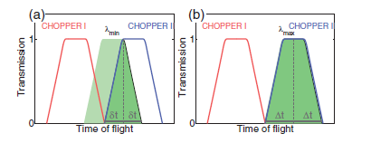
istituto
dei sistemi
complessi
Consiglio
Nazionale delle
Ricerche
  However, the last two points could be improved (work in progress):
  Δt/t₀ ≠ (z₀/L_{TOF}) for E>10 meV;
  effects of the Counter Rotating (CR) chopper pairs.
VESPA optically blind chopper
made of 2 CR pairs (4 disks)
CR3-4
z₀
Getting more realistic with CR…
(from Vickery & Deen, 2014)
CR1-2
Δt (λ_{i})

Slide 34
istituto
dei sistemi
complessi
Consiglio
Nazionale delle
Ricerche
Working out the exact CR trapezoidal transmission function (TTF).
Combining the two TTF for the three time slot of VESPA.
Calculating variance and FWHM for a number of λ values.
Excellent provisional results: Δt/t₀ is almost constant & slightly better than (z₀/L_{TOF})!

Slide 35
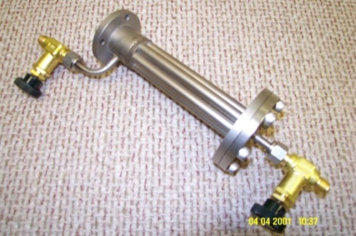
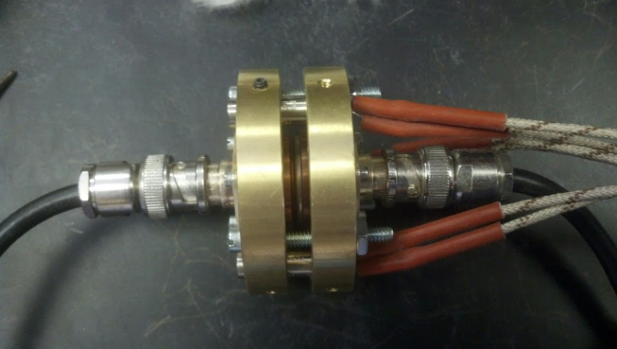
2.5 Advanced Sample Environment
istituto
dei sistemi
complessi
Sample size: 30×30 mm² or less;
closed-cycle refrigerator (in-situ temperature studies etc.);
sample changer (high-throughput).
- temperature control
- gas loading/vacuum
- electrical signals
- high-pressure lines
Data modeling
ESS Data Management & Software Center (DMSC);
DTU Copenhagen (DFT calculations);
other possible collaborations.
- sample can
- gas flow cell
- electrical cell
- high-pressure cell
- photo-lamp
neutrons

Slide 36
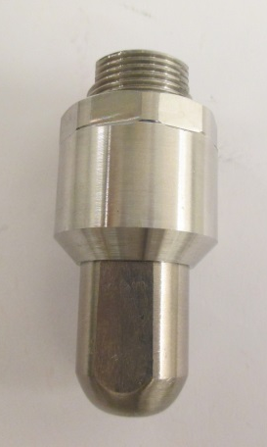
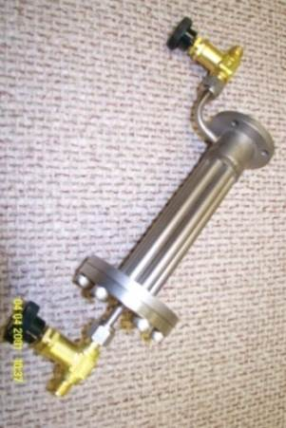
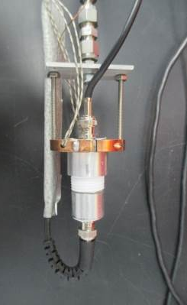
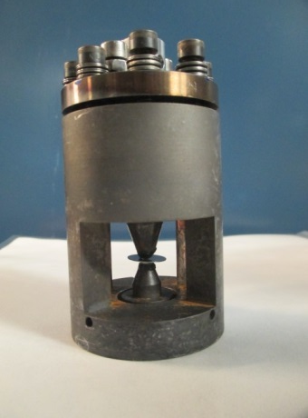
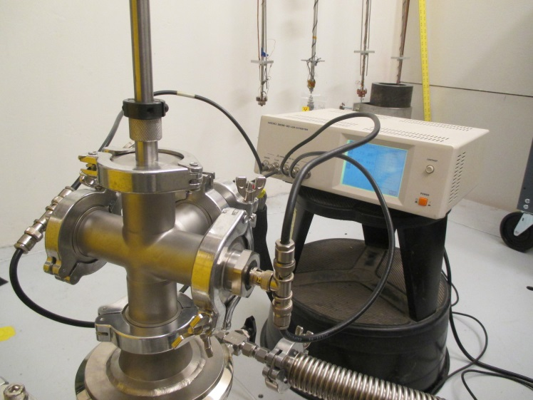
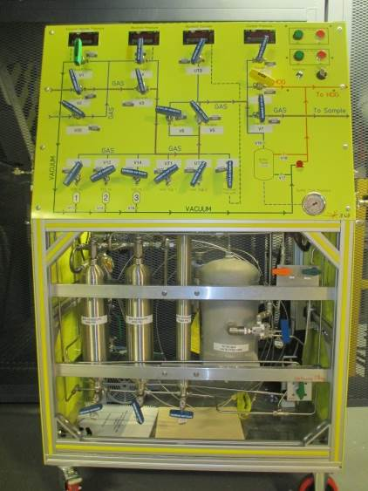
istituto
dei sistemi
complessi
Sample sticks and cells: in-situ measurements, high pressure cells, flow cells, gas manifold, photo-lamp/ battery cell;
low-temperature sample changer;
hardware/software interface.
CCR
20 cm
5 cm
neutrons
Anvil cell
HP cell
Flow cell
Battery cell
- sample can;
- gas flow cell;
- electrical cell;
- high-pressure cell;
- photo-lamp.
Sample stick and auxiliary equipment in the hutch
Gas manifold

Slide 37
istituto
dei sistemi
complessi
Aknoledgements to the help from other members of the VESPA group:
C. Vasi (IPCF-CNR, IT);
F. Grazzi, M. Celli, U. Bafile & L. Ulivi (ISC-CNR, IT);
K. Jones (STFC, RAL, UK);
S. Magazù & F. Migliardo (Un. Messina, IT).
Thanks for your kind attention !

