Slide 1


Contents:
VESPA instrument Scope Setting
Lorenzo Di Fresco
VESPA Lead Engineer (University of Milano Bicocca – ISIS Design Division)
Vespa high-level technical design
Draft project timeline
Notes:
The picture shows a sketch of the beamline located in the sector East, beamport 7 of the ESS faCILITY and a detail of the secondary spectrometer with 4 banks of HOPG anlyzer
Each bank made of an HOPG crystal, a Be filter conditioned by a CCR and a detector with He tube technology

Slide 2
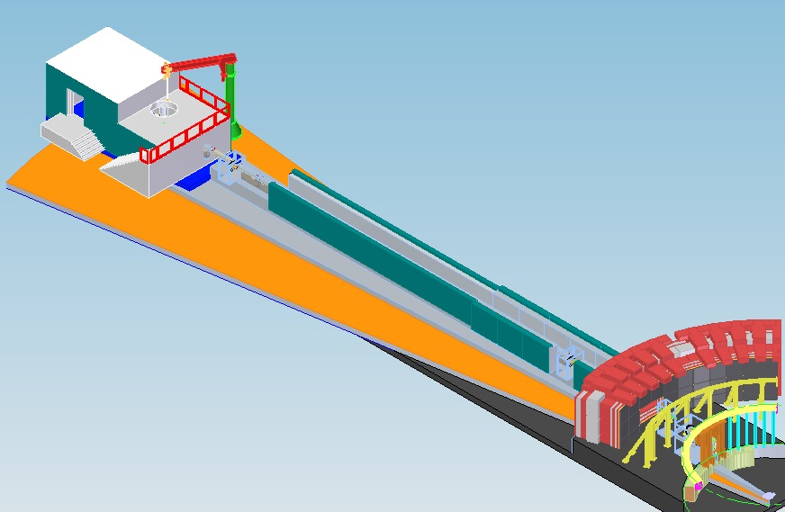
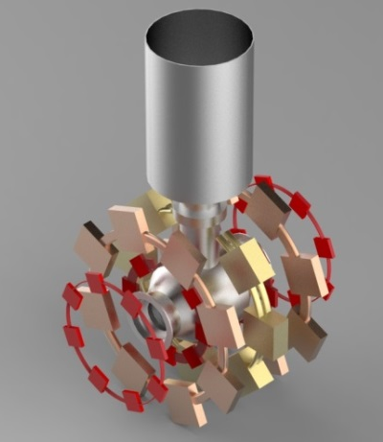

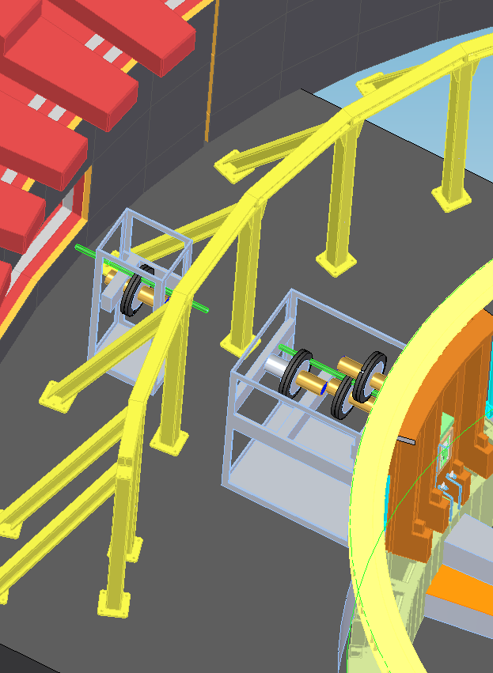
Secondary Spectrometer
VESPA
Sample to moderator L=59 m
600 3He tubes 12.5x200 mm
32 3He tubes 12.5x100 mm
30 HOPG + Be + CCR
3He: 106 liters
Intensity @sample
4x10^7
[n/cm/s/meV]
52 m
19 m
S-FOC side mounted
A crystal-analyser inverse-geometry time-of-flight spectrometer fully devoted to Neutron Vibrational Spectroscopy (NVS)
ESS Class B instrument: 12M€ budget
CNR funds availability: 12M€

Slide 3
INSTRUMENT LAYOUT
Inside bunker
Flight path
Heavy
Shutter
15.5 m
6.5 m
10 m
moderator
Elliptical mirror guide m=4
Jaws
7,44 m
19 m
52 m
6.8 m
sample
BEAM
Secondary spectrometer
59.0 m
6,0 m
11.5 m
15 m
Backscattering and equatorial diffraction banks
60 deg analyser
Focusing nose
He Detector frame:
co-planar with sample pos. 30module x 20 He tubes
Diameter 2.0 m
40 deg analyser
BEAMSTOP
Sample : 59 m from moderator

Slide 4
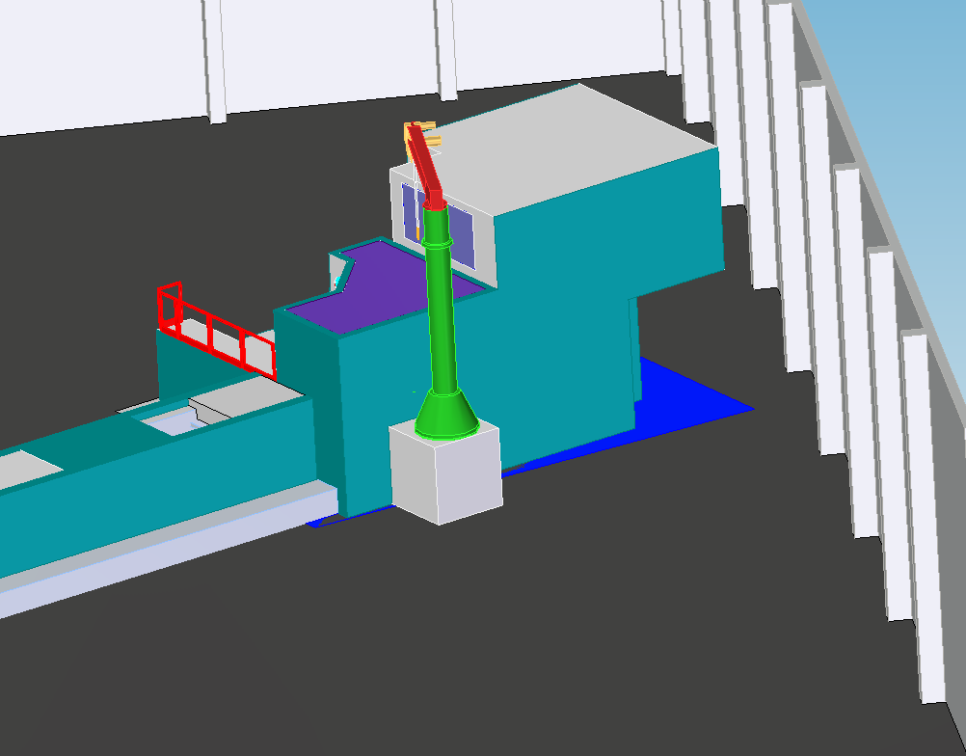
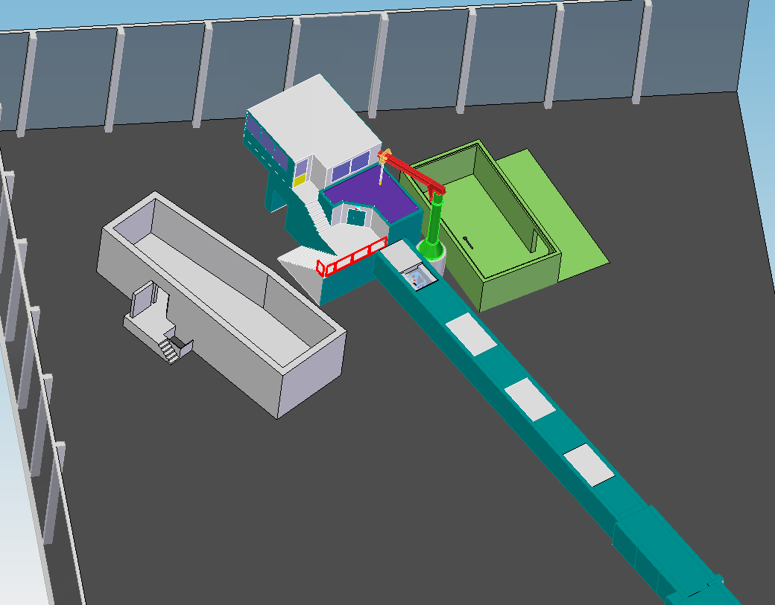
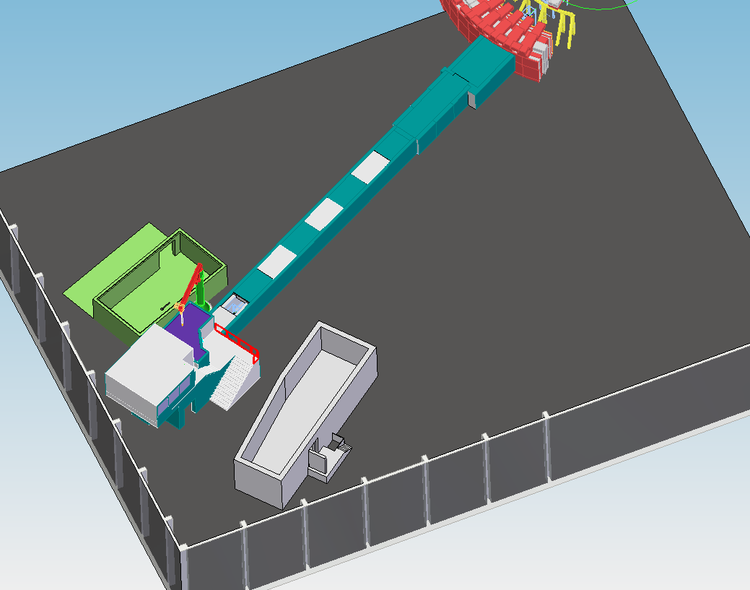
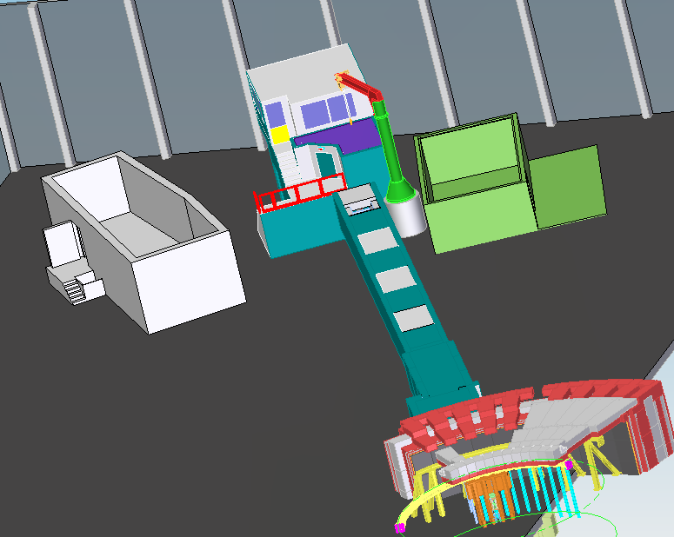

Slide 5
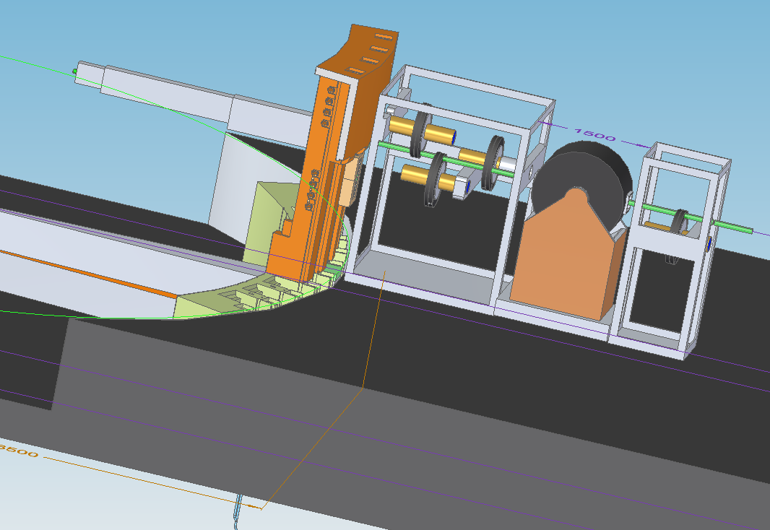
VESPA key-components
Beam direction

Slide 6
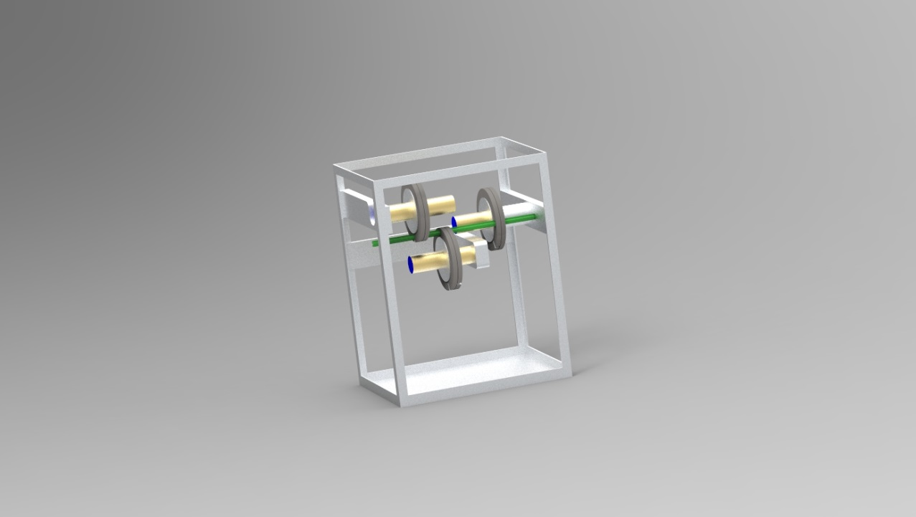
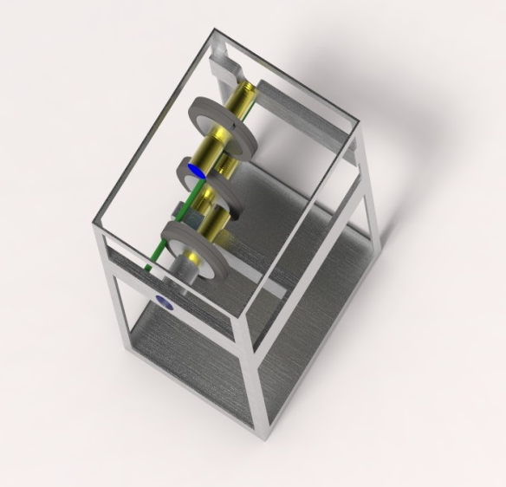
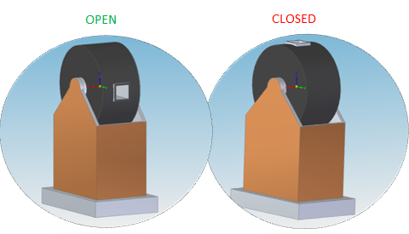
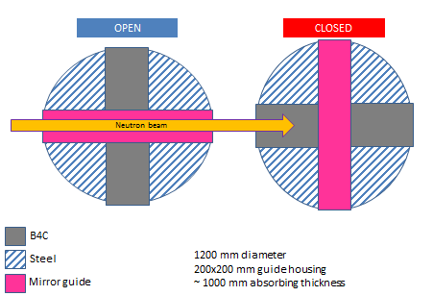
VESPA key-components
WFM PSC triplet
Shutter alt.solution

Slide 7
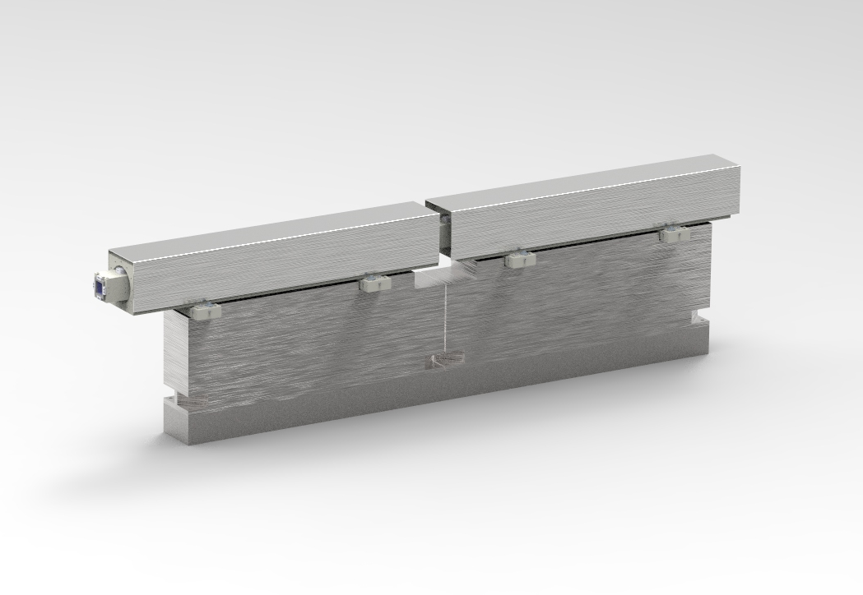
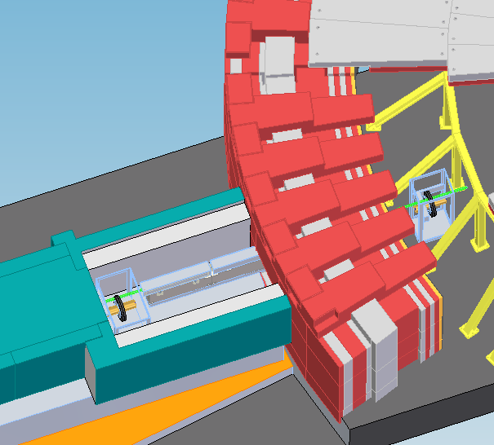
VESPA key-components
Guide system
PPSC cave
Copper substrate
Elliptical geometry or ballistic
γ - Shielded housing
Steel basement + kinematic mounts
1.5 m sections

Slide 8
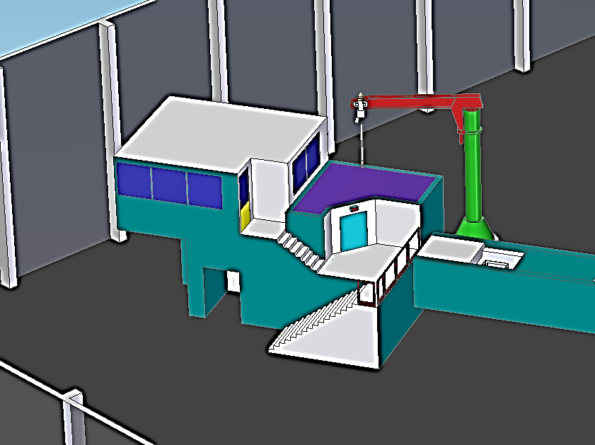
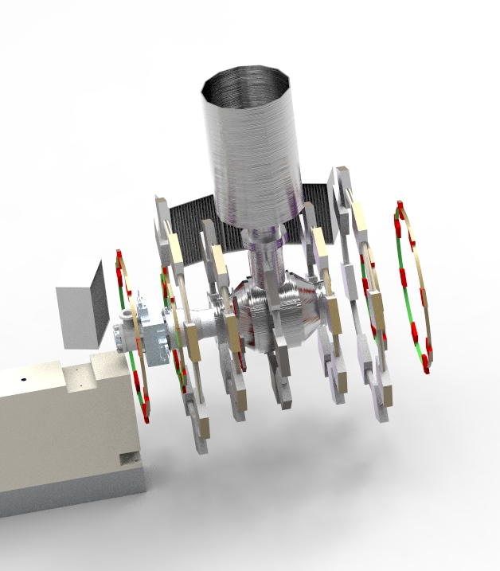
VESPA key-components
Exp. Cave and Hutch
Spectrometer and diffraction banks

Slide 9
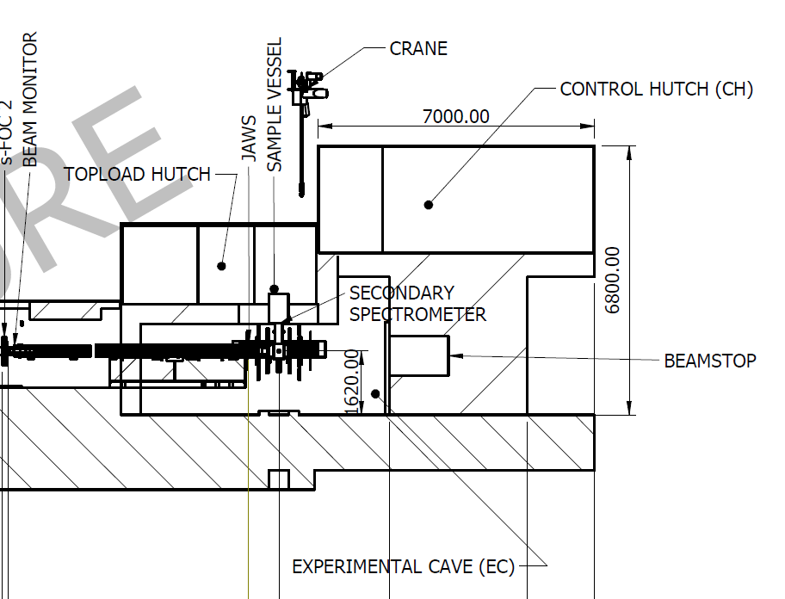
VESPA key-components
Contr. Hutch:
6x6 m^2
S= 36 m^2
Exp. Hutch:
4x5 m^2
S= 20 m^2
3
2
H: 6.8 m
H: 5 m
1
W: 6 m
L: 10 m
Exp. Cave and Hutch
Steel/concrete volume:
140 cubic meters
1 m^3 Boron (2,5ton)
Exp. Cave:
8x4.5 m^2
S= 36 m^2
Cave (1): 3 m Height; S=36m^2; S’=24 m^2 => shielding volume 72 m^3
Exp.Hutch (2): 2.5 m Height, S=20m^2; S’=10 m^2 => shielding volume 25m^3
Contr.Hutch (3): n.a.
Roof : 18m^3
Beamstop cave: 40 m^3 steel/concrete + 1m^3 Boron
W: 6 m

Slide 10
VESPA Timeline
Pre detail
phase
Procurement
Construction
Build
Phase 1
Detailed Design
Commissioning
Toll gate II
Larmor mid 2009-Mar 2014
ChipIR mid 2009-May 2014
IMAT mid 2009-sept 2015
Zoom mid 2009-Dec 2016

Slide 11
VESPA Timeline
Pre detail
phase
Procurement
Construction
Build
Phase 1
Detailed Design
Commissioning
Toll gate II
Priority Tasks Year 2017
  Neutronics Calculations
  Guide insert design
  Guide Geometry optimisation
  Shielding optimisation
  Detectors alt. solutions eval.
Toll gate II
Detailed
Design
Pre detail
phase

Slide 12
High Level Design
VESPA instrument Scope Setting
Lorenzo Di Fresco
VESPA Lead Engineer (University of Milano Bicocca – ISIS Design Division)
Thanks for your Attention!
Notes:
The picture shows a sketch of the beamline located in the sector East, beamport 7 of the ESS faCILITY and a detail of the secondary spectrometer with 4 banks of HOPG anlyzer
Each bank made of an HOPG crystal, a Be filter conditioned by a CCR and a detector with He tube technology

Slide 13
Contents:
VESPA instrument Scope Setting
Lorenzo Di Fresco
VESPA Lead Engineer (University of Milano Bicocca – ISIS Design Division)
VESPA scope OPTIONS Cost breakdown details
Options summary
“NO-Equipment” Cost details
Notes:
The picture shows a sketch of the beamline located in the sector East, beamport 7 of the ESS faCILITY and a detail of the secondary spectrometer with 4 banks of HOPG anlyzer
Each bank made of an HOPG crystal, a Be filter conditioned by a CCR and a detector with He tube technology

Slide 14
Scope Setting Data
Used data from ISIS instrument recent upgrade:
  TOSCA
  OSIRIS
Used data from ISIS phase II Instruments
  Larmor
  IMAT
  ChipIR
  Zoom
Used ESS Estimates where “required to”
Estimated additional cost for the “In Kind” element
+
Bottom-up
Comparative

Slide 15
VESPA Option 1
Heavy
Shutter
6.5 m
10 m
moderator
Elliptical mirror guide m=4
Jaws
19 m
52 m
6.8 m
BEAM
sample
Secondary spectrometer
59.0 m
6.0 m
11.5 m
15 m
Equatorial diffraction banks (85-95 deg)
60 deg analyser
60 deg analyser
40 deg analyser
He Detector frame:
co-planar with sample pos. 30module x 20 He tubes
Diameter 2.0 m
BEAMSTOP
40 deg analyser
Sample : 59 m from moderator

Slide 16
VESPA Option 1
Heavy shutter installed in the bunker
57 m mirrored guide system and shielded housing
PPS chopper cave @ 15 m from moderator
2 x WFM-PSC (1 resolution mode)
1 x FOC
2 x s-FOC
Sample position at 59 m
vertical/horizontal slit collimation
Basic sample environment (Cryostat, sample changer)
5 analyser modules (HOPG+Be-filter+CCR+20 He tubes)
1 diffraction bank 8 He tubes ( 85-95 deg)
All necessary associated infrastructure for the above (shielding, cabling etc.)

Slide 17
VESPA Option 1
 | 01 Phase 1 | 02 Project Management & Integration | 03 Design | 04 Procurement & Fabrication | 05 Installation | 06 Cold Commissioning | Total
01 Shielding | 5 k€ | 79 k€ | 159 k€ | 1,507 k€ | 397 k€ | 35 k€ | 2,181 k€
02 Neutron Optics | 4 k€ | 128 k€ | 256 k€ | 2,430 k€ | 639 k€ | 55 k€ | 3,511 k€
03 Choppers | 4 k€ | 65 k€ | 100 k€ | 1,231 k€ | 324 k€ | 55 k€ | 1,778 k€
04 Sample Environment | 4 k€ | 7 k€ | 30 k€ | 133 k€ | 35 k€ | 20 k€ | 229 k€
05 Detector and Beam Monitors | 4 k€ | 38 k€ | 75 k€ | 722 k€ | 190 k€ | 65 k€ | 1,094 k€
06 Data Acquisition and Analysis | 4 k€ | 10 k€ | 50 k€ | 185 k€ | 35 k€ | 35 k€ | 319 k€
07 Motion Control and Automation | 4 k€ | 10 k€ | 50 k€ | 124 k€ | 26 k€ | 25 k€ | 239 k€
08 Instrument Specific Technical Equipment | 4 k€ | 0 k€ | 0 k€ | 0 k€ | 0 k€ |  | 4 k€
09 Instrument Infrastructure | 4 k€ | 129 k€ | 150 k€ | 1,227 k€ | 323 k€ | 25 k€ | 1,858 k€
10 Vacuum | 4 k€ | 5 k€ | 15 k€ | 95 k€ | 25 k€ | 20 k€ | 164 k€
11 PSS | 4 k€ | 9 k€ | 50 k€ | 162 k€ | 43 k€ | 30 k€ | 297 k€
12 Contingency | 5 k€ | 48 k€ | 93 k€ | 781 k€ | 204 k€ | 37 k€ | 1,167 k€
Total | 50 k€ | 527 k€ | 1,028 k€ | 8,596 k€ | 2,240 k€ | 402 k€ | 12,841 k€
Labour included in above (Person-Years) | 1 | 4 | 9 | 7 | 10 | 3 | 34
Labour/shipping included in above | 50 k€ | 500 k€ | 900 k€ | 750 k€ | 860 k€ | 390 k€ | 3,450 k€

Slide 18
VESPA Option 1
Notes:
Vespa scope summary.xls “OPT DIFF”

Slide 19
Instrument rough estimate
VESPA Option 1
Choppers
~ 1300 -1800 k€
Mirrored guide system
~ 2500 k€
Beamline shielding
~ 1500 k€
Detectors
~ 1100 - 3800 k€
Cave
~ 1000 k€
Equipment
~ 8200 – 12000 k€
Equipment | 8,225 k€
ESS LABOUR | 1,000 k€
Labour & travel | 2,200 k€
SHIPPING | 250 k€
Contingency | 1,168 k€
VESPA TOTAL COST | 12,843 k€
Labour/travel/shipping
~ 3500 k€

Slide 20
VESPA Option 1
 |  | Q.ty |  | cost [k€]
PBS 13.6.16.1 Beam Transport & Conditioning System (BTCS) | Shielding (44 m)
 | steel | 70 | [m^3] | 1050.00
 | concrete | 120 | [m^3] | 96.00
 |  |  |  | 1146.00
 | Shutter
 | heavy shutter |  |  | 350.00
 | Choppers System
 | WFM PSC inside bunker | 2 | 198.00 | 396.00
 | FOC inside Bunker | 1 | 144.00 | 144.00
 | s FOC | 2 | 131.00 | 262.00
 | Power x 12 axis (rack power system) | 1 |  | 22.10
 | Chopper Drive x 12 axis | 1 |  | 194.40
 | Rack Master | 2 |  | 61.20
 | Rack slave | 2 |  | 23.60
 | CHIM x 3 WFM PSC over under in-bunker | 1 |  | 85.00
 | CHIM other choppers | 3 |  | 145.44
 | Vacuum system/flanges/tubes/controls | 1 |  | 50.00
 |  |  |  | 1345.44
 | PROMPT PULSE SUPPRESSION | 0 |  | 0
 | Bunker plug |  |  | 75
 | Neutron Guides
 | Elliptic guide m=4 | 55 | 36 | 2052.00
 | Straight guide m=4 | 1.5 | 30 | 45.00
 | Housing + coating | 56.5 | 7.2 | 410.40
 | Mechanics |  |  | 50.00
 |  |  |  | 2557.40
 | Beam flux monitors | 4 | 10 | 40.00
 | jaws | 1 | 30 | 30.00
 | Vecuum window/flanges/flexibles |  |  | 50.00
 |  |  |  | 5518.84
PBS 13.6.16.2 Sample Exposure System (SES) | Sample Alignment | 1 | 40 | 40
 | Cryostat (10-300 k) | 1 | 100 | 100.00
 | Sample Changer | 1 | 30 | 30.00
 | Imaging x positioning | 1 | 5 | 5.00
 | Sample vessel | 1 | 20 | 20.00
 |  | 0 |  | 0.00
 | cooling unit x laser light equipment | 0 | 5 | 0.00
 | Gas adsorption equipment and photoexcitation setup | 0 | 150 | 0.00
 | sample sticks x various exp | 0 | 50 | 0.00
 |  |  |  | 195.00
PBS 13.6.16.3 Scattering Characterization System (SCS) | Analyzers and diff banks
 | Be=filter | 5 | 35 | 175.00
 | HOPG | 5 | 20 | 100.00
 | CCR | 5 | 16.5 | 82.50
 | 3He Detector tube (1/2''x6'') | 100 | 2 | 200.00
 | He tubes x diffract | 8 | 1.5 | 12.00
 | B4C shielding panel | 8 | 0.3 | 2.40
 | Helium liters | 17.25 | 2 | 34.50
 | cables | 20 | 0.42 | 8.40
 | frames | 2 | 2.5 | 5.00
 |  |  | s-total | 619.80
 | Beam monitor (flux,div, wave) | 1 | 100 | 100.00
 | BeamStop | 1 | 60 | 60.00
 | Shielding/background | 10 | 3 | 30.00
 |  |  |  | 809.80
Notes:
Vespa scope summary.xls “OPT DIFF”

Slide 21
VESPA Option 1
 |  | Q.ty |  | cost [k€]
PBS 13.6.16.5 Experimental Cave(EC) | Cave 11x5 sqm
 | steel | 50 | 15 | 750.00
 | concrete | 90 | 0.8 | 72.00
 | exp hutch top load spectr | 1 | 60 | 60.00
 | Electrical Power (3ph & 1ph) | 0 | 50 | 0.00
 | Lighting. Misc services | 1 | 30 | 30.00
 | Water & Compressed Air | 1 | 20 | 20.00
 | He gas supply | 1 | 25 | 25.00
 | Chilled water | 1 | 20 | 20.00
 |  | 0 | 200 | 0.00
 | Gates, | 1 | 0.8 | 0.80
 | Local crane | 1 | 30 | 30.00
 | Lifting frames | 1 | 8 | 8.00
 | Painting | 1 | 5 | 5.00
 | signage | 1 | 1 | 1.00
 | water panels / service panels | 1 | 10 | 10.00
 |  |  |  | 1031.80
 |  | Q.ty |  | cost [k€]
PBS 13.6.16.12 IC&M | PSS + interlocks | 1 | 150 | 150
 | Driver Controls | 8 |  | 60
 | PC % system monitors | 0 | 15 | 0
 | Backup power supply (incl in backend electronics) | 0 | 15 | 0
 | Standalone mode | 1 | 20 | 20
 |  | 0 |  | 0
 |  |  |  | 230.00
PBS 13.6.16.6 Control Hutch (CH) | Air Conditioning |  |  | 15
 | Stairs etc |  |  | 10
 | Monitoring Oxygen etc |  |  | 5
 | Backend electronics /UPS | 1 | 200 | 200.00
 | Fire suppression |  |  | 30
 | DAE |  |  | 180
 |  |  |  | 0
 | Computers |  |  | 15
 |  |  |  | 455.00
Notes:
Vespa scope summary.xls “OPT DIFF”

Slide 22
VESPA Option 1 RISKS
Risk level | RISK | TREATMENT NAME | Treatment | CATEGORY | TREATMENT PLAN
High 2x5 | Helium technology | Technology availability | Observe | Cost overrun on Construction budget | Define/develop optional technology for neutron detection at the secondary spectrometer
High 5x2 | Unclear Bunker arrangement, inability to maintain or install or remove equipment due to high radiation levels and long shielding removal times. | Bunker access | Mitigate | Cost overrun on annual Operation costs | Detailed design and reliability evaluation of the system components into the bunker, with FMEA technique
High 4x3 | Delays caused by optimisation of the instruments |  | mitigate | Schedule, budget | Detailed time scheduling plus intermediate deliverables on neutrons calculation tasks
High 4x3 | Perfomance stays under user and ESS expectation | 12 MEuro performance | Observe | Quality and function | Costs optimisation, alternative funding stage plan
Medium 3x2 | Late delivery of key components | VESPA schedule | Mitigate | Schedule, budget | Properly assess the delivery time and transportation, also the time that is required for installation and arriving at site. Define the critical path for every component.
Notes:
Vespa scope summary.xls “OPT DIFF”

Slide 23
VESPA Option 2
Heavy
Shutter
6.5 m
10 m
moderator
Elliptical mirror guide m=4
Jaws
7.44 m
19 m
BEAM
52 m
6.8 m
sample
59 m
Secondary spectrometer
6.0 m
11.5 m
15 m
Equatorial diffraction banks (85-95 deg)
60 deg analyser
60 deg analyser
40 deg analyser
He Detector frame:
co-planar with sample pos. 30module x 20 He tubes
Diameter 2.0 m
BEAMSTOP
40 deg analyser
Sample : 59 m from moderator

Slide 24
VESPA Option 2
Heavy shutter installed in the bunker
57 m mirrored guide system and shielded housing
PPS chopper cave @ 15 m from moderator
3 x WFM-PSC (3 resolution mode)
1 x FOC
2 x s-FOC
Sample position at 59 m
vertical/horizontal slit collimation
Full sample environment (Cryostat, 2x sample changer, Gas ads.& photoexc. eq, sticks & cells)
15 analyser modules (HOPG+Be-filter+CCR+20 He tubes)
1 diffraction bank 8 He tubes ( 85-95 deg)
All necessary associated infrastructure for the above (shielding, cabling etc.)

Slide 25
VESPA Option 2
 | 01 Phase 1 | 02 Project Management & Integration | 03 Design | 04 Procurement & Fabrication | 05 Installation | 06 Cold Commissioning | Total
01 Shielding | 5 k€ | 79 k€ | 159 k€ | 1,507 k€ | 397 k€ | 35 k€ | 2,181 k€
02 Neutron Optics | 4 k€ | 128 k€ | 256 k€ | 2,430 k€ | 639 k€ | 55 k€ | 3,511 k€
03 Choppers | 4 k€ | 65 k€ | 100 k€ | 1,404 k€ | 353 k€ | 55 k€ | 1,981 k€
04 Sample Environment | 4 k€ | 19 k€ | 30 k€ | 295 k€ | 50 k€ | 20 k€ | 418 k€
05 Detector and Beam Monitors | 4 k€ | 50 k€ | 75 k€ | 1,854 k€ | 390 k€ | 65 k€ | 2,439 k€
06 Data Acquisition and Analysis | 4 k€ | 10 k€ | 50 k€ | 185 k€ | 35 k€ | 35 k€ | 319 k€
07 Motion Control and Automation | 4 k€ | 10 k€ | 50 k€ | 124 k€ | 26 k€ | 25 k€ | 239 k€
08 Instrument Specific Technical Equipment | 4 k€ | 0 k€ | 0 k€ | 0 k€ | 0 k€ |  | 4 k€
09 Instrument Infrastructure | 4 k€ | 129 k€ | 150 k€ | 1,227 k€ | 323 k€ | 25 k€ | 1,858 k€
10 Vacuum | 4 k€ | 5 k€ | 15 k€ | 95 k€ | 25 k€ | 20 k€ | 164 k€
11 PSS | 4 k€ | 9 k€ | 50 k€ | 162 k€ | 43 k€ | 30 k€ | 297 k€
12 Contingency | 5 k€ | 50 k€ | 93 k€ | 928 k€ | 228 k€ | 37 k€ | 1,341 k€
Total | 50 k€ | 554 k€ | 1,028 k€ | 10,210 k€ | 2,509 k€ | 402 k€ | 14,752 k€
Labour included in above (Person-Years) | 1 | 4 | 10 | 7 | 10 | 3 | 35
Labour/shipping included in above | 50 k€ | 500 k€ | 1,000 k€ | 750 k€ | 860 k€ | 390 k€ | 3,550 k€

Slide 26
VESPA Option 2

Slide 27
VESPA Option 2
Risk level | RISK | TREATMENT NAME | Treatment | CATEGORY | TREATMENT PLAN
High 2x5 | Helium technology | Technology availability | Observe | Cost overrun on Construction budget | Define/develop optional technology for neutron detection at the secondary spectrometer
High 5x2 | Unclear Bunker arrangement, inability to maintain or install or remove equipment due to high radiation levels and long shielding removal times. | Bunker access | Mitigate | Cost overrun on annual Operation costs | Detailed design and reliability evaluation of the system components into the bunker, with FMEA technique
High 4x3 | Delays caused by optimisation of the instruments |  | mitigate | Schedule, budget | Detailed time scheduling plus intermediate deliverables on neutrons calculation tasks
Medium 3x2 | Late delivery of key components | VESPA schedule | Mitigate | Schedule, budget | Properly assess the delivery time and transportation, also the time that is required for installation and arriving at site. Define the critical path for every component.
Medium 3x3 | Detector count rate | Detectors Action plan and schedule with mitigation plan | Observe | Schedule, budget, quality and function

Slide 28
VESPA Option 3
Heavy
Shutter
15.5 m
6.5 m
10 m
moderator
Elliptical mirror guide m=4
Jaws
7.44 m
19 m
52 m
6.8 m
BEAM
sample
Secondary spectrometer
59 m
6.0 m
11.5 m
15 m
Backscattering
Backscattering and equatorial diffraction banks
60 deg analyser
60 deg analyser
40 deg analyser
60 deg analyser
40 deg analyser
He Detector frame:
co-planar with sample pos. 30module x 20 He tubes
Diameter 2.0 m
BEAMSTOP
40 deg analyser
Sample : 59 m from moderator
Forwardscattering

Slide 29
VESPA Option 3
Heavy shutter installed in the bunker
57 m mirrored guide system and shielded housing
PPS chopper @ 15 m from moderator
3 x WFM-PSC (3 resolution mode)
1 x FOC
2 x s-FOC
Sample position at 59 m
vertical/horizontal slit collimation
Full sample environment (Cryostat, 2x sample changer, Gas ads.& photoexc. eq, sticks & cells)
30 analyser modules (HOPG+Be-filter+CCR+20 He tubes)
4x diffraction bank 8 He tubes ( 75-105 deg, 164-174 deg)
All necessary associated infrastructure for the above (shielding, cabling etc.)

Slide 30
VESPA Option 3
 | 01 Phase 1 | 02 Project Management & Integration | 03 Design | 04 Procurement & Fabrication | 05 Installation | 06 Cold Commissioning | Total
01 Shielding | 5 k€ | 79 k€ | 200 k€ | 1,507 k€ | 500 k€ | 50 k€ | 2,341 k€
02 Neutron Optics | 4 k€ | 128 k€ | 256 k€ | 2,430 k€ | 639 k€ | 55 k€ | 3,511 k€
03 Choppers | 4 k€ | 65 k€ | 120 k€ | 1,686 k€ | 353 k€ | 65 k€ | 2,293 k€
04 Sample Environment | 4 k€ | 19 k€ | 30 k€ | 295 k€ | 70 k€ | 30 k€ | 448 k€
05 Detector and Beam Monitors | 4 k€ | 50 k€ | 120 k€ | 3,500 k€ | 800 k€ | 75 k€ | 4,549 k€
06 Data Acquisition and Analysis | 4 k€ | 10 k€ | 50 k€ | 185 k€ | 35 k€ | 35 k€ | 319 k€
07 Motion Control and Automation | 4 k€ | 10 k€ | 50 k€ | 124 k€ | 26 k€ | 25 k€ | 239 k€
08 Instrument Specific Technical Equipment | 4 k€ | 0 k€ | 0 k€ | 0 k€ | 0 k€ |  | 4 k€
09 Instrument Infrastructure | 4 k€ | 129 k€ | 150 k€ | 1,227 k€ | 323 k€ | 25 k€ | 1,858 k€
10 Vacuum | 4 k€ | 5 k€ | 15 k€ | 95 k€ | 25 k€ | 20 k€ | 164 k€
11 PSS | 4 k€ | 9 k€ | 50 k€ | 162 k€ | 43 k€ | 30 k€ | 297 k€
12 Contingency | 5 k€ | 50 k€ | 104 k€ | 1,121 k€ | 281 k€ | 41 k€ | 1,602 k€
Total | 50 k€ | 554 k€ | 1,145 k€ | 12,330 k€ | 3,095 k€ | 451 k€ | 17,625 k€
Labour included in above (Person-Years) | 1 | 4 | 11 | 7 | 12 | 3 | 38
Labour/shipping included in above | 50 k€ | 500 k€ | 1,060 k€ | 750 k€ | 1,200 k€ | 390 k€ | 3,950 k€

Slide 31
VESPA Option 3
ESS LIST | OPTION 2 |  | OPTION 3
Shielding | 2,181 k€ | 160 k€ | 2,341 k€
Neutron Optics | 3,511 k€ | 0 k€ | 3,511 k€
Choppers | 1,981 k€ | 312 k€ | 2,293 k€
Sample Environment | 418 k€ | 30 k€ | 448 k€
Detector and Beam Monitors | 2,439 k€ | 2,110 k€ | 4,549 k€
Data Acquisition and Analysis | 319 k€ | 0 k€ | 319 k€
Motion Control and Automation | 239 k€ | 0 k€ | 239 k€
Instrument Specific Technical Equipment | 4 k€ | 0 k€ | 4 k€
Instrument Infrastructure | 1,858 k€ | 0 k€ | 1,858 k€
Vacuum | 164 k€ | 0 k€ | 164 k€
PSS | 297 k€ | 0 k€ | 297 k€
Labour & travel incl. in the above | 3,550 k€ | 400 k€ | 3,950 k€
TOTAL | 13,411 k€ | 2,612 k€ | 16,023 k€
TOTAL + 10% contingency | 14,752 k€ | 2,873 k€ | 17,625 k€

Slide 32
VESPA Option 3
Risk level | RISK | TREATMENT NAME | Treatment | CATEGORY | TREATMENT PLAN
High 2x5 | Helium technology | Technology availability | Observe | Cost overrun on Construction budget | Define/develop optional technology for neutron detection at the secondary spectrometer
High 5x2 | Unclear Bunker arrangement, inability to maintain or install or remove equipment due to high radiation levels and long shielding removal times. | Bunker access | Mitigate | Cost overrun on annual Operation costs | Detailed design and reliability evaluation of the system components into the bunker, with FMEA technique
High 4x3 | Delays caused by optimisation of the instruments |  | mitigate | Schedule, budget | Detailed time scheduling plus intermediate deliverables on neutrons calculation tasks
Medium 3x2 | Late delivery of key components | VESPA schedule | Mitigate | Schedule, budget | Properly assess the delivery time and transportation, also the time that is required for installation and arriving at site. Define the critical path for every component.
Medium 3x3 | Detector count rate | Detectors Action plan and schedule with mitigation plan | Observe | Schedule, budget, quality and function

Slide 33
OPTION SUMMARY
ESS LIST | OPTION 1 | OPTION 2 | OPTION 3
Shielding | €k 2,181.1 | €k 2,181.1 | €k 2,341.0
Neutron Optics | €k 3,511.5 | €k 3,511.5 | €k 3,511.5
Choppers | €k 1,778.3 | €k 1,980.8 | €k 2,292.8
Sample Environment | €k 229.0 | €k 418.3 | €k 448.3
Detector and Beam Monitors | €k 1,093.8 | €k 2,438.8 | €k 4,549.0
Data Acquisition and Analysis | €k 319.0 | €k 319.0 | €k 319.0
Motion Control and Automation | €k 238.5 | €k 238.5 | €k 238.5
Instrument Specific Technical Equipment | €k 4.0 | €k 4.0 | €k 4.0
Instrument Infrastructure | €k 1,858.3 | €k 1,858.3 | €k 1,858.3
Vacuum | €k 164.0 | €k 164.0 | €k 164.0
PSS | €k 296.5 | €k 296.5 | €k 296.5
Labour included in the above | €k 3,449.5 | €k 3,549.5 | €k 3,949.5
TOTAL | €k 11,674.0 | €k 13,410.9 | €k 16,022.9
TOTAL
TOTAL + 10% contingency | €k 12,841 | €k 14,752 | €k 17,625
No PPSC
analyser modules
1 diffraction bank
1 sample changer
No PPSC
15 analyser modules
1 diffraction bank
2 sample changer
PPSC
30 analyser modules
4 diffraction bank
2 sample changer
ESS labour (7man/yr) 1000 k€

Slide 34
Labour and other cost detail
Option 1
ISIS-CNR People Predicted Expenditure
ISIS - CNR | 2017 | 2018 | 2019 | 2020 | 2021 | 2022 | 2023 | Total man years worked
People
Mechanical
Lead Engineer | 1.00 | 1.00 | 1.00 | 1.00 | 0.80 | 0.80 | 0.80 | 6.40
Senior Design Eningeer | 0.20 | 0.80 | 0.80 | 0.10 | 0.00 | 0.00 | 0.00 | 1.90
Design Engineer | 0.20 | 1.00 | 1.00 | 1.00 | 1.00 | 0.40 | 0.10 | 4.70
Electrical
Electrical Design Engineer | 0.00 | 0.20 | 0.50 | 0.50 | 0.20 | 0.10 | 0.00 | 1.50
Project
Project Sponsor | 0.05 | 0.05 | 0.05 | 0.05 | 0.04 | 0.04 | 0.04 | 0.32
Project manager | 0.30 | 0.50 | 0.50 | 0.50 | 0.50 | 0.50 | 0.20 | 3.00
Planner | 0.10 | 0.10 | 0.10 | 0.10 | 0.05 | 0.03 | 0.02 | 0.50
Detectors
Detector Group Leader | 0.02 | 0.02 | 0.05 |  |  |  | 0.02 | 0.11
Detector Engineer | 0.05 | 0.20 | 0.20 | 0.15 | 0.15 |  | 0.20 | 0.95
Logistics
Logistics assistant |  |  |  |  | 0.25 | 0.50 | 0.25 | 1.00
Science
Lead Scientist | 0.25 | 0.25 | 0.25 | 0.25 | 0.15 | 0.15 | 0.20 | 1.50
Second scientist | 0.30 | 0.30 | 0.30 | 0.10 | 0.10 | 0.10 | 0.20 | 1.40
Operations
Lead tecnician |  | 0.10 | 0.50 | 0.75 | 0.75 |  |  | 2.10
Beamline Technician |  |  | 0.10 | 0.75 | 0.50 |  |  | 1.35
Grand Total |  |  |  |  |  |  |  | 26.7
STAFF Cost (avg 65.3 k€/MY)
k€ 1,745

Slide 35
Labour and other cost detail
Option 1
ISIS-CNR Travel Predicted Expenditure
 | 2017 | 2018 | 2019 | 2020 | 2021 | 2022 | 2023 | Total Travel
Establishment
ISIS | 7 | 7 | 8 | 12 | 15 | 20 | 20 | 89
CNR | 10 | 10 | 10 | 15 | 18 | 20 | 15 | 98
Grand Total |  |  |  |  |  |  |  | k€ 187
Other "NO-equipment" Predicted Expenditure
 | 2017 | 2018 | 2019 | 2020 | 2021 | 2022 | 2023
ESS STAFF (7MY) | 108 | 108 | 108 | 108 | 108 | 108 | 108 | 756
Contractors(CNR) for Installation @ ESS |  |  |  |  |  | 450 | 75 | 525
Shipping |  |  |  |  | 200 |  |  | 200
Prebuild |  |  |  | 25 |  |  |  | 25
Grand Total |  |  |  |  |  |  |  | k€ 1,506
Total "NO-equipment" Predicted Expenditure
ISIS-CNR People | k€1,745
ISIS-CNR Travel | k€ 187
Other | k€1,506
TOTAL | k€3,438

Slide 36
Labour and other cost detail
Option 2
ISIS-CNR People Predicted Expenditure
ISIS - CNR | 2017 | 2018 | 2019 | 2020 | 2021 | 2022 | 2023 | Total man years worked
People
Mechanical
Lead Engineer | 1.00 | 1.00 | 1.00 | 1.00 | 0.80 | 0.80 | 0.80 | 6.40
Senior Design Eningeer | 0.20 | 0.80 | 0.80 | 0.10 | 0.00 | 0.00 | 0.00 | 1.90
Design Engineer | 0.20 | 1.00 | 1.20 | 1.20 | 1.00 | 0.40 | 0.10 | 5.10
Electrical
Electrical Design Engineer | 0.00 | 0.20 | 0.50 | 0.50 | 0.20 | 0.20 | 0.00 | 1.60
Project
Project Sponsor | 0.05 | 0.05 | 0.05 | 0.05 | 0.04 | 0.04 | 0.04 | 0.32
Project manager | 0.30 | 0.50 | 0.50 | 0.50 | 0.50 | 0.50 | 0.20 | 3.00
Planner | 0.10 | 0.10 | 0.10 | 0.10 | 0.05 | 0.03 | 0.02 | 0.50
Detectors
Detector Group Leader | 0.02 | 0.05 | 0.05 |  |  |  | 0.02 | 0.14
Detector Engineer | 0.05 | 0.20 | 0.20 | 0.20 | 0.20 |  | 0.20 | 1.05
Logistics
Logistics assistant |  |  |  |  | 0.25 | 0.50 | 0.25 | 1.00
Science
Lead Scientist | 0.25 | 0.25 | 0.25 | 0.25 | 0.15 | 0.15 | 0.20 | 1.50
Second scientist | 0.30 | 0.30 | 0.30 | 0.10 | 0.10 | 0.10 | 0.20 | 1.40
Operations
Lead tecnician |  | 0.10 | 0.50 | 0.75 | 1.00 |  |  | 2.35
Beamline Technician |  |  | 0.10 | 0.75 | 0.75 |  |  | 1.60
Grand Total |  |  |  |  |  |  |  | 27.9
STAFF Cost (avg 65.3 k€/MY)
k€ 1,819

Slide 37
Labour and other cost detail
Option 2
ISIS-CNR Travel Predicted Expenditure
 | 2017 | 2018 | 2019 | 2020 | 2021 | 2022 | 2023 | Total Travel
Establishment
ISIS | 7 | 7 | 8 | 12 | 15 | 20 | 20 | 89
CNR | 10 | 10 | 10 | 15 | 18 | 20 | 15 | 98
Grand Total |  |  |  |  |  |  |  | k€ 187
Other "NO-equipment" Predicted Expenditure
 | 2017 | 2018 | 2019 | 2020 | 2021 | 2022 | 2023
ESS STAFF (7MY) | 108 | 108 | 108 | 108 | 108 | 108 | 108 | 756
Contractors(CNR) for Installation @ ESS |  |  |  |  |  | 500 | 75 | 575
Shipping |  |  |  |  | 200 |  |  | 200
Prebuild |  |  |  | 25 |  |  |  | 25
Grand Total |  |  |  |  |  |  |  | k€ 1,556
Total "NO-equipment" Predicted Expenditure
ISIS-CNR People | k€1,819
ISIS-CNR Travel | k€ 187
Other | k€1,556
TOTAL | k€3,562

Slide 38
Labour and other cost detail
Option 3
ISIS - CNR | 2017 | 2018 | 2019 | 2020 | 2021 | 2022 | 2023 | Total man years worked
People
Mechanical
Lead Engineer | 1.00 | 1.00 | 1.00 | 1.00 | 0.80 | 0.80 | 0.80 | 6.40
Senior Design Eningeer | 0.20 | 0.80 | 0.80 | 0.20 | 0.00 | 0.00 | 0.00 | 2.00
Design Engineer | 0.20 | 1.00 | 1.20 | 1.20 | 1.00 | 0.75 | 0.10 | 5.45
Electrical
Electrical Design Engineer | 0.00 | 0.20 | 1.00 | 1.00 | 0.50 | 0.30 | 0.00 | 3.00
Project
Project Sponsor | 0.05 | 0.05 | 0.05 | 0.05 | 0.04 | 0.04 | 0.04 | 0.32
Project manager | 0.30 | 0.50 | 0.50 | 0.50 | 0.50 | 0.50 | 0.25 | 3.05
Planner | 0.10 | 0.10 | 0.10 | 0.10 | 0.05 | 0.03 | 0.02 | 0.50
Detectors
Detector Group Leader | 0.02 | 0.05 | 0.05 |  |  |  | 0.05 | 0.17
Detector Engineer | 0.05 | 0.20 | 0.20 | 0.25 | 0.20 |  | 0.25 | 1.15
Logistics
Logistics assistant |  |  |  |  | 0.30 | 0.50 | 0.25 | 1.05
Science
Lead Scientist | 0.25 | 0.25 | 0.25 | 0.25 | 0.15 | 0.15 | 0.20 | 1.50
Second scientist | 0.30 | 0.30 | 0.30 | 0.15 | 0.15 | 0.15 | 0.20 | 1.55
Operations
Lead tecnician |  | 0.10 | 0.50 | 0.75 | 1.00 |  |  | 2.35
Beamline Technician |  |  | 0.10 | 0.75 | 1.00 |  |  | 1.85
Grand Total |  |  |  |  |  |  |  | 30.3
STAFF Cost (avg 65.3 k€/MY)
k€ 1,981

Slide 39
Labour and other cost detail
Option 3
ISIS-CNR Travel Predicted Expenditure
 | 2017 | 2018 | 2019 | 2020 | 2021 | 2022 | 2023 | Total Travel
Establishment
ISIS | 7 | 7 | 8 | 12 | 15 | 20 | 20 | 89
CNR | 10 | 10 | 10 | 15 | 18 | 20 | 15 | 98
Grand Total |  |  |  |  |  |  |  | k€ 187
Other "NO-equipment" Predicted Expenditure
 | 2017 | 2018 | 2019 | 2020 | 2021 | 2022 | 2023
ESS STAFF (7MY) | 108 | 108 | 108 | 108 | 108 | 108 | 108 | 756
Contractors(CNR) for Installation @ ESS |  |  |  |  |  | 550 | 100 | 650
Shipping |  |  |  |  | 200 |  |  | 200
Prebuild |  |  |  | 25 |  |  |  | 25
Grand Total |  |  |  |  |  |  |  | k€ 1,631
Total "NO-equipment" Predicted Expenditure
ISIS-CNR People | k€1,981
ISIS-CNR Travel | k€ 187
Other | k€1,631
TOTAL | k€3,799

Slide 40
OPTIONS SUMMARY
VESPA instrument Scope Setting
Lorenzo Di Fresco
VESPA Lead Engineer (University of Milano Bicocca – ISIS Design Division)
Thanks for your Attention!
Notes:
The picture shows a sketch of the beamline located in the sector East, beamport 7 of the ESS faCILITY and a detail of the secondary spectrometer with 4 banks of HOPG anlyzer
Each bank made of an HOPG crystal, a Be filter conditioned by a CCR and a detector with He tube technology

