Slide 1
Correlation spectroscopy alternative: enhanced performance and lower costs for VESPA
Ferenc Mezei^{1,2,4}, Federica Migliardo³, Salvatore Magazù⁴
¹European Spallation Source ERIC, P.O. BOX 176, 22100 Lund, Sweden
²HAS Wigner Research Center, P.O. BOX 49, 1525 Budapest, Hungary
³Department of Chemical, Biological, Pharmaceutical and Environmental Sciences, University of Messina, Viale D’Alcontres 31, 98166 Messina, Italy
⁴Department of Mathematical and Informatics Sciences, Physical Sciences and Earth Sciences, University of Messina, Viale D’Alcontres 31, 98166 Messina, Italy

Slide 2
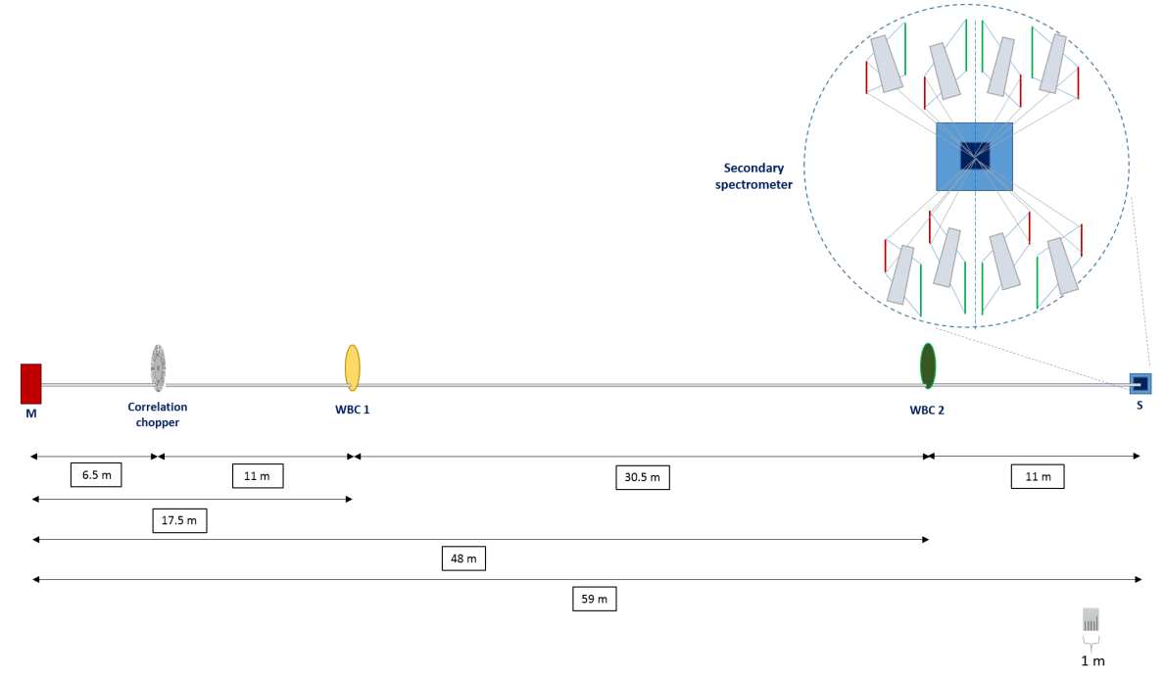
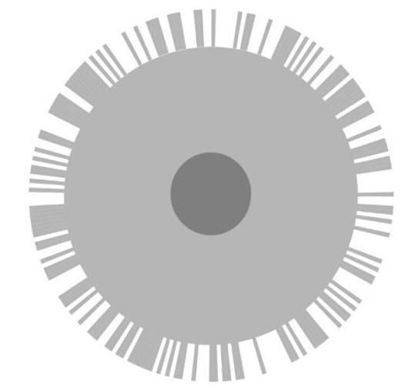
Advantages of using statistical chopper in the VESPA configuration
We propose the use of the correlation method instead of the much lower intensity transmission WFM multichopper system proposed for VESPA with the goal of focusing on a broad neutron energy transfer range including high energies up to 500 meV.
Compared to the large cuts in the ESS long pulse intensity by a conventional high resolution pulse shaping chopper, with a correlation chopper 50 % of the time integrated hot neutron flux will be made use of.
By replacing the WFM chopper system of VESPA by the statistical chopper operating at reduced speed of 12000 – 15000 RPM (instead of 18000 RPM) and 2-3 frame overlap choppers, at the same resolution of 1 % of incoming neutron energy of VESPA we obtain up to 90 times more neutrons in the measured spectra at (high energy & resolution).

Slide 3
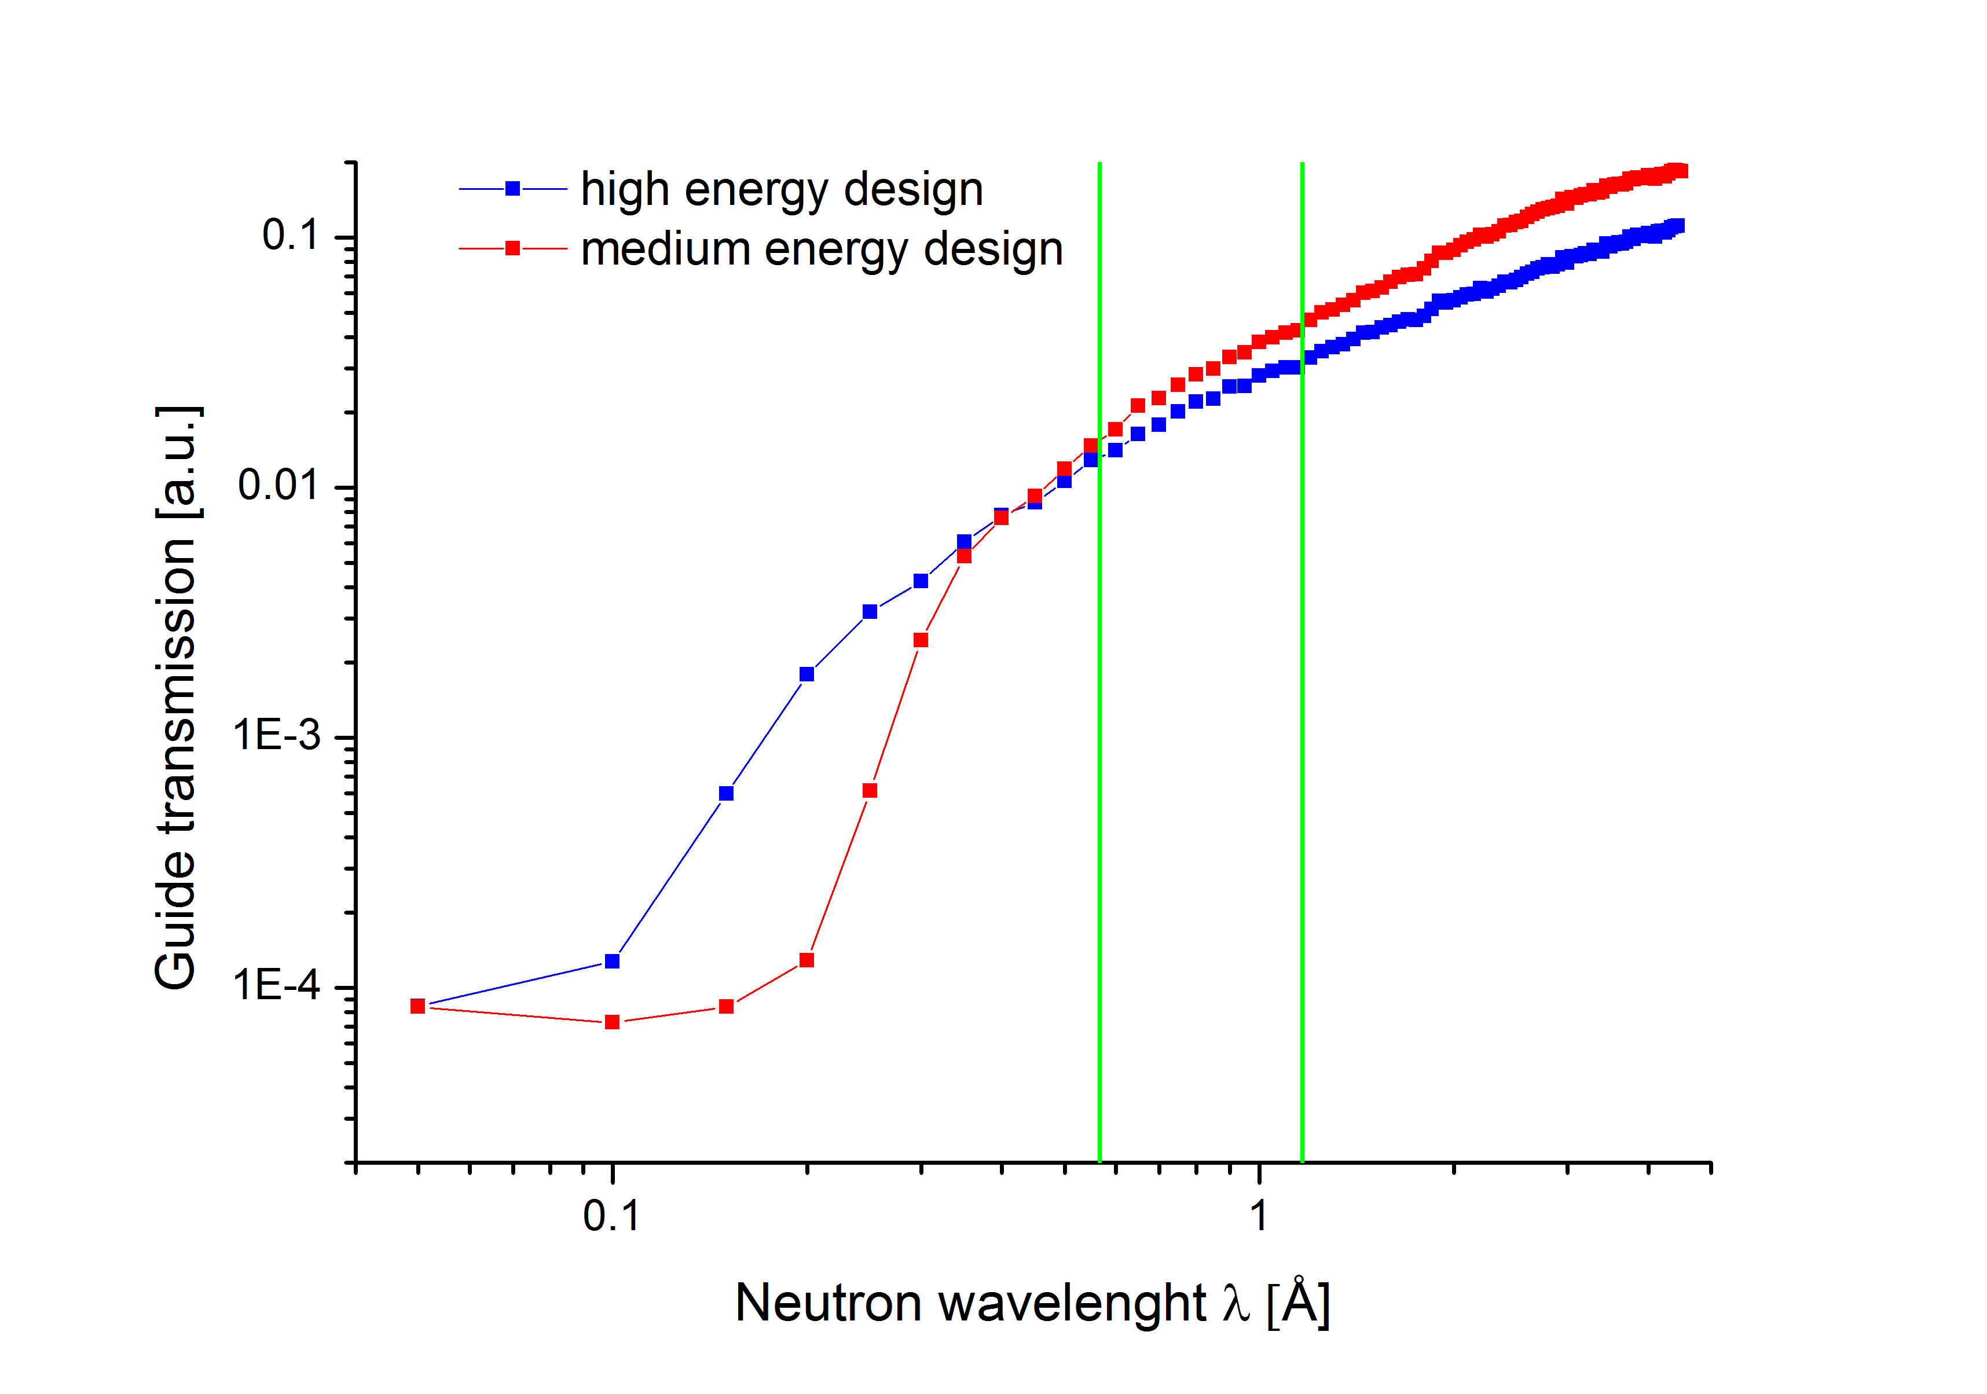
Neutron guide for short wavelength neutron transport over large distances:
- divergence limited by supermirror critical angle
- other cut-off effects can be minimized by adapted design at the prize of moderate losses at long
wavelength

Slide 4
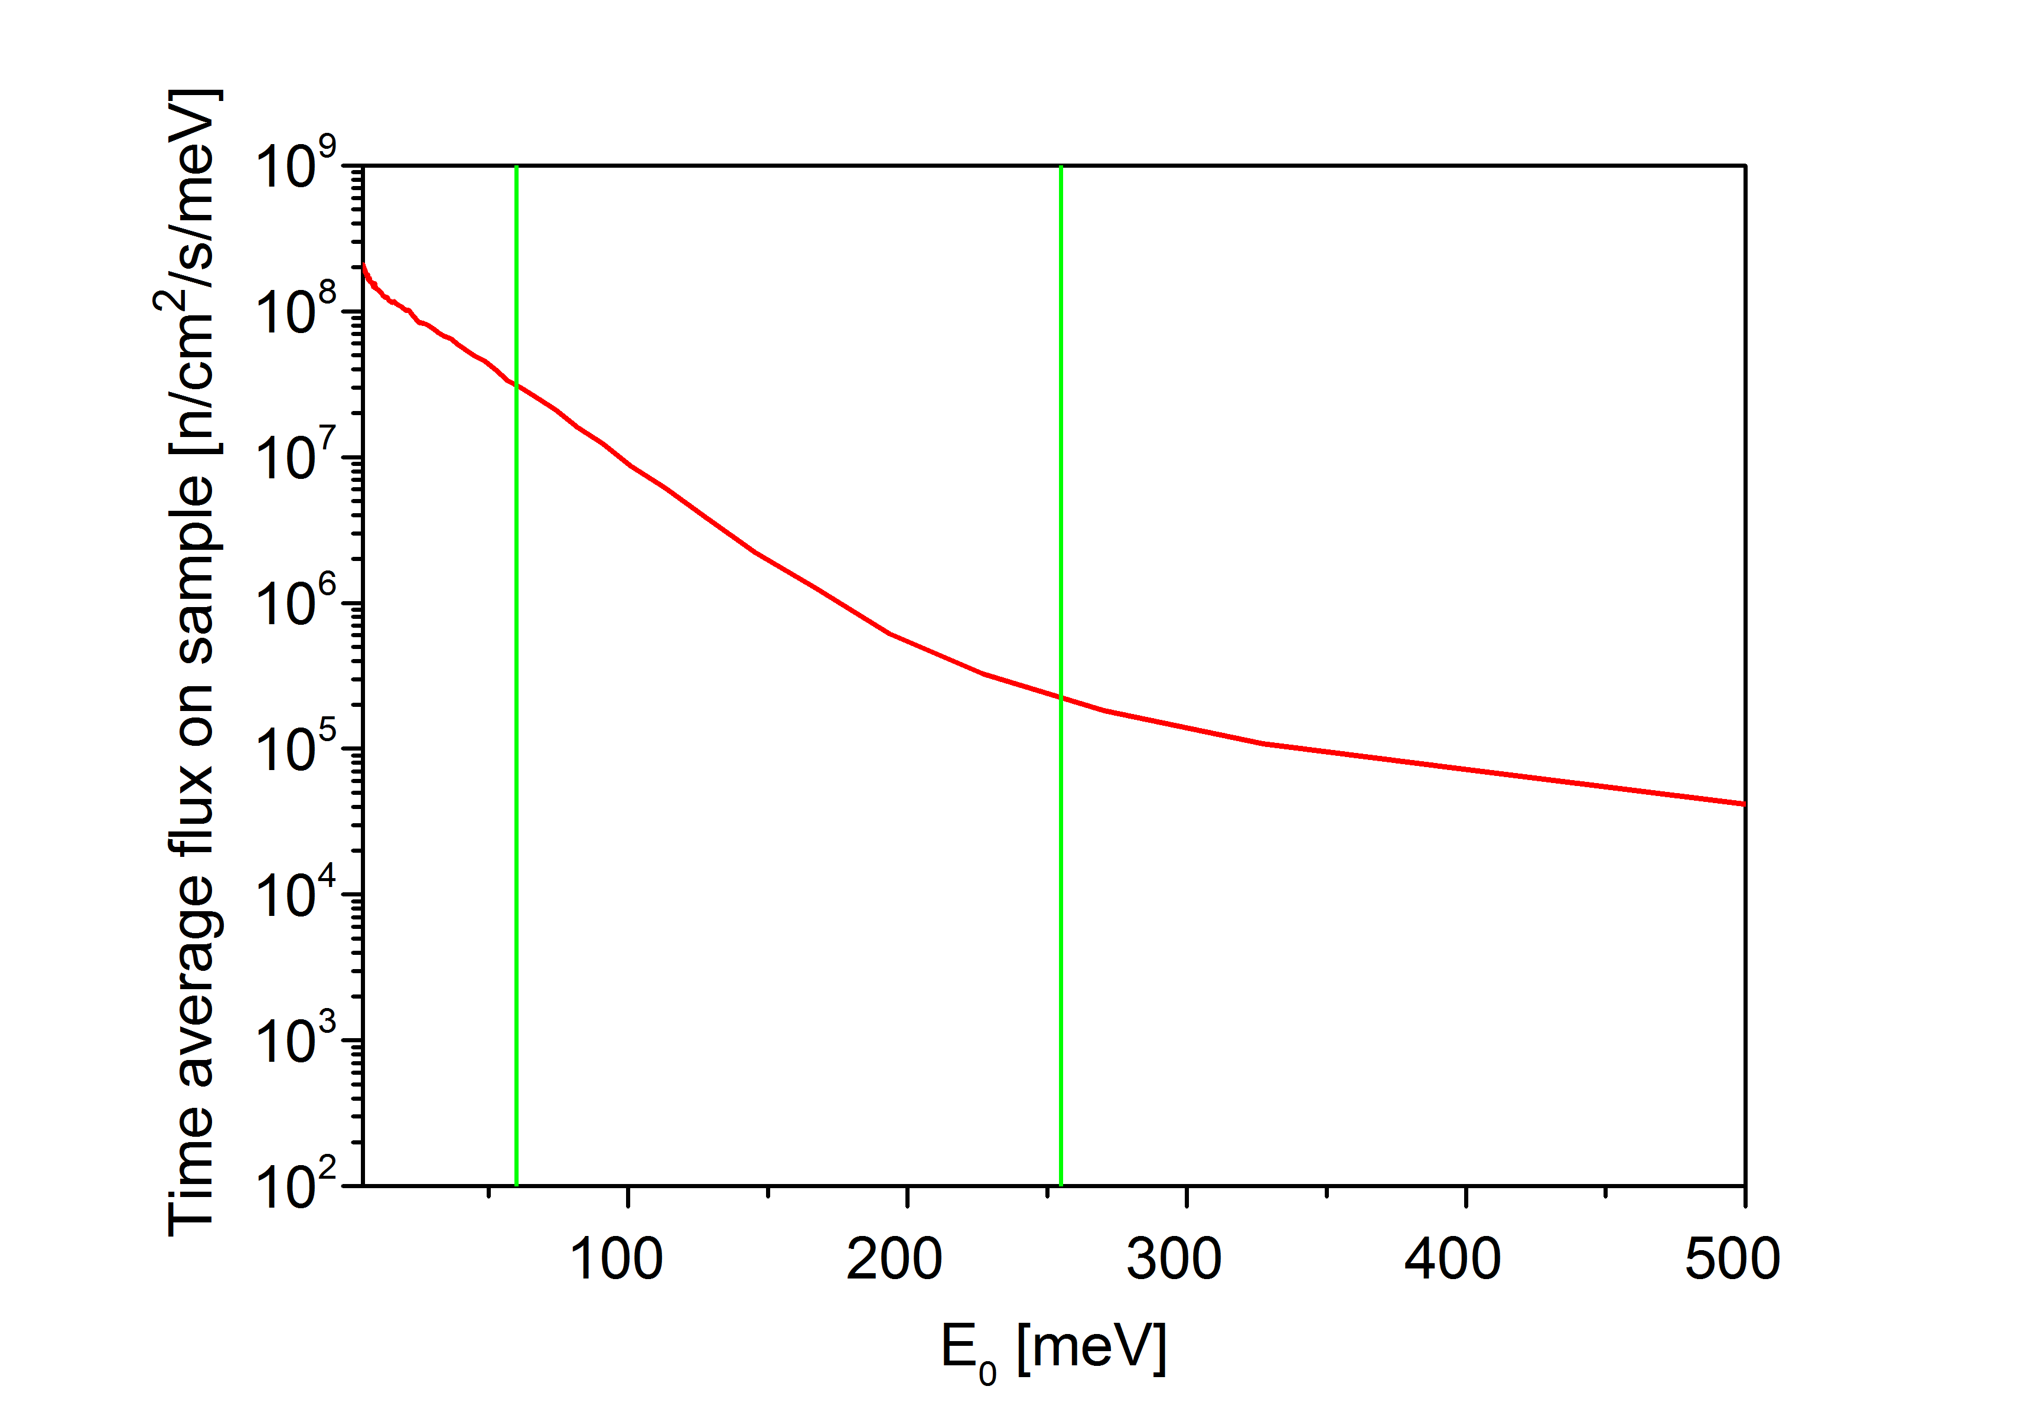
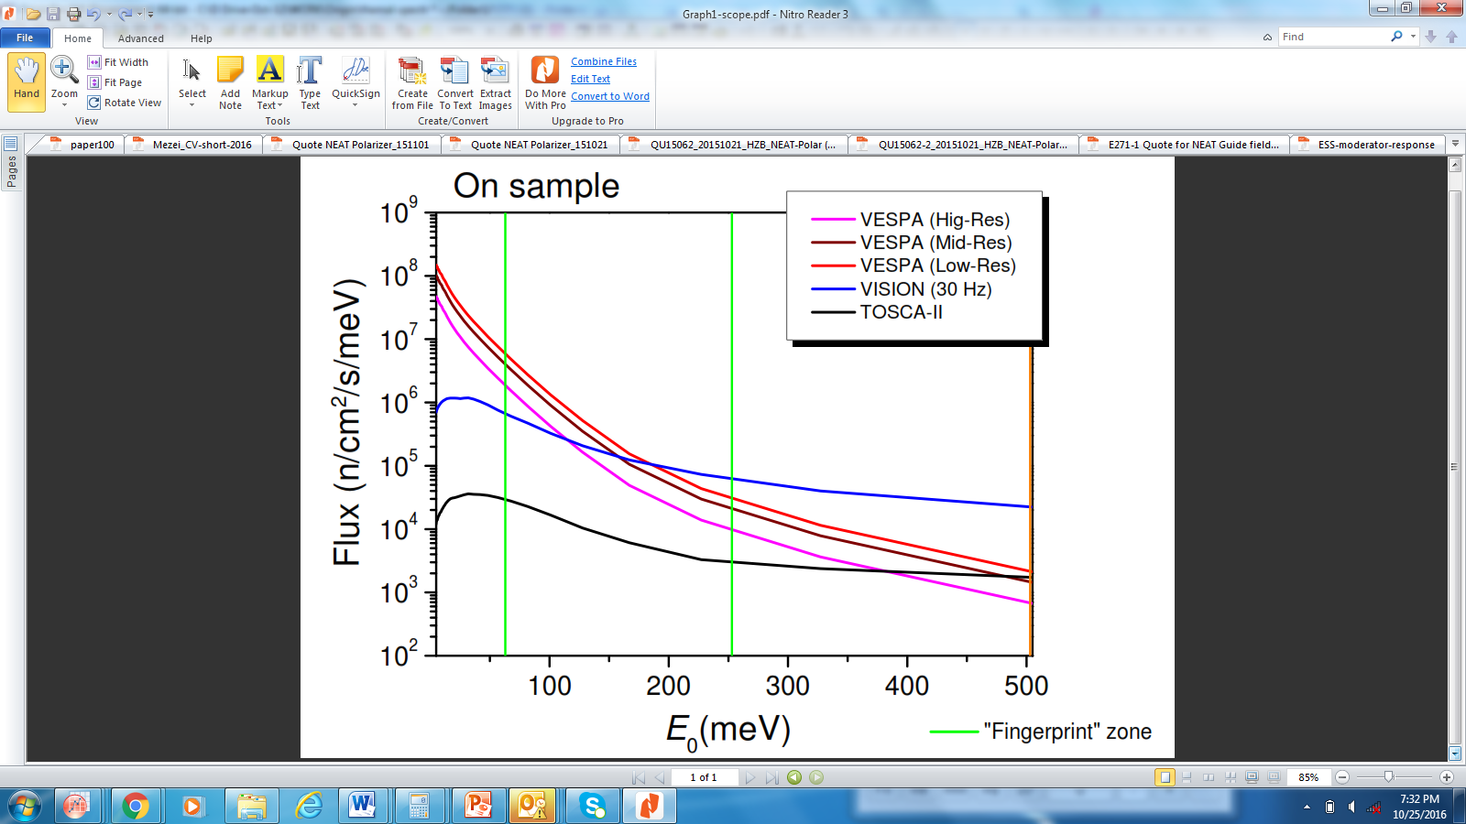
Intensity comparison for correlation spectroscopy high intensity mode vs. “Low-Res”
+ free lunch: better resolution by statistical chopper φ =700mm, 15000 RPM, 3 cm beam width
x1.6 @ 500 meV, x4.5 @ 60 meV, x16 @ 5 meV,

Slide 5
Intensity comparison for correlation spectroscopy high intensity mode vs. “Low-Res”
+ free lunch: better resolution by statistical chopper φ =700mm, 15000 RPM, 3 cm beam width
x1.6 @ 500 meV, x4.5 @ 60 meV, x16 @ 5 meV,
“Hig-Res”: resolution is lower than in the CS high intensity mode for E_{o} < 135 meV
nominal resolution not achieved > 90 meV

Slide 6
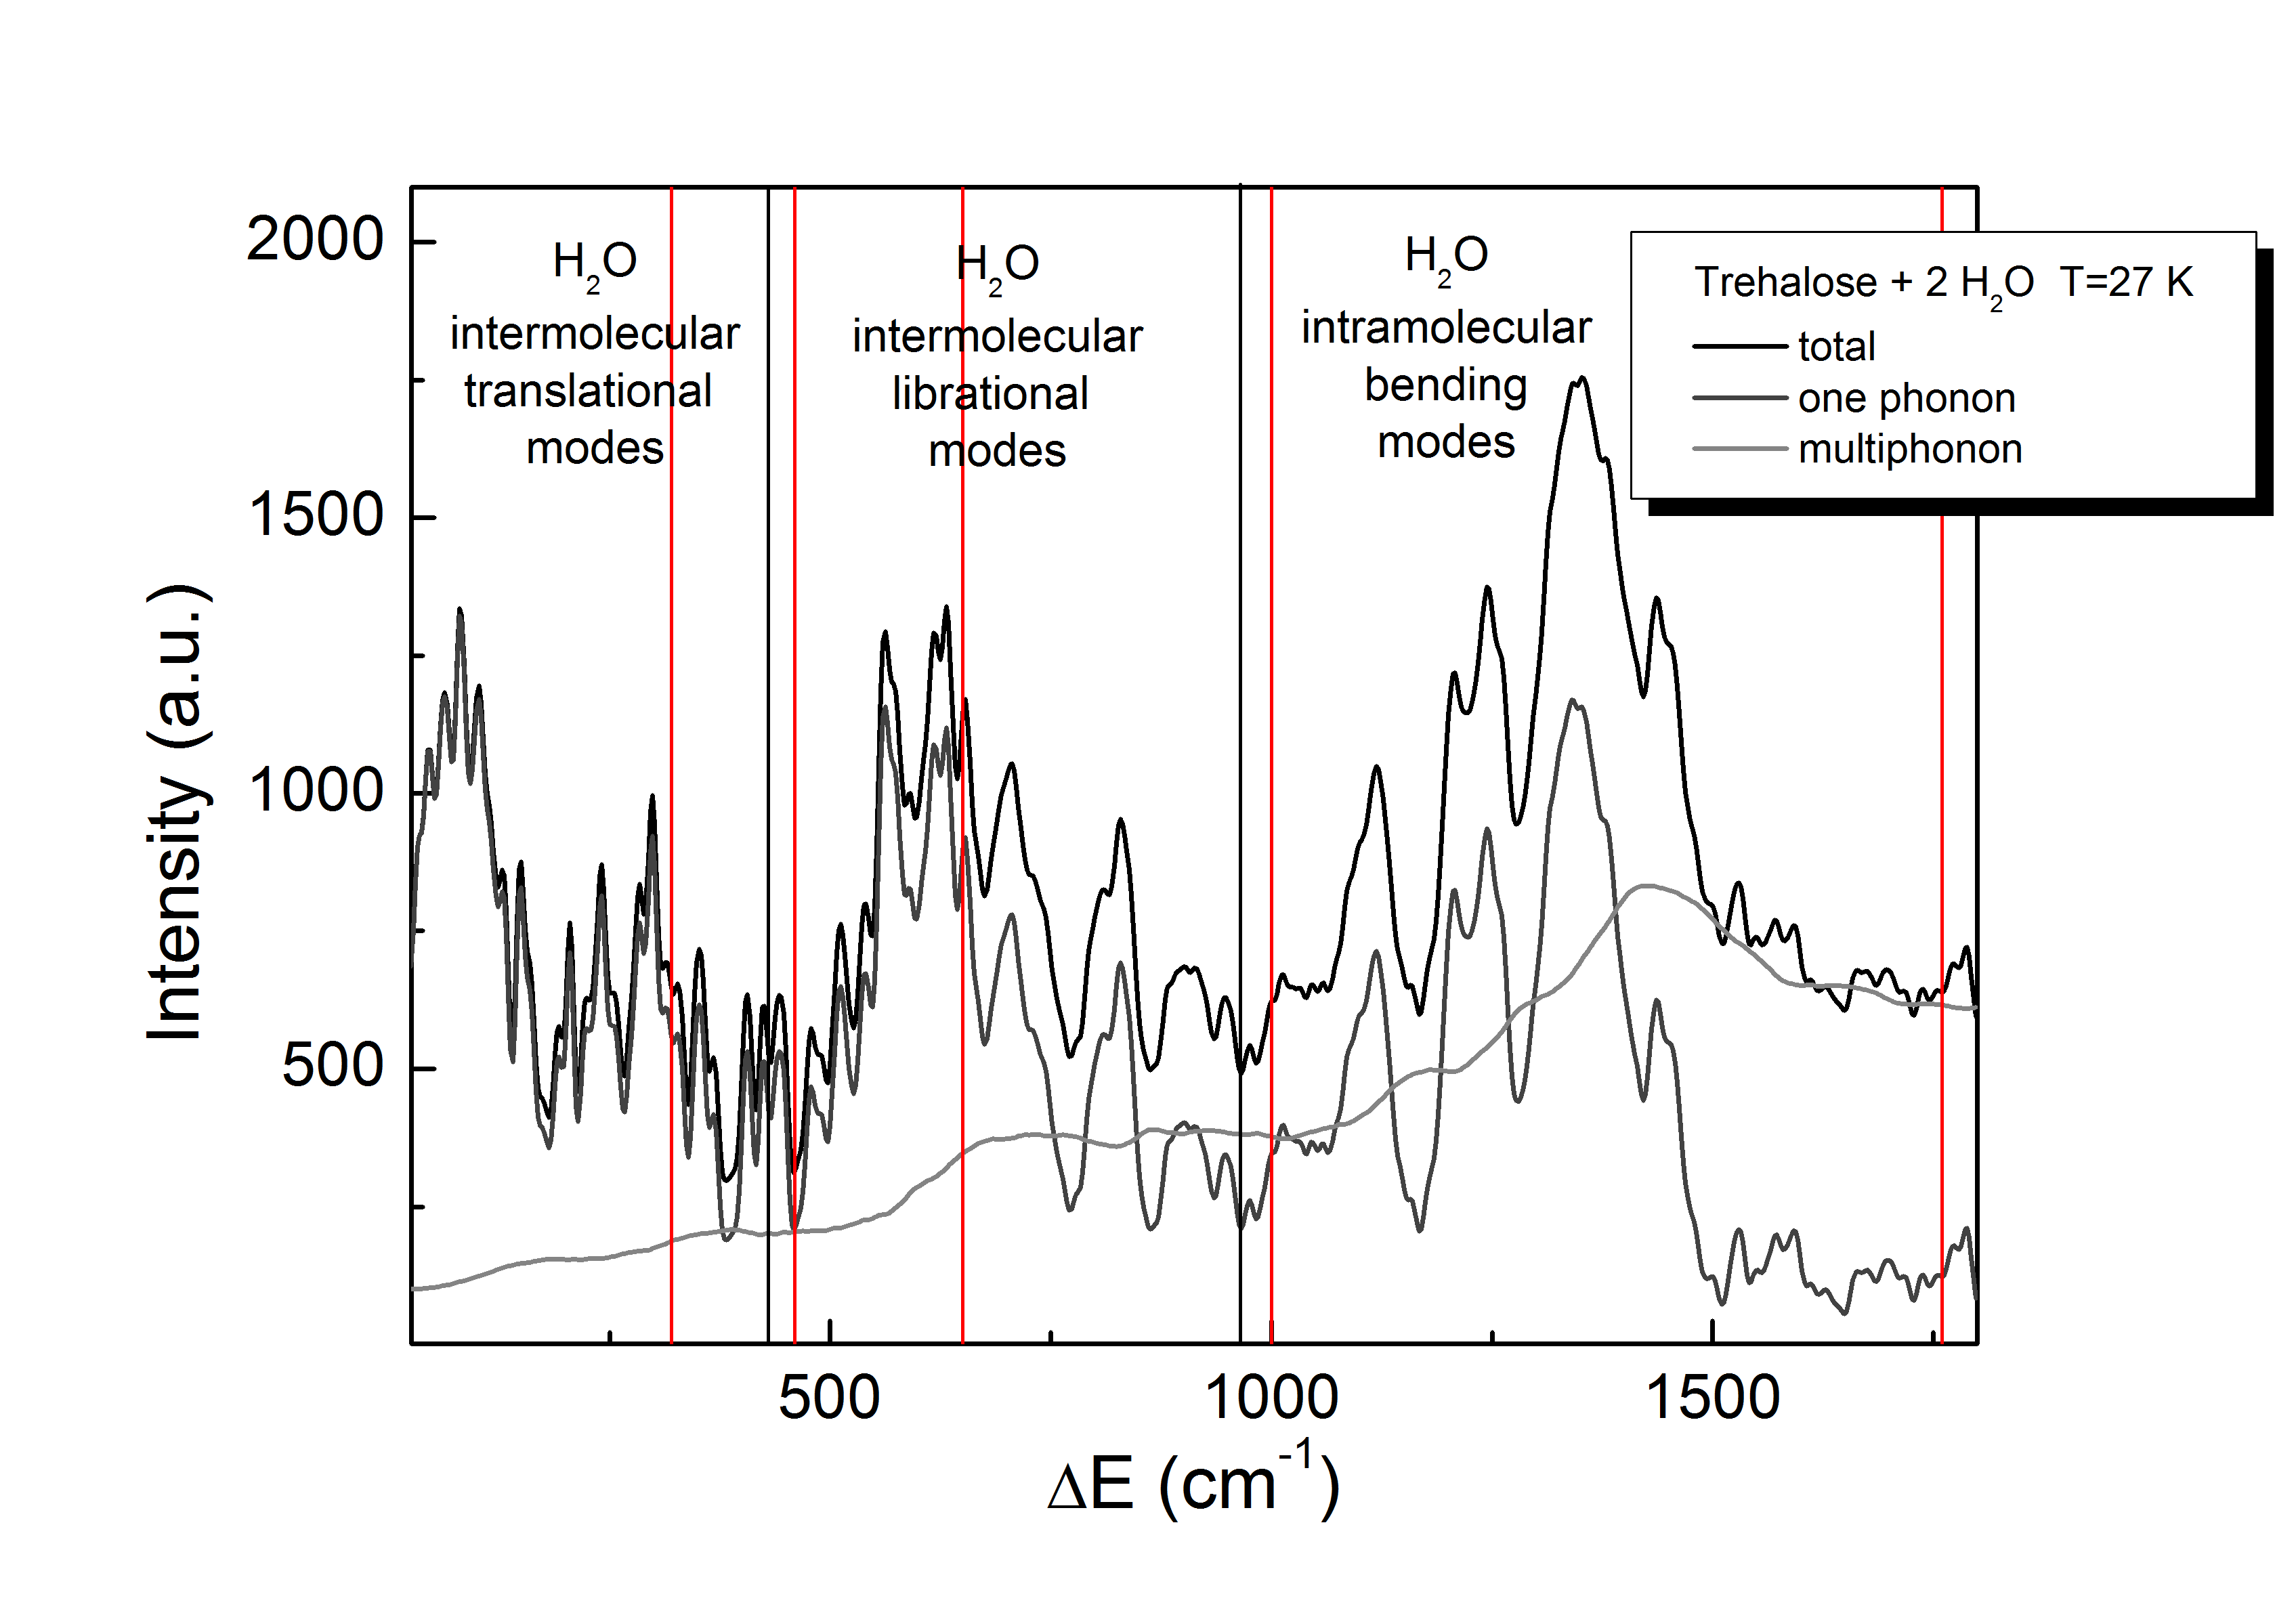
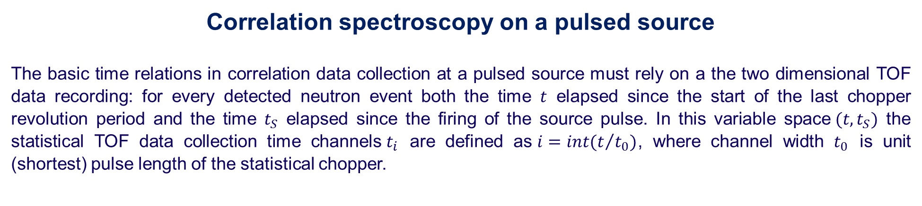
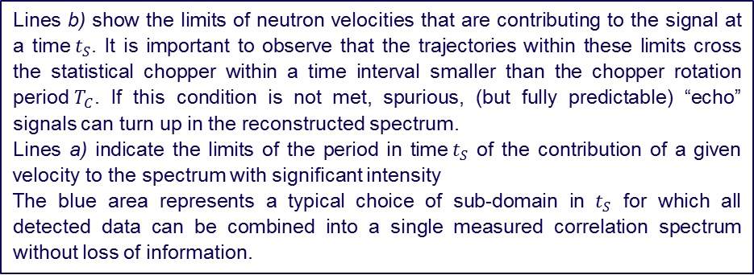
Correlation spectroscopy on a pulsed source
The basic time relations in correlation data collection at a pulsed source must rely on a the two dimensional TOF data recording: for every detected neutron event both the time $t$ elapsed since the start of the last chopper revolution period and the time $t_{S}$ elapsed since the firing of the source pulse. In this variable space$(t, t_{S})$ the statistical TOF data collection time channels$t_{i}$ are defined as$i=int(t/{t_{0})}$, where channel width $t_{0}$ is unit (shortest) pulse length of the statistical chopper.
Lines b) show the limits of neutron velocities that are contributing to the signal at a time$t_{S}$. It is important to observe that the trajectories within these limits cross the statistical chopper within a time interval smaller than the chopper rotation period$T_{C}$. If this condition is not met, spurious, (but fully predictable) “echo” signals can turn up in the reconstructed spectrum.
Lines a) indicate the limits of the period in time${ t}_{S}$ of the contribution of a given velocity to the spectrum with significant intensity
The blue area represents a typical choice of sub-domain in $t_{S}$ for which all detected data can be combined into a single measured correlation spectrum without loss of information.

Slide 7
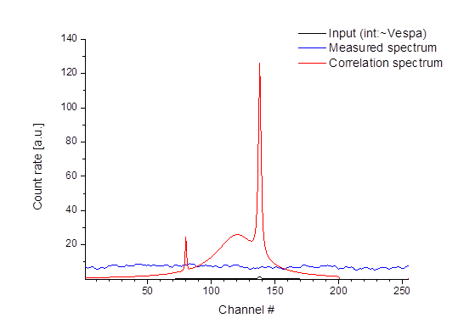
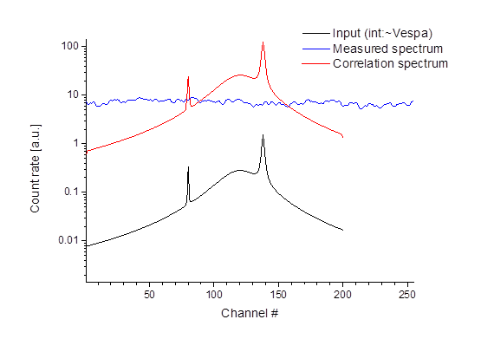
Experiment simulation
The effective intensity gain considering the statistical counting error (assuming zero external, unmodulated background) will be different for different structures in the spectrum and can be roughly estimated as [average intensity gain]*[integrated intensity of structure]/[integrated intensity of all structures collected at once].
Figure shows the intensity gain in data collection rate (i.e. effective beam intensity) due to noise propagation when adding time channels in statistical chopper based correlation spectroscopy using the n = 255 units sequence. The line follows the approximate phenomeno-logical formula in the range of the added channel numbers shown.
The “Input” curve is shown with infinite resolution and with the intensity of the neutrons detected at WFM multichopper VESPA alternative at 400 – 500 meV and comparable high resolution.
Blue curve: actually observed modulated spectrum within the 5 ms period of the chopper rotation (starting at ~ 4 ms after the source pulse)
Red curve: raw output for the direct TOF spectrum from correlation calculations made on the blue curve in the data reconstruction processing.
The independently collected data are the points of the modulated spectrum (blue) and the points in the reconstructed direct spectrum (red) are statistically not independent combinations of the measured points with different coefficients. This can be made unique use of for freely trading resolution for intensity in the post-experiment al data analysis.
The broad peak is 80 % of the total integrated spectrum, its intensity gain in terms counting time needed for a given precision is a factor ~70 (the integrated intensity gain is a factor of 90), the larger sharp peak is 19 % of the integral, so the gain is a factor ~15 and for the small sharp peak with a weight of 0.8 % the gain is a factor of ~ 0.7.

Slide 8
Experiment simulations
Another way to increase intensity at the expense of resolution is to change the widths of the beam window at the chopper without changing the chopper disc or speed. The chopper transmission in time average itself is 50% independently of slit width and chopper speed, but the intensity depends, as in the conventional case, on the area of the beam window at the chopper.
Figure shows the intensity gain options.
Wide slit: extension of the beam area from 1x6 cm² to 3x6 cm² the
Same, lower resolution: intensity gains that can be obtained by data processing after the experiment, depending on the needs of different features in the spectrum. The curves with dots have been obtained by adding 2 neighboring TOF channels
New opportunities at higher energies: with a CORELLI type chopper operating at a more conservative speed of 15000 RPM we could achieve 0.65 % energy resolution at E₀ = 500 meV. The higher intensity and resolution capability of the statistical chopper will also allow VESPA to extend its operational range above 1 eV. The energy resolution capability will be 1 % at E₀ = 1.2 eV at 15000 RPM (and 1 cm beam window width). More importantly, the correlation method allows disc chopper spectroscopy to work with poorly absorbing chopper discs. With 50 % of the beam transmitted and the statistical noise being determined by the total scattering intensity, even with 10% transparent discs (readily achievable with common ¹⁰B loading for E₀ < 3 eV) the contribution of this unmodulated background to the data collection noise would be essentially negligible.
Order(s) of magnitude enhanced opportunities for studying small samples: cf. key strengths of correlation spectroscopy :
a) The full intensity gain applies to the relatively stronger structures of the sample spectrum!
b) The full intensity gain benefits the signal to noise ratio with respect of the general background noise!

Slide 9
Advantages of using statistical chopper in the VESPA configuration
Higher intensity and resolution in the “fingerprint zone”: same science more efficiently
Trading resolution vs. intensity after the experiment(!)
Lower sensitivity on background: small samples
Simpler design, substantial savings (to use for other options)
Extends well accessible energy range to ~2 eV

