Slide 1
Time-of-flight
Reciprocal space
EXplorer
A bispectral chopper spectrometer for
magnetism, materials science and soft matter
Jörg Voigt
Lund, 28.10.2016
Notes:
explain history
STAP meeting
Recommendations: thermal, magnetism
but bispectral essential, exciting possibilities for other research fields

Slide 2
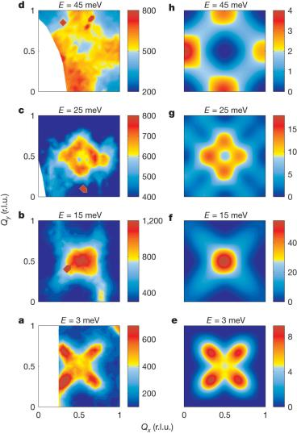
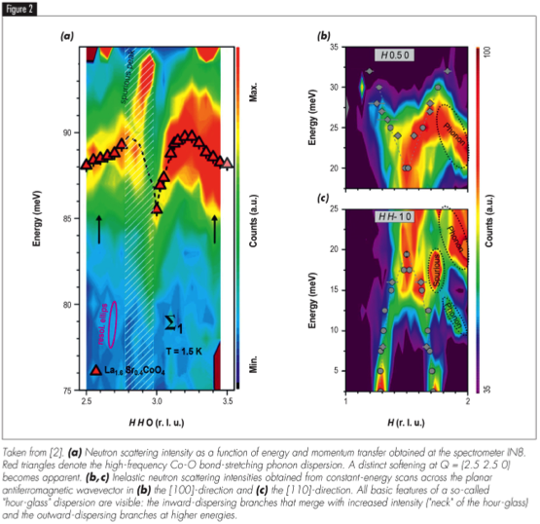
Order at high temperature ➔High energy excitations
Interplay lattice, charge, spin ➔ Distinguish excitations
Resolving gaps and zone boundary behavior
Line shapes
Identify spurions
35
30
90
25
Thermal energy range (beyond 100 meV)
indispensable!
20
85
25
20
80
15
10
Hour glass magnetic spectrum in La_{2-x}Sr_{x}CoO₄.
ILL Science highlight
Y. Drees et al.,
Nat. Comm. 4:2449 | DOI: 10.1038/ncomms3449 |
5
75
Notes:
spurions, shortcomings from TAS measurements Bild aus Proposal nehmen

Slide 3
Order at high temperature ➔High energy excitations
Interplay lattice, charge, spin ➔ Distinguish excitations
Resolving gaps and zone boundary behavior
Line shapes
Identify spurions
Thermal energy range (beyond 100 meV)
indispensable!
Hour glass magnetic spectrum in La_{2-x}Sr_{x}CoO₄.
A. T. Boothroyd et al. , Nature 471, 341-344
Notes:
spurions, shortcomings from TAS measurements Bild aus Proposal nehmen

Slide 4
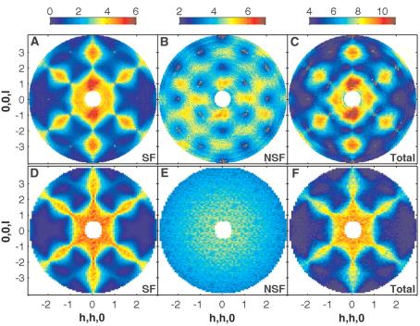
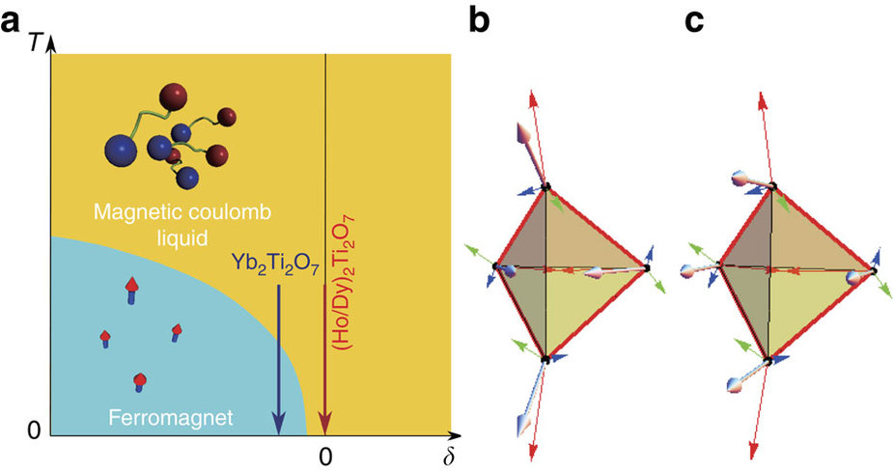
Frustrated magnets: Condensed matter cosmology
Beyond the static picture
Magnetic monopoles
Higgs Mechanism
TREX: High energy resolution
+
Polarization analysis
T. Fennel et al., Science 326, 415-417
L. J. Chang et al., Nat. Comm., 3, 992

Slide 5
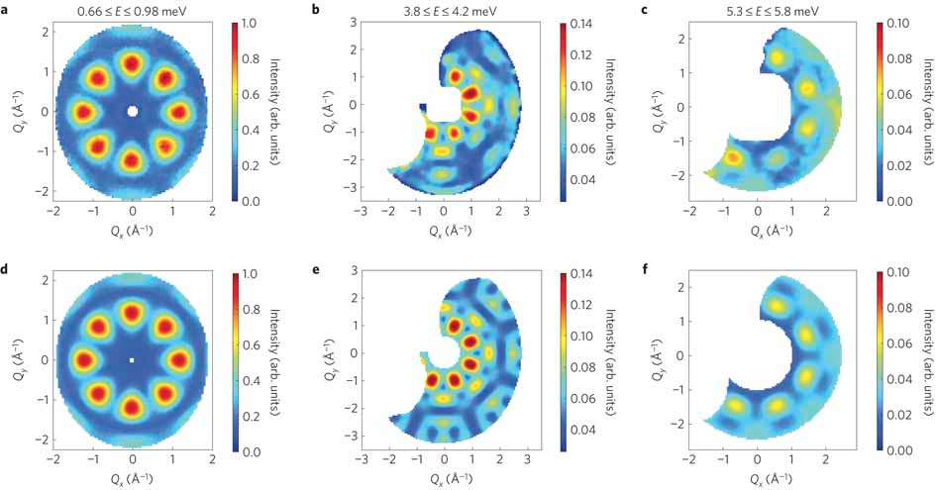
Molecular magnets
Quantum spin dynamics from full S(Q,ω)

Slide 6
Functional Materials: Multiferroics
Very good energy resolution
Good Q resolution
Test ground for theory (line shape …)
IN5: Ba₃NbFe₃Si₂O₁₄
Loire et al., PRL 106, 207201 (2011)

Slide 7
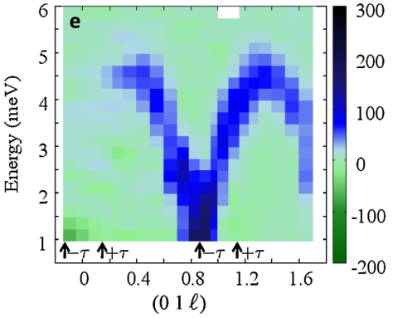
Functional Materials: Multiferroics
High Intensity, High Resolution
&
Polarization Analysis
Very good energy resolution
Good Q resolution
Polarization
IN5: Ba₃NbFe₃Si₂O₁₄
Loire et al., PRL 106, 207201 (2011)
PA: now TAS; future: T-REX

Slide 8
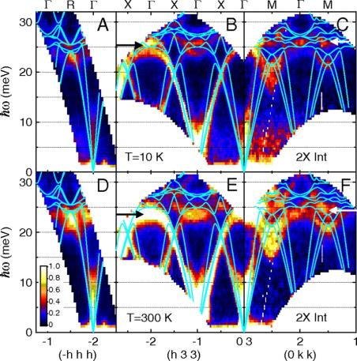
Energy Materials
Thermoelectrics: Electron-Phonon coupling: Line shape at high energy
Ion Transport: QENS at large momentum transfer + PA (H, Na, Li, Cl, N, …)
Olivier Delaire et al. PNAS 2011;108:4725-4730
W. Paulus et al, JACS 130, (2008), 16080
Thermal energies to tens of µeV
+
large Q
From lattice dynamics
to diffusive motion
Notes:
The Tof technique is a well established and robust method in use for the study of excitations and motion correlations in condensed matter.

Slide 9
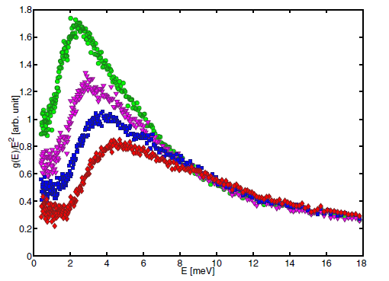
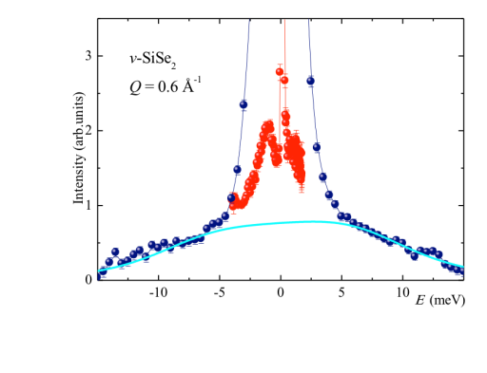
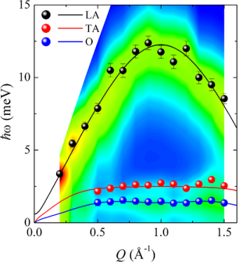
Disordered Materials
Vibrational Density of States
The reduced DoS, g(ω)/ω², shares universal vibrational features (e.g. boson peak), in systems spanning from hard glasses to proteins and DNA.
Wide ω- and Q-range
extrapolation towards the incoherent approximation
High “flux”
evolution as a function of pressure and temperature
Propagation of short-wavelength, collective coherent excitations
Requires a combination of thermal incident energies with small momentum transfers.
A polychromatic beam (RRM), with correspondingly variable resolution, has recently proven extremely useful to fully map and interpret the dispersion curves.

Slide 10
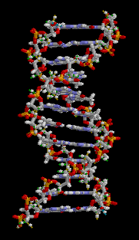
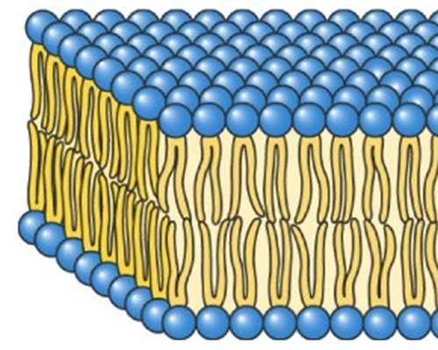
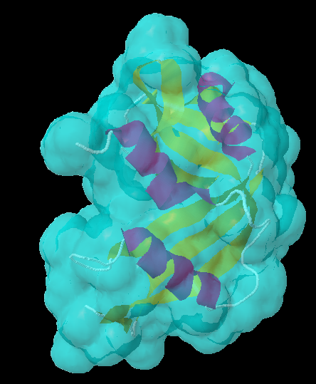
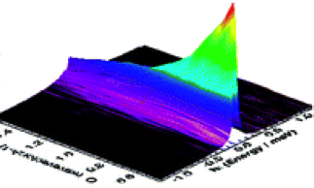
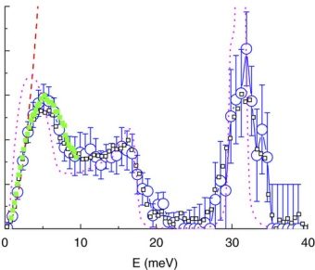
Soft Matter & Life Science
Proteins, DNA, RNA and lipid membranes are central to cellular function.
Their biological functions are governed by their dynamical character, particularly on the picosecond time-scale.
Diffusional and relaxational motions
Widely studied by QENS
T-REX:
  Cold E_{i} and δE down to 20 μeV
  PA
Vibrational collective motions.
…Purely Inelastic Scattering
New topic
Thermal E_{i}
Flux limited

Slide 11
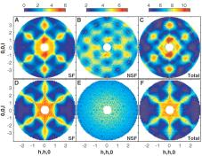
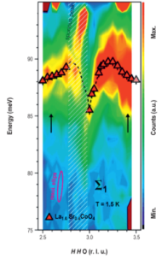
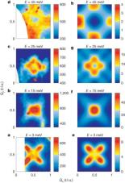

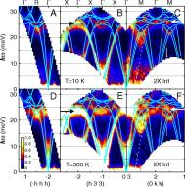
T-REX Application Cloud

Slide 12
Instrument layout
Basic features
Maximized RRM
  Moving energy region of interest
  Fast mapping
Flexible chopper system to adjust resolution + timeframe
Optimized thermal transport
  no line-of-sight
  high brilliance transfer
  low to medium divergence
Polarization
  Cold: combine with extraction
  thermal: magic box
  Wide angle ³He PA
Detector
169.3 m
Sample
166.3 m
λ (Å)
Notes:
----- Meeting Notes (29.01.15 14:19) -----
add box with list of changes

Slide 13
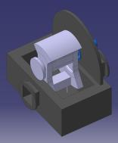
T₀ Chopper: Optimize background, don’t cut thermal
Preliminary design, neutronic calculations needed

Slide 14
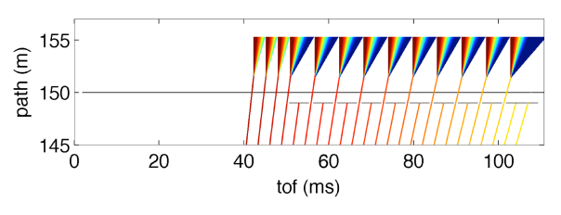
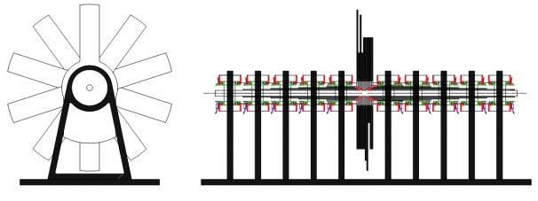
Final wavelength window too small ➔ Fan chopper
Not so Fixed final wavelength window
Block beam 2x(T_{M} – τ_{M})
Fully opaque during τ_{M}
Flexibility: λ_{f} < n λ_{max}
M-chopper
Fan chopper
7cm
60 mm
Frequency: 14 Hz
60cm
14

Slide 15
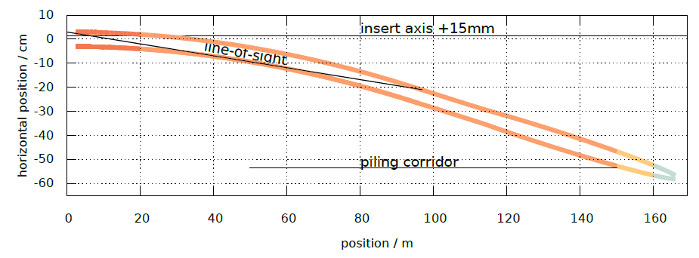
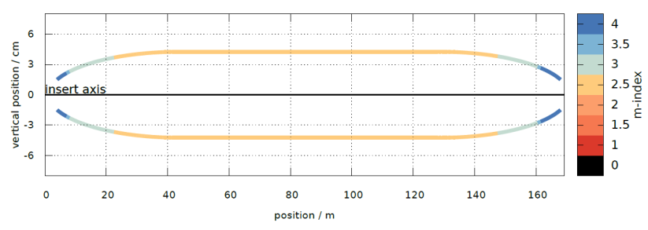
Guide profiles + m-index optimization
From back tracing option
insert axis -17 mm

Slide 16
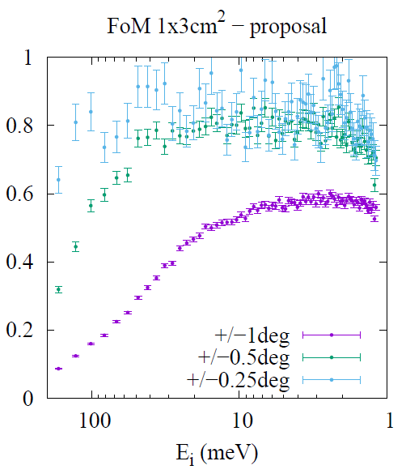
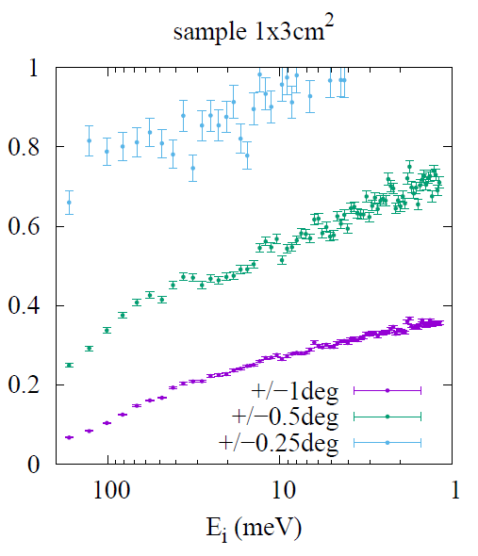
Brilliance transfer
Proposal
Current design top moderator

Slide 17
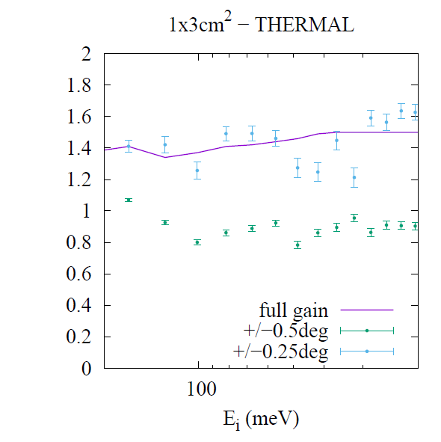
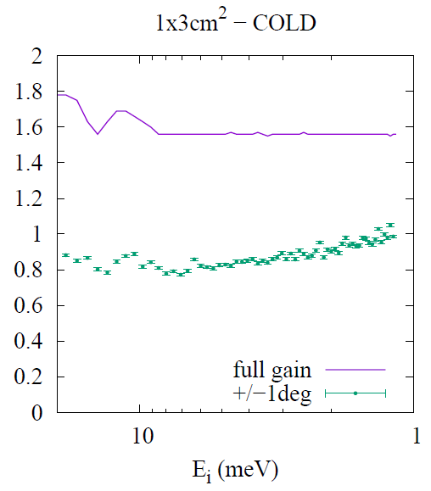
Expected performance
NO NEGATIVE IMPACT ON THE SCIENCE CASE
Brightness
Brightness

Slide 18
Polarisation Concept
Supermirror arrays
Highest FOM
Passive device
E_{i} < 20 meV
No transmission for thermal
³He spin filter cells
Tunable FOM
Continuous initial polarization
Reduced transmission and
high polarization for low energy
Cold neutrons
Thermal neutrons
FeSi solid state SM Analyzer Array
³He at 22 bar cm and 80% P_{He}
CoTi SM Analyzer
³He at 15 bar cm and 80% P_{he}
³He at 6.7 bar cm and 80% P_{He}
E. Babcock et al., Jour. Phys. Soc. Jap. S.E., proceedings of QENS/WINS 2012, Nikko Japan

Slide 19
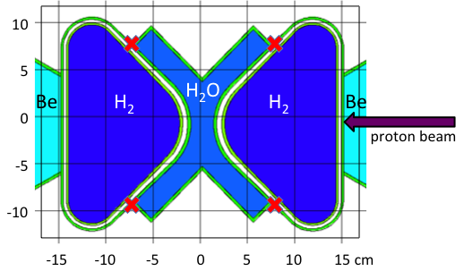
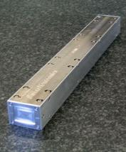
Bender for cold-n extraction + polarizer
2000
5500
6000
shutter
curve
Insert axis
45
optics axis -17mm
60
12
150 μm Si wafer coated with NiTi m=4
Vertical saturation field of 1kGauss
Kinematic mount to switch between thermal (0.7 ÷ 2.4Å) and
cold (2 ÷ 6.5Å)
polarized neutron beams
Removable for thermal spectrum
Expected cost: 85 k€
2 x including Polarizer
SWISS NEUTRONICS DESIGN

Slide 20
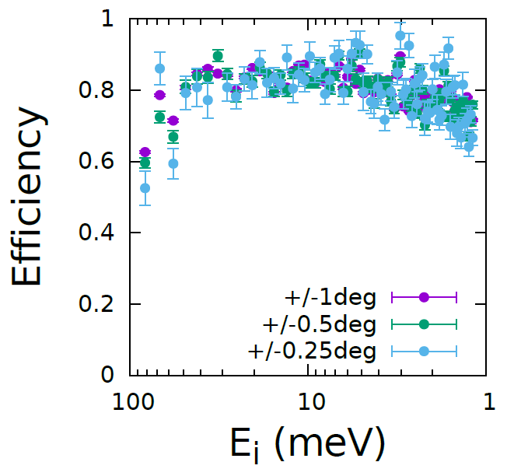
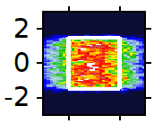
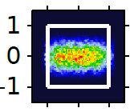
Expected cold-n extraction performance
2D POS
2Å
2D DIV

Slide 21
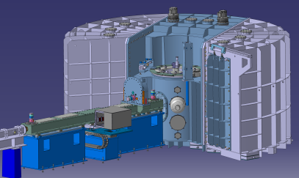
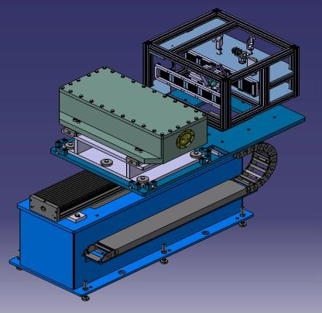
Polarization and wide angle analysis
On-beam polarizer
Analysis:
magic PASTIS magnetic system
SEOP for thermal neutrons
  Continuously pumped
Ideal transmission for cold neutrons
Adiabatic spin rotation for thermal neutrons
Homogeneous field configuration
Offline gas polarization
Variable pressure
Notes:
----- Meeting Notes (29.01.15 14:19) -----
Add adiabatic spin rotation

Slide 22
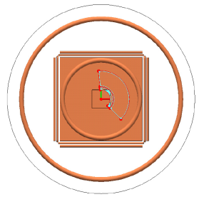
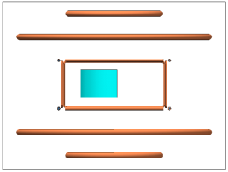
Wide angle polarization analysis
Analysis:
magic PASTIS magnetic system
88.5°
85.5°
40°
Homogeneous field configuration
Offline gas polarization
Variable pressure
Notes:
----- Meeting Notes (29.01.15 14:19) -----
Add adiabatic spin rotation

Slide 23
T-REX Application Cloud
Going beyond needs
Bispectral + polychromatic
Polarization Analysis
Optimized background conditions

Slide 24
Thank you for the attention

Slide 25


Changes since the proposal
Optimization for top moderator (3 cm height)
All choppers outside the bunker
Matching the concept to the planned facility
Shutter
(Polarization)
Bender
BWC
T0C
PSC
FANC
MC
Exp cave
1
2
LoS
³He cell
monolith
bunker
Hall 2
Guide Hall
Hall 3
curved guide R=19.5 km
-0.2°
6 m
28 m
50 m
90 m
110 m
155 m

Slide 26
Polarization Analysis PA for Soft Matter,
Life Sciences or Energy Research on Materials with Light Elements
Polarization Analysis & Deuteration → direct coherent & incoherent partial scattering functions S_{inc/coh}(Q,t) for direct comparison of QUENS data to MD simulation - nowhere possible at the moment! -
C. Gerstl et al.,
Macromolecules 45,
(2012), 7293−7303
D Bhowmik et al.,
Macromolecules 47, (2014), 304−315

Slide 27

















Acknowledgements
Thomas Brückel
Nicolo
Violini
Andreas Wischnewski
Stefano Pasini
Sven Janaschke
Margarita Russina
Pascale P. Deen
Katharina
Rolfs
Kim Lefmann
Technische Universität München
Wiebke Lohstroh
Luca
Silvi
Giovanna Simeoni
Anette Vickery
Linda Udby

Slide 28
Concentrating on an energy transfer ROI
Notes:
The Tof technique is a well established and robust method in use for the study of excitations and motion correlations in condensed matter.

Slide 29
Flexible chopper system
Chopper windows + polychromatic illumination: Large optimized dynamic range
Chopper frequency to control overall resolution
 | φ_{M} = 2.5º | φ_{M} = 4.3º
φ_{p} = 22º | λ_{f}/λ_{i} ≈ 1, HR elastic | λ_{f}/λ_{i} ≈ 1.4, energy loss
φ_{p} = 36º | λ_{f}/λ_{i} ≈ 0.7, energy gain | λ_{f}/λ_{i} ≈ 1, HF elastic
Variable initial wavelength
Fixed final wavelength window

Slide 30
Bandwidth choppers: Distinct band, max. # pulses
P,M choppers define extraction time
Reduced intensity of outer pulses
Less severe for larger distance
Finite distance of P chopper discs
-> P bandwidth ≈ 30Å
Clean spectrum up to 90 Å

Slide 31
Bandwidth choppers: Distinct bands, max. # pulses
P,M choppers define extraction time
Reduced intensity of outer pulses
Less severe for larger distance
Finite distance of P chopper discs
-> P bandwidth ≈ 30Å
Clean spectrum up to 90 Å

Slide 32
INS with chopper spectrometers @ESS
Multiple Energy

Slide 33
Energy selection
Only one common pulse
Same wavelength step δλ assured by frequency ratio
Accept pulses from fixed origin
  Transmission independent from λ
L_{M}= 165 m
L_{P}= 110 m
Notes:
----- Meeting Notes (29.01.15 14:19) -----
include legend

Slide 34
Detector specifications
Detection efficiency > 50 % for λ = 1Å
Gamma rejection < 10⁻⁶
Area: 40 m²
Position resolution:
  25 mm x 25 mm tangential to cylinder surface
  30 mm radial @ λ = 1 Å,
  10 mm radial @ λ = 5 Å
Vacuum compatibility
Cost < 10 M€

Slide 35
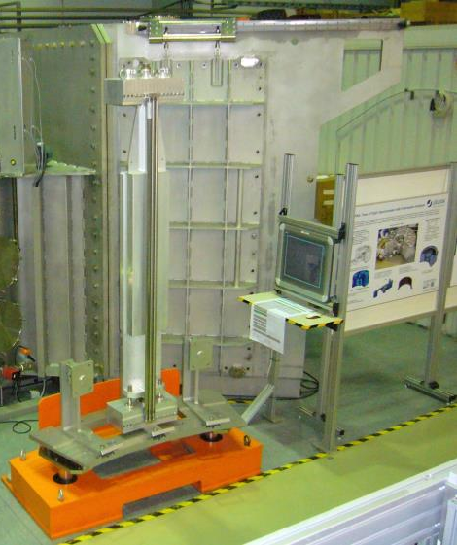
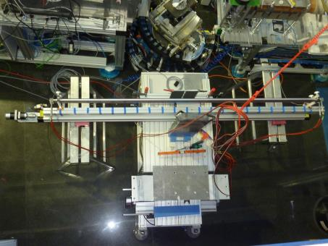
³He Tubes for TOPAS

