Slide 1
Target Imaging Systems
Cyrille Thomas
www.europeanspallationsource.se
2 October 2016

Slide 2
Layout
Large Collaboration
Introduction to Target Imaging
Optics Design
Luminescent Coating Development
Early Results
Planning

Slide 3
Large Collaboration
Oslo University:
Håvard Gjersdal, Ole Rohne, Martin Jaekel, Erik Adli
ESS:
Cyrille Thomas, Thomas Shea
Monika Hartl, Yong Joong Lee
Collaboration, Coordination
HV:
Shrikant Joshi
Produce Samples for Qualification
Establish and Deliver Industrial Process
Coating of the Target, PBW, DumpL
Imaging System
Design
Production
Luminescent Material Coating Development
Qualify Material
Industrial Coating Process

Slide 4
Large Collaboration
Luminescent Coating Development
ESS BI: project lead, planning, measurement and characterisation, X-ray, neutron, photo-luminescence, vacuum, thermal
ESS Target Division and NSS: Material scientists: advise, environment and material lifetime calculations, R&D luminescent materials
Oslo University: support with measurements and characterisation, XRD, low energy proton beam, photo-luminescence, thermal
HV: Develop coating process, prepare samples for research, establish industrialisation of the coating
BNL: BLIP, high energy proton Irradiation test (under RADIATE collaboration)
GSI: heavy ion facility, collaboration with BI physicists, share expertise on luminescence materials
SNS: studies on a high power target, share expertise, common interest of finding a new luminescent material
Stony Brook University: coat SNS target, research and collaboration on SNS coating and new coating materials
Los Alamos National Lab: Post Irradiation Examination: XRD, High energy Proton beam
J-Parc: proposed collaboration, low energy ions facility,

Slide 5
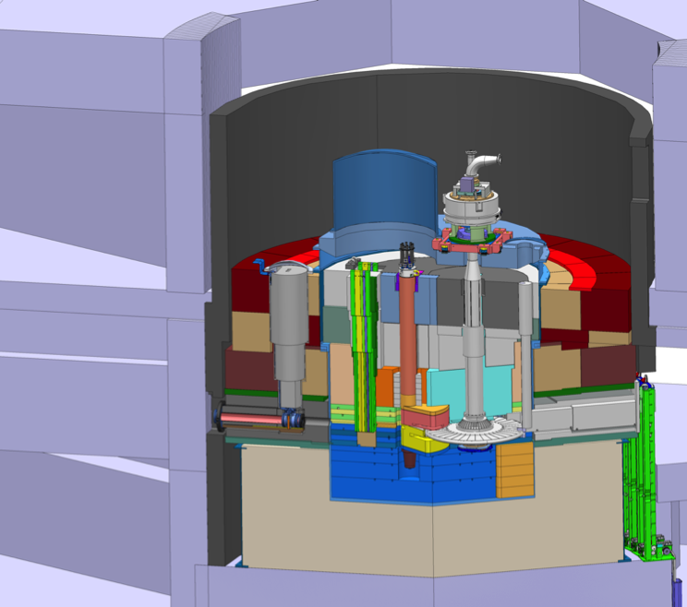
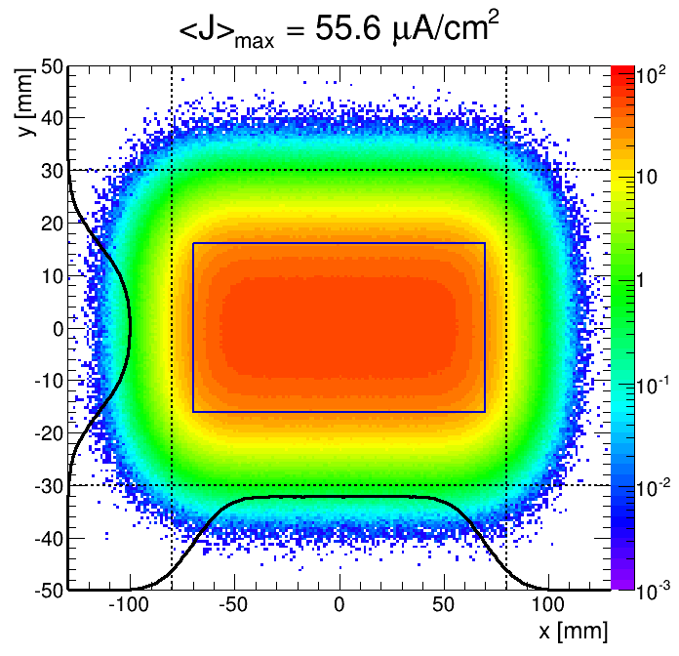
Introduction to Target Imaging
Proton beam window:
luminescent coating, aperture monitors
Proton beam instrum. plug:
wire grid, optics, aperture monitors
Target: luminescent coating
Optics
Readout
Luminescent Coating
Location of Electronics
Proton
beam
Beam Tunning
Machine Protection
Beam Monitoring

Slide 6
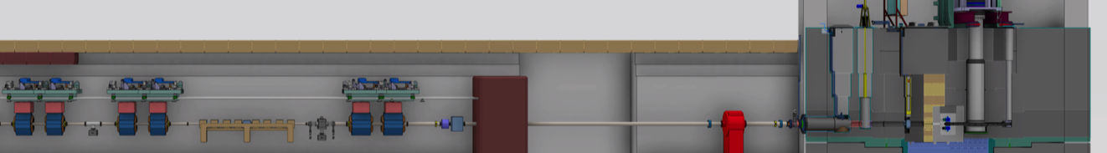
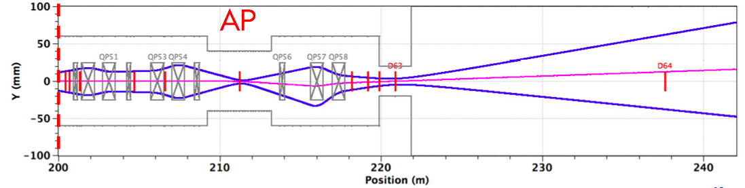
Two Regions, Two Rulebooks
Accelerator region
Target region
@ shield wall
>100 MW/mm² peak
Heine Thomsen (ISA, Aarhus University)
Small beam in large aperture
1 W/m onto components
Hands-on maintenance
Large beam to target/moderator
5 MW onto components
Remote maintenance

Slide 7
Beam Mode on Target and on Dump
Mode | Pulse Length (µs) | Rep. rate | Max Av. Power at 2GeV (kW) | Tuning Dump | Target
Probe Beam | 5 | 0 to 1Hz | 0.6 | ✓ | ✓
Fast tuning | 5 | 14Hz | 8.5 | ✓ | ✓
Slow tuning | 50 | 0 to 1Hz | 6 | ✓ | ✓
Long pulse verification | 2860 | 1/30Hz | 12 | ✓ | ✓
Shielding verification | To defined, 30kW beam power on target, full pulse length |  |  | ✗ | ✓
Production | 2860 | 14Hz | 5000 | ✗ | ✓
Peak current: 62.5mA

Slide 8
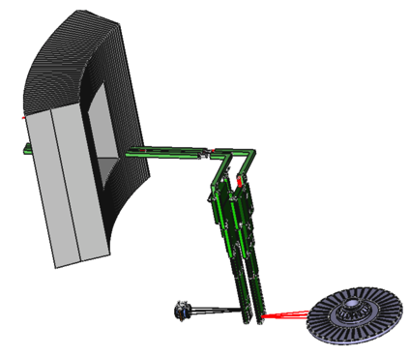
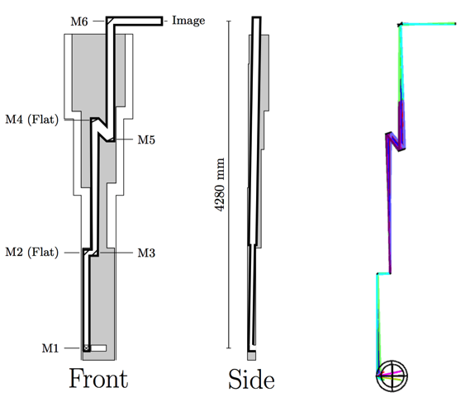
Optics Design
Three optical systems will be built : TW, PWB and dump
Constraints:
radiation environment
Characteristics :
wavelength band specified by luminescent coating, (residual) gas environment, and the illumination source
ca. 13 meter optical path, including many bends (for TW and PWB)
high resolution (1 mm) required
High through-put and transmission
Driven design towards
all-reflective optics
with curved mirrors
challenging when
using all-reflective optics

Slide 9
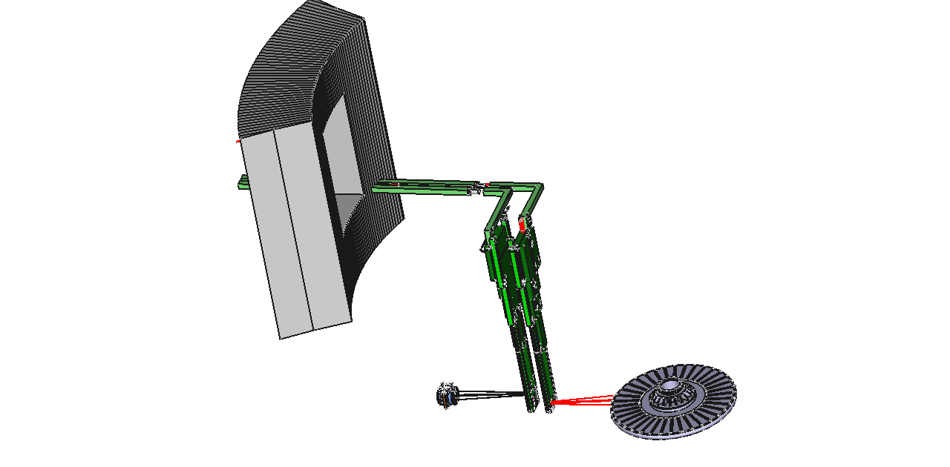
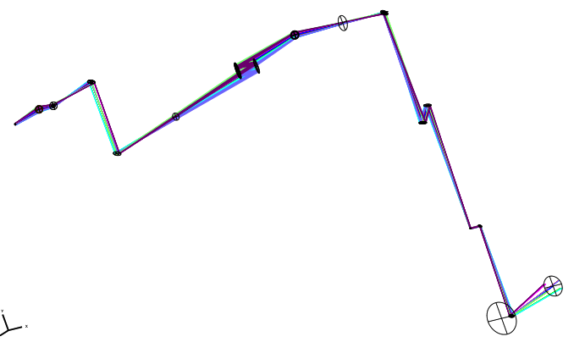
Optics Design
A2TAA
PBIP
PBW
TW
Courtesy Håvard Gjersdal, Oslo

Slide 10
Optics Design
Courtesy Håvard Gjersdal, Oslo

Slide 11
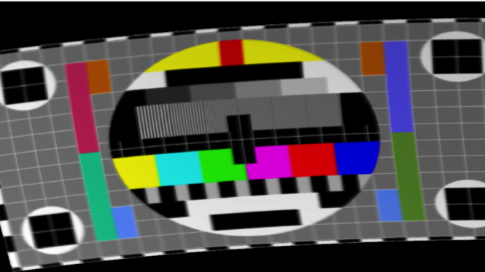
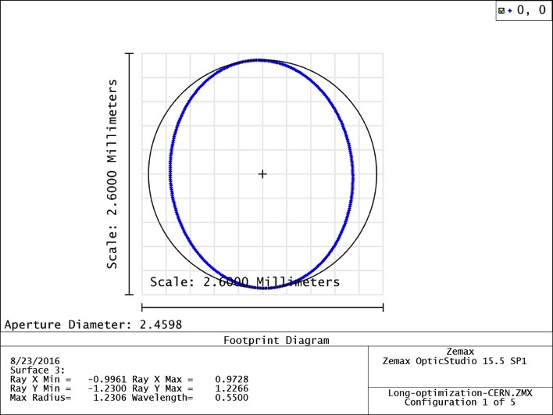
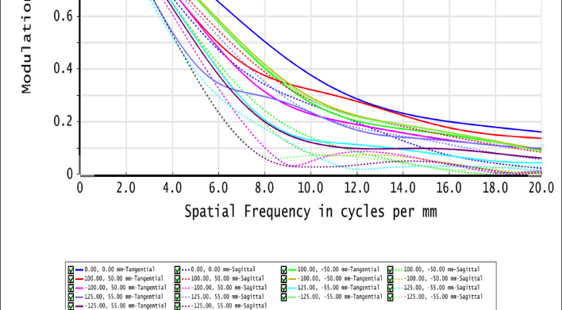
Optics Design
Image quality in the A2TAA room
T≈ 10⁻⁶
NA ≈ 0.001
R ≈ 1.2mm

Slide 12
Luminescent Coating Development
Objectives:
  Deliver a luminescent material as the source for the imaging systems
  Deliver an industrialised coating process (control, reliability, quality assurance, manage schedule)
Requirements:
  Luminescence performance (yield, spectrum, lifetime) under environment constraints (radiation, temperature)
  Lifetime (material properties) larger or equals Coated Component’s lifetime
  Controlled coating process (quality assurance, schedule)

Slide 13
Luminescent Coating Development
Luminescent material characteristics satisfying the requirements:
The photon yield: predict signal signal intensity and signal to noise ratio and related image quality
The emission spectrum: the photons wavelength (or energy) is of prime importance.
  It should be in an efficient range for the readout image systems
  It should be on a different from the proton beam induced fluorescence of the (residual) gas environment.
The luminescence lifetime: should be less or much less than 1µs in order to perform a still image of the beam on the moving target
Radiation tolerance: the luminescence properties should remain sufficient to permit minimal imaging performance along the life of the coated component
The temperature dependence: the luminescence yield at should be understood. The SNS coating has a strong dependence on temperature, and at 473K its luminescent yield is dramatically reduced
Luminescence from secondary particle: neutron, gamma, and other hadron particles may distort the beam density profile
Mechanical properties: compatibility with the coating process and strength of the coating
Vacuum compatibility: outgassing rate of the material should be acceptable for the vacuum system

Slide 14
Down-selection
The down selection process will go through several phases:
Phase 1: Material selection and evaluation of process compatibility:
  Material identification, compatibility with thermal spray, compatibility with mechanical requirements.
Phase 2: Refinement of the deposition process, performance of factory floor testing:
  Sprayed sample and refinement of the coating process, and verification of the photo-luminescence
Phase 3: Photoluminescence Characterisation:
  Photoluminescence study: time resolved and spectra, vacuum compatibility, photoluminescence temperature dependence.
  As complementary studies, and for later irradiation test, the most promising material candidates should also have structural measurements records. This can be done by means of X-ray Diffraction techniques, Neutron Diffraction Techniques, and eventually SEM imaging.
Phase 4: Irradiation with no or minimal activation:
  Proton luminescence yield and spectrum, low energy proton beam, but also at high energy beam.
  Characterise radiation tolerance: thermo-mechanical studies, and luminescence properties
Phase 5: Irradiation with significant activation:
  Irradiation with neutron and protons, aim to mimic radiation environment of ESS
  Qualify the material for high power target after PIE, phases 3 and 4
  Phase 6: Industrialization:
  Final phase: documents the industrialised process for the preparation and coating of the selected material on the TW, the PBW, and the Dump (Dump surface and / or screens)

Slide 15
Down-selection
 |  |  | Requirements:
Phase 1 | Material selection and evaluation of process compatibility | HV: materials coated on Al, steel, photo-luminescent checked, | 3
Phase 2 | Refinement of the deposition process, performance of factory floor testing | ESS and Oslo Univ. conduct further characterisation of the produced samples: 1st validation of the process | 1, 3
Phase 3 | Photoluminescence Characterisation | ESS and Oslo Univ. : Complete characterisation, XRD, photon-luminescence (spectrum and lifetime), proton-luminescence | 1
Phase 4 | Irradiation with no or minimal activation | Oslo Univ. , GSI, possibly COSY and LANSCE: Low energy proton beam, heavy ion beam | 1, 2
Phase 5 | Irradiation with significant activation | BNL, SNS, proton irradiation at high dose: qualify the material for high power target environment LANL: Post Irradiation Examination (PIE): structure and composition of the irradiated material, photo and proton –luminescence, other particles luminescence | 2, 1
Luminescence properties
Coating lifetime
Industrial process

Slide 16
Baseline and First Materials
SNS like coating
  Powder not produced anymore: some powder has been bought for characterisation and comparison
    Phase 1, 2, 3, 4, phase 5 done (SNS), PIE (LANL) planned
  HV has produced similar coating samples
    Initial phases 1, 2, 3
    Phase 5 planned (BLIP)
New materials proposed
  Y₂O₃: phase 1, 2, 3, 4, but 3 not complete, and 5 planned
  Y₂O₃:Z_{r}O₂: phase 1, 2, 3, 4, no luminescence
  Y₂WO₆ and Y₂WO₆ doped La3+, high temperature (>400 degrees) luminescent material: phase 5 planned
  YAG and YAP, to be tested, not know to be radiation hard as a crystal screens

Slide 17
Early Results
Thermal spray process (Shrikant Joshi, HV)
Coating test facilities and test results (Oslo Team)
BLIP Irradiation
Early results on SNS coating (ESS team)

Slide 18
Unique Plasma Spraying Facility
University West possesses state-of-the-art axial-feed
thermal spray gun
Such axial-feed plasma spray equipment available only in two groups in Europe and none other in Sweden.
University West has unique knowledge in powder and suspension plasma spraying….as well as their combination!
Courtesy Shrikant Joshi, HV

Slide 19
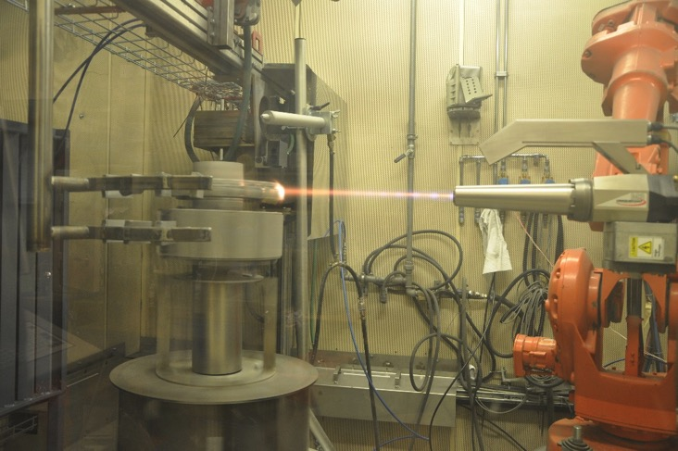
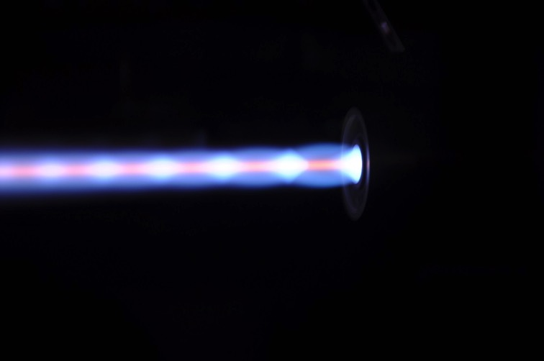
Unique HVAF Spraying Facility
University West’s HVAF facility also among the first in Europe
Still one of only few such facilities in the region
Courtesy Shrikant Joshi, HV

Slide 20
Coatings for ESS: Short-term Plan
Spray deposition, testing of Al₂O₃-Cr₂O₃ coatings deposited using “recommended” powder source (F.J.Brodmann & Co LLC, Louisiana, USA) to replicate the SNS/Stony Brook results
Spray deposition & testing of 1-2 other commercial powders of identical chemistry
Spray deposition & testing of suspensions of identified Alumina-Chromia chemistry
Preliminary studies with a couple of mutually identified alternate chemistries, in powder and/or suspension form
Supply of coated specimens to Oslo for testing; testing support from Oslo
Test kit to assess “good” and “bad” coatings in the lab
Courtesy Shrikant Joshi, HV

Slide 21
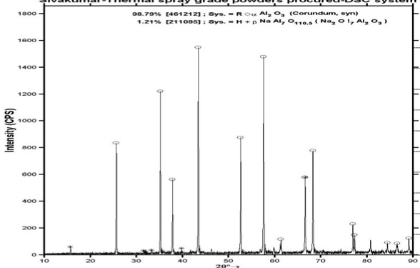
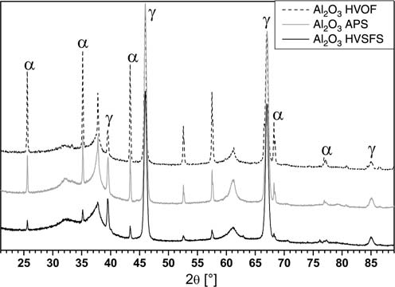
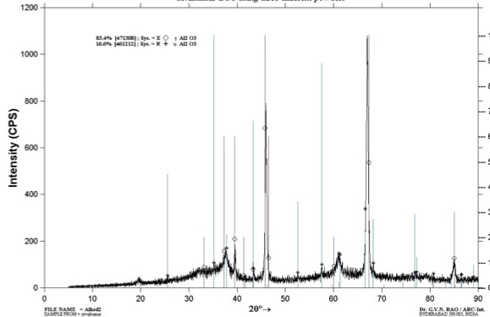
Phase pure α-Al₂O₃ coatings with SPPS
Al₂O₃ powder
APS,HVOF,
HVSFS
sprayed Al₂O₃
SPPS sprayed Al₂O₃
Detonation
sprayed
Al₂O₃
Appropriate precursor chemistry, right choice of process parameters
Journal of the European Ceramic Society, 33 (2013) 2823–2829
Courtesy Shrikant Joshi, HV

Slide 22
Plasma spray trials with Brodmann powder
Varied parameters over a wide plasma power, enthalpy window
Courtesy Shrikant Joshi, HV

Slide 23
Preliminary evaluation of luminescence
Lab kit provided by ESS; measures photo-excitation response; characteristic ‘R lines’ around 693-695 mm
Courtesy Shrikant Joshi, HV

Slide 24
Reference sample
Prelim (i)
Prelim (ii)
Characteristic peak for promising Al₂O₃-Cr₂O₃ coatings
Response from lab kit to identify ‘good’ and ‘bad’ coatings
Sample # 0
Sample # 1
Sample # 2
Sample # 3
Sample # 4
Sample # 5
Courtesy Shrikant Joshi, HV

Slide 25
Reference sample
Sample # 6
Sample # 7
Sample # 8
Sample # 9
Sample # 10
Initial promise evident over a wide parametric window !!!
Further tests in progress
Courtesy Shrikant Joshi, HV

Slide 26

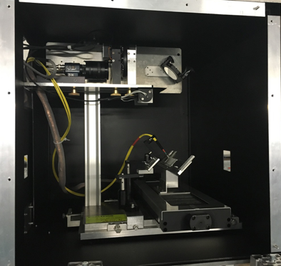
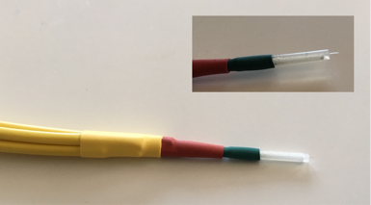
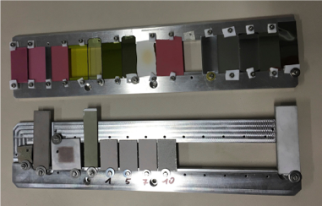
440 GeV proton beam extracted from the CERN SPS (ion beam also available)
Pulse length of 7.2 μs
Bunch intensity is between 3×109 and 1.2×1011 protons
Single pulses (1-288 bunches), maximum intensity of 3.5×1013 protons, 20-50 seconds between pulses.
A few hundred pulses can be requested, total available protons ≈1015
Beam parameters can be tuned, we choose single-bunch pulses (up to 1.2x1011 protons) and a beam size of ≈ 2x2mm2.
Courtesy Martin Jaekel, Oslo

Slide 27

Fibres alignment on black marker dot using laser.
Proton beam centred on marker
Yttria stabilised Zirconia plate
Left : GSI irradiated area (OD=0.7)
Right : non-irradiated area (OD=1)
115 µm, Brodmann powder, Flame sprayed on Al, 13x14 mm2)
Irradiated at GSI, clearly damaged by the Uranium beam.
Courtesy Martin Jaekel, Oslo

Slide 28

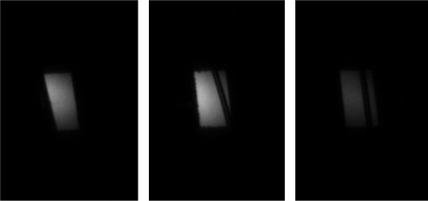
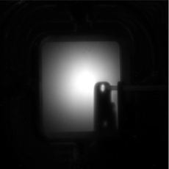

Comparing different plasma sprayed Al2O3:CR coatings
HV5, HV7, HV9, 100nA p, 10ms exposure time, roam temperature.
Total light yield as a function of surface temperature
Sprayed Yttria, HV Trollhättan, 500nA p,100ms exposure time
Courtesy Martin Jaekel, Oslo

Slide 29
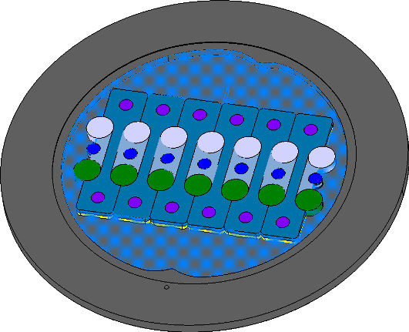
BLIP Irradiation
Component | Material | Quantity
Tensile Specimen | Al6061-T6 | 6
 | Al5754-O | 6
LFA Specimen | Al6061-T6 | 7
 | Al5754-O | 7
TEM/SP Specimen | Al6061-T6 | 14
 | Al5754-O | 14
Luminescent Coating Specimen | Al₂O₃-Cr1% | 6
 | Y₂O₃ | 1
 | Y₂WO₆ | 1
Filler | Al6061-T6 | 1
Substrate | Al6061-T6 | -
Frame | SS 304 | -
Window | SS 304 | -
Disk diameter: 2.975mm<d<3mm

Slide 30
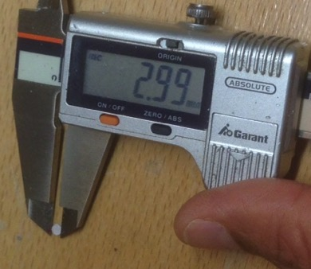
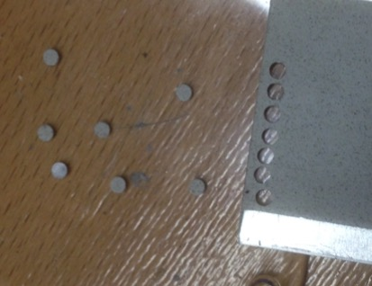
BLIP Irradiation
Samples Produced (HV)
Tight specification for the disks
Tight schedule: disk delivered at the end September 2016 in Juelich
15 August 2016
Samples Cut to 3mm (+0 -25µm) (HV)
Failed!
5 September 2016
Communication
Passed on ESS Team
12 September 2016
Brainstorming, design tool, tried manufacturers, do it ourselves
26 September 2016

Slide 31
Early Results
SNS coating studies: performed at SNS on the target, with W. Blockland
Luminescence characterisation:
Photo-luminescent and proton-luminescent spectra
Proton and photo-spectra
O lines
Investigation on ‘oxygen lines’:
Sharp lines at 777nm and 426nm
Short lifetime (<1µs)
Almost constant intensity along lifetime of the material
He lines
O lines
Spectral measurement on end of life and freshly installed SNS Target
Ruby lines measured and characterised
Proton and photo emission spectrum comparable

Slide 32
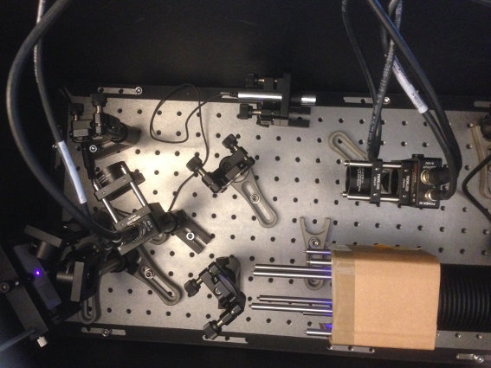
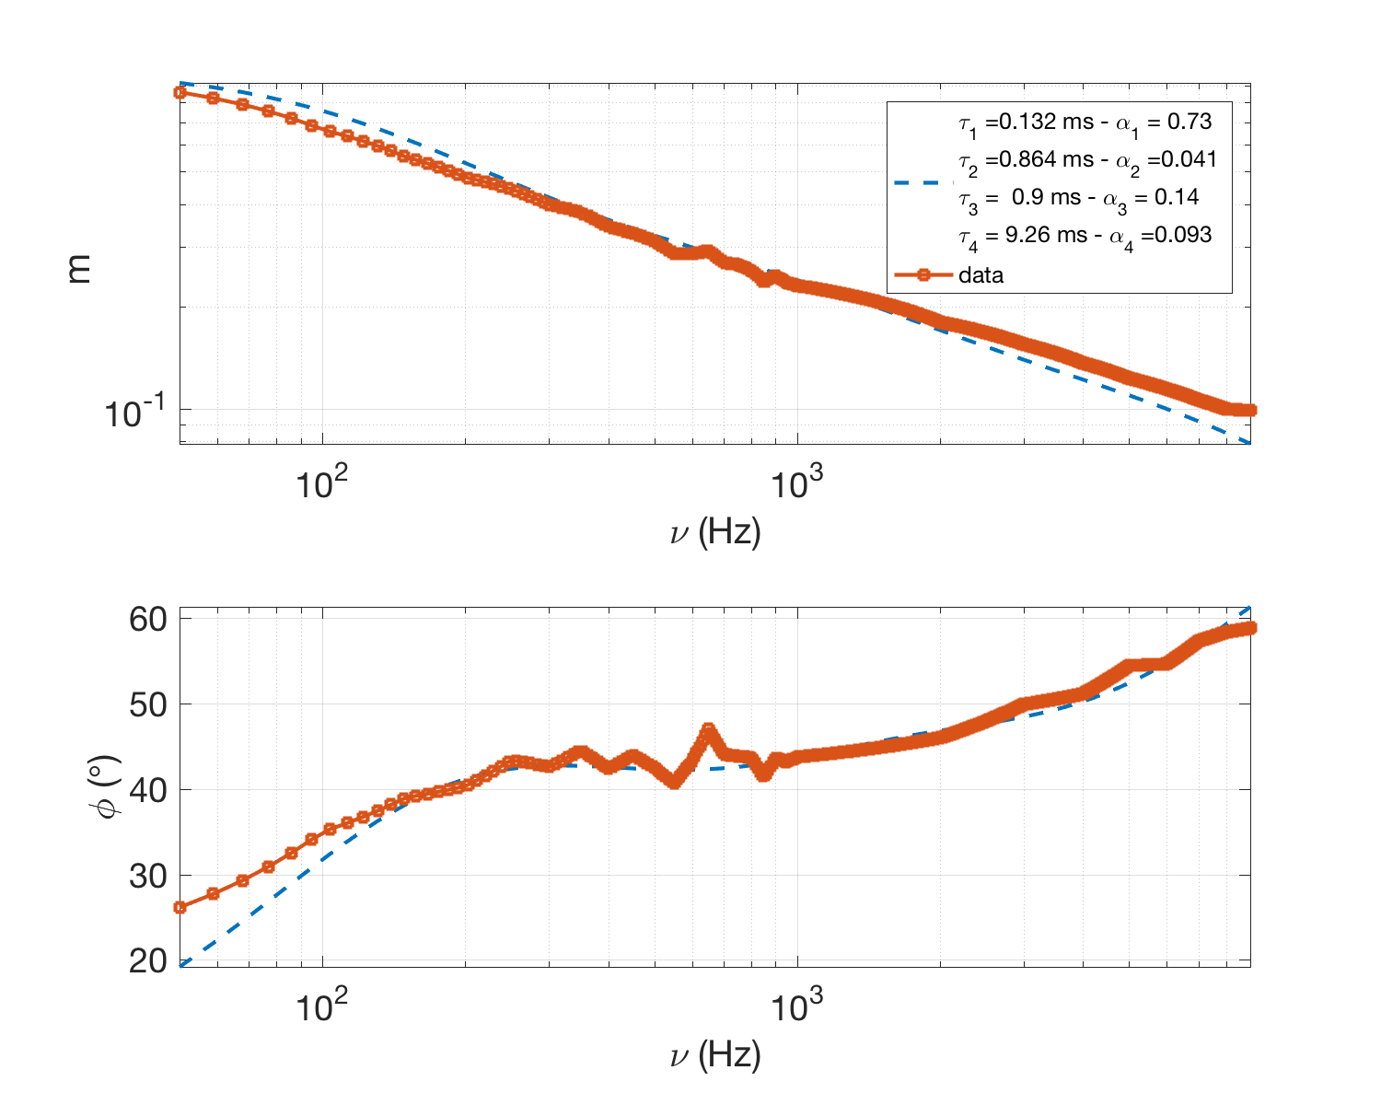
Early Results
Bench test setup at ESS
Luminescence characterisation:
Proton and photo-spectra
D₁
lifetime
D₂
ms scale lifetime!
Source
Sample
BS
lifetime

Slide 33
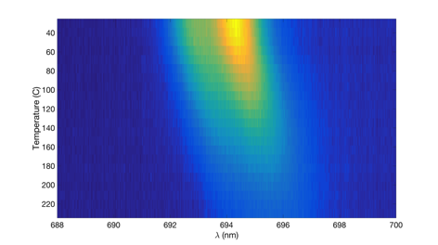
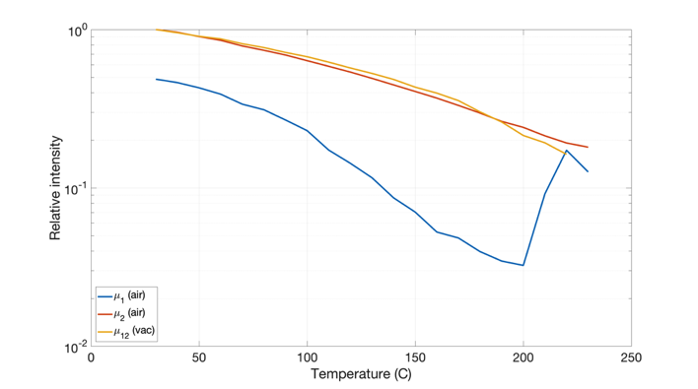
Early Results
In-vacuum and in-air setup (ESS Vacuum Group):
Controlled sample heater + Spectrometer
Luminescence characterisation:
Measure Outgassing
Measure Photon Yield at nominal Target temperature
Proton and photo-spectra
lifetime
Thermal effect on luminescence
Influence of surface temperature on the luminescence and wavelength of a Cr-doped Al2O3 sample
70% drop at 200 C
Thermal: Air and Vacuum
Courtesy Martin Jaekel, Oslo

Slide 34
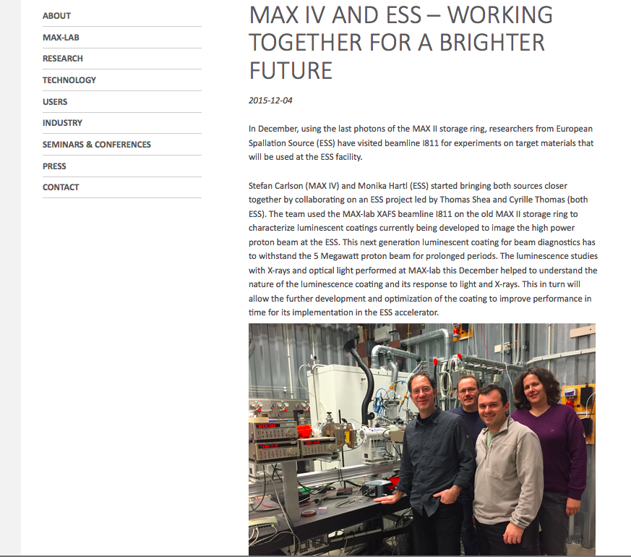
Early Results
XASF performed at MAX II
Luminescence characterisation:
Proton and photo-spectra
lifetime
Thermal effect on luminescence
https://www.maxlab.lu.se/node/2026
Structure and composition

Slide 35
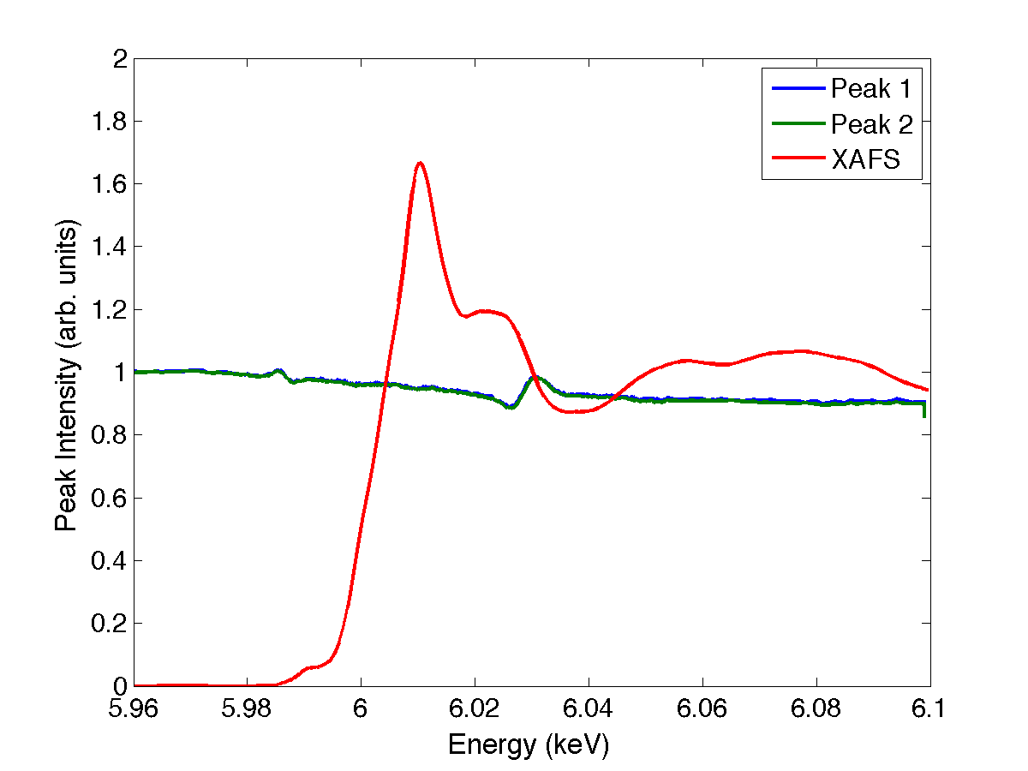
Early Results
XASF performed at MAX II
Luminescence characterisation:
ISIS user labs:
X-ray fluorescence spectroscopy:
Al₂O₃ 95.208 %
P₂O₅ 0.563 %
Cr₂O₃ 3.791 %
Proton and photo-spectra
lifetime
Thermal effect on luminescence
“P” might influence the structure formed upon spraying
  Further investigation needed:
  Knowledge to produce precursor powder!
Structure and composition
XASF and XEOL
XRD (Olso):
Expected Cr³⁺
Structure: octahedral
Al₂O₃ -> 2Al + 3/2 O₂
Tools in place for the determination of the structure and composition

Slide 36
Schedule Coating development
2016
2017
2018
2019
2020
PDR
CDR
Mock-up Ready
SAR
BLIP: cassette ready
PIE (LANL)
BLIP Irradiation
TW and PBW Spray
TW and PBW Spray
TW and PBW Spray
GSI
GSI
HiRadMat
Dump Spray
Dump screens Spray
SNS Target Coating
SNS Target Coating

Slide 37
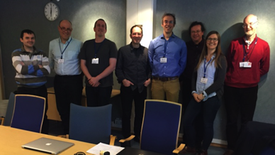
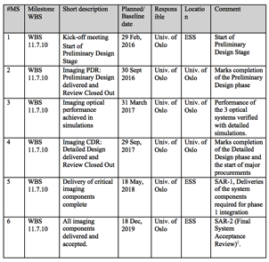

Schedule
Imaging system milestones
Delivery of
critical components
complete
2018-05
Delivery of
all components
complete
2019-12
Simulation
design frozen
2017-03
Kick-off, 2016-02
PDR
2016-09
CDR
2017-09
2016-01
2017-01
2018-01
2019-01
2019-12
PBIP PDR
2016-03
PBIP CDR
2017
TW BEW
components
ready for welding
2017-09
ESS beam
ready for target
mid-2019
TW
assembly
complete
2018-01
Tuning dump
vacuum comp.
CDR 2016-12
Some milestones for interfacing systems
( )
Imaging system development is driven by interfacing system milestones, not by beam on target/dump.

Slide 38
Acknowledgement

Slide 39
Questions?

