Slide 1
BLM update a.k.a. what Irena and the gang did on their summer vacation…
Tom Shea
www.europeanspallationsource.se
16-10-04

Slide 2
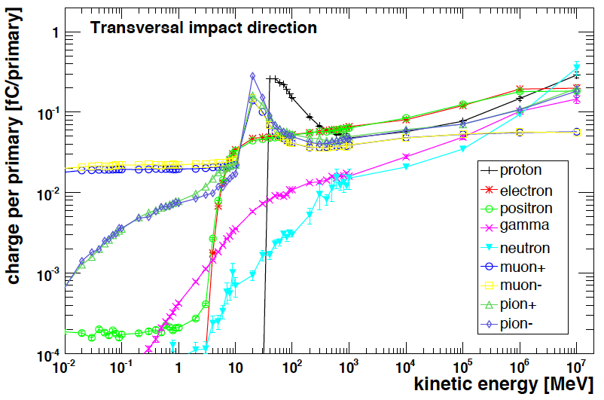
ESS BLM: 3 detector technologies
ESS SCL – ICBLM
Ionization chambers (ICs) developed for LCH BLM – primary BLMs in SCL
Photon background due to the RF cavities must be taken into account when using ICs a linac
  Bckg. mainly due to el. field emission from cavity walls, resulting in bremsstrahlung photons created on cavities/beam pipe materials [3].
  Levels are difficult to predict numerically – they depend on the quality of cavities, operation conditions and time.
  Energy spectra estimation [4]: photons with
  energies up to tens of MeV can be expected.
  Plan to asses this experimentally as well.
LHC IC sensitivity to photons:
  “cut off” at transversal photon and electron
  Incidence ~2MeV (~30MeV for p and n) [1]
Background sampling and subtraction in the
signal processing necessary.
ESS SCL - 2nd detector type: - cBLM
(Cherenkov based BLM)
Currently considering to design Cherenkov radiation sensitive detectors.
To be used as an addition to the ICs, which are the primary BLM detectors in the SC parts.
Cherenkov radiation based detector offer inherent rejection of the RF cavity background..
LHC BLM IC response functions [1]

Slide 3
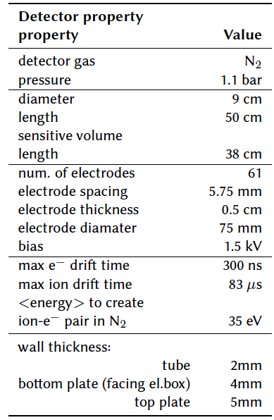
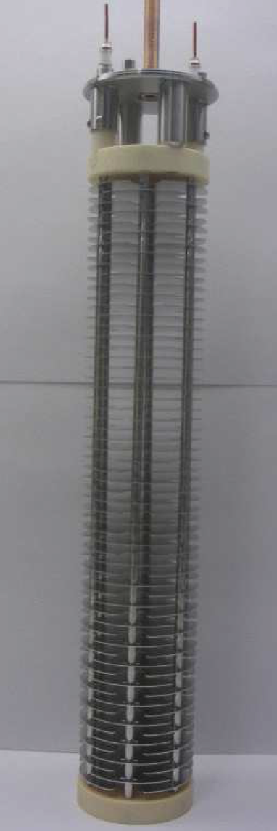
ESS BLM: ICBLM
See update from Slava
Data from [1], [2]
ICBLM (Ionization Chamber based BLM)
Showers of secondary particles (charged and neutral) are expected in the SC linac.
Parallel plate gas Ionization Chambers (ICs) developed for the LHC BLM system will be used – chosen due to their fast response.
ICs ordered in Summer 2014 (production line setup in Russia, to replenish spares for LHC and make prod. series for ESS and FAIR).
Inner structure of the LCH BLM [1]

Slide 4
For ESS, digital processing

Slide 5
ESS BLM: 3 detector technologies
ESS NC linac: nBLM (neutron sensitive BLM)
Plan to place BLM detectors in the MEBT and DTL sections.
Particle fields outside the beam pipe and tanks in this area expected to be dominated by neutrons and photons.
RF cavity background still a possible source of photons in these areas – neutron sensitive detectors should be considered.
Micromegas detectors chosen for these parts of the linac – IKC annex AIK 7.9/CEA 1.11
The idea is to design a micromegas detector sensitive to fast neutrons and not to thermal n, X- and γ-rays based on signal discrimination [5].
See Philippe’s presentation

Slide 6
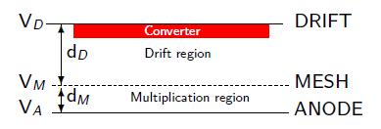
Neutron detection with Micromegas
Neutron detection ➔ neutron-to-charge converter
Solid converter: thin layers deposited on the drift or mesh electrode (¹⁰B, ¹⁰B₄C, ⁶Li, ⁶LiF, U, actinides…)
  Sample availability & handling
  Efficiency estimation
  Limitation on sample thickness from fragment range
  ⇒ limited efficiency
  Not easy to record all fragments
Detector gas (³He, BF₃…)
  Record all fragments
  No energy loss for fragments ⇒ reaction kinematics
  No limitation on the size ⇒ high efficiency
  Gas availability
  Handling (highly toxic or radioactive gasses)
Neutron elastic scattering
  gas (H, He)
  solid (paraffin etc.)
    Availability
    High energies
    Efficiency estimation & reaction kinematics

Slide 7
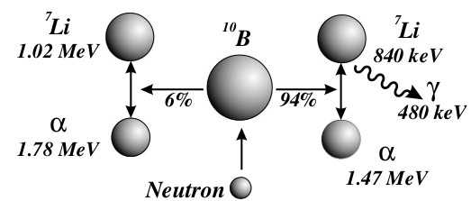
ESS nBLM
See Philippe’s presentation
nBLM – the neutron sensitive BLM
Micromegas detectors will be used in these parts of the linac.
Detector in development by the micromegas experts from CEA Saclay
The idea is to design a micromegas detector sensitive to
fast neutrons and “blind” to thermal n, X- and γ-rays
based on signal discrimination [5].
Taken from [5]
Current proposal: assembly of 2 modules [5].
  1st module (slow losses)
    Capable of monitoring low fluxes (~few n cm⁻²s⁻¹).
    Polyethylene: moderator to thermalize the incoming fast n.
    B₄C layer(s) to capture thermalized n.
    Cd (~mm) to eliminate background thermal n.
  2nd module (fast losses)
    appropriate for high fluxes of fast n, coming from the front.
    Polyethylene for n conversion to p recoils (~ few mm) through n elastic scattering on H atoms.
    Al foil or deposition (~50nm) on the polyethylene (thickness defines the neutron energy threshold), followed by a micromegas.
  Optional: ²³⁸U converter layer to produce fission fragments
Cd or other absorber
Polyethylene
Taken from [5]
MM +
Polyethylene + Al
MM
+
B₄C
~20 cm
~10 cm

Slide 8
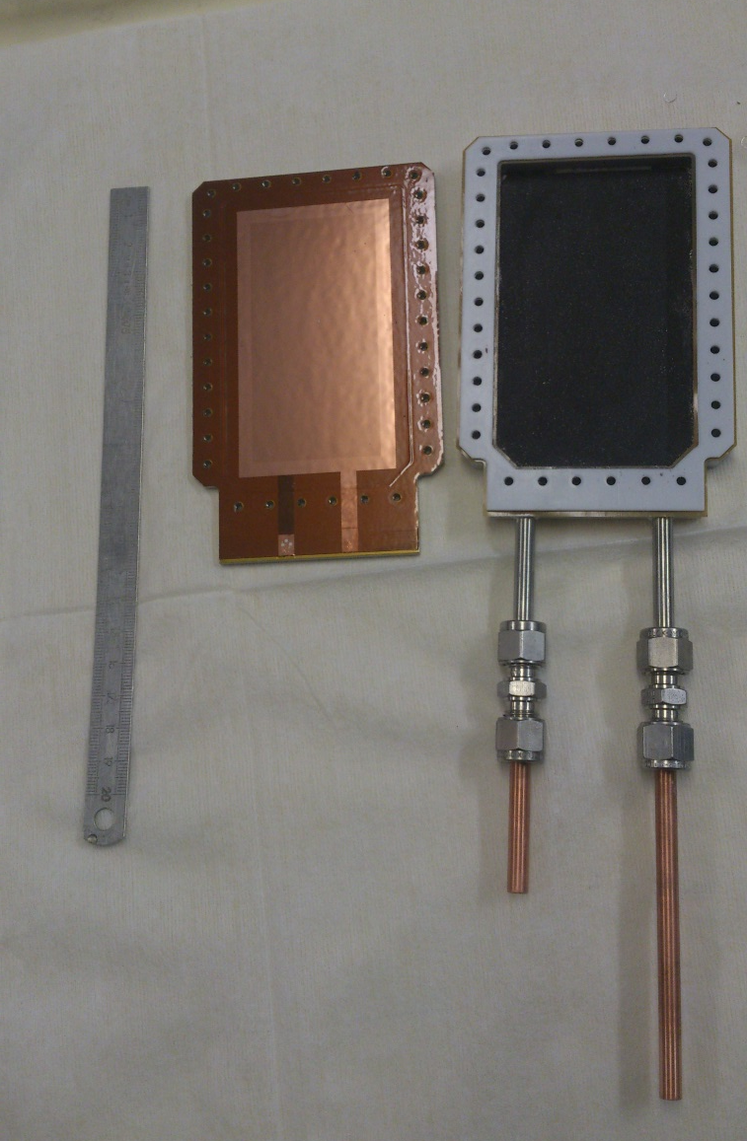
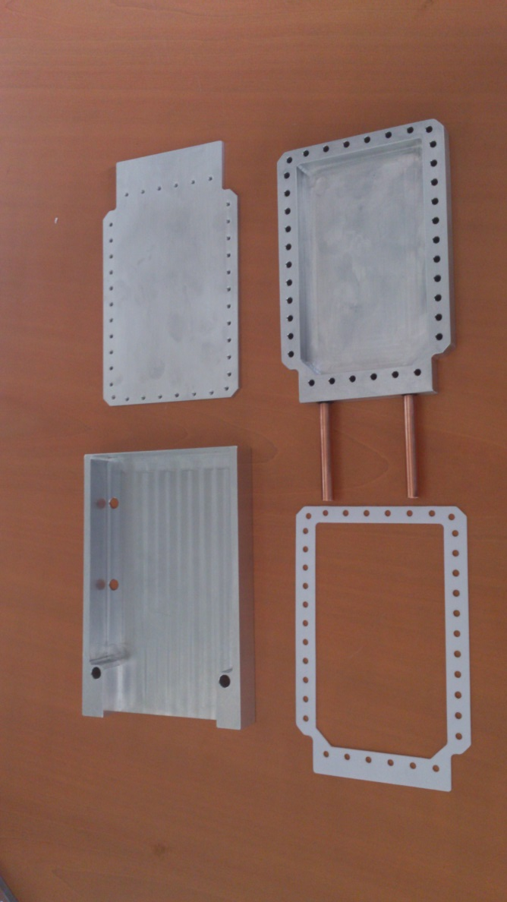
Building a simple neutron counter
¹⁰B layer (thick!) deposited on the inner part of the chamber
The ¹⁰B layer is the less trivial part to build
Material availability
Deposition methode
  Sputtering
  Evaporation
  Electrodeposition
  …
Teflon / kapton joint
Microbulk glued
on a metallic plate
Gas tubes

Slide 9
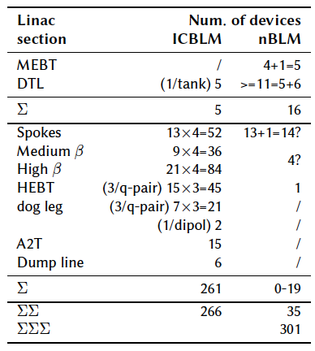
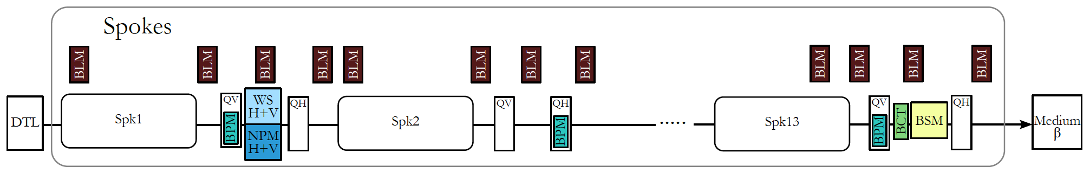
ESS BLM detector count
NC linac – nBLMs
Original count when writing the technical annex:
  MEBT: 1 per collimator or chopper dump
  DTL: at least 1/tank, 1 between the tanks, 1 at start or end of the DTL
SC linac - ICBLMs
3-4 devices per doublet lattice cell: 4 where there is a cryomodule and 3 in the transport section.

Slide 10
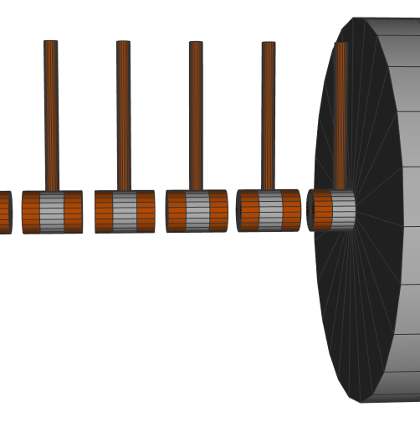
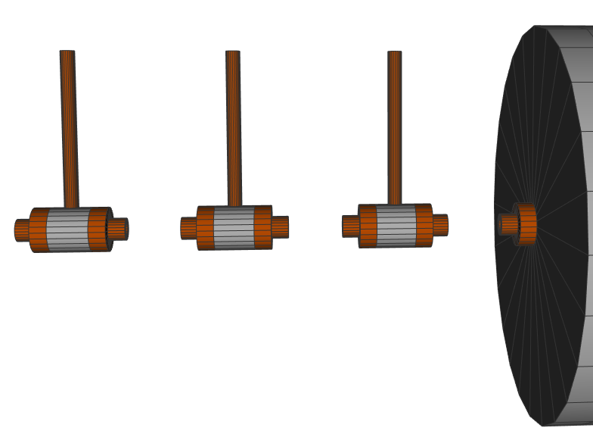
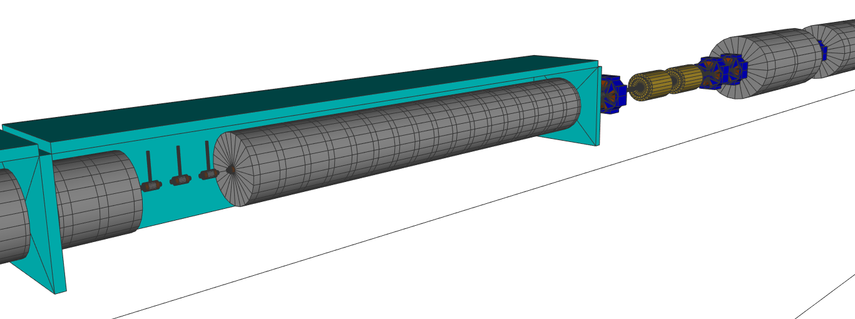
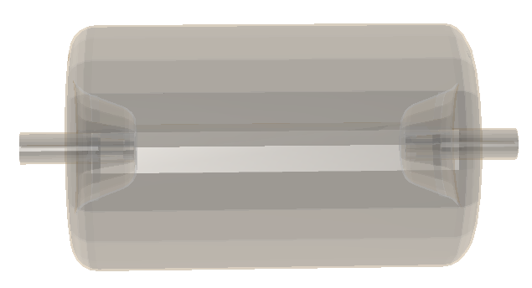
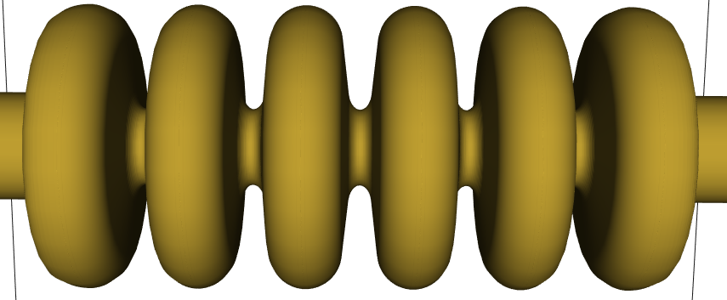
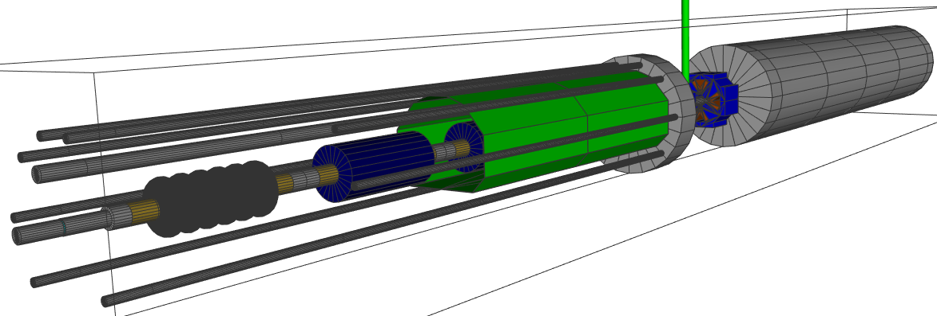
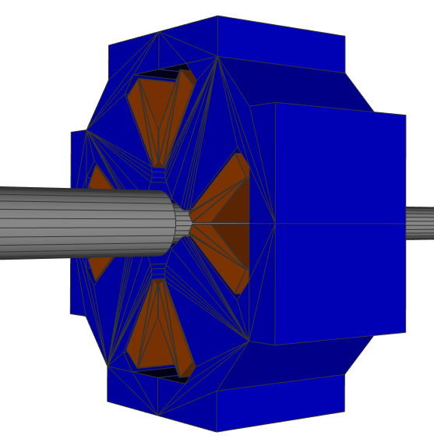
ESS BLM simulations: linac geometry
DTL “detector”
volumes
Spoke Cryomodule
DTL tank1
cells
DTL tank5
cells
Medium Beta cavity
Medium Beta Cryomodule
Spoke Cavity
quad

Slide 11
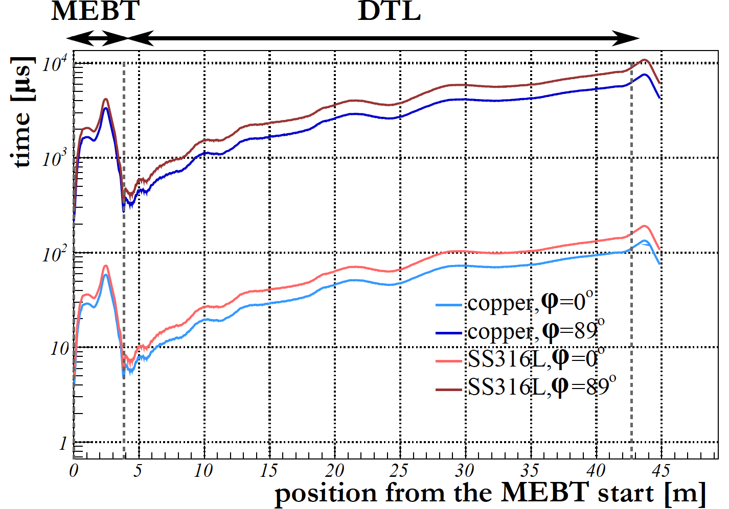
Response time
Required response time set in the past:
  NC linac (MEBT-DTL): ~5 μs.
  SC linac: ~10 μs.
  Numbers based on a simplified melting time calculations, where a block of material (copper or stainless steel) is hit by a beam of protons with a uniform profile under perpendicular incidence angle, no cooling considered [7].
Numbers recently re-checked with a Gaussian beam and update beam parameters:
  NC linac: calculated melting time values
  of 3-4μs imply even stronger demands on
  the response time (confirmed with a MC
  simulation as well).
  SC linac: the 10μs requirement for
  response time fits well with the results
  of this calculations.
  However: other damage mechanisms may
  mandate even shorter response time
  SCL (discussed further).

Slide 12
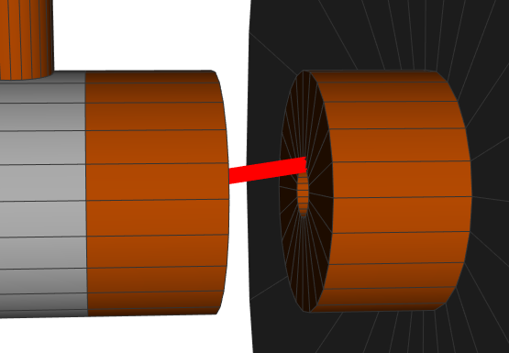
Response time
Implications on the response time
NC linac
  Depending on the gap distance, an incidence
    close to perpendicular potentially possible
    in the DTL tank1 due to the almost flat
    surfaces between the gaps.
  With the simplified DTL geometry for the BLM
  simulation: geometrically possible though highly
  improbable - requires an incidence angle larger
  than about 3 times the worst case one (for a
  Gaussian beam with typical RMS~1mm, where 3RMS of the beam core hits the gap surface).
  Deserves further studies with more accurate DTL mechanical model.
SC linac
  Plan to check the beam pipe melting time with the beam under “worst case” angle.
  However: degradation of cavities observed at SNS after loosing <15μs pulse of 26mA beam ~10/day [8].
  Experience at the SNS motivates setting response time limit for ESS SC linac significantly lower than 15μs.

Slide 13
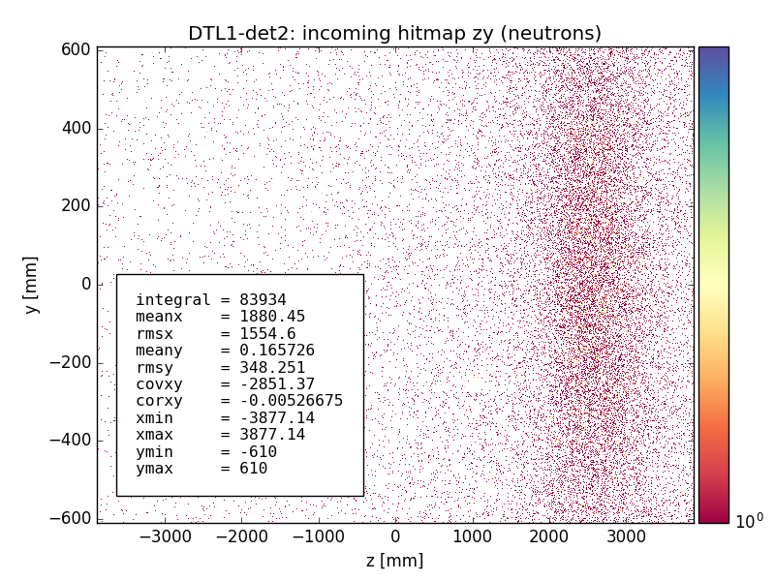
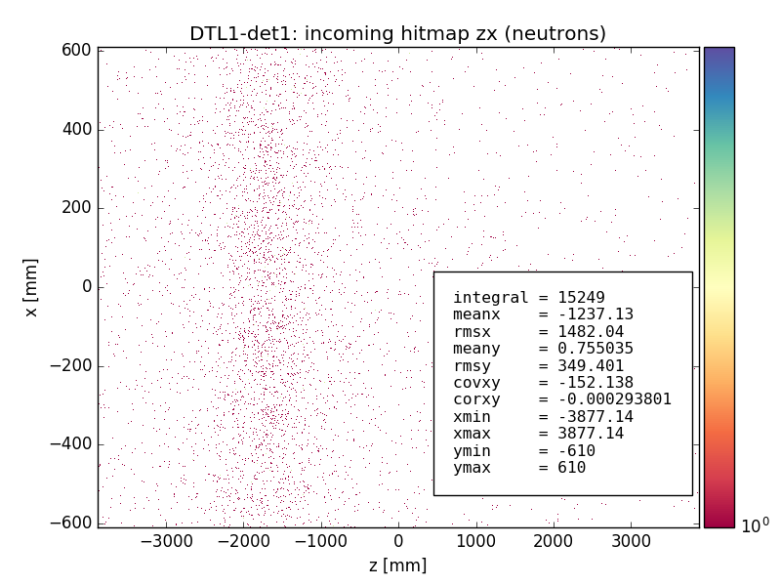
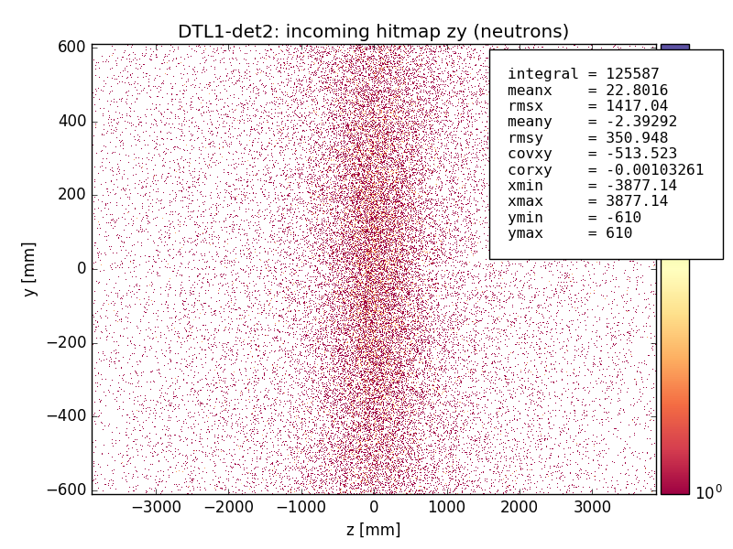
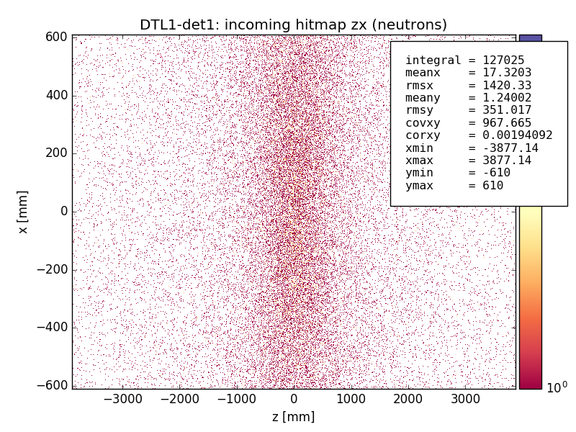
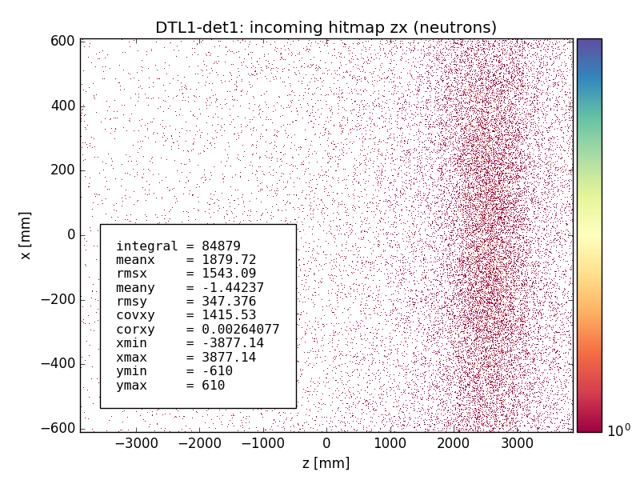
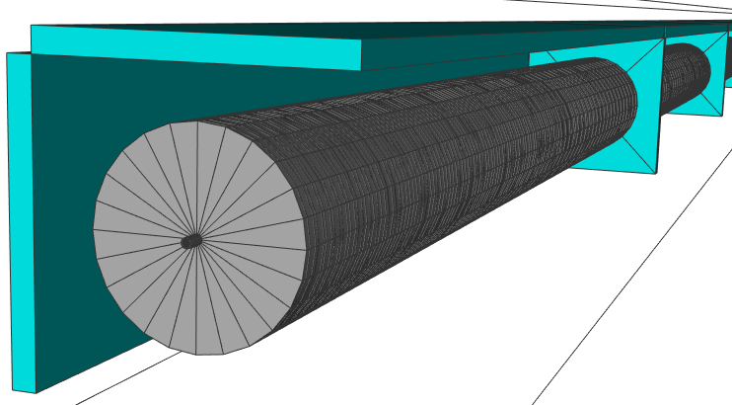
Detector locations: DTL1 – preliminary results
DTL tank1 example (preliminary):
Proton beam under 50mrad from the z-axis with Gaussian profile (RMS~1mm), energy set to the nominal values at the loss location.
Incoming neutron hit maps for 3 different localized loss locations along the DTL tank1.
  Det1 and det2: all hit maps exhibit a peak on the the axis that runs along the tank (z-axis), indicating possible correlation of the peak position with the loss location.
  Det0: flat hit map distribution
det0
y
det2 “detector” volume
x
z
det1

Slide 14
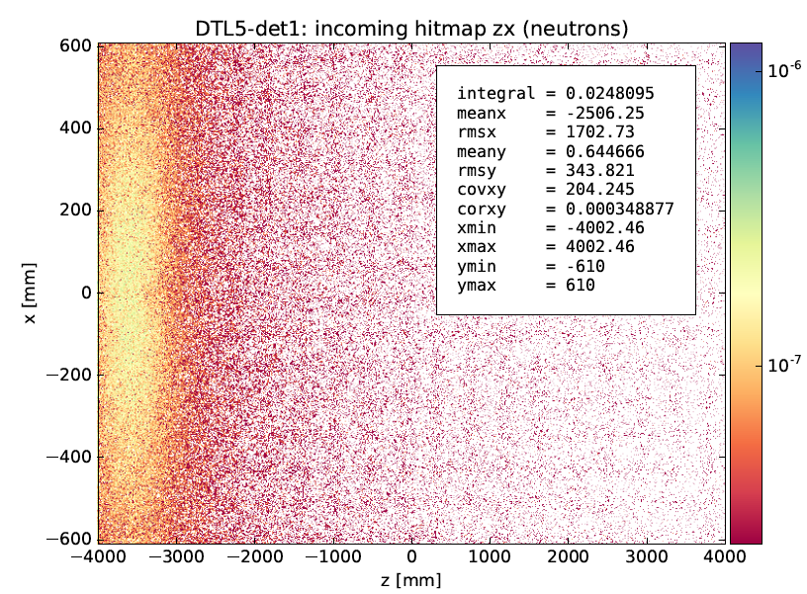
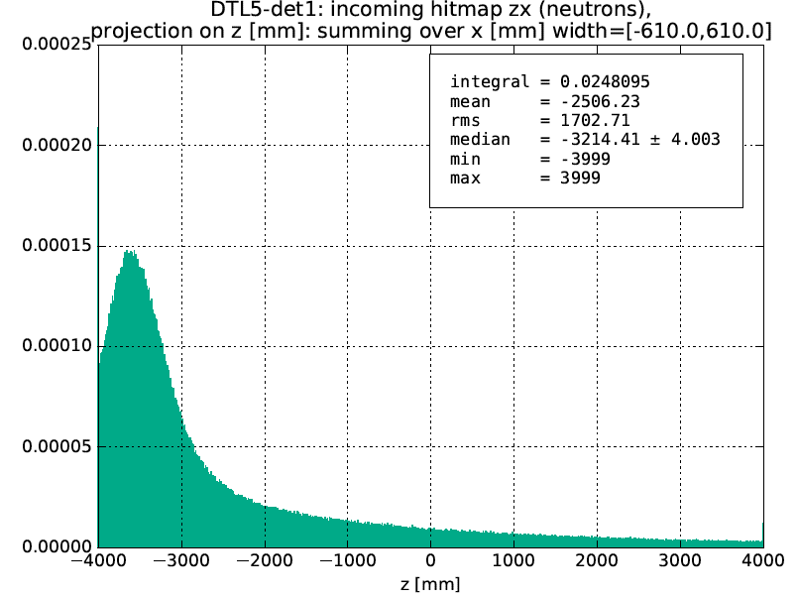
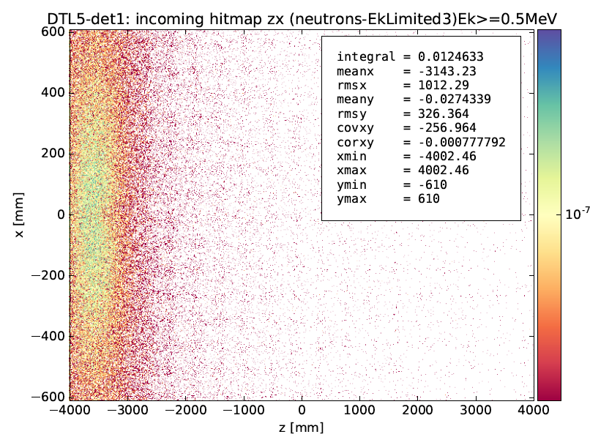
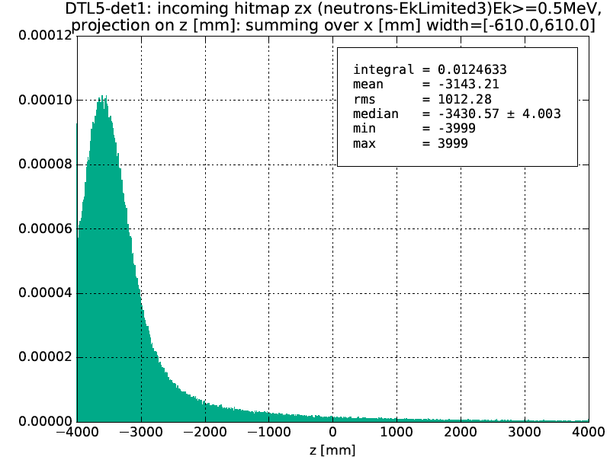
nBLM: threshold energy to discriminate slow/fast neutrons – E_{n,Thr}
The hit maps depend on the energy cut – with higher E_{thr,n}the hitmaps get “cleaner”
Detector DTL5-det1 plots from sim2-10: pencil beam under 5mrad, at the beginning of the DTL5:
Neutron hit map and projection (normalized to the number of primaries) – no cut
Neutron hit map and projection (normalized to the number of primaries) – E_{k} >0.5MeV

Slide 15
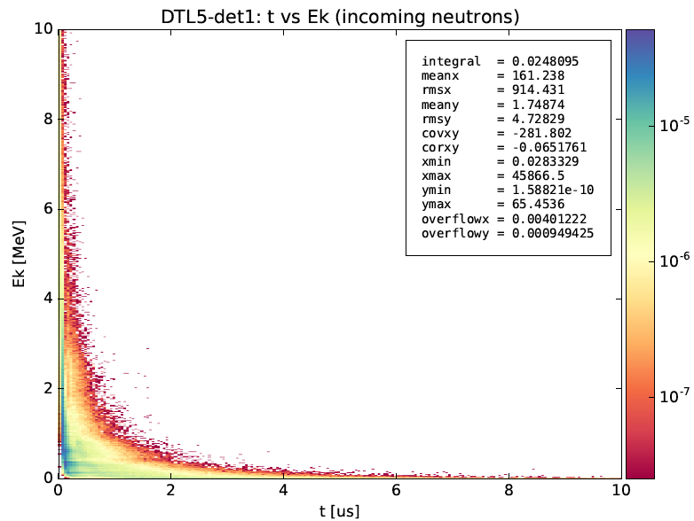
nBLM: threshold energy to discriminate slow/fast neutrons – E_{n,Thr}
Method for determination of the “best” E_{thr}:
Produce neutron E_{k} vs time (“PT”) 2d histos.
Select the E_{thr} and project the hits with Ek>E_{thr} on the “time” axis.
Find the E_{thr} for which f_{lim} fraction of the hits in the projected histogram lie above the PT time limit t_{lim}
Selected:
  Limit1: t_{lim}=1μs, f_{lim1}=0.01
  Limit2: t_{lim}=1μs, f_{lim2}=0.1
Sim2-10: neutron Ek vs time for the DTL5-det1 detector, normalized per number of primaries

Slide 16
nBLM: threshold energy to discriminate slow/fast neutrons – E_{n,Thr}
Comments
No dramatic change in E_{thr} with loss location (thus energy), beam angles beam sizes and detector position (if det1 and det2 considered) visible in the data at hand
Average E_{th} - averaged over all simulations runs reported in the plots on the previous slide:
  limit1 (t_{lim}=1μs, f_{lim1}=0.01): (0.44 ± 0.06) MeV
  limit2 (t_{lim}=1μs, f_{lim1}=0.1): (0.06 ± 0.01) MeV
  Guidelines regarding the detector design:
    To insure the best impurity, assume the 0.5MeV limit for E_{thr}. If this turns out to be a bad choice for some reason (unacceptable detector dimensions or to too low count rates, once the detector sizes are fixed,…), go for E_{thr}= 0.05MeV

Slide 17
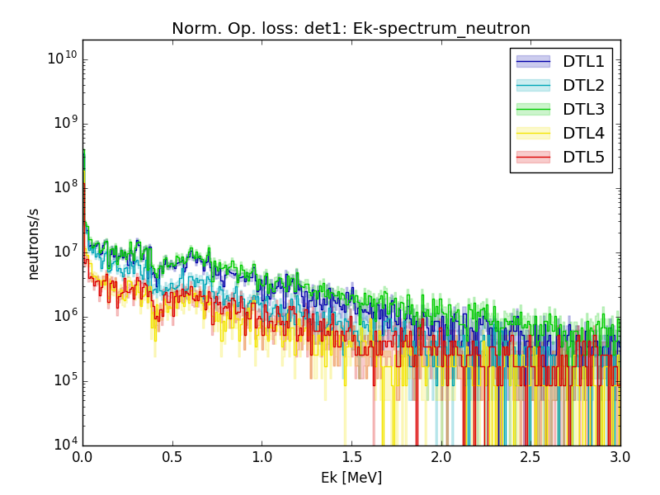
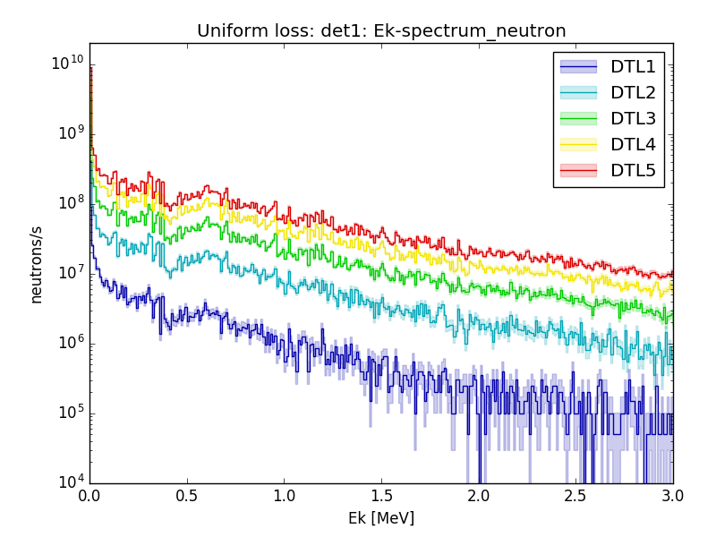
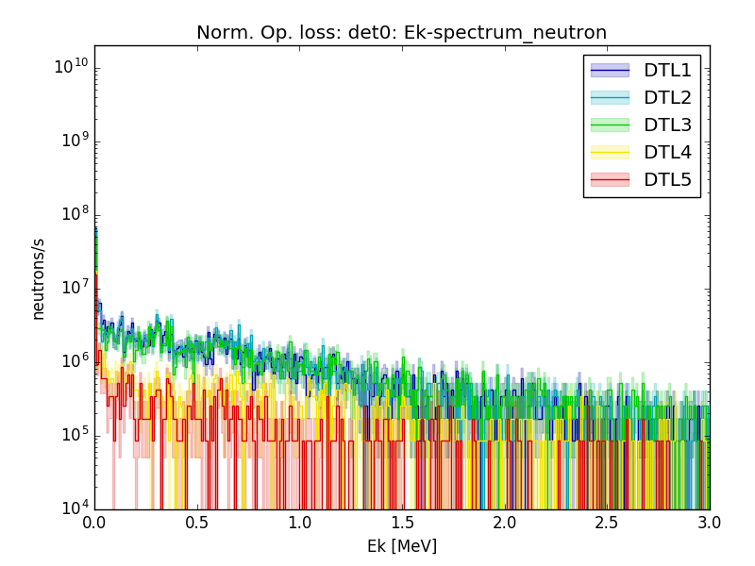
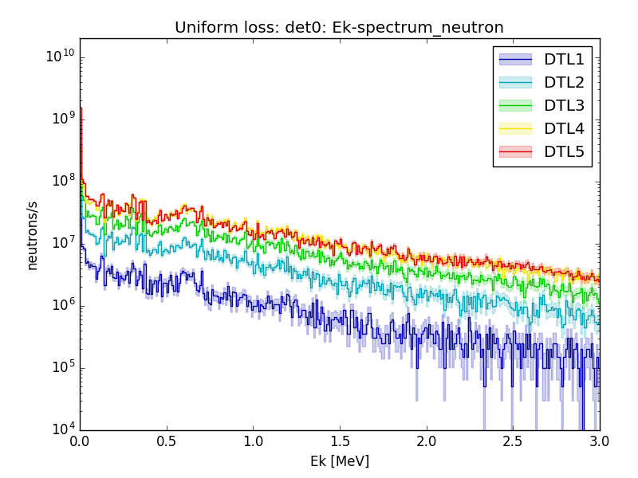
Dynamic range
Norm. op. vs. 1W/m loss neutron spectra (neutrons/s hitting the det. volumes surrounding the DTL tanks) in NC linac
Note: Results of the beam dynamics
error study [9,10] used as the inputs to
BLM simulation and assumed to
represent a realistic loss scenario of the
ESS linac during normal operation.
1W/m loss:
Increase in incoming neutrons
with the tank number (neutron
cross section increases with Ek).
Normal operation loss:
Neutron flux lowest in the last two
tanks (emittance decreases with Ek).
Norm. op. vs. 1W/m loss
Shape of the spectra the same for both
loss scenarios.
All spectra for the 1W/m above
the corresponding ones for norm.
op. loss (except for DTL1, det0, where
1W/m loss same or slightly below nor.
op. one).
The difference increases with tank
number (~0 to ~1.5 order of mag.) .
Norm. op: det1
1W/m: det1
Norm. op: det0
1W/m: det0

Slide 18
Dynamic range
ESS BLM dynamic range specifications
nBLMs:
Once detector locations and dimensions are fixed, count rates can be calculated:
  Upper limit: can be set by assuming total beam loss with a focused beam under “worst case” incidence angle.
  Lower limit: can be set to a fraction of the neutron flux expected during the normal operation.
  Suggestion for the detector development regarding the lower limit:
    Check the expected flux at normal operation at detector location with lowest expected flux. Select 1-10% of this flux for the lowest limit, the exact number depends on the detector size and should be adapted to give a reasonable dynamic range
ICBLMs:
  Preliminary values set in the past [11]:
    “BLM is required to be able to measure at least 1% of 1W/m loss during normal. operation and up to 1% of the total beam loss”.
    Gave estimation on the ICLBM current range: ~800nA – few mA.
  Plan to re-assess that once the ICBLM detector locations are fixed.
  However for now assume the preliminary values when talking to CERN/CAENels regarding the input currents for the BLEDP and time constant tuning.

Slide 19
What about electronics?
Currently documenting Building Blocks for two BLM systems
icBLM
  CERN analog front end crate in gallery, updated for our dynamic range
    Also evaluate CAENels FMC and HV AMC solution
  MTCA control box
    Prototype/backup: CAEN DAMC (in the lab since last Fall 2015) with fiber optic serial input (demonstrated summer 2016) to gate array
    Final: IOxOS 1410 due October 2016
nBLM
  Saclay analog front end in tunnel
  MTCA control box
    Prototype/backup: CAEN DAMC with ~2 Gsample/s ADC (500 Msamples/s currently)
    Final: IOxOS 1410, same digitizers
See Maurizio’s talk

Slide 20
Recent and Upcoming BLM Activities
July 2016: nBLM kickoff meeting
August 2016: virtually all icBLM components at Protvino for assembly
September 2016: integrating nBLM demo ADC in MTCA
November 2016: demonstrate vertically integrated MTCA electronics with micromegas detector at Saclay
1 December 2016: PDR1 for nBLM
Q1 2017: first deliveries of icBLMs, launch construction of ESS prototype nBLM system, tests of detectors in cavity test facility…
Risks: ICS components for Saclay demo, IOxOS readiness, lack of SC cavity damage model

