Slide 1
ESS FPGA development framework
with application to BI instrumentation

Slide 2
ESS FPGA development framework
FPGA introduction for dummies
ESS platform
ESS DEVENV for IKCs
nBLM

Slide 3
ESS FPGA development framework
FPGA introduction for dummies
ESS platform
ESS DEVENV for IKCs
nBLM

Slide 4
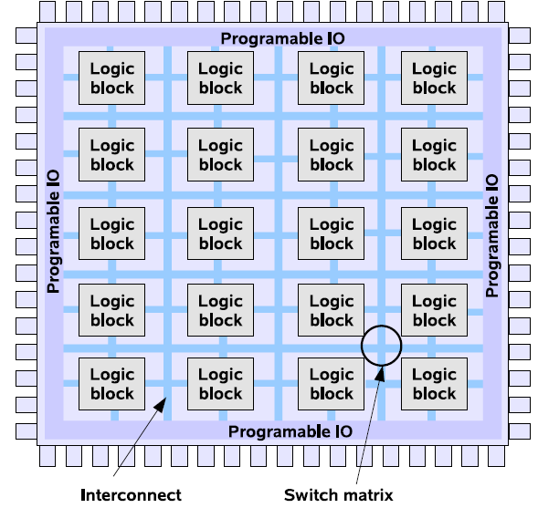
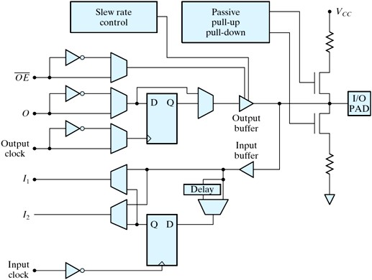
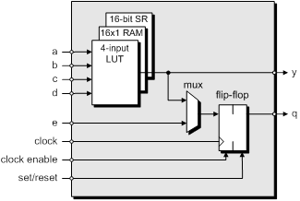
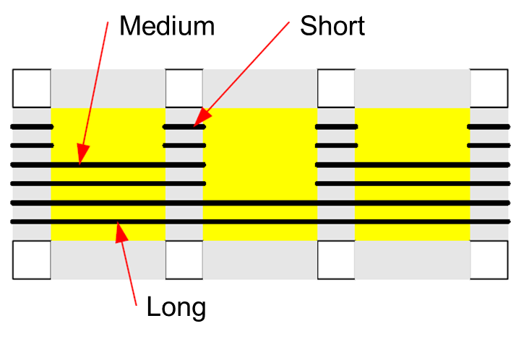
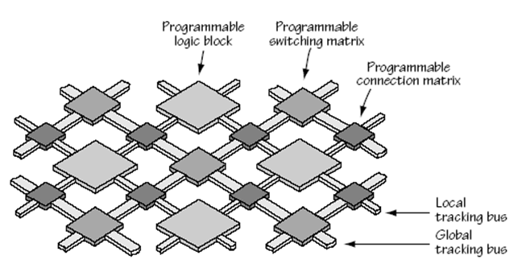
FPGA Architecture
Notes:
An FPGA is a type of integrated circuit (IC) that can be programmed for different algorithms after fabrication.
Modern FPGA devices consist of up to two million logic cells that can be configured to implement a variety of software algorithms.
Although the traditional FPGA design flow is more similar to a regular IC than a processor,
an FPGA provides significant cost advantages in comparison to an IC development effort and offers the same level of performance in most cases.
Another advantage of the FPGA when compared to the IC is its ability to be dynamically reconfigured.
This process, which is the same as loading a program in a processor, can affect part or all of the resources available in the FPGA fabric.

Slide 5
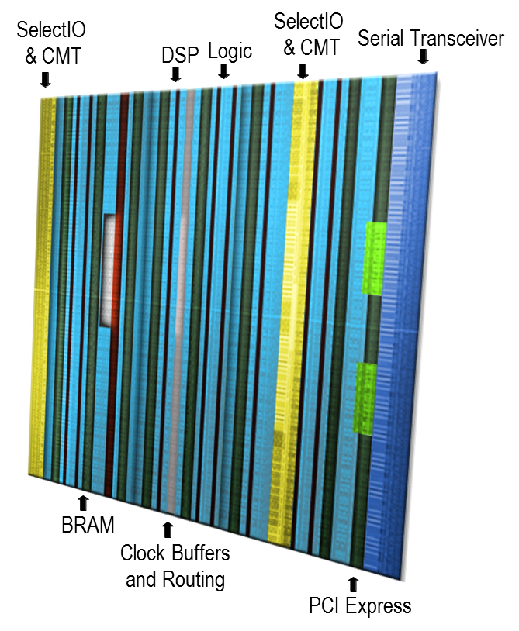
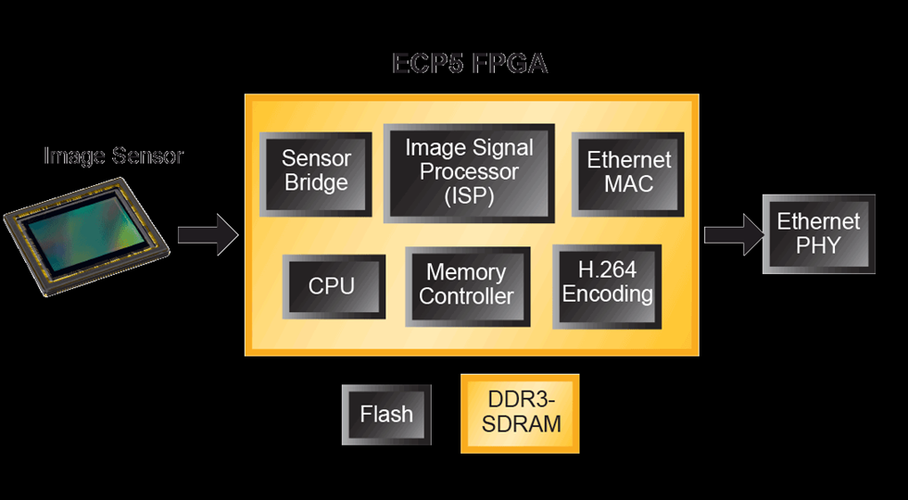
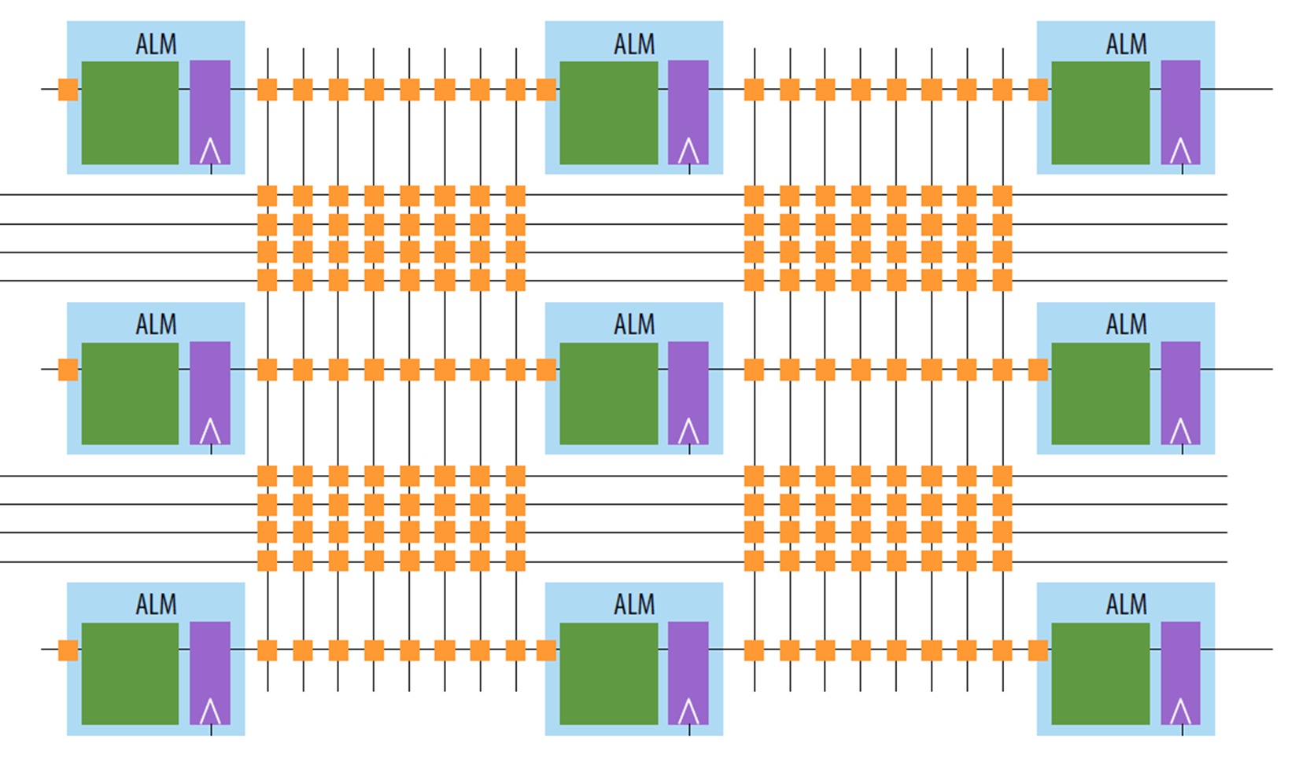
FPGA Architecture
Contemporary FPGA architectures incorporate the basic elements along with additional computational and data storage blocks that increase the computational density and efficiency of the device.
The combination of these elements provides the FPGA with the flexibility to implement any software algorithm running on a processor.

Slide 6
Hardware Description Language - Introduction
HDL is a language that describes the hardware of digital systems in a textual form.
It resembles a programming language, but is specifically oriented to describing HARDWARE STRUCTURES and BEHAVIORS.
The main difference with the traditional programming languages is HDL’s representation of extensive parallel operations whereas traditional ones represents mostly serial operations.
The most common use of a HDL is to provide an alternative to schematics.

Slide 7
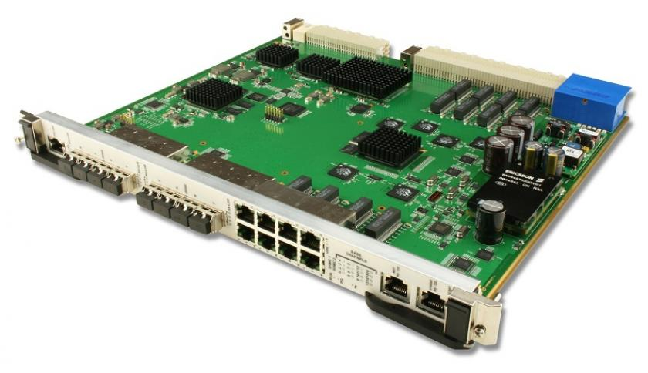
System
Architect
FPGA
Designer
GOLDEN
Model
HDL
Sources
Schematic
Sources
IP
Simulation Scripts
Test
Vectors
SIMULATE
SYNTHESIZE
Project
PLACE & ROUTE
Constrain
HW
Platform
BITSTREAM

Slide 8
ESS FPGA development framework
FPGA introduction for dummies
ESS platform
ESS DEVENV for IKCs
nBLM

Slide 9
Beam Diagnostics
The Beam Diagnostics work package includes the development of all beam instrumentation for the ESS linac:
BLM (Beam Loss Monitor)
BCM (Beam Current Monitor)
BPM (Beam Position Monitor)
FC (Faraday Cup)
WS (Wire Scanner)
NPM (Non-Invasive Profile Monitor)
EMU (Emittance Measurement Unit)
LBM (Longitudinal Bunch Profile Monitor)
etc…..
Integrated Control System (ICS)
The ESS Control System is a complex network of hardware, software and configuration databases that integrates the operations of all the various parts of the Accelerator, Target, Instrument and Conventional Facility infrastructures.
ESS has a large network of laboratories to exchange knowledge, personnel and experience with, and that in many cases will contribute directly to the project through In-Kind Contributions (IKCs)

Slide 10
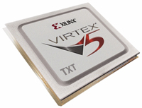
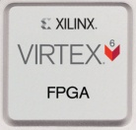
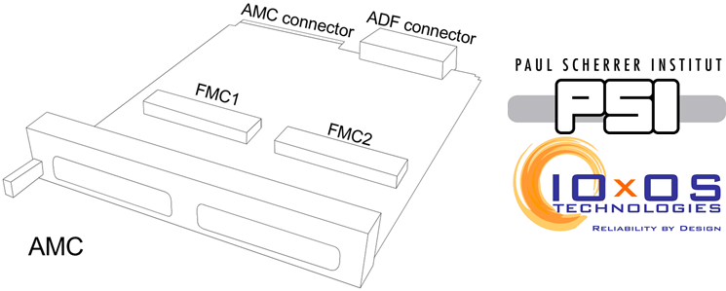
MTCA.4 AMC
BEAM DIAGNOSTIC
PROTOTYPE
PLATFORM
MIGRATION
ICS
FINAL
PLATFORM

Slide 11
FPGA comparison
DAMC-FMC25 (VIRTEX-5)
Device | Configurable Logic Blocks (CLBs) |  |  | DSP48E Slices | Block RAM |  |  | Blocks CMTs | PowerPC Processor | Blocks Endpoint Blocks for PCI Express | Ethernet MACs | Max RocketIO Transceivers |  |  | Total I/O Banks | Max User I/O
 | Array (Row x Col) | Virtex-5 Slices / LUTs FFs | Max Distributed RAM (Kb) |  | 18 Kb | 36 Kb | Max (Kb) |  |  |  |  | GTP | GTX
XC5VFX70T | 160 x 38 | 11,200 / 44,800 | 820 | 128 | 296 | 148 | 5,328 | 6 | 1 | 3 | 4 | N/A | 16 |  | 19 | 640 | ̴1/2
SIS8300-L (VIRTEX-6)
Device | Logic Cells | Configurable Logic Blocks (CLBs) |  | DSP48E1 Slices | Block RAM Blocks |  |  | MMCMs | / | Interface Blocks for PCI Express | Ethernet MACs | Maximum Transceivers |  |  | Total I/O Banks | Max User I/O
 |  | Slices | Max Distributed RAM (Kb) |  | 18 Kb | 36 Kb | Max (Kb) |  |  |  |  | GTP |  | GTX
XC6VLX130T | 128,000 | 20,000 | 1,740 | 480 | 528 | 264 | 9,504 | 10 | / | 2 | 4 | 20 |  | 0 | 15 | 600 | 1
Kintex UltraScale FPGA
 | System Logic Cells | CLB FFs / CLB LUTs | Maximum Distributed RAM (Mb) | DSP Slices |  | Block RAM/FIFO w/ECC (36Kb) | Total Block RAM (Mb) | CMTs (1 MMCM, 2 PLLs) |  | PCIe Gen3 x8 |  | GTH 16.3Gb/s Transceivers
KU040 | 530,250 | 484,800 / 242,400 | 5.9 | 1,920 |  | 600 | 19.0 | 10 |  | 3 |  | 20 |  |  |  |  | ̴̴5

Slide 12
ESS FPGA development framework
FPGA introduction for dummies
ESS platform
ESS DEVENV for IKCs
nBLM

Slide 13
ICS Continuous Integration/Delivery
Courtesy of Leandro Fernandez
JAVA flow

Slide 14
FPGA design/delivery
Logs and
documentation
Notification
Bitstream
Development
Environment
Repository

Slide 15
minor
feature
major
feature
Feature
branch
Master
branch
V1.0.0
V1.1.0
V1.1.1
V2.0.0
Production
branch
hotfix
branch
http://semver.org/
MAJOR.MINOR.PATCH
MAJOR version when you make incompatible API changes
MINOR version when you add functionality in a backwards-compatible manner
PATCH version when you make backwards-compatible bug fixes

Slide 16
Logs (Simulation, Synthesis, Mapping, Routing)
Documentation
Simulation results
Manual
acceptance
Folder
structure
Scripts
Patterns
Golden Model
Configuration
Constrains
AMC
Bitstream
V1.0.0
Production
Branch
commit
Simulate
FPGA Flow
Notification

Slide 17
ESS FPGA development framework
FPGA introduction for dummies
ESS platform
ESS DEVENV for IKCs
nBLM

Slide 18
BPI page mileston

Slide 19
nBLM test
The ESS-nBLM-500M is a custom application develop on top of the CAEN ELS DAMC-FMC25 carrier board. The board mounts two Analog Devices AD9434 evaluation boards which provide one 500 MSPS, 12 bit channel each.
The following test equipment was used during the evaluation of ESS-nBLM-500M FPGA ﬁrmware:
Schroff 7-slot MicroTCA.4 crate
NAT-MCH-PHYS, NAT-MCH-RTM CPU board, NAT AC 600 Power Supply
Operating system used: Debian GNU/Linux 8.6 (Jessie) with 3.16.0 kernel
Tektronix AFG 3022B function generator

Slide 20
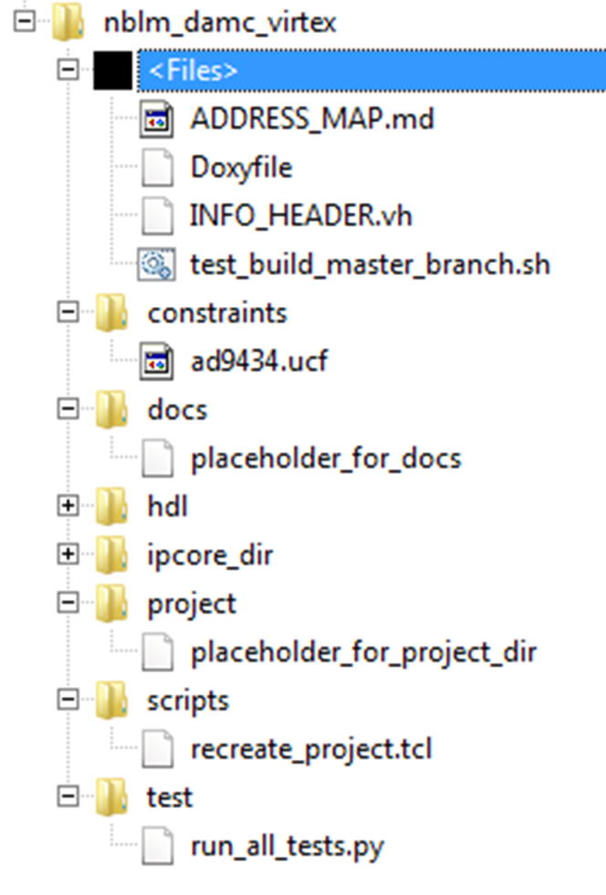
nBLM bitbucket
The used version of the FPGA ﬁrmware was 0.1.02, generated from the following commit in ESS-nBLM-500M repository (https://bitbucket.org/europeanspallationsource/ess-nblm-500m-software) with recreate_project.tcl script with Xilinx ISE 14.7.
The software used to perform the test was obtained from ESS-nBLM-500M-software repository (https://bitbucket.org/europeanspallationsource/ess-nblm-500m-software).

Slide 21
nBLM
This example assumes that there is a function generator attached to the input in the following configuration:
Setting Value
Mode Pulse
Amplitude 120 mVpp
Pulse width 30 ns
Frequency 1 kHz
The maximum event frequency was determined to be 320 Hz when capturing 1us of data (500 samples) and 270 Hz when capturing 2us of data (1000 samples).
We suspect that the limiting factor is the plotting library [SW].

Slide 22
Questions

