Slide 1
Welcome, news and intro
Andreas Jansson
www.europeanspallationsource.se
3 October 2016

Slide 2
Overview
ESS project overview (non-BI related)
Lund Organization
Installation Planning and Readiness Reviews
Internal Reviews – CDRs & PDRs
Delivery Milestones & Delays

Slide 3
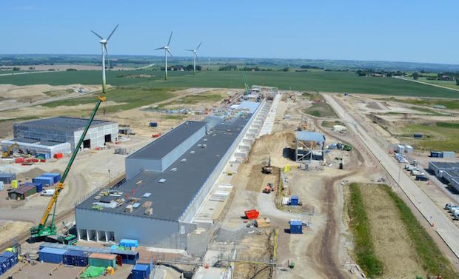
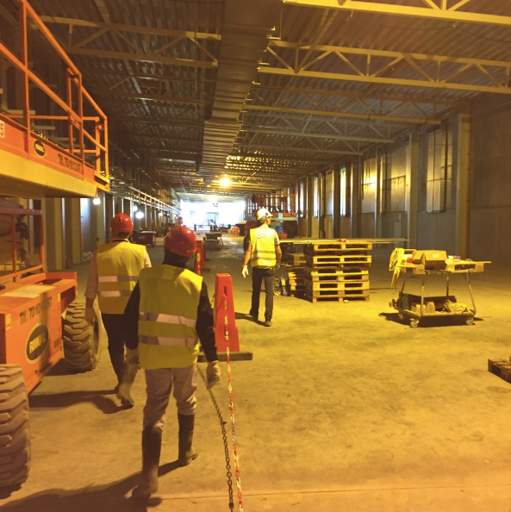
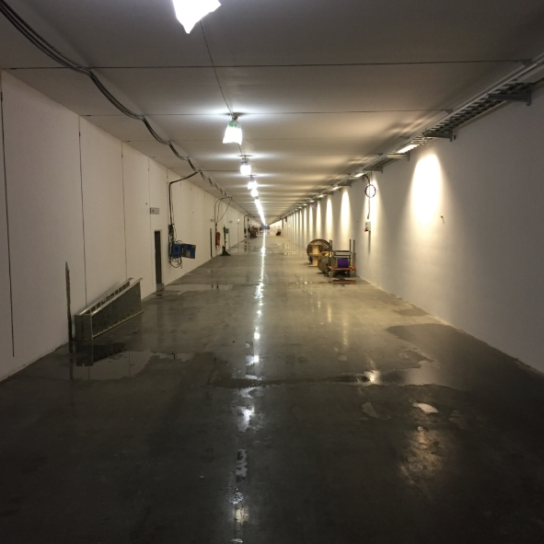
Progress on civil construction
27 April 2016

Slide 4
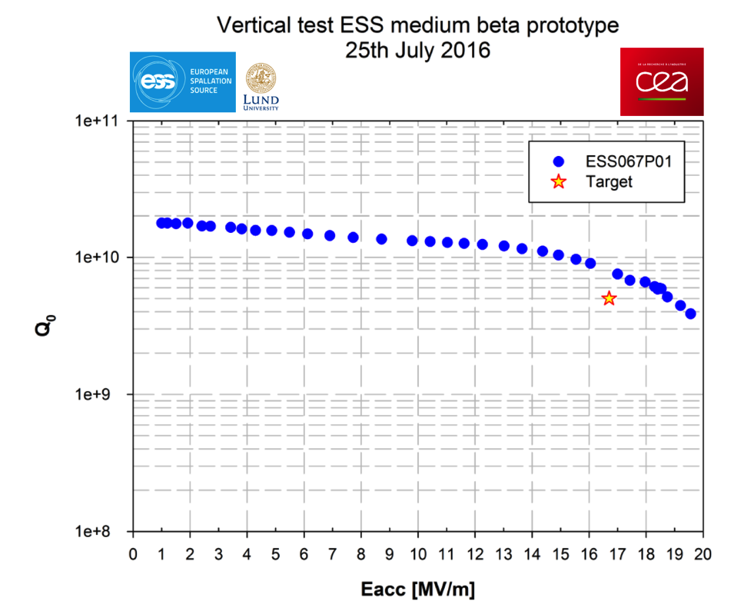
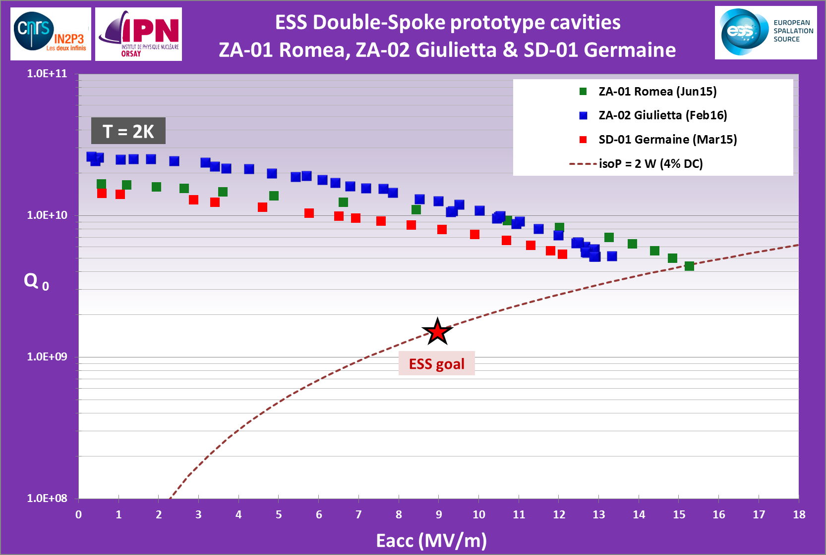
SC Cavity Performance
Pcav<0.5W
Chemical etching
WP4 - Spoke
Cavities and
Cryomodules
WP5 - Elliptical
Cavities and
Cryomodules
Ultra pure water
high pressure rinsing

Slide 5
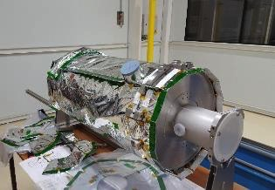
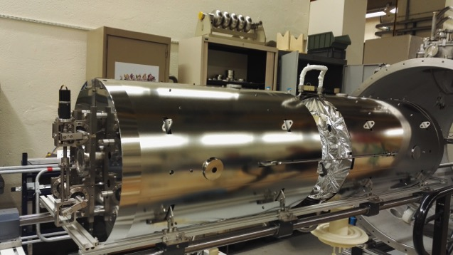
Prototype Cryomodules
WP4 - Spoke
Cavities and
Cryomodules
WP5 - Elliptical
Cavities and
Cryomodules

Slide 6
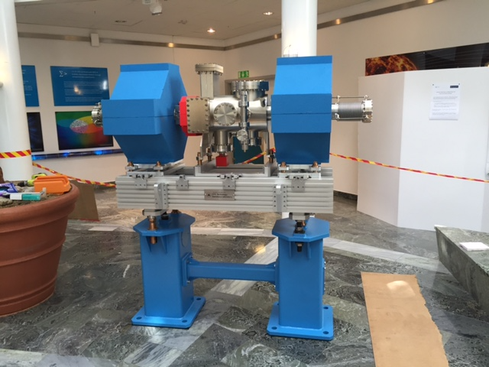
LWU prototype (Daresbury)
WP12
Vacuum

Slide 7
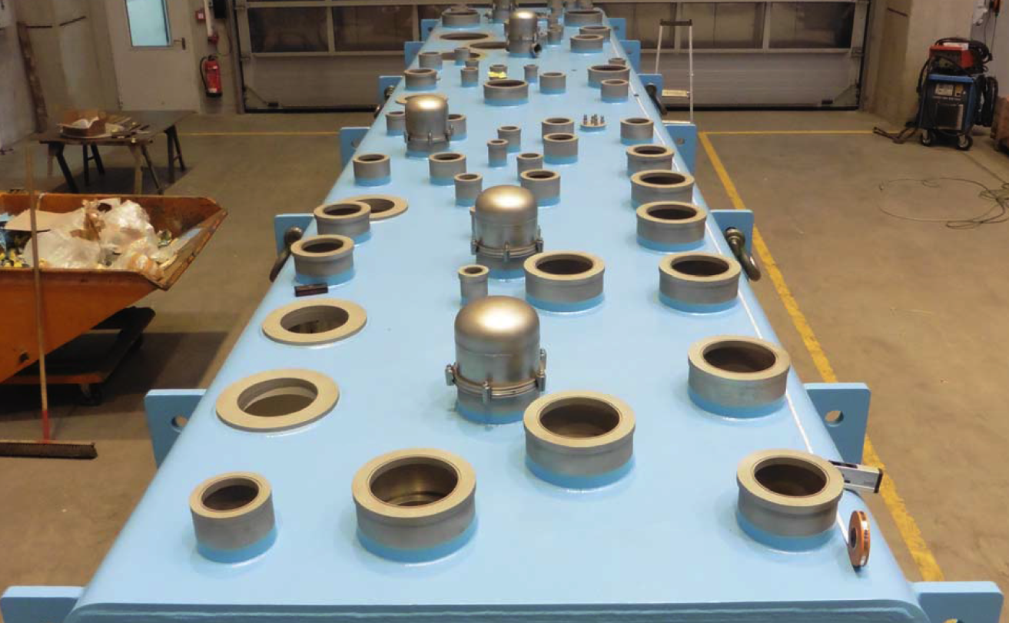
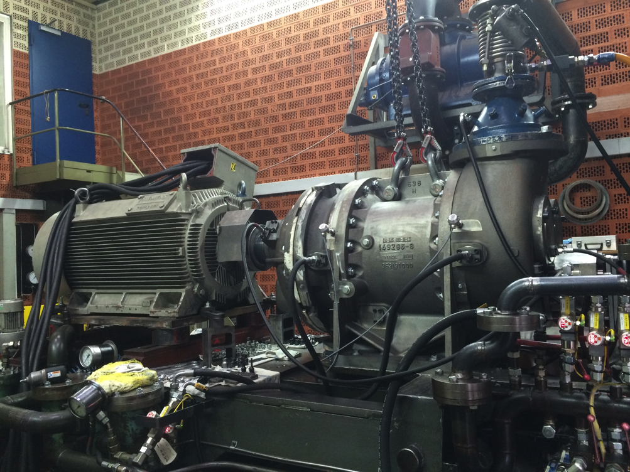
Cryo hardware
WP11 - Cryogenics
Notes:
Screw compressor (FAT, all successful) and ACCP valve box cover

Slide 8
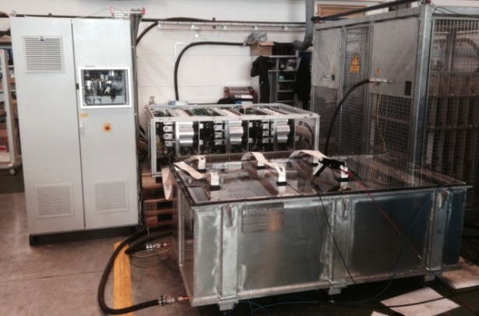
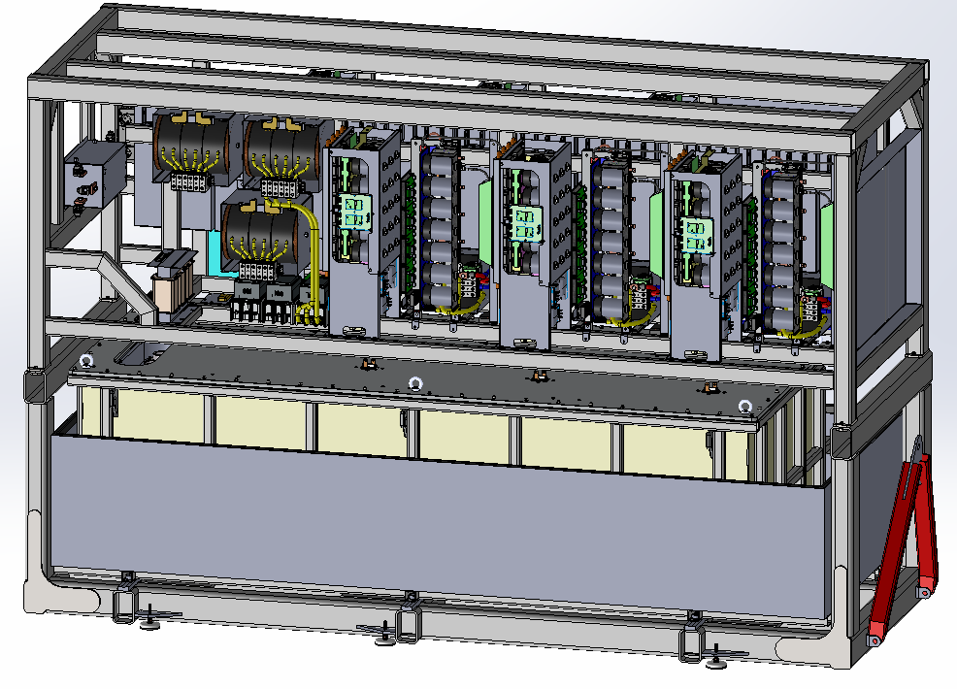
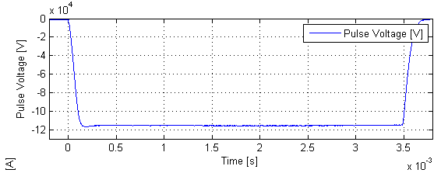
SML Modulator
Part I
Part II
WP17 - Modulators

Slide 9
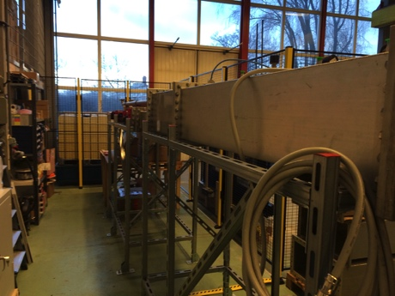
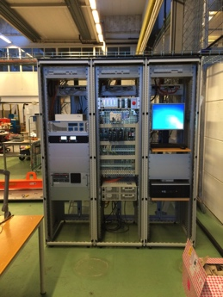
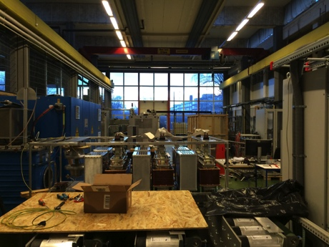
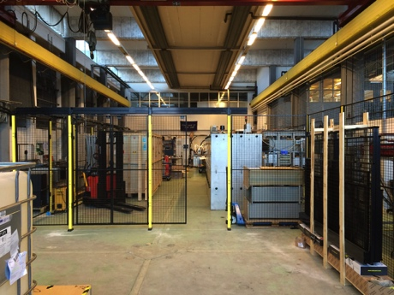
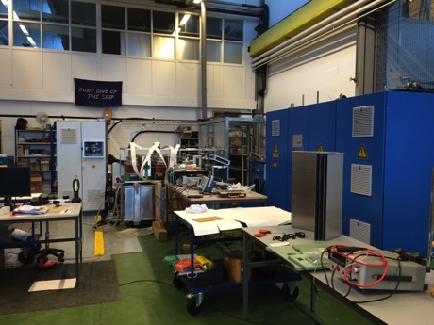
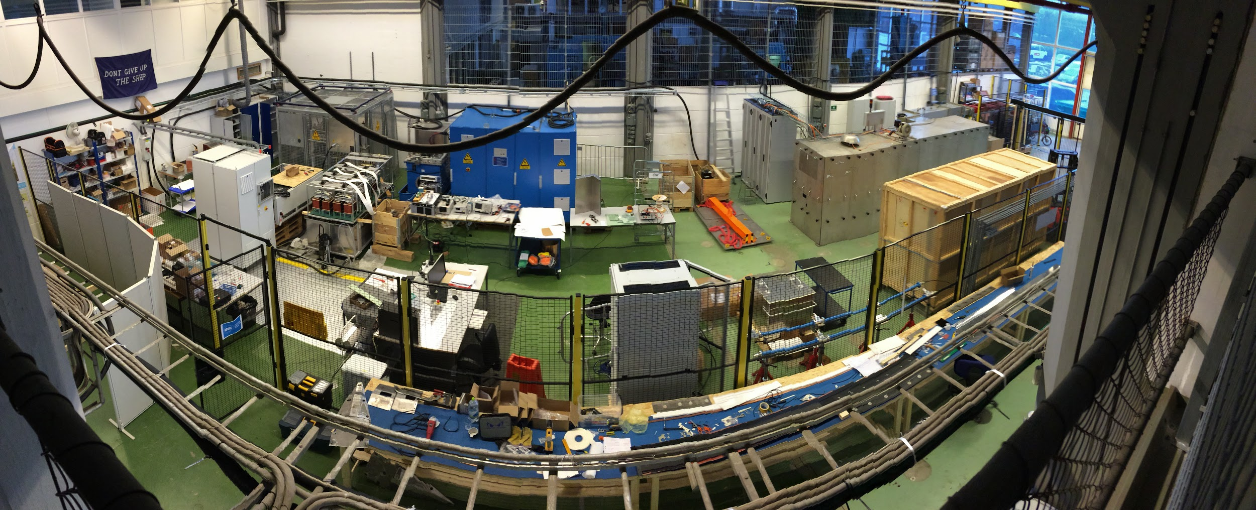
RF Test Stand

Slide 10
First plasma in the ion source in Catania
WP3 – Warm Linac

Slide 11
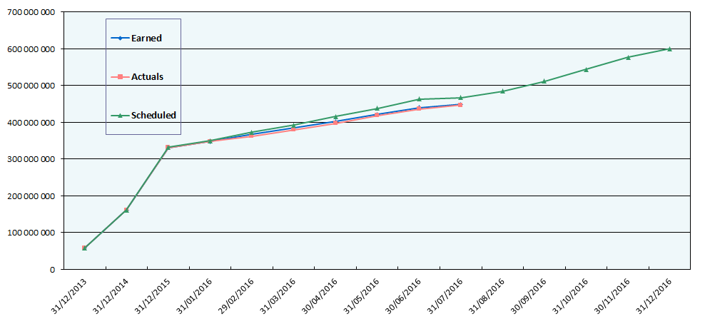
July– 2016 – ESS TOTAL
Scheduled: 467 MEURO
Earned: 449 MEURO
Actuals: 447 MEURO
Completed of total project : 24 %

Slide 12
Accelerator installation and commissioning organization (project)
BAS-U
ESS Accelerator installation manager
Accelerator installation manager
Nick Gazis
Deputy: Edgar Sargsyan
Area coordinator RF gallery – E. Sargsyan
Area coordinator Tunnel and FE cave – N. Gazis
Area coordinator Cryobuildings – W. Hees
Area coordinator Test stand – W.Hees
AD and ESS central installation services
RATS and logistics
(Central function)
Planning coordination – Edgar Sargsyan
Quality – Matthew Conlon
System installation coordinators
System installation coordinators
System installation coordinators
System installation coordinators
Safety – Lali Tchelidze
Services
Components

Slide 13
AD org chart
ACCELERATOR DIVISION
Mats Lindroos
Beam Physics, Operation & Beam Diagnostics
Andreas Jansson – GL
Engineering Resources
David McGinnis – GL
Eugene Tanke
Nick Gazis
Carl-Johan Hårdh (C)
Daniel Lundgren (C)
Mats Pålsson (C)
LINAC
Håkan Danared – GL
Radio Frequency
Anders Sunesson - GL
Admin & QA
Caroline Prabert
Inga Tejedor
Matthew Conlon
Safety
Lali Tchelidze – GL
Duy Phan
Enric Bargalló
Eder García Etxearte (I)
Frank Kornegay (C 15%)
Mikael Motyka (S)
Spec. Technical Services
John Weisend II – GL
Wolfgang Hees
Anton Lundmark
Evangelia Vaena
Frithiof Jensen
Gunilla Jacobsson
Beam Physics
Mamad Eshraqi - SL
Marc Munoz
Renato de Prisco
Ryoichi Miyamoto
Yngve Levinsen
Saeid Pirani (S) (at INFN)
Beam Diagnostics
Tom Shea – SL
Benjamin Cheymol
Cyrille Thomas
Hooman Hassanzadegan
Hinko Kocevar
Irena Dolenc Kittelmann
Maurizio Donna
Rafael Baron
Charlotte Roose
Ebbe Malmstedt (C)
Thomas Grandsaert (C)
Johan Norin (C)
Linac Hardware
Vacant - SL
Christine Darve
Georg Hulla
Walter Wittmer
Felix Schlander
Nuno Elias (EIS)
Peo Gustafsson (C)
Frank Hellström (C)
Fredrik Håkansson (C)
Accelerator Integration
Stephen Molloy – SL
Aurélien Ponton
Edgar Sargsyan
Iñigo Alonso
Power Converters
Carlos Martins – SL
Göran Göransson
Marko Kalafatic
Paulo Jose Torri (2 May)
Anders Andersson (C)
RF Sources
Morten Jensen – SL
Rihua Zeng
Rafael Montano
Bruno Lagoguez
Chiara Marrelli
Rutambhara Yogi
Staffan Ekström
Stevo Calic
Iñigo de la Fuente
Krisztian Löki (S)
Miklós Boros (S)
Cryogenics
Philipp Arnold – SL
Jaroslaw Fydrych
John Jurns
Xilong Wang
Xiaotao Su
Piotr Tereszkowski (C)
Vacuum
Marcelo Juni Ferreira – SL
Hilko Spoelstra
Simone Scolari
Christophe Jarrige
Fabio Ravelli (1 June)
Kristell Barthélemy (20 June)
Peter Ladd (C 50%)
Planning
Luisella Lari
Lena Gunnarsson
Håkan Danared – Deputy Head of Division
John Weisend II – Deputy Head of the Project
63 employees (2016-04-01)
Consultants, Students, Interns and empl from
Eng Integr Sup Div, in Yellow + Planners = 21 people
Beam Diagnostics
Tom Shea – SL
Benjamin Cheymol
Cyrille Thomas
Hooman Hassanzadegan
Hinko Kocevar
Irena Dolenc Kittelmann
Maurizio Donna
Rafael Baron
Charlotte Roose
Ebbe Malmstedt (C)
Thomas Grandsaert (C)
Johan Norin (C)
13
Caroline Prabert 2016-04-01

Slide 14
BI Organization in Lund
Tom (Section Leader)
Prioritize work within group to meet milestones
Provide technical/planning feedback and suggestions
Coordinate work across BI systems
If needed, make technical decisions and propose scope/schedule changes.
Andreas (Work Package Leader)
High level review and maintenance of WP plan and budget
Organize PDRs/CDRs in accordance with plan
Handle scope and schedule changes
Push in-kind contract signatures and address in-kind issues*
Solve high level issues with other groups*
*These issues should be solved at section level as far a possible.
Please adress first directly with identified point persons.

Slide 15
Lund Section Organization
System Leads
Technology Team
BLM – Tom (interim*)
BCM – Hooman
BPM – Rafael
FC – Benjamin
EMU – Benjamin
WS – Benjamin
NPM - Cyrille
BSM – Benjamin (interim*)
Target Diagnostics - Cyrille
Insertable Stops - Tom
Hardware – Rafael
Software – Hinko
FPGA – Maurizio
Mechanical – Thomas G
Always involve relevant system System Lead in any communication
CC Tom and Andreas when appropriate
Very simplified: How? -> Tom
When -> Andreas (& Tom)
* While Irena on maternily leave

Slide 16
Communication and information
CHESS http://chess.esss.lu.se/
Reference documents
Installation Plan (more on this later)
Confluence http://ess-ics.atlassian.net/
BI Section Page
Building Block Pages (see Rafaels talk)
Accelerator Home Page
Accelerator Event Calendar https://ess-ics.atlassian.net/wiki/display/AD/Accelerator+Events+Calendar
Indico http://indico.esss.lu.se/
Technical Board Meetings (under Accelerator)
TAC reviews (under Conferences)
Annual Reivews (under Conferences)
Primavera P6
Now have installation planning integrated
Access limited due to license issue, mostly via planners
Mirror of in-kind agreement milestones for partners

Slide 17
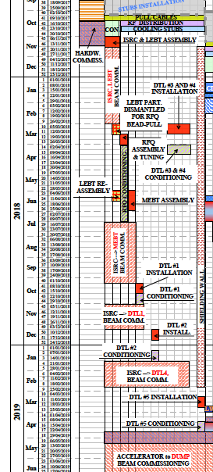
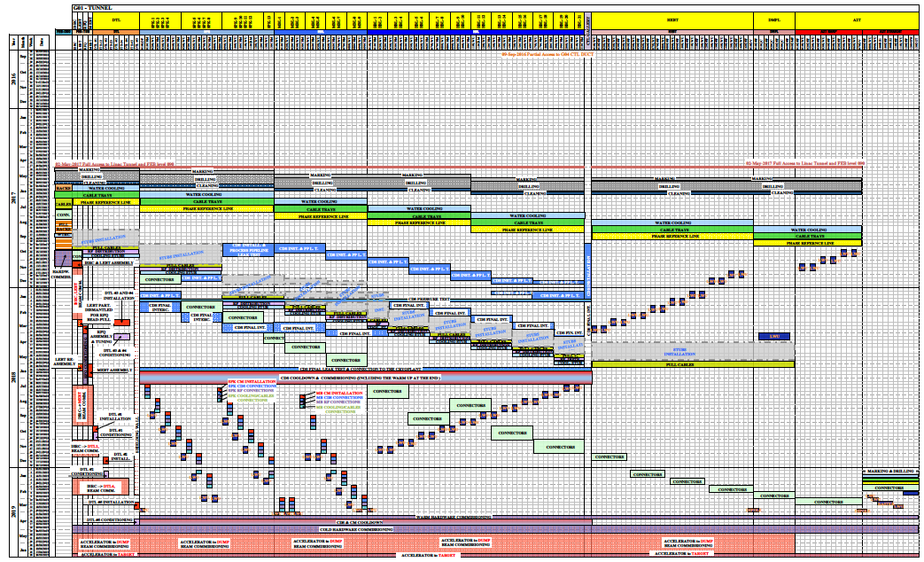
Installation Plan - Tunnel

Slide 18
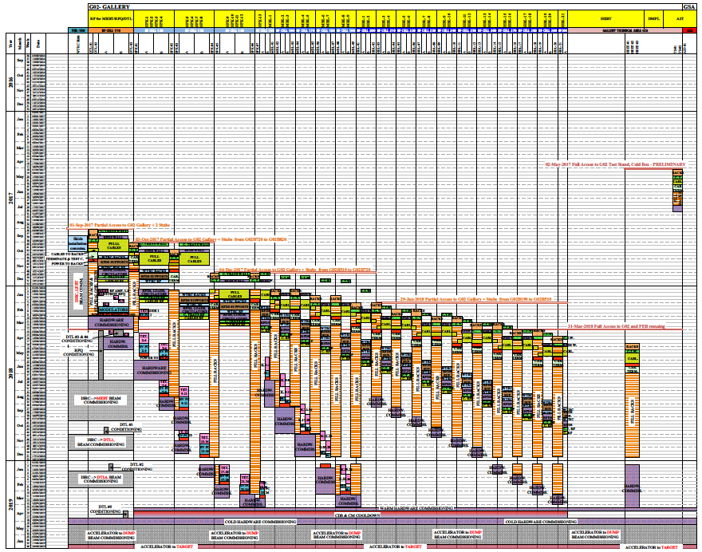
Installation plan – FEB & Gallery
CHESS:
ESS-0055889

Slide 19
Licensind and Readiness Reviews
Modelled on DOE Accelerator Rediness Reviews
Part of our licensing procedure with SSM, but wider than just radiation safety
All equipment relevant to the part fo the machine to be comissionign need to be installed and tested by the reivew

Slide 20
ESS Readiness Reviews
Review | Scope | Installation Starts | Review date | Commissionoing Starts | Commissioning Completed
1 | Ion Source & LEBT | Nov 2017 | Dec 2017 | Jan 2018 | Jun 2018
2 | RFQ & MEBT | May/Jun 2018 | June 2018 | July 2018 | Oct 2018
3 | DTL 1 | Aug 2018 | Sep 2018 | Oct 2018 | Dec 2018
4 | DTL 2-4 | Jan 2019 (DTL2) | Feb 2019 | Feb 219 | Mar 2019
5 | DTL 5 & SPK & MBL & HEBT | Jan 2018 (SPK) Feb 2019 (DTL5) | Mar 2019 | Mar 2019 | Jun 2019
6 | AT2 & HEBT & Target & Instruments & NSS essential infrastructure | - | Jun 2019 | End Jun 2019 | -

Slide 21
Internal Reviews – PDRs and CDRs
Reviews are there to help us out!
PDR: ensure common understanding of deliverables by all stakeholders, and that design concept is likely to perform well and be maintainable. Also that planning is consistent with delivery milestones.
CDR: ensure the design will work according to specs, and is ready for production. Also that production schedule is consistent with delivery milestones
For recent examples: see e.g. MEBT BI PDR, Target Imaging PDR on Indico.
Have agreement to and will adapt review to scope of deliverable for PBI (e.g. document review for small scope)
It can be a lot work, but it pays in the long run.
Notes:
Texas multiwires

Slide 22
Deadlines
The ESS schedule is very tight, but works if everyone delivers on time. Very little float.
Very important that we all do our utmost to deliver according to agreed dates (even if we “know” others are late).
In case unforeseen circumstances means that this is impossible, please share this as soon as possible so that we can address it together.

Slide 23
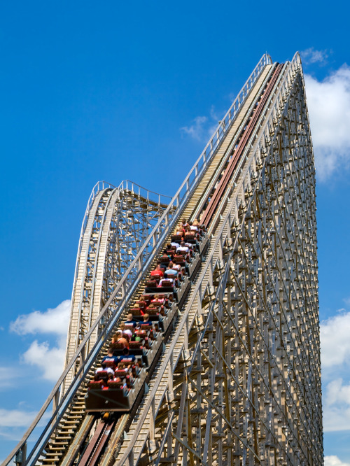
Outlook
It’ll be a fun ride, but might
be bumpy at times.
Remember, we’re in it together…

