Slide 1

nBLM project at ESS
A New Beam Loss Monitor Concept Based on Fast Neutrons Detection using Micromegas detector
ESS 2nd BI Forum
Bilbao October 3-4, 2016
Laura Segui & Philippe Legou
for Saclay group
A. Delbart, D. Desforge, F. Gougnaud, C. Lahonde-Hamdoun,
P. Legou, J. Marroncle,T. Papaevangelou, L. Segui, G.Tsiledakis
DSM/Irfu, CEA Saclay

Slide 2
Overview
▪ Why new BLM?
▪ Micromegas in few words
nBLM simulations
Examples of Micromegas detectors setup
▪ Summary

Slide 3


Why new BLM?
  Measure the Beam Losses quite accurately and their locations
Two objectives: monitoring and safety
Challenges
• RF cavities emit γ's → background for ionization chambers used as BLMs
• Continuous monitoring of small losses is needed
Requirements
1 - Blind for γ’s and X-rays contributions from cavity emissions
2 - directionality → good correlation beam loss location / detection (blind for thermal neutrons)
3 - good efficiency
4 - Sensitive enough to monitor small losses
5 - Appropriate for high rates, radiation hardness
6 - Sensitive and fast enough to react on “catastrophic event”
 Proposal:
Neutron BLM (nBLM), based on Micromegas detector equipped with neutron convertors and moderators
A NEW BEAM LOSS MONITOR CONCEPT BASED ON FAST NEUTRON DETECTION AND VERY LOW PHOTON SENSITIVITY, Jacques Marroncle et al, IBIC 2016

Slide 4
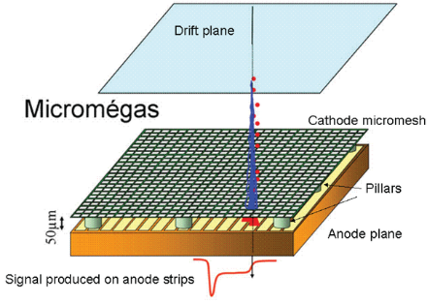
Micromegas Detector
Micromegas: Multi-Pattern Gaseous Detector, invented in 1995 at CEA Saclay¹
Parallel plate detector with a strengthened thin mesh dividing the gas volume in 2 parts:
  drift region (1 to 10 mm) → E ≈ 100 V/mm
  amplification region (30 to 100 µm) → E ≈ 10000 V/mm
Lot of improvements, evolutions can be done on Micromegas and by changing their parameters (gaps, gas, electric potential, read-out…). It can achieved:
  high fluxes greater than 10⁸ counts/cm²/s (KABES, DEMIN)
  spatial resolutions down to 15 µm
  time resolution down to 30 ps
  cylindrical shape are now working routinely (ASACUSA, Clas12)
large surface area (>1 m²) can be covered (COMPASS, ATLAS)
Resistive bulk technologies, reduce spark effects, reducing dead time → BLM
¹ Y. Giomataris, P. Rebourgeard, J.P. Robert and G. Charpak, “Micromegas: A high-granularity position sensitive gaseous detector for high particle-flux environments”, Nuc. Instrum. Meth. A 376 (1996) 29.

Slide 5
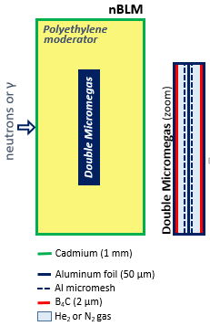
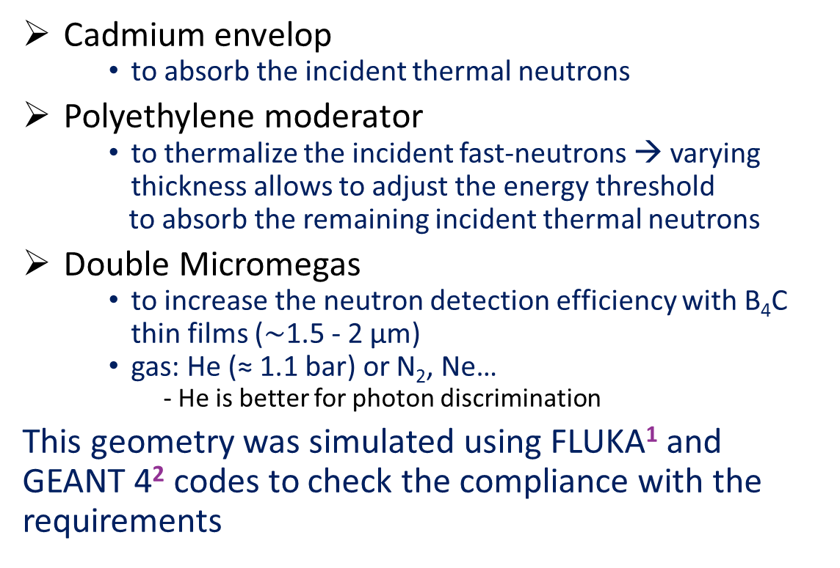
nBLM geometry
Cadmium envelop
  to absorb the incident thermal neutrons
Polyethylene moderator
  to thermalize the incident fast-neutrons → varying thickness allows to adjust the energy threshold
  to absorb the remaining incident thermal neutrons
Double Micromegas
  to increase the neutron detection efficiency with B₄C thin films ($\sim$1.5 - 2 µm)
  gas: He (≈ 1.1 bar) or N₂, Ne…
    - He is better for photon discrimination
This geometry was simulated using FLUKA¹ and GEANT 4² codes to check the compliance with the requirements
(zoom)
¹ G. Battistoni et al., The FLUKA code: Description and Benchmarking, in Proc. AIP Conf. Proc. 03, vol. 896, 2007, pp.31. http://dx.doi.org/10.1063/1.2720459.
² GEANT Collaboration, S. Agostinelli et al., GEANT4-a sim-ulation toolkit, NIM A 509 (2003) 250.

Slide 6
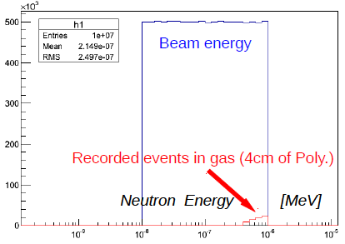
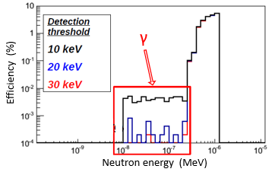
nBLM response to external “thermal” neutrons
0.01 < E_{neutron} (eV) < 1
¹¹³Cd (n, γ) ¹¹⁴Cd capture
0.001
0.01
0.1
1
(eV)
0.001
0.01
0.1
1
10
Incident E_{neutron} (eV)
Thermal neutrons with respect to detection thresholds:
  10 keV → Eff. < 0.007 %
  30 keV → nBLM is blind to external thermal neutrons
  Background: γ contributions coming from ¹¹⁴Cd and ¹⁰B neutron are taken into account, but almost completely removed with low detection thresholds.

Slide 7
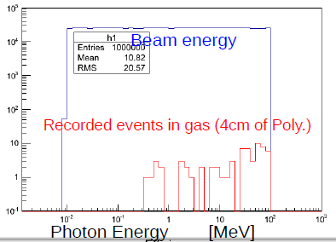
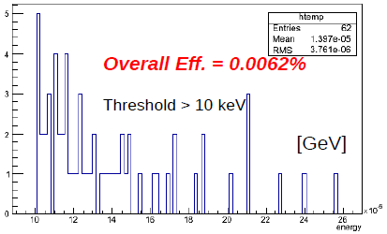
nBLM response to X-rays and γ
0.01 < E_{photon} (MeV) < 100
10⁻²
10⁻¹
1
10⁻¹
10²
10
14
18
22
26
Incident E_{photon} (MeV)
ΔE_{photon} (keV)
Photons with respect to detection thresholds:
  10 keV → Eff. < 0.0062 %
  20 keV → nBLM almost blind to photons
  Note: Micromegas is a thin gas chamber with small amount of material, explaining their transparency to photons (low RL)

Slide 8
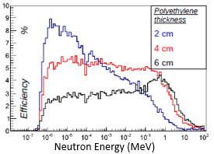
nBLM efficiency to fast neutrons
Moderator thickness
  2, 4 and 6 cm
  Threshold energy = 10 keV
  Overall efficiency for 4 cm → 3.8%
  Moderator thickness can be changed to tune slightly the neutron energy threshold.
Contribution of all neutrons under 0.2 eV is suppressed
  Thermal neutrons are almost removed

Slide 9
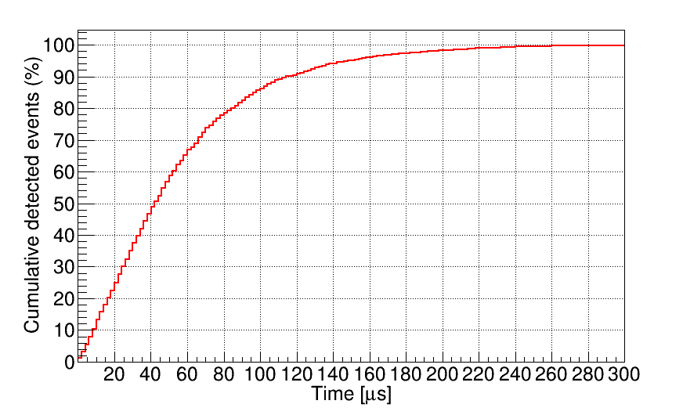
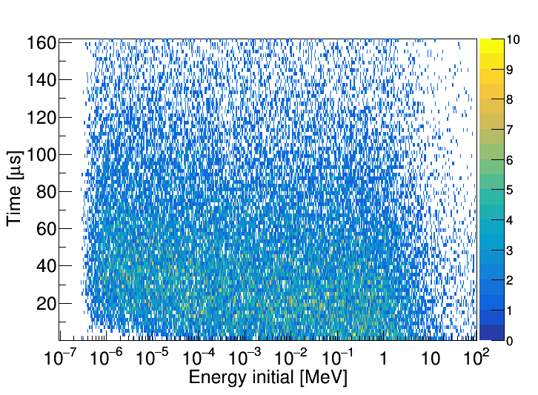
nBLM MonteCarlo simulations
nBLM time response:
Neutrons 0.1 eV < E < 100 MeV
Isotropically distributed in Cd surface, pointing towards the detector, ~15x10⁴ n/cm²
Time since particle creation until first energy deposit (Geant4 simulation).
Deposited
Eth = 10 keV
Deposited
Eth = 10 keV
▪ Only 10% of events detected in the first 10 μs
▪ 95% after 150μs (time due to neutron moderation time)
Could be too slow for safety reasons → Add a fast stage nBLM

Slide 10
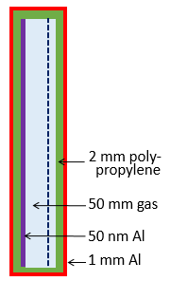
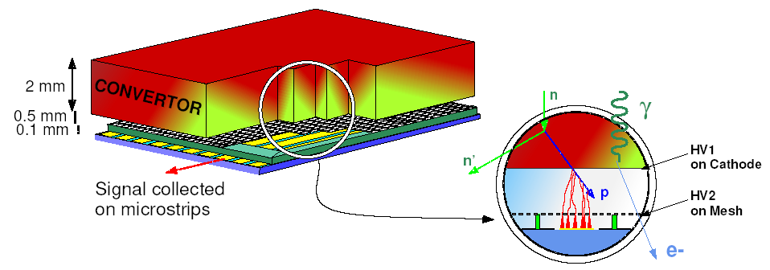
Fast nBLM
Principle of operation: detection of recoil protons produced in polypropylene
Fast nBLM geometry
  1 mm Al + 2 mm polypropylene will be enough to be quite insensitive to thermal neutron
  thin Al (50 nm) coating on polypropylene to polarize the Micromegas and to insure a high transparent to recoil protons.
Polyethylene
moderator
neutrons
or γ
fast MM
Double MM

Slide 11
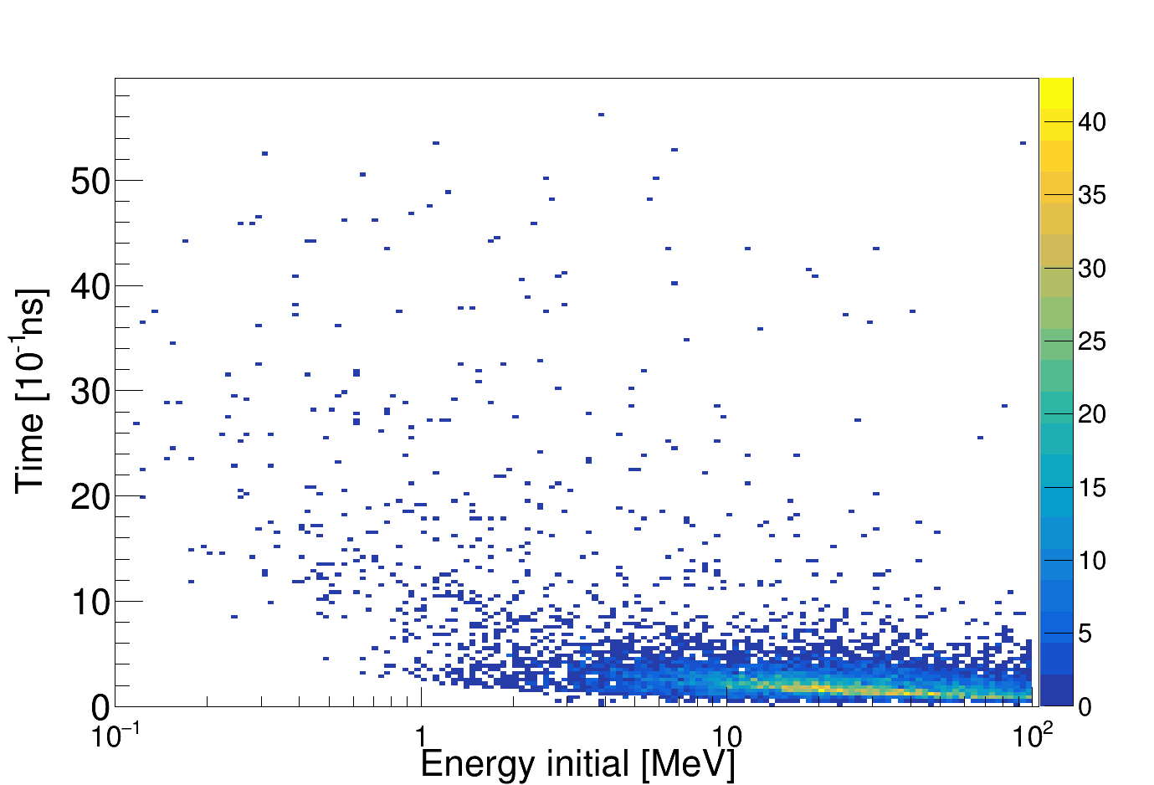
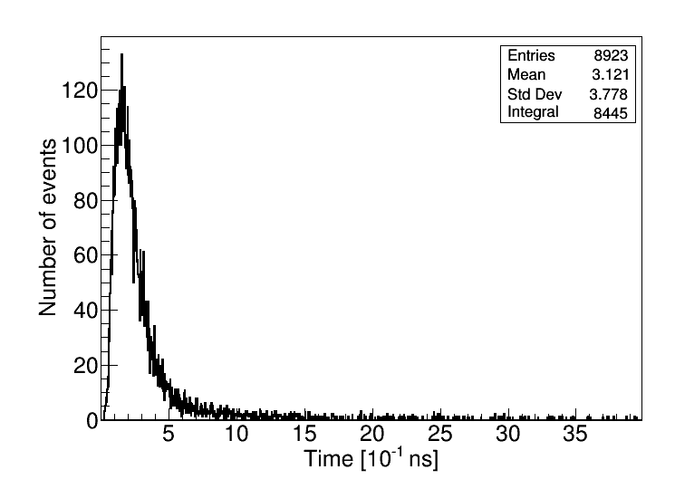
Fast response of the fast nBLM MonteCarlo studies
Time response and efficiency
▪ Neutrons between 0.1 – 100 MeV / Isotropically distributed in external Al surface, pointing towards the detector
▪ ~95% of events interacts in the volume in < 4 ns
Initial n energy
vs. time
Fast neutron (Th=10 keV) → low efficiency
  for E_{neut.} = 1 MeV → Eff. = 3 10⁻⁴
  for E_{neut.} = 10 MeV → Eff. = 8 10⁻⁴
Thermal neutrons: E=0.025 eV
  Thres. = 1 keV → Eff. = 6.6 10⁻⁵
  Thres. = 5 keV → Eff. = 5.8 10⁻⁶
  Thres. = 10 keV → Eff. < 5 10⁻⁷
Time distribution
Note : Fast-BLM’s mission is dealing with critical events  huge neutrons emission
L. Segui ESS BI Forum, Oct. 2016 1 1

Slide 12
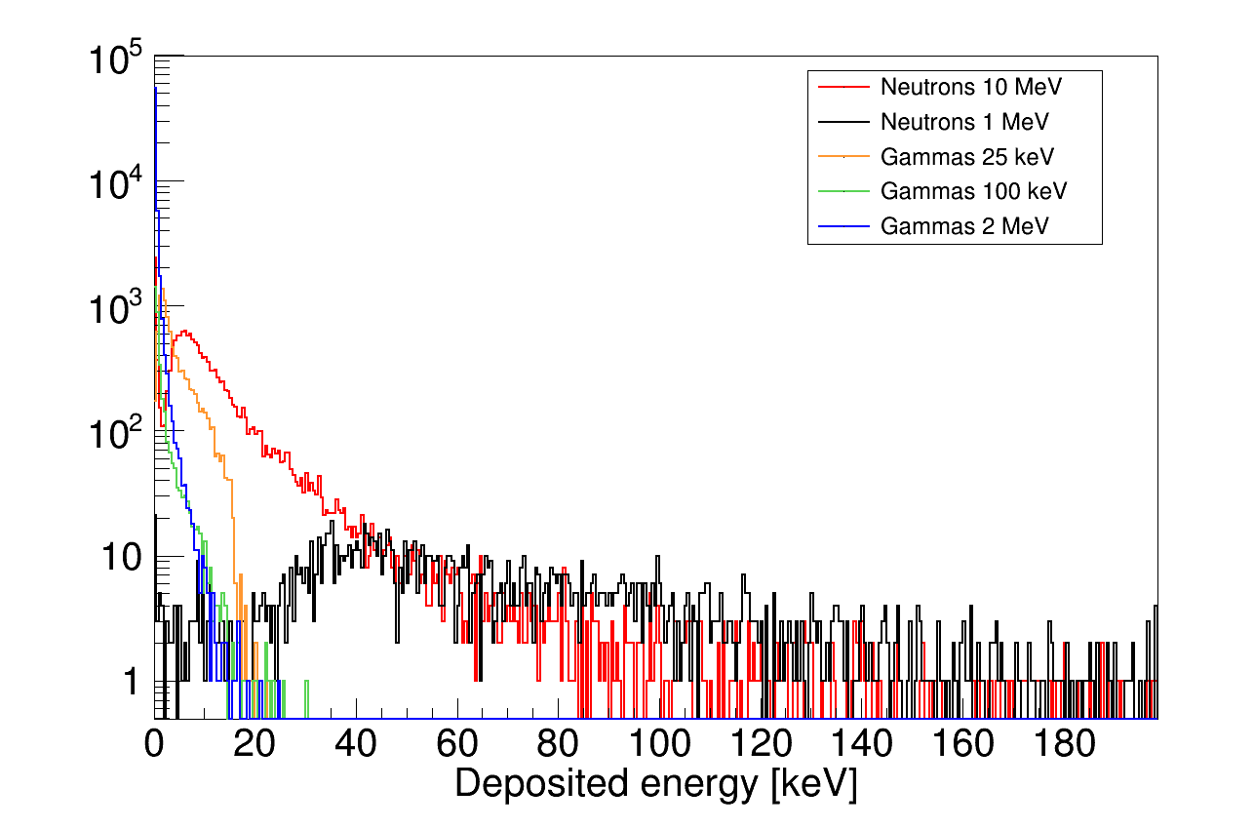
Fast nBLM MonteCarlo studies
Gammas and neutrons
Geant4, isotropic beam
Blind to gammas
Very good photon/neutron discrimination
With an energy cut >20 keV → detector blind to gammas
L. Segui ESS BI Forum, Oct. 2016 12

Slide 13
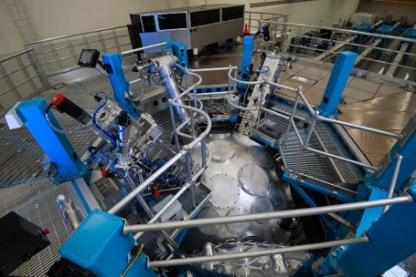

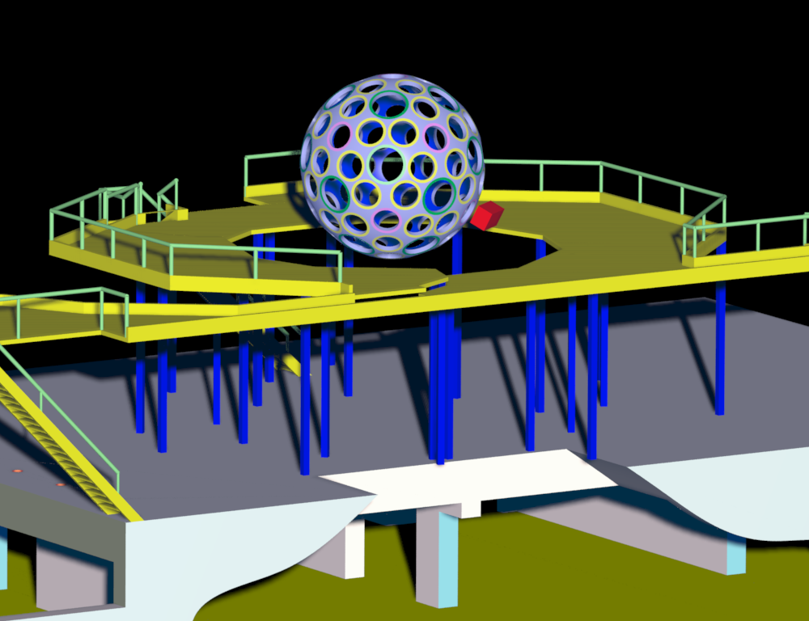
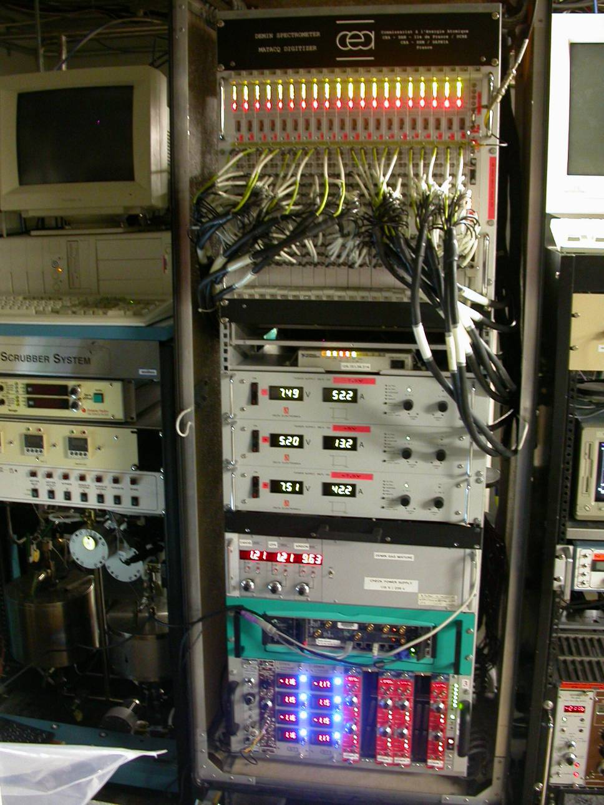
Example of experimental conditions in neutrons detection
(Inertial Confinement Fusion)
DEMIN
AND ANCILLARY RACK LOCATIONS
NY- USA
DEMIN
ANCILLARY RACK

Slide 14
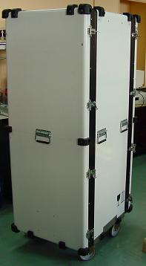
Ancillary rack
  ▪ Digitizers for pramp cards
  ▪ GPIB/Ethernet interface
  ▪ Power supplies for digitizers
  ▪ Gas flow regulator
  ▪ PC (drives the gas regulator)
  ▪ NIM crate :
    · High volyage unit
    (cathodes & Meshes)
    · Power supplies for preamps
180cm=71’’
70cm=27.5’’
14
Philippe Legou ESS Meeting 2016, July 25th

Slide 15
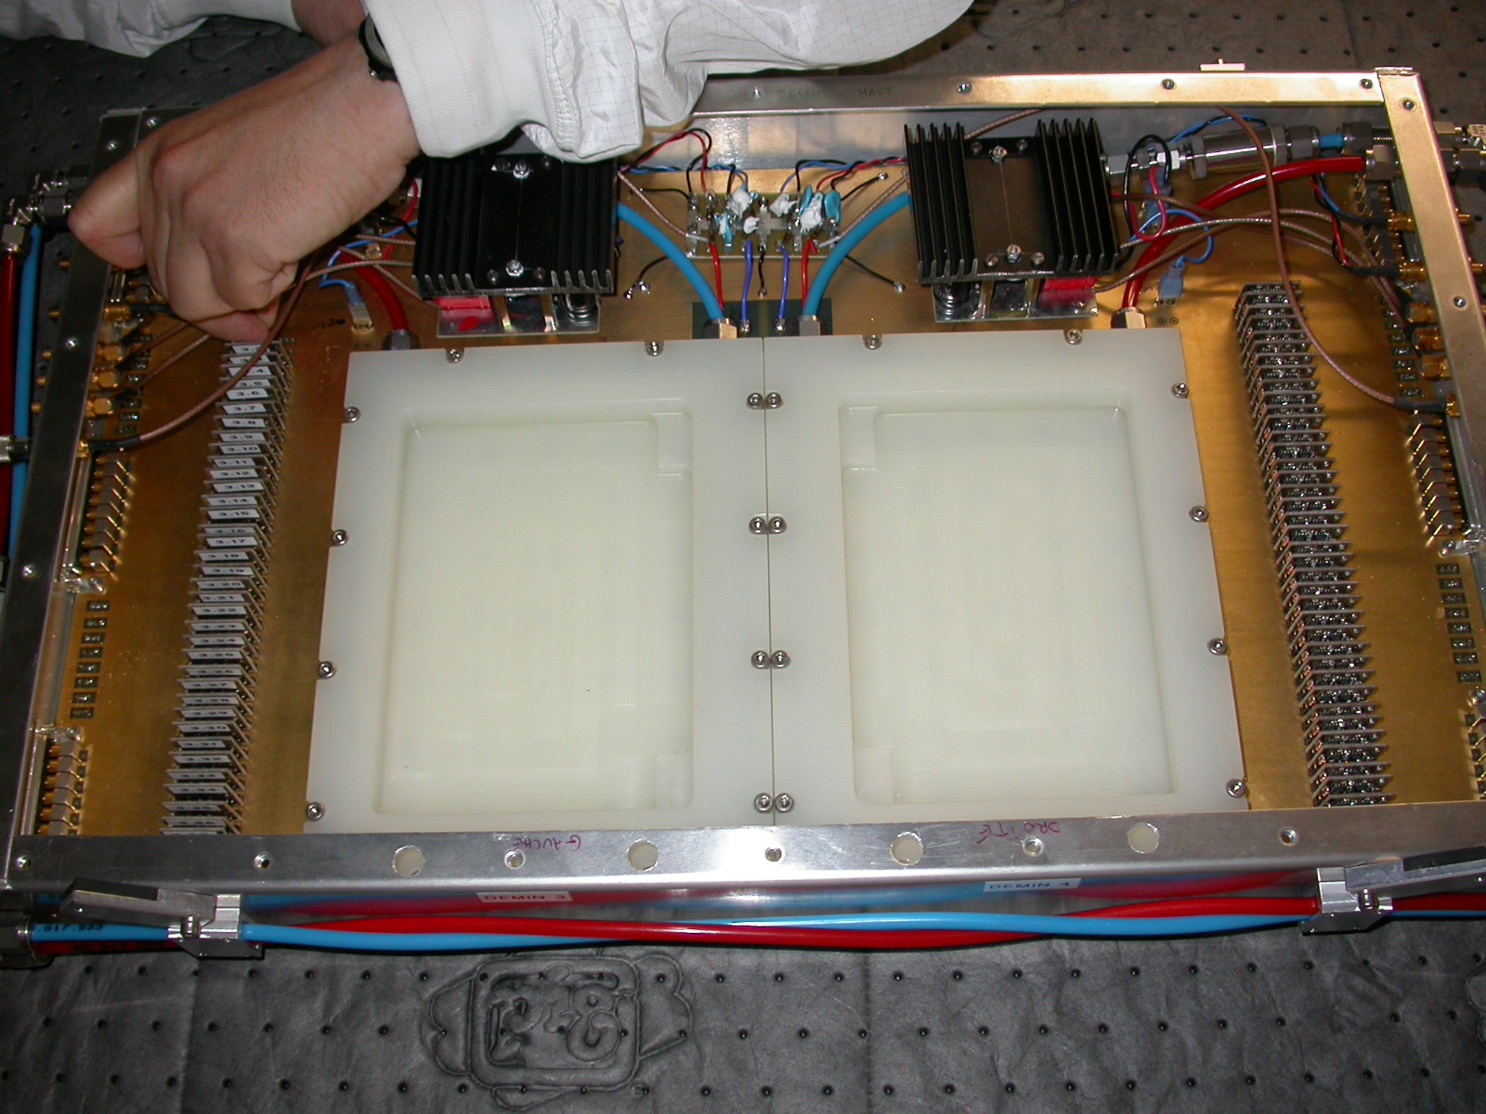
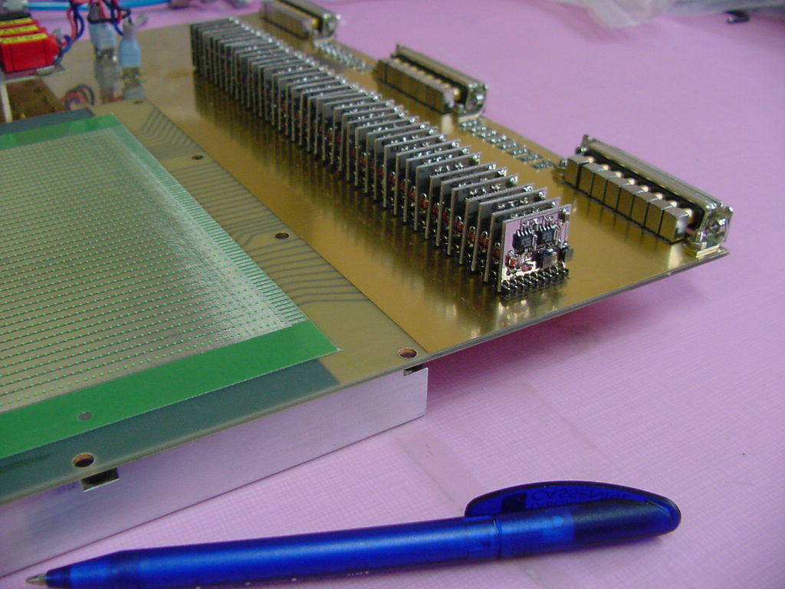
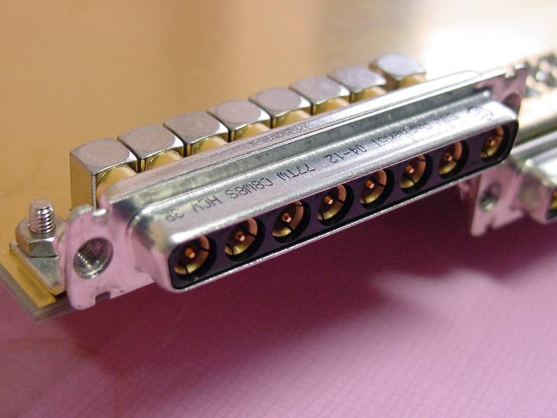
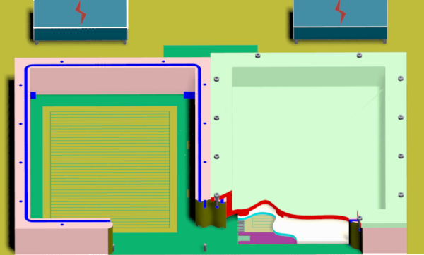
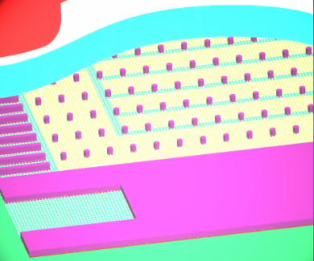
Strips, preamplifiers and conectors : good signals integrity
Coaxial connectors for analog
signals
Reading strips
preamplifiers
Cables for :
▪ Signals
▪ Low voltage / High Voltage
▪ Temperature sensor
The 4-layers PCB
Strips, spacers and the mesh are sticked
on the PCB by a single process.

Slide 16
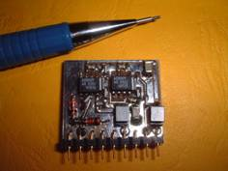
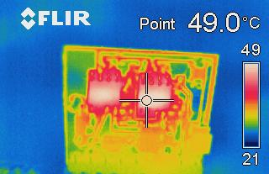
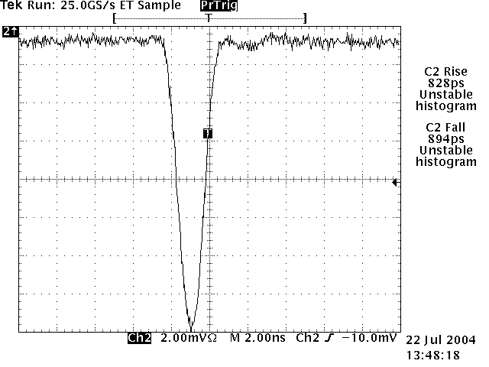
Example of Front end electronics used in neutron detection
The new front-end : FAMMAS
( Fast Amplifier Module for Micromegas ApplicationS)
In few figures …
Power supply : + 5V -5V
Consumption ≅ 50 mW
Input: positive or negative
Noise: 600 µV rms
Rise time : < 1ns
weight : 4g
Size: 22 x 20 x 5 mm
16

Slide 17
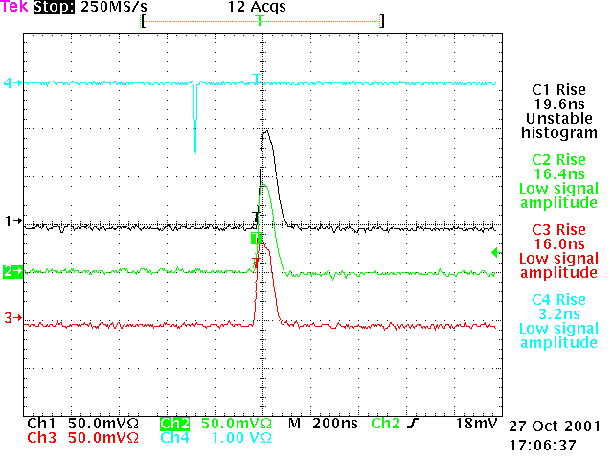
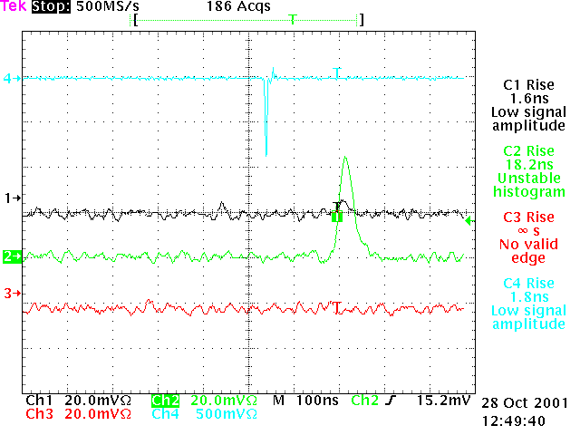
Beam test
Test conditions : ▪ visualisation at about 30 meters coaxial cable.
▪ Gaz : COMPASS.
▪ Beam.
Good signal / noise ratio
No crosstalk between neighbour channels
Mesh Voltage : 350 V
Mesh Voltage : 370 V

Slide 18
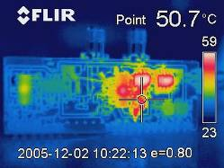
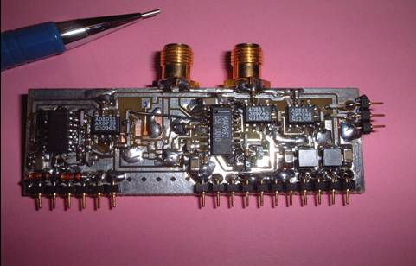
Front-end module with differential output
In few figures …
Power supply : + 5V -5.2V
Noise: 700 µV rms
Input: positive or negative
Output : ECL differential
Size: 60 x 22 x 5 mm
weight : 8g
Buffer area
plegou@cea.fr
18

Slide 19
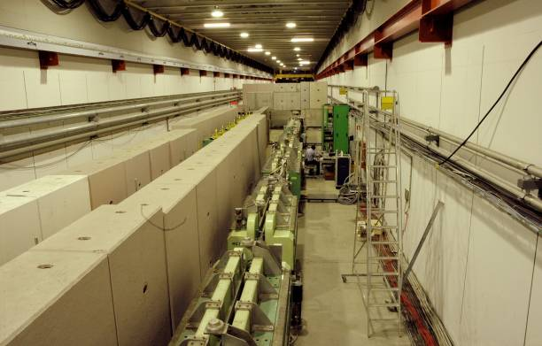
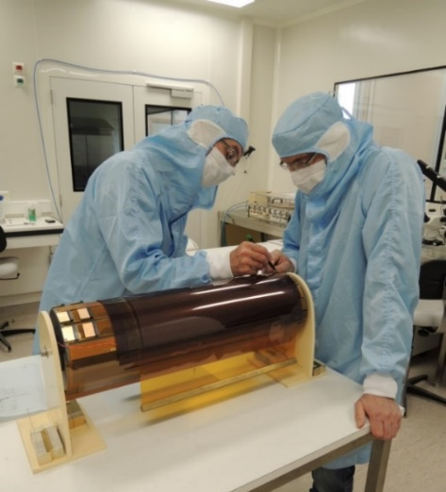
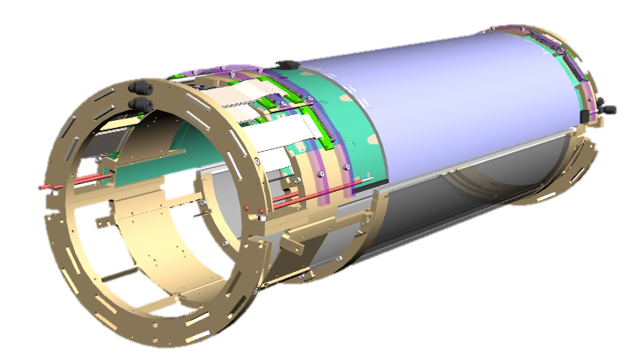
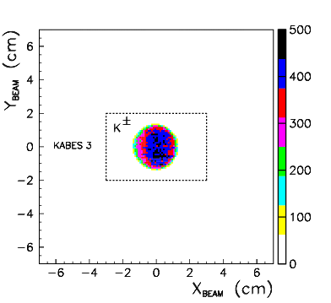
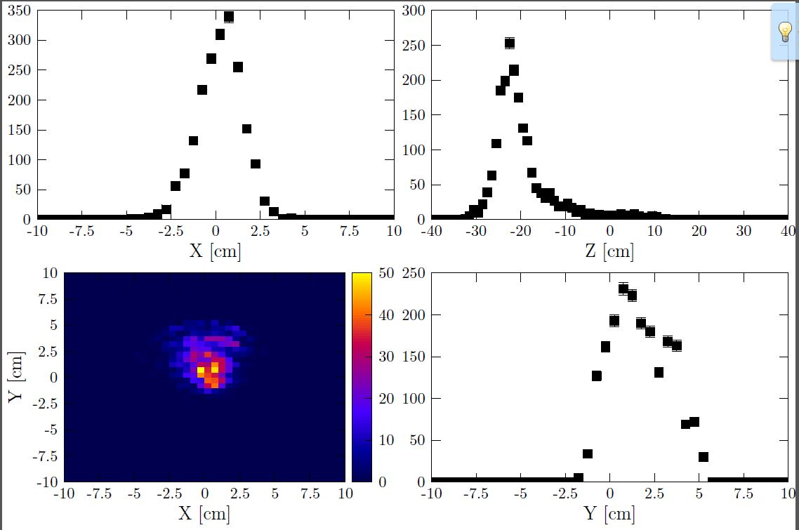
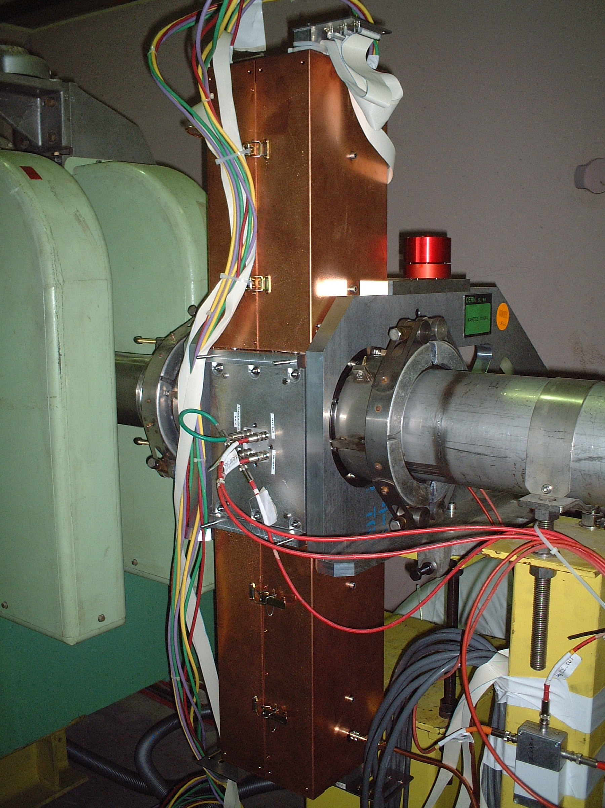
Examples of Micromegas applications
KABES on the SPS at CERN
ASACUSA
Curved tracker
2014 / today
KABES
TPC – CERN
2003 / 2005
NA 48 experiment in operation at CERN
from summer 2003 to end of 2005.
Flux 3x10⁶/cm²/s –
Principle TPC + Micromegas
KABES & SEXTANT
Beam Spectrometers using Micromegas in Time Projection Chamber mode,
Ph.Legou et al , 2007. NSS '07. IEEE (Volume:1 )
The ASACUSA Micromegas Tracker: A cylindrical, bulk Micromegas
detector for antimatter research
REVIEW OF SCIENTIFIC INSTRUMENTS 86, 083304 (2015)

Slide 20

nBLM project for ESS
CEA/Saclay in-kind contract with ESS
Expected time for optimization, design, construction, characterization, installation & commissioning of 42 modules: 2.5 year
▪ Dec. 2016 : PRD1, first design of the prototype
  On going design and simulations to optimize:
  Drift, polyethylene thickness, convertor, …
▪ June 2017: PDR2 and prototype
Test the detector at:
    • LICORNE (fast neutrons)
    • COCASE (high activity ⁶⁰Co irradiator)
    • ORPHEE (high thermal neutron flux / aging)
    • SEDI laboratory (long term stability)
▪ Nov. 2017: CDR1
  Initial prototype tests report
▪ April 2018: CDR2
  Final prototype tests
  Documentation of different systems:
  Slow control, electronics, etc...
▪ Dec. 2018 : System delivered to ESS
▪ ESS hand over: begin of 2019
ESS operation 2019
Dec. 2018
System
delivered
April 2018
Final design
June.2017
PDR2 prototype
Dec.2016
PDR1
L. Segui ESS BI Forum, Oct. 2016 15

Slide 21
Conclusion / Summary
Simulation of a new nBLM based on Micromegas detector has been performed
    good sensitivity to fast neutrons → overall efficiency ≈ 4%
    “blind” to thermal neutrons → directionality
    “blind” to X-rays and γ’s → to be safe from cavity photon emissions
    fast BLM component → t < 5 ns
    big neutron signal deposit (due to moderation) allows to count neutrons individually
    Reliable Micromegas solution
Future: design prototypes
  robustness, reliability, radiation hardness…
  gas choice
  fast and low noise FEE
  sealed mode… already tested but need to be checked
… and test with real neutrons

Slide 22
Gracias …

Slide 24
Fast nBLM MonteCarlo studies
Gammas and neutrons: drift and gas studies
As an example of studies on-going
For HE gammas, 0 events detected below 8 mm drift →
<2.0 x 10⁻⁷
Equilibrium between efficiency and gamma rejection
  Below 8 mm drift, “blind” for HE gammas with Eth at 20 keV
  Efficiency still of 3% (0.3%) for 10 (1) MeV neutrons at 5 mm
Repeat study with Ne → higher efficiency but also for gammas → smaller rejection

Slide 25
Fast nBLM MonteCarlo studies
Gammas and neutrons
 | Efficiency (x10⁻⁴)
 | 1 keV, min Edep | 10 keV cut | 20 keV cut
n 1 MeV | 3.56 | 3.41 | 3.27
n 10 MeV | 34.60 | 13.5 | 5.18
γ 25 keV | 20.0 | 1.78 | 0.008
γ 100 keV | 7.01 | 0.13 | 0.014
γ 2 MeV | 129.00 | 0.07 | 0.040
Blind to gammas
With an energy cut >20 keV → detector blind to gammas

Slide 26
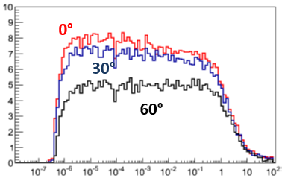
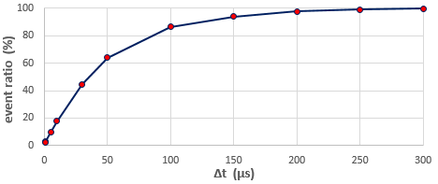
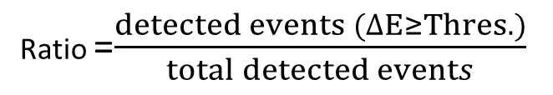
angular and time responses of nBLM
nBLM angular response
  quite low effect due to neutron slowing down inside moderator
  this behavior let us expect a nBLM efficiency greater than the active surface of Micromegas
Efficiency (%)
Neutron energy (MeV)
nBLM time response
  only 17% of events are detected during the 10 first µs, while they are all after 300 µs!
  due to neutron moderation time
  might be too slow for safety purposes
  ➔ Proposition to add a fast stage of BLM
Ratio =$\frac{detected events (∆E≥Thres.)}{total detected events}$

Slide 27
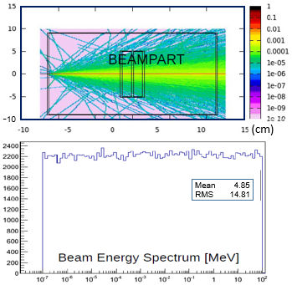
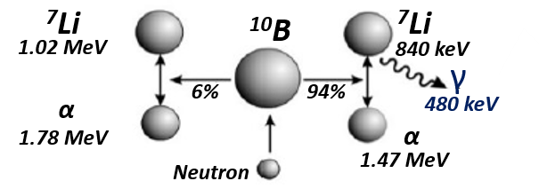
Event simulation
Hypothesis for FLUKA & GEANT 4 codes
  Neutrons: double exponential distribution for energy ranging from 0.1 eV to 100 MeV
  Photons: double exponential distribution from 10 keV to 100 MeV
  Withdrawing is done upstream and transversely to the nBLM entrance window in a volume filled with air
  angular divergence of 10 mrad for incident neutrons
Codes: calculate the energy deposition in the gas
Checked: results obtained with both codes are similar!

