Slide 1
LEBT EMU and DOPPLER
STATUS
BI FORUM
Franck Senée presented by Jacques Marroncle
Bilbao 2016, Oct. 3rd 2016

Slide 2
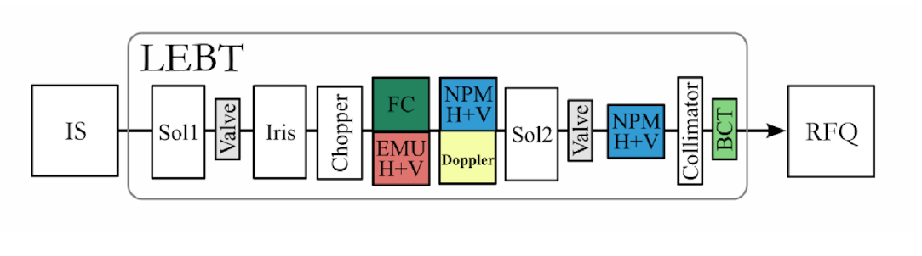

ESS LEBT
PERMANENT TANK
CEA: 2 emu (H - V) & 1 doppler unit
ESS ion source parameters:
Proton beam
75 keV
Current max = 100 mA
Pulse length = 6 ms
Repetition rate = 14 Hz
Duty cycle 8%
EMU V
EMU H
BEAM

Slide 3
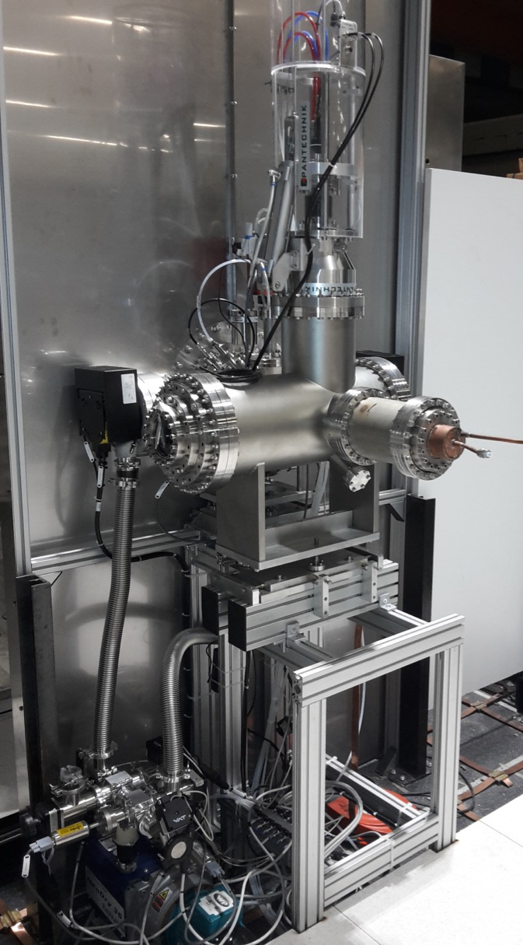
Beam profil and Commissioning phases at catania
LEBT Beam profilE and Commissioning
phases at catania
1
2
3
Doppler design
(Ø max = 80 mm)
EMU design
(Ø min = 6 mm)
1
P TANK
PRELIMINARY TANK
2
C TANK
PRELIMINARY TANK
installed at Catania
COMMISSIONING TANK
P TANK
C TANK
3
C TANK
PERMANENT TANK

Slide 4
EMU: Allison scanners type
EMU @ IRFU: philippe abbon - philippe daniel-thomas - jean-françois denis -françoise gougnaud - tom joannem - nicolas misiara - FRANCK SENÉE - VICTOR SILVA - Olivier tuske

Slide 5
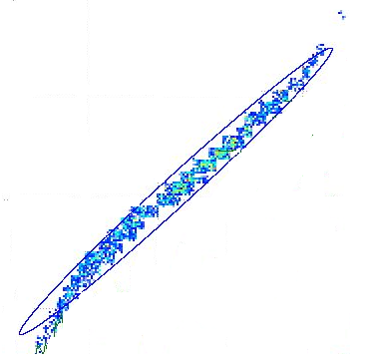
Working Principle
intensity
intensity
intensity
y’1
Angle y’
y’2
Angle y’
y’3
Angle y’
y’3
y’1
y1
Beam Axis
y’2
y’2
y2
y’1
y’3
y
y3
x
y1
y2
y3
z

Slide 6
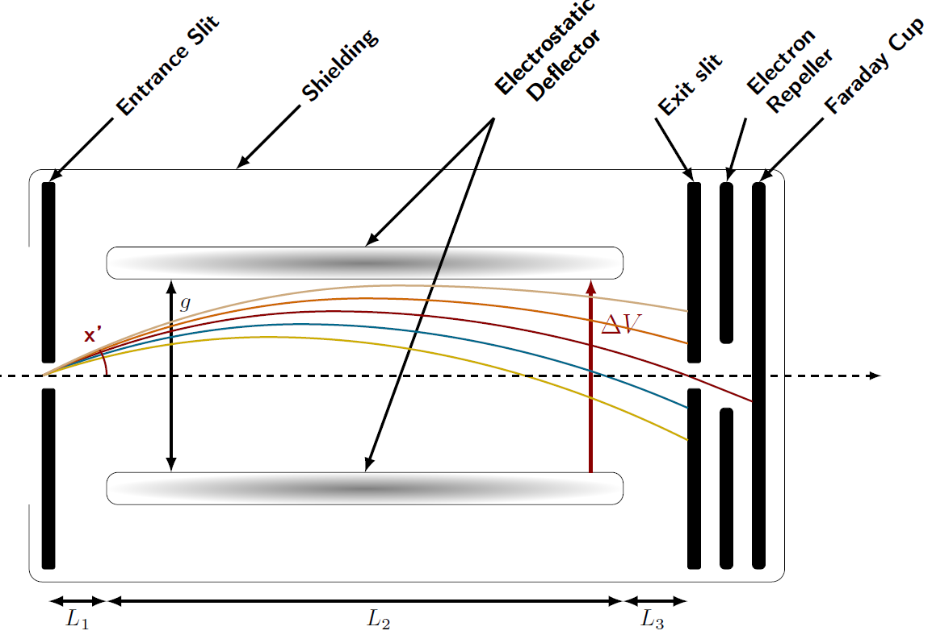

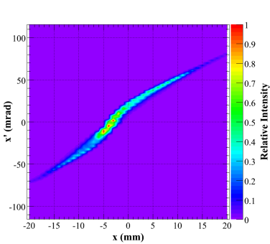

Allison scanner
thermal
screen
I (µA)
0.39 π.mm.mrad
with $L_{1}$= $L_{3}$
U: kinetic energy (eV) of the beam particles (H+)

Slide 7
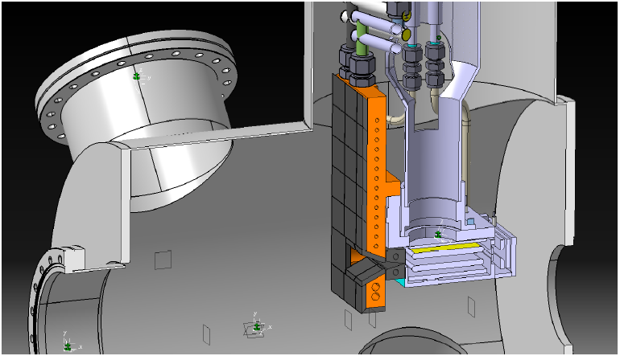
Design overview
Actuator
repeller
Beam-Stopper
100 µm Slit for beamlet selection
Deviation plates
FC
7

Slide 8
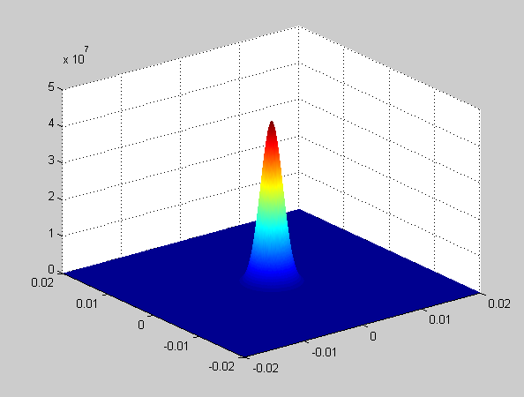

Thermo-mechanical calculations
Beam inputs:
Description | Value | Unit
Beam energy | 75 | kV
Beam intensity at peak | 100 | mA
Repetition rate | 14 | Hz
Pulse length | 6 | ms
Duty cycle | 8 | %
MINIMAL radius beam size (rms) | 3 | mm
MAXIMAL beam size diameter | 80 | mm
Average power absorbed | 630 | W
Peak power | 7.5 | kW
  Gaussian power deposition for a 3 mm RMS beam: 165 W/mm²
Beam energy deposition during 1 second = 630 J
7,63 Mauser = 510 J
.357 Magnum (9×33mm) = 646 J

Slide 9
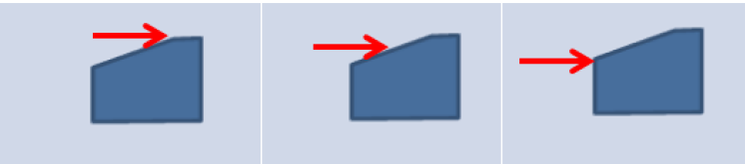
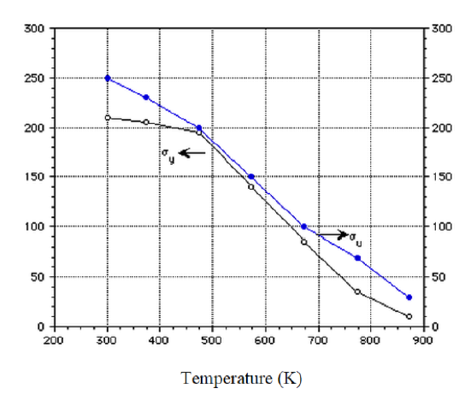
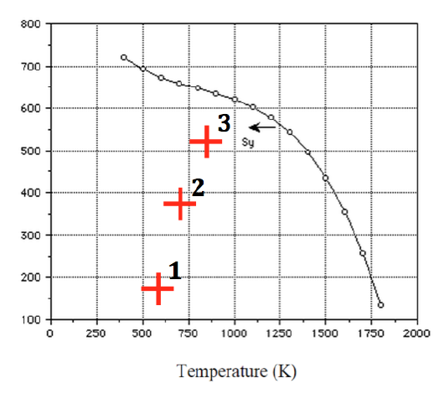
Tmc: TZM entrance slit
BEAM IMPACT:
6 mm diameter
1
2
3
ANSYS simulation: Von Mises (MPa) stress
Elasticity limit [MPa] for Copper (left) and for TZM (right) versus temperature [k]
Cu
TZM
selected
2
3
1
TZM alloy: Titanium – Molybdenum – Zirconia

Slide 10
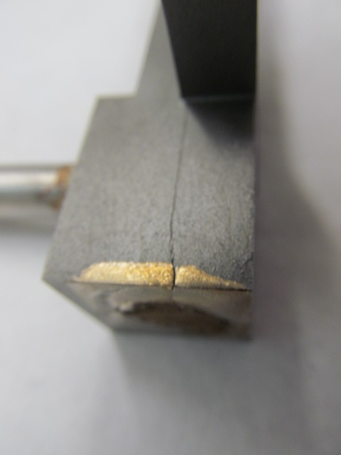
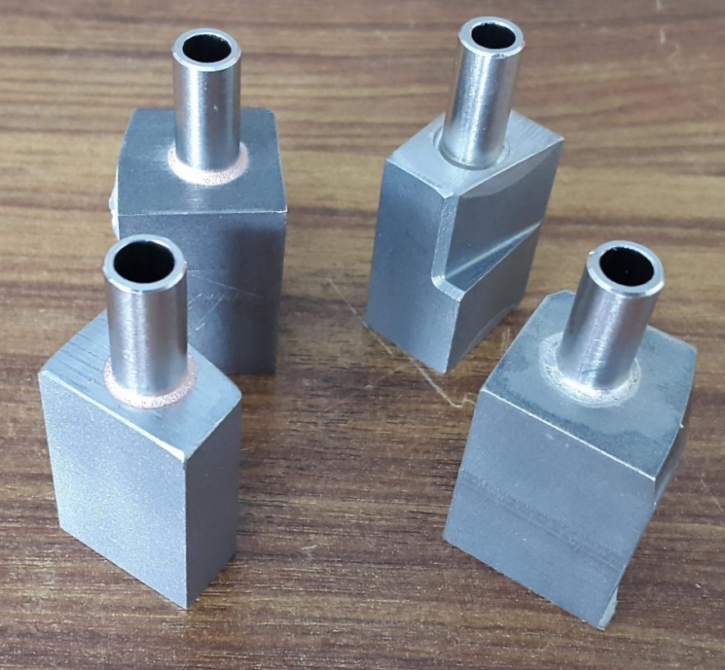
TZM entrance slit : BRAZING TESTS
Brazing tests on :
damaged ESS slits
and other TZM samples
OTHER
ESS
ESS
OTHER
Result of several brazing tests : TZM cracking (July 2016)
After this failure, the new brazing solution (Au-Ni) works successfully, with very low leakage
NOT OK with Au-Cu as brazing filler metal
OK with Au-Ni as brazing filler metal: Leakage rate = 2,7.10⁻¹⁰ mbar.l.s⁻¹

Slide 11
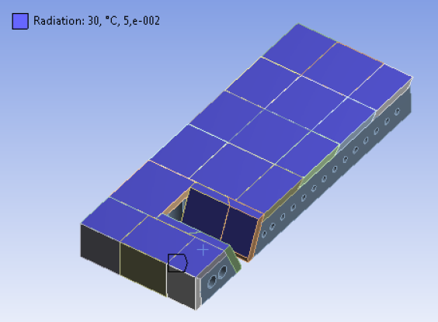
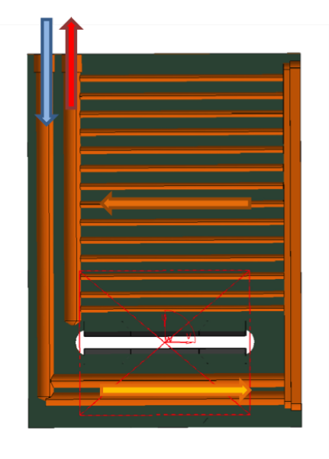
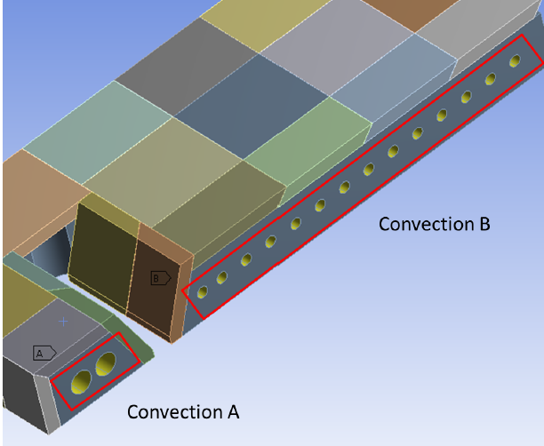
Tm calculations: BEAM STOPPER
4 bars
Thickness
W= 5 mm
Cu= 20 mm

Slide 12
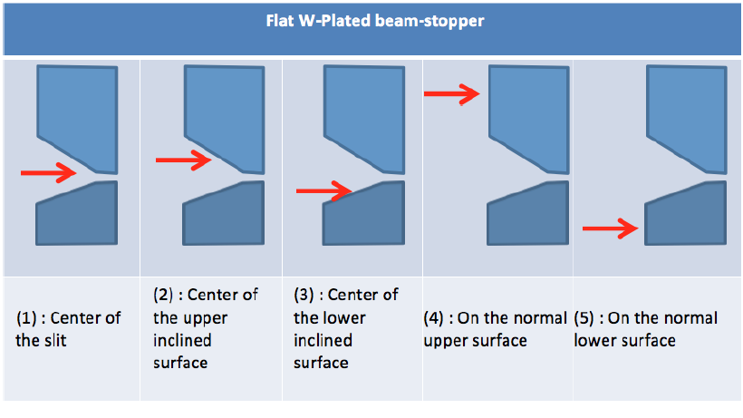
Tm calculations: BEAM STOPPER
BEAM IMPACT:
6 mm diameter
ANSYS simulation: Von Mises [Mpa] stress

Slide 13
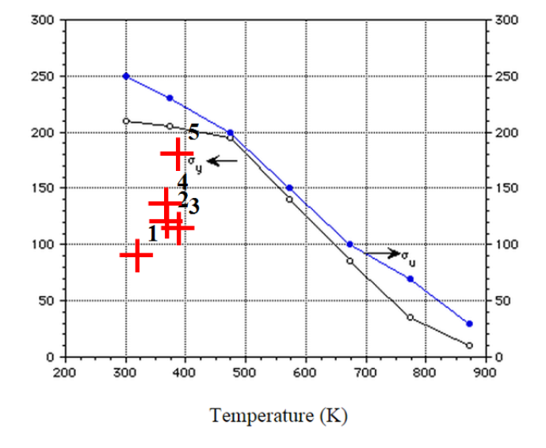
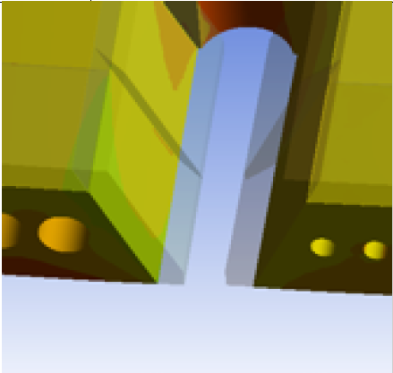
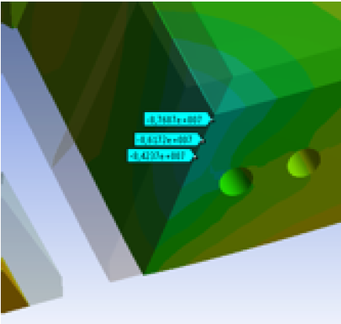
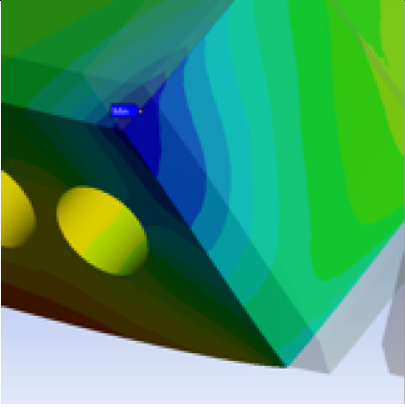
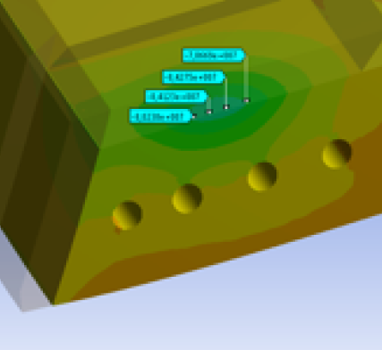
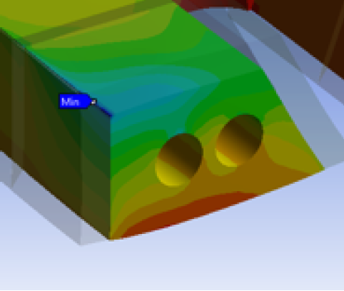
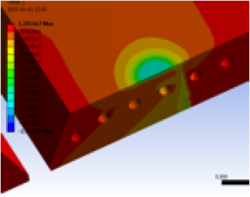
Tm calculations: BEAM STOPPER
W+Cu
Cu
4
1
2
W+Cu
selected
3
4
5

Slide 14
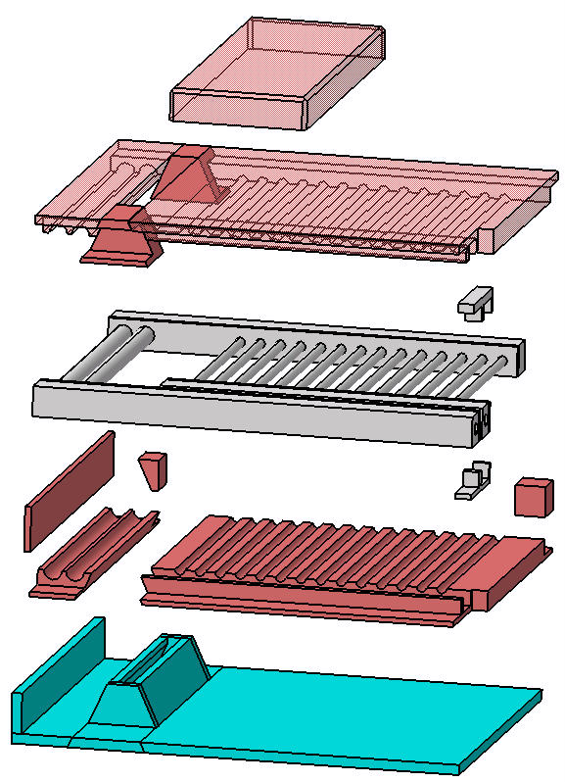
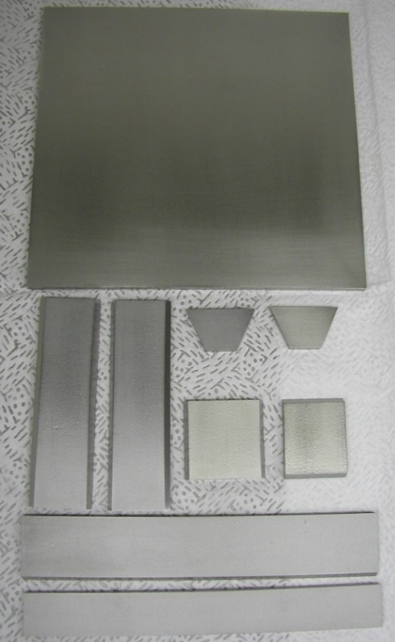
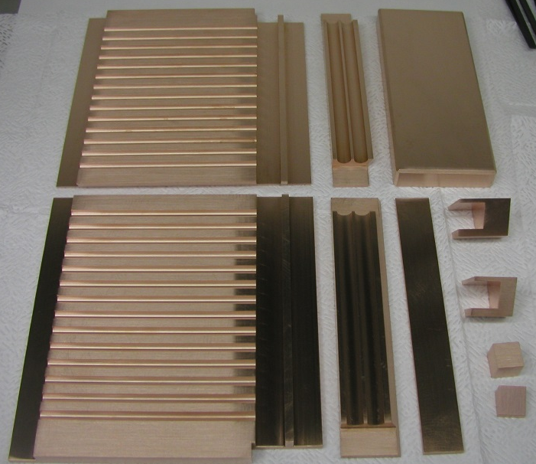
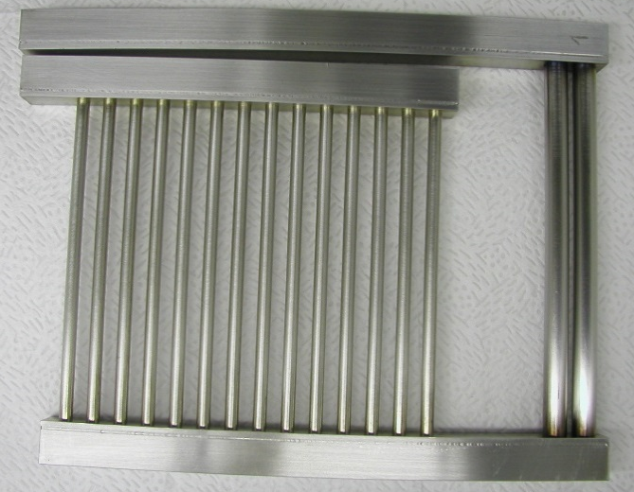
PARTS Assembly before the HIP cycle (950°C/1400bars: 2H)
HIP: Hot Isostatic Pressure
Copper parts
Goal→ improving the mechanic contact
Works before assembly:
- New design for assembly whole parts
- Machining W parts and Copper
- Nickel-W face being in contact with the Copper
- Manufacturing of the water box
- Machining of the Carbon inserts and stainless steel container
Water box
W parts
Copper parts
W parts
Water box

Slide 15
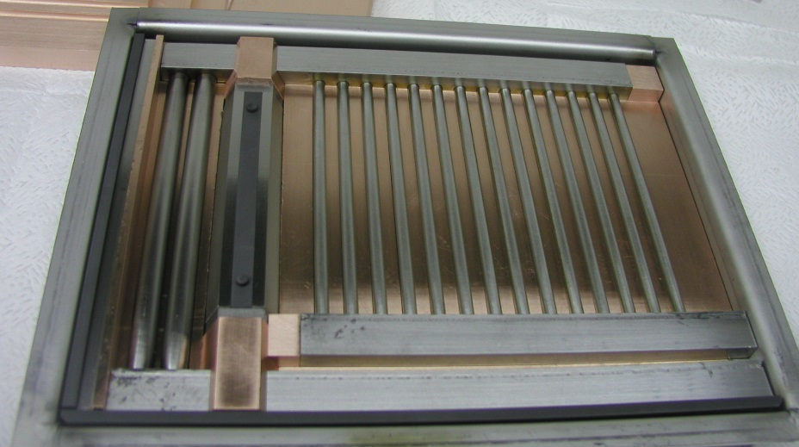
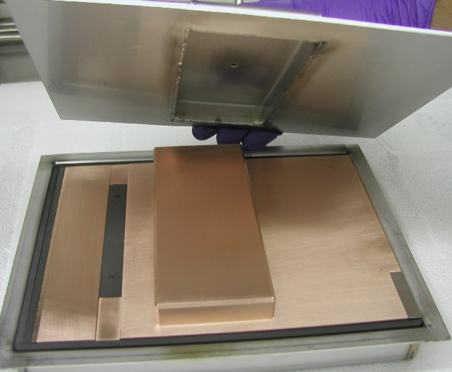
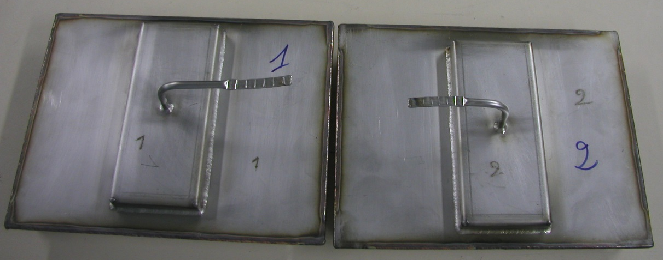
PArts Assembly before the HIP cycle (950°C/1400bars: 2H)
Setting up of the parts in the container
Setting up completed
Container ready for the HIP cycle

Slide 16
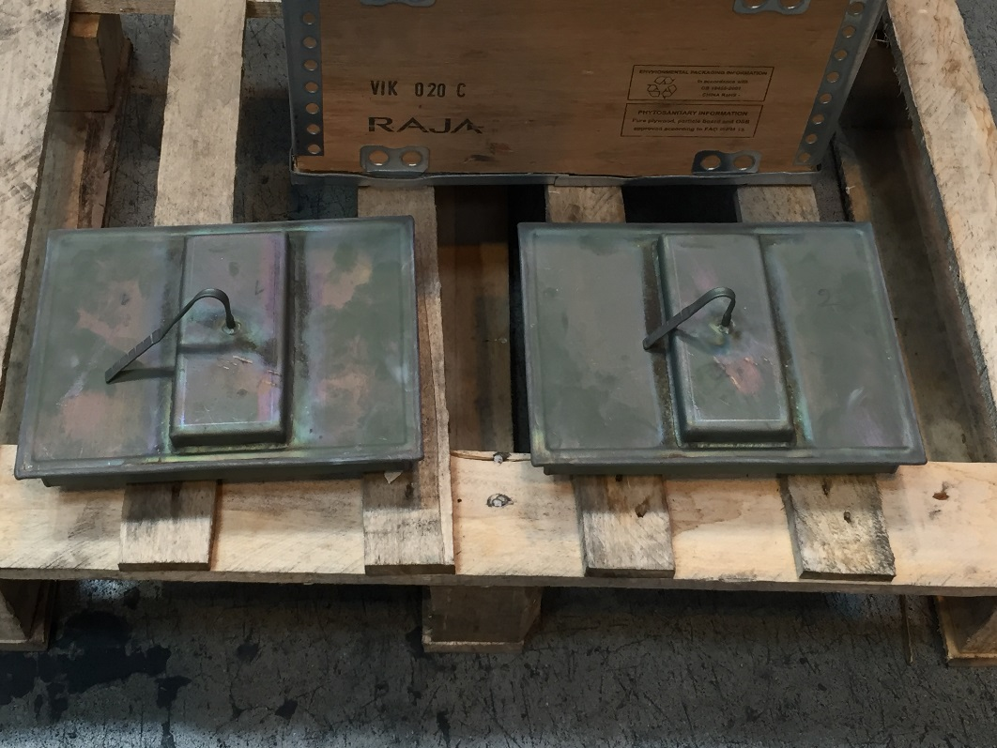
PArts Assembly before the HIP cycle (950°C/1400bars: 2H)
HIP cycle performed on September 23rd 2016
Machining after HIP (Hot Isostatic pressing) :
Remove the container (expected on September 30th, 2016)
Final machining and water-cooling stainless pipes brazing on the BS → expected at Saclay by mid October 2016.

Slide 17
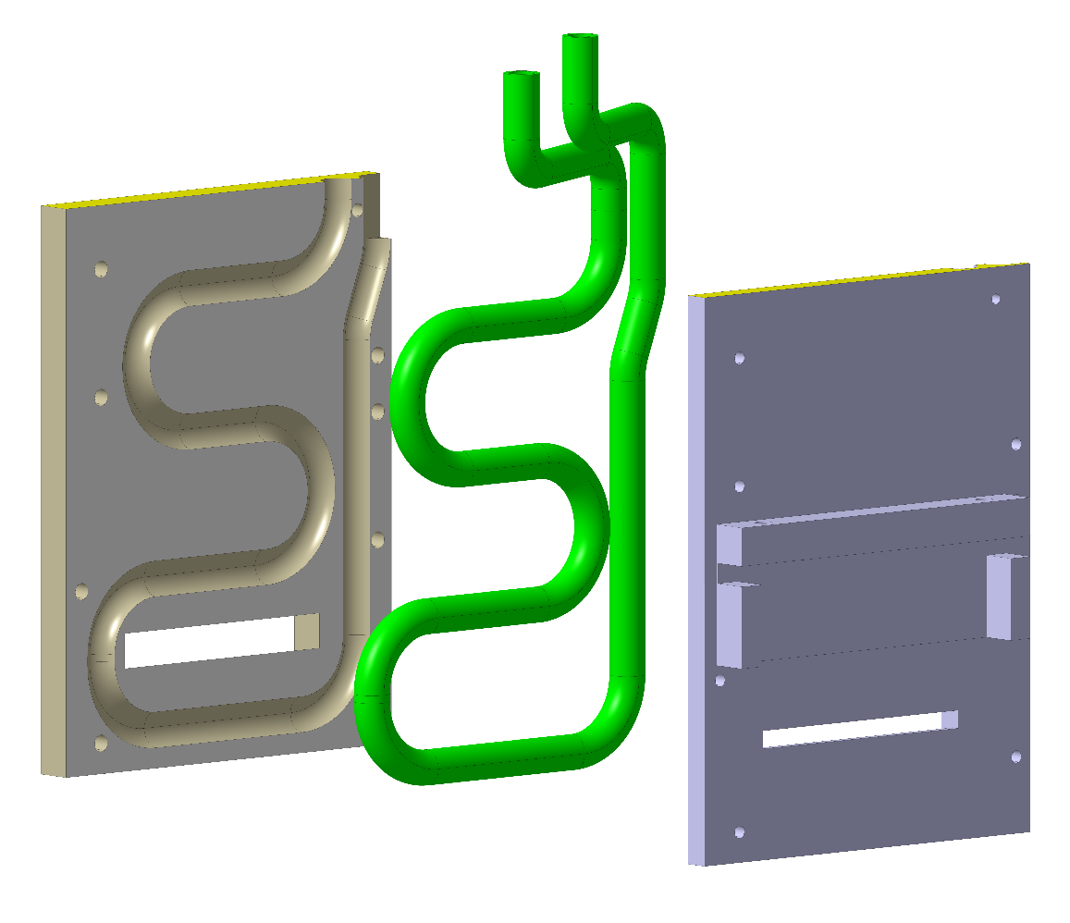
BACKUP SOLUTION
In case of the HIP process will not be ready on time, a whole Beam-Stopper made of Copper has been performed
It will allow to get at least one complete EMU for the acceptance test date but at lower power density than the nominal one.
Delivery foreseen on October 5th 2016

Slide 18
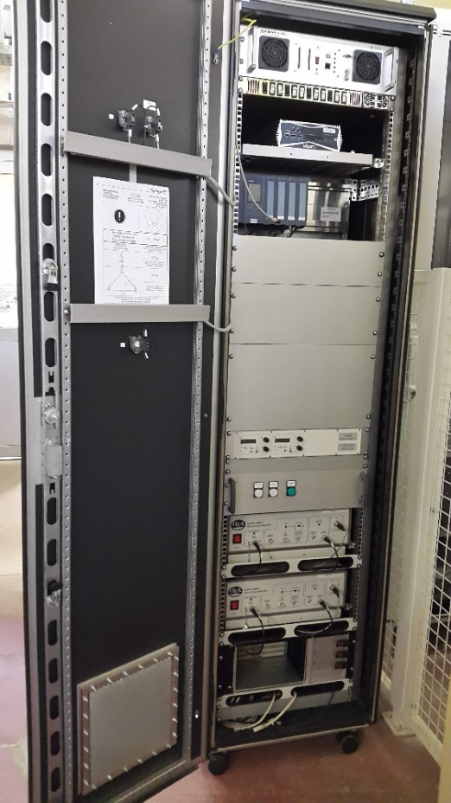
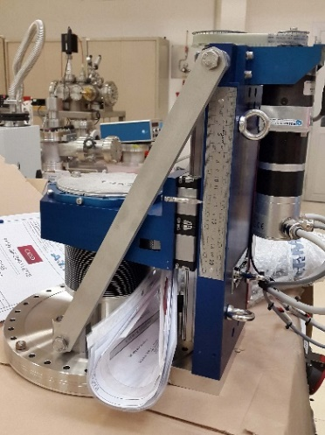
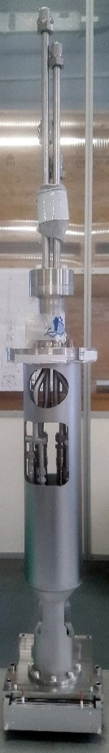
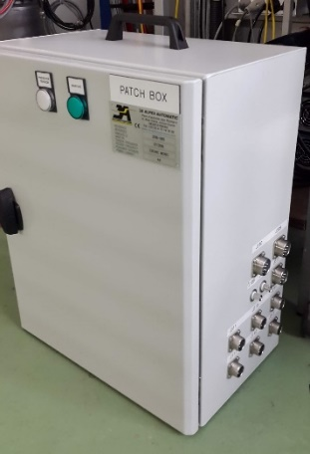
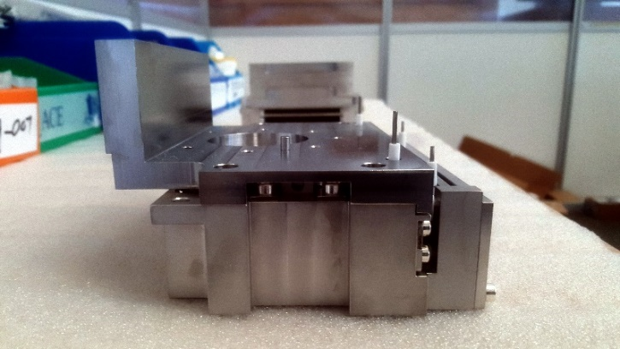
Status and schedule
cabinet
patch box
actuators
mast
deviation plate mechanics
all mechanical EMU parts are already at Saclay, but the slits and the BS scheduled by mid-October 2016.
we will do our very best to install that in Catania during the week 46 (Nov. 14th-18th)
acceptance test at Saclay with a single EMU and with beam expected the week before.

Slide 19
THE DOPPLER UNIT
DOppler @ IRFU: françoise gougnaud - pierre mattei - yves lussignol - FRANCK SENÉE- Olivier tuske

Slide 20
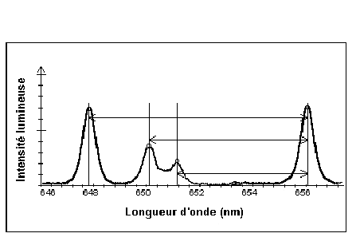
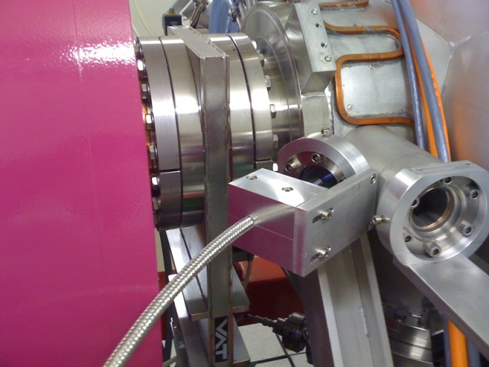
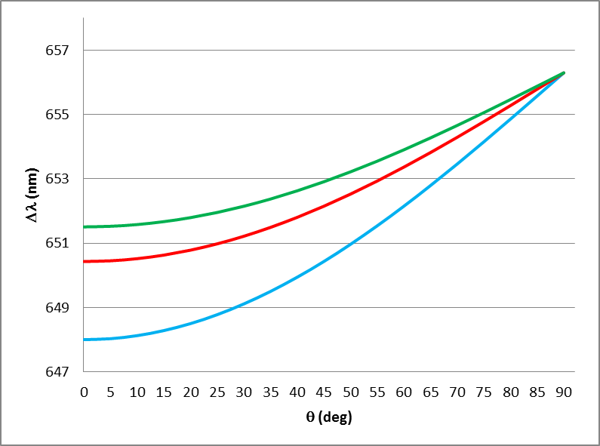


THE DOPPLER UNIT: principLe
Doppler shift of the H_{α} ray
$$∆λ=λ_{0}\frac{v}{c}\cos{θ}$$
Hydrogen beam
H⁰(H⁺) H⁰(H₂⁺) H⁰(H₃⁺)
Plasma H⁰ (light emission excited residual gas)
656.3 nm
ΔλH⁺
ΔλH₂⁺
θ
ΔλH₃⁺
$∆λ$measured by a spectrometer which is able to separate the species
Spectrometer
The intensity of the spectroscopic rays is proportional to the quantity of the produced species, but the production rate of the H_{α} ray by the residuel gas interaction is different for each species
➔
implying that corrections using recombined cross sections must be applied
θ
expected Δλ versus angle, for 75 keV beam

Slide 21
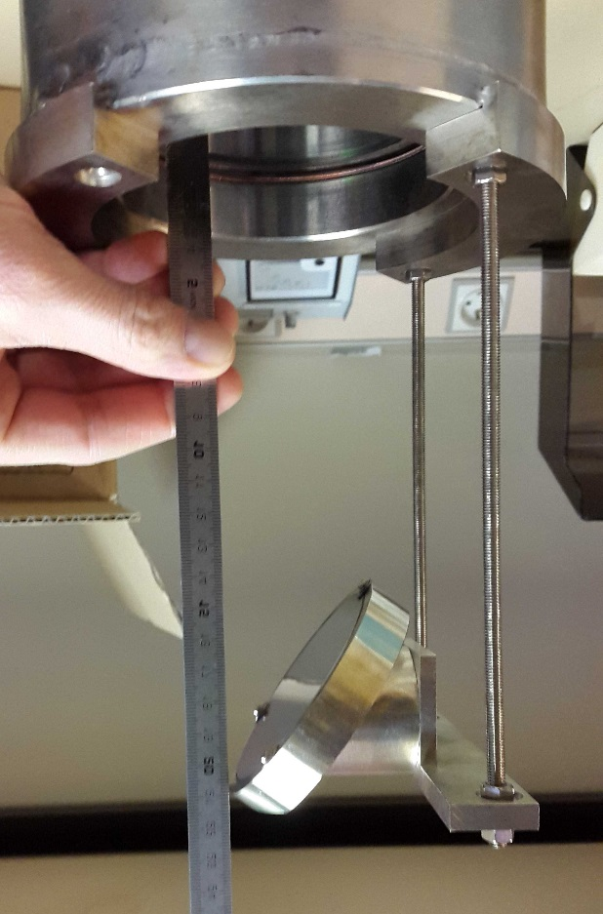
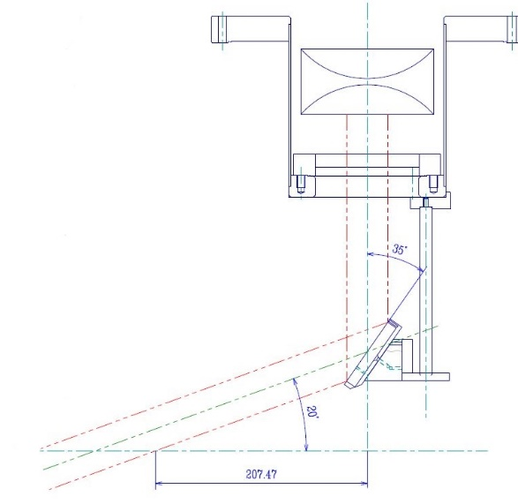
ACCEptance test approved on the silhi source on end May 2016
DN100CF viewport
A mirror located inside the VC at
179mm from the viewport and tilted by 35° wrt the
perpendicular allow to
observe the beam under 20° incident angle.
20°
beam direction
beam axis

Slide 22
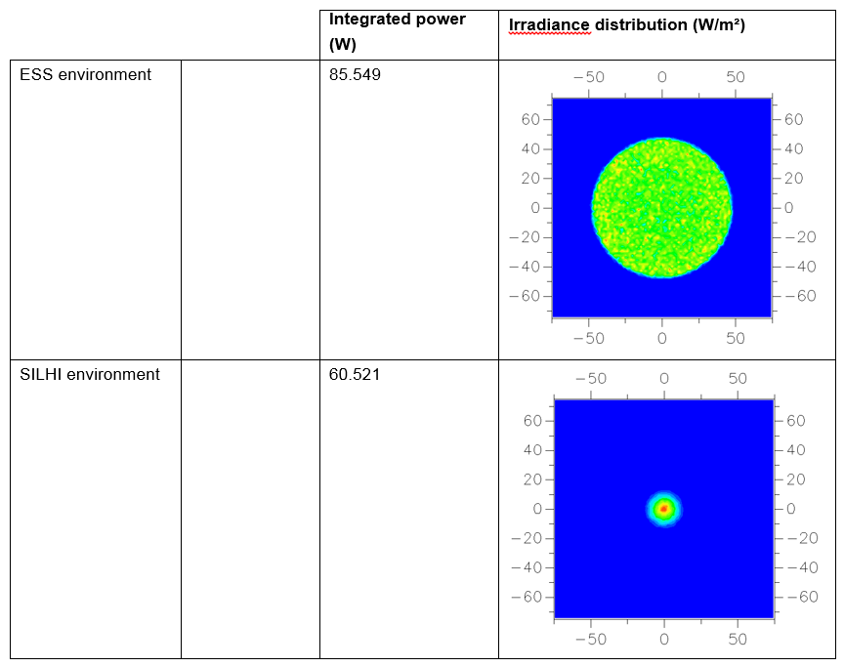
ACCEptance test approved on the silhi source
Apilux simulation obtained with both environments:
ESS environment
86
30% more light is expected with the ESS optical fiber coupling and the whole beam will be observed (100 mm diameter).
SILHI environment
61
The measurement of the specie fractions works in real time mode and for a single pulse of 6 ms length (world first!)

Slide 23
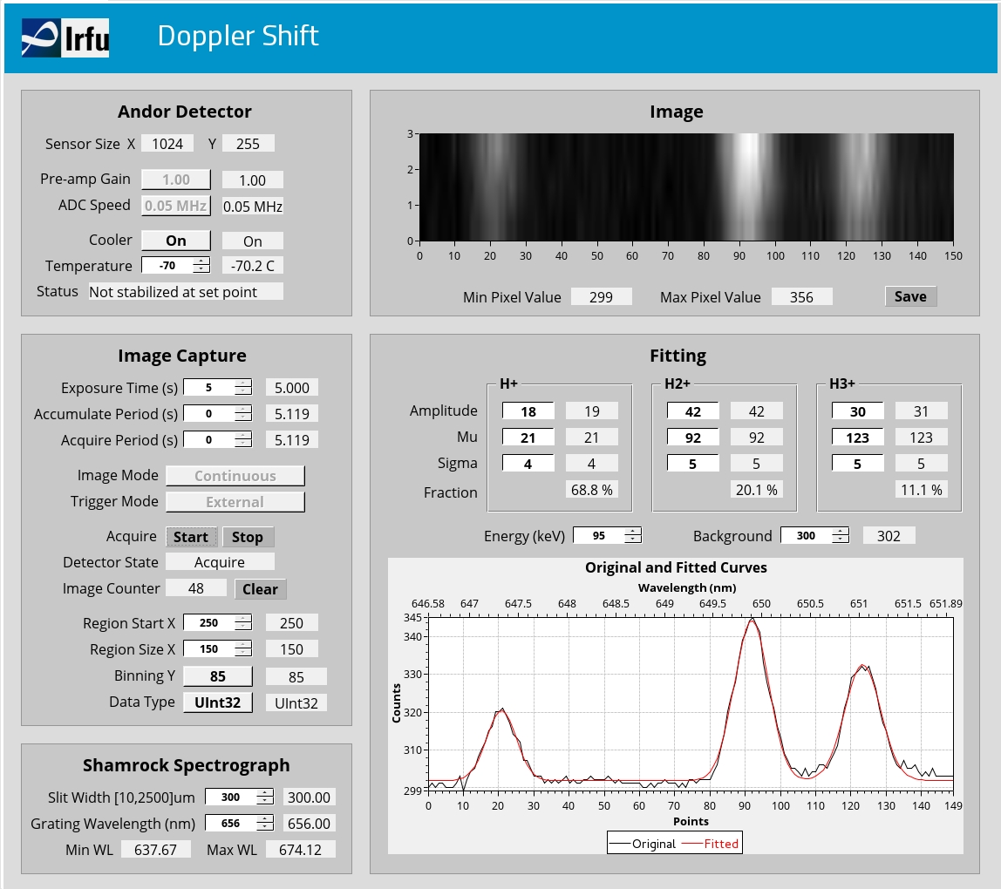
ACCEptance test approved on the silhi source
Operator Control sytem interface made from a single GUI screen
The essential
Parameters can be control:
Exposure time
Binning Y
Slit width
Grating….
A special thanks to Hinko and Cyrille for their help

Slide 24
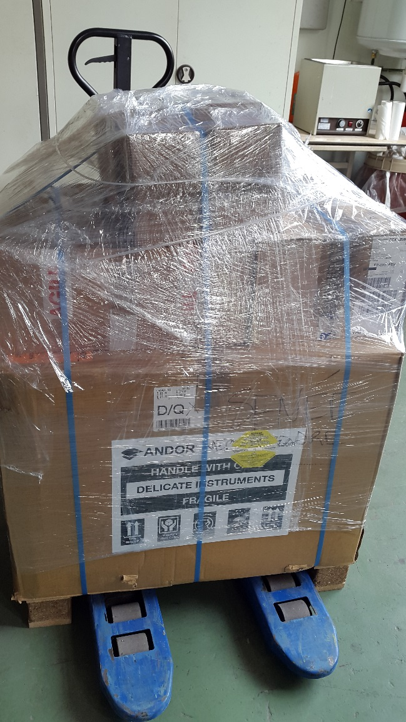
Status and schedule
Interface Viewport / Optical system
Doppler unit delivered at Catania on July 7th 2016.
Installation and test with beam of the Doppler unit is scheduled on week 42 (Oct. 17-21)

Slide 25
SUmmary
EMU
  brazing and HIP:
      done on Sept. 23rd 2016
      waiting for final conclusion, but optimistic at first glance
  backup BD in cooper should be ready by Oct. 5th
  all components foreseen to be at Saclay by mid-Oct.
  Acceptance test at Saclay: week 45 (Nov. 7th-11th)
  installation at Catania foreseen for week 46
Doppler Unit
  acceptance test successfully done at Saclay on May 2016
  delivered at Catania on July 7th 2016
Interface Viewport / Optical system

