Slide 1
BCM electronics (requirements, design, interfaces and planning) ESS BI forum, 3-4 Oct. 2016, Bilbao
Hooman Hassanzadegan
ESS, BI section

Slide 2
Requirements
BCM number and location have been defined by the BI taking into account space limitations and the requirements relevant to Beam Physics and machine protection as well.
The BCM design needs to satisfy the L4 requirements. These includes ex. current and pulse rate ranges, accuracy, time resolution, bandwidth, MPS response time etc.
Other requirements include those of LLRF and the ones defined by the BI to satisfy the performance requirements, maximize synergy with other systems and facilitate long-term operation and support.
A BCM PDR was held on Nov. 12th 2015 with the outcome of 51 recommendations by the attendees. Some of these can influence the BCM design.

Slide 3
Other requirements/considerations
uTCA is the chosen standard for the ESS BCM system.
BCM electronics is under the ESS (not in-kind) responsibility. Considering near-term developments, part of the work needs to be outsourced due to manpower limitations and tight schedule.
The BCM cable length from the toroid to the AFE can have a large influence on the overall measurement bandwidth. The estimated range of the cable length is from ~25m (LEBT and MEBT) to ~65m (A2T and DmpL).
The BCM cables will be routed through the RF stubs with a high temperature.
The BCM sensors will be of different types. Also, the pulse current and width will change along the linac (ex. about 10% of the current is expected to be lost in the RFQ). Despite these changes, it is planned to use same type of electronics for all the BCMs with the exception of the fast ones (i.e the MEBT FCT and the current-monitor BPM).

Slide 4
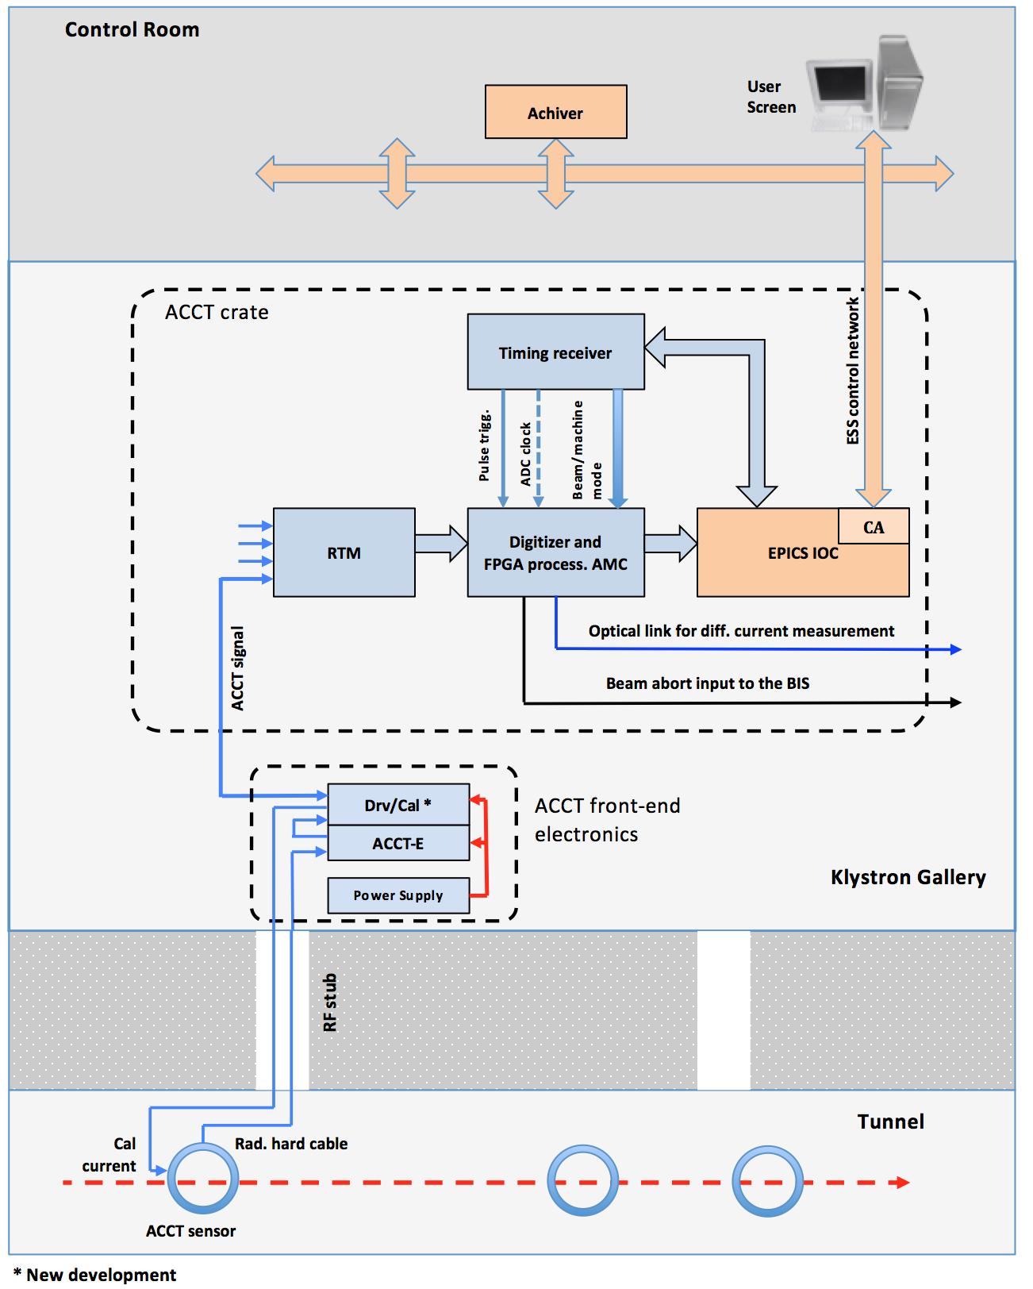
BCM system layout
(not final)

Slide 5
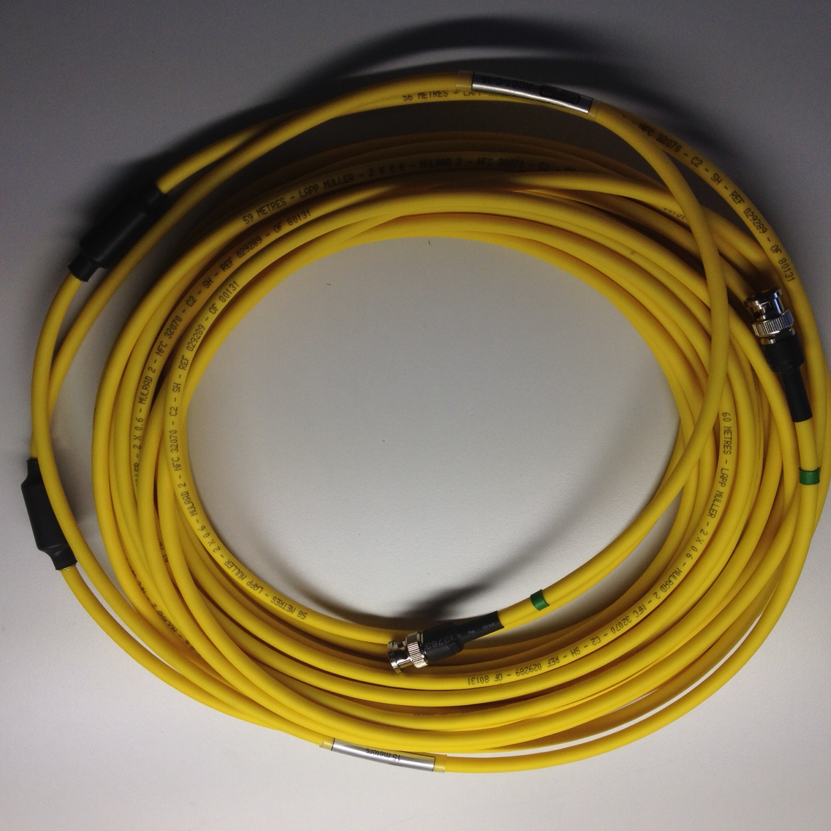
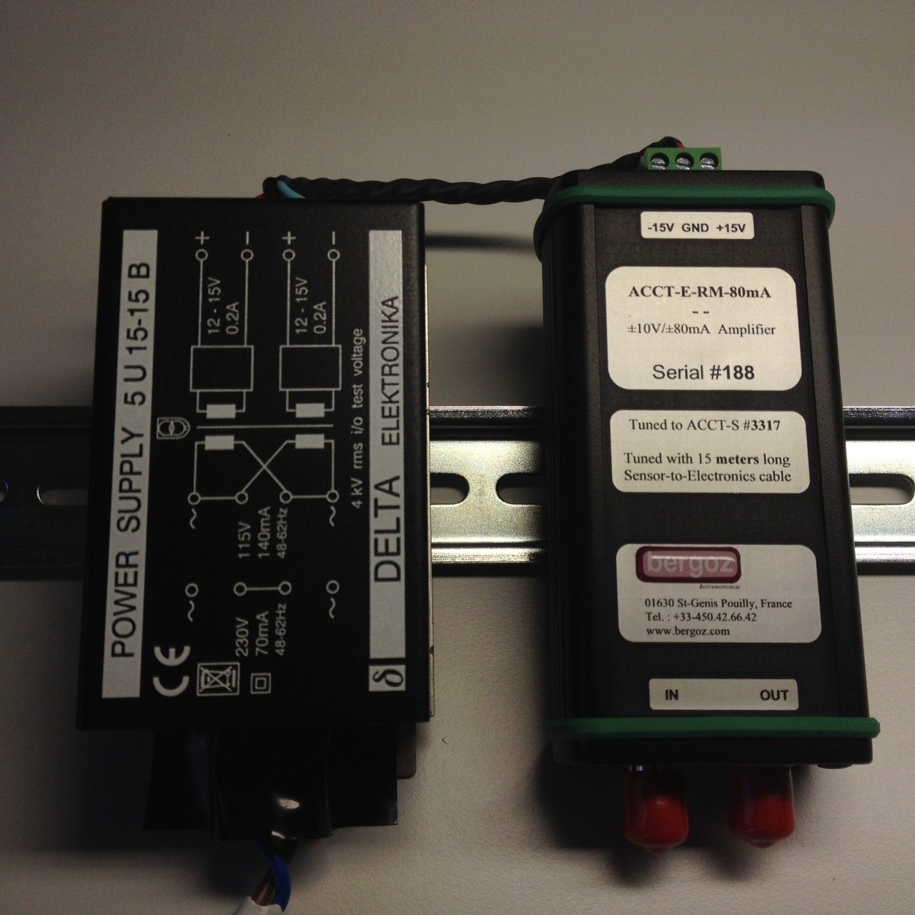
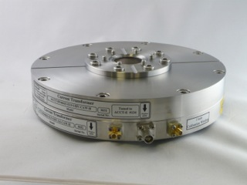
Bergoz front-end electronics
The Bergoz front-end unit (i.e. ACCT-E) converts the ACCT output current into a proportional voltage of +/-10 V full-scale.
The ACCT-E output needs to be connected to high impedance.
The ACCT-E is supplied by a Bergoz +/-15 V power supply.
Both the ACCT-E-RM and power supply are rail mount.
The 1 MHz ACCT bandwidth can only be achieved with a cable length of max 25 m from the toroid to the front-end.

Slide 6
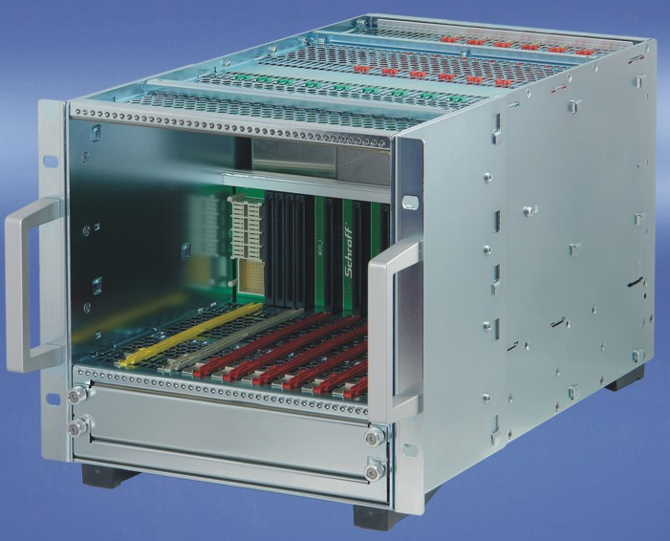
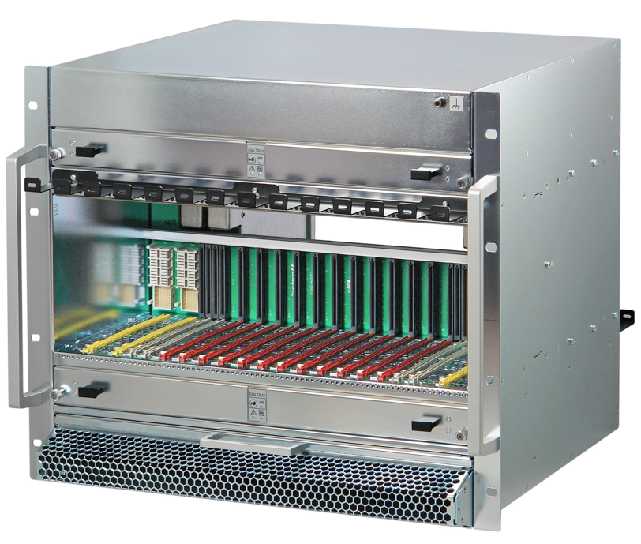
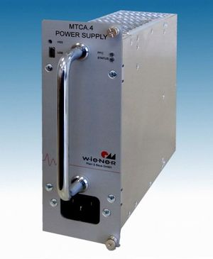
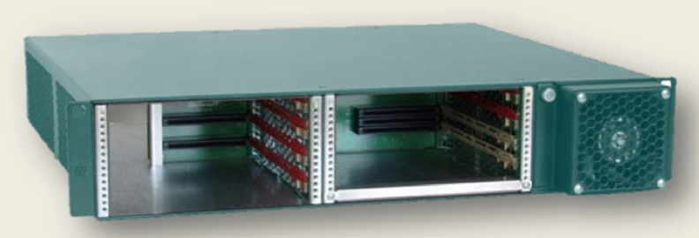
uTCA crates
Tests with different types of crates are going on within the ESS BI.
The large 19-inch crate can provide full redundancy for power, cooling. In particular in can support two WIENER 1000W power supplies of double-width.
The compact crate does not provide full redundancy within each crate, but it can be a good solution due to price and space limitations.
The ACCT separation in the MB, HB and HEBT sections will be large that basically means 1 (2 for redundancy) crate per ACCT. The larger crates are less attractive particularly for these sections.

Slide 7
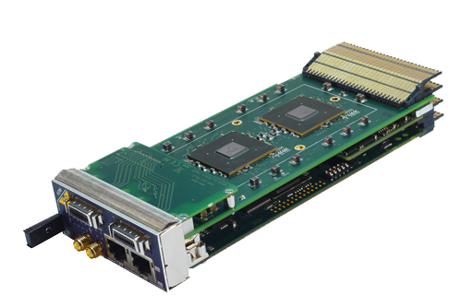
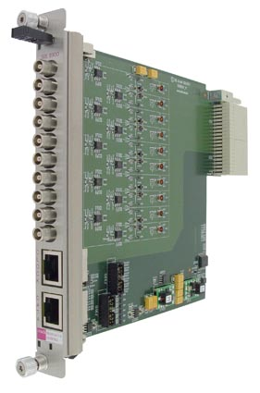
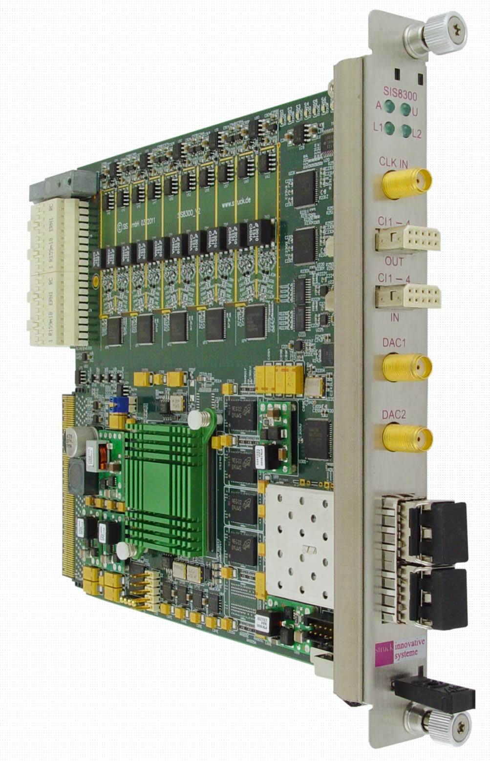
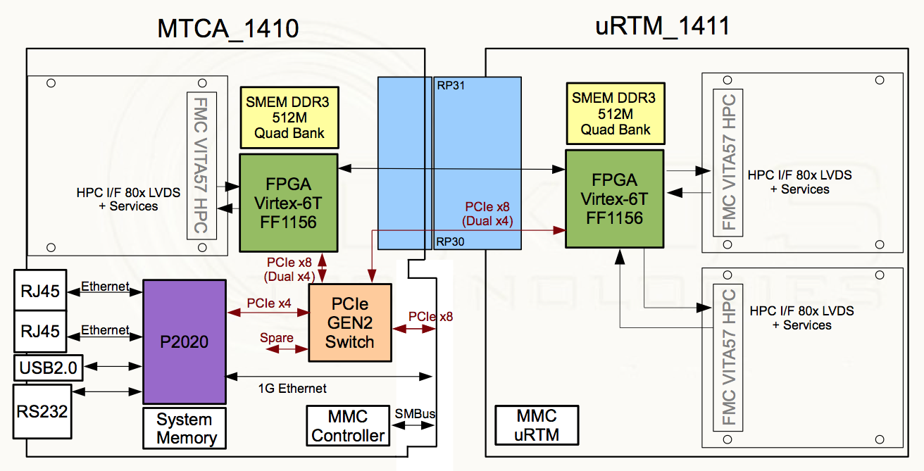
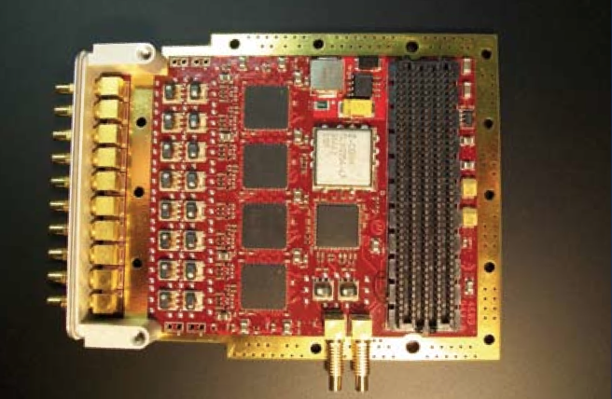
uTCA modules
Current developments are based on Struck SIS8300-L / L2 AMC and SIS8900 RTM.
A Struck-compatible AMC is being developed by IOxOS.
Infrastructure modules consist of crate power, cooling, CPU, MCH and timing and event-receiver timing module.

Slide 8
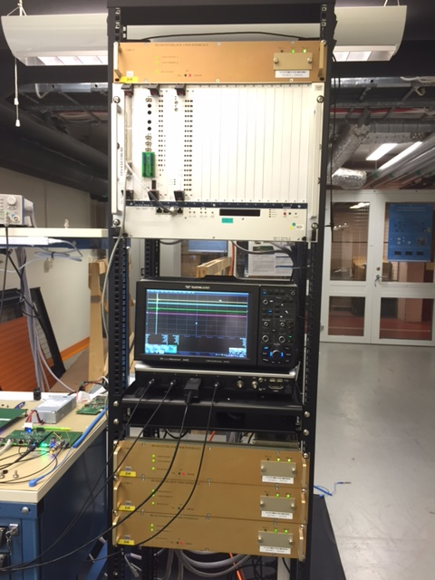
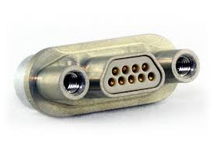
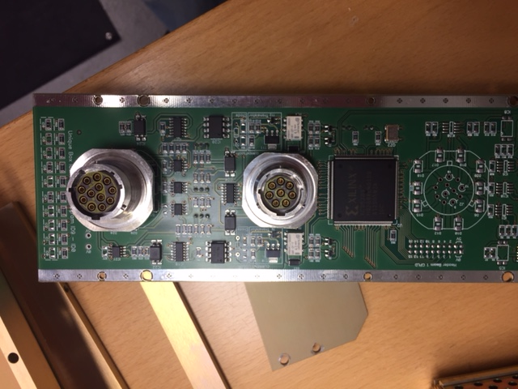
BIS interface (machine protection)
The ESS BIS interface will be based on the CERN CIBU design
The ESS MPS group plans to replace the bulky Burndy connectors with micro-D.
The ESS MPS group has provided a circuit schematics for the electrical interface. The ‘user’ side of this interface should be integrated into the ACCT electronics and maintained by the BI section.

Slide 9
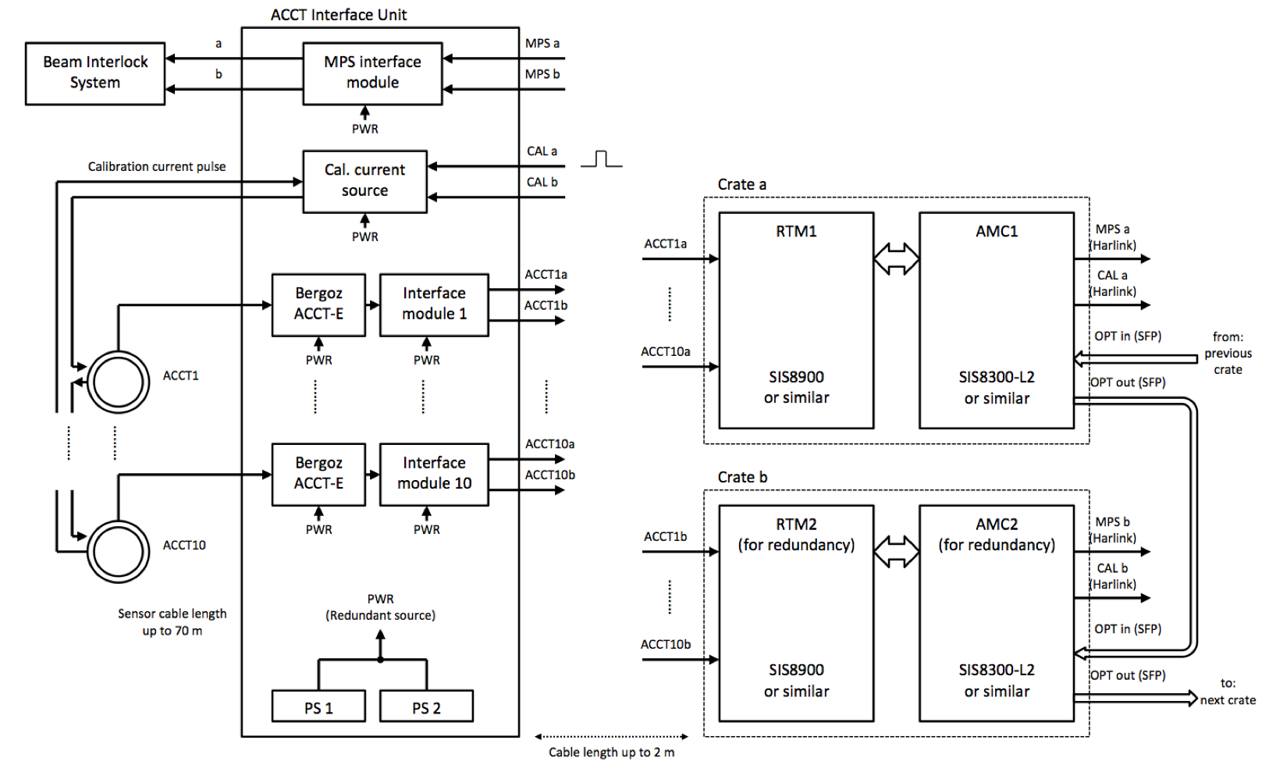
ACCT Interface Unit
A simplified and non-redundant version of this system is planned for the early LEBT BCM tests in Catania in 2017.
BCM system layout
not final (some interfaces will possibly change)

Slide 10
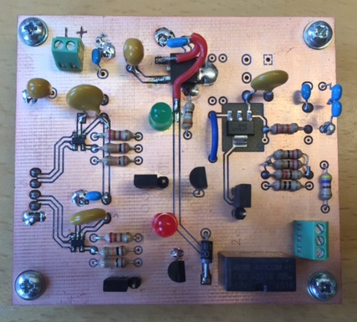
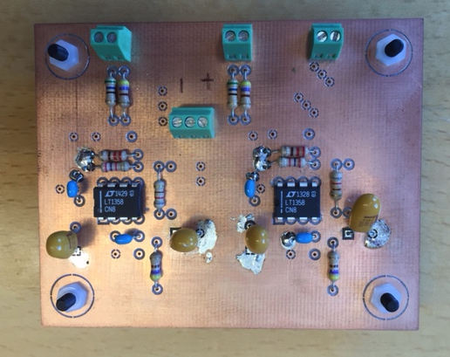
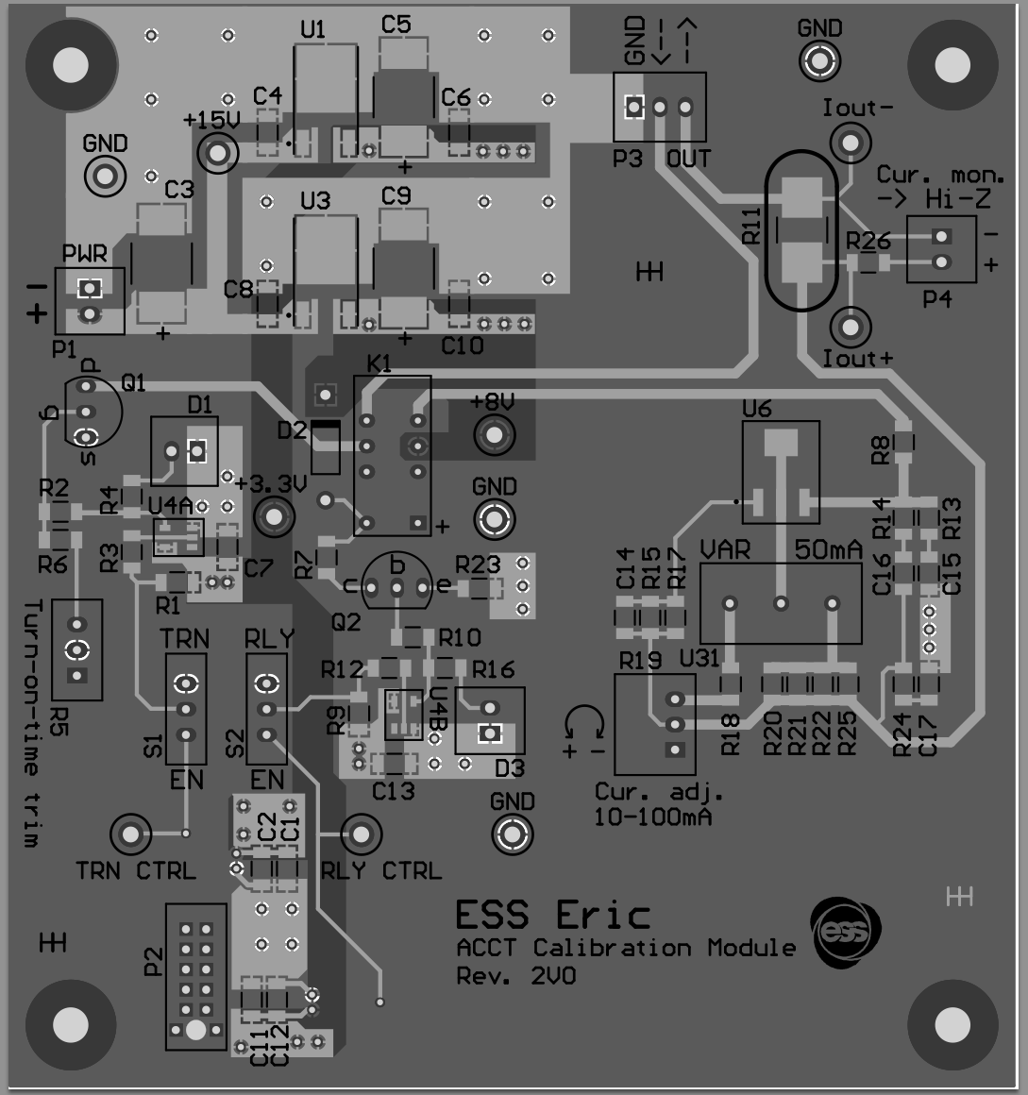
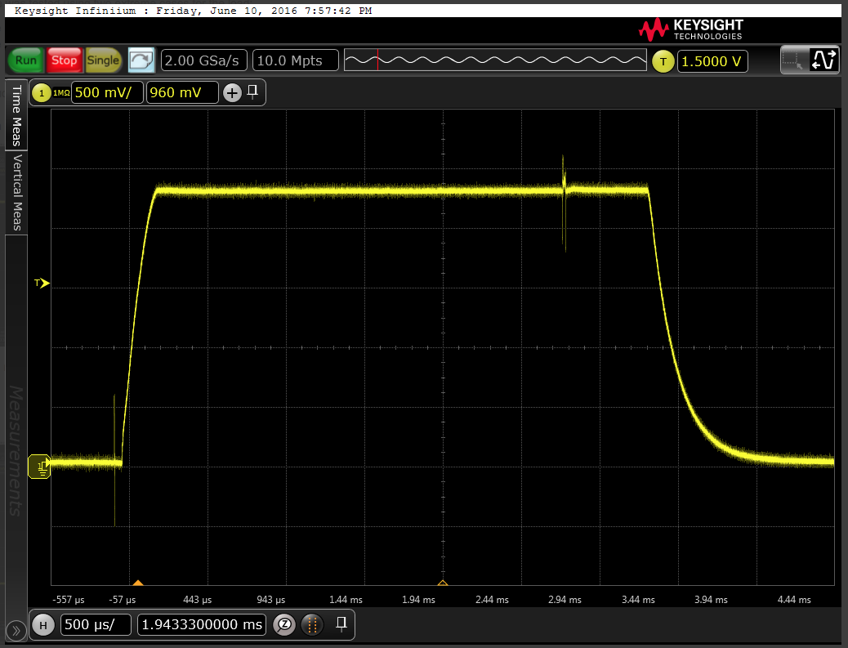
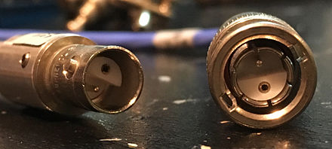
ACCT Interface Unit prototyping
The ACCT Interface Unit will provide interconnections between the uTCA crate, the toroid and the Beam Interlock System.
It will include several custom-designed modules such as an interface module to match the ACCT-E output to the RTM input, an externally-controlled calibration current source, a redundant power source as well as an interface module for machine protection.
Prototyping work for these modules are currently going on at ESS.

Slide 11
Differential BCM interlock layout - preliminary
03.12.2015 – V3
M.Werner
Preliminary!!!
To be reviewed
and updated
by ESS
LEBT
MEBT
DTL
LEDP…
2.4? m
6.4? m
10.0? m
42.4? m
IS
LEBTCHOP
FC
RFQ
MEBTCHOP
FC
FC
FC
1
2
3
4
5
6
7
valve
valve
valve
FCT
valve
valve
valve
Beam
destination:
1
S
S
2
S
3
S
S
S
4
S
>4
Explanation:
ADC/FPGA module
PERMIT
BIS
FC
Faraday Cup
Signal splitter
at ACCT-E box
ADC/FPGA module
PERMIT
S
Redundancy by two ADC/FPGA modules in parallel.
Beam destination has to be communicated to the ADC/FPGA modules (over backplane).
Please insert beam stops into this drawing!
This scheme assumes that valves are always open during beam operation.
Signal splitter: the output of the ACCT-E box is connected to a dual output differential signal transmitter. Attention: a power supply with higher current may be necessary!

Slide 12
ACCT firmware summary
A demo BCM firmware was developed by Cosylab earlier in Feb. 2014 and was successfully tested in the ESS lab.
Current firmware development work is divided into two part being: an application-specific firmware and an integration firmware.
A Catania version of the firmware (possibly with reduced functionality) is foreseen for the early LEBT BCM tests in 2017.
Due to lack of internal resources the firmware development is currently being done by external partners for the near-term BCM developments.
The firmware needs to be maintained and improved in long-term by the ESS staff.
A warm-linac version of the application-specific firmware has already been received and the development work of the integration firmware will start soon (kick-off meeting planned for Oct. 6-7).
An optical fiber interface for crate-to-crate data transfer and a timing data receiver are foreseen for the future versions of the firmware.

Slide 13
Permit handler
BCM Firmware block diagram (draft) V04
M. Werner
03.12.2015
From ADC
Baseline & droop
Scaler
Cross-bar-switch
Diff-Interlock
Check shape
From ADC
Baseline & droop
Scaler
Diff-Interlock
Check shape
From ADC
Baseline & droop
Scaler
Number of diff. Interlock stages: see description!
Check shape
From ADC
Baseline & droop
Scaler
Check shape
Diff-Interlock
Test signals
From ADC
Baseline & droop
Scaler
Check shape
Diff-Interlock
BIS-Interface
BIS
From ADC
Baseline & droop
Scaler
Check shape
Diff-Interlock
provided by
ESS / MPS
From ADC
Baseline & droop
Scaler
Check shape
From ADC
Baseline & droop
Scaler
MEBT chopper protection
FPGA pins
Check shape
From ADC
Baseline & droop
Scaler
Single PERMIT signal
BIS Backbone
Check shape
Not all connections are shown!
From ADC
Baseline & droop
Scaler
Check shape
Trigger
Serial Timing data receiver (provided by ESS)
Processed ADC data
Manual calibration support
Register(s)
Beam destination
Raw ADC data
FPGA pins
Beam current,
Pulse width,
Pulse period
Data interface to DDR memory
(provided by ESS)
DDR memory

Slide 14
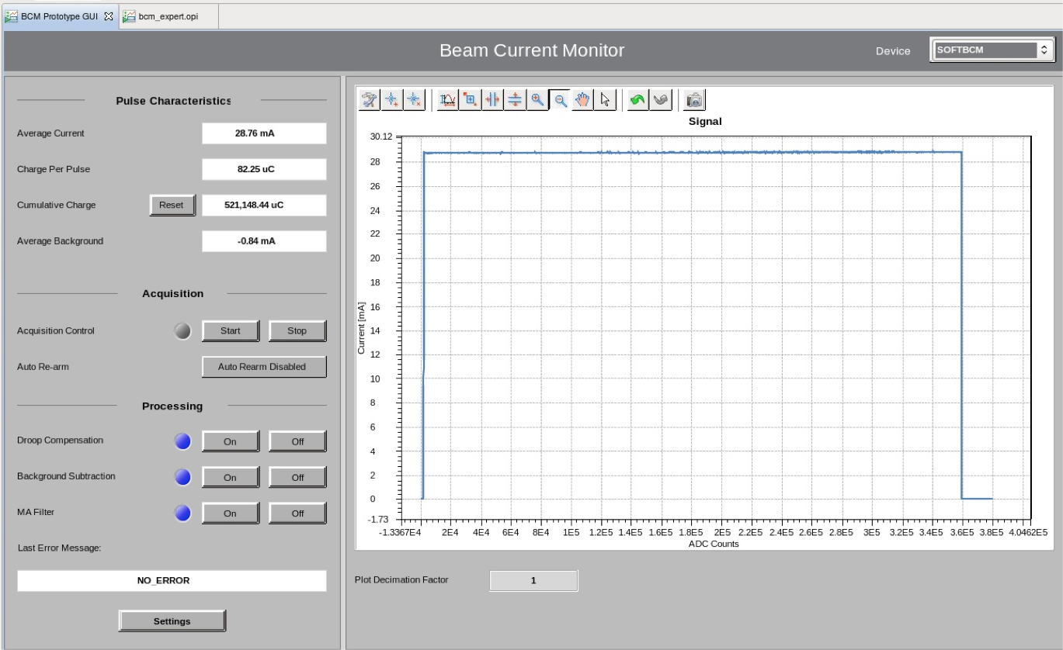
ACCT software summary
BCM software including EPICS modules for the timing and digitizer cards, application-specific BCM functionality as well as generic and BCM-specific CSS operator panels was provided earlier by the ICS for the demo BCM.
Due to the lack of resources with the ICS division, software support for the BCM system is mainly provided by the BI section for the near-term BCM developments.
ICS support is needed for the BCM system in long-term.

Slide 15
Milestones
Delivery of the LEBT ACCT system with reduced functionality to Catania (possibly with the demo firmware/software): Jan. 31st 2017
Delivery of the Catania custom firmware (delivered): Dec. 31st 2016
Delivery of the Catania integration firmware: Jan. 31st 2017
BCM CDR: May 2017
Purchase authorization signed for the procurement of the final electronics: June 2017
Final electronics installation and system integration: March 2018

