Slide 1
INFN- Legnaro National Lab. Activity
on ESS DTL Diagnostics: BPM & BCM
Beam position monitor prototype development
Beam current monitor
Marco Poggi INFN-LNL

Slide 2
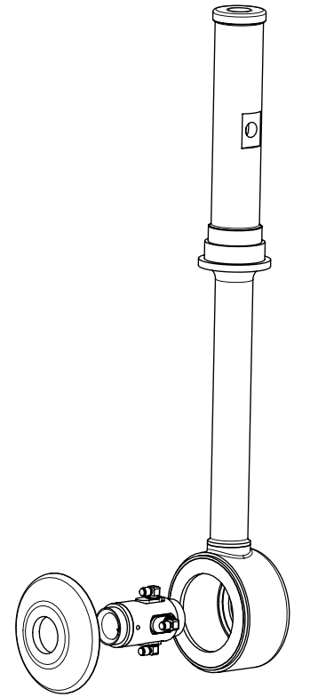
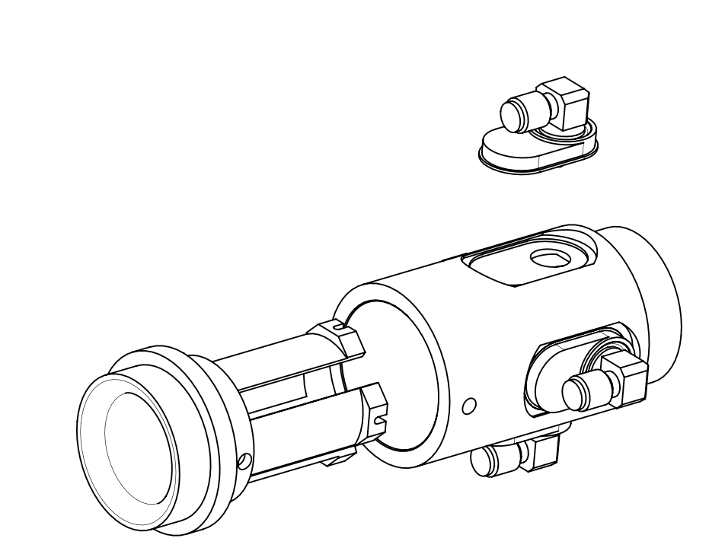
SMA
BPM
EBW
beam
BPM + DRIFT TUBE

Slide 3
ESSENTIALLY concentrated on mechanical problems.
first version with SMA connectors (AS SnS bpm) broken at first electron beam welding attempts
second prototype with SMP connectors failed again
The prototype with the SMP connectors was repaired with tin soldering. Electrically it works, but it is not good for the vacuum, it is not reliable as it is the Elecron Beam weldings.
Problems with SMA connectors purchase!
NEW tender for another prototype
with again SMA connectors.

Slide 4
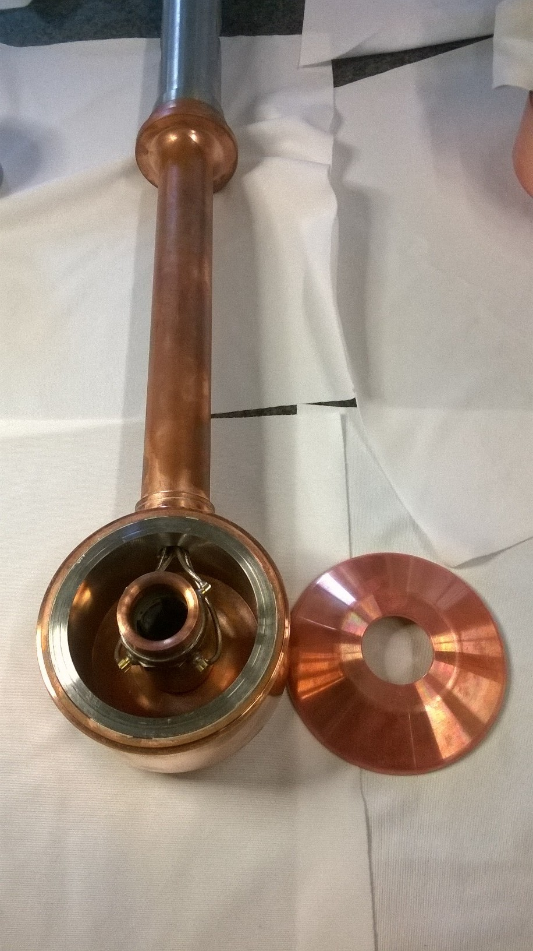
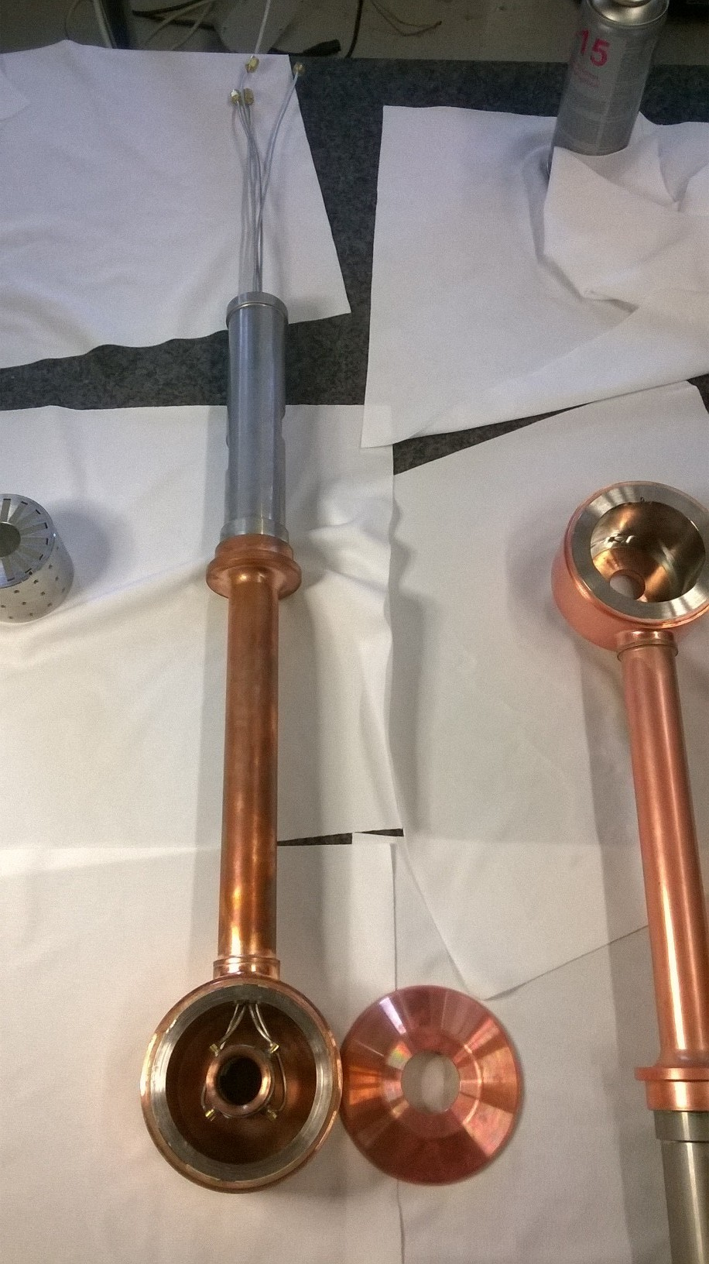
Signal
cables
stem
Drift tube
bpm

Slide 5
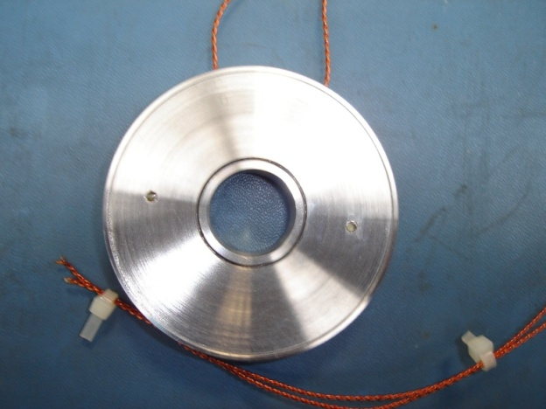
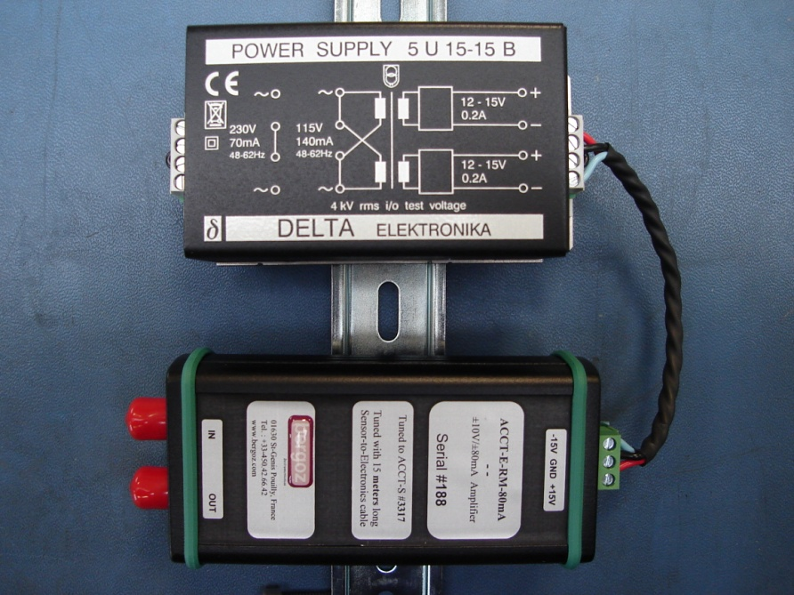
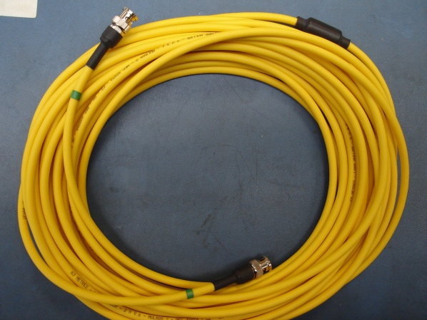
Beam current monitor
In vacuum sensor:
22 mm height, ID=30 mm, OD=102 mm
Front-end electronics
Cable
Low cutoff frequency: 3Hz High cutoff frequency: 1MHz Droop: <2%/ms Full scale output voltage: +/-10V Full scale range: 80 mA

Slide 6
INFN duty about issues from March 31, 2016 meeting
(from Hooman e-mail)
- Epoxy resin (SNS design) not allowed according to the ESS vacuum regulations.
overshoot/undershoot issues after the rising/falling edge of the pulse: problems for the differential current measurements.
The wires from and towards ACCT should not pick up noise from the environment. It is preferred to use shielding/screening for these wires.
SO FAR NONE OF THESE issues has been adequately addressed!!

Slide 7
Bunch Length Monitor
LBM1 in MEBT: sigma= ~80ps, Ek=3.6MeV BSM Feschenko Method
- LBM2 after DTL: sigma=~18ps, Ek=90MeV BSM Feschenko Method
- LBM3 beginning of medium Beta sections: sigma=~12-9ps, Ek~220MeV Shishlo method?
- LBM4 end of high Beta section: sigma=~3ps, Ek=2GeV Cherenkov radiation method

Slide 8
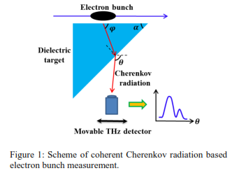
Cherenkov radiation method
Contact with Prof. Potylitsyn, from Tomsk Polytechnic in Moscow: possibility to make a simulation to choose the radiator for proton bunch
Meeting with M. Ferianis and M. Veronese from Trieste: experiences and collaboration

Slide 9
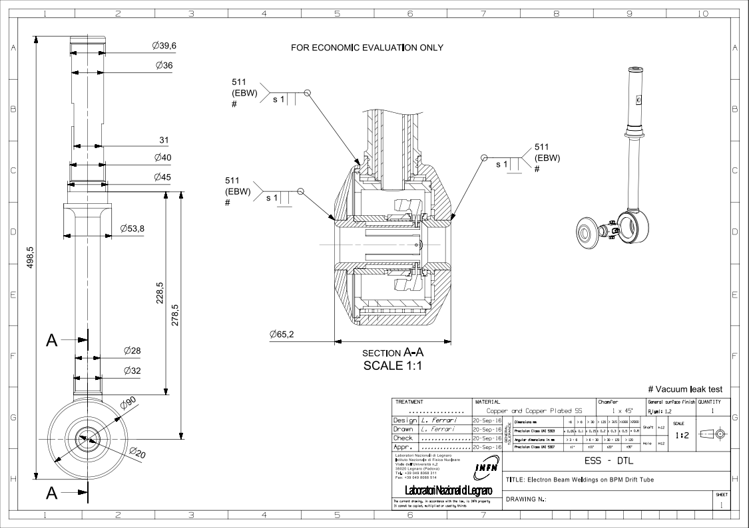

Slide 10
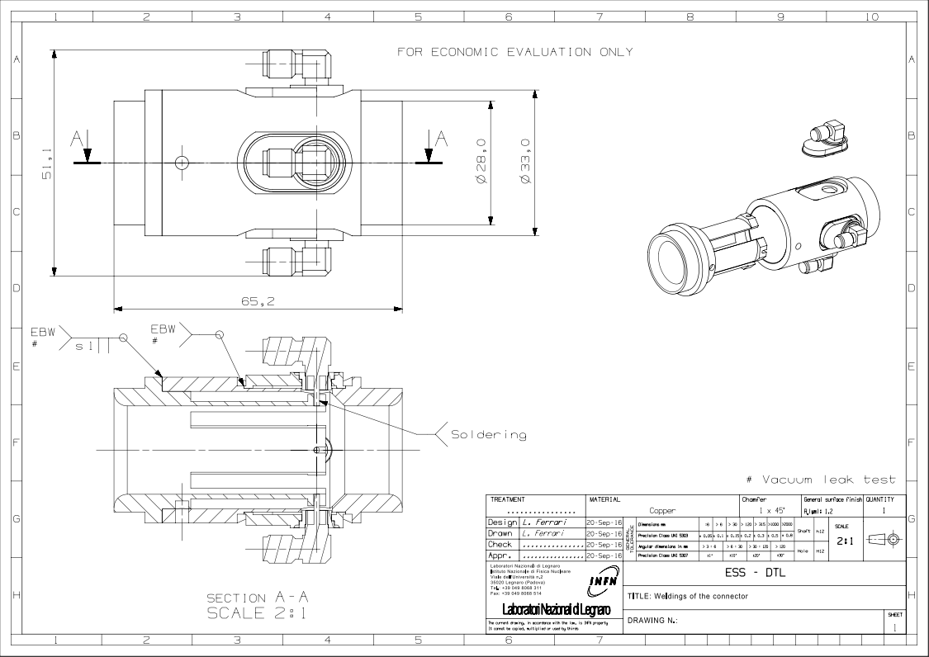
BEAM

