Slide 1
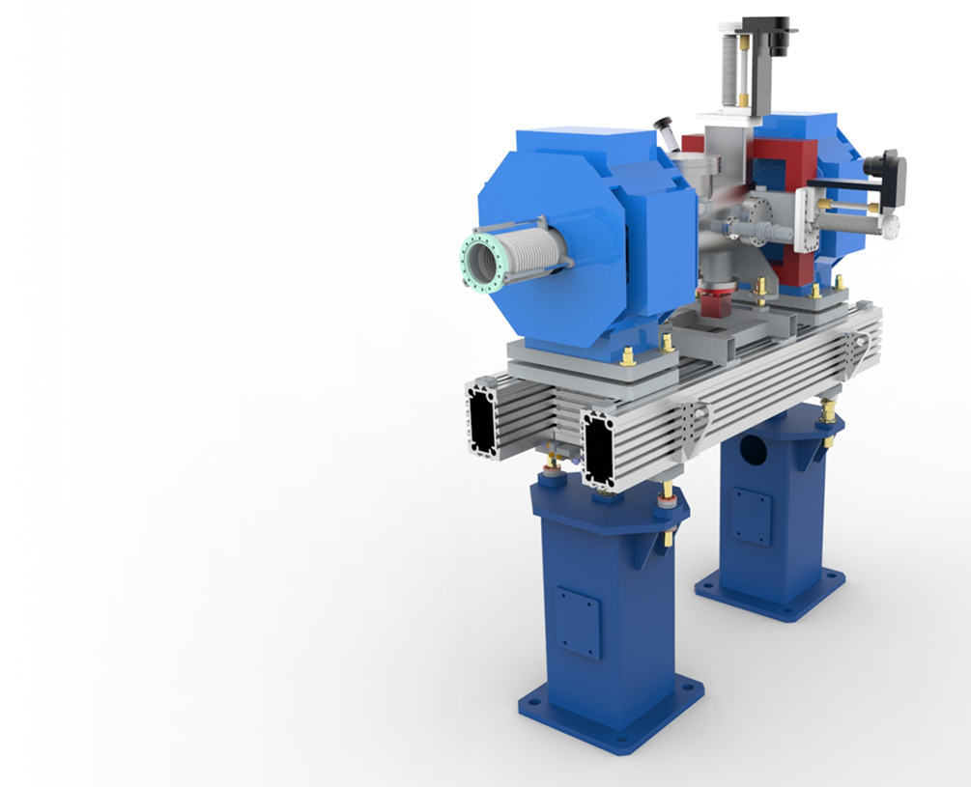
LWU update Beam Transport Modules (LWUs) - UK-A-6
Dr Paul Aden, STFC Daresbury Laboratory
3rd October 2016

Slide 2
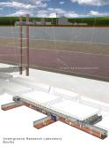
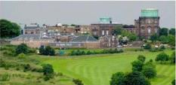
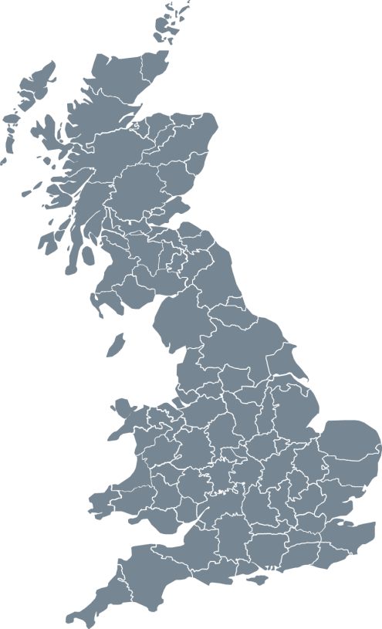
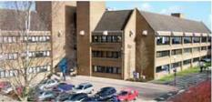
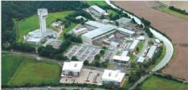
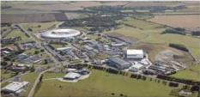
STFC
UK Astronomy Technology Centre
Edinburgh, Scotland
Boulby Underground Laboratory
North Yorkshire
Polaris House
Swindon, Wiltshire
Daresbury Laboratory
Sci-Tech Daresbury Warrington, Cheshire
Chilbolton Observatory
Stockbridge, Hampshire
Rutherford Appleton Laboratory
Harwell Didcot, Oxfordshire

Slide 3
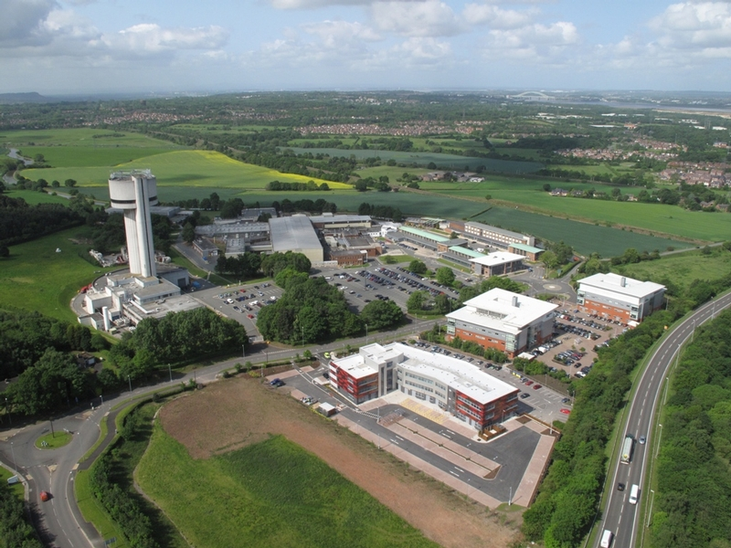
STFC, Daresbury Laboratory

Slide 4
Overview of the scope

Slide 5
BTM WP Scope
To design, procurement and assemble;
2 Prototypes
3 Test Chambers
74 Linac Warm Units
52 Beam pipe modules
2 Differential pumping systems
4 mobile installation cleanrooms
Total Cost £10.5m
Approximately 30 FTEs
2016-2019
Notes:
Over the next four years we have been asked to delivery …

Slide 6
BTM WP Scope
To design, procurement and assemble;
2 Prototypes
3 Test Chambers
74 Linac Warm Units
52 Beam pipe modules
2 Differential pumping systems
4 mobile installation cleanrooms
Total Cost £10.5m
Approximately 30 FTEs
2016-2019
Notes:
Over the next four years we have been asked to delivery …

Slide 7
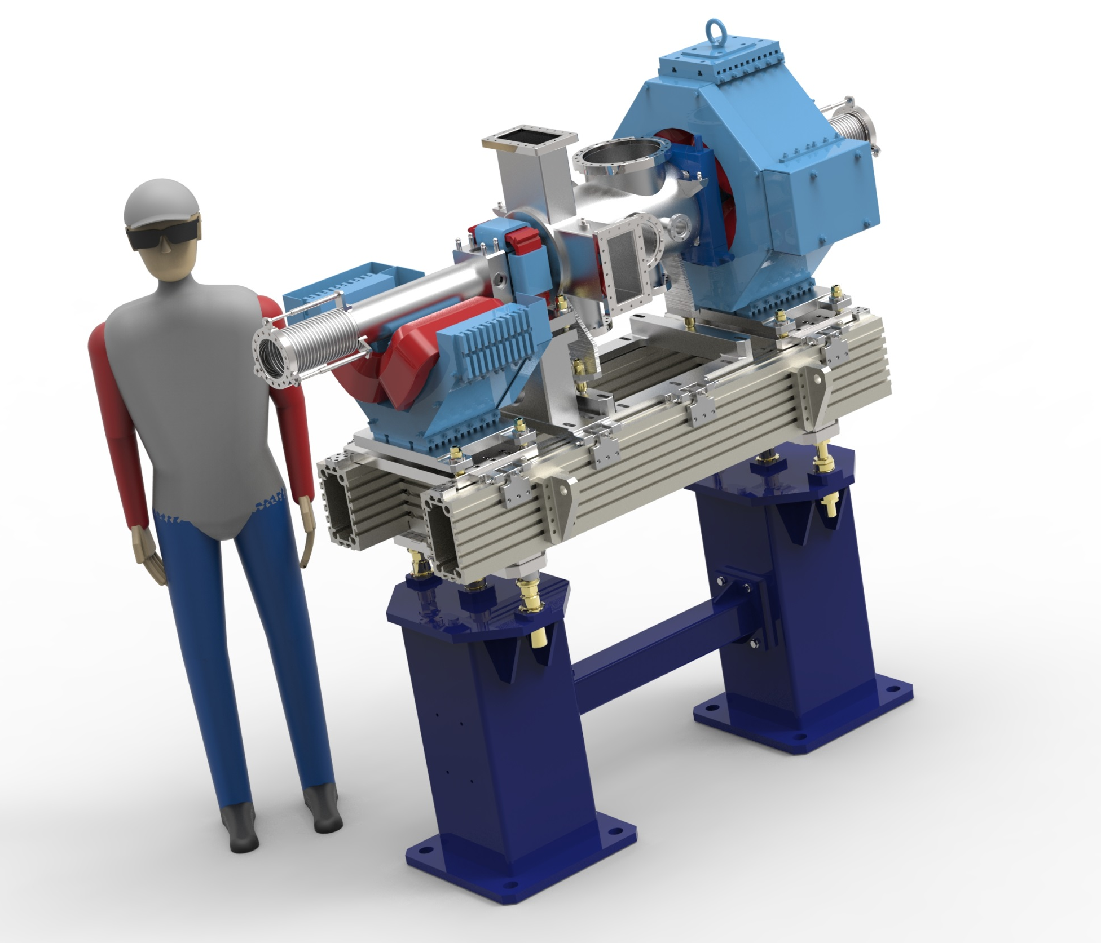

Slide 8
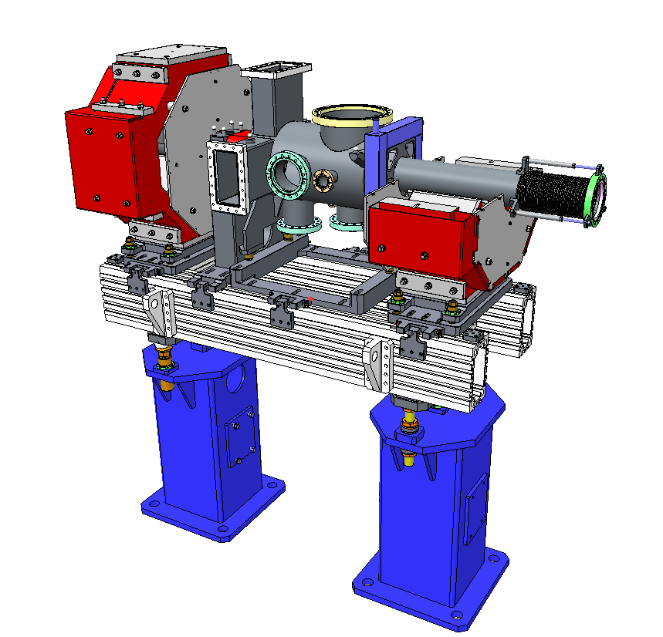
LWU Design
Quadrupole Magnets
Low Particulate Chamber
- ISO 5 or better
BPM on entrance or exit
Aluminium slotted girder
Fiducials, laser tracker alignment
-100µm Accuracy
Semi–kinematic
girder adjustment
Built in lifting points
Pedestals

Slide 9
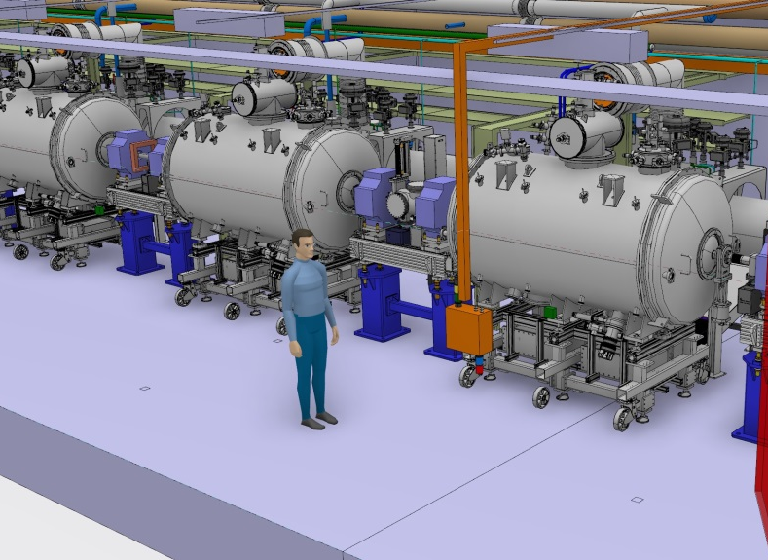

Slide 10
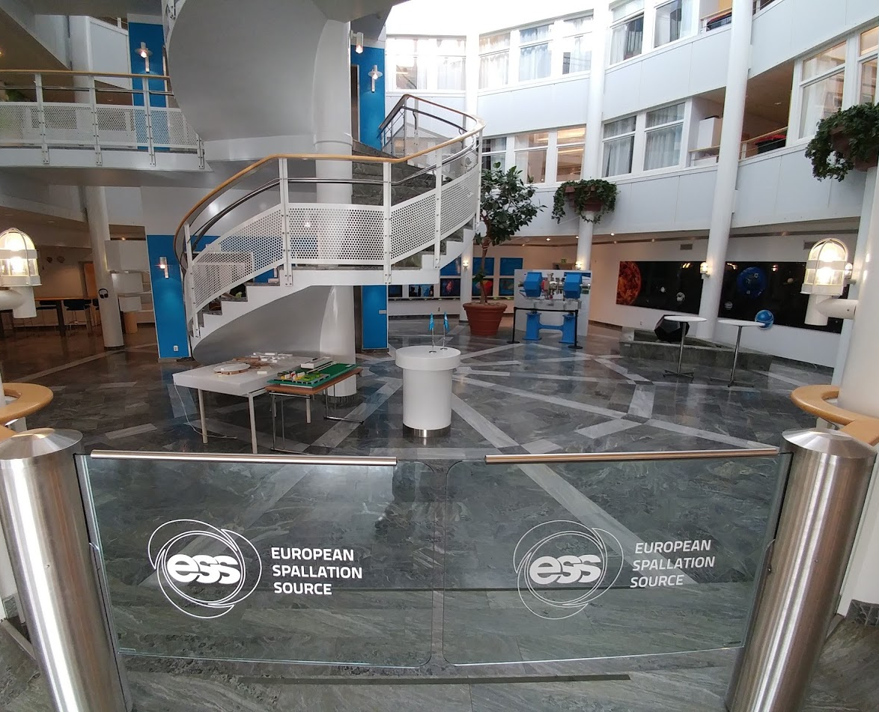

Slide 11
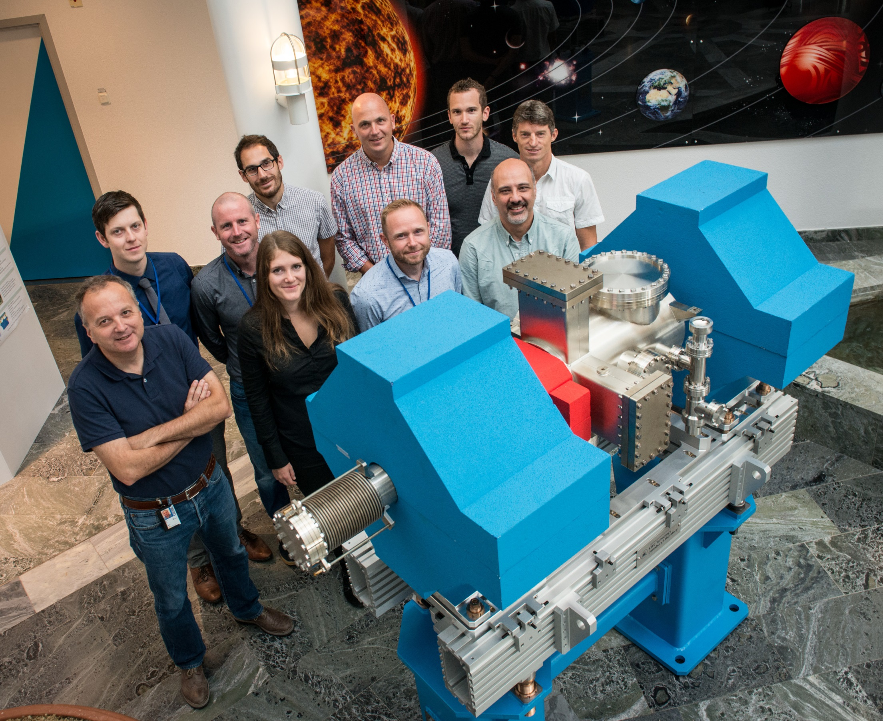

Slide 12
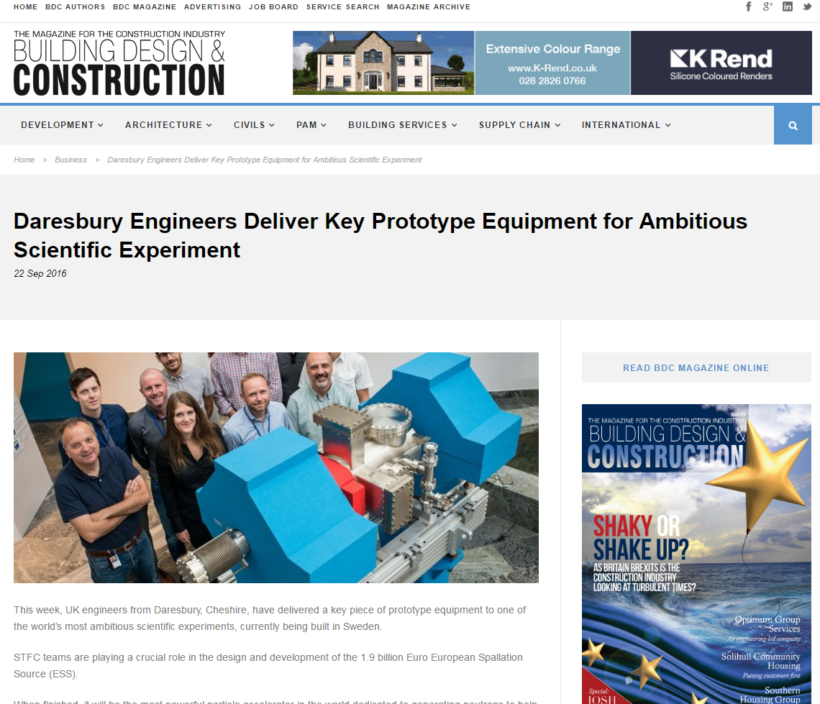
Local Media Coverage

Slide 13
Design updates
BPM and BCM integrated into design
CDR took Place in June
All designs complete and agreed, up to the 1st Dipole
14 variations of LWU
Procurement of the LWUs has begun
2nd Prototype under test
Pre-Series Assembly starting in 12 weeks.

Slide 14
CDR Decision
The committee finds that the design presented is sufficiently advanced and ready to move to procurement and manufacture
if the the heating due to eddy currents is eliminated. If the heating remains, the current design must be re-evaluated to examine the impact of this effect.
20-21 June 2016
CDR for LWU - J.G. Weisend II

Slide 15
Eddy Currents
Expected to be heating the chambers to at least 100ºC
Likely to be cycling around once a week
Obviously detrimental to and sensitive instrumentation
Could cause problems with outgassing from the chambers

Slide 16
CDR Decision
The committee finds that the design presented is sufficiently advanced and ready to move to procurement and manufacture
if the the heating due to eddy currents is eliminated. If the heating remains, the current design must be re-evaluated to examine the impact of this effect.
This has now been resolved, and a decision has been taken to revert to DC magnets.
20-21 June 2016
CDR for LWU - J.G. Weisend II

Slide 17
BTM WP Scope
To design, procurement and assemble;
2 Prototypes
3 Test Chambers
74 Linac Warm Units
52 Beam pipe modules
2 Differential pumping systems
4 mobile installation cleanrooms
Total Cost £10.5m
Approximately 30 FTEs
2016-2019
Notes:
Over the next four years we have been asked to delivery …

Slide 18
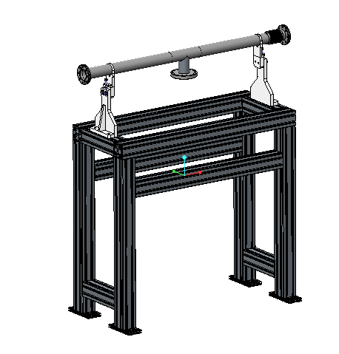
Beam Pipe Modules
ISO 5 Low particulate Chamber
Pumping Ports
Pipe Adjustment

Slide 19
BTM WP Scope
To design, procurement and assemble;
2 Prototypes
3 Test Chambers
74 Linac Warm Units
52 Beam pipe modules
2 Differential pumping systems
4 mobile installation cleanrooms
Total Cost £10.5m
Approximately 30 FTEs
2016-2019
Notes:
Over the next four years we have been asked to delivery …

Slide 20
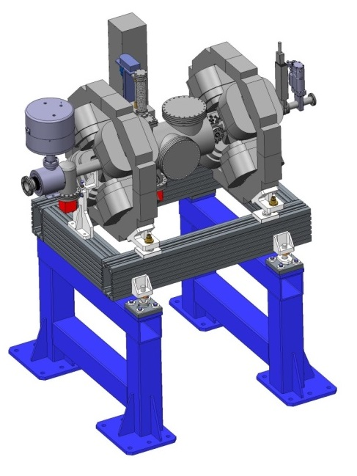
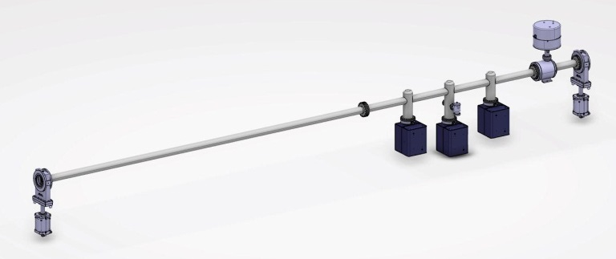
Differential Pumping Sections
Pumping ratio to be 10:1 (1 x 10⁻⁹ mbar on cryo side)
Concepts;
Notes:
Similar to previous work at stfc

Slide 21
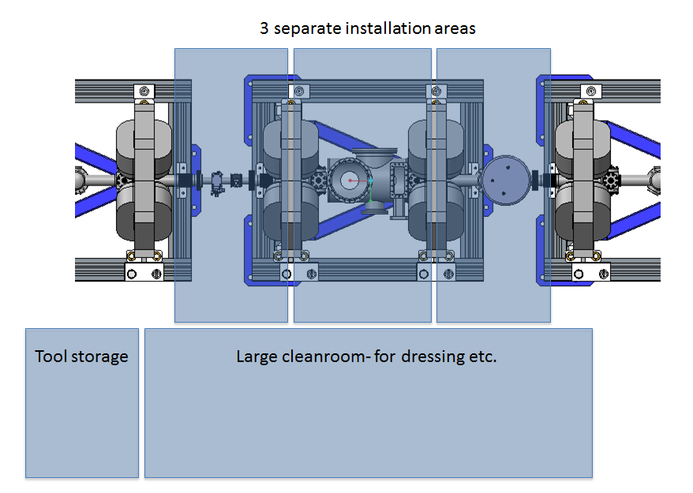
Mobile Installation Cleanrooms

Slide 22
Cleanroom Design
Design now in progress
Any requirements for installing instrumentation should be made now.
E.g. lifting equipment, space constraints etc.
‘Prototype’ cleanroom to be delivered in December
Will allow testing of installation procedures

Slide 23
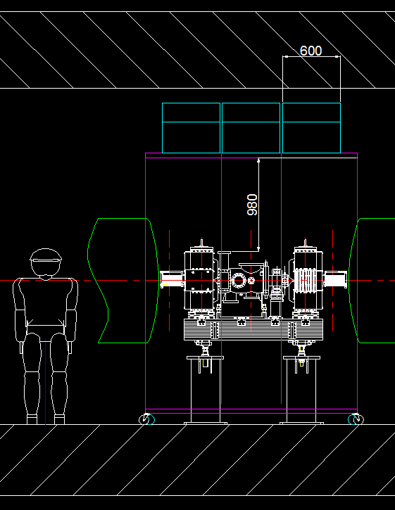
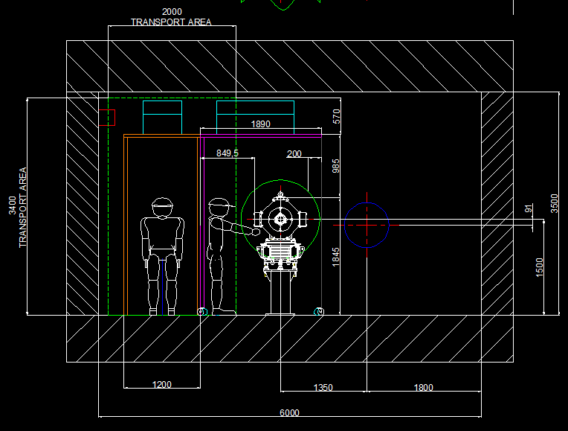
Space Constraints

Slide 24
Schedule

Slide 25
Schedule
2015 | 2016 | 2017 | 2018 | 2019 | 2020
BTM Design
Tunnel available (May 2017)
1st Prototype
LWU by
March 2019
2nd Prototype
CDR
Magnet Deliveries
BPM Deliveries
BTM Assembly
BP Assembly
LWU Assembly
Installation Cleanrooms
Differential Pumping System 1
Differential Pumping System 2

Slide 26
Technical Annex
Submitted to the In-kind review committee
(not likely to be formally signed until December)
Considered complete

Slide 27
ESS Milestone Weighting
Milestone ID | Short description | Planned/ Baseline date | Location | Comment | Weighted MS value % See 5.1.5
 | Progress meetings and reporting | Twice-monthly meetings Monthly reports | As agreed | Physical meetings or via video/teleconference as agreed by Parties in advance of each meeting | 1 %
A41910 | Vacuum Lab commissioned | 31 July 2015 | ESS Lund |  | 8 %
A20146050 | PDR | 10 Nov 2015 | ESS Lund |  | 1 %
A20146060 | CDRs | Jun 20-21, 2016 November 2016 | Partner premises | 1 x CDR for each major equipment type | 15 %
A20146060 | SARs | Timetable to be agreed by Parties | Partner premises | 1 x SAR for each major equipment type | 50 %
 | Final Report & final deliverables |  |  |  | 25 %
Total Weighted Milestone Value |  |  |  |  | 100%

Slide 28
Project Team

Slide 29
Project Team
Paul Aden
Project manager
Keith Middleman
Deputy PM, Vacuum Work Package Manager
John Simpson
Project Sponsor
Neil Bliss
PME Group Leader
Richard Smith
Mechanical Engineer
Danish Naeem
Quality & Mechanical Engineer
Alan Muir, Philip Craine, Mike Cordwell
Mechanical Design Engineers
Phil Atkinson
TMVE group Leader
George Miller
Lead Technician

Slide 30
Summary
Technical Annex Completed
Prototype Delivered
CDR Passed, (up to 1st Dipole) designs now fixed
Procurement Started
BPM manufacture started
Installation Cleanroom designs started
2nd CDR to take place early next year
More staff now hired to cope with project management and quality control work load.

Slide 31
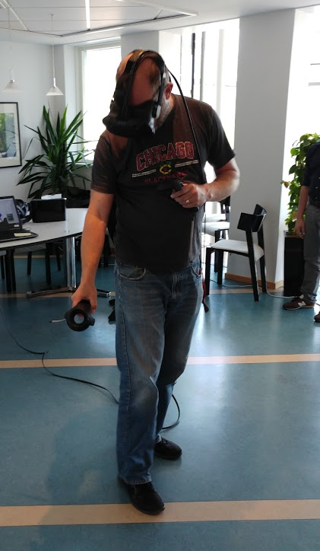
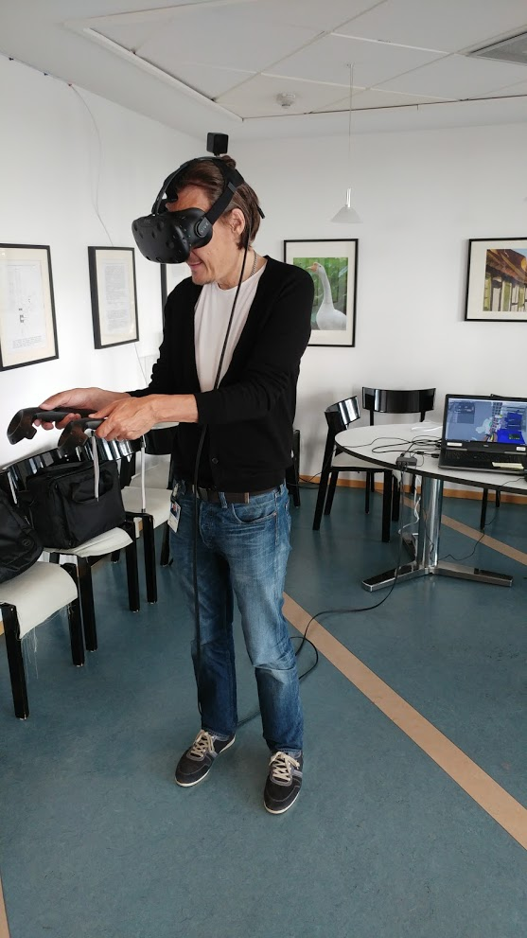
Virtual Reality

Slide 32
Thanks

