Slide 1




Design and Testing of the Multi-Grid Boron-10
Demonstrator on the Time-of-Flight Spectrometer, CNCS
Anton Khaplanov
On behalf of ESS Detector Group and Collaborators
www.europeanspallationsource.se
2016-11-09

Slide 2



Introduction
ILL:
Bruno Guerard, Jean-Claude Buffet,
Jean-Francois Clergeau, Anthony Leandri
ESS:
Anton Khaplanov, Fatima Issa, Richard Hall-Wilton, Oliver Kirstein, Tomasz Brys, Michail Anastasopoulos, Isaak Lopez Higuera, Richard Bebb, Sara Arranz, Carina Höglund*, Linda Robinson*, Susan Schmidt*
Centre for Energy Research (Hungary):
Eszter Dian
Linköping University:
Jens Birch, Lars Hultman, (also *)
SNS:
Ken Herwig, Georg Ehlers, Michelle Everett, Kevin Berry
Earlier – the participants of the CRISP project on Large-Area detectors.
Horizon 2020 grant agreement 676548
WP 4.3: Large-Area Detectors
Previous publications:
B4C layers:
*C. Höglund et al, J of Appl. Phys. 111, 104908 (2012)
Characterization:
*A. Khaplanov et al., arXiv:1209.0566 (2012)
*B Guerard et al., NIMA, 720, 116-121 (2013), http://dx.doi.org/10.1016/j.nima.2012.12.021iJ
*J. Correa et al., Trans. Nucl. Sc. (2013), DOI: 10.1109/TNS.2012.2227798
*A. Khaplanov et al., (2014) J. Phys.: Conf. Ser. 528 012040 doi:10.1088/1742-6596/528/1/012040
Gamma sensitivity:
*A. Khaplanov et al., JINST 8, P10025 (2013), arXiv:1306.6247
Alpha background:
*A. Khaplanov et al., JINST 10, P10019 (2015); doi:10.1088/1748-0221/10/10/P10019

Slide 3
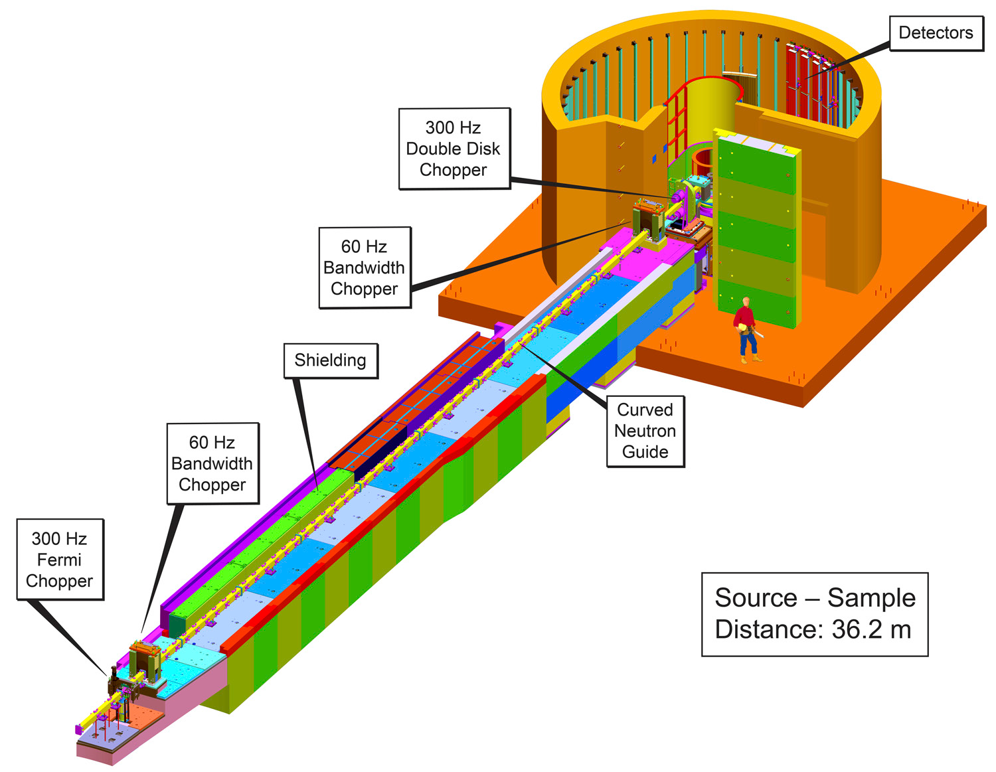
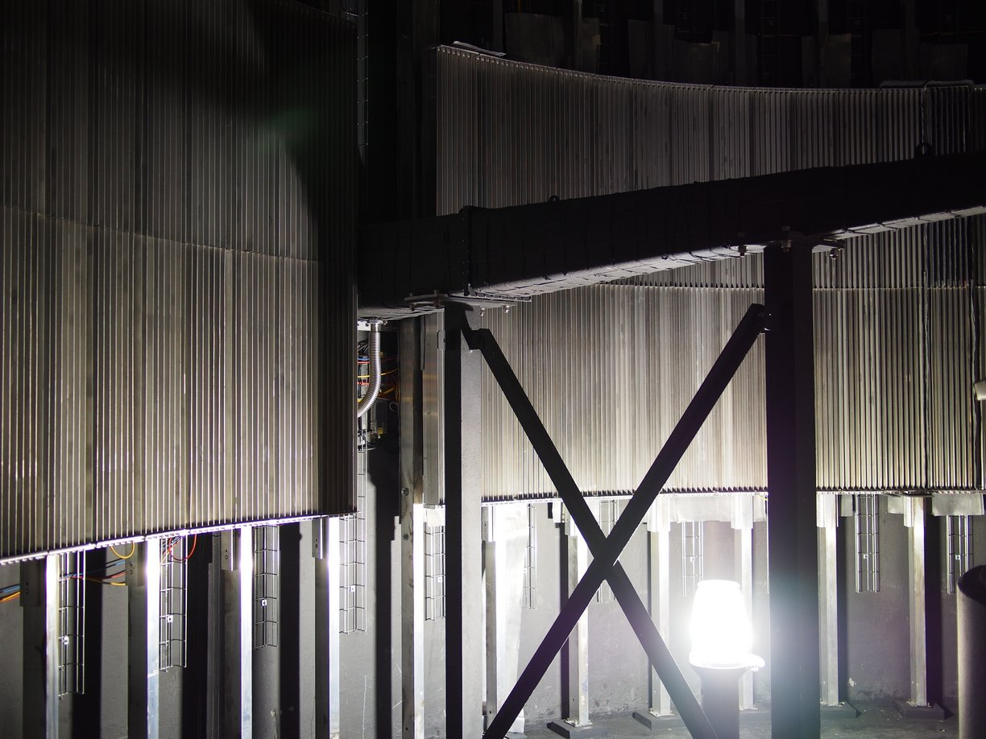
Multi-Grid Test at CNCS, SNS
Goals:
Side-by-side comparison to He3
Test at spectrometer
User experiments
Dedicated tests
Operation for 6+ months
Solution:
Size = half of “8-pack” module – 0.2m²
96 grids, 2 modules of 48 grids
32 boron layers
Adapted layer thickness
Gas flow-through
Installation June-July 2016
Detector inaccessible
Currently 4th month of operation
As CNCS experiment 17219

Slide 4
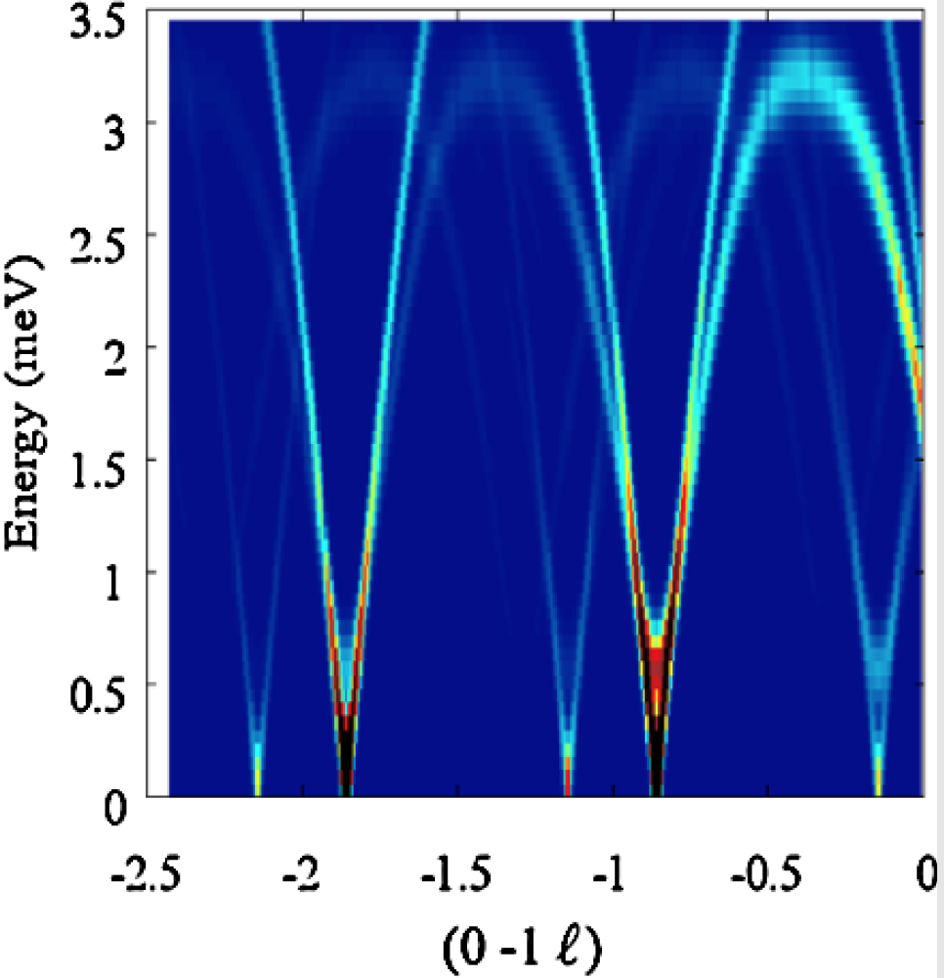
Time-of-Flight Spectrometers
Neutron scattering instruments
addressing 0.1-100 meV states
Time-of-flight information
2-4 m sample to detector distance
→ Energy transfer
20-40 m² detector area
Position resolution O(1inch)
Momentum transfer
High dynamic range
Low background
Incident beam
Detector
n E_{i}, Q_{i}
n E_{f}, Q_{f}
Sample
Information on momentum transfer
Information on energy transfer

Slide 5
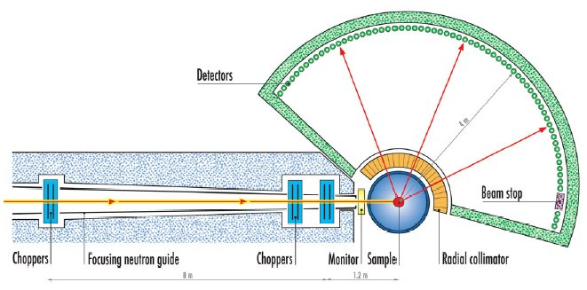
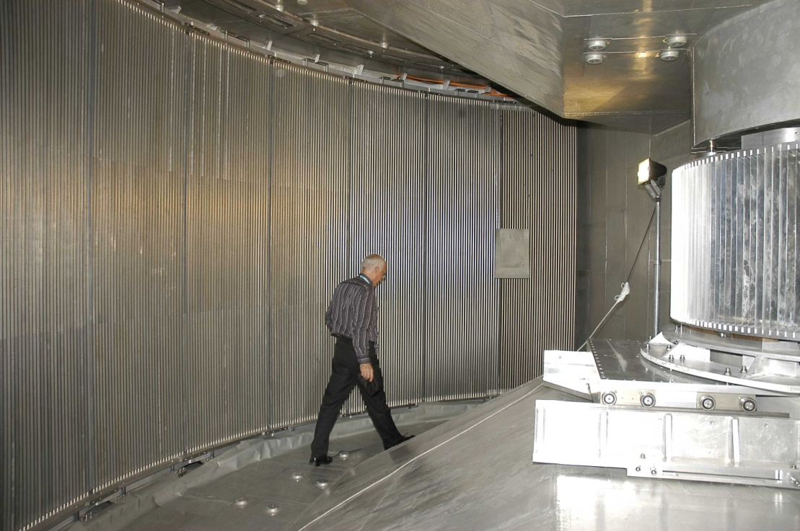
Time-of-Flight Spectrometers
Some present-day examples:
IN5 at ILL, CNCS at SNS
He3 tubes used in many current instruments
Pros: Good efficiency Cons: Rate limitations
Low background Cost, availability of He3
We show Multi-Grid meets Efficiency and Background requirements and improves on Rate and Cost

Slide 6
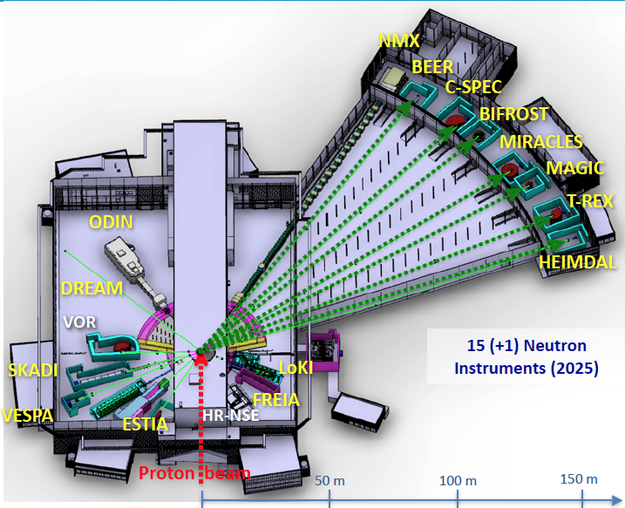
Multi-Grid for Direct Spectrometers at ESS
3 ToF spectrometers for ESS
CSPEC and T-REX – design phase
VOR – accepted proposal
Multi-Grid confirmed as baseline detector technology
Instrument | C-SPEC | T-REX | VOR
Sample – detector | 3.5 m | 3 m | 3 m *
Detector height | 3.5 m | 2.2 m | 3 m *
Detector area | 29 m² | 21 m² | 37 m² *
*preliminary

Slide 7

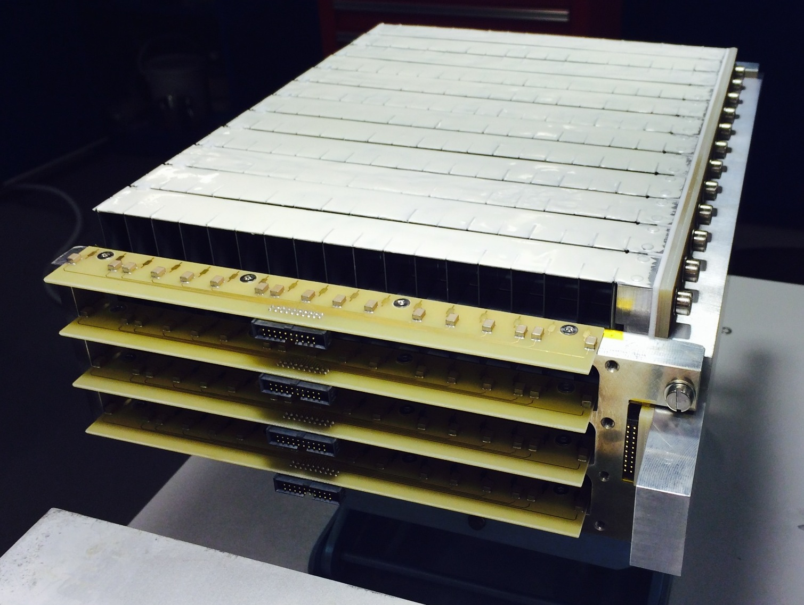
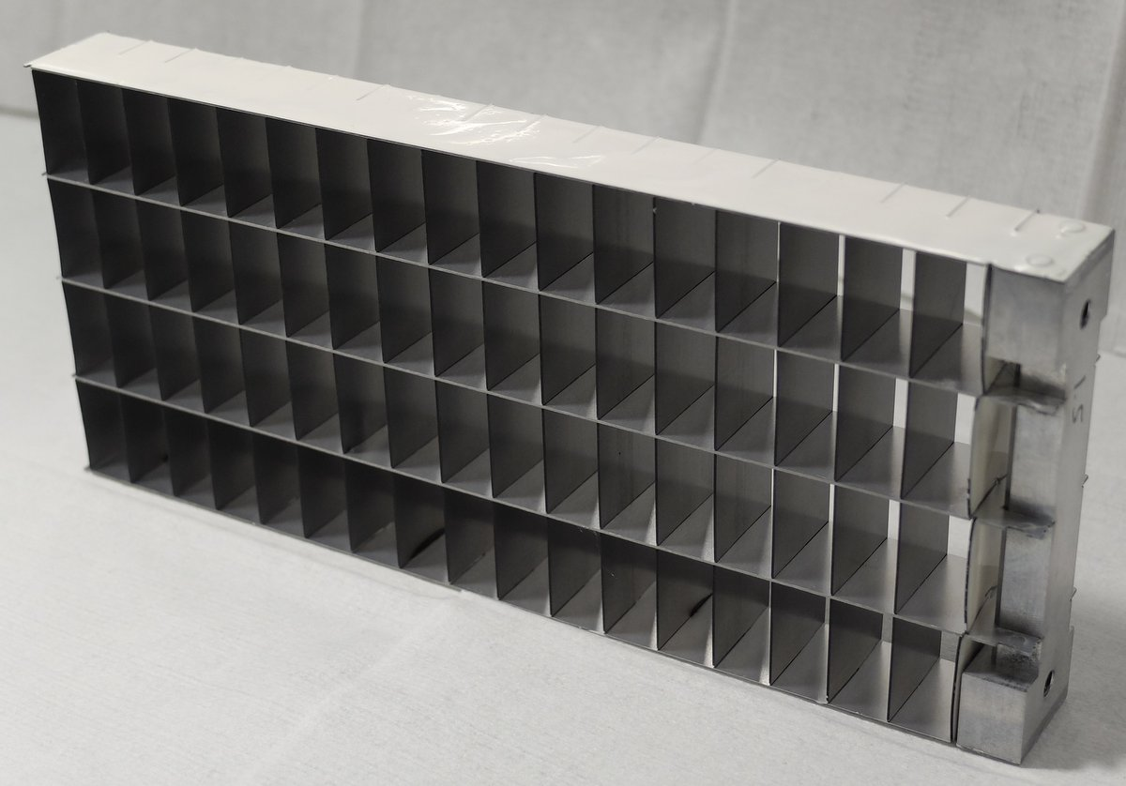
Multi-Grid Principle
gas
n
conversion
fragment 2
n
fragment 1
gas
B-10 film
Al substrate
n
High total efficiency
Readout split over many layers – lower local rate
No need for resistive readout – low gain
Introduced at ILL, jointly developed by ILL and ESS under CRISP project, and now under BrightnESS

Slide 8
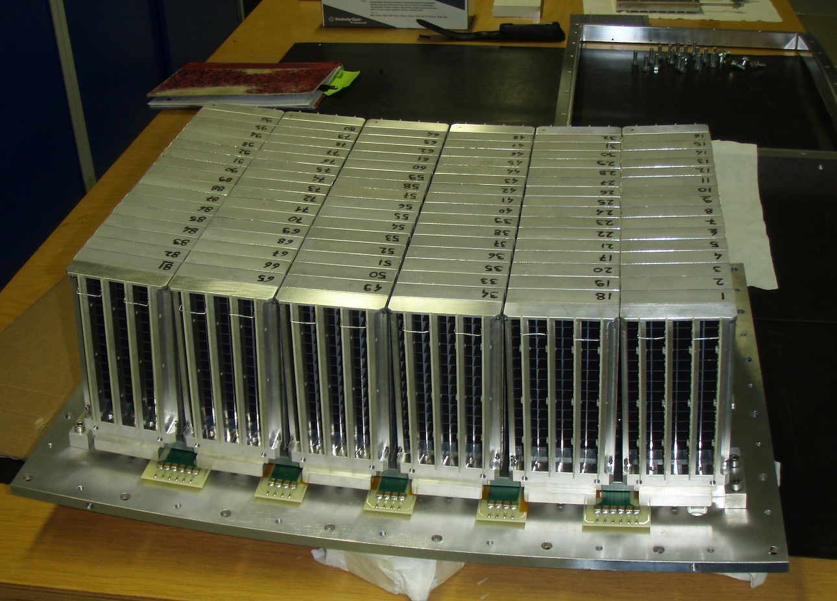
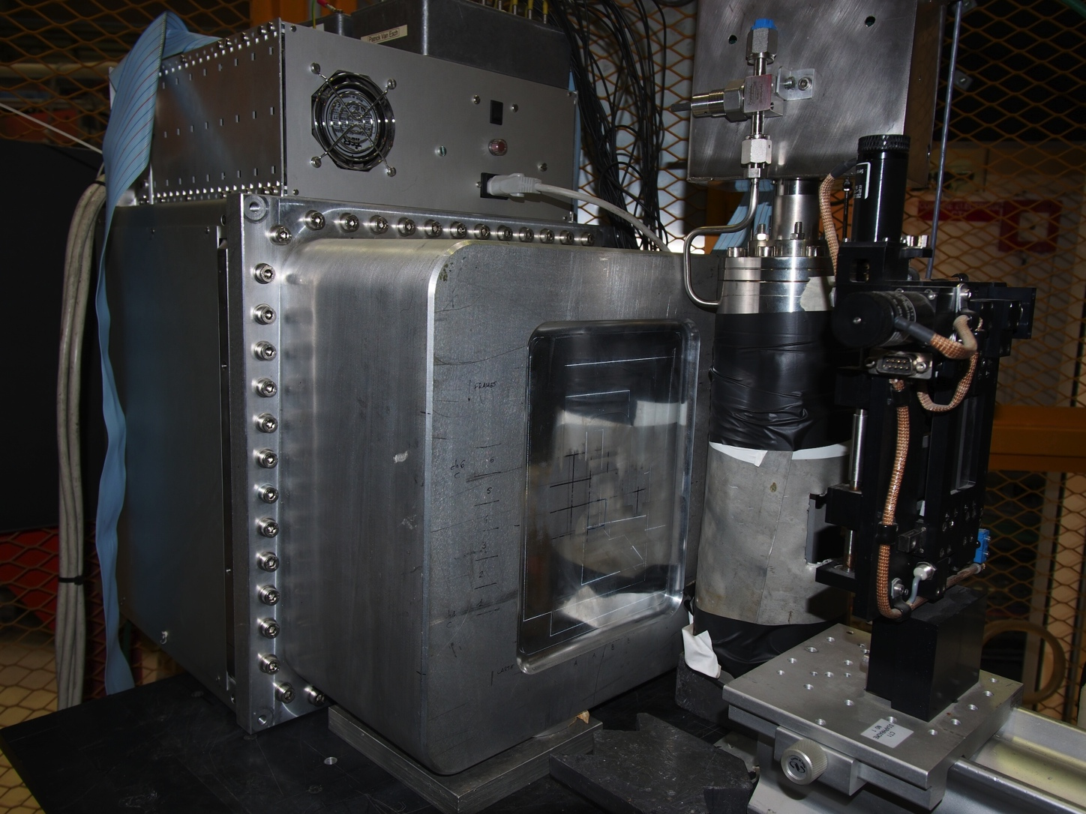
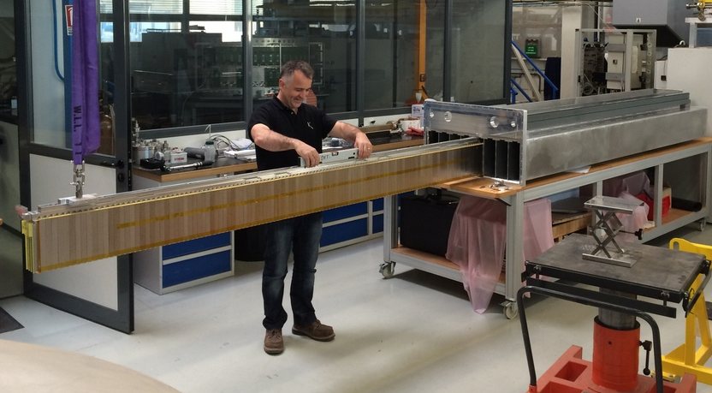
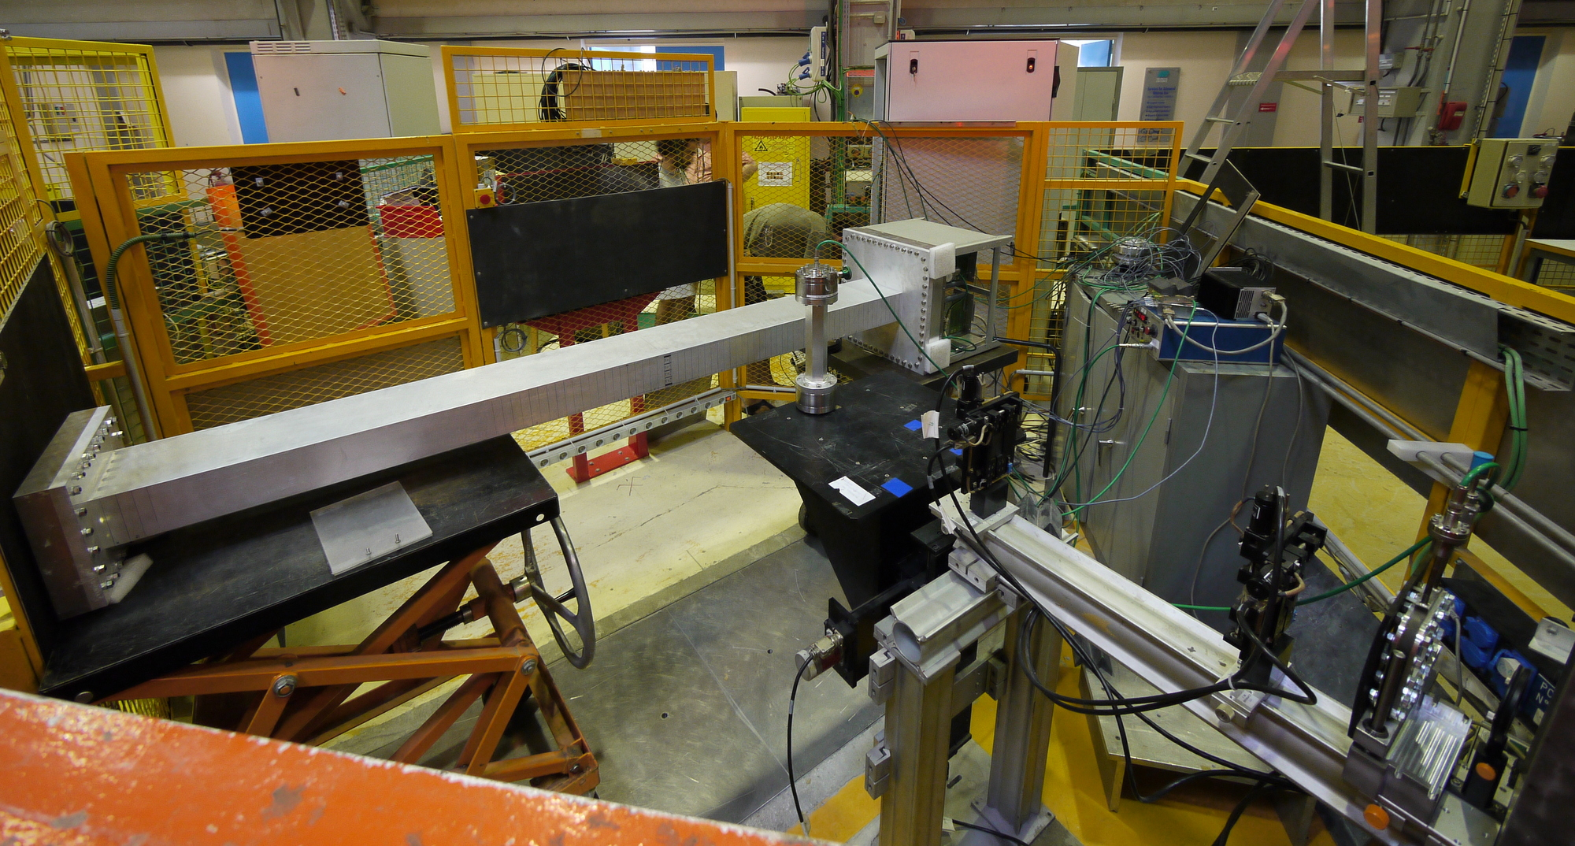
Earlier
Prototypes
IN6 demo – 96 grids – Oct 2012
Proto1 – 6 / 12 grids – Dec 2010
IN5 demonstrator – 1024 grids – Sep 2014
Proto2 – 96 grids – Jul 2011

Slide 9
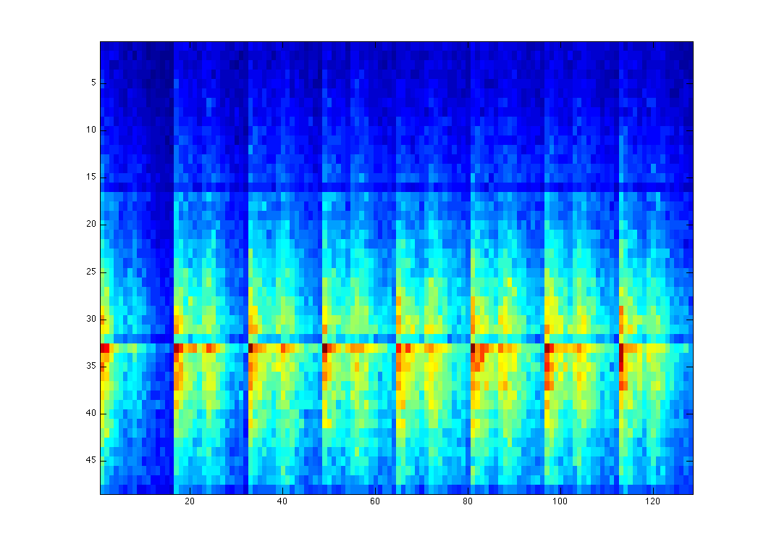
Readout Scheme
Grid-wire coincidences
Signals in 1 grid and 1 wire define an event
3d-position localization
grid # and wire # → unique voxel
Voxel position in spherical coordinates
Theta and phi → scattering angle
Radial coordinate → energy determination
rows
frames
n
wires
n E_{i}, Q_{i}
n E_{f}, Q_{f}
Wire rows

Slide 10
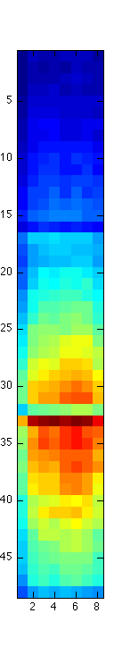
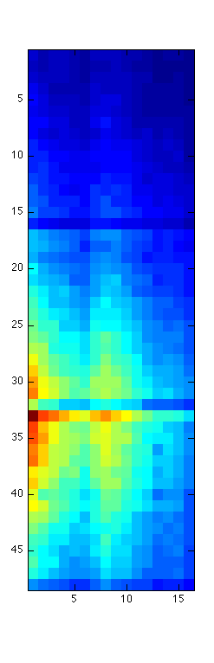
Source measurements
Front projection
Side projection
Wire rows

Slide 11
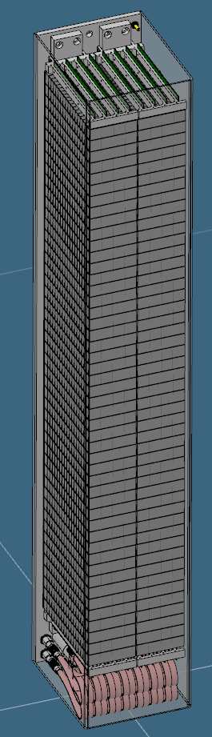
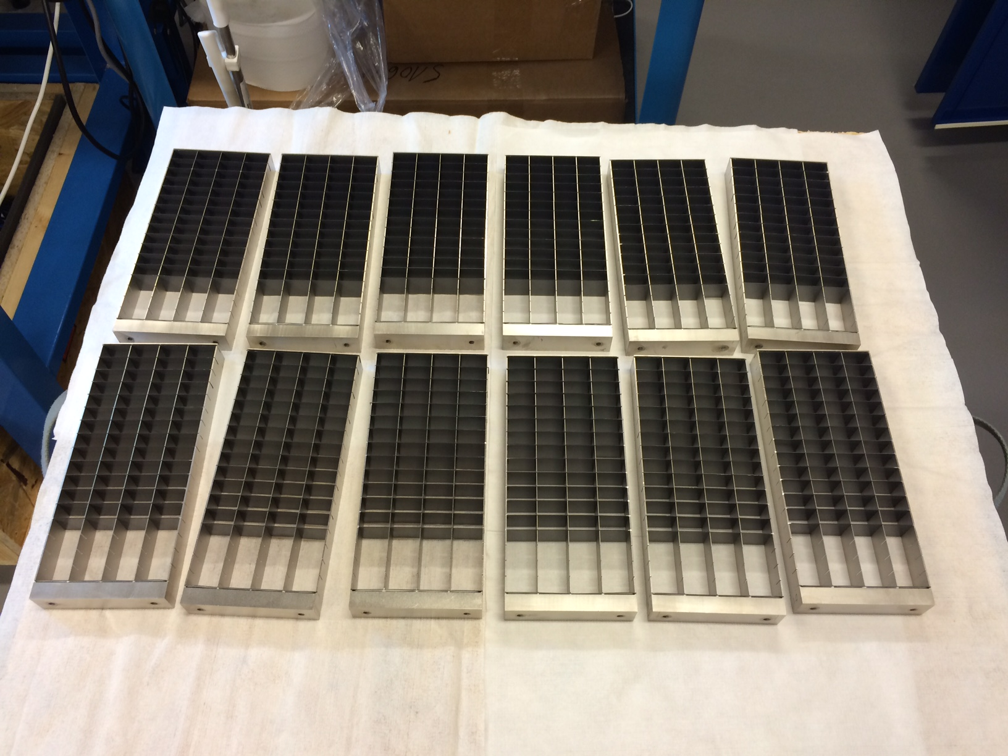
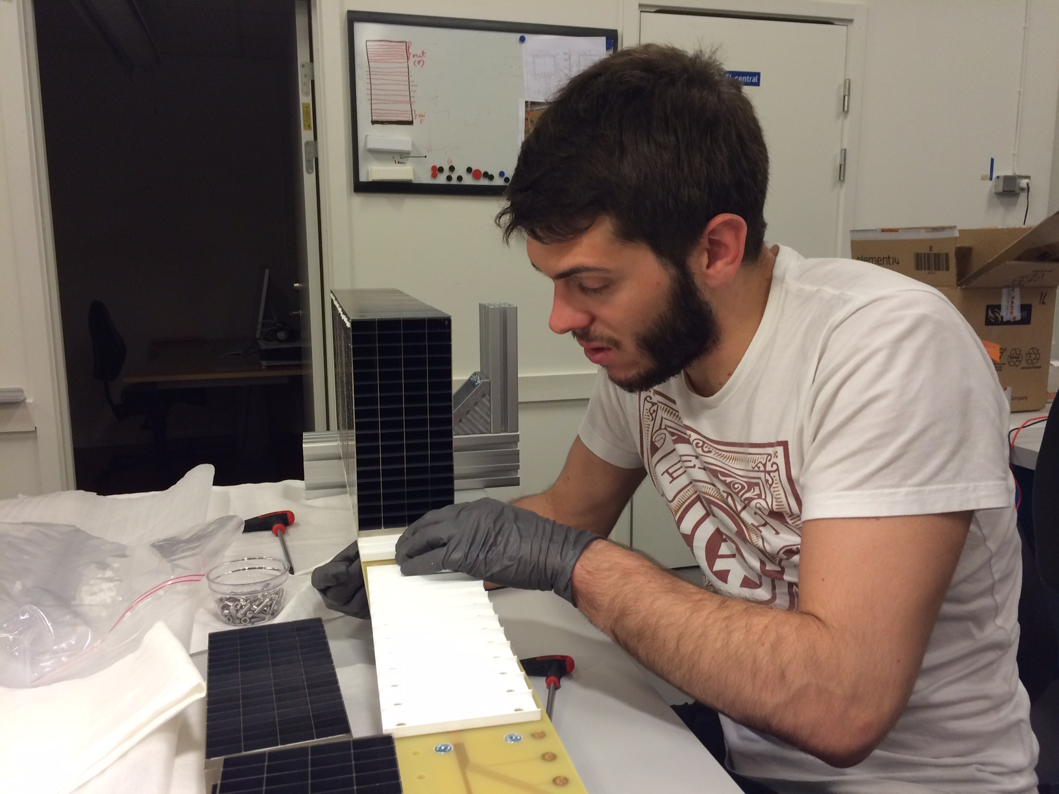
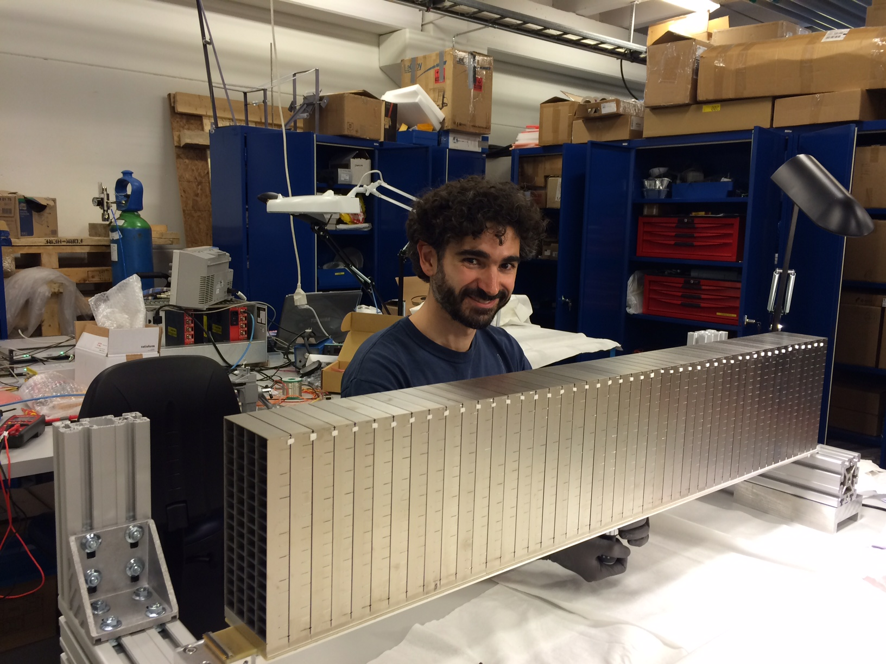
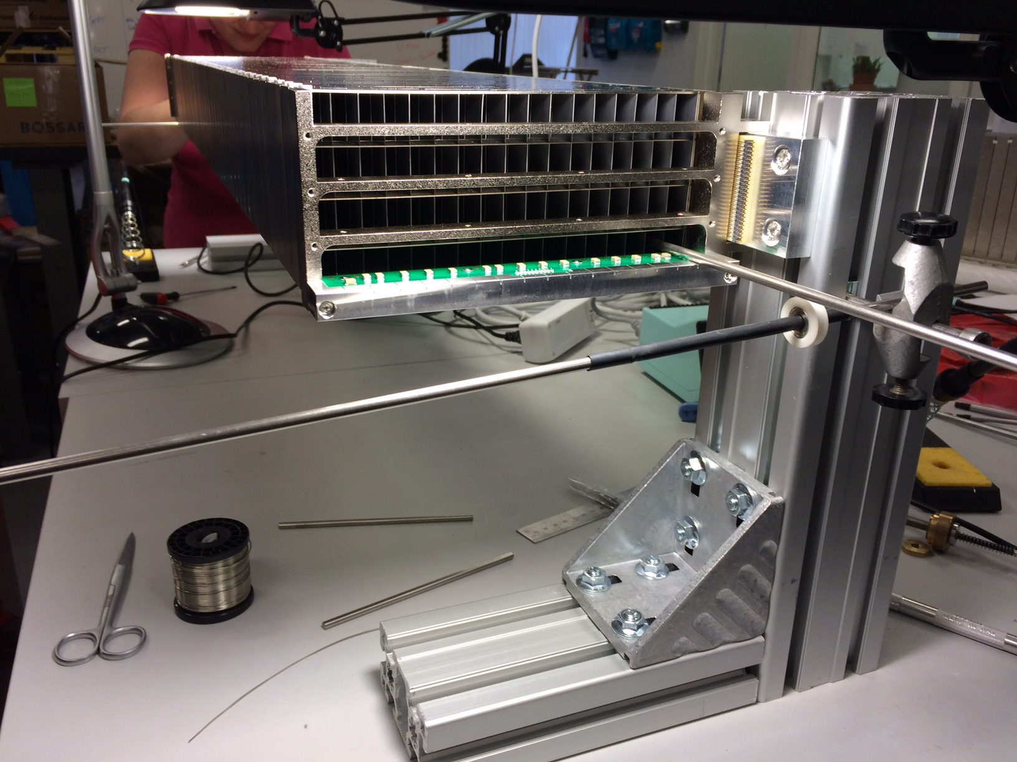
Construction of MG.CNCS in Lund

Slide 12
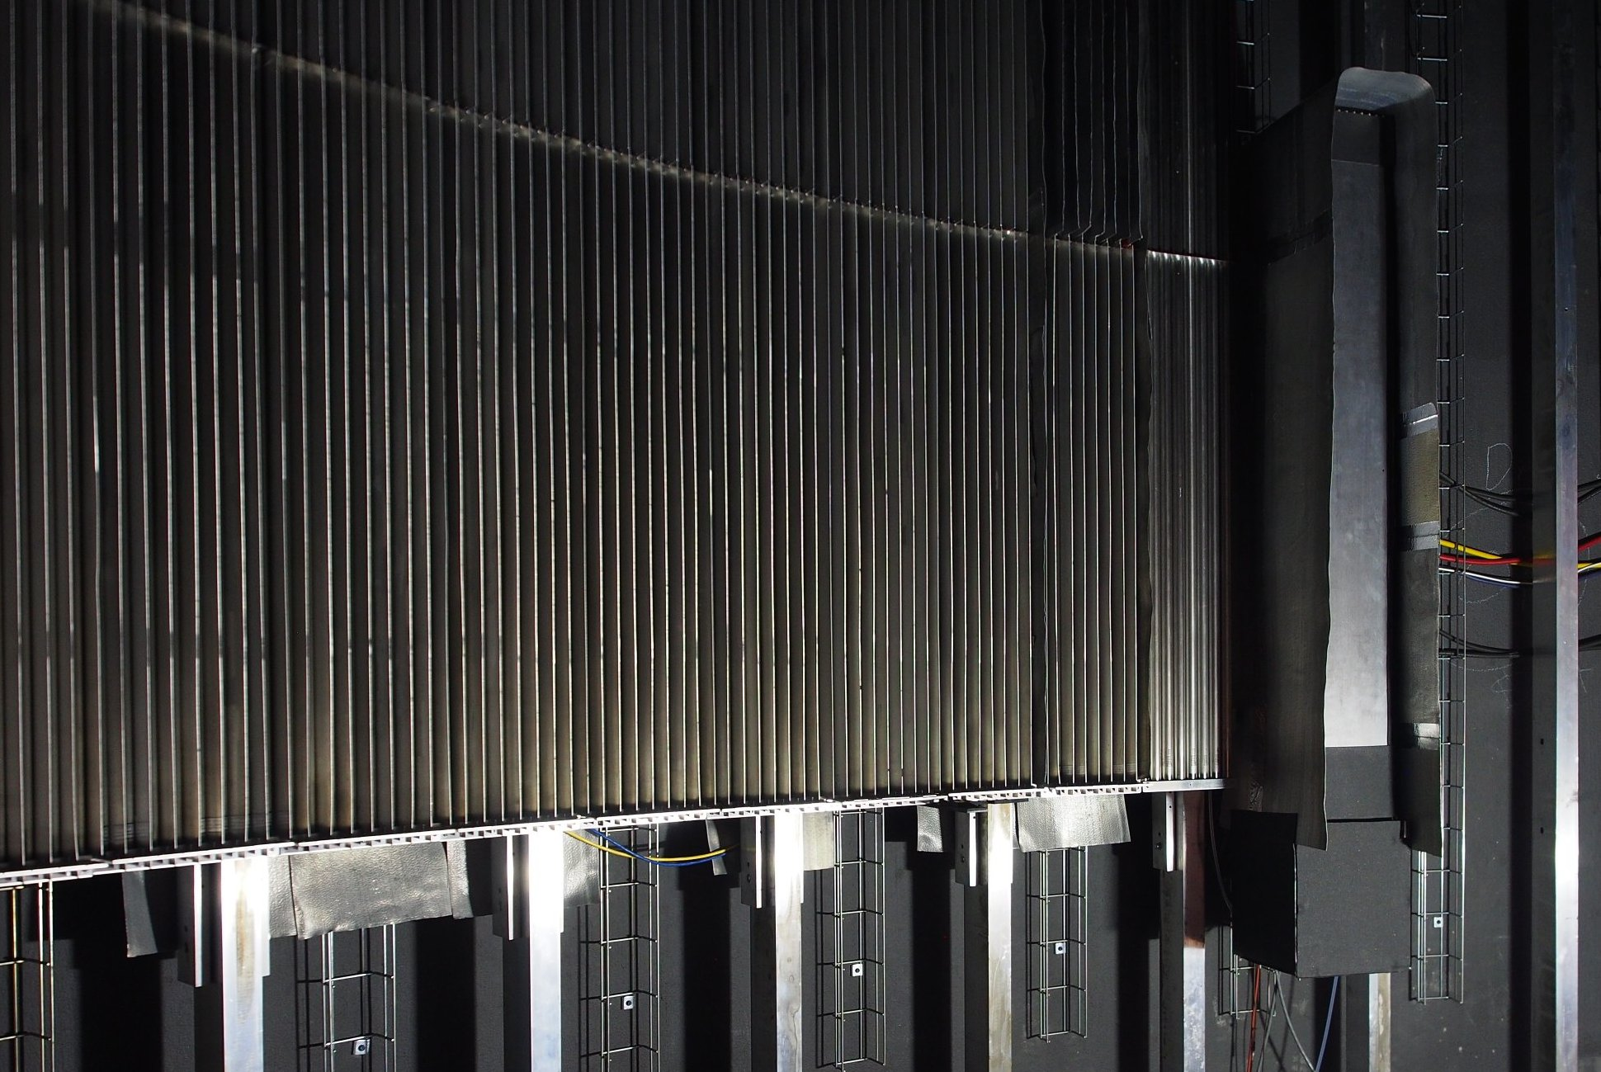
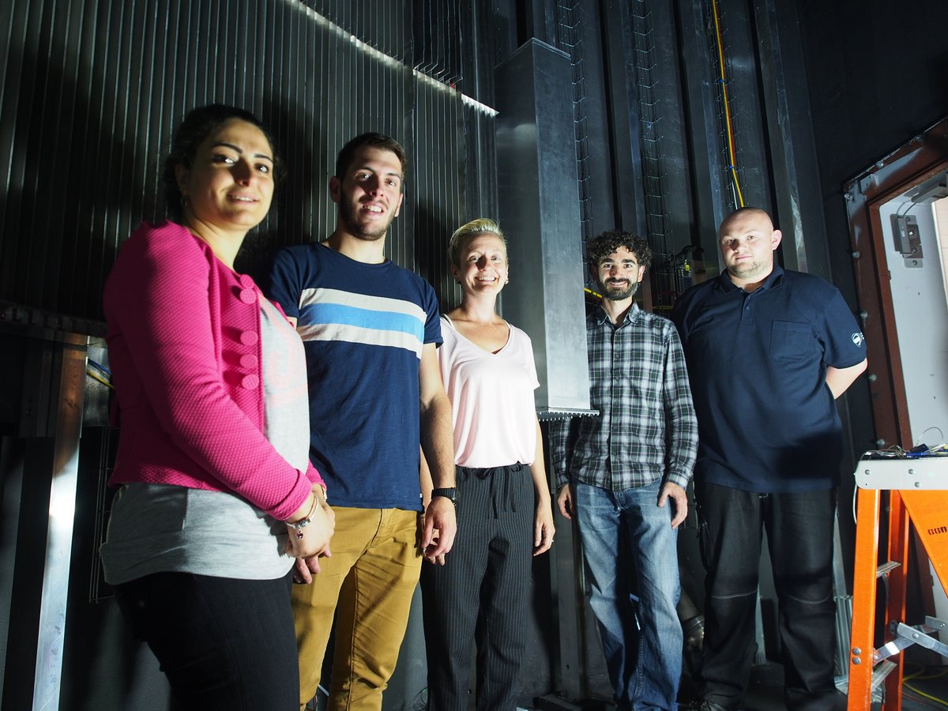
Multi-Grid test at CNCS
Detector installed at 57° scattering angle
shielded with boron and cadmium
(~same location as Proportional Technologies detector test)
He-tubes
MG
Installation completed!
Detector inaccessible for next 6 months
³He 8-packs
M-G
1.1m
View from sample
20cm
19cm

Slide 13
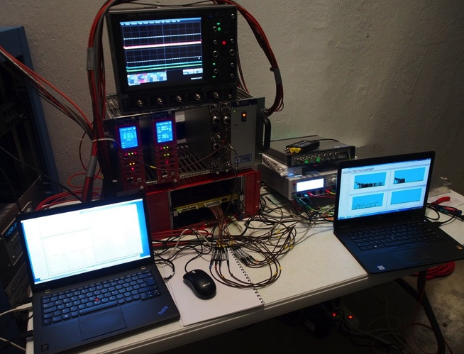
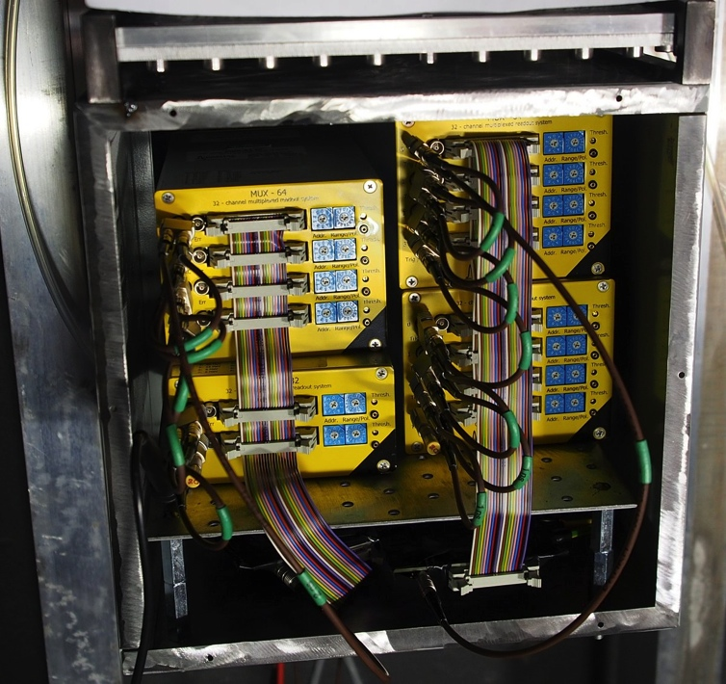
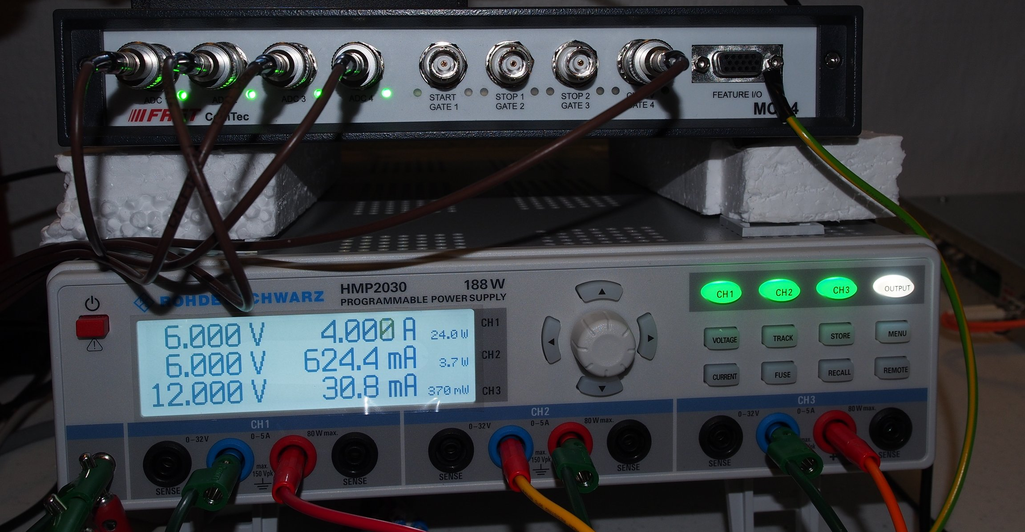
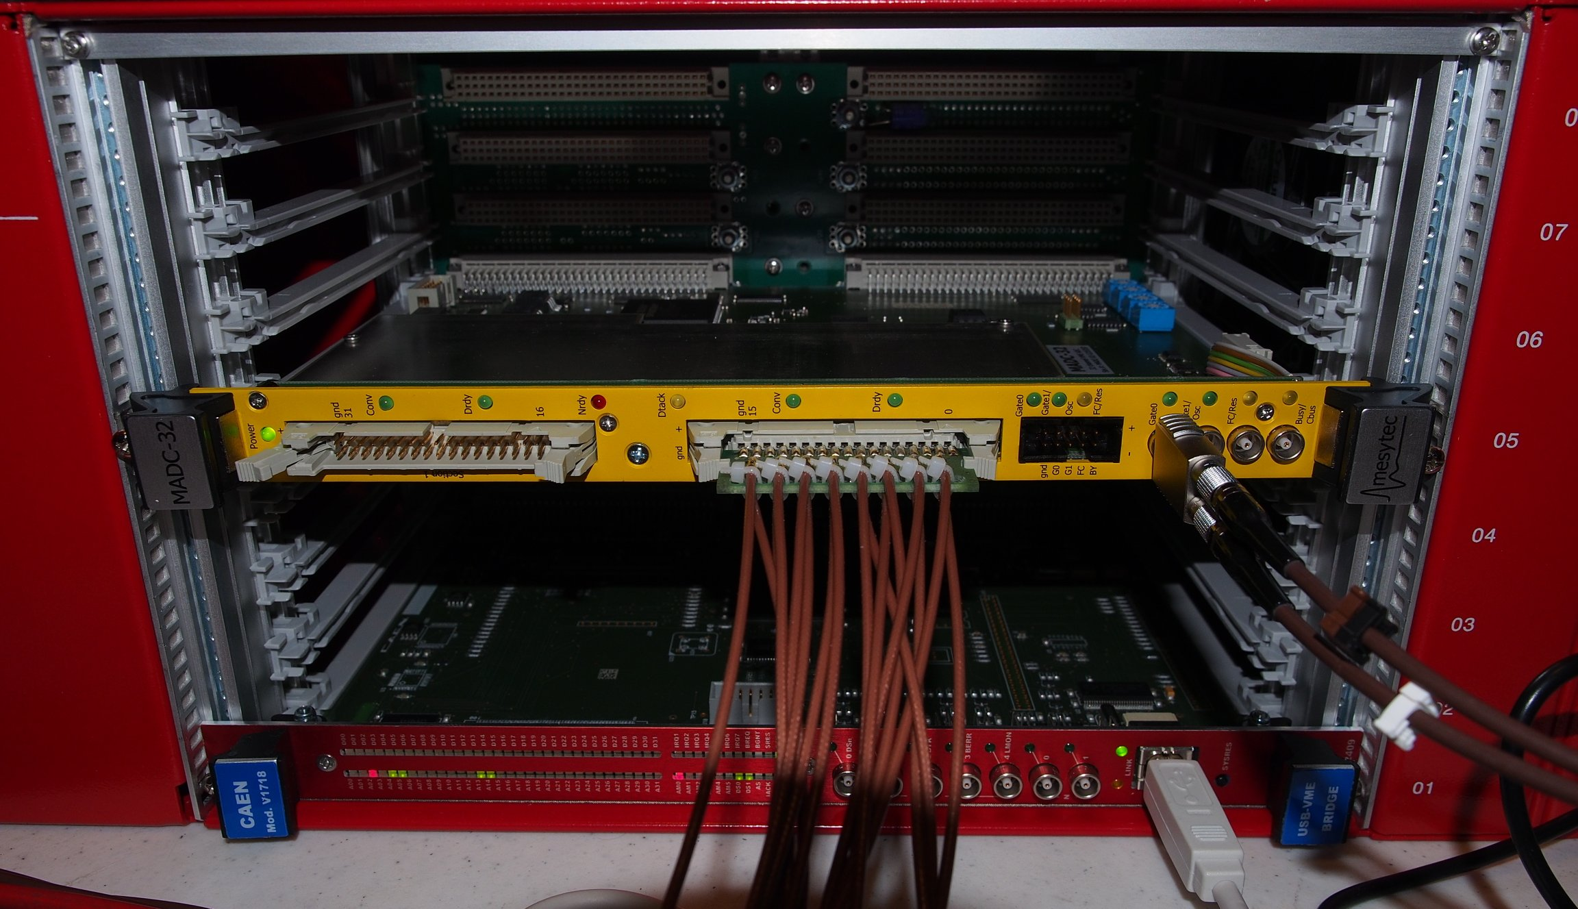
Data Collection
Front-end
Acquisition
Digitization
Collected data per event:
1-2 wires – pulse height + position for each
1-2 grids – pulse height + position for each
Time stamp for each event
1-2, in order to account for multiplicity 2
Usually multiplicity 1 in wires, 2 in grids

Slide 14
Spectra
Pulse height spectra
Wire 1 PHS
Wire 2 PHS
Grid 1 PHS
Grid 1 PHS
Wire 1 Pos
Wire 2 Pos
Grid 1 Pos
Grid 1 Pos
Position spectra

Slide 15
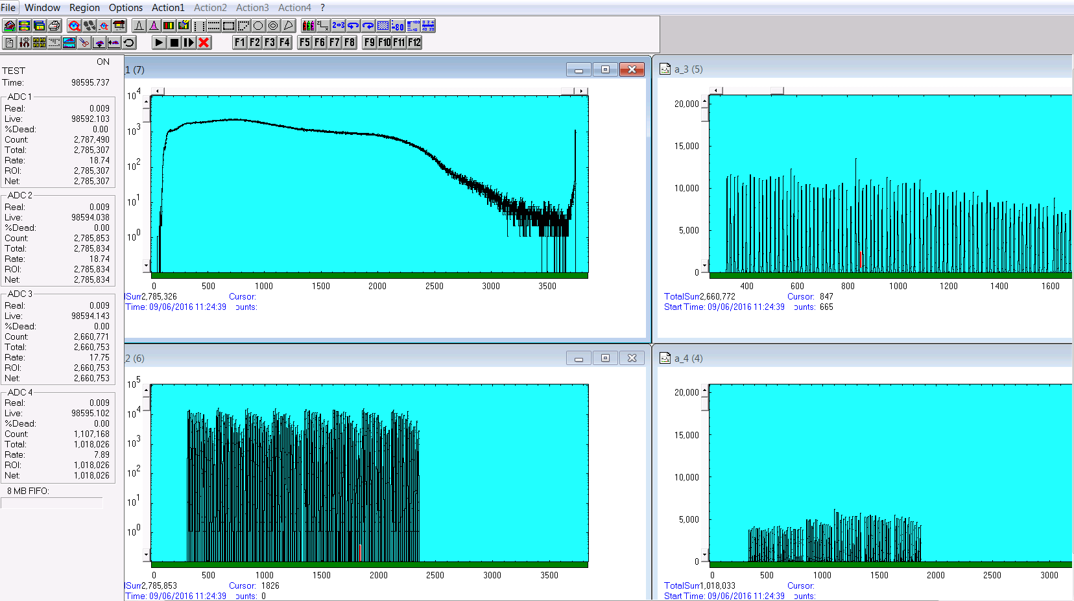
Raw Data Monitoring
Pulse height spectra and channel counts monitored on-line

Slide 16
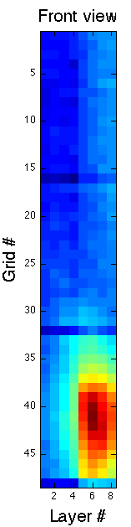
Data Collection
Collected data:
Time-of-Flight
Position of detection

Slide 17
Energy Reconstruction
Time-of-Flight
Front of MG ~20cm closer to sample
Back of MG ~same distance as He3
Energy transfer, E_{i}-E_{f}
(0,0,0)
E_{i}
v_{i}
λ_{i}
t_{s}
distance
E_{f}
v_{f}
λ_{f}
Reconstructed for each n
(x,y,z)

Slide 18
Approximate Relative Efficiency
Spectra normalized to detector area and acquisition time
Peak area ratio ≈ relative efficiency
(peak counts in MG) / (peak counts in He3)
Efficiency comparable
Multi-Grid will produce at least the same quality of data
meV | Å | Peak ratio
0.76 | 10.4 | 1.155
1.0 | 9.0 | 0.956
1.55 | 7.2 | 0.964
2.49 | 5.73 | 0.956
3.32 | 4.96 | 0.915
4.5 | 4.26 | 0.841
8.0 | 3.20 | 0.774
12 | 2.61 | 0.717
15 | 2.34 | 0.697

Slide 19
Instrument Energy Resolution
Instrument energy resolution independent of detector
Dominated by incoming beam
High flux and high resolution settings correspond to published data for CNCS
1st set of runs
2nd set of runs
Data for AI 240Hz, HF 300Hz, HR 180 Hz from http://sns.gov/cncs

Slide 20
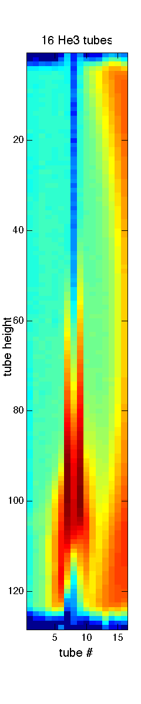
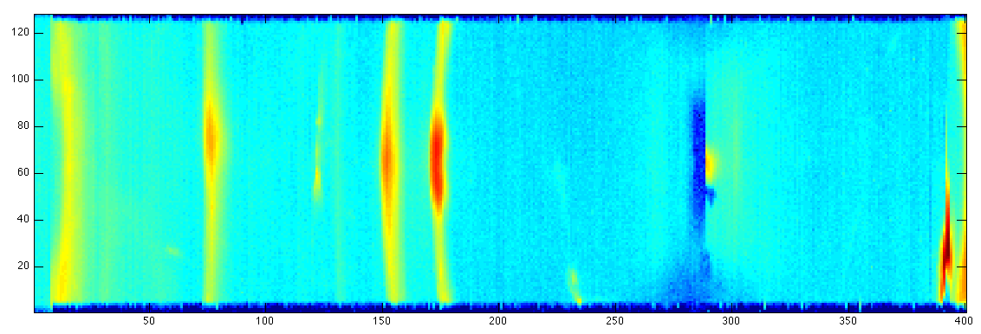
Single Crystal Measurement
16 tubes
UGe2 sample
Sample rotation and neutron energy adjusted so that a Bragg reflection moves between He3 and Multi-Grid
13.74 meV (2.44 Å) – reflection in MG
17.20 meV (2.18 Å) – reflection in He3
Multi-Grid
Full He3 array. 400 tubes, 400x128 pixels
MG
He3: Saturation, loss of counts
Loss of position resolution
MG: No Saturation
Position reconstructed correctly
(Not to scale)

Slide 21
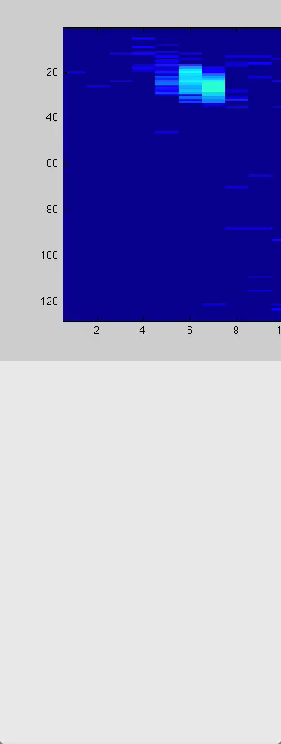
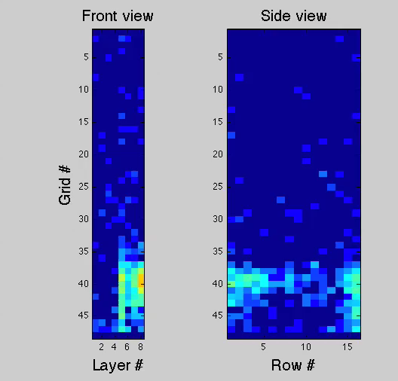
Bragg Peak measured in both detectors
CNCS He3 detector
Multi-Grid detector installed at CNCS (SNS)

Slide 22
Conclusions
Operation with no access for 3.5 months so far.
All data compared to He3. Good performance demonstrated for ToF spectrometer.
Spectra comparable between MG and He3. All known features in both.
Backgrounds on similar levels. Some better in He3, some in MG.
Energy resolution of He3 reproduced.
GEANT4 simulations reproduce features due to scattering.
Detector endorsed for CSPEC, T-REX at ESS
Horizon 2020 grant agreement 676548

Slide 23
Rate over time
July 14th
Oct 17th

Slide 24
Extras

Slide 25
Energy Reconstruction
3559.6
Grid reference
(2981.9, 149.6, 1943.9)
Sample center (0, 0, 0)
149.6
E_{i}
v_{i}
λ_{i}
t_{s}
dist
E_{f}
v_{f}
λ_{f}
Reconstructed for each n
Pixel position (x, y, z)
t_{d}

Slide 26
Energy Reconstruction
Front Cells Only
Correction for depth does not compromise data quality
Detector equivalent to a flat detector
Grid reference
(2981.9, 149.6, 1943.9)
E_{i}
v_{i}
λ_{i}
Sample center (0, 0, 0)
149.6
t_{s}
E_{f}
v_{f}
λ_{f}
dist
PRELIMINARY
~16% of events in 1st cells for 9Å
Pixel position (x, y, z)
t_{d}

Slide 27
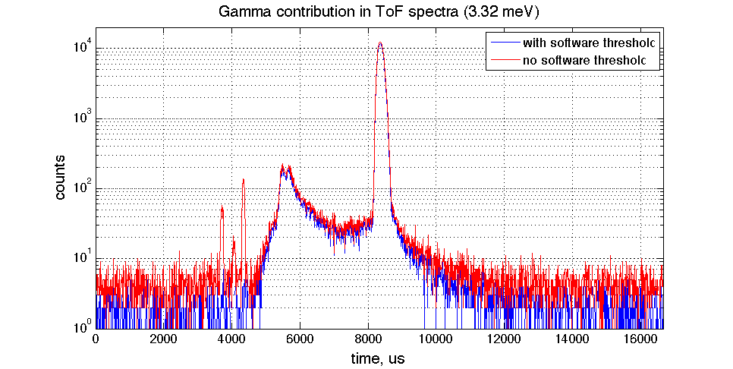
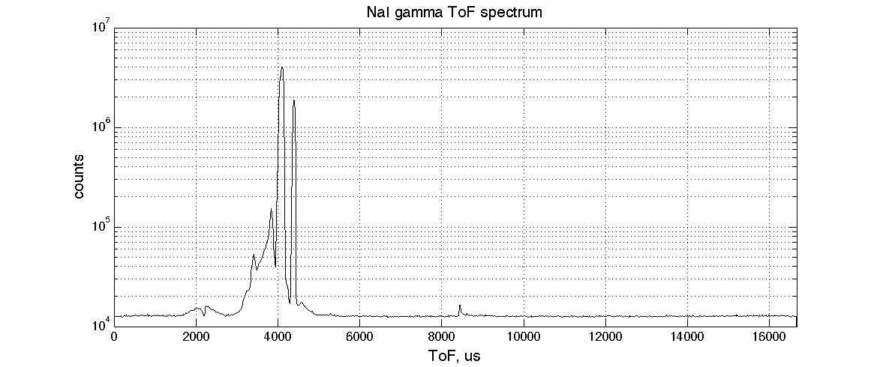
Gamma Sensitivity
PRELIMINARY
MG threshold set so γ just barely detected
Fully removed using software threshold
All data shown is with the threshold on
Independent γ detector ToF data
γ flashes as neutrons approach sample
PRELIMINARY

Slide 28
Multi-Grid test at CNCS
Optimized grid
Efficiency optimized depending on the wavelength range
Efficiency for CNCS:
Using 32 layers (16 cells)
and optimized for 4Å
Constant layer thickness:
0.75um optimal.
~2% improvement using varied thickness:
7blades 0.5um,
7blades 1.0um,
3 blades 1.5um

Slide 29
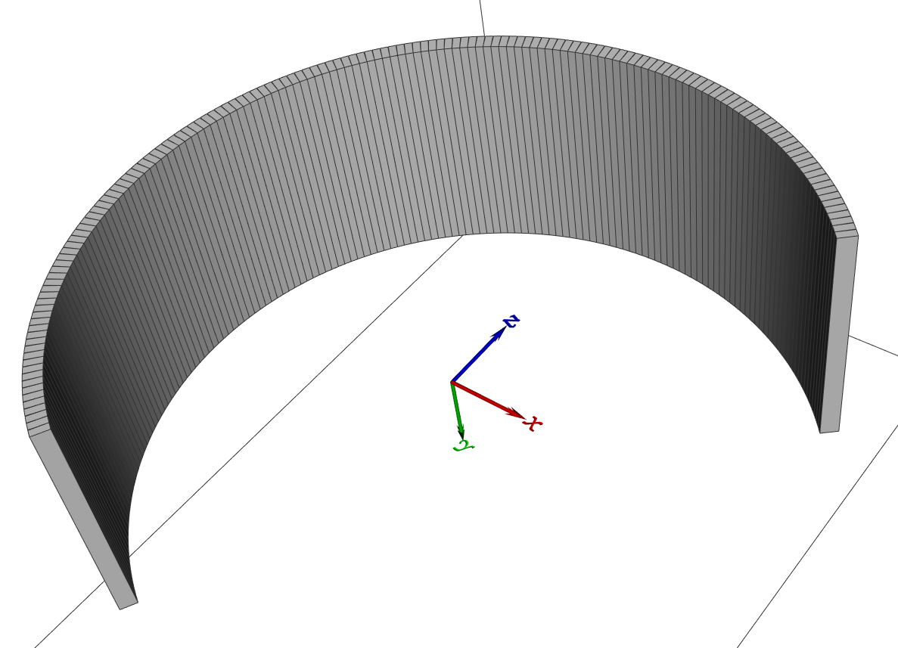
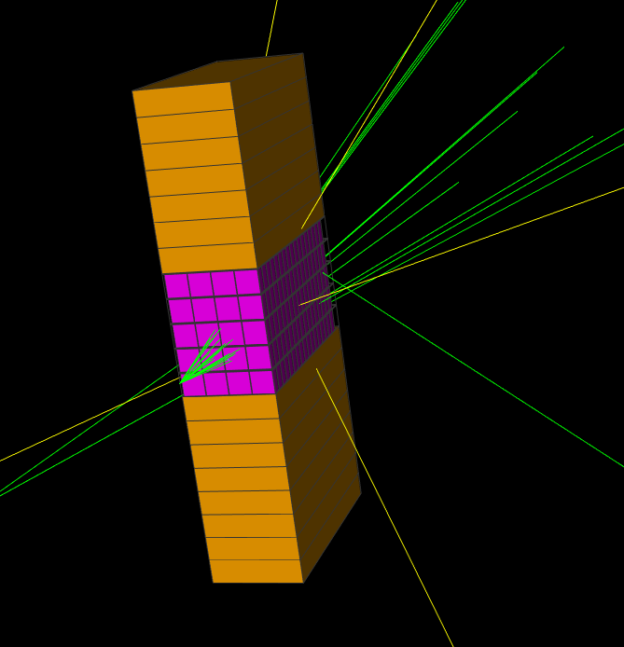
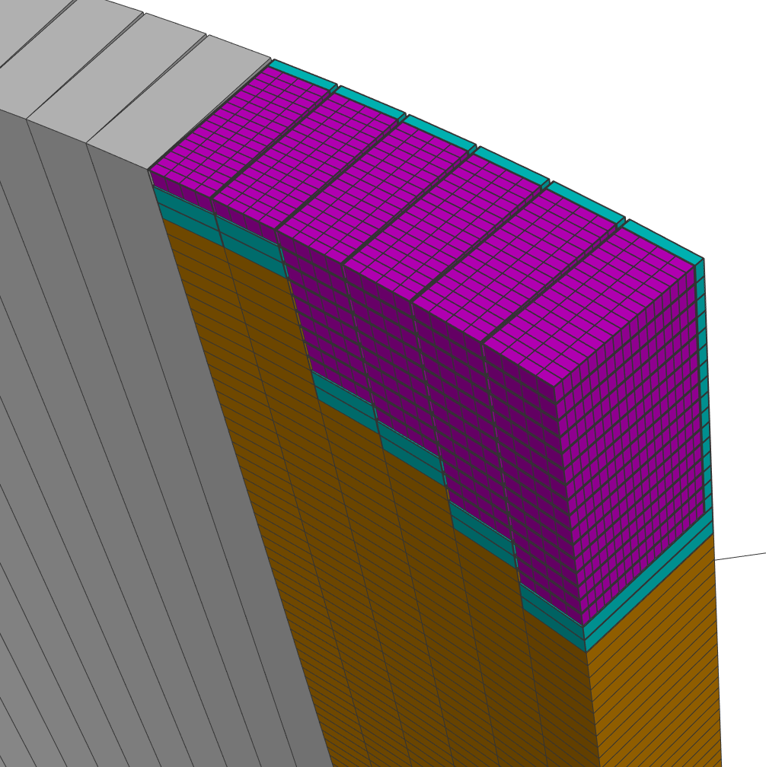
Multi-Grid Simulations
Aluminium cross section
ESS Detector Group Framework
Extension of GEANT4 including crystal structure and thermal cross sections
Work of Eszter Dian, poster #N28-18, Tuesday, Nov. 1 @ 14:00
CER, Hungary in-kind contribution
Simulation package:
*T. Kittelmannet al., "Geant4 Based Simulations for Novel Neutron Detector Development", (CHEP) (2013); doi:10.1088/1742-6596/513/2/022017;
*arXiv:1311.1009v1.
T. Kittelmann, M. Boin. "Polycrystalline neutron scattering for Geant4: NXSG4", Computer Physics Communications 189, 114-118 (2015); doi:10.1016/j.cpc.2014.11.009

Slide 30
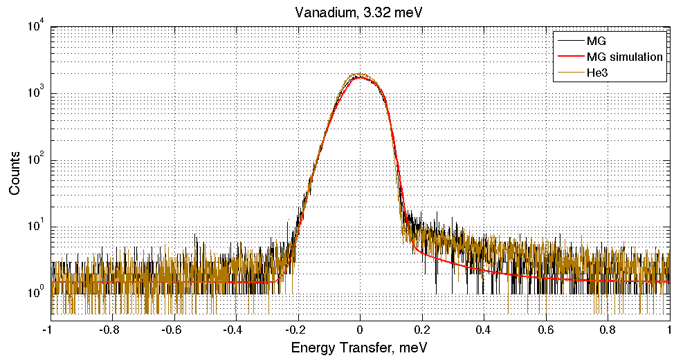
Al Bragg Edge Test
Vanadium energy transfer spectrum
Scattering on Al above and below Al Bragg edge
Reproduced by simulations.
Sample environment and incoming beam complicate the effect
Aluminium cross section
Cross section
N energy
Work of Eszter Dian, poster #N28-18, Tuesday, Nov. 1 @ 14:00

Slide 31
Fast Neutrons
U fast n pulse from sample
Prompt pulse from target
Same detector area considered
Fast n pulses appear to be ~ x2 lower in MG
Under investigation

Slide 32
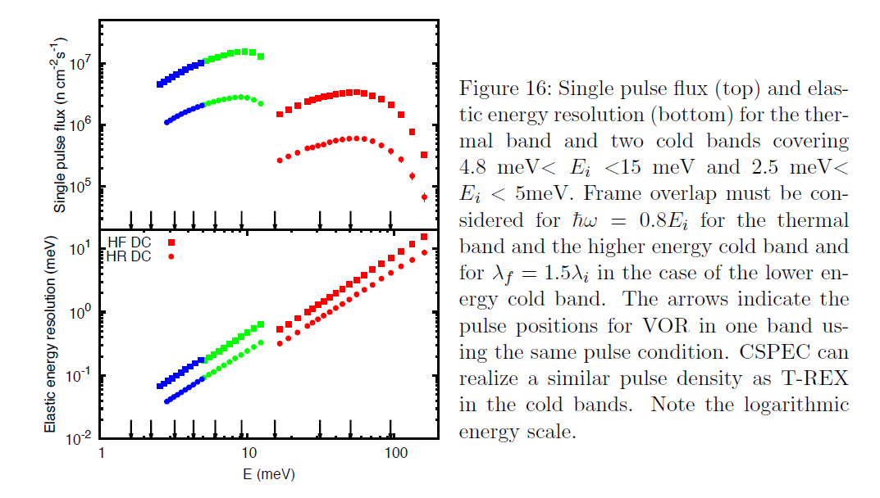
Rates Assumptions
Generic assumptions for ESS direct spectrometers
1e6 n/s/cm2 per monochromatic pulse
10x monochromatic pulses per period
14x periods in a second
Sample size – 1cm2
Sample scatters 10% of the beam (all modes combined)
Sample scatters 0.1% of the beam in one Bragg reflection
Typical scattering come (for powder) at ~90 deg
Elastic peak width – 50us
Analogous analysis for diffractometers:
Paper in preparation: I. Stefanescu, B-based detectors for the diffraction instruments at ESS

Slide 33
Rates Assumptions
4 rate situations to consider:
Average rates – mixed elastic and inelastic scattering, averaged over time and detector area
Average instant rates – mostly elastic incoherent, spread over the detector area, but pulses in time
Worst-case average – elastic and inelastic coherent, averaged over time, but focused on a few pixels
Worst-case instant – mostly elastic coherent, focused in time and focused on a few pixels

Slide 34
Rates Summary, in Hz
B10 MG | Global | pixel | voxel | wire | grid
Average rate | 2e5 | 20 | 2 | 200 | 80
Incoherent instant | 2e7 | 2000 | 200 | 2e4 | 8000
Worst-case average rate | 2e5 | 2000 | 200 | 500 | 5000
Worst-case instant rate | 2e8 | 4e6 | 4e5 | 1e6 | 1e7
He3 | Global | tube
Average rate | 2e5 | 2000
Incoherent instant | 2e7 | 2e5
Worst-case average rate | 2e5 | 5000
Worst-case instant rate | 2e8 | 1e7
To convert to rates in 1’’ He3:
Same physical rates, but readout only by a single tube in place of a wire row
→ Rate (He3 tube) = rate (MG wire) *10

Slide 35
Rates Summary, in Hz
B10 MG | Global | pixel | voxel | wire | grid
Average rate | 2e5 | 20 | 2 | 200 | 80
Incoherent instant | 2e7 | 2000 | 200 | 2e4 | 8000
Worst-case average rate | 2e5 | 2000 | 200 | 500 | 5000
Worst-case instant rate | 2e8 | 4e6 | 4e5 | 1e6 | 1e7
He3 | Global | tube
Average rate | 2e5 | 2000
Incoherent instant | 2e7 | 2e5
Worst-case average rate | 2e5 | 5000
Worst-case instant rate | 2e8 | 1e7
Average and peak rates OK
Bragg peaks will saturate,
Incoherent elastic peak will not saturate in MG; may saturate in He3
He3 – higher gain (needed for charge division) + x10 higher rate → ageing

