Slide 1
NMX Event Classification
Martin Shetty
www.europeanspallationsource.se
9 November 2016

Slide 2
Goals
How many bad?
How are they bad?
Algorithms: keep it simple
Prototype algorithms
Examine individual events

Slide 3
Metrics
Domain bounds (span)
Density
ADC integral
Integral normalized
Average value
Weighted average
Difference between X & Y
C-ness & U-ness

Slide 4
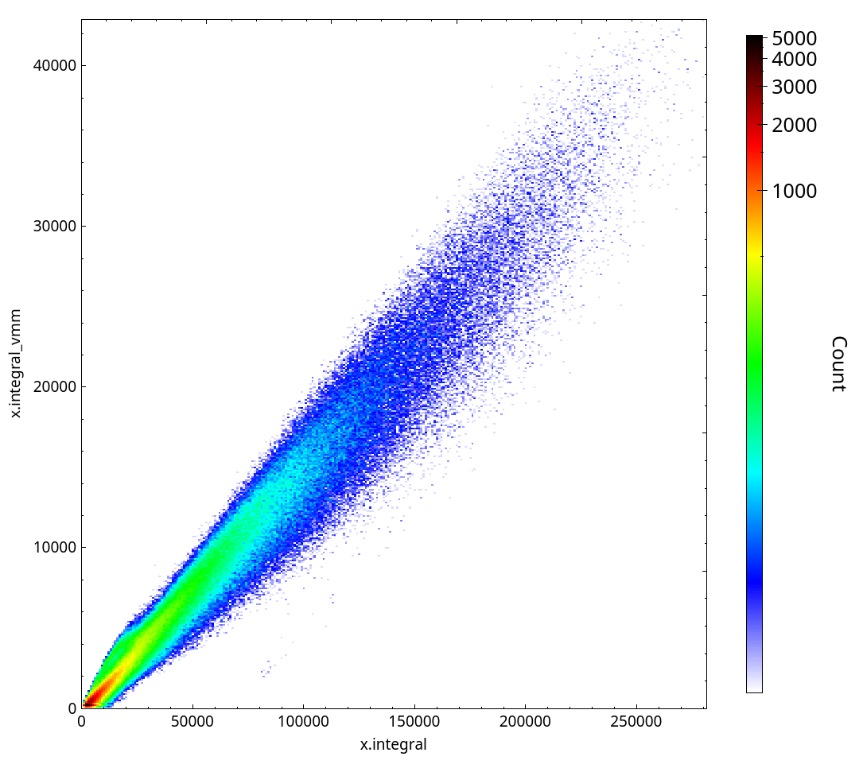
Integral

Slide 5
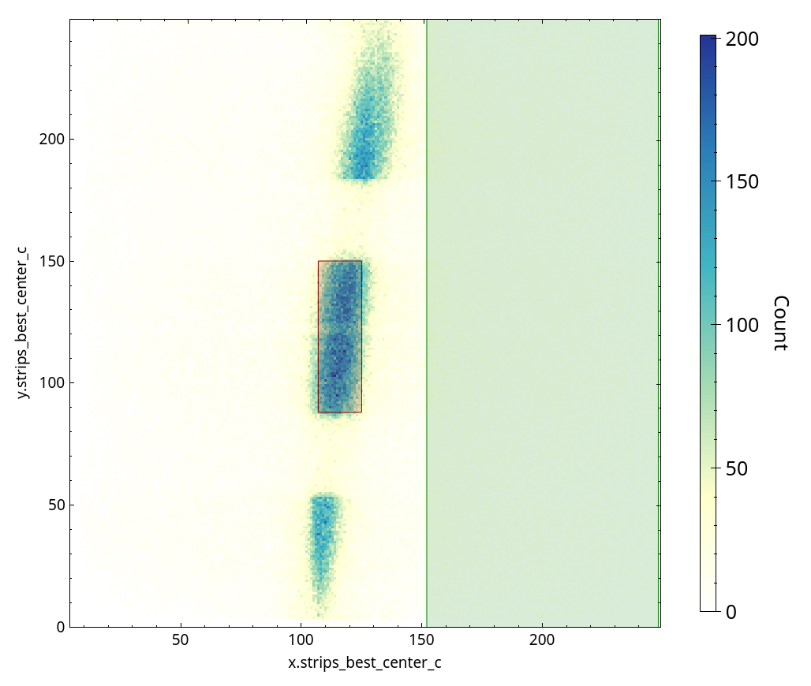
Integral

Slide 6
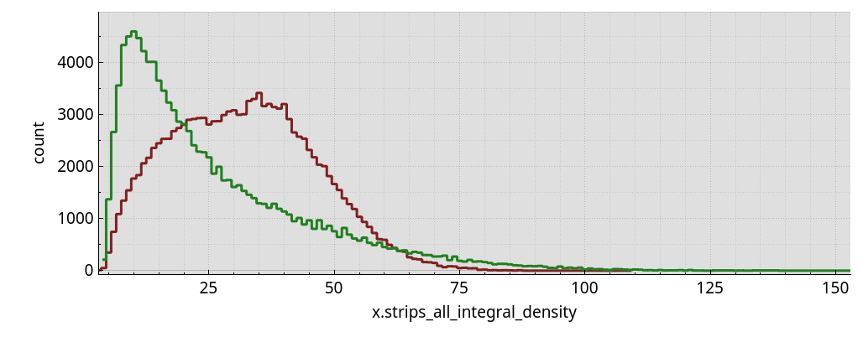
Integral

Slide 7
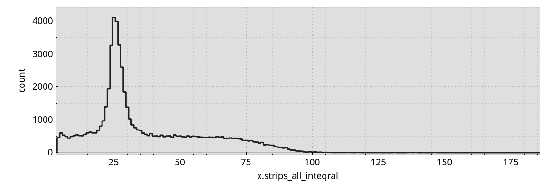
Integral

Slide 8
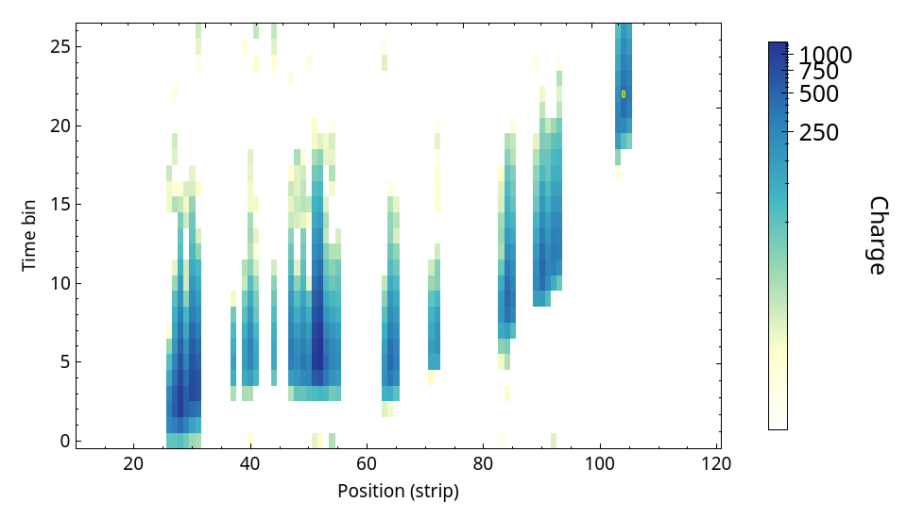
Sparseness

Slide 9
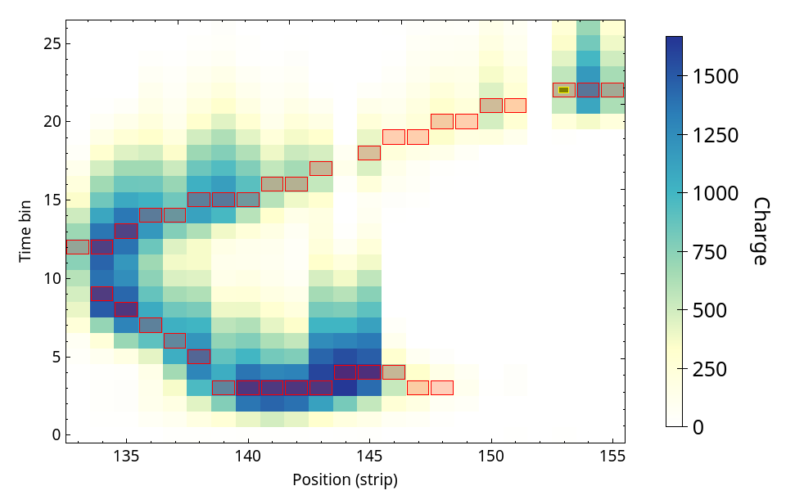
C-ness

Slide 10
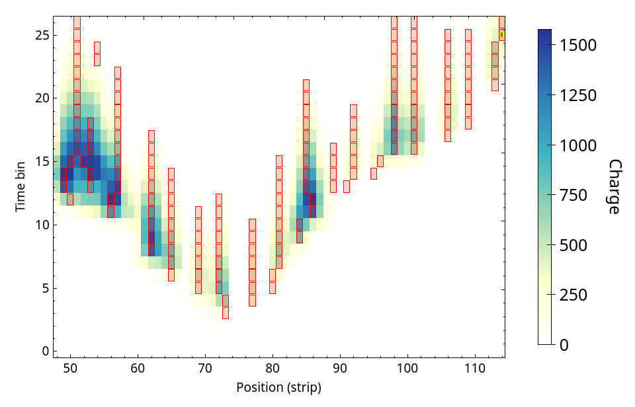
U-ness

Slide 11
Metrics redux
A few hundred and counting…
2 planes (X & Y)
2 perspectives (strips, timebins)
Subspaces: global maxima, local maxima, simulated VMM points, other subsets
Software for viewing correlations between metrics to evaluate their usefulness

