Slide 1
High-Resolution Gadolinium-GEM Neutron Detectors for the NMX Instrument at ESS
Dorothea Pfeiffer
This work was partially funded by the EU Horizon 2020 framework, BrightnESS project 676548
09.11.2016

Slide 2
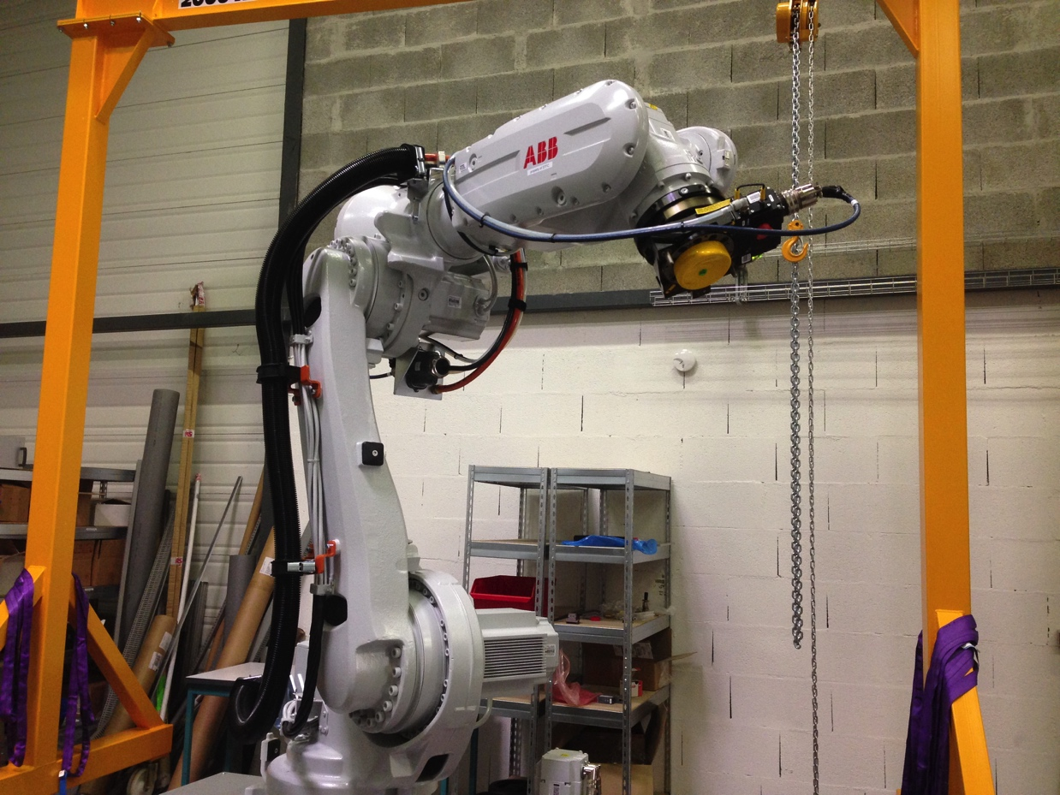
NMX detectors

Slide 3
Reflections of example crystal
NMX: Macromolecular Diffractometer
Science goal: Protein crystallography with neutrons

Slide 4
TOF separation of reflections

Slide 5
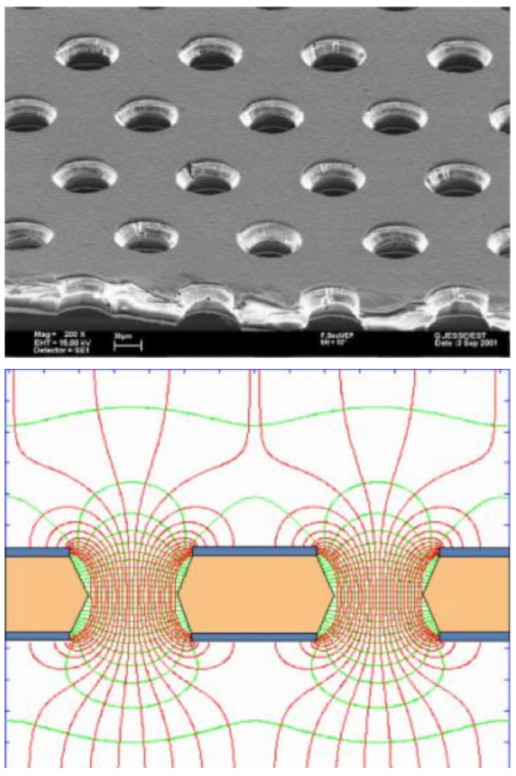
Requirements and challenges
GEM foil
200 μm position resolution (beyond state of art for time resolved neutron detectors)
High rate requirements with up to MHz/cm²
High gain stability and count rate stability
Mechanical robustness (detectors mounted on freely movable robotic arms)
Reasonable gamma suppression
Idea: Use GEM detector with Gd converter
Electrical field in holes

Slide 6
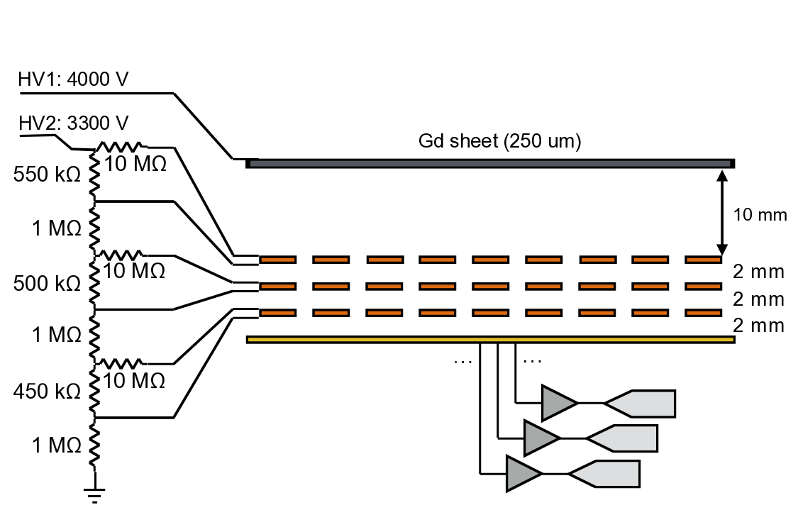
Gd-GEM backwards setup
conversion electron
Start of track
neutron

Slide 7
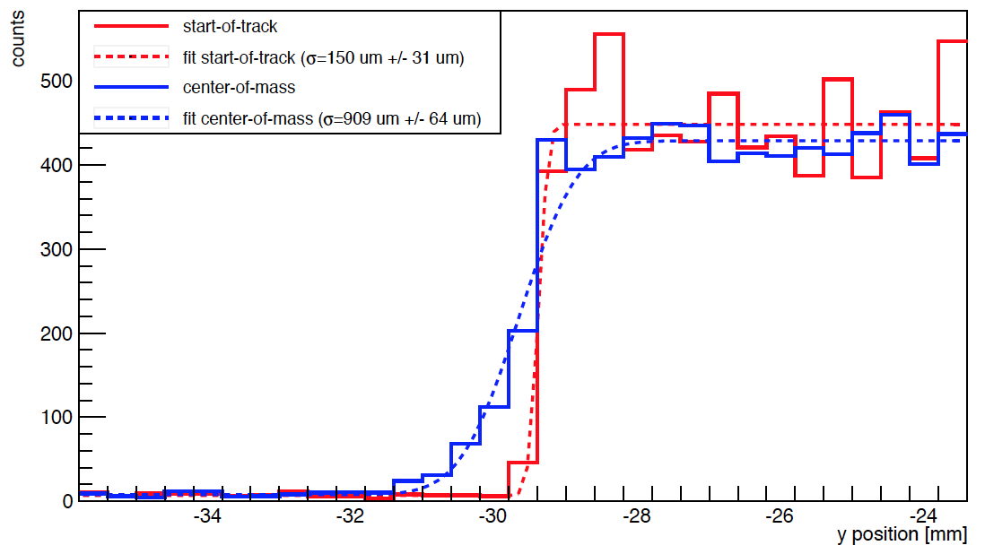
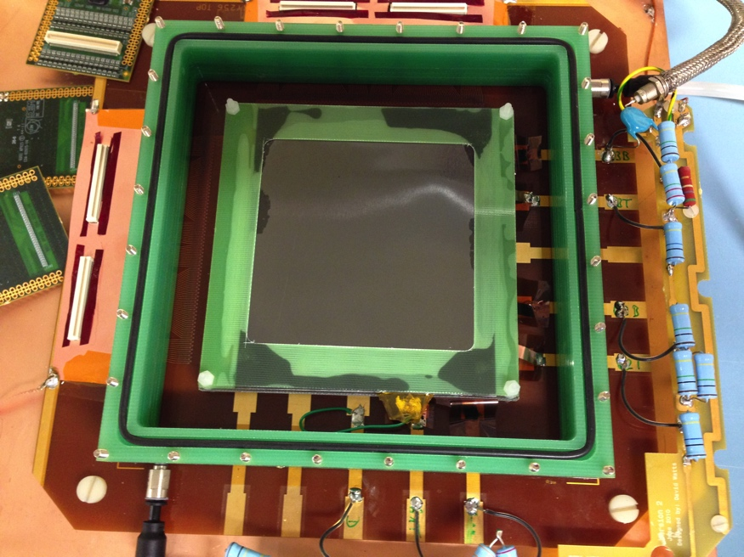
¹⁰B₄C GEM μTPC Results
D. Pfeiffer et al., JINST 10 (2015) 04, P04004
Pristine position resolution σ <200 μm reached with Single GEM
Detection efficiency < 5 % at normal incidence of neutron

Slide 8
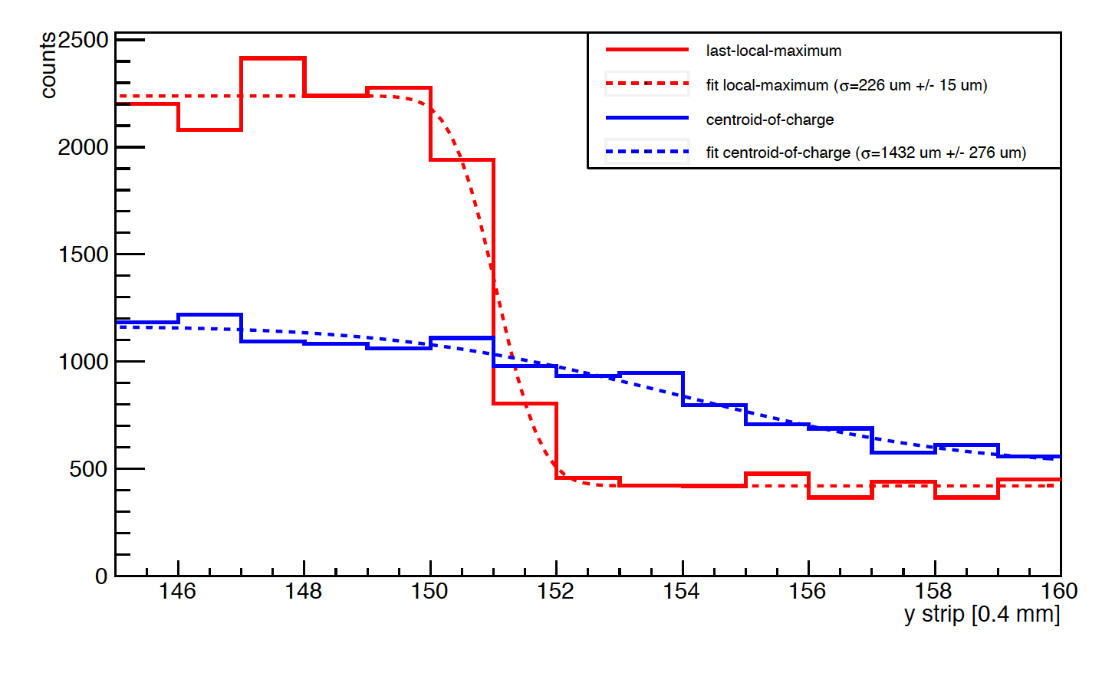
Gd-GEM μTPC Results
D. Pfeiffer et al, 2016 JINST 11 P05011
Position resolution σ <300 μm reached with Triple GEM, APV-25
Detection efficiency < 12 % at normal incidence of neutron

Slide 9
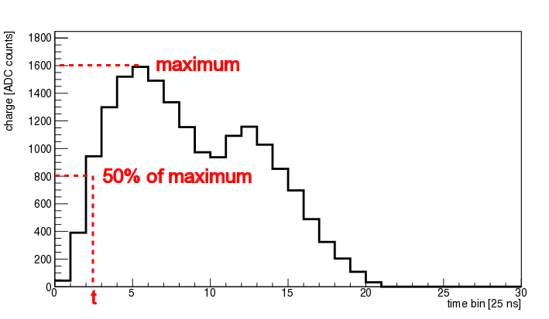
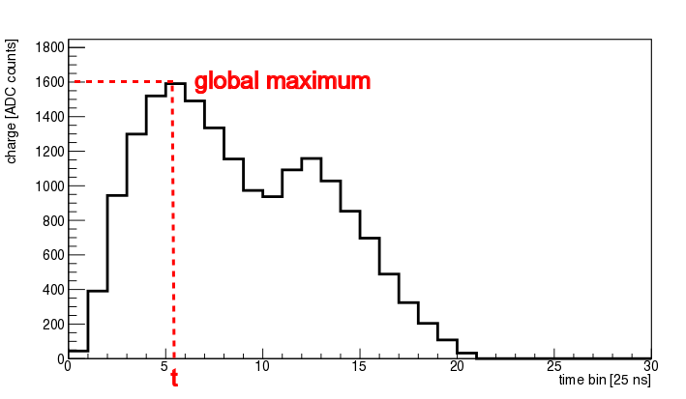
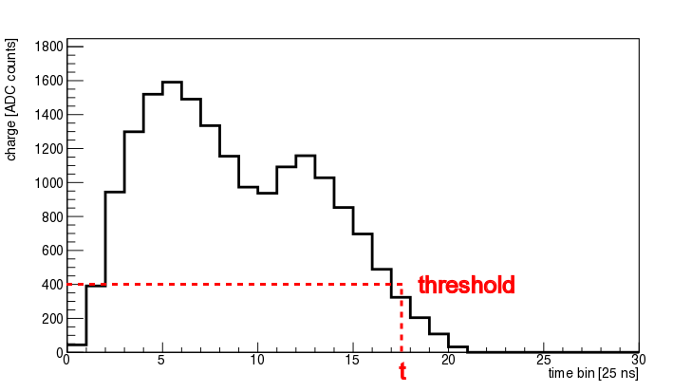
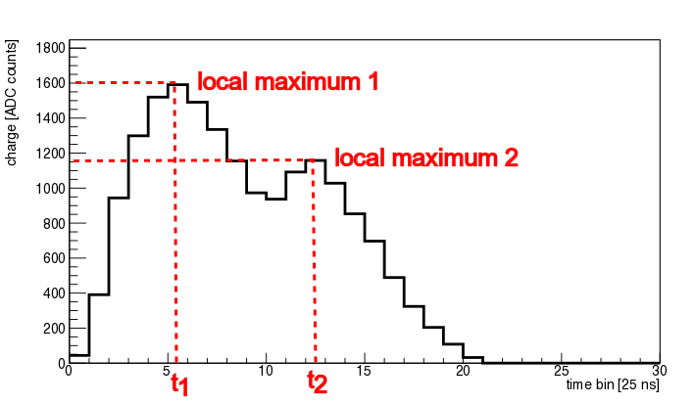
Better tracking algorithms needed
Used for ¹⁰B₄C
VMM-like?
Used for APV-25

Slide 10
Geant4 Gd simulation problems Getting worse in 10.2.p02
gamma
gamma
gamma
Photon Evaporation 10.1
Photon Evaporation 10.2
Without Photon Evaporation
ce
ce
Problems with gamma spectra:
https://zzz.physics.umn.edu/lowrad/_media/meeting8/ychen_gdgammas_aarm2015.pdf

Slide 11
Task division Geant4/Garfield++
1a
1b
2
Primary particle entering gas
Charged particle
Charged particle
gamma
Physics model in Geant4
PAI/PAIPhot Model
In gas region
(Standard and low energy EM physics)
(Standard and low energy EM physics)
Geant4
Point of transfer of
Control between
Geant4/Garfield++
“Kill” secondary e⁻ produced in gas region in Geant4
“Kill” primary when entering gas region in Geant4
“Kill” gamma when entering gas region in Geant4
TrackHeed Method
in Heed/Garfield++
TransportDeltaElectron()
SetParticle()
NewTrack()
TransportPhoton()
Garfield++
Garfield++ simulation according to needs

Slide 12
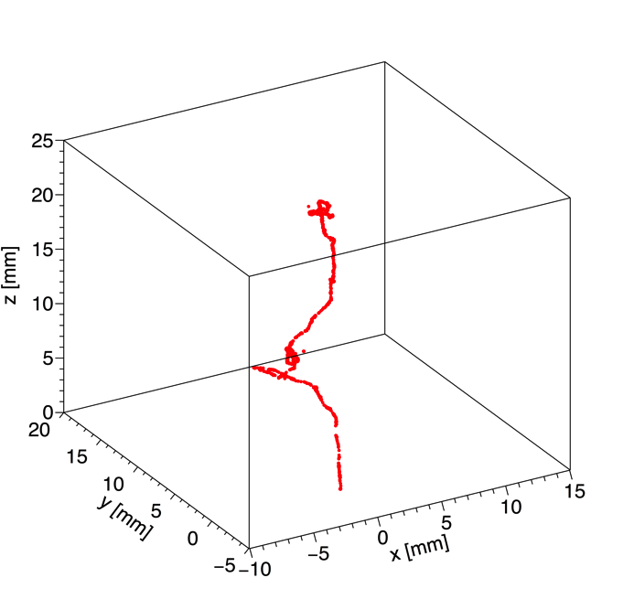
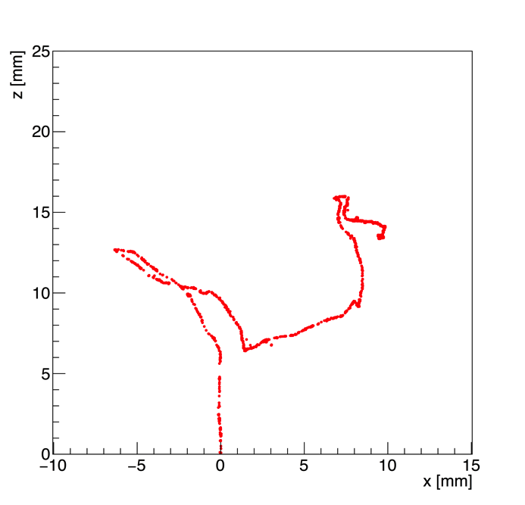
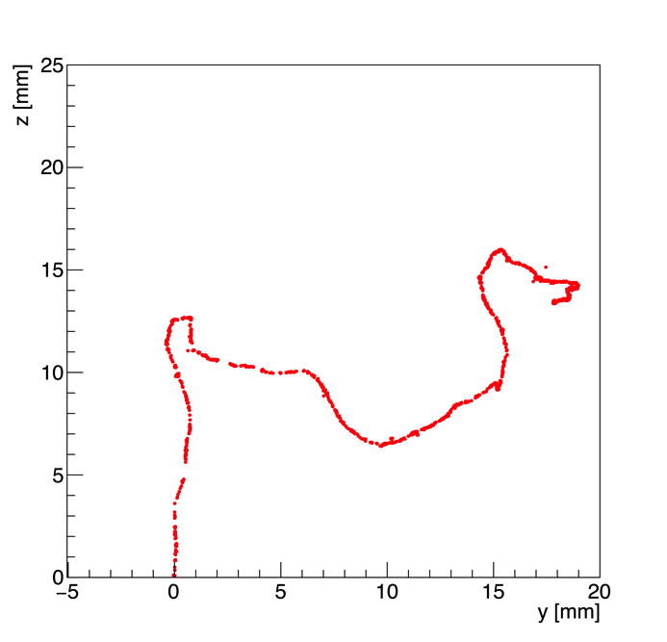
Degrad Simulations
3D
xz
yz
DEGRAD simulation of 70 keV electron in Ar/CO₂ 70/30
DEGRAD by Steve Biagi: http://magboltz.web.cern.ch/magboltz/
Only Monte Carlo program that incorporates all relevant physics processes for electrons in gas
Simulations with Geant4/Garfield interface have to be benchmarked against Degrad
Check of primary ionization distribution in Geant4/Garfield++

Slide 13
Detection efficiency gammas based on threshold
Threshold where 10% of ce are lost
Threshold where 25% of ce are lost
Brightness Report on Natural and enriched Gadolinium converters design
Simulations of converter and gamma sensitivity will be published soon

Slide 14
Arrival position neutron on converter

Slide 15
Arrival time neutron on converter

Slide 16
Arrival position ce in drift

Slide 17
Arrival position Compton e⁻ in drift

Slide 18
Arrival position gamma in drift

Slide 19
Number of conduction electrons in drift

Slide 20
Number of CE electrons in drift

Slide 21
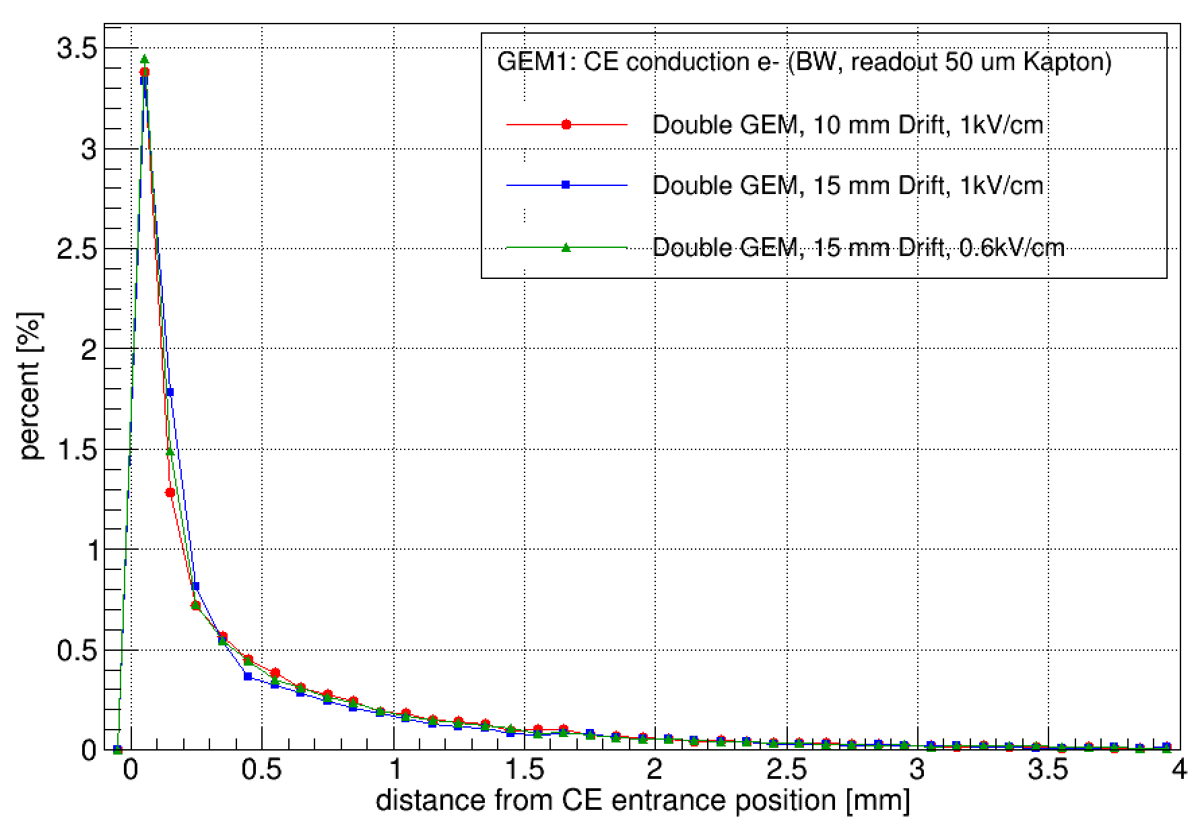
Limits of reconstructed position of CE (relative to arrival position in drift)
Compare to DEGRAD!

Slide 22
Tasks discussed at CERN meeting (July 2016) and per email
Implemented (Michael, Patrik, Doro)
Fast conversion of DATE APV-25 rawdata to root file
Study of VMM-2 data format (now understood)
Fast conversion of DATE VMM-2 rawdata to root file
Extensive measurements with APV-25 to compare with simulations and decide detector geometry (converter, drift, readout)
First measurements with VMM-2 with gamma sources
First measurements with VMM-2 with neutrons
Extensive detector simulations
Implemented (Martin)
Software to convert root file
Software to display events and generate metric

Slide 23
Tasks discussed at CERN meeting (July 2016)
Implemented
NMX Data storage (Carsten, DMSC)
In progress
Search for better metric for position resolution using real data (Martin, Carsten, Doro)
Integrating Geant4/Garfield interface into ESS simulation framework (Carsten)
Understanding of implications of VMM-2 data format for achievable rates etc (Morten)
Modification of VMM-2 slow control to facilitate the work with several chips (Michael)
Open or unknown:
Use of GPU to do tracking (Troels)
Use of DSP board for tracking (Hans, Doro)

Slide 24
TO DO
Complete analysis of the 2016 measurements
2016 measurements needed to finalize detector design

Slide 25
SRS Data Format for VMM-2

Slide 26
One VMM
Frame counter
00000000
Data marker
564d32
VMM-ID
0e
Trigger counter
0000
Incremented with each trigger
Trigger timestamp
0000
Data 1
801ec506
Repeated n times (for each strip hit)
Data 2
fc000000
End marker
fafafafa

Slide 27
Frame counter
00000000
Two VMMs
Data marker
564d32
VMM-ID
0e
First VMM
Trigger counter
0000
Incremented with each trigger
Trigger timestamp
0000
Data 1
c038d60a
Repeated n times (for each strip hit)
Data 2
fc000000
Frame counter
00000001
Data marker
564d32
VMM-ID
0f
Second VMM
Trigger counter
0000
Incremented with each trigger
Trigger timestamp
0000
Data 1
c0345e07
Repeated n times (for each strip hit)
Data 2
fc000000
End marker
fafafafa

Slide 28
Data 1
4 Bytes
801ec506
Bit 31
Bit 0
32 Bits
1000 0000 0001 1110 1100 0101 0000 0110
Bit 0
Bit 31
32 Bits reversed
0110 0000 1010 0011 0111 1000 0000 0001
Bit 14 - 15
Bit 0 - 7
ADC (10 Bits)
11
0110 0000
0x360 = 864
Bit 22 - 23
Bit 8 - 13
TDC (8 Bits)
00
10 1000
0x28= 40
Bit 26 - 31
Bit 16 - 21
BCID (12 Bits)
0000 01
01 1110
0x5e = 94

Slide 29
Data 2
4 Bytes
fc000000
Bit 31
Bit 0
32 Bits
1111 1100 0000 0000 0000 0000 0000 0000
Bit 0
Bit 31
32 Bits reversed
0000 0000 0000 0000 0000 0000 0011 1111
Bit 31
Flag (1 Bits)
1
Bit 30
Over threshold flag (1 Bits)
1
Bit 0 - 29
Channel No (12 Bits)
00 0000 0000 0000 0000 0000 0000 1111
0xF = 15

