Slide 1
SKADI
Budget for Agreed Scope
29. September 2016 | Sebastian Jaksch

Slide 2
Scope from Scope Setting Meeting
1m² of detector arranged in a balanced way
relaxed width of footprint at front end: >6deg
polarised beam with polariser in first collimation section, no polarisation analysis (PA)
2m inner diameter tank (to allow 1m² square detector)
moveable detectors (includes motion control)
all choppers
cold commissioning
upgradeable to full scope: full detector coverage, PA, full sample environment

Slide 3
Top-Level Requirements
Q-range to a Q_{min}<8×10⁻⁴ Å⁻¹ to 1 Å⁻¹
SKADI shall allow data to be collected simultaneously over a dynamic Q-range of Q_{max}/Q_{min} >1000.
SKADI shall allow time resolved studies with a single shot time resolution below 200 ms.
SKADI shall provide polarized neutron scattering
SKADI shall provide a Q resolution of <10% dQ/Q between Q=1×10⁻³ Å⁻¹ and Q_{max} in max flux mode and a high resolution mode
SKADI shall allow for custom sample environments of at least 1.5×1.5×2 m³ with masses of at least 2000 kg.
Competetive Instrument on world-class level
Early success by attractive scientific opportunities
Additional value to instrument suite (detector/SE)

Slide 4
Budget Overview
What we get for that:
World-class instrument features
Q-range
Flux
Detector capabilities
Robust/reliable technical solutions
Good interconnection with other instruments (SE+sharing or technology)
complementarity with Loki to achieve a versatile instrument suite
Robust planning → Early success
 | Total
01 Shielding | € 1,999,000
02 Neutron Optics | € 3,415,200
03 Choppers | € 767,480
04 Sample Environment | € 427,500
05 Detector and Beam Monitors | € 2,674,200
07 Motion Control and Automation | € 384,000
08 Instrument Specific Technical Equipment | € 836,000
09 Instrument Infrastructure | € 381,000
11 PSS | € 114,640
12 Contingency | € 1,222,113.33
Total | € 12,713,133.3
Labour included in above (Person-Years) | 34 (7 years of fabrication)

Slide 5
Changes compared to June Budget
As compared to minimum scope from June
(-973 k€ not accounting for phase 1+ contingency)
Minor
Chopper: 720 k€ → 767 k€
SE: 250 k€ → approx. 427 k€ (depending on pool etc.)
Detectors/Beam Monitors: 2750 k€ → 2647 k€
MCA: 545 k€ → 334 k€
Instr. Spec. Eq.: 1322 k€ → 836 k€
Infrastructure: 510 k€ → 381 k€
Total: -1083 k€ (Pennies make the dollar.)
Major
Shielding: 4080 k€ → 1999 k€
Neutron Optics: 1480k€ → 3451 k€
Total: 110 k€

Slide 6
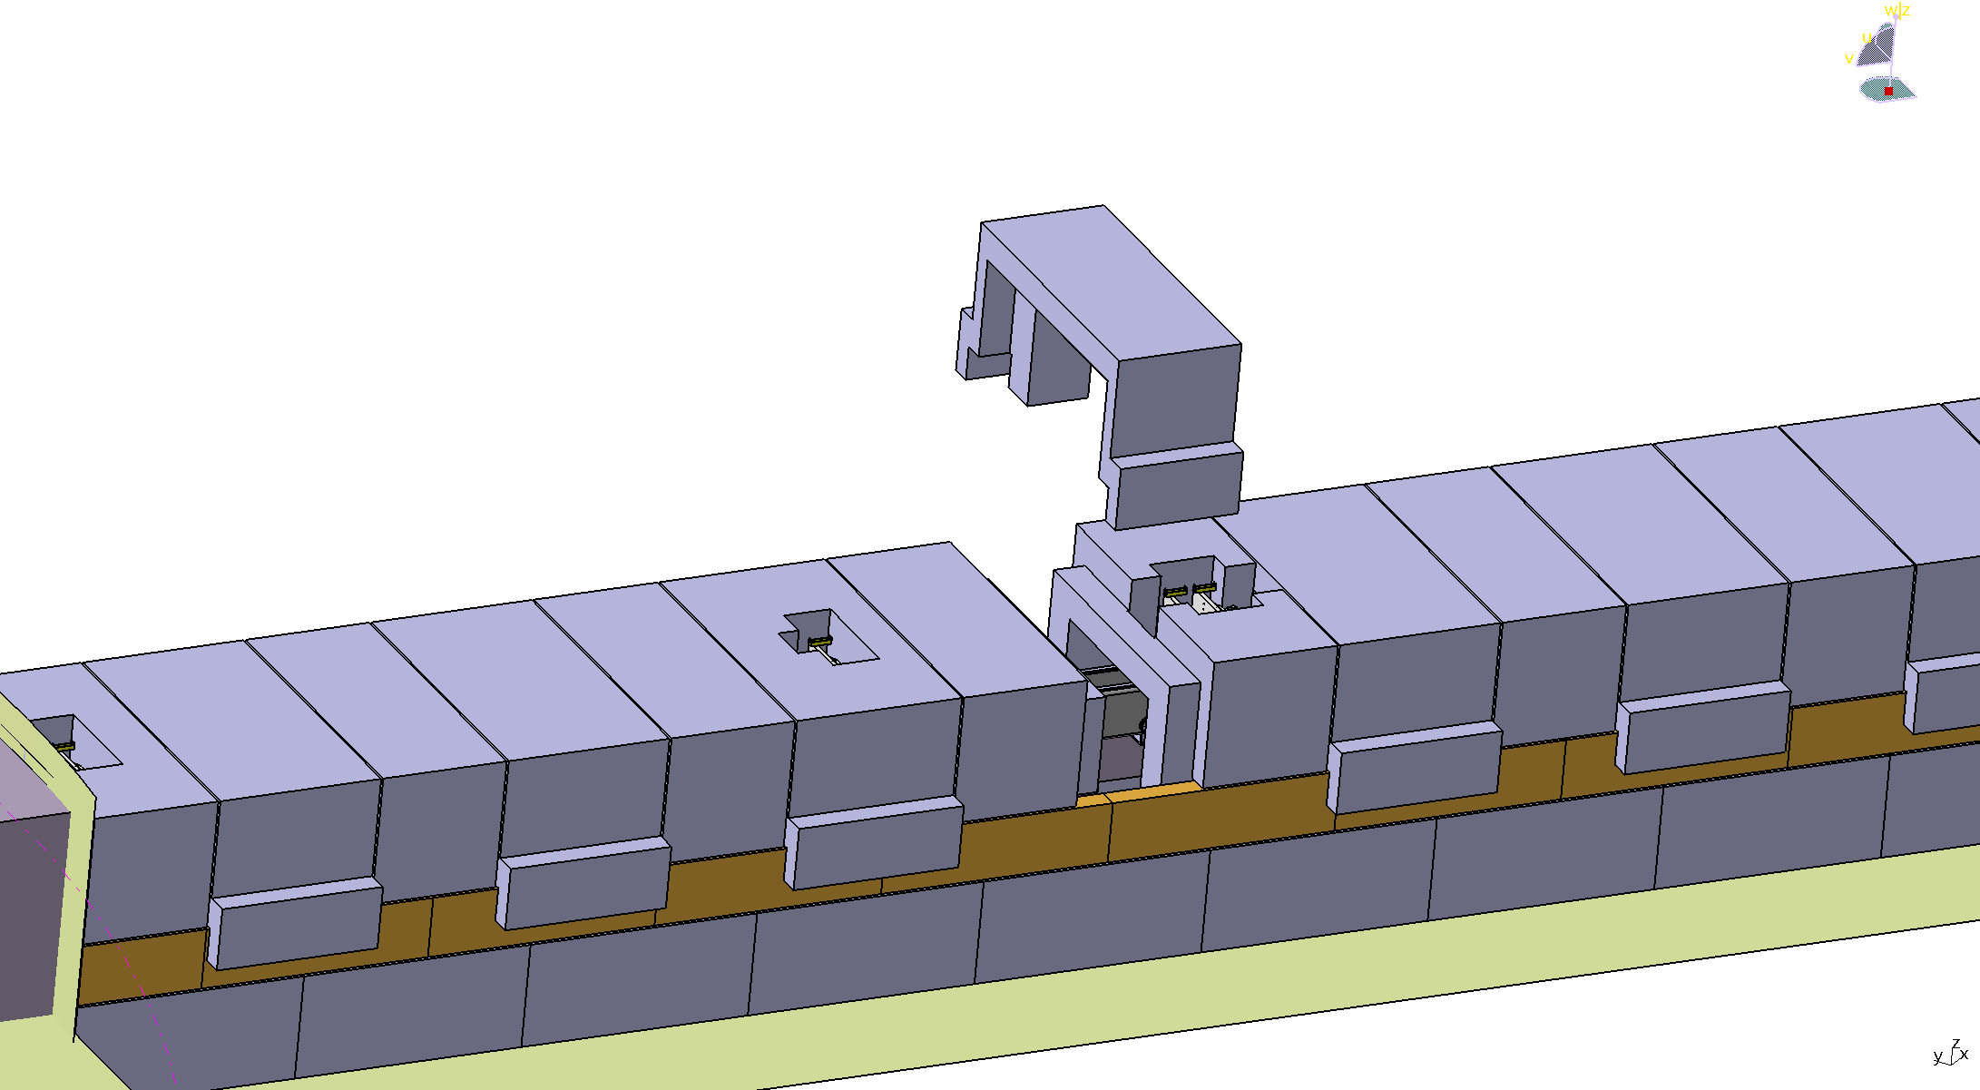
Shielding
01 Shielding | 02 Project Management & Integration | 03 Design | 04 Procurement & Fabrication | 05 Installation | 06 Cold Commissioning | Total
Material |  |  | € 1,739,000 |  |  | € 1,739,000
Labour | € 24,000 | € 60,000 | € 82,000 | € 94,000 |  | € 260,000
Total |  |  |  |  |  | € 1,999,000
Labour | 2PM | 6PM | 8PM | 9PM |  | 25PM
Offer for concrete shielding: 787 k€
Steel sheets (gamma shielding): 550 k€
Boron Plates (avoid steel activation): 152 k€
Shutter in Bunker Wall: 250 k€ + work
Installation
Provides passive Shielding against H1 events
Provides low background conditions for excellent measurements

Slide 7
Shielding: Concrete Cave
Company offer:
Radiation tunnel for complete instrument (start at Bunker, including the detector tank)
Delivery
Installation
Form of blocks can be defined freely
Meets the shielding requirements + structural stability
Total € 787,000

Slide 8
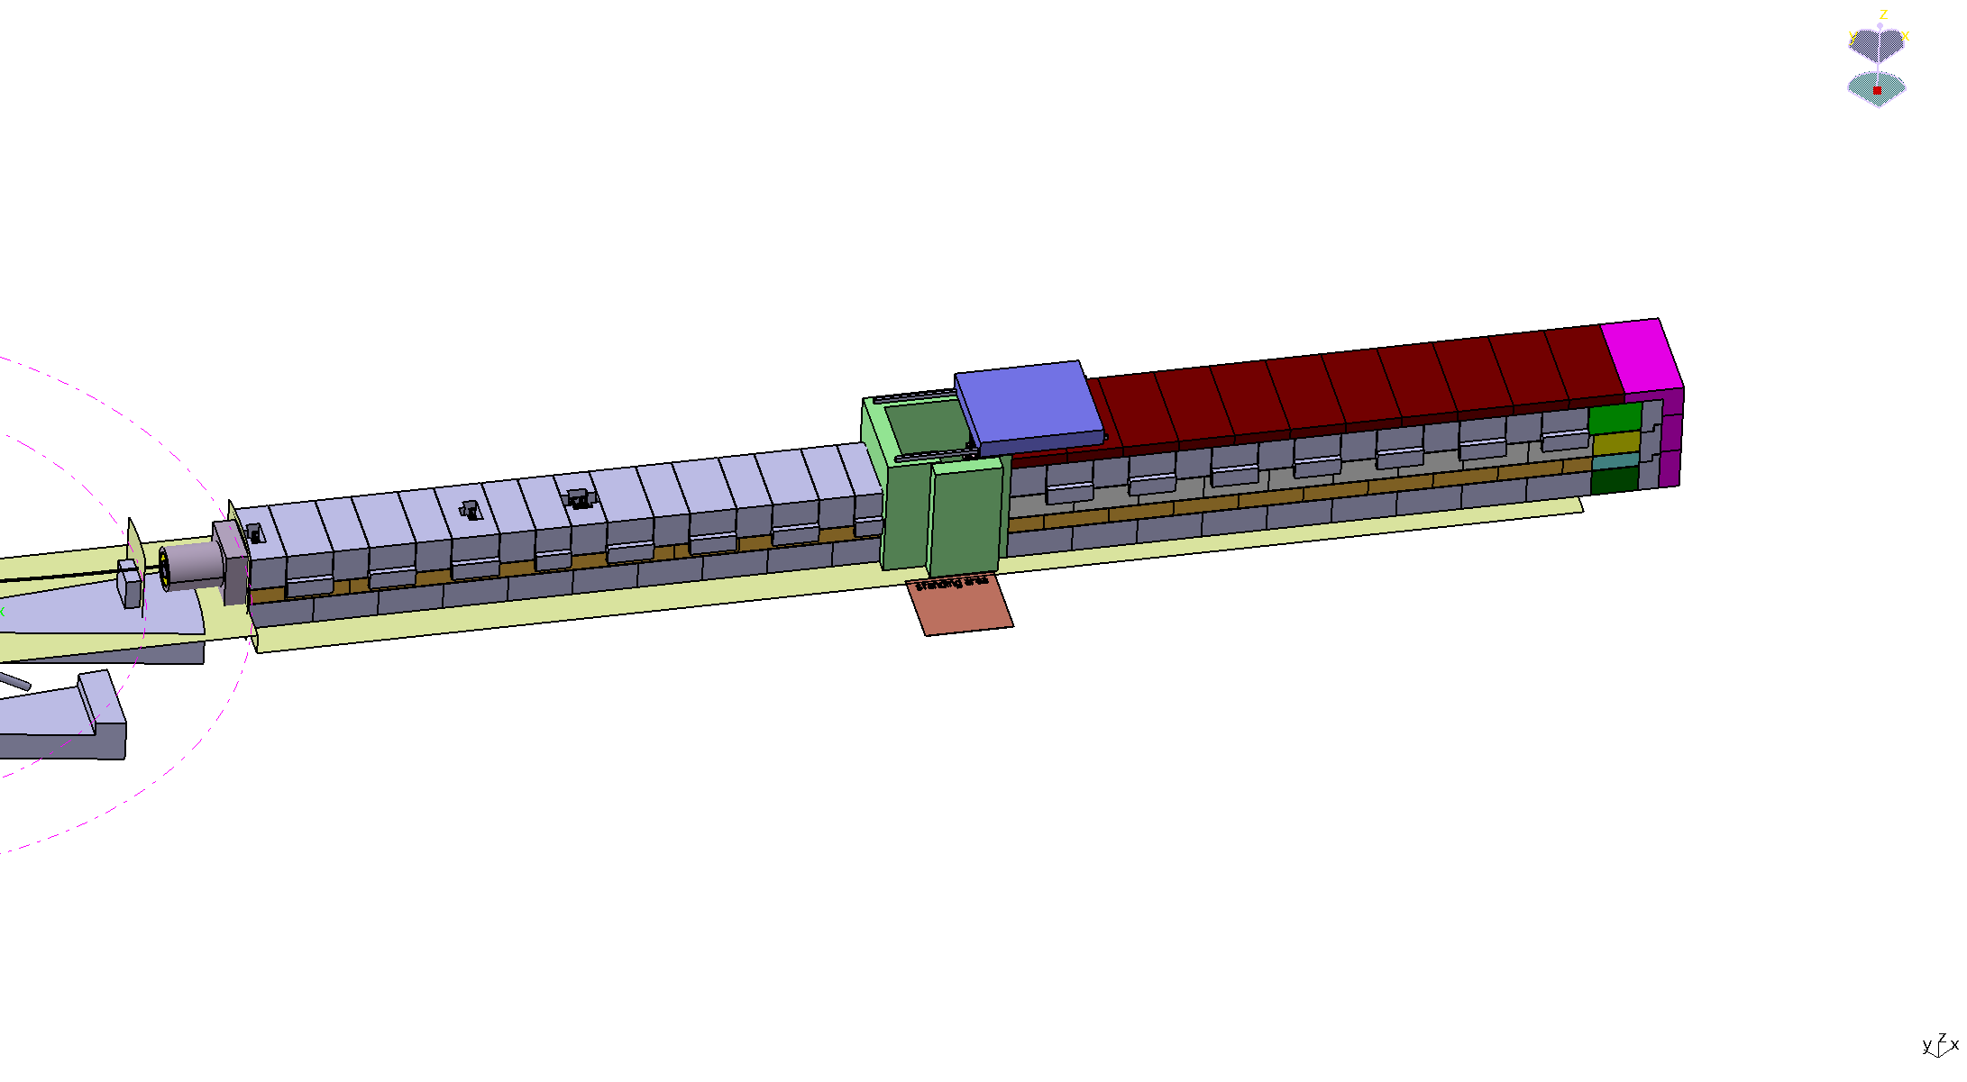
Shielding: Boron+Steel
Steel: Necessary to shield against H1 events (full conversion to gamma)
Boron: Necessary to not activate all the steel
Strategy: Use concrete cave as a basis and put sheets to it
Cost estimate:
Material: € 152,000 (Boron) and € 550,00 (Steel) sheet material
9 Month of installation work (3 person for 3 month)
Total € 796,000

Slide 9
Neutron Optics
02 Neutron Optics | 02 Project Management & Integration | 03 Design | 04 Procurement & Fabrication | 05 Installation | 06 Cold Commissioning | Total
Material | €150,000.00 | €150,000.00 | €1,307,200.00 | € 78,000.00 | € 122,000.00 | €1,807,200.00
Labour | €168,000.00 | €352,000.00 | € 742,000.00 | €232,000.00 | € 114,000.00 | €1,608,000.00
Total | €349,800.00 | €552,200.00 | €2,254,120.00 | €341,000.00 | €259,600.00 | € 3,794,666.67
Labour | 13PM | 34PM | 73 PM | 22 PM | 8.5 | 150.50
Mostly dedicated in house fabrication of components
Major cost drivers:
Collimation housing
Neutron Guide
Bender
Provides beam transport and beam conditioning
„Heart“ of the instrument

Slide 10
Neutron Optics: Collimation Housing
Collimation housing (23.1 m)
Project Management | Procument/Fabrication | Installation | Cold commisioning
4PM engineer | 12PM technician | 12PM technician (2 for 6 months) | 4PM engineer (2 for 2 months)
lump sum | 231k€ | 23k€ | as monolith inset
Houses the optics of the instrument (also polarizer)
Reaches from the bunker to the sample position
3 positions for the guide components possible
Steel container as vacuum housing
Provides needed stability/protection for optical components
Needs to be sturdy, yet highly accurate to maintain flux/resolution
Huge piece of equipment

Slide 11
Neutron Optics: Neutron Guide
Neutron Guide (15.1m)
Project managment | Procument/Fabrication | Installation | Cold Commissioning
1PM Engineer | 1PM Engineer | included in Collimation Housing | 3PM Enginner
lump sum | 400k€ | included in Collimation Housing | included in Collimation Housing
Mostly pre-fabricated purchase
Medium to low m values necessary
Trumpet geometry to maintain high flux
Needs to be cut and fitted exactly in order to move around the additional components in the collimation
Provides neutron transport to sample position

Slide 12
Neutron Optics: Bender
Bender
Project Management | Procurement/Fabrication | Installation | Cold Commisioning
1PM engineer | 4PM technician | 1PM engineer | 0.5PM engineer
pauschal | 32 k€ Vacuum tube, 320 k€ Neutron Guide | 2k€ | as monolith inset
Prefabricated to specific specs
medium m-values required
needs to maintain function in high-radiation shield
both major source for flux and background (reduction)
Provides neutron transport through the bunker

Slide 13
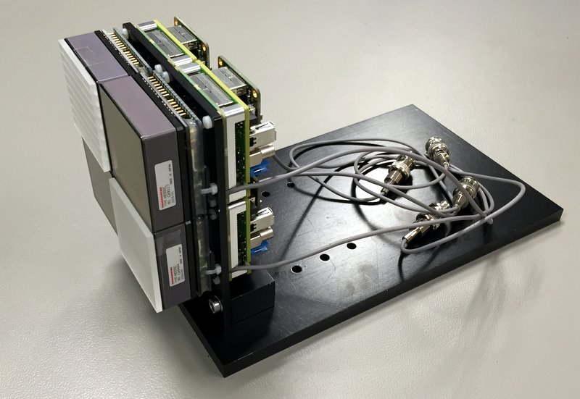
SoNDe inclusion
We buy as many modules from the SoNDe budget as possible.
Single Module Costing
Component | Cost
Scintillator | € 300
MaPMT Modules | € 3,000
Electronics | € 5,540
Subtotal | € 8,840
Rebate (20%) | € 1,768
Total | € 7,072
Total procurement budget in SoNDe: 1.6 M€ → 226 Modules
Built in the instrument, but not costed
Still needed 174 modules → 1.23 M€
Infrastructure and Installation for the Detector System: 1.2 M€
Complete Management and Design also delivered by SoNDe
Additionally needed: Monitors+Detector Infrastructure

Slide 14
Sample Environment
 | in Pool | amount of users | Needed specifically
6kV HV supply | 0 | occasional | together with Loki | € 25,000 | € 25,000
Humidity chamber | 1 | occasional | together with Loki | € 40,000 | € 40,000
Stopped flow | 1 | occasional | together with Loki | € 40,000 | € 40,000
Rheometer | 1 | occasional | together with Loki | € 125,000 | € 125,000
Thermo Jet | 3 | frequent | yes | € 50,000 | € 50,000
injection systems, syringe pump | 1 | frequent | yes | € 100,000 | € 100,000
SANS magazine 5*10 | 0 | frequent | yes | € 30,000 | € 30,000
SANS magazine 5*10 individ. thermalised | 0 | frequent | yes | € 50,000 | € 50,000
 |  |  | total | € 195,000 | € 460,000
Use pool efficiently
Share with Loki

Slide 15
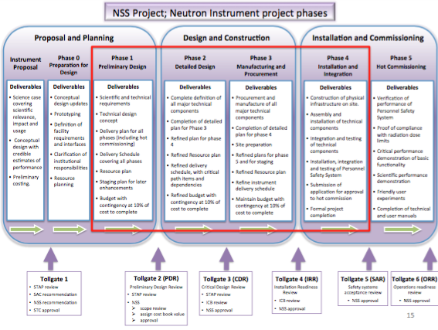
Schedule

Slide 16
Schedule
 | 1 -- 2017 | 2 -- 2017 | 1 -- 2018 | 2 -- 2018 | 1 -- 2019 | 2 -- 2019 |  | 1 -- 2020 | 2 -- 2020 | 1 -- 2021 | 2 -- 2021 | 1 --2022 | 2 -- 2022
Shielding
Optics
Choppers
SE
Detectors
MCA
Specific
Infrastructure
PSS
In Bunker
Shutter
 |  |  |  |  | Design
 |  |  |  |  | Procurement
 |  |  |  |  | Installation
 |  |  |  |  |  |  |  | TG3 |  | TG4 |  |  | TG5
Initial Phase: Get ready for start of source (beginning 2020)
After the shutter is installed the works are independent from the source
Goal: Operation beginning 2022 or earlier

Slide 17
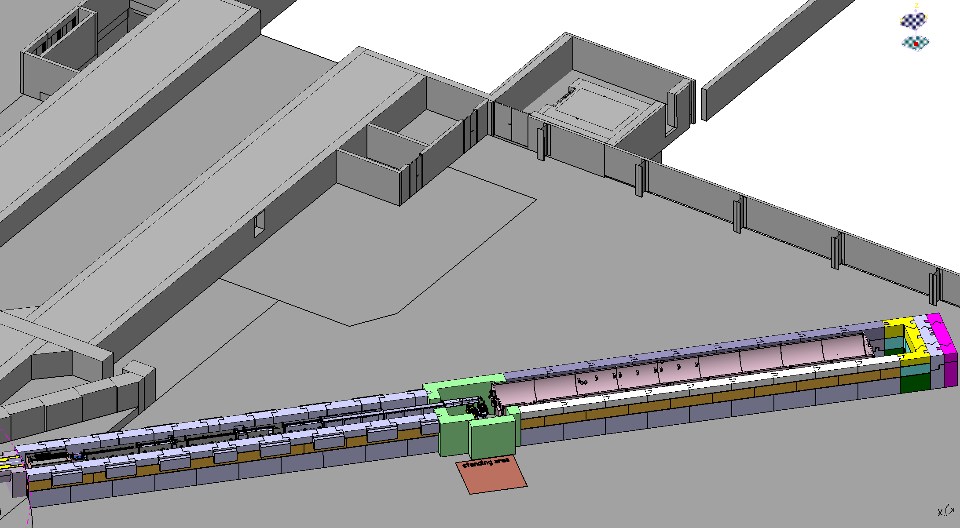
Staging
Components in need of staging
Detector
Sample Environment
PA
Overall Strategy for staging
break down into inexpensive parts
Single Detector Modules
Single Sample Environments
Share PA with other instruments
Due to the breakdown of costs should be possible to cover by the operations budget
Improvement of SKADI along with ramping up the overall facility

Slide 18
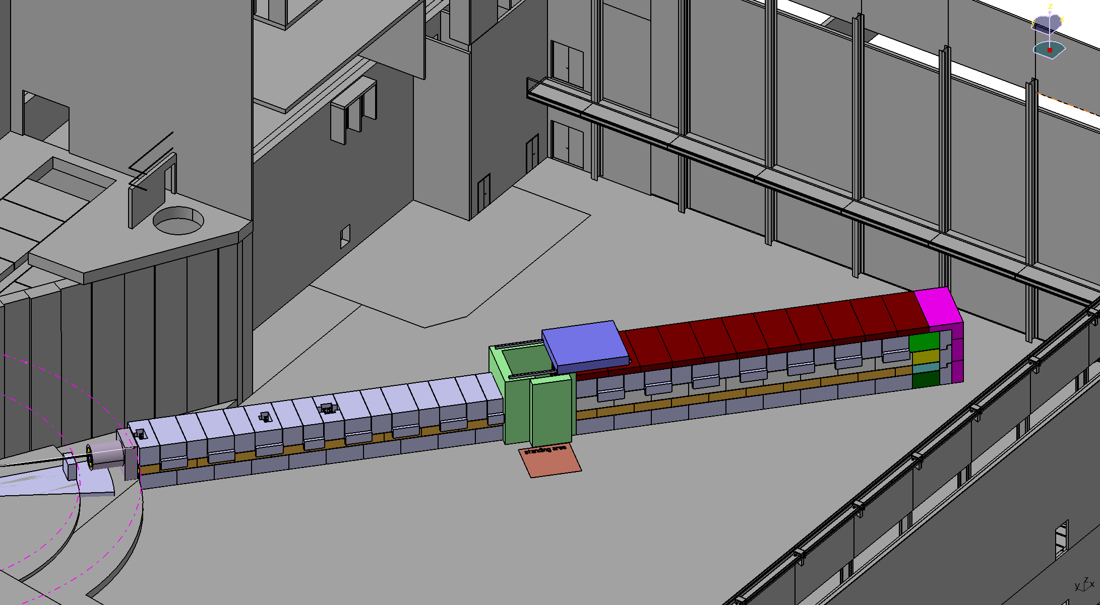
Take home
Science
Overall scope maintained as close as possible
World-class instrument
About factor five increase over today‘s best instruments
Technical
Technical groups concur with costing and amount of work/resources
No high-risk components
man power available both at FZJ and LLB to start work immediately
Schedule appropriate for day-one instrument
Budget
Close to the 12 M€ mark
Specialties
SoNDe supports SKADI with full purchase power
Sharing of equipment/techniques well under way

Slide 19
Thanks to ...
Sylvain Désert
Jacques Jestin
Henrich Frielinghaus
Romuald Hanslik, FZJ
Achim Gussen, FZJ
... and you, for YOUR attention!

