Slide 1
Neutron Beam Extraction System Design status for IAC
Jarich Koning
www.europeanspallationsource.se
4th Oct 2016

Slide 2
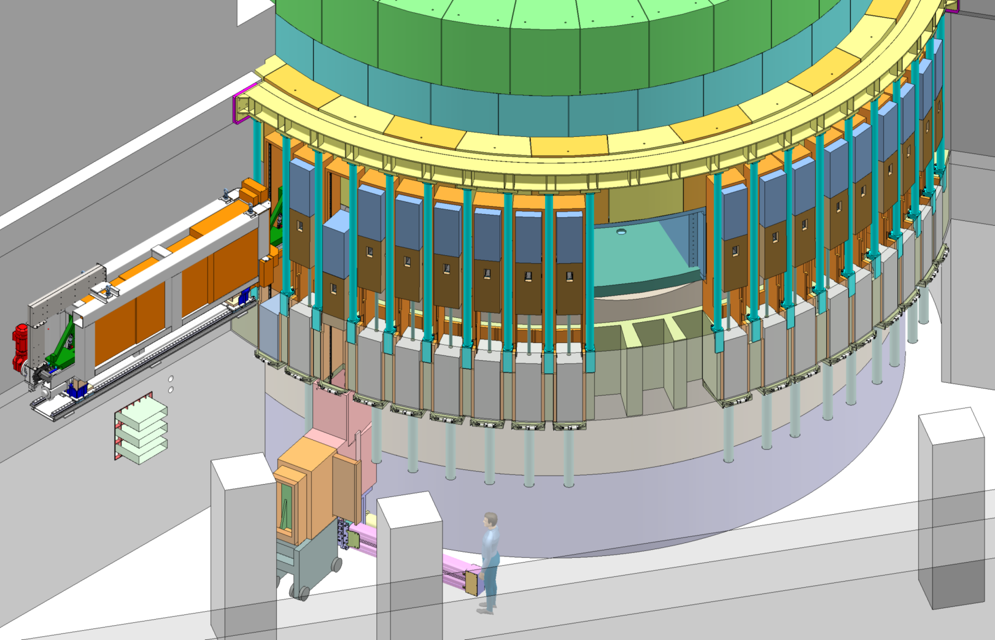
NBEX overview
NBEX breakdown
Neutron Beam Port Insert
Neutron Beam Window
Light Shutter System
RH Tooling
In this presentation
Light Shutter System
NBEX alignment
Optic envelope
NBW
RH Tooling

Slide 3
Light Shutter System
GBS
Gamma-Beam-Shutter (GBS) on top of Bridge-Beam-Guide (BBG).
Not configurable, but some customization is ok
Each ‘Shutter’ has ballscrew-style actuator
Brake is ‘normally open’ → no power means GBS closes by gravity descent
Actuator pushes BBG up to mount against NBW
During maintenance, GBS will stay in front of beam port on dedicated hooks
Floor-to-vessel shielded as much as possible
All handling from basement, except:
NBPI exchange from bunker
Rescue scenarios from Bunker
BBG
NBPI
Bunker roof support
GBS hooks
NBW
Target level floor
Floor fill shielding
Floor filler block
Block locking system
Handling tooling
Shutter actuator
Rigid chain actuator

Slide 4
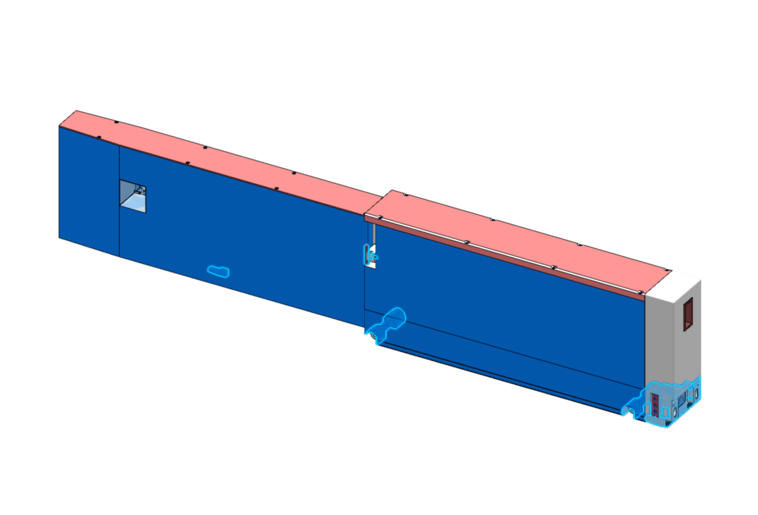
Alignment strategy
Port blocks measured at installation (expected <±2mm) → TNBA
Machine internal mounting pads to correct to within <±0.05mm
Replicate port block situation on test-bench
Align NBPI + BBG (=shutter) internal guides there (±50µm / <200µrad guide-to-guide)
BBG provides fiducials to help bunker-mounted equipment
NBPI-to-BBG kinematic mount delivers good repeatability
Blind-folded mounting of NBPI and BBG should each deliver some ±150µm / <<200µrad absolute
Before operation many chances to correct: check NBPI without NBW in place, check NBPI+BBG with optically open NBW
Notes:
TNBA, Theoretical Neutron Beam Axis

Slide 5
Alignment – one time
No mechanical interface, use fiducials on BBG as reference
Good manufacturing allows < ±200μm on interface
Dowels + good manufacturing allow Y, Z and rX with < ±100μm on interface
Custom machined mount blocks comprising full kinematic mount allow NBPI at < ±100μm, thus effectively the beamguides are at < ±150 μm vs TNBA
NBW
Port blocks (±2mm overall)
Z
BBG
NBPI
Bunker beam line
X
Mounts
Mounts
Mounts
Mounts
Baseplate (±0.1mm flat and level)
Experiment Hall
floor
Target building
Bunker floor
(±25mm on edge)
Monolith concrete
Beam guides in NBPI aligned at test-stand to < ±50μm
Pillar/walls
Theoretical Neutron Beam Axis
Needs ±25mm seismic clearance
Target building base slab

Slide 6
Repeatability
If Target building stable: BBG kinematic mount leads here to
< ±50 μm, too
Full kinematic mount allows < ±50μm
Whenever NBPI extracted → new NBPI → see prev. slide
NBW
Port blocks
Z
BBG
NBPI
Bunker beam line
X
Mounts
Mounts
Mounts
Mounts
Baseplate
Experiment Hall
floor
Monolith concrete
Experiment Hall
floor
Target building
Bunker floor
Pillar/walls
Post-installation alignment opportunity in Basement
Target building base slab

Slide 7
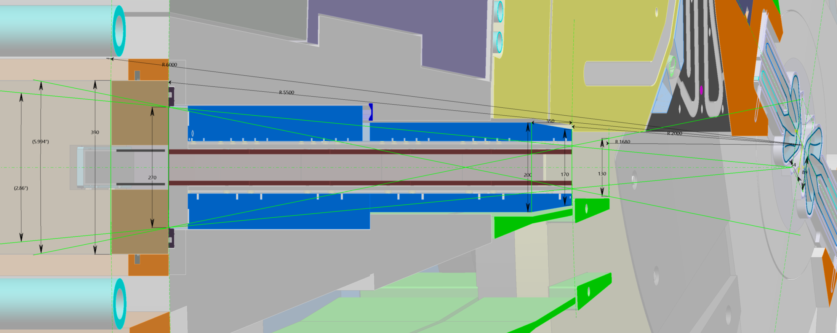
Optic envelope up to R6m
NBPI horizontal cross-section
~130mm @ ~R1.68m, 170mm @ R2m, 200mm @ R2.35m, 270mm @ R3.75m
NBW max width could be 270mm
Light shutter space is 390mm (from R5.5m to R6.0m)
Max focal point opening is 2.86° constrained by NBW
Max pinhole opening is 6.00° constrained by NBPI front and NBW
Moderator visibility depends on exact port
Max 300W nuclear heating → H₂O cooling (35°±5°C, ΔT_{max}=3°C)
Thermal conditioning of beam guides is up to instrument
Conditioning need depends on selected atmosphere (HV or He@Atm)

Slide 8
NBW: one-piece Al6061T6
Vacuum seals milled into NBW
NBW max surface:
H 562 x W 270mm
AA12 case possibly resulting in several thickness NBW variants
Z, Y and rX dowels integrated
Other DoFs known from as-built metrology
RH features integrated
NBPI engaging force integrated
Water connectors integrated
One-piece, single use
NBW area
Vacuum sealing edge
Dowel-in-hole and dowel-in-oblong hole constrain Y, Z and rX
Vessel-side water flange

Slide 9
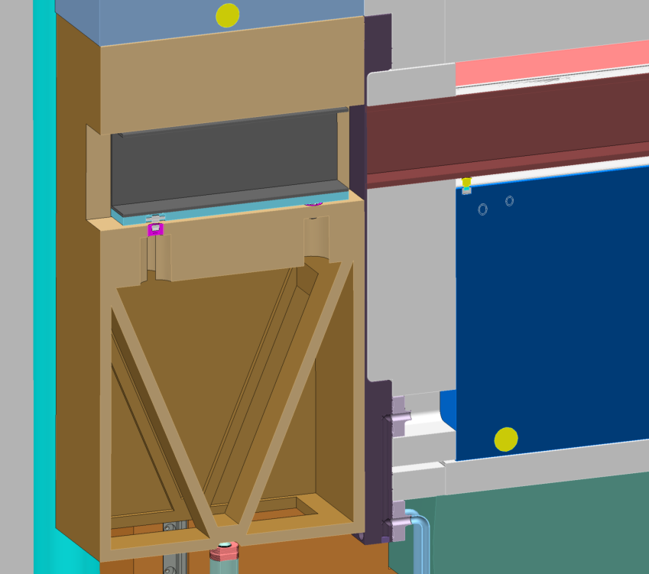
BBG to NBW mount
NBW provides kinematic mount to BBG
NBW connects Cooling water flow to NBPI
NBW pushes NBPI (on its integrated disc spring stacks) forward on its kinematic mount to port blocks
Mount:
Sphere (3DoFs)
Cylinder (2DoFs)
Top pad touches (1DoF)
NBW area
Cooling
Tilting axis
Notes:
Extra slides follow

Slide 10
Beamlines in NBW & BBG
Freia (pink)
Heimdal (red&blue)
Loki (purple)
NMX (green/grey)
ESTIA (yellow)
SKADI (grey)
Pictures:
Left: Insert back flange@5.5m
Mid: NBW@5.5m
Right: BBG@R6m

Slide 11
Window thicknesses
Monolith NBW
Considering safety case of chopper failure creating projectile
Different chopper and projectile cases considered
Impacting projectile directly drives NBW thickness
NBW height x width irrelevant for projectile impact
Ongoing investigations are in the order of 10mm
In NBPI: when Instruments requires He atmophere: 2 x 1mm
Preliminary investigation shows only 15C ΔT on Si benders
In light shutter to enclose air: 2 x 0.5mm
Further beamline: up to instruments

Slide 12
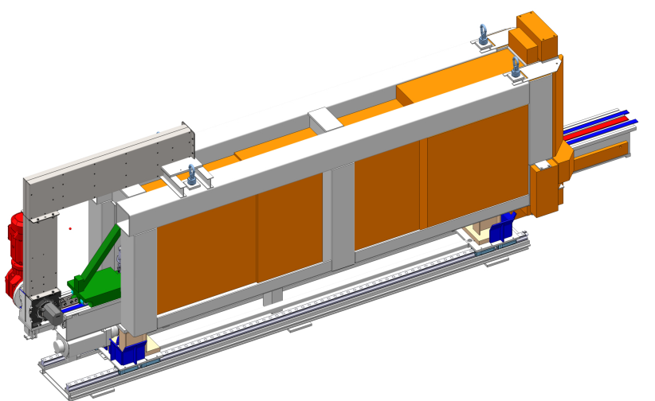
NBEX Handling Strategy
Lower shielding
Shutter cask on cart
Lower shielding cart
Shutter blocks handling
Remove shutter actuator
Remove blocks one by one in basement using
Rigid chain actuator from basement
Block locking system in basement ceiling
Radiating blocks
Shall use shielded vault in basement
Shall use shutter cask
NBPI handling
Leave GBS in vault, in target floor
Clear beamline and adjacent beamlines’ choppers
Install and use NBPI exchange tool
NBW handling
Use several tools from basement
Move in vertical vault
Support table
NBPI Exchange
Floor Unit
NBW handling tool

Slide 13
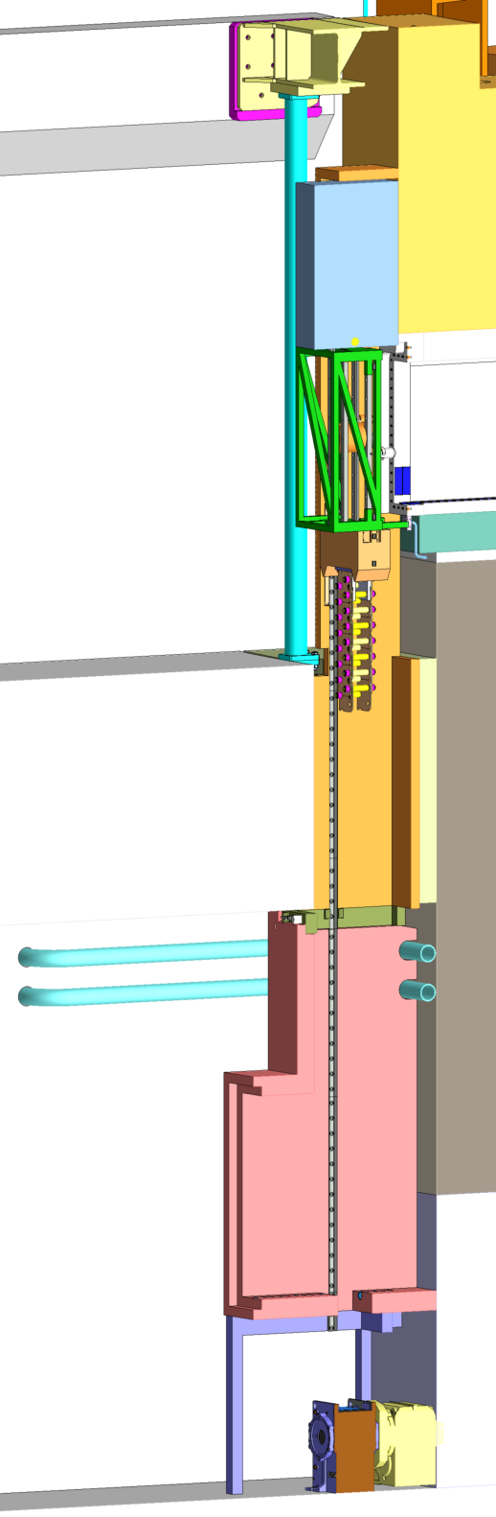
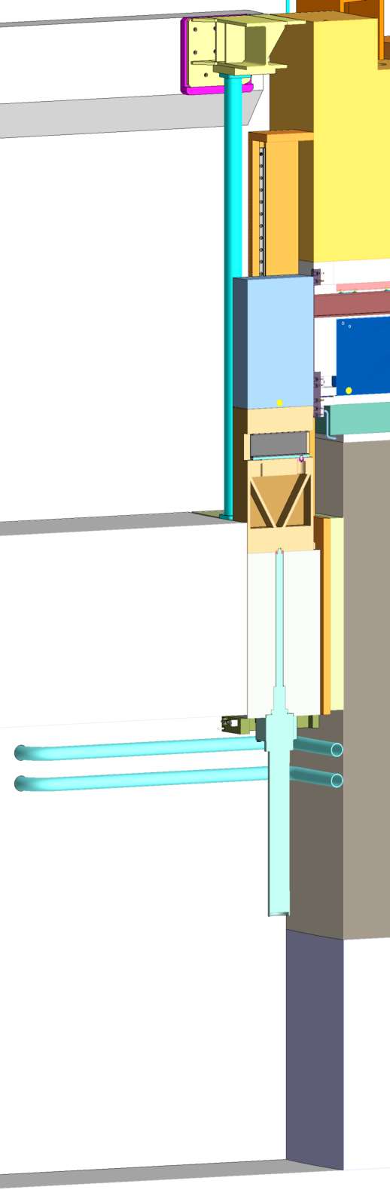
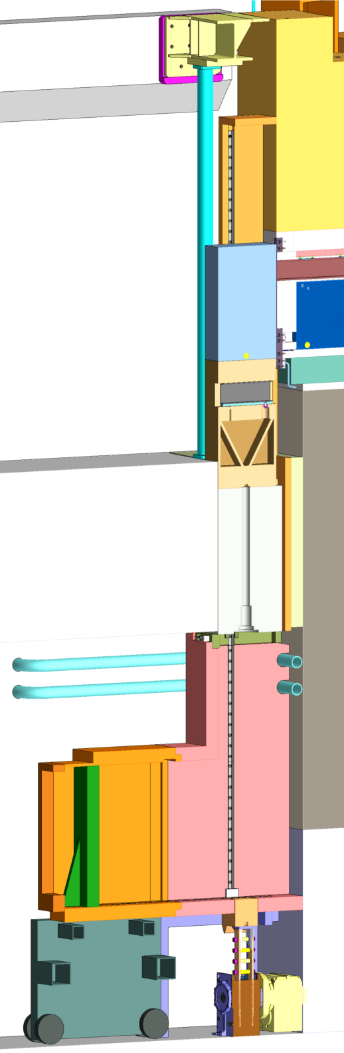
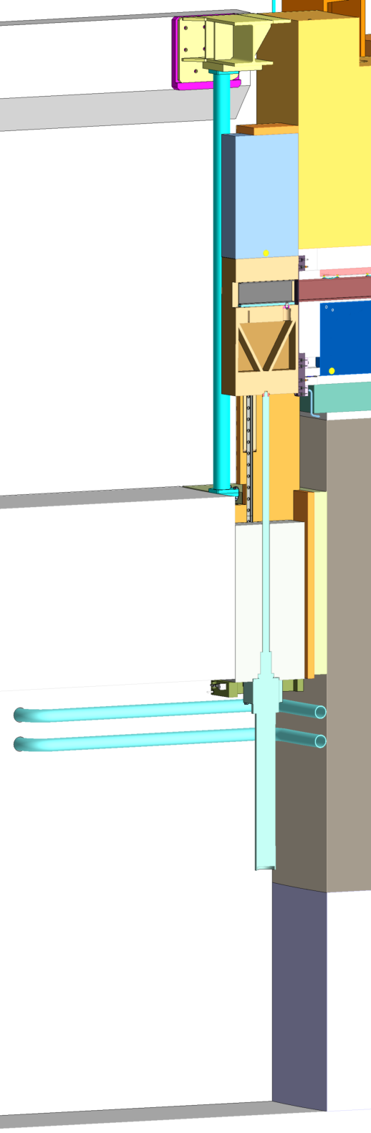
NBEX Handling Tasks
Operational ‘on-off’:
Open beamlines
Closed beamlines
Bi-spectral switch = extra positions defined by ballscrew positioning
Operational ‘on-off’:
Open beamlines
Closed beamlines
Bi-spectral switch = extra positions defined by ballscrew positioning
For all maintenance:
Remove ballscrew actuator, install shield, tools in basement
Use rigid-chain actuator with locking system bringing blocks down
BBG block can be brought to ACF for scrapping
Normally GBS remains on locking hooks – with a mechanical override this can be removed as well
Operational ‘on-off’:
Open beamlines
Closed beamlines
Bi-spectral switch = extra positions defined by ballscrew positioning
For all maintenance:
Remove ballscrew actuator, install shield, tools in basement
Use rigid-chain actuator with locking system bringing blocks down
BBG block can be brought to ACF for scrapping
Normally GBS remains on locking hooks – with a mechanical override this can be removed as well
Then:
NBPI maintenance (replacement)
Use NBPI exchange tool (next slide)
NBW maintenance (replacement)
Use several tools from vertical vault (2 slides further)
Sealing surface refurbishment
Use tool from vertical vault (after NBW removal)
NBEX maintenance carts
NBEX block removal
Operational
Shutdown

Slide 14
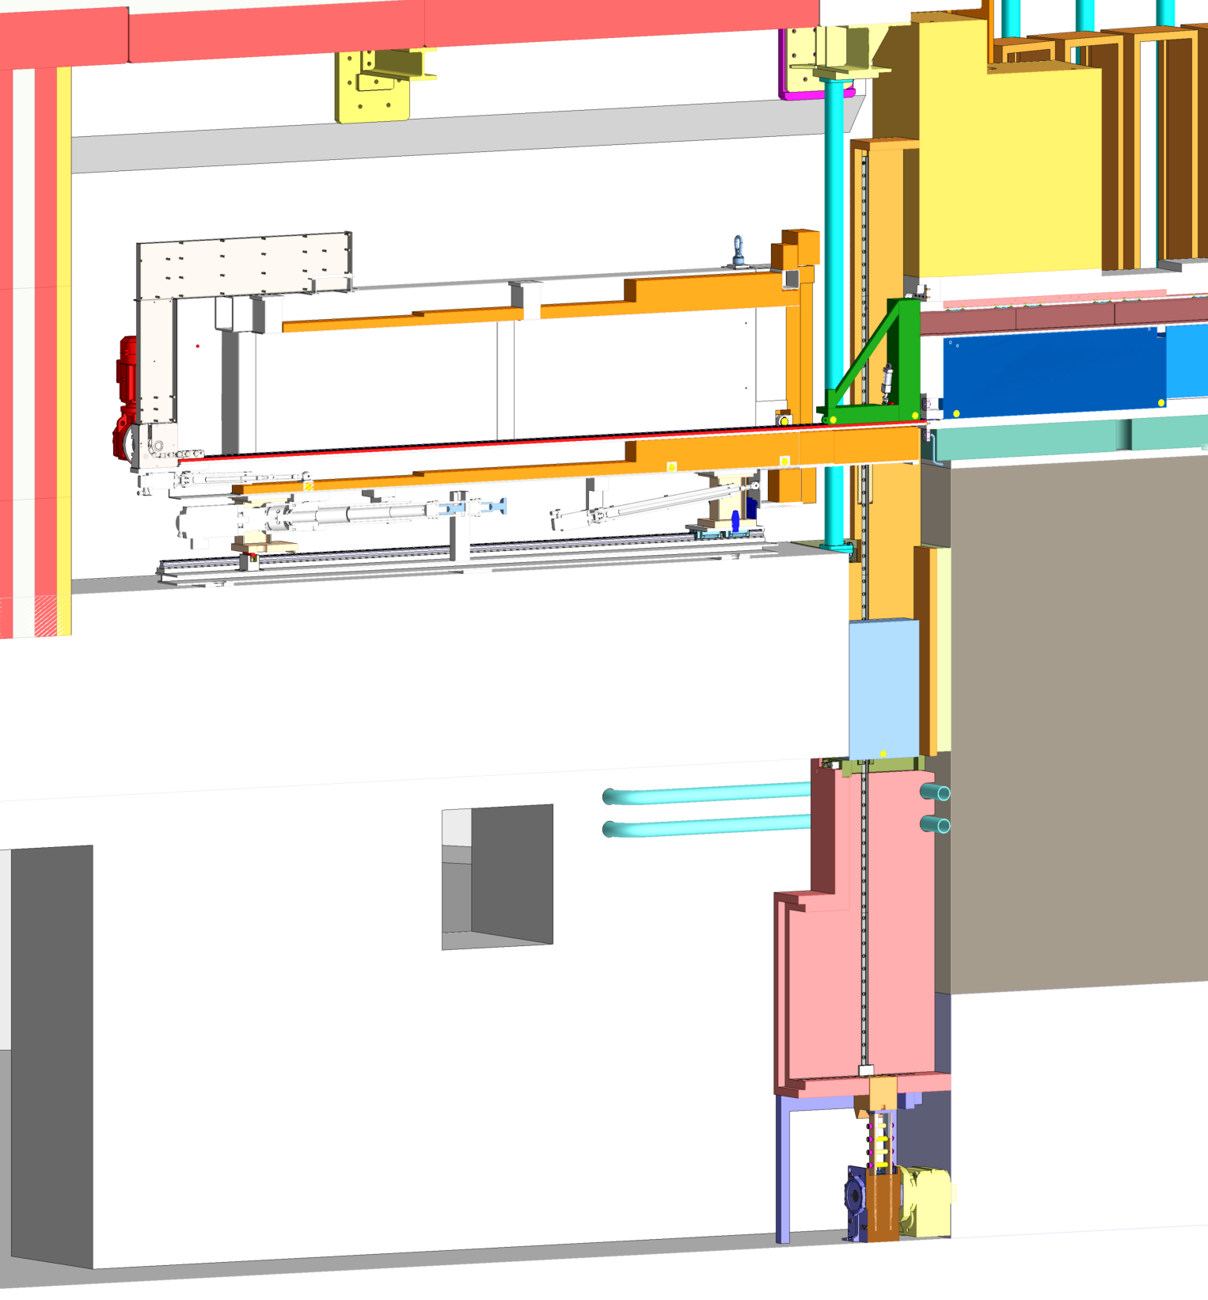
Insert exchange
Hoist floor unit in
Hoist tool in
Lower door
Push tool FW
Bring carriage FW
Pick up NBPI
(and bring to ACF)
NBPI extraction tool
Handling carriage forward

Slide 15
Handling the NBW
Uses rigid chain actuator from Basement
Unbolts/collects/moves NBW into shutter cask
Polishes/refurbishes vacuum sealing surface
Helium leak testing carriage
Bolting
Handling
Polishing / Inspection
He leak testing

Slide 16
Further development
No cooling/conditioning for the BBG
Humid air to Nitric Acid (under intense gamma)requires confinement of air in beam guides
No trespassing from bunker into shutter space nor contact
Instrument that pushes forward like ESTIA: work out safety implications, check with PSS.
Upcoming tailoring:
Bi-spectral switch in BBG
ESTIA ‘retractable’ beamline
NBW variants

Slide 17
Neutron Beam Extraction System
Model reference: ESS-0065135
Notes:
Extra slides follow

Slide 18
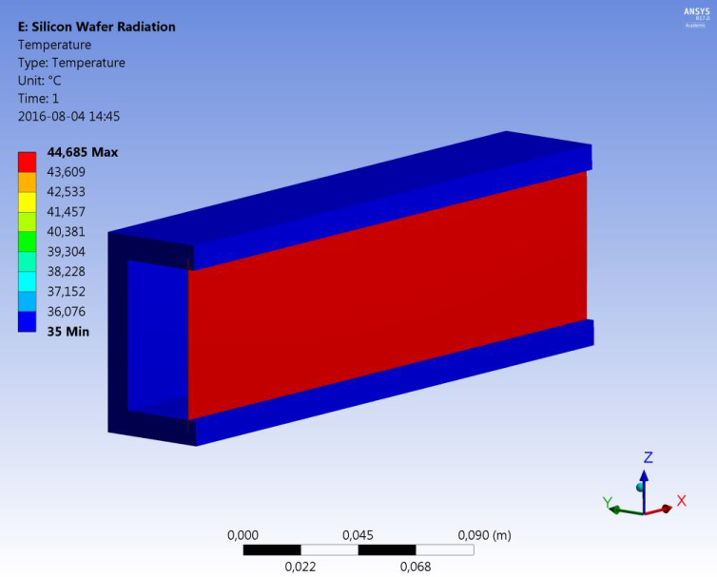
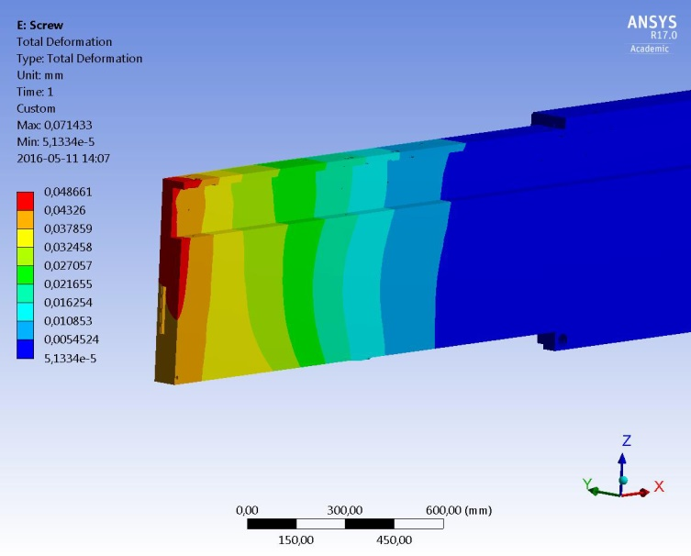
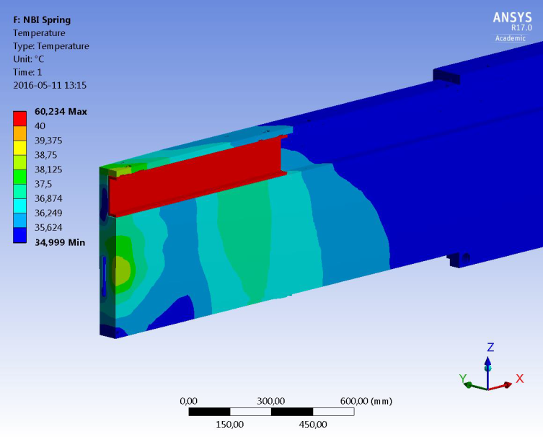
Thermal results
ESS-0058384, rev 2
Cooling not optimized
Si-wafers-to-BGs in vacuum assumed
BGs passively cooled
Wafers in guides with radiative heat transfer, ΔT_{max}=10°C
Cooled NBPI deformation, s_{max}=49μm (cooling is not optimized)
BGs with spring-and-screws, ΔT_{max}=15°C

Slide 19
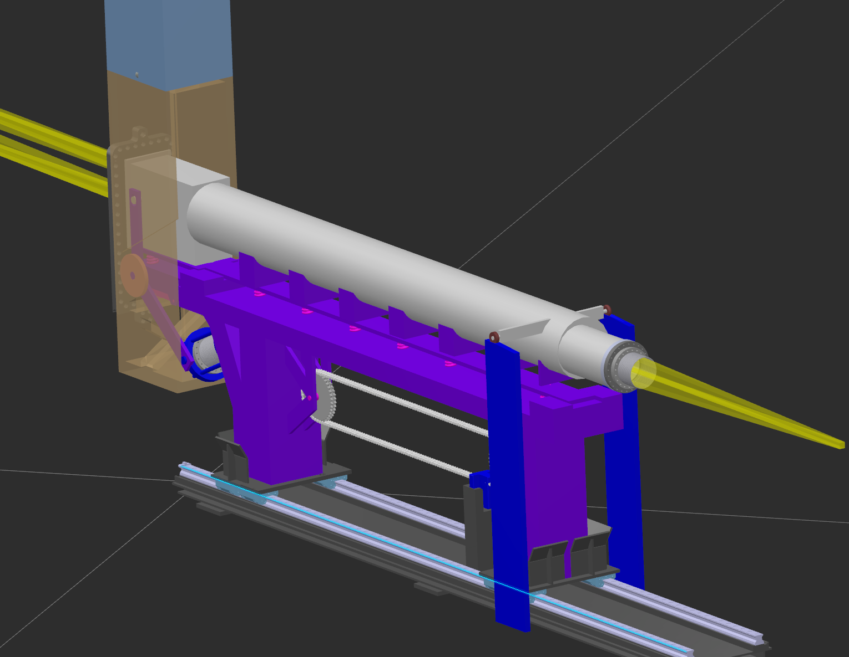
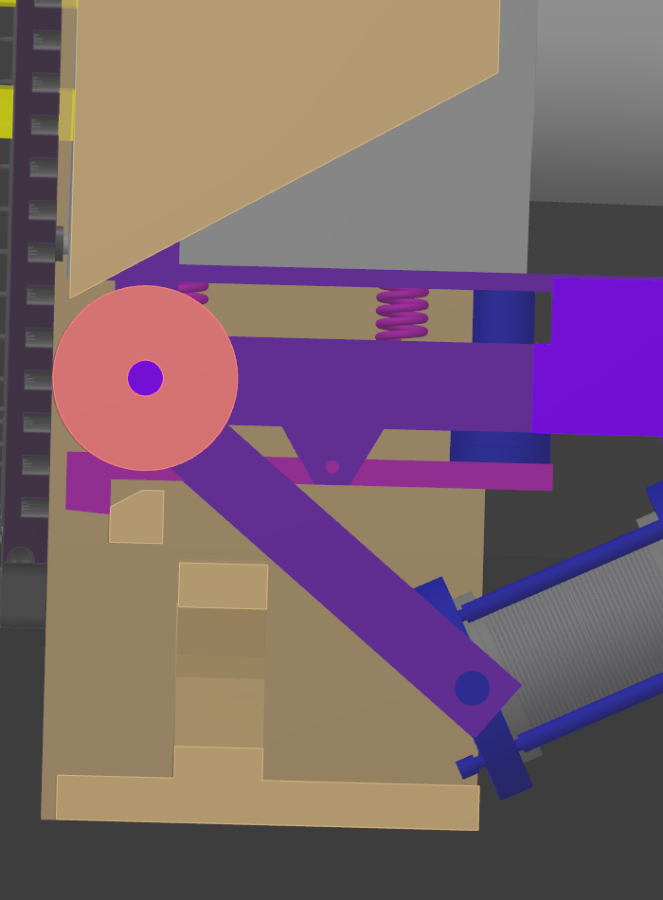
ESTIA retractable beamline
Uses two vacuum ‘actuators’. Unlocked by BBG+GBS moving downwards
BBG+GBS motion then pushes back the grey vessel
Passive motion

Slide 20
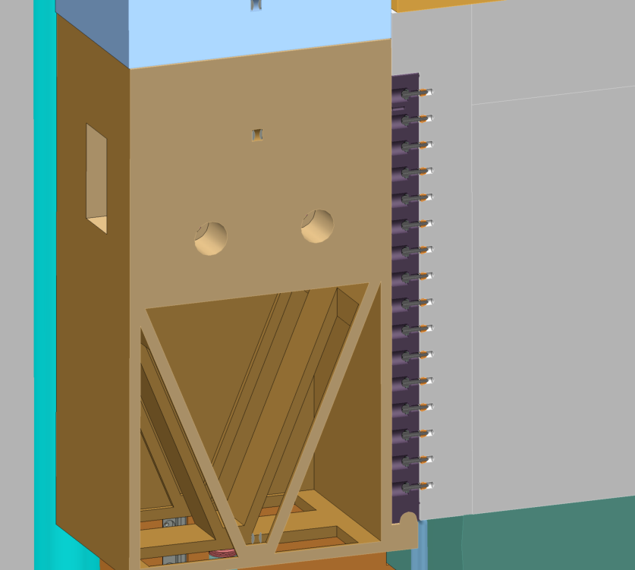
BBG tilting engagement
Tilting axis
Actuator force
Notes:
Extra slides follow

Slide 21
NBEX ← interface → Instrument
Highlighted: Common NBEX fixed features
Vertical relocation of wheels only after discussion with NBEX
Sizing of wheels yet to be confirmed
Rest of volume is up to Instrument
BBG Side view
TCS
TCS

Slide 22
NBEX ← interface → Instrument
Highlighted: Common NBEX fixed features
Rest of volume is up to Instrument
NBPI back
view

