Slide 1
Instrument maintenance with in the Common Shielding bunker
28-9-2016
Iain Sutton
On behalf of the Neutron Technologies Division

Slide 2
Intro
Why is having a coherent maintenance strategy important ?
Because it contributes to;
  Instrument availability for science
  Operating costs
  Minimizing exposure of personnel
  The facilities overall reputation

Slide 3
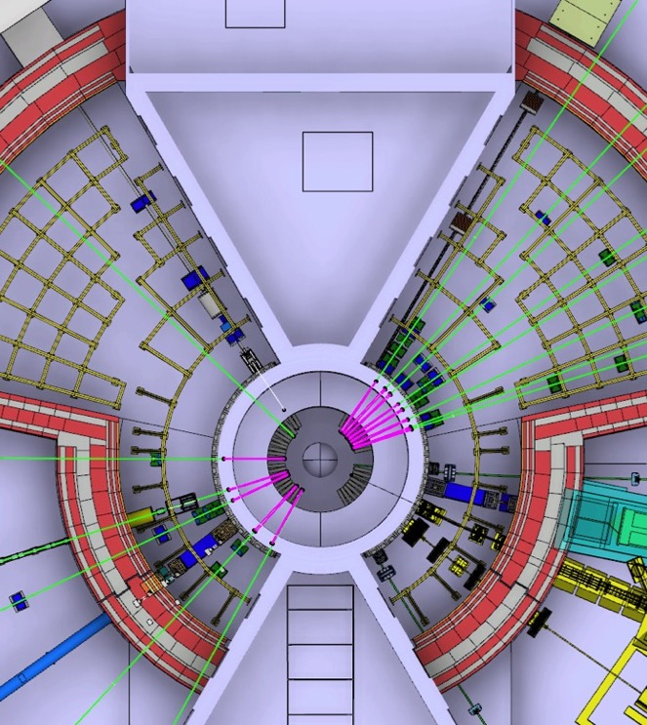
Context
ESS specific context
  Long source instruments
    Components@ R6
  Shielding common volume
    Vertical access
HPower source issues
  Neutron activation
  Neutron damage
Project constraints
  Minimise initial investment

Slide 4
Equipment within Common shielding bunker
Component type Numbers
Choppers 98 axis
Optics 400 m (200 sections)
Shutters 30
Collimators 10
Monitors 30
Supports 200
Service supply
22 instruments assumed (13L-9S)

Slide 5
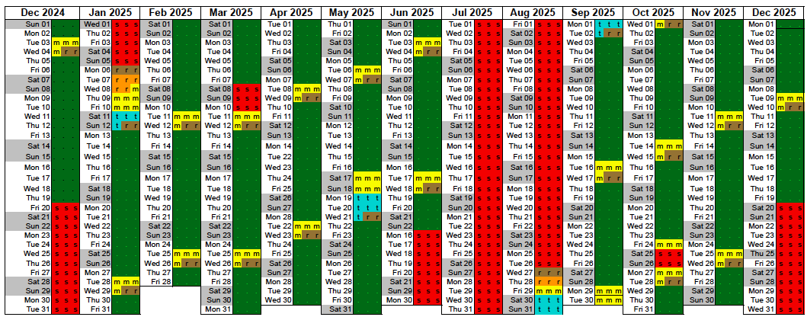
Operational context
Schedule
2 long shut downs >20days
2 short shut downs ~5days
18 very short shut downs <3days
Notes:
Early years
instrument availability
rapid ramp up
ongoing build

Slide 6
Workload
Type 1: Scheduled activities
Type 1A: Long periodicity
  Installation / Decommissioning
Type 1B: Short periodicity
  Inspection/re-alignment/overhaul
Type 2: Unscheduled activities
Breakdown
  Repair / Replacement
INTERVENTIONS
in CSB pa
SCHEDULED
1(A)
PERIODIC
1(B)
REGULAR
UNSCHEDULED
2
BREAKDOWN
10-20
6
60
(All estimates are steady state – post burn-in)
Notes:
Interventions may be considered as two types;
Type 1: Scheduled activities
Type 1A: Long periodicity events
Installation / Decommissioning
Type 1B: Short periodicity events
Inspection/ Adjustment /Replacement
Type 2: Unscheduled activities
(‘random’ events with 5-20 incidents p.a.)
Breakdown repair
Inspection / Adjustment / Replacement
Accident scenario

Slide 7
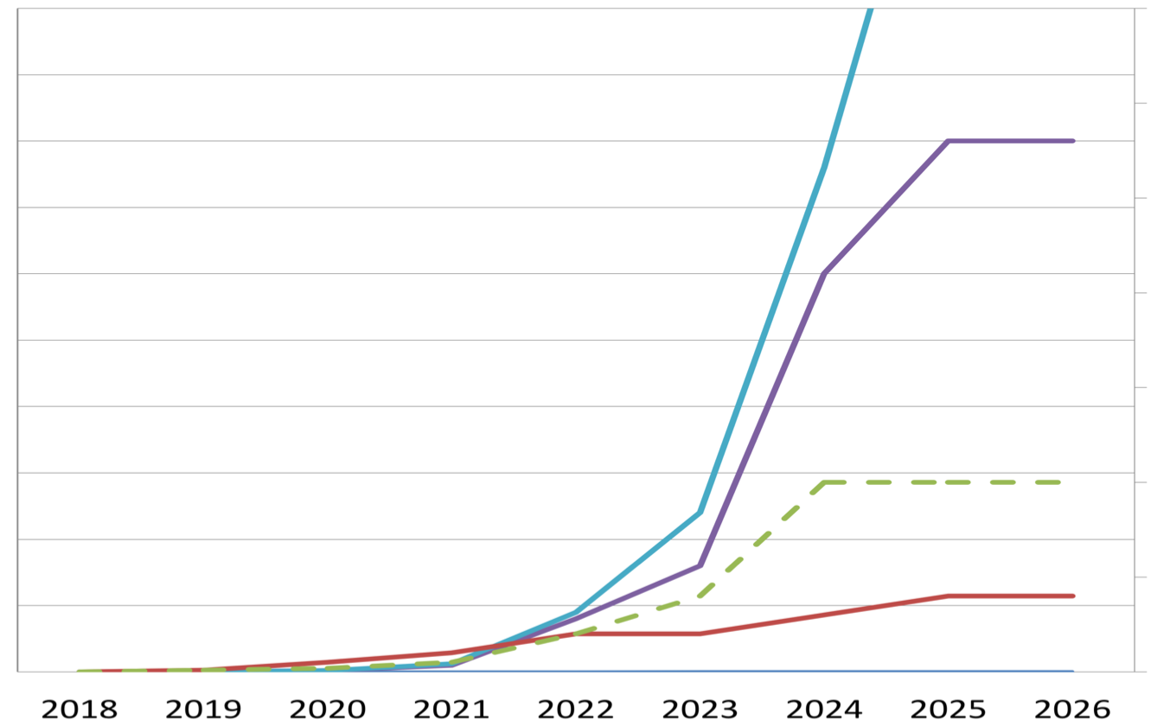
Activation
Full remote handling ?
Activation
Integrated beam
Floor level access prohibited
Vertical access only
MIXED REGIME
Beam power
Long tools & local shielding / hot spot removal
Restricted floor access with local shielding
Beam days

Slide 8
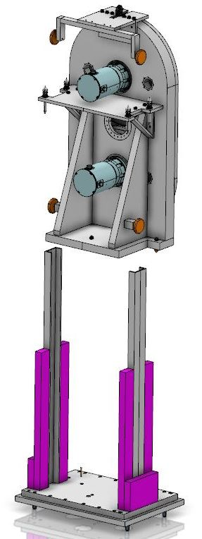
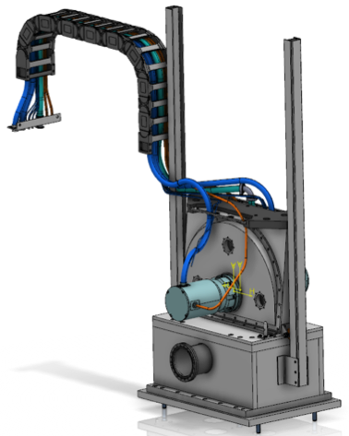
Strategy
Is to have a strategy !
Be prepared ….with a minimal upfront investment
Classification of access zones
  Graded requirements
  Equipment validation
Established Interfaces
  Fixation
  Support & alignment
  Service connections
Standardised methods & tooling
Pre-equip units for RH strategically
Notes:
don't reinvent the wheel SNS
ISIS
Ensure future compatibility
upgrade path

Slide 9
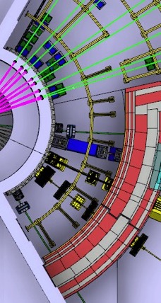
Operational constraints
Hotspots
Shutters
Collimators
PPS choppers (Tzero)
Beam stop
Monolith face (?)

Slide 10
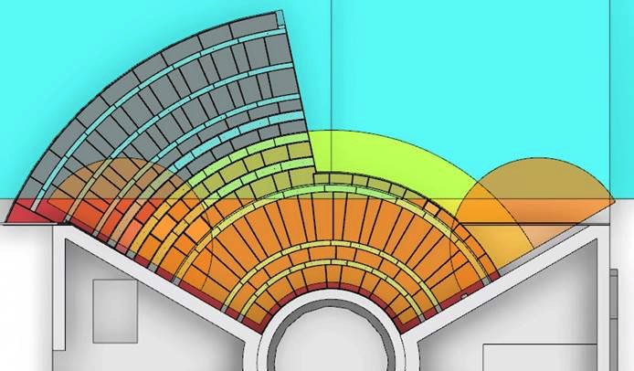
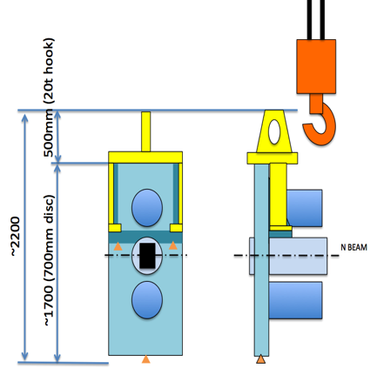
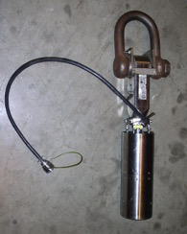
Logistics
Hall Crane
Bunker crane
20t winch
2t winch (requesting)
Coverage Acceptable
Hall Crane
30t winch
5t winch
Coverage Acceptable
Issues
Bunker area limited lift height ( modifications under study)
Handover zone is limited
System will be slow !
Hand over zone
Bunker Crane

Slide 11
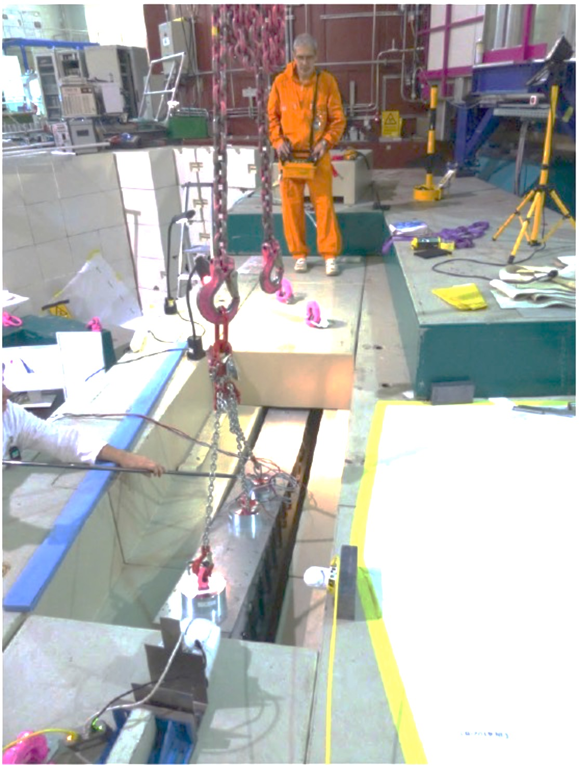
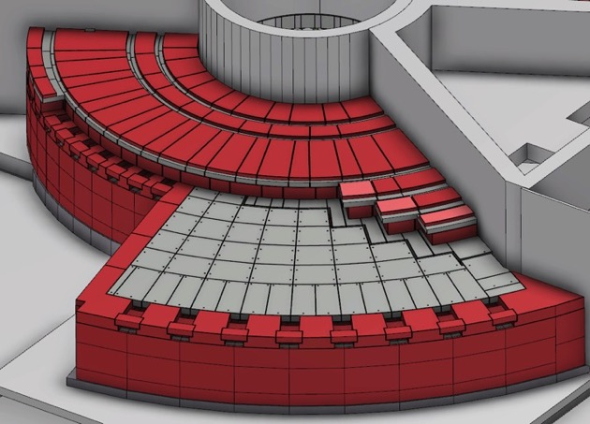
Maintenance
Access on temporary platform on top of bunker pillars.
Main strategy is long tools and other “simple” solutions.
Highly activated components will require hot-swap.

Slide 12
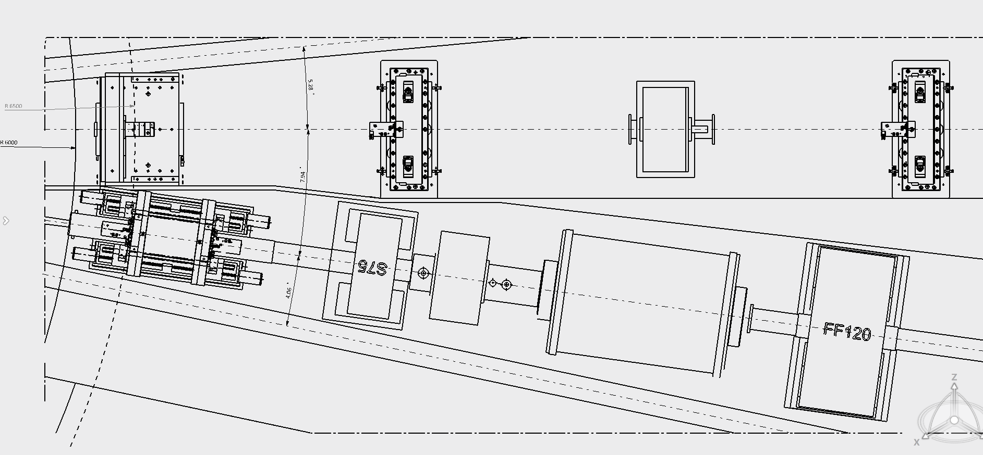

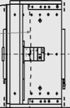
Extraction at monolith face
1.
Straight lift of
optics component section
Straight vertical extraction
using crane
1.
2.
2.
Horizontal translation on rails

Slide 13
Risks to operational performance
Bottle necks
  Number of interventions
  Saturation of crane capacity or tooling
  Cranes are single point failures
Ensuring implementation of standards
  Poor reliability
  Incompatible equipment
  Material activation
Aggressive build schedule
  Getting out of burn in before activity build up

Slide 14
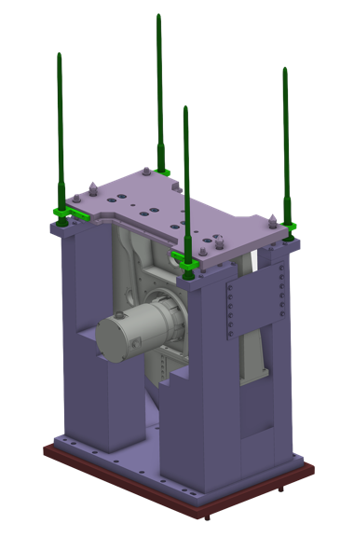
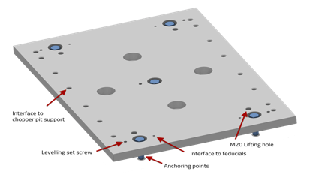
Vibration mitigation
Reduce source terms
  Balance
  Magnetic bearings
Avoid coupling
  Rigid structures
  Rigid fixation
Isolate sources
  Support – Base
  Separate base plates (PPSc)
Attenuate
  Bolted & grouted base plate
Spring loaded fixation
Rigid support
Reservation for Thin isolator
Bolted & grouted baseplate
Notes:
don't reinvent the wheel SNS
ISIS
Ensure future compatibility
upgrade path

Slide 15
Target Safety related instrument failure
Current strategy “a layered and graded approach.”
Beam port a ‘thick’ window (Rated for normal safety case)
BP shutter a ’thick-ish’ window (v50)
Upstream side of high speed choppers a ’complimentary’ window
@ 11.5m a ’thick-ish’ window ‘fire break’
Metallic guides only upstream of ‘fire break’
Common shielding
Safety related equipment
Fire break
Normal equipment
BEAM PORT
SHUTTER
GUIDE
GUIDE
1
2
3
4

Slide 16
Remote handling
Current thinking
On which equipment this should apply to and why

Slide 17
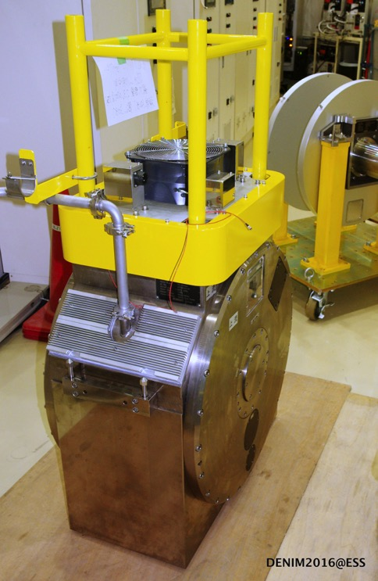
Which equipment should be equipped to be remote handled ?
Equipment which represents a significant hazard to personnel during interventions (due to activation).
PPS choppers
Shutters & collimators
Some supports (?)
Equipment which requires regular intervention.
Overhaul or inspect period < 10 years.
Removed frequently i.e. is installed between R6 – R11.5
Equipment presenting a significant risk of breakdown. Reliability < 98%

Slide 18
Which operation should be carried out using remote handling ?
Operations
Disconnection
  Beamline components, hold down and Services
Removal
  Fitment of cask if required
(Re)insertion
Repositioning or alignment (if required)
Reconnection

Slide 19
Status
Where are we now
A plan for the way forward
outstanding issues

Slide 20
Thanks you for your attention !
Many thanks for contribution from the Bunker group and the Neutron Chopper Group

Slide 21
Interventions
- type 1A
- Scheduled, PERIODIC (?)

Slide 22
Type 1A
Once in an (instrument) life time (10yrs) aka bunker annual events !
These activities are expected to be infrequent (periodicity >10yrs) when considered on a beam line by beam line basis.
Note when each bunker is considered as a system of 8-12 beam lines interventions become annual.
Interventions
Beam port activation
Instrument installation
Beam port deactivation
Instrument removal
Installation of neighboring instrument

Slide 23
Current situation
‘Vertical shutter removal’
Monolith
Key points
Components situated in bunker and in basement
Access to mobile components via basement
Access to some components requires access via bunker
Static assembly access via bunker
N
Mobile assembly accessed via basement

Slide 24
Interventions
-type 1(b) schedule Regular (every shut-down

Slide 25
Type 1B ‘the regulars’
These activities will be regular occurrences
These events will predominate work load of tech support during operation
Systems must be in place to enable these activities to be carried out minimising exposure to personnel
– ie minimising hands on.

Slide 26
Scheduled & Regular
Activity Incidence over 10yr period
Beam port systems inspection 40
Neutron chopper maintenance 100
Optics realignment 20
Instrument shutter maintenance 20
Other component maintenance 60
Removal neighboring & Hot 80
Total 320

Slide 27
Interventions
- Type II unscheduled (BREAKDOWNS)
Breakdown, Screw ups, and other stuff that just happens

Slide 28
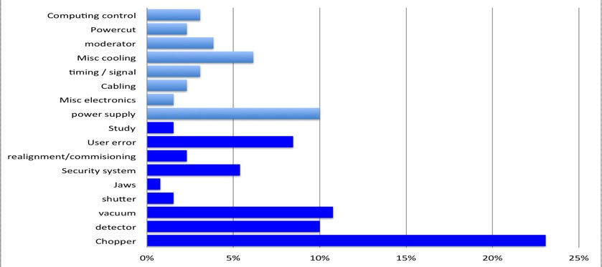
Sub system level breakdown data
CAUSE OF STOPPAGE
BLUE Chopper system
RED Other component
GREEN At request of I.S.
Cycles (Normalized to 35 day)
Beam interruptions
Note: excluding - Sample environments, Computing & Motion control
Causes not requiring access within heavy shielding for repair
~ 3 ‘significant’ interruption per 100 beam days
+3.5 uses of shutters to effect ‘running repairs’
Causes often requiring access within heavy shielding for repair
Source: ISIS
Notes:
Calculated failure rates for existing instruments and equipment
And from that
Factoring in the increase comlexity of ESS instruments tried to come up with some estimates for our own instruments
Failure of a specific instruments every 3 or 4 years
Failure of ‘An’ instrument each 35day cycle

Slide 29
Unscheduled
(breakdowns & unforseen)
Activity Incidence over 10yr period
Beam-port systems breakdown 4
Neutron chopper failure 40
Optics breakdown 20
Instrument shutter breakdown 20
Other component breakdown 60
Removal of hot components (neighboring work) 30
Accident scenarios (H2) 2
NOTE : Indicative figures – work in progress

Slide 30
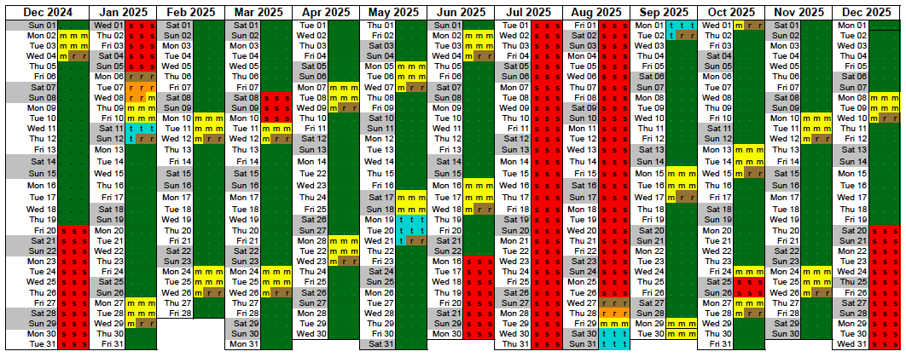
Availability
& Source Schedule
Lengthening short breaks 3 > 5 days enables them to be used for repair.
Results in increased overall availability
Notes:
As a general rule unscheduled shut downs for repair are restricted to GREEN zones
Access to components in other zones must await scheduled ‘short shutdown’ – to cope with more complex interventions.
Longer interventions will be dealt with in two steps, with removal of equipment during one S-SD, repair off line and replacement at the next S-SD.
In the case of interventions requiring extended SD then shutters can be held close after start up of the facility.

Slide 31
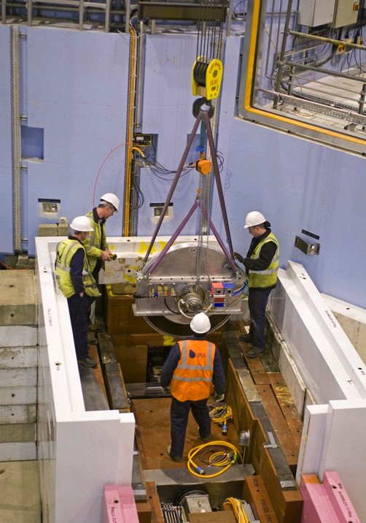
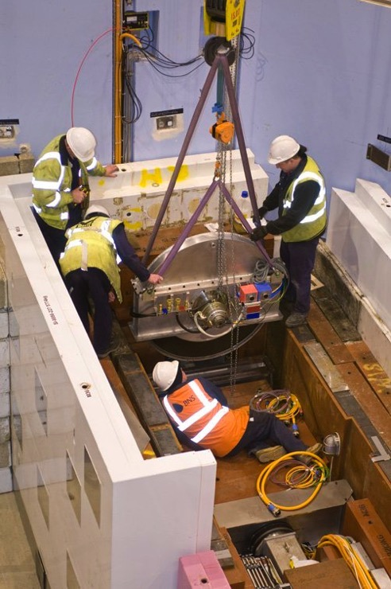
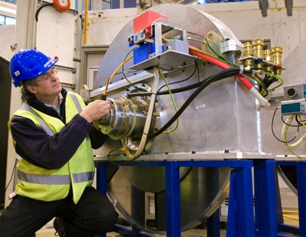
DC-LR installation
.2.1m
1.4m

Slide 32
Worst case
Disc chopper Large rotor
Odin, Freia, (4-6 units)
Assuming a rotor of 1800mm
The height of the unit is 2100mm
Assuming a lifting tool of 300mm
Gap to floor of 200mm
Free height require > 2600mm
300
2100
N
200 gap

Slide 33
Hook height
300mm (20t hook)
~2300
~1800 (700mm disc)
N BEAM
Gap 200mm

Slide 34
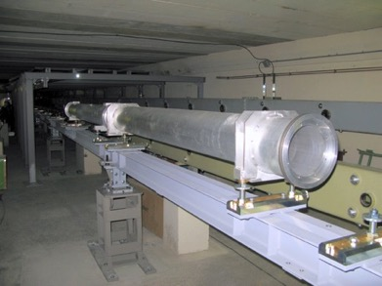
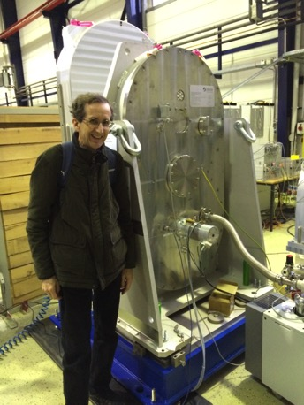
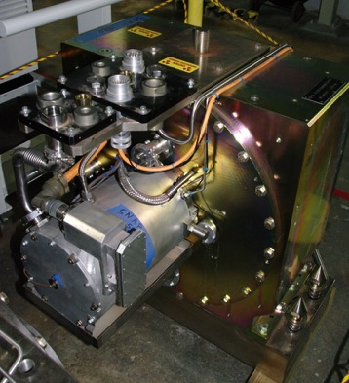
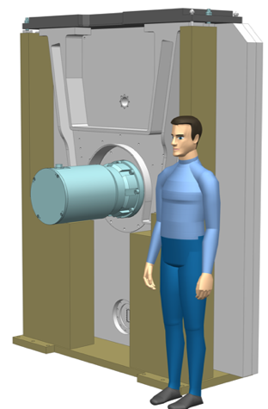
Types of equipment in the bunker
Guide modules (2m each)
Over/Under Choppers
Face-to-Face Choppers
and Single Choppers
PPS Choppers
Large Rotor choppers
(1m and above)
Other components are not considered especially collimators

Slide 35
Components and their placement
(with respect to the instrument in the beam line allocation document)
Components | Total number | In bunker | In bunker and serviced by monolith crane | Serviced by monolith crane but not in bunker
Over/Under Chopper | 23 | 16 | 16 | 0
Single Chopper | 33 | 19 | 16 | 2
Face-to-Face chopper | 26 | 20 | 19 | 0
Large rotor choppers (1-1.4m) | 7 | 7 | 5 | 0
Large rotor choppers (>1.4m) | 3 | 2 | 1 | 0
PPS | 6 | 4 | 4 | 0
Guide module | 218* | 201 | 165 | 10
Other | 12 | 3 | 2 | 2
Total | 391 | 272 | 228 | 14
*Every instrument is considered to have a single guide module from m30 onwards

Slide 36
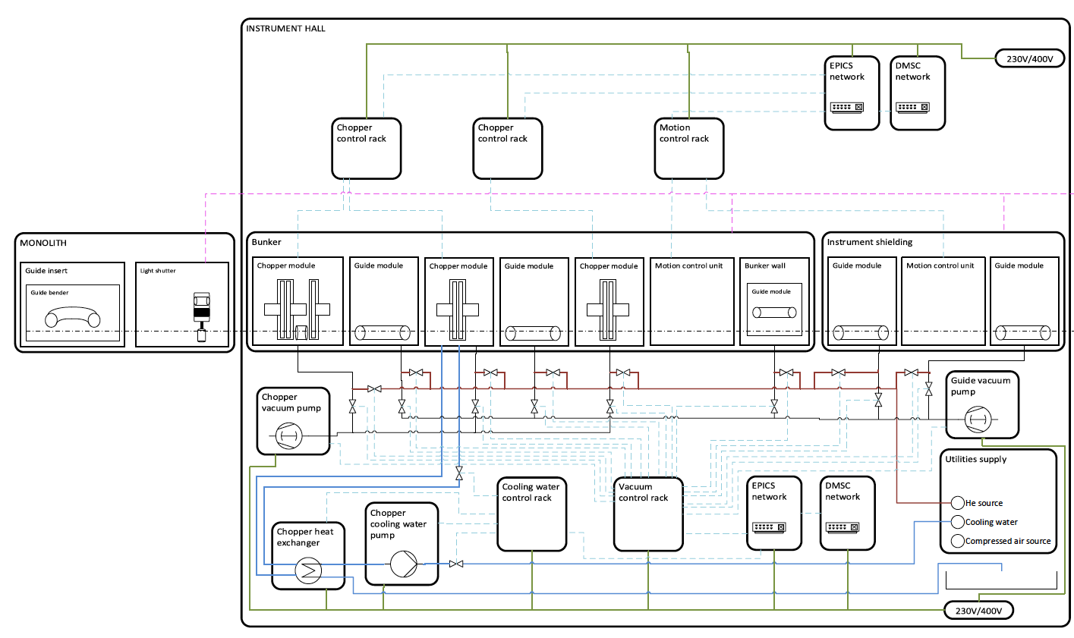
Installed systems
What
Insert schematic of bunker components here

Slide 37
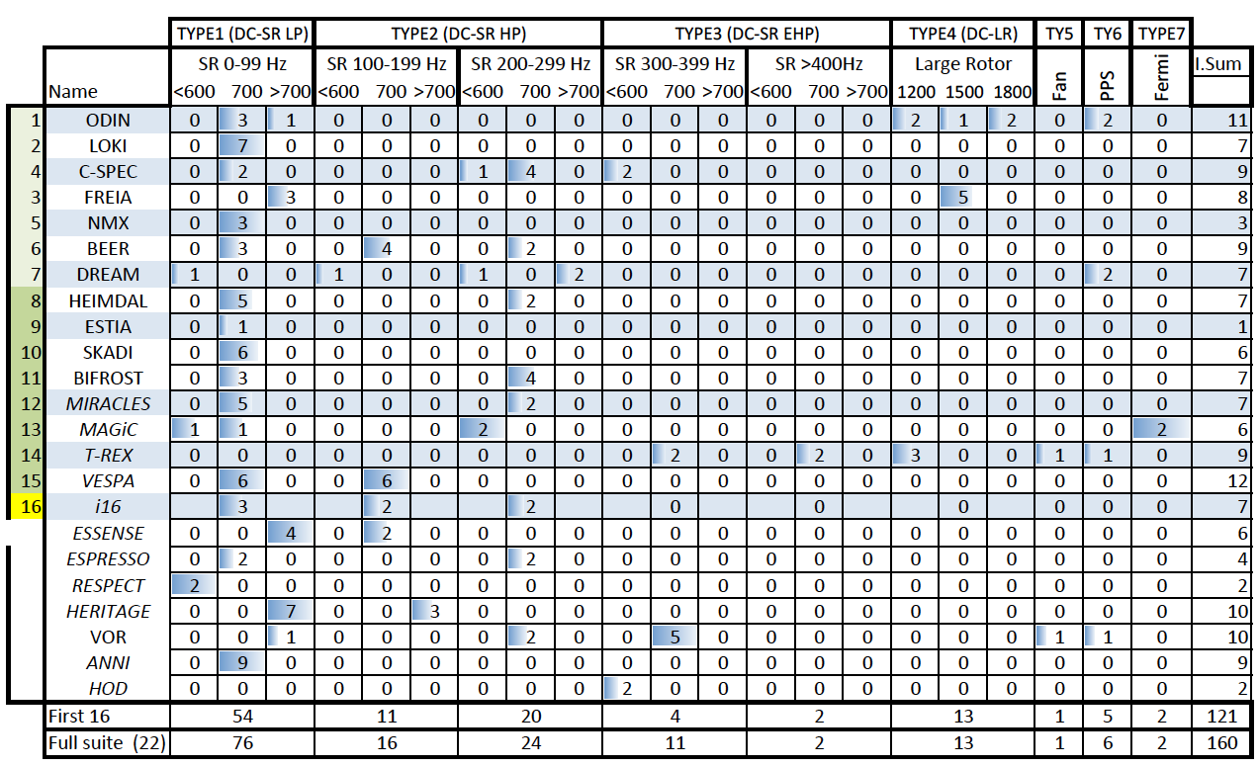
Installed systems
Neutron choppers
High or Hot equipment
High speed double choppers 8-10 assemblies
PSS = 5 assemblies

Slide 38
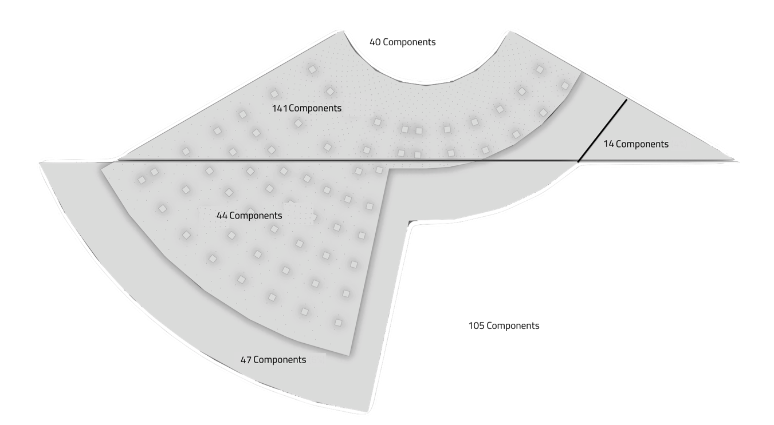
Component map

Slide 39
DCSR (2PA-1-CRD)
Conclusions
A hook height of 2.5m is a minimum for current equipment
2.7m prefered
2t – 5t lifting equipment would be strongly preferred.
Special mountings will be required to ensure installation compatibility

Slide 40
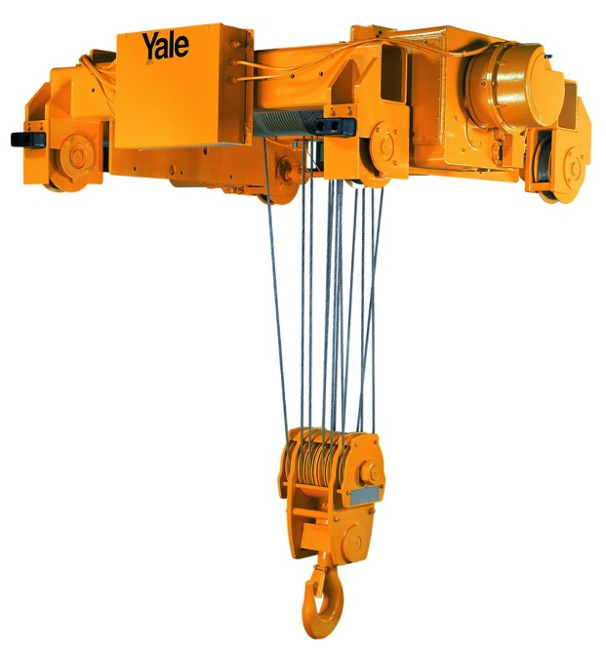
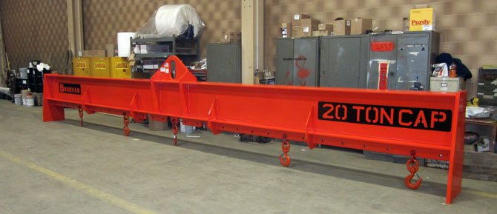
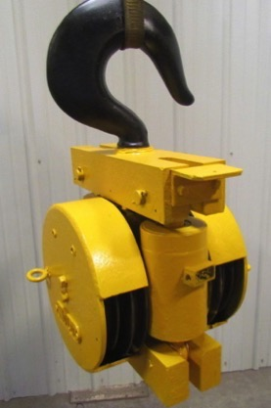
20t lifting kit
Spreader bar is 500mm deep
Hook eye is 500mm high
Hook assembly can be 1.3m tall
20t equipment is big !

Slide 41
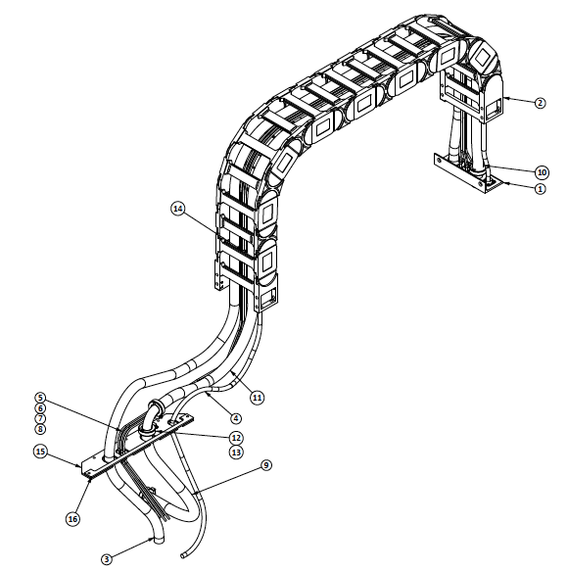
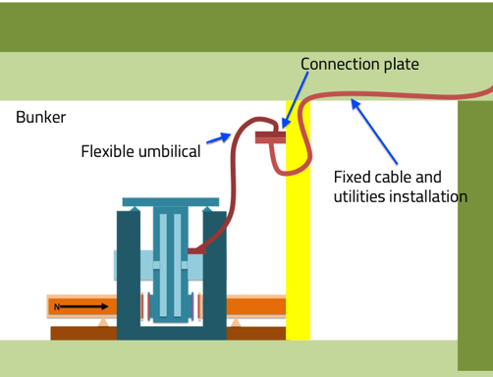
CHIM – Umbilical and routing
Standard ESS package for:
  utilities
  cables
Supplier specific cables
Connection plate is now simplified
Routing is work in progress
WIP

Slide 42
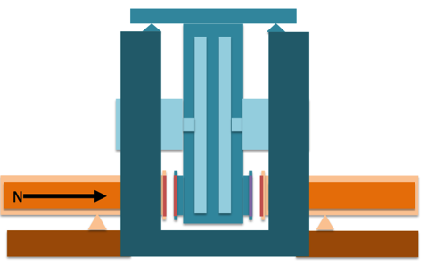
Bunker remote handling plate (Horizontal) solution
4 connectors per cable
Rack

Slide 43
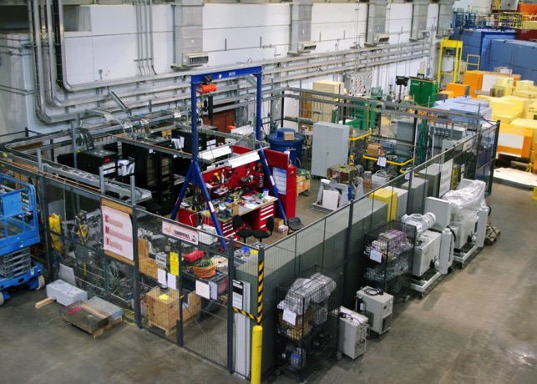
ChIMF (Chopper Integration and Maintenance Facility)
ChIMF-1 in hall 2 (Partially moved to Pre-OPS)
ChIMF-2 in hall 1 (Pre-OPS)
Principal activities,
  Systems Integration
    Assembly of new systems
    Minor modification of components
  Commissioning
    Setup
    Electrical tests
    Mechanical tests (low energy)
    Pressure tests
    Cooling tests
  Maintenance
  Repair
Area defined in ESS-0047351
Area flexible to allow for site changes
  Example, one area more focused on T0
150sqm broken down into
Basic machine shop (15sqm)
Mechanical assembly (25sqm)
Metrology (10sqm)
Electrical assembly (15sqm)
General assembly (25sqm)
System test area (40sqm)
Parts storage (15sqm)
QA (10sqm)
Not including active storage area (20+25sqm)

