Slide 1
Summary of Target In-Kind contribution TIK 6.7 Mock-up and Test Stands – Hot Workshop
Magnus Göhran
Work Package Manager – Remote Handling Systems – WP6
www.europeanspallationsource.se
October 11, 2016

Slide 2
Outline
Scope
Requirements
Cost value
Schedule

Slide 3
TIK 6.7 Scope The Mock-up and Test Stands
ISO View of the MUTS
Roughly 6x6x6 meters frame work structure
PDR Status of design
Outer Frame is fixed
Inner Frame is modular to be able to accommodate the equipment

Slide 4
TIK 6.7 Scope The Mock-up and Test Stands
ISO view of the backside of the MUTS
Target Wheel Cask and Floor Valves is not part of the Scope
Waste Shipment Container included to highlight tight space claim interfaces

Slide 5
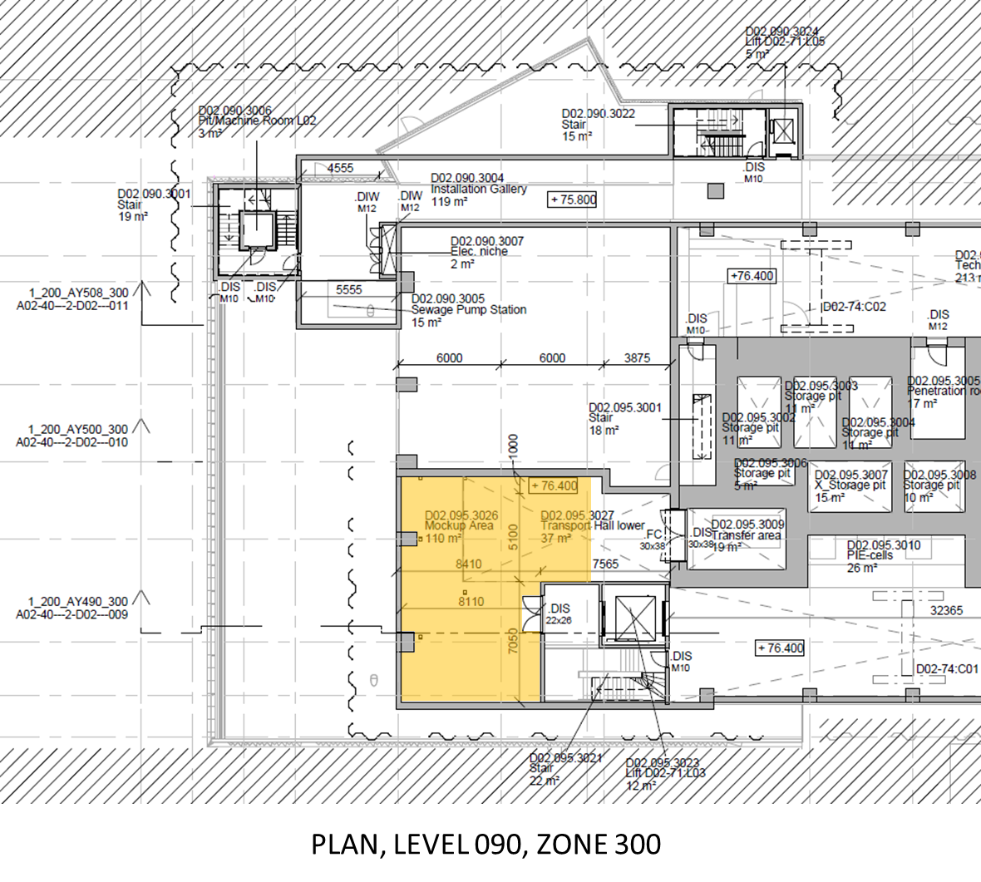
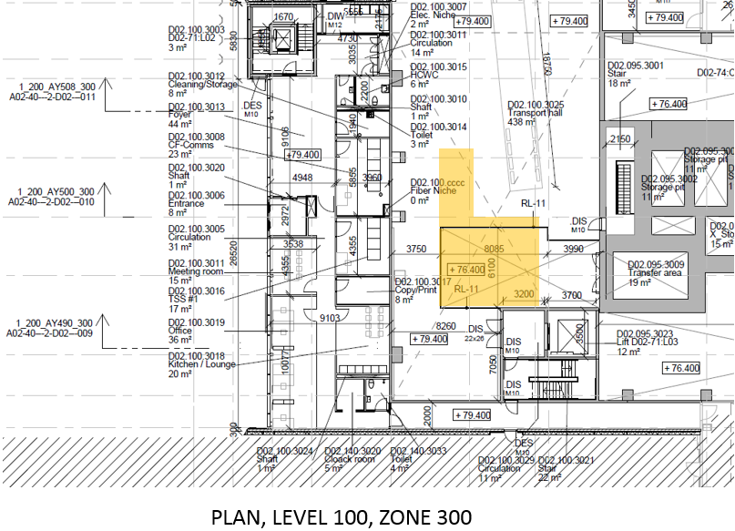
TIK 6.7 Scope The Mock-up and Test Stands
Main functions:
Training possibilities for maintenance personnel/operators
Component alignment
Provide a platform that enables SAT possibilities for following components:
Target Wheel and Shaft incl. monitoring plug
Moderator Reflector Plug
Proton Beam Window
Proton Beam Instrumentation Plug
Neutron Beam Extraction System
Transfer the structural loads
Sub functions:
Provide service air for use with power tools and/or components that requires pressurized air
Introduce new plugs into Casks prior to insertion in the Monolith during maintenance
Applicable Regulations, codes and standards:
Low Voltage Directive 2006/95/EC
Electromagnetic Compatibility Directive 2004/108/EC
Pressure Equipment Directive 2016/68/EU
Execution of steel structures EN 1090-1/2
Design and Construction Rules for Mechanical Components ESS-0023107
ESS rules for codes and standards
Space allocation in the D02 Building:

Slide 6
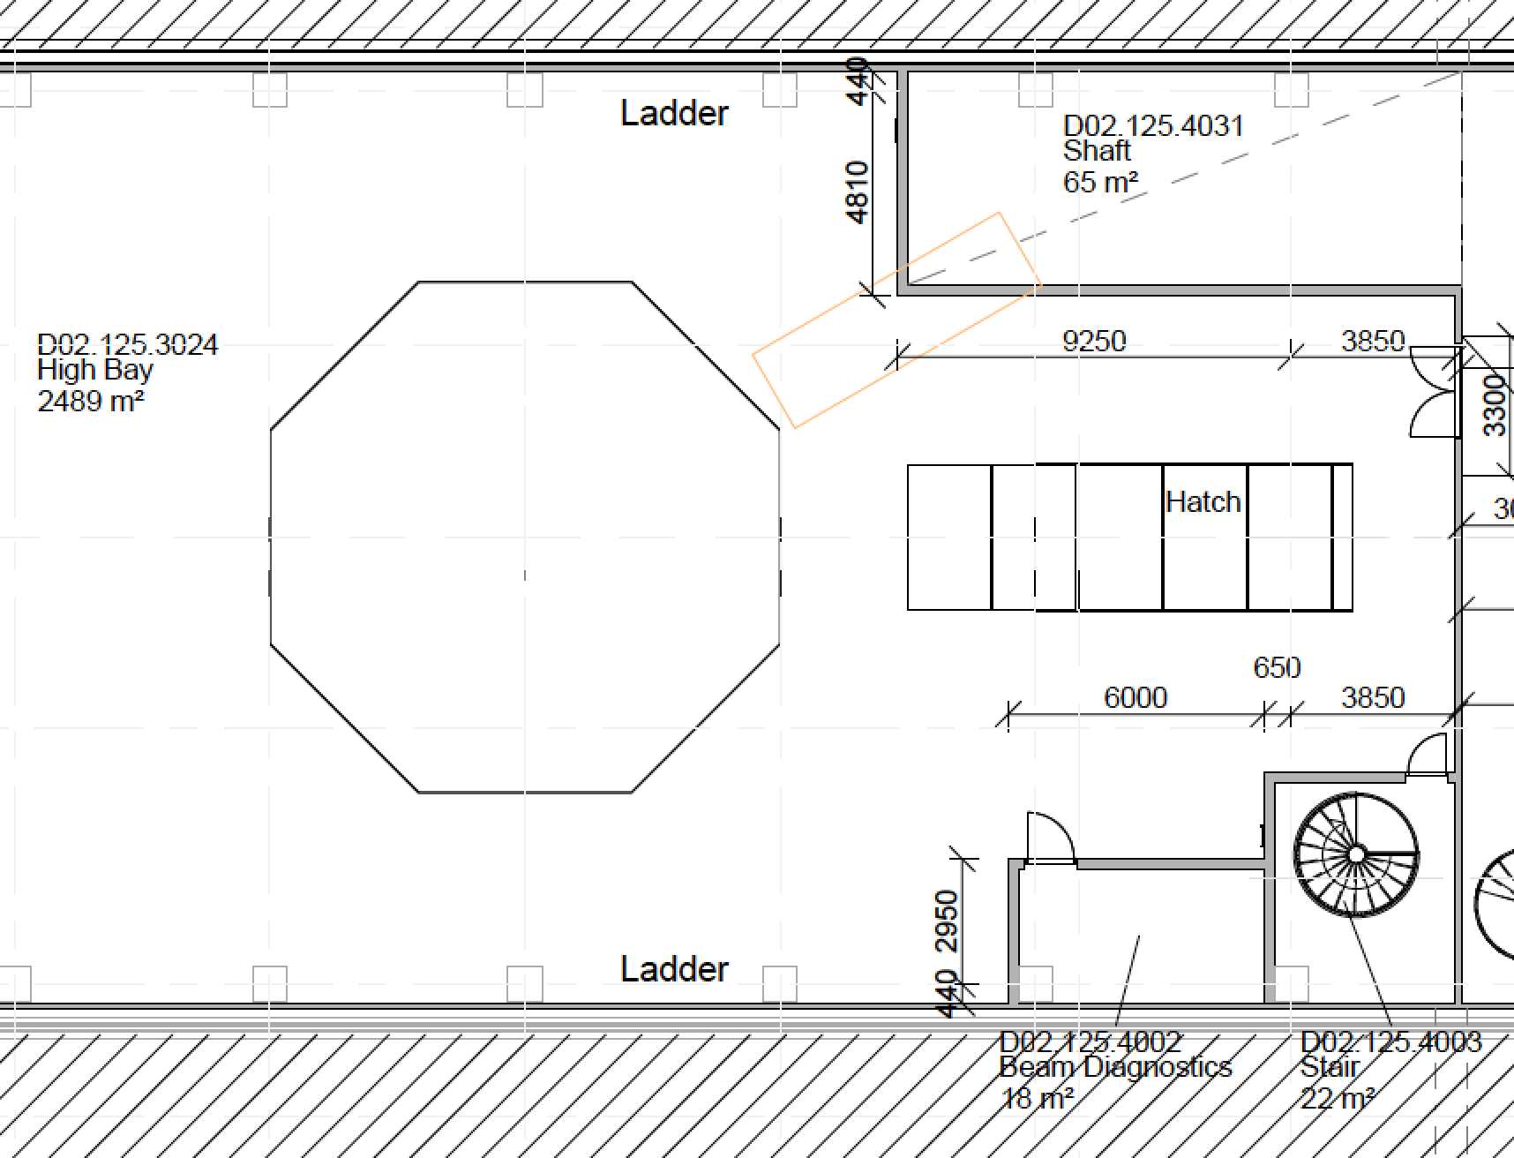
TIK 6.7 Scope The Hot Workshop
Requirements:
Room Size Minimum 35 m²
Weld (TIG-MMA)
Permanent Drill Press
Hydraulic Press
Band saw – Metallic
Lathe
Tool Cabinets on wheel including hand tools
Wash cabinet/possibility (de-grease, de-contamination)
Over head lifting, crane
Lifting table
Small grinder
Milling machine
Induction heater
Alignment table for welding
Space allocation in the D02 Building:
The Hot Workshop should be of general use for the target operation with the main function of hands on repair work on machine components with a low or very low level of induced activation or contamination.

Slide 7
TIK 6.7 Interfaces
Mock-up and Test Stand
Site Infrastructure (Conventional Facilities)
Target Systems (WP 12.2)
Moderator and Reflector Systems (WP 12.3)
Monolith Systems (WP 12.4)
Fluid Systems (WP 12.5)
Remote Handling Systems (WP 12.6)
Hot Workshop
Site Infrastructure (Conventional Facilities)
Target Systems (WP 12.2)
Moderator and Reflector Systems (WP 12.3)
Monolith Systems (WP 12.4)
Fluid Systems (WP 12.5)
Remote Handling Systems (WP 12.6)

Slide 8
TIK 6.7 Cost
In-Kind Values
In-Kind Scope

Slide 9
TIK 6.7 Schedule
Key Milestones

