Slide 1
Summary of Target In-Kind contribution
TIK 6.2 Casks and Associated Handling Devices
Magnus Göhran
Work Package Manager – Remote Handling Systems – WP6
www.europeanspallationsource.se
October 11, 2016

Slide 2
Outline
Scope
Requirements
Cost value
Schedule

Slide 3
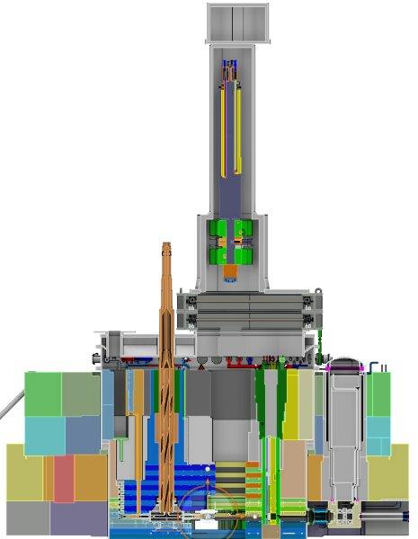
TIK 6.2 Scope
The Casks and Associated Handling Devices
In-kind scope
  Primary internal transport casks for monolith maintenance including internal hoists
  Floor Valves
  Covers and hoods for shielding blocks
  Temporary shielding and supports
  Tools, fixtures and docking stands
Location
  Inside the D02 building (Target Building)
Internal Hoist
MR Plug Cask
Floor Valve
Temporary
Shielding

Slide 4
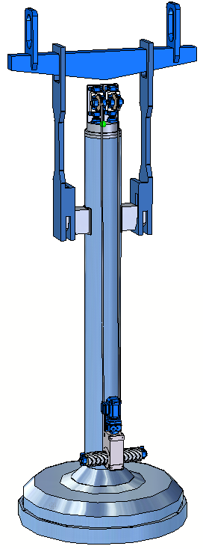
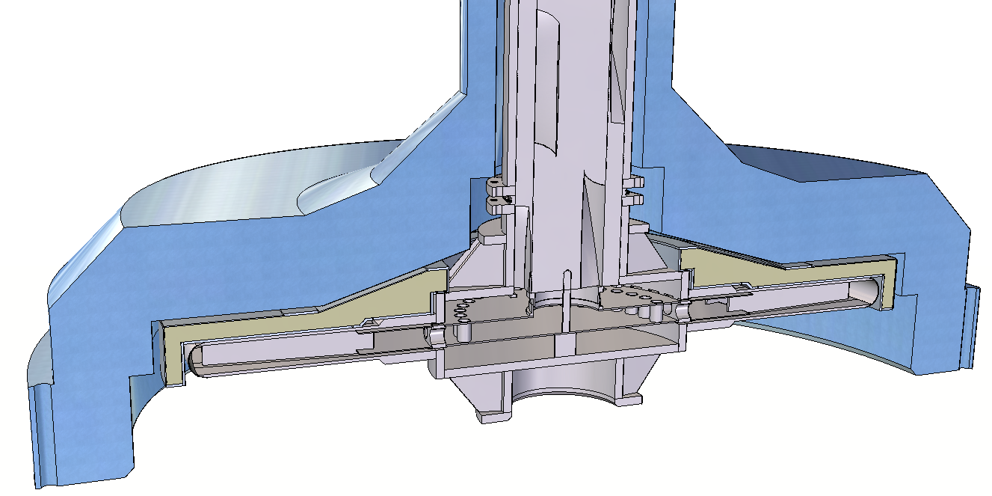
TIK 6.2 Scope
The Casks and Associated Handling Devices
Main Functions
  Protect personnel from radiation hazards
    Confining radioactive components
    Structural Shielding
  Maintain monolith components
    Internal hoists
    Alignment
  Interim storage of shielding during monolith maintenance in the high bay
  To be transported in the D02 building with the high bay crane
  Separate Control System
Target Wheel Cask with lifting beam

Slide 5
TIK 6.2 Scope
The Casks and Associated Handling Devices
Regulation
  Specific Requirements for the ESS-Facility in Lund, Doc id. SSM 13-3285
  Guidance with the background and reasons for Radiation Safety Authority's regulations on lifting equipment and lifting operations at nuclear facilities, (Swedish) SSM2014-4363-24
    KTA 3902 for the design of lifting equipment
    KTA 3903 for inspection and testing of lifting equipment
    EN 60709 Instrumentation and control systems important to safety – Separation
Swedish Work Environment Authority
  AFS 2006:4 Use of Work Equipment
  AFS 2006:6 Use of hoists and lifting equipment
  AFS 2008:13 Signs and signals
  AFS 2006:6 Use of cranes and lifting devices
Design and construction rule
  Target Station - Remote Handling Systems [WBS 12.6] – Design and Construction Rules for Mechanical Components, ESS-0023107

Slide 6
TIK 6.2 Interface Control Document
12.2 Target Systems
12.6.5.2 Mock-up and Test Stands
12.4 Monolith System
12.6.4 Casks and Associated Handling Devices
12.3 Moderator Reflector Systems
12.6 Remote Handling System
12.6.2 Active Cells
12.2.2 Target Wheel
12.3.3 Moderator and Reflector Assemblies
12.4.2.2 Proton Beam Instrumentation Plug
12.4.3.1 Proton Beam Window
Floor Valves
Active Cells Mode Control System
Mock-up
12.2.3 Target (Drive) and Shaft
Target Monitoring Plug
12.4.3.2 Monolith Vessel
12.4.3.4 Covers and penetrations
12.4.3 Confinement system
Site infrastructureHigh Bay Crane
Target Monitoring Plug
12.4.4.2 Inner Shielding Systems

Slide 7
TIK 6.2 Cost
In-Kind Values
In-Kind Scope

Slide 8
TIK 6.2 Schedule
Key Milestones

