Slide 1
ESS Overview & Status
6th Target Technical Board Meeting
Antonio Vergara
Deputy Technical Director
www.europeanspallationsource.se
11 October 2016

Slide 2
ESS construction cost baseline
(Jan 2013 pricing) | M EUR
Conventional Facilities | 531,9
CF scope supported by host countries | -93,0
Accelerator Systems | 510,2
Target Systems | 155,2
Integrated Control System | 73,0
Design & Engineering | 33,7
Neutron Scattering Systems | 350,0
Project Support & Administration and Licensing | 123,8
Contingency | 158,2
Total Construction Budget and ESS Cost Book Value | 1843,0

Slide 3
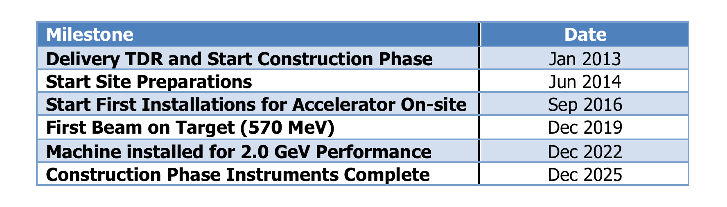
ESS Schedule baseline – external milestones
Ready for Beam on Target!

Slide 4
Construction investment
CURRENT
Sweden (member) | 35.0 %
Denmark (member) | 12.5 %
Germany (member) | 11.0 %
United Kingdom (member) | 10.0 %
France (member) | 8.0 %
Italy (member) | 6.0 %
Spain (founding observer) | 5.0 %
Switzerland (member) | 3.5 %
Norway (member) | 2.5 %
Poland (member) | 2.0 %
Czech Republic (member) | 2.0 %
Hungary (member) | 0.95 %
Lithuania (future member) | 0.45 %
Estonia (member) | 0.25 %
Total (minus preconstruction) | ~97 %
FUTURE
Belgium (founding observer) | tbd
Netherlands (founding observer) | tbd
Greece (future observer) | tbd
Turkey (future observer) | tbd
Latvia, Portugal, Finland | tbd
Notes:
Founding Members
Czech Republic
Denmark
Germany
Estonia
France
Italy
Hungary
Norway
Poland
Sweden
Switzerland
Founding observers
Belgium
Spain
Netherlands
United Kingdom
Ireland

Slide 5
ESS In-kind Partners
Aarhus University
Atomki - Institute for Nuclear Research
Bergen University
CEA Saclay, Paris
Centre for Energy Research, Budapest
Centre for Nuclear Research, Poland, (NCBJ)
CNR, Rome
CNRS Orsay, Paris
Cockcroft Institute, Daresbury
Elettra – Sincrotrone Trieste
ESS Bilbao
Forschungszentrum Jülich
Helmholtz-Zentrum Geesthacht
Huddersfield University
IFJ PAN, Krakow
INFN, Catania
INFN, Legnaro
INFN, Milan
Institute for Energy
Research (IFE)
Rutherford-Appleton Laboratory, Oxford(ISIS)
Kopenhagen University
Laboratoire Léon Brilouin (LLB)
Lund University
Nuclear Physics Institute of the ASCR
Oslo University
Paul Sherrer Institute
Polska Grupa Energetyczna - PGE
Roskilde University
Tallinn Technical University
Technical University of Denmark
Technical University Munich
Science and Technology Facilities Council
University of Tartu
Uppsala University
WIGNER Research Centre for Physics
Wroclaw University of technology
Warsaw University of Technology
Zurich University of Applied Sciences (ZHAW)

Slide 6
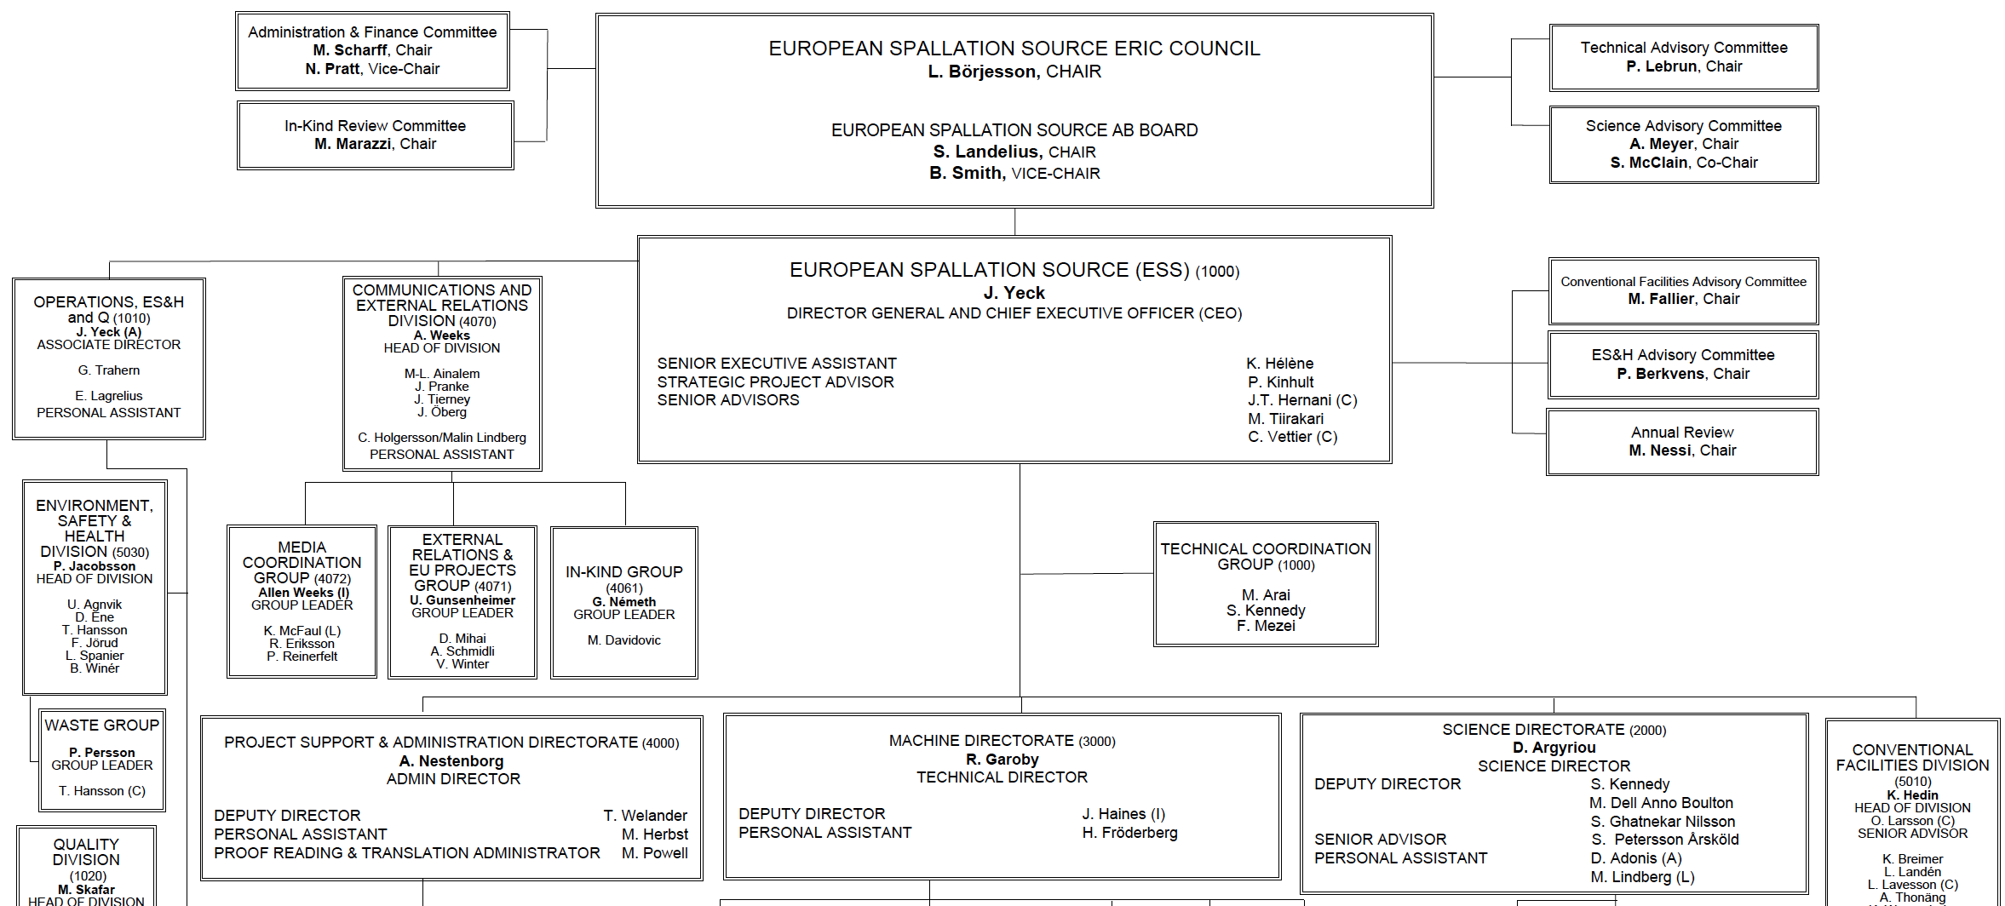
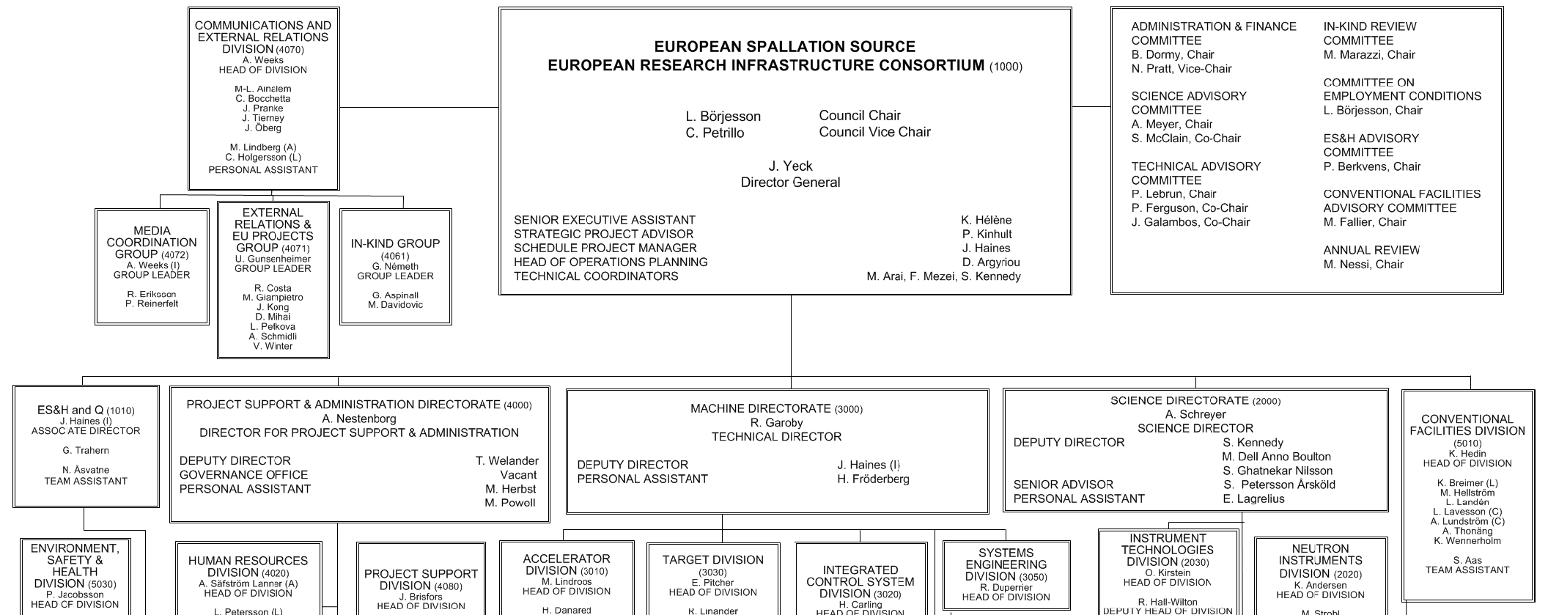
Organisation
~ 100
Partner Institutes
John Womersley
(1 Nov. 2016)
PROJECT MANAGER
John Haines
(15 Aug. 2016)
48
Nationalities
Ralf Trant
(1 Oct. 2016)
Antonio Vergara
(15 Aug. 2016)
375
Employees

Slide 7
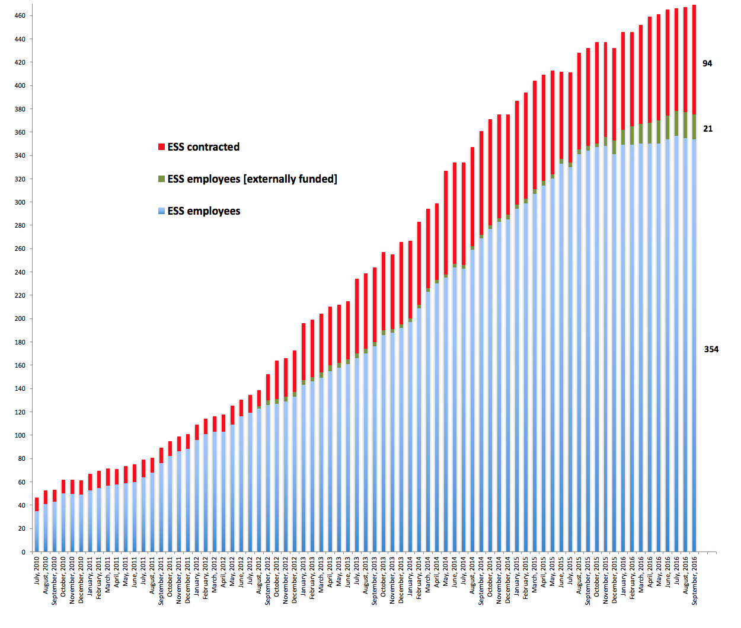
ESS staff 2016-09-30

Slide 8
2016 priorities
Continue emphasis on schedule performance – key to success
Transition in-kind partners into execution phase
3rd Annual Project Review and Response – April
Submit application to regulatory authority for license to commission first stages of accelerator systems – May
Establish a “cash facility” for liquidity gap/hold schedule – June
Start machine installation, e.g., accelerator cryo piping – Oct
Establish operations plans consistent with requirements – Nov
Engage new members – ongoing
Done!
Done!
In progress
In progress

Slide 9
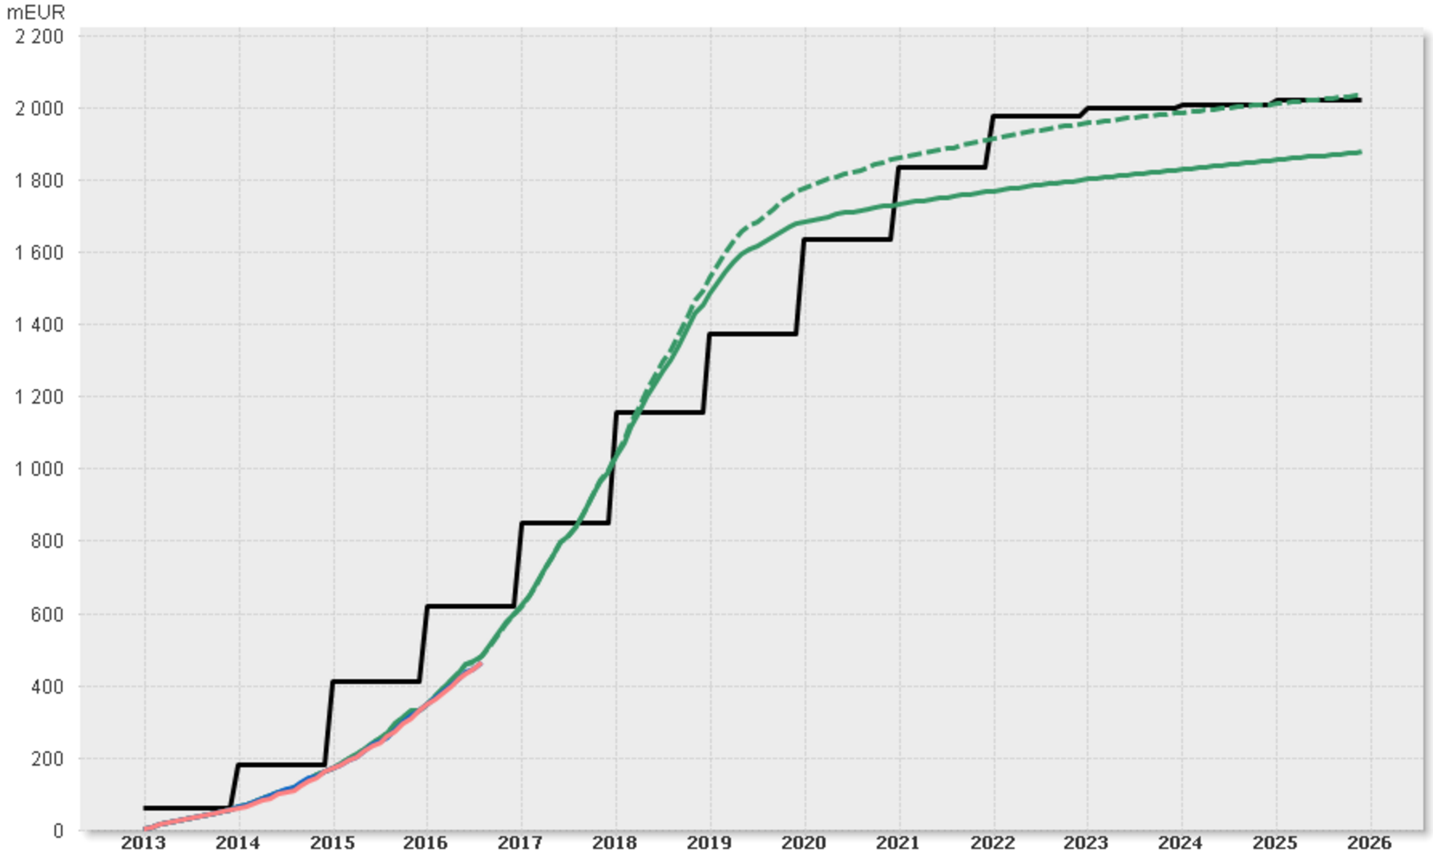
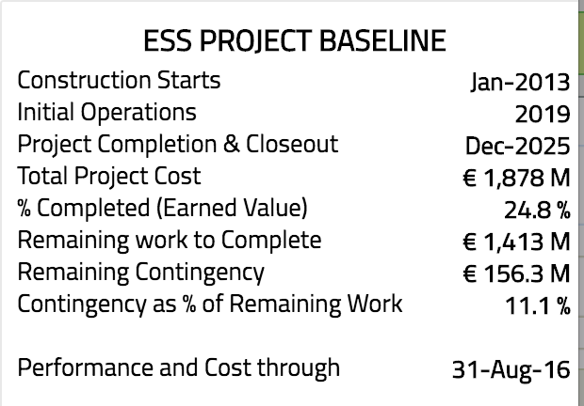
Construction Profile, Aug 2016
ESS Construction Funding and Budget Profile (As Year Prices)
⧫ Construction Project Complete
⧫ Machine 2.0 GeV
⧫ First installations
(of Machine Systems)
⧫ 1st Call for
User Proposals
Total Funding (Cumulative)
⧫ Machine Ready for Beam on Target
⧫ Operations Starts
Total Baseline Budget incl. Contingency (Cumulative)
⧫ Construction
Starts
Total Baseline Budget excl. Contingency (Cumulative)
Total Earned Value (Cumulative)
Total Actual Cost (Cumulative)
Notes:
Schedule variance = Earned – Schedule
Cost Variance = Actuals - Earned
SPI = Earned/Scheduled
CPI = Earned/Actuals

Slide 10
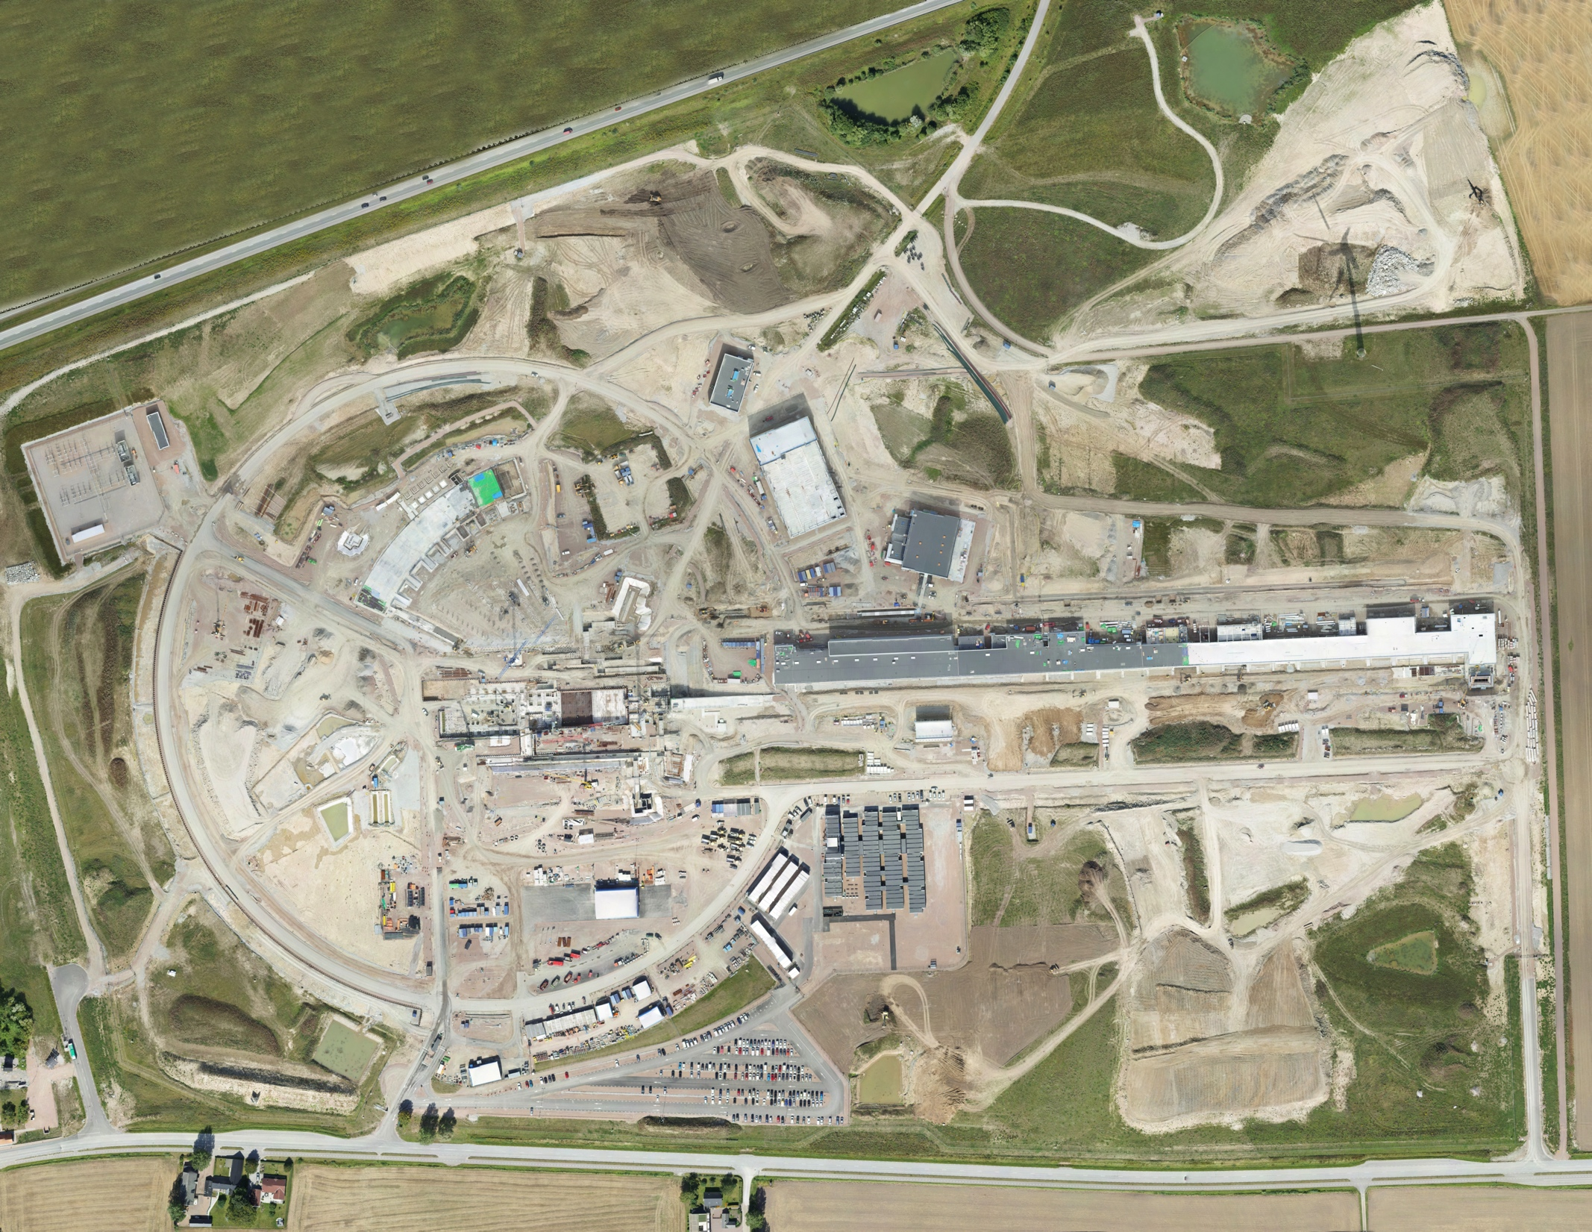
Aerial view
26 August 2016

Slide 11
In-kind possible and agreed/planned
Stretch Goal 747.5m
675m
544.9m

Slide 12
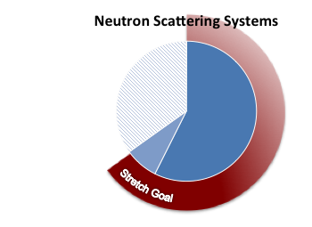
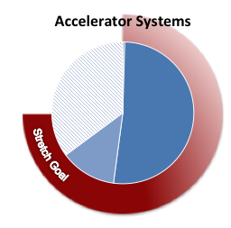
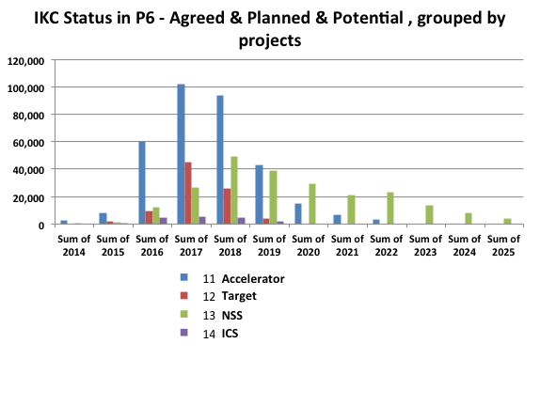
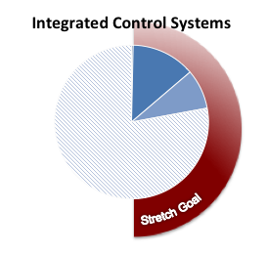
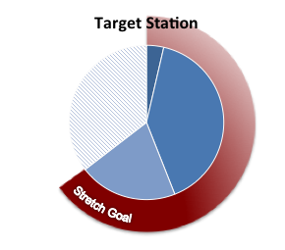
IK status - Project dashboard
Agreed
Planned
Potential
Stretch goal

Slide 13
Level 2 Cost Baseline tracking
% complete
34%
18%
17%
20%
49%
12%
50%
Notes:
Schedule variance = Earned – Schedule
Cost Variance = Actuals - Earned
SPI = Earned/Scheduled
CPI = Earned/Actuals

Slide 14
Construction project summary
  Construction ~25% complete today and over 30% by end of 2016
  Priority on schedule performance – key to success
  Emphasis on securing in-kind deliverables in collaboration
  Additional work to ensure European Spallation Source ERIC provides the institutional framework needed for long term success
  Working to establishing operations plans consistent with facility requirements and supportable by the Council
  Core Values are Excellence, Openness, Collaboration, and Sustainability
  Mission – design, build, and operate the world’s
  leading research facility using neutrons

Slide 15
14th TAC Meeting – 5th to 7th October
Interface issues
  The Committee appreciates that the project has improved organization to address interface issues, as exemplified by the appointment of the ESS Project Manager, and the ad hoc Interface Advisory Committee (IAC) on the beam extraction and bunker design
  Good start but a lot of work remains ahead
IK contributions
  The «agreed+planned» amounts (524 MEUR) approach the set objective of «agreed+planned+potential» (685 MEUR), on par with the IK intentions from Member Countries
  Still, the «agreed» IK contributions only amount to 26 MEUR
  In spite of this, work is proceeding in partner institutes on the basis of «Heads of Agreements»
  This situation wlll however not allow to engage in series procurement (tendering and contracting)
  The Committee is concerned that this may result in unrecoverable delays in production of series components, and recommends to accelerate the signature of IK agreements. This is a major threat to the project schedule.

Slide 16
14th TAC Meeting – 5th to 7th October
Schedule
  In absence of signed production contracts for series components, the present project schedule (and thus the 2019 deadline) is very optimistic.
  Rebaselining of schedule will have to be done when this is settled
ES&H
  The Committee takes note of the appointment of a new Associate Director for ES&H
  The Committee advises to expedite the implementation of operational safety in order to be fully ready within the next 6 months for starting component tests and installation
Procurement
  A large amount of procurement has to be done in the coming 2 years
  The Committee recommends to set up an efficient purchasing service with experienced buyers
Staffing
  Staff numbers are in line with the plan for staff complements
  In order to prepare for installation and commissioning, the Committee advises to recruit (and retain) not only young people, but also experienced staff

Slide 17
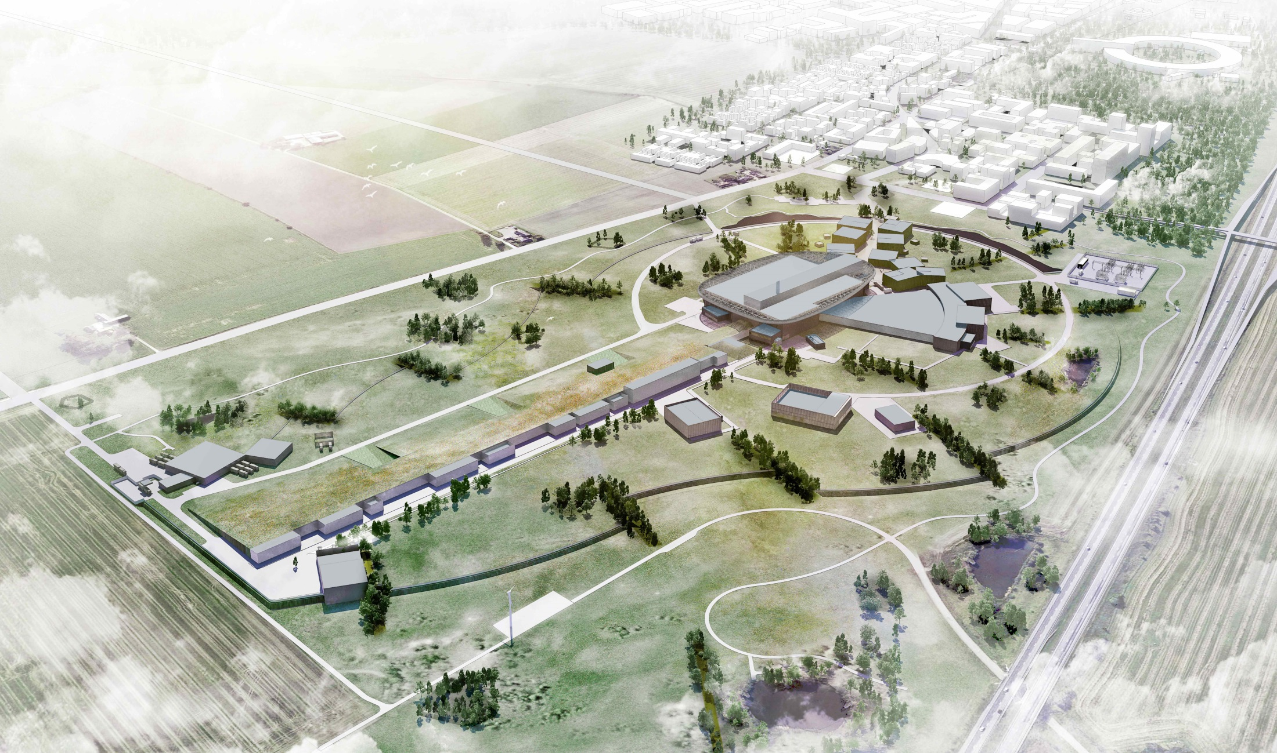
Thank you and have a nice meeting.

