Slide 1
Summary of Target In-Kind contribution TIK-4.1 Target System Instrumentation
Ulf Odén
WP Manager Target System
www.europeanspallationsource.se
10 October 2016

Slide 2
TIK 4.1 Target System Instrumentation
OUTLINE
Target Instrumentation Parameters
Target Instrumentation Concept Design
Proposed solution
Requirements
Cost value
Schedule

Slide 3
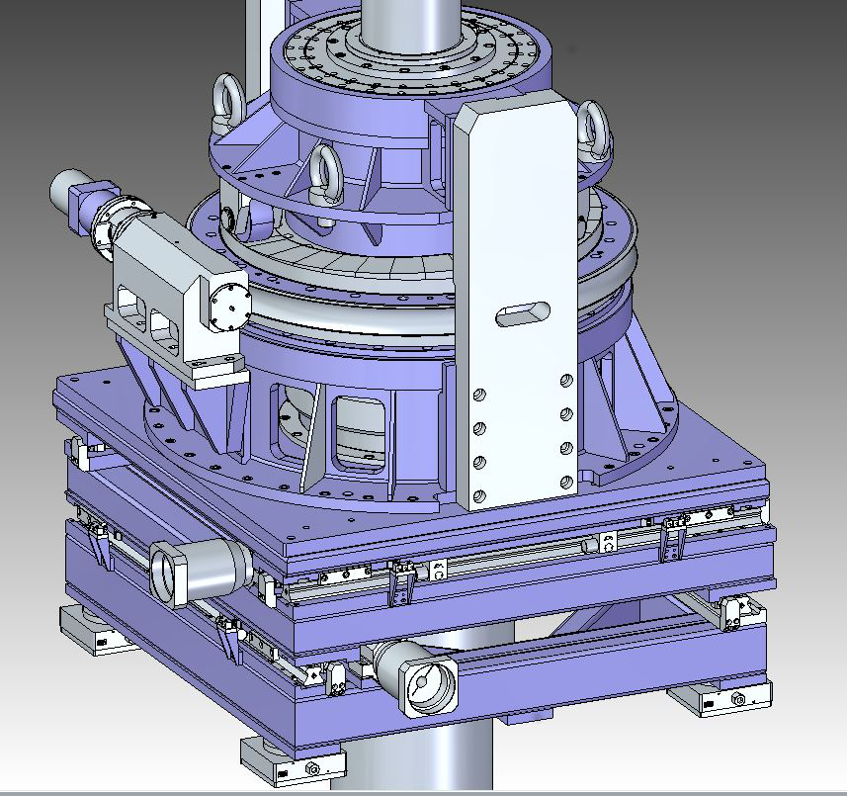
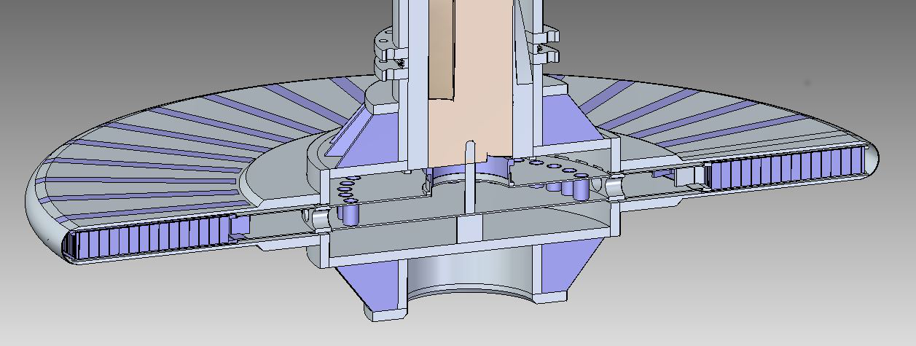
TIK 4.1 Target Wheel Drive & Shaft

Slide 4
TIK 4.1 Target Instrumentation Parameters

Slide 5
TIK 4.1 Target Instrumentation Concept Design
Target Wheel TIK 4.1
Spallation Material Geometry
Wheel Position
Wheel Balance
Spallation Material Temperature
Structural Integrity Shaft and Shroud

Slide 6
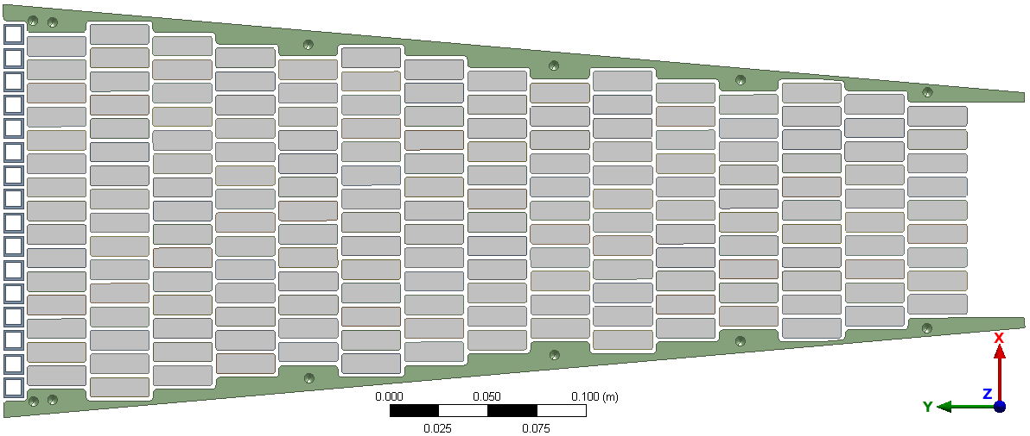
TIK 4.1
Target Instrumentation Concept Design
Spallation Material Geometry
(DTU)
Target Monitoring Plug
Gamma Imaging System
1x1mm 2m long groves
Scintillator
Fiber
CCD Camera

Slide 7
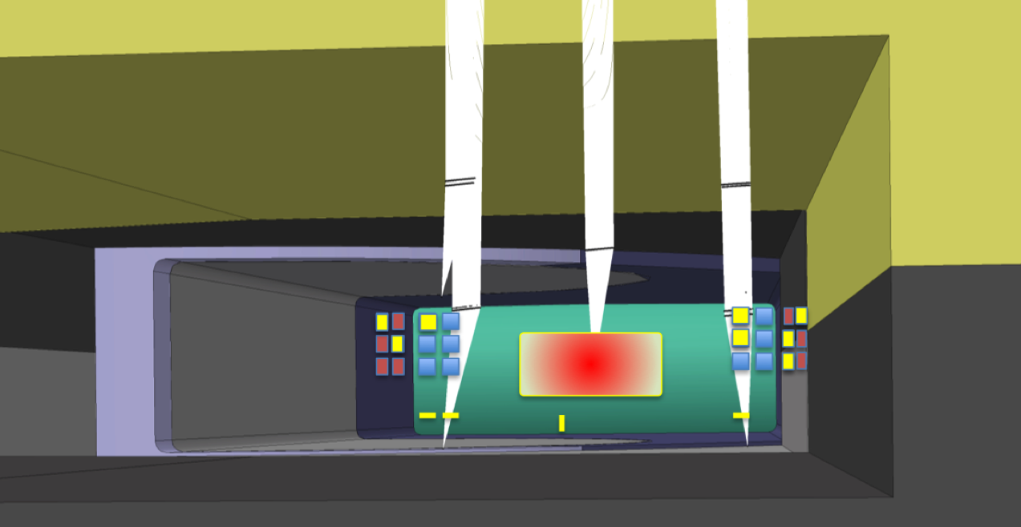
TIK 4.1 Target Instrumentation Concept Design
Wheel Position
z
TIK 4.1 Target Monitoring Plug
- Optical
x
y
TIK 4.1 Target Wheel Pedestal
- ??
Target Wheel
TIK 4.1 Moderator Plug
- ??
Pedestal
Proton Beam Instrumentation Plug
green – target wheel
red - P⁺ Beam
squares - fiducials

Slide 8
TIK 4.1 Target Instrumentation Concept Design
Wheel Balance (vibration)
Target Driver Unit
- Bearing Measurement
TIK 4.1
Target Monitoring Plug
- Optical
Proton Beam Instrumentation Plug
- ??
green – target wheel
red - P⁺ Beam
squares - fiducials

Slide 9
TIK 4.1 Target Instrumentation Concept Design
Temperature
Target Monitoring Plug
IR camera
Thermocouples??

Slide 10
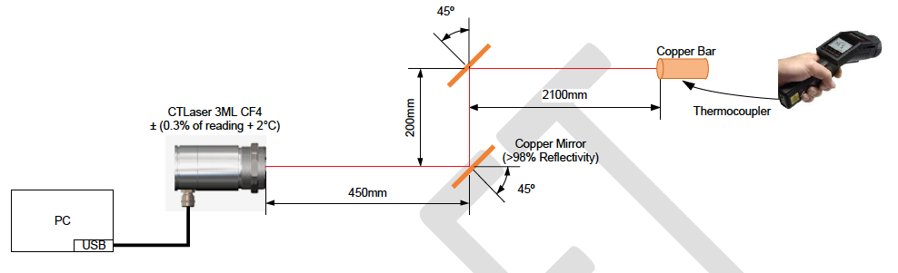
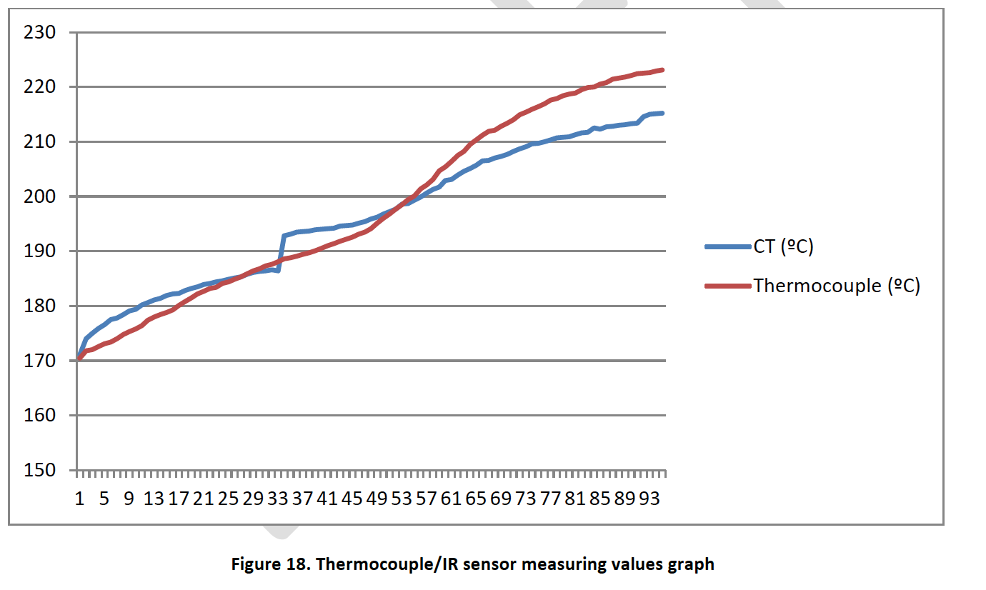
TIK 4.1 Target Instrumentation Concept Design
Temperature
IR camera

Slide 11
TIK 4.1 Target Instrumentation Concept Design
Structural Integrity Shaft and Wheel Shroud
Sound equipment to
identify cracks

Slide 12
TIK 4.1 Target Instrumentation Concept Design
Conclusion
Proposed solution
Continue explore the gamma imaging system (performed by DTU)
Distance measurement (x y z) by laser placed in the Target Monitoring Plug supplemented by Proton Beam Instrumentation Plug (z)
Vibration measurement in the Drive Unit bearings supplemented by laser measurement, placed in the Target Monitoring Plug
IR temperature measurement of each sector, placed in the Target Monitoring Plug
Continue explore Sound Equipment to indicate cracks in the Shaft and Wheel Shroud

Slide 13
TIK 4.1 Target Instrumentation Concept Design
Requirement
To be evaluated during preliminary design in cooperation with TIK 2.1 Target Wheel Drive & Shaft
X Y Z => +/- 0.1 mm

Slide 14
TIK 4.1 Cost Book
Preliminary Design 120 k€
Final Design 230k€
Make Phase 63 k€
Components 170 k€
Total 583 k€*
*Gamma Imaging System excluded

Slide 15
TIK 4.1 In-Kind Scope
In Kind Value
In Kind Scope

Slide 16
TIK 4.1 Key Milestone and In-Kind Partner Start Dates

