Slide 1
Summary of Target In-Kind contribution TIK 6.2 Casks and Associated Handling Devices
Magnus Göhran
Work Package Manager – Remote Handling Systems – WP6
www.europeanspallationsource.se
October 11, 2016

Slide 2
Outline
Scope
Requirements
Cost value
Schedule

Slide 3
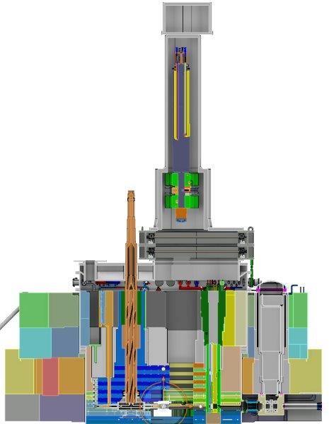
TIK 6.2 Scope The Casks and Associated Handling Devices
In-kind scope
Primary internal transport casks for monolith maintenance including internal hoists
Floor Valves
Covers and hoods for shielding blocks
Temporary shielding and supports
Tools, fixtures and docking stands
Location
Inside the D02 building (Target Building)
Internal Hoist
MR Plug Cask
Floor Valve
Temporary
Shielding

Slide 4
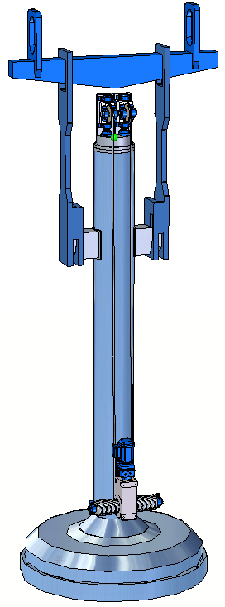
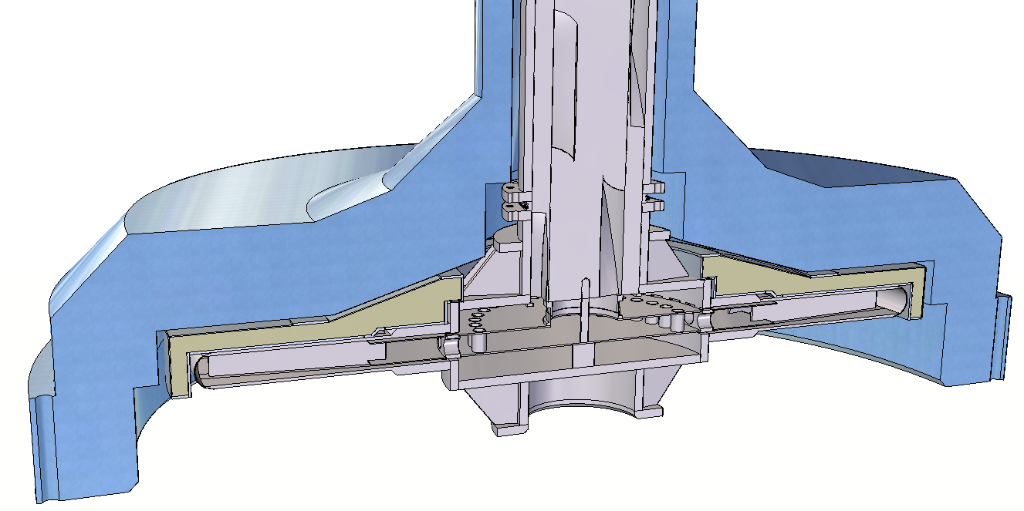
TIK 6.2 Scope The Casks and Associated Handling Devices
Main Functions
Protect personnel from radiation hazards
Confining radioactive components
Structural Shielding
Maintain monolith components
Internal hoists
Alignment
Interim storage of shielding during monolith maintenance in the high bay
To be transported in the D02 building with the high bay crane
Separate Control System
Target Wheel Cask with lifting beam

Slide 5
TIK 6.2 Scope The Casks and Associated Handling Devices
Regulation
Specific Requirements for the ESS-Facility in Lund, Doc id. SSM 13-3285
Guidance with the background and reasons for Radiation Safety Authority's regulations on lifting equipment and lifting operations at nuclear facilities, (Swedish) SSM2014-4363-24
KTA 3902 for the design of lifting equipment
KTA 3903 for inspection and testing of lifting equipment
EN 60709 Instrumentation and control systems important to safety – Separation
Swedish Work Environment Authority
AFS 2006:4 Use of Work Equipment
AFS 2006:6 Use of hoists and lifting equipment
AFS 2008:13 Signs and signals
AFS 2006:6 Use of cranes and lifting devices
Design and construction rule
Target Station - Remote Handling Systems [WBS 12.6] – Design and Construction Rules for Mechanical Components, ESS-0023107

Slide 6
TIK 6.2 Interface Control Document
12.2 Target Systems
12.6.5.2 Mock-up and Test Stands
12.4 Monolith System
12.6.4 Casks and Associated Handling Devices
12.3 Moderator Reflector Systems
12.6 Remote Handling System
12.6.2 Active Cells
12.2.2 Target Wheel
12.3.3 Moderator and Reflector Assemblies
12.4.2.2 Proton Beam Instrumentation Plug
12.4.3.1 Proton Beam Window
Floor Valves
Active Cells Mode Control System
Mock-up
12.2.3 Target (Drive) and Shaft
Target Monitoring Plug
12.4.3.2 Monolith Vessel
12.4.3.4 Covers and penetrations
12.4.3 Confinement system
Site infrastructureHigh Bay Crane
Target Monitoring Plug
12.4.4.2 Inner Shielding Systems

Slide 7
TIK 6.2 Cost
In-Kind Values
In-Kind Scope

Slide 8
TIK 6.2 Schedule
Key Milestones

